Slide 1

Design, Power & Sample Sizes for Multi-Arm Trials
Test More, Recruit Less
June 2026

Slide 2


Calvin O’Brien
Research Statistician

Slide 3
Agenda
01
Overview of Multi-Arm Trials
02
Multi-Arm Design Considerations
03
Sample Size & Power in Multi-Arm Trials
04
Discussion and Conclusions
Questions welcome throughout

Slide 4

The complete solution for optimizing your clinical trial designs
Pre-clinical research
Animal studies
ANOVA / ANCOVA
Confirmatory
1000+ Scenarios for Fixed term, Adaptive & Bayesian Methods
Survival, Means, Proportions & Count endpoints
Group Sequential Trials
Bayesian:
                Assurance
  Credible Intervals
  Posterior Error Approach
Sample Size Re-Estimation
Cross over & personalized medicine
MAMS
Prediction
Early Phase
CRM
MCP-Mod
Simon’s Two Stage
Flemings GST
Post Marketing
Cohort Study
Case-control Study

Slide 5
nQuery Licensing nQuery operates on a tiered licensing model
BASE
PLUS
PRO
EXPERT
Sample size and power for fixed terms trials over 100’s of designs,
endpoints and hypothesis types.
Sample size for fully Bayesian (e.g. credible intervals)
+ Hybrid Bayes/Frequentist methods and designs (e.g. Assurance)
Sample size and power for range of early stage and confirmatory clinical trial
Adaptive Designs and tools for monitoring and adjustment in-trial
Additional tools for study design and monitoring.
Focus currently on milestone prediction for enrollment and (survival) event targets
Click Here to see our Package Comparison Tool

Slide 6
Part 1
Overview of
Multi-Arm Trials

Slide 7
Introduction
The standard two-arm RCT compares a single treatment against control
Highly robust, but inefficient when multiple treatments or doses need evaluating
Multi-arm trials test several treatments simultaneously within a single trial
Two main comparison structures: many-to-one, where each treatment is tested against a shared control, and all-pairs, where every treatment is compared against every other
Running one multi-arm trial is more efficient than running several separate two-arm trials
A shared control arm means fewer patients are needed overall, reducing cost and time without sacrificing statistical power
The design introduces key statistical challenges around multiple comparisons
Controlling error rates across multiple tests requires careful planning at the design stage

Slide 8
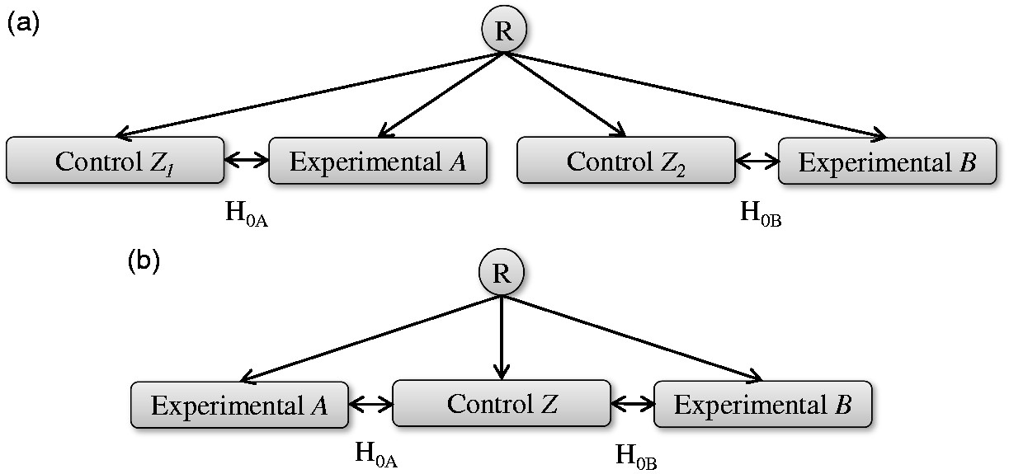
Source: Howard, D. R., Brown, J. M., Todd, S., & Gregory, W. M. (2018). Recommendations on multiple testing adjustment in multi-arm trials with a shared control group. Statistical methods in medical research, 27(5), 1513-1530. https://doi.org/10.1177/0962280216664759

Slide 9
Multiple Comparisons Problem
By performing multiple comparisons at the same significance level, the type-I error rate is inflated
5 independent comparisons at 5% significance level - 22.62% type-I error chance
Family-wise error rate (FWER) controlled to account for this inflation
FWER = P(at least one type-I error rate)
Controlled in multiple ways; adjusting per hypothesis error rate (PHER), introducing testing hierarchy / ordering.
Single step / stepwise testing, fixed sequence testing, graphical based testing
Other issues such as correlation between test statistics, allocation ratios, success/power definitions.

Slide 10
Regulatory Context
Both the FDA and EMA have issued guidance on multiplicity in clinical trials
The FDA's guidance on multiple endpoints (2017, finalized 2022) and the EMA's guideline on multiplicity issues (EMA/CHMP/44762/2017) both emphasize the need for strong control of the familywise error rate in confirmatory trials
Strong FWER control is the expected standard in confirmatory Phase III trials
Regulators expect sponsors to pre-specify their multiple testing procedure and demonstrate that the FWER is strongly controlled across all planned comparisons
Regulatory guidance does not strictly define when multiplicity correction is required in multi-arm trials
Whether to correct, and by how much, often comes down to the trial's objectives, the nature of the comparisons, and dialogue with regulators

Slide 11
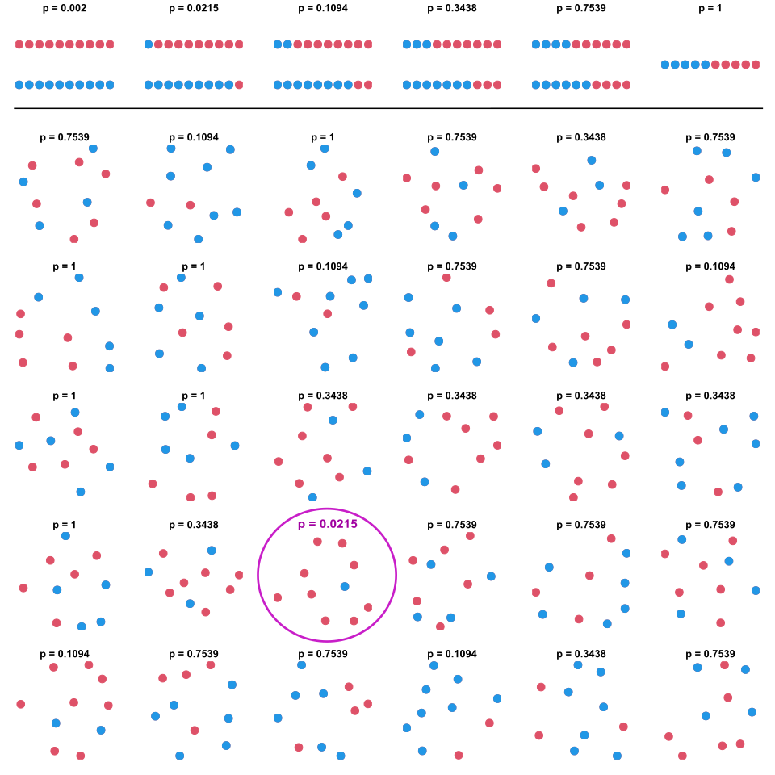
Source: https://commons.wikimedia.org/wiki/File:Multiple_binomial_testing.svg

Slide 12
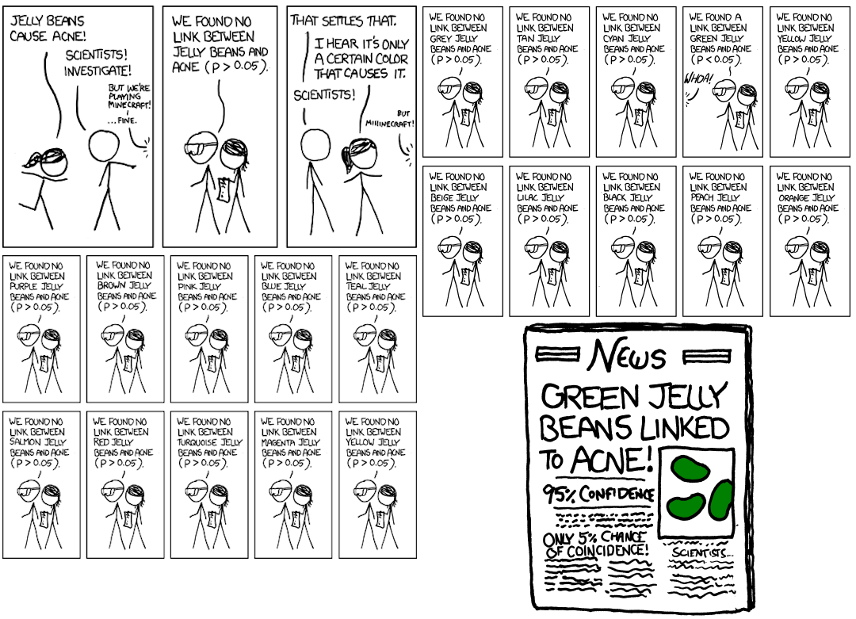
Source: https://xkcd.com/882/

Slide 13
Part 2
Multi-Arm Design Considerations

Slide 14
Design Considerations for Multi-Arm
Number of Arms | How many arms, which treatments or doses, what the shared control is (placebo vs. standard of care). More arms means more to learn but more participants, sites, and multiplicity.
Controlling FWER | The multiple comparisons problem and how the family-wise error rate is kept in check; the correction method.
Testing Hierarchy | Co-primary, primary, and secondary endpoints, tested in a pre-specified order. Step-up, step-down, fixed sequence testing, graphical.
Success Criteria | What "a successful trial" means: at least one arm winning (disjunctive) versus all arms winning (conjunctive) vs specific arms (marginal).
Sample Size Allocation | How participants are split across arms. Equal allocation is rarely optimal in a many-to-one design; the shared control does more work, so it should be weighted larger (≈√K times each experimental arm).

Slide 15
Strong vs Weak Control of FWER
FWER = the probability of at least one false positive across the family of comparisons. How you control it decides which claims you can make.
Weak Control
Guarantee
Holds only under the global null (all arms ineffective)
Limitation
No protection once one arm is truly effective
Examples
Omnibus ANOVA / F-test, unadjusted global test
Use for
Exploratory, proof-of-concept, screening
Strong Control
Guarantee
Holds under any mix of true and false nulls
Strength
Every individual rejection stays protected
Examples
Bonferroni, Holm, Dunnett, closed testing
Use for
Confirmatory trials, regulatory claims on an arm or dose
To claim a specific arm works, you need strong control. Weak control only tells you that something worked.

Slide 16





Controlling Family-Wise Error Rate
Single Step - Common PHER, no ordering of testing
(Weighted) Bonferroni, Šidák, Dunnett
Step-Up - Start with least significant p-value, retain until you reject, then reject remaining
Dunnett, Hochberg
Step-Down - Start with most significant p-value, reject until you retain, then retain remaining
Dunnett, Holm-Bonferroni, Holm-Šidák
Fixed Sequence - Predefined ordering of testing
Stepwise Fixed Sequence, Fallback Procedure
False Discovery Rate - Control FDR vs FWER (Equivalent to Step-Up)
Benjamini–Hochberg, Benjamini–Yekutieli

Slide 17
Part 3
Sample Size & Power in Multi-Arm Trials

Slide 18
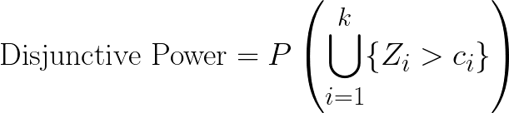
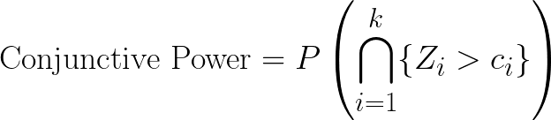
Power for Multi-Arm Trials
To sufficiently power a trial, the goal of the trial needs to pre predetermined:
  All tests significant (conjunctive)
  At least one test significant (disjunctive)
  Specific test significant (marginal)
  Multiple comparisons correction method can highly impact specific marginal powers (step-up, step-down, fixed ordering)
Conjunctive needs large sample sizes compared to disjunctive / marginal.

Slide 19

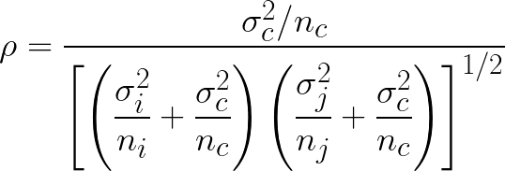
Sample Size Allocations
Correlation between test statistics affected by sample size allocation ratios
This correlation must be carried into the multiplicity adjustment and power calculation, so allocation and Type I error control are linked
Root K optimal allocation for equal variances, minimizes the overall variance of the treatment effect estimates
Potentially not feasible, higher probability of control assignment difficult to justify
Alternative Optimal Allocation Methods
A-Optimality - Minimum mean variance
D-Optimality - Minimum joint variance
E-Optimality - Minimum worst-case variance
Correlation for equal variances & treatment sample sizes
Correlation for unequal variances & treatment sample sizes

Slide 20
Worked Example 1 - TD-1473
“Assuming that the less effective TD-1473 dose results in a 45-point improvement in placebo-adjusted CDAI score change at Week 12, the more effective dose results in a 60 point improvement, the residual SD is 100 points, and a sample size of 160 subjects with 60 subjects in each of the active dose groups and 40 subjects in the placebo group, 100,000 simulations performed using SAS/IML software yielded the following power estimates for 2-sided testing with the familywise Type I error rate controlled at 5% using the Hochberg step-up procedure:
• 82% power to show at least one of the two doses effective
• 58% power to show both doses effective”
Parameter | Value
Treatment arms, K | 2 (two TD-1473 doses)
Endpoint | CDAI change, week 12
Common SD | 100 CDAI points
Mean diff. vs placebo | High 60 / Low 45
Allocation | 2:3:3 (Placebo, T1, T2)
Multiplicity | Step-up Hochberg
Alpha (2-sided) | 0.05
Sample size | 40 placebo, 60 each dose (N=160)
Disjunctive power (≥ 1 dose) | ~82%
Conjunctive power (both) | ~58%

Slide 21
Worked Example 2 - Esketamine
“The sample size for this study was calculated assuming a treatment difference for the doubleblind induction phase of 4, 4.5, 5 points in MADRS total score between each dose (28 mg, 56 mg, 84 mg) of esketamine and the placebo respectively, a SD of 10 for each treatment group, a 1- sided significance level of 0.05 and a drop-out rate of 12.5%. A total of 183 subjects will need to be randomized to treatment in a 2:1:1:1 ratio (72 subjects on placebo group and 37 subjects per intranasal esketamine dose group) to achieve 80% power to detect difference for at least one dose group of intranasal esketamine to placebo using a Dunnett adjustment.”
Parameter | Value
Treatment arms, K | 3 (28, 56, 84 mg)
Endpoint | MADRS change, induction end
Common SD | 10 MADRS points
Mean diff. vs placebo | 4 / 4.5 / 5 (by dose)
Allocation | 2:1:1:1 (placebo weighted)
Multiplicity | Single-step Dunnett
Alpha (1-sided) | 0.05
Sample size | 72 placebo, 37/dose (N=183)
Dropout | 12.5%
Disjunctive power (≥ 1 dose) | 80%

Slide 22
Discussion and Conclusions
Multi-arm trials compare several treatments or doses at once, answering more questions in one study and needing fewer patients than running separate two-arm trials.
Comparing multiple arms to a common control inflates the family-wise Type 1 error, so a multiplicity adjustment is required.
There is no single best multiplicity method, as each procedure trades power depending on whether you need any, all, or an ordered set of comparisons to succeed.
Power and allocation should be chosen deliberately, deciding between disjunctive, conjunctive and marginal power and weighting the shared control arm to get the most power for a given sample size.

Slide 23


Statsols.com/nquery-demo

Slide 24
Thank you
CONTACT US
info@statsols.com
MORE INFO
statsols.com

Slide 25
References - Intro
EMA, Draft guideline on multiplicity issues in clinical trials. Available from: https://www.ema.europa.eu/en/multiplicity-issues-clinical-trials-scientific-guideline
EMA, Points to consider on multiplicity issues in clinical trials. Available from: https://www.ema.europa.eu/en/multiplicity-issues-clinical-trials-scientific-guideline
U.S. Food and Drug Administration, Multiple Endpoints in Clinical Trials Guidance for Industry. Available from: https://www.fda.gov/media/162416/download
Hooper, R. (2025). To adjust, or not to adjust, for multiple comparisons. Journal of clinical epidemiology, 180, 111688. https://doi.org/10.1016/j.jclinepi.2025.111688
Howard, D. R., Brown, J. M., Todd, S., & Gregory, W. M. (2018). Recommendations on multiple testing adjustment in multi-arm trials with a shared control group. Statistical methods in medical research, 27(5), 1513-1530. https://doi.org/10.1177/0962280216664759
Molloy, S. F., White, I. R., Nunn, A. J., Hayes, R., Wang, D., & Harrison, T. S. (2022). Multiplicity adjustments in parallel-group multi-arm trials sharing a control group: clear guidance is needed. Contemporary clinical trials, 113, 106656. https://doi.org/10.1016/j.cct.2021.106656
Statsols, Designing MAMS Trials. Available from: https://www.statsols.com/guides/designing-mams-clinical-trials

Slide 26
References - Multiple Comparisons Corrections
Bonferroni, C.E. (1936) Teoria statistica delle classi e calcolo delle probabilità. Pubblicazioni del R Istituto Superiore di Scienze Economiche e Commerciali di Firenze, 8, 3-62.
Šidák, Z. (1967) Rectangular confidence regions for the means of multivariate normal distributions. Journal of the American Statistical Association, 62(318), 626–633.
Dunnett, C.W. (1955) A multiple comparison procedure for comparing several treatments with a control. Journal of the American Statistical Association, 50(272), 1096–1121. https://doi.org/10.1080/01621459.1955.10501294
Dunnett, C. W., & Tamhane, A. C. (1992). A Step-Up Multiple Test Procedure. Journal of the American Statistical Association, 87(417), 162–170. https://doi.org/10.1080/01621459.1992.10475188
Dunnett, C. W., & Tamhane, A. C. (1995). Step-up multiple testing of parameters with unequally correlated estimates. Biometrics, 51(1), 217–227. https://doi.org/10.2307/2533327
Hochberg, Y. (1988). A sharper Bonferroni procedure for multiple tests of significance. Biometrika, 75, 800–802. https://doi.org/10.2307/2336325
Dunnett, C. W., & Tamhane, A. C. (1991). Step-down multiple tests for comparing treatments with a control in unbalanced one-way layouts. Statistics in medicine, 10(6), 939–947. https://doi.org/10.1002/sim.4780100614
Liu W. (1997). Some results on step-up tests for comparing treatments with a control in unbalanced one-way layouts. Biometrics, 53(4), 1508–1512. https://doi.org/10.2307/2533517
Holm, S. (1979). A simple sequentially rejective multiple test procedure. Scandinavian Journal of Statistics, 6(2), 65–70.

Slide 27
References - Multiple Comparisons Corrections
Wiens, B.L. (2003), A fixed sequence Bonferroni procedure for testing multiple endpoints. Pharmaceutical Statistics, 2, 211-215. https://doi.org/10.1002/pst.64
Dmitrienko, A., Wiens, B., & Westfall, P. (2006). Fallback tests in dose-response clinical trials. Journal of biopharmaceutical statistics, 16(5), 745–755. https://doi.org/10.1080/10543400600860600
Benjamini, Y. & Hochberg, Y. (1995) Controlling the false discovery rate: a practical and powerful approach to multiple testing. Journal of the Royal Statistical Society: Series B (Methodological), 57, 289-300. https://doi.org/10.1111/j.2517-6161.1995.tb02031.x
Benjamini, Y. & Yekutieli, D. (2001) The Control of the False Discovery Rate in Multiple Testing under Dependency. Annals of Statistics, 29, 1165-1188. https://doi.org/10.1214/aos/1013699998

Slide 28
References – Sample Size & Power
Horn, M. and Vollandt, R. (1998). Sample sizes for comparisons of k treatments with a control based on different definitions of power. Biometrical Journal, 40, 589-612. https://doi.org/10.1002/(SICI)1521-4036(199809)40:5<589::AID-BIMJ589>3.0.CO;2-8
Kieser, Meinhard. (2020). Methods and Applications of Sample Size Calculation and Recalculation in Clinical Trials. Springer. Switzerland.
Julious, Steven A. (2023). Sample Sizes for Clinical Trials. Second Edition. Chapman & Hall / CRC Press. Boca Raton, Florida.
Grayling, M. J., & Wason, J. M. (2020). A web application for the design of multi-arm clinical trials. BMC cancer, 20(1), 80. https://doi.org/10.1186/s12885-020-6525-0
ClinicalTrials.gov, Efficacy and Safety of TD-1473 in Crohn's Disease (DIONE). Available from: https://clinicaltrials.gov/study/NCT03635112
ClinicalTrials.gov, A Study to Evaluate the Efficacy, Safety and Tolerability of Fixed Doses of Intranasal Esketamine in Japanese Participants With Treatment Resistant Depression. Available from: https://clinicaltrials.gov/study/NCT02918318

