Slide 1

Challenges in Survival Trial Design
Complex Survival and Adaptive Design
September 2026

Slide 2


Ronan Fitzpatrick
Head of Statistics

Slide 3
Agenda
01
Survival Design Challenges
02
Complex Survival Patterns
03
Adaptive Design
04
Conclusions & Discussion
Questions welcome throughout

Slide 4


Pre-clinical research
Animal studies
ANOVA / ANCOVA
Pilot Studies
Confirmatory
1000+ Scenarios for Fixed term,
Adaptive & Bayesian Methods
Survival, Means, Proportions & Count endpoints
Group Sequential Trials
Bayesian:
                Assurance
  Credible Intervals
  Posterior Error Approach
Sample Size Re-Estimation
Cross over & personalized medicine
MAMS
Prediction
Early Phase
CRM
MCP-Mod
Simon’s Two Stage
Flemings GST
The complete solution
for optimizing your
clinical trial designs
Post Marketing
Cohort Study
Case-control Study

Slide 5
nQuery Licensing nQuery operates on a tiered licensing model
BASE
PLUS
PRO
EXPERT
Fixed Term
Bayesian +
Fixed Term
Adaptive +
Bayesian + Fixed Term
Prediction +
Adaptive + Bayesian + Fixed Term
Sample size and power for fixed terms trials.
100’s of designs,
endpoints and hypothesis types.
Sample size for fully Bayesian (e.g. credible intervals)
Hybrid Bayes/Frequentist methods and designs (e.g. Assurance).
Sample size and power for early stage and confirmatory clinical trials.
Adaptive Designs and tools for monitoring and adjustment in-trial.
Includes additional tools for study design and monitoring.
Includes milestone prediction for enrollment and (survival) event targets
Click Here to see our Package Comparison Tool

Slide 6
Survival Analysis
Design Challenges
Part 1

Slide 7
Survival Analysis Design Overview
Survival Analysis (time-to-event (TTE) analysis) is concerned with inferences regarding the expected length of time until an “event” of interest occurs
e.g. Death/Overall Survival (OS), Disease Progression/Progression Free Survival (PFS)
One of the most common endpoints in clinical trials, especially in oncology
Note that earlier stage trials often use simpler binary equivalents (e.g. response rate)
However, survival analysis comes with number of distinctive design and statistical challenges compared to other endpoints
This webinar will cover survival analysis trial design with a focus on common challenges and impact of more complex design choices
Including impact of non-proportional hazards and adaptive design on study design process

Slide 8
Survival Analysis Design Considerations
Study Design | Design: Two-Arm (standard approach) vs other, adaptive/complex designs Endpoint: OS vs PFS; OS role (efficacy and/or harm), 1st event vs recurrences Analysis: Statistic (Hazard Ratio, other?), Test (Log-Rank, Cox, other?), Estimand
Accrual/ Censoring | Strategy: Event-Driven vs Fixed Follow-up vs Fixed Study Length + adjustments Accrual: Accrual Period (target N vs fixed length), expected accrual pattern Censoring: Administrative censoring (from strategy), impact of interval censoring
Survival/ Hazard | Model: Exponential, Weibull, Log-Normal, Gamma etc. Constant vs Piecewise Pattern: Proportional Hazards vs NPH (delayed, diminishing, crossing effect) Statistic: Hazard Rate, Survival Rate, Median Survival, Shape/Scale Parameters
Other | Dropout: Model (same as survival?), type (MCAR/MAR/MNAR), ICE/Estimand Treatment Crossover: Non-compliance, drop-in, both; Model, ICE/Estimand Complex: Time-varying effect from covariates, competing risks, cure effects Other: Test differ from Analysis?, multiple hypotheses (e.g. PFS+OS), multi-state

Slide 9


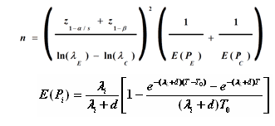





Power for Survival Analysis Trials
Power analysis should follow clinical trial design
  Study Design, Endpoint/Statistic, Analysis/Test
NB: Power is driven by events NOT the sample size
  Often can calculate events separately from sample size
Thus, sample size determination is often calculating sample size to achieve the target number of events
  “Meta-model” for sample size (N) can vary in complexity
    e.g. Via formulae (e.g. Freedman, Lachin & Foulkes), integration (e.g. Kim & Tsiatis, Tang) or Markov model (e.g. Lakatos)
Sample Size impacted by wider variety of factors than events (when calculated separately)
  Events (Schoenfeld): Sig. level, hazard ratio + power
  Sample Size: Accrual Period, Accrual Pattern, Study Length, Hazard Rates/Pattern, Dropout Rates/Pattern, Censoring Strategy, Treatment Crossover + more
D Schoenfeld (1981)
L.S. Freedman (1982)
J.M. Lachin & M.A Foulkes (1986)
E Lakatos (1988)
Y. Tang (2021/2022)

Slide 10
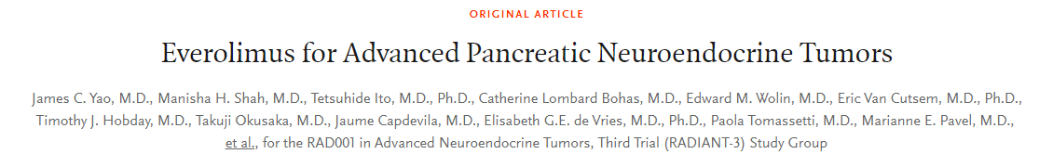
Log-Rank Test Example
“Using an unstratified log-rank test at the one-sided 2.5% significance level, a total of 282 events would allow 92.6% power to demonstrate a 33% risk reduction (hazard ratio for RAD/placebo of about 0.67, as calculated from an anticipated 50% increase in median PFS, from 6 months in placebo arm to 9 months in the RAD001 arm).
With a uniform accrual of approximately 23 patients per month over 74 weeks and a minimum follow up of 39 weeks, a total of 352 patients would be required to obtain 282 PFS events, assuming an exponential progression-free survival distribution with a median of 6 months in the Placebo arm and of 9 months in RAD001 arm.
With an estimated 10% lost to follow up patients, a total sample size of 392 patients should be randomized.”
Parameter | Value
Significance Level (1-Sided) | 0.025
Placebo Median Survival (months) | 6
Everolimus Median Survival (months) | 9
Hazard Ratio | 0.667
Accrual Period (Weeks) | 74
Minimum Follow-Up (Weeks) | 39
Power (%) | 92.6

Slide 11
Complex Survival
Patterns
Part 2

Slide 12
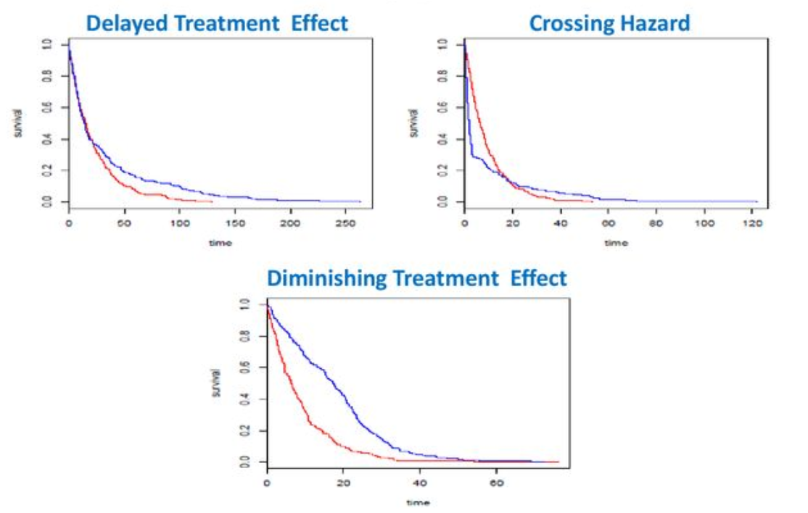
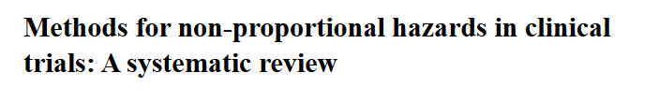
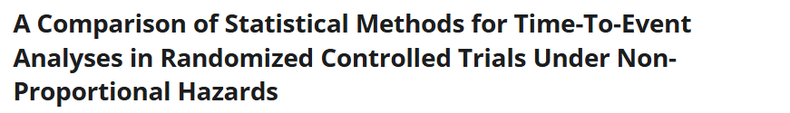
Non-Proportional Hazards (NPH) Overview
Most common tests (Log-Rank, Cox Regression) used in survival analysis trials assume proportional hazards
  PH assumes that the hazard ratio is constant over time
However, growing interest in methods which can handle scenarios where PH assumption breaks down
  Newer treatment modalities (e.g. immunotherapy) have more complex survival effect than cytotoxic treatments
  e.g. Delayed Effect, Diminishing Effect, Crossing Effect
Multiple statistical proposals to handle NPH survival
  Methods ideally increase power, are robust to different NPH patterns and are inferentially meaningful (estimand)
  Significant on-going debate between these methods due to trade-offs between these considerations
  Still common to default to average hazard ratio (AHR) from log-rank/Cox model analysis
Satrajit Roychoudhury (2018)

Slide 13
Non-Proportional Hazards Methods
Log-Rank/Cox Model | Equivalent to testing “Average Hazard Ratio” (weighted average proposals also exist) – similar results from univariate Cox model (which has additional flexibility)
Linear-Rank Tests | Gehan-Breslow-Wilcoxon, Tarone-Ware, Fleming-Harrington, Peto-Peto, Threshold Lag, Generalized Lag, Modestly Weighted Linear-Rank (MWLRT)
Combination Tests | Maximum Combination Test (MaxCombo) of multiple linear-rank tests, Cox Regression (for hypothesis test) and RMST (for inference) strategy
Survival Time | Milestone Survival Difference (via unweighted or weighted Kaplan-Meier), Restricted Mean Survival Time (RMST) Difference, Landmark Analysis
Modelling | Time-Varying Coefficient Models (e.g. Cox Change-point, Splines), Accelerated Failure Time Models, Relative Time, Frailty Models, Piecewise Parametric
Other | Additional tests (Gorfine, adjusted K-S, log(OR), Responder Analysis, Machine Learning

Slide 14

Maximum Combination (MaxCombo) Test
Maximum Combination (MaxCombo) tests multiple weighted linear-rank tests simultaneously
  2-4 tests: Log-Rank, Fleming-Harrington (FH) popular
  Weighted linear-rank tests weigh events differently depending on when event occurred in study
    e.g. FH(0,1) weighs later events higher, FH(1,0) earlier E higher
MaxCombo has Type I error control under general null hypothesis (equal curves) but issues w/ “strong null”
  Critics (Friedlin & Korn, Magirr) show can reject null even when experimental always worse than control (early harm)
Proposals/alternatives proposed that downweigh early events less aggressively & resolve “strong null” issue
  Reduce FH weights from 1 to 0.5 in standard MaxCombo
  Modestly Weighted Log-Rank Test (MWLRT) and Robust MWLRT from Magirr (MaxCombo of MWLRT + Log-Rank)
Tests* | Proposal
FH(0,1; 1,0) | Lee
FH(0,0**; 0,1; 1,0) | Karrison
FH(0,0; 0,1; 1,0; 1,1) | Lin et al
FH(0,0; 0,0.5; 0.5,0; 0.5,0.5) | Roychoudhury et al
FH(0,0; 0,0.5) | Mukhopadhyay et al
FH0,0; 0,0.5; 0.5,0) | Mukhopadhyay et al
FH(0,0); MWLRT | Magirr and Öhrn
*FH = Fleming-Harrington, **FM(0,0) = Log-Rank Test

Slide 15
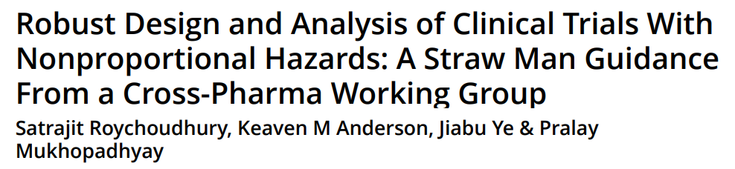
MaxCombo Example
“We will assume 15 months of constant enrollment, a constant dropout rate of 0.001 per month, control group observations follow an exponential survival distribution with a median of 8 months. After careful elicitation of all available evidence, we assume a possible delayed treatment effect scenario (alternative hypothesis): no treatment effect for 6 months (HR = 1), followed by a large treatment effect (HR = 0.56) thereafter. As this is a confirmatory trial for potential regulatory submission, strict control of 2.5% Type I error is required, and those investing in the study wish to ensure 90% power under this NPH scenario … This calculation includes … trial duration of 32 months … Therefore, the initial sample size of the trial is 442 with a target accrual of 360 events”
Parameter | Value
Significance Level (1-Sided) | 0.025
Control Median Survival (months) | 8
Delayed Effect (Months, HR = 1) | 6
Hazard Ratio (Post DE) | 0.56
Accrual Period (Months) | 15
Maximum Follow-up | 32
Dropout (per month) | 0.001
Power (%) | 90%

Slide 16
Survival Analysis
Adaptive Designs
Part 3

Slide 17
Adaptive Survival Analysis Trials
“A clinical trial design that allows for prospectively planned modifications to one or more aspects of the trial based on interim analysis of accumulating data from participants in the trial” – ICH E20 (Draft)
Examples: Early Stopping, Sample Size Re-estimation, Adaptive Allocation, Arm Selection
Recent growth in popularity as expertise & regulatory guidance improved
FDA Guidance (2019), CONSORT Adaptive Design Statement (2020), ICH E20 Draft (2025)
Survival analysis trials a natural target for adaptive design since often have long study lengths, high sample size and “checkpoint” of milestone N/E
But applying adaptive design to survival analysis endpoint creates distinct challenges compared to continuous or binary endpoints

Slide 18
Survival Adaptive Trial Challenges
Interim Analysis Timing
Timing of interim analyses in survival analysis trials typically dependent on reaching milestone events
But that depends on entire trial process (accrual, hazard, dropout/censoring) and therefore uncertain
Therefore need to plan for possible deviations and impact on logistical and statistical aspects of trial
  e.g. in survival group sequential design, use spending function to allow for post-hoc boundary adjustment
Impact of Design Assumptions
Many extensions of adaptive design to survival analysis assume proportional hazards (e.g. log rank GSD)
Under this assumption, derivation under independent increments is simple and information ∝ events
But under NPH, derivation complex and information not proportional to (just) events so timing more difficult
Concerns over early stopping under NPH, especially early futility stopping under delayed effects scenario
  Later interims and flexible stopping (error spending, dual calendar/information time criteria) under NPH
Operational Concerns
Consider impact of overall survival (OS) even if PFS is primary or interim endpoint – safety, multiplicity etc
Expect larger overrunning cohorts - must account for potential inefficiency and effect on analysis if stop early
For events re-estimation, can create operational bias depending on SSR strategy (especially under NPH)
  Increasing sample size biases towards earlier events while waiting longer towards later events

Slide 19
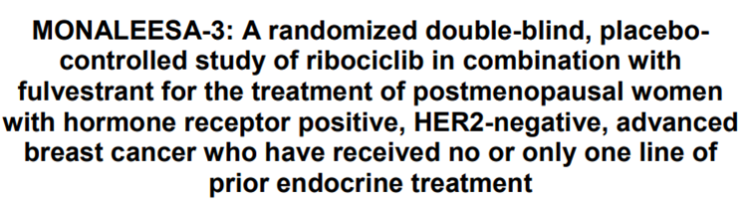
Group Sequential Survival Example
“The median PFS in the control arm (fulvestrant + placebo) is … 9 months. It is hypothesized … ribociclib will result in a clinically meaningful 33% reduction in the hazard rate of PFS, corresponding to an increase in median PFS to 13.4 months. A maximum of 364 PFS events will be required to detect a hazard ratio of 0.67 with 90% power using the log-rank test and a 3-look (interim look futility only, interim look efficacy only, then final analysis) group sequential design at one-sided cumulative 2.5% level of significance. Assuming that enrollment will continue for approximately 18 months at a uniform rate and 10% dropout rate by the time of PFS final analysis, a total of 660 patients should be randomized to the two treatment groups in 2:1 ratio to observe 364 events at approximately 8 months following the randomization of the last patient, i.e., 26 months total.”
“Two interim analyses are planned after approximately 182 and 291 of the 364 targeted PFS events (50% and 80% information fraction respectively) have been documented. These analyses are expected to take place around 16 and 21 months ... An α-spending function according to 2-look Lan-DeMets group sequential design with O’Brien-Fleming type stopping boundary … will be used to construct the efficacy stopping … A beta-spending function using a user-defined gamma spending function (γ = 2) will be used to construct the non-binding futility boundary …”
Parameter | Value
Significance Level | 0.025
Contol Median Survival | 9
Trmt Median Survival | 13.4
Hazard Ratio | 0.67
Accrual Period | 18
Study Length | 18+8=26
Power | 90%
N (post-10% dropout) | 594 (198:396)
Looks (Information time) | 3 (0.5, 0.8)
Efficacy Bound (Look 2) | O’Brien-Fleming
Futility Bound (Look 1) | Hwang-Shih-DeCani (γ=2)

Slide 20
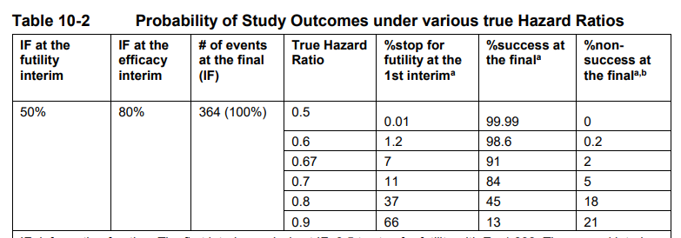

Slide 21
Discussion and Conclusions
Survival analysis is one of the most common endpoints in clinical trials and has distinct trial design and statistical analysis challenges
Sample size determination requires calculating the events and finding the required sample size given accrual, hazards, dropout and other factors
Non-proportional hazards is a growing area of interest with a wide variety of statistical proposals – associated design tools more available now
Adaptive design offers significant opportunity in survival analysis but also presents unique challenges to ensure operationally and statistically valid study designs

Slide 22


statsols.com/nquery-demo

Slide 23
Thank you
CONTACT US
info@statsols.com
MORE INFO
statsols.com

Slide 24
References
Previous Webinars
Overcoming Challenges in Survival Analysis Trials: https://www.statsols.com/guides/overcoming-challenges-in-survival-analysis
Design and Evaluation of Complex Sequential Trials: https://www.statsols.com/guides/design-and-evaluation-of-complex-sequential-analysis-trials
Simulation for Survival Group Sequential Trials: https://www.statsols.com/guides/simulation-for-survival-group-sequential-trials
Impact of ICH E20 on Adaptive Design in Clinical Trials? https://www.statsols.com/guides/impact-of-ich-e20-on-adaptive-design-in-clinical-trials
Worked Examples
Yao, J. C., et. al. 2011. Everolimus for advanced pancreatic neuroendocrine tumors. New England Journal of Medicine, 364(6), 514-523.
Roychoudhury, S., Anderson, K.M., Ye, J. and Mukhopadhyay, P., 2021. Robust Design and Analysis of Clinical Trials With Nonproportional Hazards: A Straw Man Guidance From a Cross-Pharma Working Group. Statistics in Biopharmaceutical Research, 1-15.
Slamon, D.J., Neven, P., Chia, S., Fasching, P.A., De Laurentiis, M., Im, S.A., Petrakova, K., Bianchi, G.V., Esteva, F.J., Martin, M. and Nusch, A., 2020. Overall survival with ribociclib plus fulvestrant in advanced breast cancer. New england Journal of medicine, 382(6), pp.514-524.
Survival Analysis Overview
Cox, D.R. and Oakes, D., 1984. Analysis of survival data. CRC press.
Cox, D.R., 1972. Regression models and life‐tables. Journal of the Royal Statistical Society: Series B (Methodological), 34(2), 187-202.
Collett, D., 2015. Modelling survival data in medical research. CRC press.
Fleming, T.R. and Harrington, D.P., 2013. Counting processes and survival analysis. John Wiley & Sons.
Klein, J.P., Van Houwelingen, H.C., Ibrahim, J.G. and Scheike, T.H. eds., 2016. Handbook of survival analysis. CRC Press.
Lin, H. and Zelterman, D., 2002. Modeling survival data: extending the Cox model.
Lemeshow, S., May, S. and Hosmer Jr, D.W., 2011. Applied survival analysis: regression modeling of time-to-event data. John Wiley & Sons.
Kilickap, S., Demirci, U., Karadurmus, N., Dogan, M., Akinci, B. and Sendur, M.A.N., 2018. Endpoints in oncology clinical trials. J BUON, 23, 1-6.
U.S. Food and Drug Administration, Clinical Trial Endpoints for the Approval of Cancer Drugs and Biologics. December 2018 Available from:
http://www.fda.gov/downloads/Drugs/GuidanceComplianceRegulatoryInformation/Guidances/ucm071590.pdf
U.S. Food and Drug Administration, Approaches to Assessment of Overall Survival in Oncology Clinical Trials (Draft Guidance). August 2025. Available from: https://www.fda.gov/media/188274/download

Slide 25
References
Survival Analysis Sample Size
Freedman, L. S. 1982. Tables of the number of patients required in clinical trials using the logrank test. Statistics in medicine, 1(2), 121-129.
Schoenfeld, D. A. 1983. Sample-size formula for the proportional-hazards regression model. Biometrics, 499-503.
Lachin, J. M., & Foulkes, M. A. 1986. Evaluation of sample size and power for analyses of survival with allowance for nonuniform patient entry, losses to follow-up, noncompliance, and stratification. Biometrics, 507-519.
Lakatos, E. 1988. Sample sizes based on the log-rank statistic in complex clinical trials. Biometrics, 229-241.
Lakatos, E., & Lan, K. K. G., 1992. A comparison of sample size methods for the logrank statistic. Statistics in Medicine, 11(2), 179–191.
Bariani, G.M., de Celis, F., Anezka, C.R., Precivale, M., Arai, R., Saad, E.D. and Riechelmann, R.P., 2015. Sample size calculation in oncology trials. American journal of clinical oncology, 38(6), 570-574.
Tang Y. 2021. A unified approach to power and sample size determination for log-rank tests under proportional and nonproportional hazards. Statistical Methods in Medical Research ,Vol. 30(5) 1211–1234.
Tang, Y., 2022. Complex survival trial design by the product integration method. Statistics in medicine, 41(4), 798-814.
Cheng, H. and He, J., 2023. Sample size calculation for the combination test under nonproportional hazards. Biometrical Journal, 65(4), p.2100403.
Hsieh, F.Y. and Lavori, P.W., 2000. Sample-size calculations for the Cox proportional hazards regression model with nonbinary covariates. Controlled clinical trials, 21(6), 552-560.
Wu, J. (2014). Sample size calculation for the one-sample log-rank test. Pharmaceutical Statistics, 14(1), 26–33.
Phadnis, M.A., 2019. Sample size calculation for small sample single-arm trials for time-to-event data: Logrank test with normal approximation or test statistic based on exact chi-square distribution?. Contemporary clinical trials communications, 15, p.100360.
Jung S. H. (2008). Sample size calculation for the weighted rank statistics with paired survival data. Statistics in medicine, 27(17), 3350–3365.
Lachin, J.M., 2013. Sample size and power for a logrank test and Cox proportional hazards model with multiple groups and strata, or a quantitative covariate with multiple strata. Statistics in medicine, 32(25), 4413-4425.
Julious, S. A. (2023). Sample sizes for clinical trials (2nd Edition). CRC Press.
Chow, S.C., Shao, J., Wang, H. and Lokhnygina, Y., 2017. Sample size calculations in clinical research. Chapman and Hall/CRC.
Machin, D., Campbell, M.J., Tan, S.B. and Tan, S.H., 2018. Sample sizes for clinical, laboratory and epidemiology studies. John Wiley & Sons.
Ryan, T.P., 2013. Sample size determination and power. John Wiley & Sons.

Slide 26
References
Non-Proportional Hazards
Bardo, M., Huber, C., Benda, N., Brugger, J., Fellinger, T., Galaune, V., Heinz, J., Heinzl, H., Hooker, A.C., Klinglmüller, F. and König, F., 2024. Methods for non-proportional hazards in clinical trials: a systematic review. Statistical Methods in Medical Research, 33(6), pp.1069-1092.
Klinglmüller, F., Fellinger, T., König, F., Friede, T., Hooker, A.C., Heinzl, H., Mittlböck, M., Brugger, J., Bardo, M., Huber, C. and Benda, N., 2025. A Comparison of Statistical Methods for Time‐To‐Event Analyses in Randomized Controlled Trials Under Non‐Proportional Hazards. Statistics in Medicine, 44(5), p.e70019.
Fine, G. D., 2007. Consequences of delayed treatment effects on analysis of time-to-event endpoints. Drug Information Journal, 41(4), 535-539.
Alexander, B.M., Schoenfeld, J.D. and Trippa, L., 2018. Hazards of hazard ratios-deviations from model assumptions in immunotherapy. The New England journal of medicine, 378(12), pp.1158-1159.
Public Workshop: Oncology Clinical Trials in the Presence of Non‐Proportional Hazards, The Duke‐Margolis Center for Health Policy, Feb. 2018. Available at: https://slideplayer.com/slide/14007912/
Royston, P. and B Parmar, M.K., 2020. A simulation study comparing the power of nine tests of the treatment effect in randomized controlled trials with a time-to-event outcome. Trials, 21(1), pp.1-17.
Logan, B.R., Klein, J.P. and Zhang, M.J., 2008. Comparing treatments in the presence of crossing survival curves: an application to bone marrow transplantation. Biometrics, 64(3), pp.733-740.
Fleming, T.R. and Harrington, D.P., 1981. A class of hypothesis tests for one and two sample censored survival data. Communications in Statistics-Theory and Methods, 10(8), pp.763-794.
Pepe, M.S. and Fleming, T.R., 1989. Weighted Kaplan-Meier statistics: a class of distance tests for censored survival data. Biometrics, pp.497-507.
Breslow, N. E., Edler, L., & Berger, J., 1984. A two-sample censored-data rank test for acceleration. Biometrics, 1049-1062
Lan, K.K.G. and Wittes, J., 1990. Linear rank tests for survival data: equivalence of two formulations. The American Statistician, 44(1), 23-26.
Yang, S and Prentice, R, 2010. Improved Logrank‐Type Tests for Survival Data Using Adaptive Weights, Biometrics 66: 30‐38
Lee, S. H., 2007. On the versatility of the combination of the weighted log-rank statistics. Computational statistics & data analysis, 51(12), 6557-6564.
Hasegawa, T., 2014. Sample size determination for the weighted log-rank test with the Fleming–Harrington class of weights in cancer vaccine studies. Pharmaceutical Statistics, 13(2), 128–135.
Karrison, T., 2016. Versatile tests for comparing survival curves based on weighted log-rank statistics. Stata Journal, StataCorp LP, vol. 16(3), 678–690.

Slide 27
References
Lin, R.S., Lin, J., Roychoudhury, S., Anderson, K.M., Hu, T., Huang, B., Leon, L.F., Liao, J.J., Liu, R., Luo, X. and Mukhopadhyay, P., 2020. Alternative Analysis Methods for Time to Event Endpoints Under Nonproportional Hazards: A Comparative Analysis. Statistics in Biopharmaceutical Research, 12(2), 187-198.
Roychoudhury, S., Anderson, K.M., Ye, J. and Mukhopadhyay, P., 2021. Robust Design and Analysis of Clinical Trials With Nonproportional Hazards: A Straw Man Guidance From a Cross-Pharma Working Group. Statistics in Biopharmaceutical Research, 1-15.
Mukhopadhyay, P., Ye, J., Anderson, K.M., Roychoudhury, S., Rubin, E.H., Halabi, S. and Chappell, R.J., 2022. Log-rank test vs MaxCombo and difference in restricted mean survival time tests for comparing survival under nonproportional hazards in immuno-oncology trials: a systematic review and meta-analysis. JAMA oncology.
Freidlin, B. and Korn, E.L., 2019. Methods for accommodating nonproportional hazards in clinical trials: ready for the primary analysis?. Journal of Clinical Oncology, 37(35), 3455.
Bartlett, J.W., Morris, T.P., Stensrud, M.J., Daniel, R.M., Vansteelandt, S.K. and Burman, C.F., 2020. The hazards of period specific and weighted hazard ratios. Statistics in Biopharmaceutical Research, 12(4), p.518.
Mukhopadhyay, P., Ye, J., Anderson, K.M., Roychoudhury, S., Rubin, E.H., Halabi, S. and Chappell, R.J., 2022. Log-rank test vs MaxCombo and difference in restricted mean survival time tests for comparing survival under nonproportional hazards in immuno-oncology trials: a systematic review and meta-analysis. JAMA oncology.
Freidlin, B. and Korn, E.L., 2019. Methods for accommodating nonproportional hazards in clinical trials: ready for the primary analysis?. Journal of Clinical Oncology, 37(35), 3455.
Bartlett, J.W., Morris, T.P., Stensrud, M.J., Daniel, R.M., Vansteelandt, S.K. and Burman, C.F., 2020. The hazards of period specific and weighted hazard ratios. Statistics in Biopharmaceutical Research, 12(4), p.518.
Magirr, D. and Burman, C.F., 2019. Modestly weighted logrank tests. Statistics in medicine, 38(20), 3782-3790.
Magirr, D., 2021. Non‐proportional hazards in immuno‐oncology: Is an old perspective needed?. Pharmaceutical Statistics, 20(3), pp.512-527.
Magirr, D., & Burman, C. F., 2023. The MaxCombo Test Severely Violates the Type I Error Rate. JAMA oncology, 9(4), 571–572.
Mukhopadhyay, P., Roychoudhury, S. and Anderson, K.M., 2023. The MaxCombo Test Severely Violates the Type I Error Rate—Reply. JAMA oncology, 9(4), 572-572.
Magirr, D. and Öhrn, F., 2026. Robust Modestly Weighted Log‐Rank Tests. Pharmaceutical Statistics, 25(1), p.e70066.

Slide 28
References
Royston, P. and Parmar, M.K., 2013. Restricted mean survival time: an alternative to the hazard ratio for the design and analysis of randomized trials with a time-to-event outcome. BMC medical research methodology, 13(1), 1-15.
Uno, H., Claggett, B., Tian, L., Inoue, E., Gallo, P., Miyata, T., Schrag, D., Takeuchi, M., Uyama, Y., Zhao, L. and Skali, H., 2014. Moving beyond the hazard ratio in quantifying the between-group difference in survival analysis. Journal of clinical Oncology, 32(22), 2380.
Uno, H., Wittes, J., Fu, H., Solomon, S., Claggett, B., Tian, L., Cai, T., Pfeffer, M., Evans, S. and Wei, L., 2015 Alternatives to Hazard Ratios for Comparing the Efficacy or Safety of Therapies in Noninferiority Studies, Annals of Internal Medicine, 163(2), p.127
Kim, D.H., Uno, H. and Wei, L.J., 2017. Restricted mean survival time as a measure to interpret clinical trial results. JAMA cardiology, 2(11), 1179-1180.
Uno, H. and Tian, L., 2020. Is the log-rank and hazard ratio test/estimation the best approach for primary analysis for all trials?. Journal of clinical oncology: official journal of the American Society of Clinical Oncology, 38(17), pp.2000-2001.
Eaton, A., Therneau, T. and Le-Rademacher, J., 2020. Designing clinical trials with (restricted) mean survival time endpoint: Practical considerations. Clinical Trials, 17(3), 285-294.
Xu, Z., Zhen, B., Park, Y., & Zhu, B., 2017. Designing therapeutic cancer vaccine trials with delayed treatment effect, Statistics in medicine, 36(4), 592-605
Xu, Z., Park, Y., Liu, K. and Zhu, B., 2020. Treating non-responders: pitfalls and implications for cancer immunotherapy trial design. Journal of hematology & oncology, 13(1), 1-11.
Phadnis, M. A., Mayo, M. S., 2021. Sample size calculation for two-arm trials with time-to-event endpoint for non-proportional hazards using the concept of Relative Time when inference is built on comparing Weibull distributions. Biometrical Journal, 63(7), 1406-1433
Anderson, K.M., 1991. A nonproportional hazards Weibull accelerated failure time regression model. Biometrics, 281-288.
Balan, T.A. and Putter, H., 2020. A tutorial on frailty models. Statistical Methods in Medical Research, 29(11), 3424-3454.
Chen, L.M., Ibrahim, J.G. and Chu, H., 2014. Sample size determination in shared frailty models for multivariate time-to-event data. Journal of biopharmaceutical statistics, 24(4), 908-923.
Gorfine, M., Schlesinger, M. and Hsu, L., 2020. K-sample omnibus non-proportional hazards tests based on right-censored data. Statistical Methods in Medical Research, 29(10), pp.2830-2850.
Rényi, A., 1953. On the theory of order statistics. Acta Math. Acad. Sci. Hung, 4(2), pp.48-89.
Buyse, M., 2010. Generalized pairwise comparisons of prioritized outcomes in the two‐sample problem. Statistics in medicine, 29(30), pp.3245-3257.

Slide 29
References
Adaptive Design
The International Council for Harmonisation of Technical Requirements for Pharmaceuticals for Human Use (2025), E20: Adaptive Designs for Clinical Trials (Draft Version), Available from: https://database.ich.org/sites/default/files/ICH_E20EWG_Step3_DraftGuideline_2025_0625_0.docx
US Food and Drug Administration. (2019). Adaptive design clinical trials for drugs and biologics guidance for industry. Available from: https://www.fda.gov/media/78495/download
Dimairo, M., Pallmann, P., Wason, J., Todd, S., Jaki, T., Julious, S.A., Mander, A.P., Weir, C.J., Koenig, F., Walton, M.K. and Nicholl, J.P., 2020. The Adaptive designs CONSORT Extension (ACE) statement: a checklist with explanation and elaboration guideline for reporting randomised trials that use an adaptive design. bmj, 369.
Jennison, C., & Turnbull, B. W. (1999). Group sequential methods with applications to clinical trials. CRC Press.
Wassmer, G., & Brannath, W. (2025). Group sequential and confirmatory adaptive designs in clinical trials (2nd Edition). Cham: Springer International Publishing.
Chow, S. C., & Chang, M. (2023). Adaptive design methods in clinical trials (2nd Edition). Chapman and Hall/CRC.
University of Sheffield (2023), PANDA: A Practical Adaptive & Novel Designs and Analysis toolkit. Available at: https://panda.shef.ac.uk/
Kim, K., & Tsiatis, A. A. 1990. Study Duration for Clinical Trials with Survival Response and Early Stopping Rule. Biometrics, 46(1), 81–92.
Liu, Y., & Lim, P. 2017. Sample size increase during a survival trial when interim results are promising. Communications in Statistics-Theory and Methods, 46(14), 6846-6863.
Tsiatis, A.A. and Davidian, M., 2025. Independent increments and group sequential tests. Statistics in Medicine, 44(25-27), p.e70307.
Zhao, Y. and Anderson, K., 2025. Software for complex group sequential designs. Contemporary Clinical Trials, 155, p.107994.
Zhao, Y., Zhang, Y., Leon, L. and Anderson, K.M., 2023. Group Sequential Design for Non-Proportional Hazards: Logrank, Weighted Logrank, and MaxCombo Methods. arXiv preprint arXiv:2312.01723.
Zhao, Y., Zhang, Y. and Anderson, K.M., 2024. Group sequential design under non-proportional hazards: Methodologies and examples. In Biostatistics in Biopharmaceutical Research and Development: Clinical Trial Design, Volume 1 (pp. 219-234). Cham: Springer Nature Switzerland.
Litwin, S., Wong, Y.-N. and Hudes, G. 2007, Early stopping designs based on progression-free survival at an early time point in the initial cohort. Statistics in Medicine, Vol. 26(14) 4400-4415.
Freidlin, B., & Korn, E. L. 2017. Sample size adjustment designs with time-to-event outcomes: a caution. Clinical Trials, 14(6), 597-604.

