Slide 1

Study Design Considerations for Phase IIA Proof-of Concept Trials
Simon's Two-Stage Design and Beyond
August 2026

Slide 2



Brian Fox
Research Statistician

Slide 3
Agenda
01
Overview of Phase II Trial Designs
02
Simon’s Two Stage Design
03
Complex Phase IIa Designs
04
Discussion and Conclusions
Questions welcome throughout

Slide 4

The complete solution for optimizing your clinical trial designs
Pre-clinical research
Animal studies
ANOVA / ANCOVA
Confirmatory
1000+ Scenarios for Fixed term, Adaptive & Bayesian Methods
Survival, Means, Proportions & Count endpoints
Group Sequential Trials
Bayesian:
                Assurance
  Credible Intervals
  Posterior Error Approach
Sample Size Re-Estimation
Cross over & personalized medicine
MAMS
Prediction
Early Phase
CRM
MCP-Mod
Simon’s Two Stage
Flemings GST
Post Marketing
Cohort Study
Case-control Study

Slide 5
nQuery Licensing nQuery operates on a tiered licensing model
BASE
PLUS
PRO
EXPERT
Sample size and power for fixed terms trials
100’s of designs,
endpoints and hypothesis types
Sample size for fully Bayesian (e.g. credible intervals)
+ Hybrid Bayes/Frequentist methods and designs (e.g. Assurance)
Sample size and power for early stage and confirmatory clinical trial
Adaptive Designs and tools for monitoring and adjustment in-trial
Additional tools for study design and monitoring
Incl milestone prediction for enrollment and (survival) event targets
Click Here to see our Package Comparison Tool

Slide 6
Overview of Phase II Trial Designs
Part 1

Slide 7
Where Phase II Sits in Drug Development
3 pre-approval Clinical Trial phases - I, II (IIa/IIb), III
  Phase IV – Post-approval evaluation
Phase II bridges Phase I (safety) and Phase III (confirmatory)
Phase II study has large impact on the very costly and time consuming Phase III trial
  Screen out ineffective treatments
  Inform Phase III dose(s)
PHASE I - Safety
First-in-human
PHASE II - Proof of Concept & Dose-finding
Often Split into 2 distinct phases, Phase IIa & Phase IIb
PHASE III – Confirmatory Trial
Confirm efficacy & safety at scale

Slide 8
Phase IIa & IIb
Phase IIa: Proof-of-Concept Trial
Find proof of positive response for proposed treatment to recommend for further clinical trial evaluation
Example Methods: One sample, Fleming’s GST, Simon’s Design
Phase IIb: Dose-Finding
Find dose-response curve to describe dose-response relationship, evaluate if strong enough response & if so select Phase III doses
Example Methods: Contrast tests, Cochran-Armitage, MCP-Mod, Multi-arm Multi-Stage designs

Slide 9
Phase IIa – Trends
Adaptive & Bayesian
  Bayesian Designs becoming more common
  Multi-Stage – Beyond Simon’s Design
  Master Protocols (Basket, Umbrella, Platform)
Regulatory
  Project Optimus
  ICH E20
  Decentralised & Hybrid Trials
Endpoint
  Moving beyond Binary Endpoint
  TTE: PFS & OS used directly
  Composite, Efficacy & Toxicity

Slide 10
Phase IIa – Challenges
Response
  Delayed and atypical response patterns
  Translation to Phase III
Complexity
  Error Control
  Master protocols
Oncology
  Safety Considerations
  Recruitment Obstacles
  High failure rates
  Time constraints
  Solution?

Slide 11
Simon’s Two-Stage Design
Part 2

Slide 12

Simon’s Design
Simon’s Design is 2-stage design with early futility stopping
Tests null “poor” response vs alternative “good” response
2 Common Criteria for Design
Optimum: Minimise expected N (ESS)
Minimax: Minimise maximum N
Analysis & SSD based on exact binomial results for “response”
Get # responses for test failure/success
Recruit n1
<r1 responses
Recruit n2
Start Stage I
End Stage I
Start Stage II
End Stage II
<r responses
>r responses
Do not recommend
Recommend
>r1 responses
Stop Early (Futility)
Decision

Slide 13
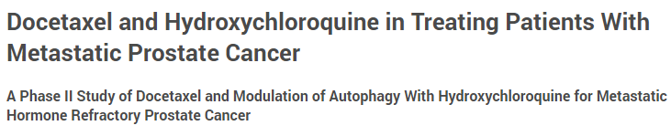
Simon’s Design Example
“The first stage will enroll 15 patients. If there are 8 or fewer responses … not worthy of further study … stop the trial. … 9 or more responses, … accrual continues for a total of 43 patients. … 26 or fewer responses … no further investigation … 27 or more responses … further investigation … “Expected" sample size of the trial is 23.5 … “
“ Upon reviewing response data for the first 8 patients, … no responses thus far. As per the two-stage optimal Simon's design … The study was stopped due to lack of improved efficacy compared to historical controls.”
Parameter | Value
Test Significance Level (α) | 0.05
Design Criterion | Optimal
“Poor” Response (π₁) | 0.5
“Good” Response (π₁) | 0.7
Power | 80
Clinicaltrials.gov: Journal of Clinical Oncology (2011)
Identifier: NCT00786682

Slide 14
Simon’s Admissible Designs
Optimum and Minimax are two extremes on a continuum of valid designs
Optimum: Minimises the expected N under H₀ → higher maximum N
Minimax: Minimises max. N → higher expected N
Admissible designs are compromises between these two
Trade a slightly larger expected N for a smaller maximum N – or vice versa
Design | Stage 1 (r₁ / n₁) | Final (r / n) | E[N | H₀]
Minimax | 12 / 23 | 23 / 37 | 27.743
Admissible | 8 / 16 | 24 / 39 | 25.242
Optimal | 8 / 15 | 26 / 43 | 23.501

Slide 15
Part 3
Complex Phase IIA Designs

Slide 16
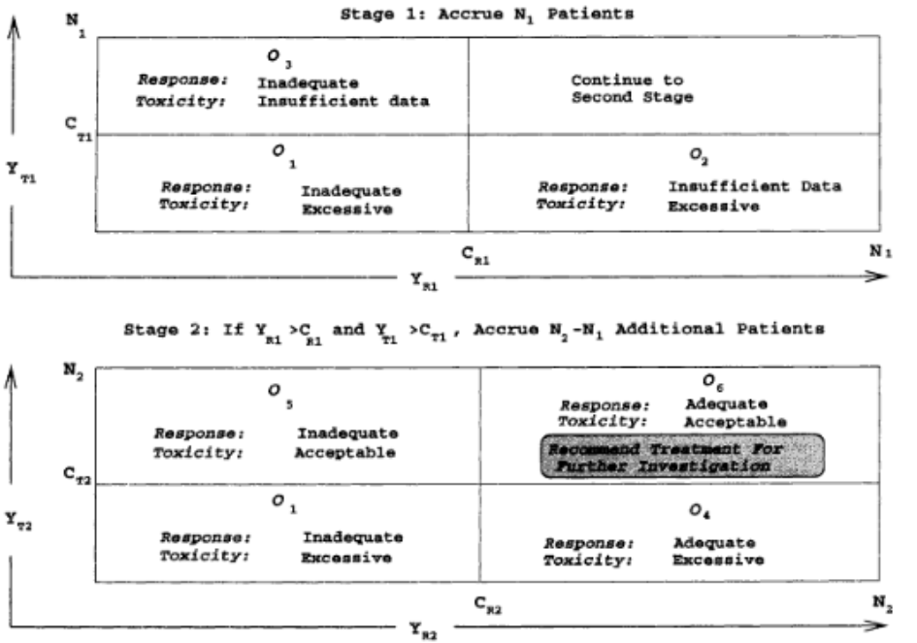
Response & Toxicity - Bryant & Day Design
Extends Simon’s two-stage design to two co-primary endpoints
  Stop early for futility OR excessive toxicity
Tackles uncertainty in level of toxicity assumed
  Common primary objective of Phase II
2 Common Criteria for Design
  Optimal: Minimise expected N (ESS)
  Minimax: Minimise maximum N
Source: J. Bryant, R. Day, (1995), 'Incorporating Toxicity Considerations Into the Design of Two-Stage Phase II Clinical Trails', Biometrics; 51: 1372 - 1383.

Slide 17
Bryant & Day Example
Bryant & Day Example Parameters
Simon’s Design Example Parameters
Parameter | Value
Response Significance Level (α_{R}) | 0.05
Toxicity Significance Level (α_{T}) | 0.1
Design Criterion | Optimum
Unacceptable Response (π_{R0}) | 0.5
Acceptable Response (π_{R1}) | 0.7
Unacceptable Non-Toxicity (π_{T0}) | 0.8
Acceptable Non-Toxicity (π_{T1}) | 0.95
Power | 80
Parameter | Value
Test Significance Level (α) | 0.05
Design Criterion | Optimum
“Poor” Response (π₁) | 0.5
“Good” Response (π₁) | 0.7
Power | 80
Clinicaltrials.gov: Journal of Clinical Oncology (2011)
Identifier: NCT00786682

Slide 18
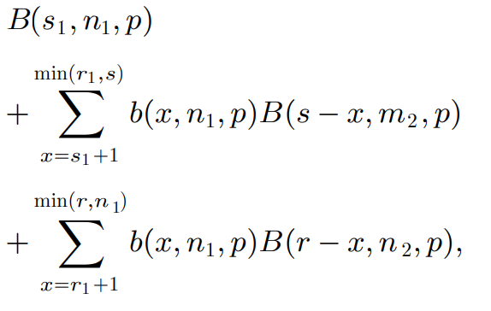
Adaptive Response - Lin & Shih’s Design
Adaptive 2-stage design which allows choice between “Optimistic” and “Sceptical” response estimates
  Case 1 (Sceptical) Proportion - π₁
  Case 2 (Optimistic) Proportion - π₂
Tackles uncertainty in estimate used for the alternative
  Common issue in Phase IIa Oncology trials
Study is powered under Optimistic or Sceptical choices based on interim result
4 different Optimality Criteria
Criterion | Design
1 | Min expected N under π₀
2 | Min max expected N over π₀, π₁, π₂
3 | Min max N in case 1 & 2, then expected N under π₀
4 | Min max N in case 1 & 2, then max expected N

Slide 19
Lin & Shih’s Design Example
Lin & Shih Example Parameters
Simon’s Design Example Parameters
Parameter | Value
Test Significance Level (α) | 0.05
Design Criterion | Type I
Maximum Ineffective Prop. (π₀) | 0.5
Case 1 Min. Efficacy Prop. (π₁) | 0.7
Case 2 Min. Efficacy Prop. (π₂) | 0.8
Case 1 Type II Error (β₁) | 0.2
Case 2 Type II Error (β₂) | 0.2
Power | 80
Parameter | Value
Test Significance Level (α) | 0.05
Design Criterion | Optimum
“Poor” Response (π₁) | 0.5
“Good” Response (π₁) | 0.7
Power | 80
Clinicaltrials.gov: Journal of Clinical Oncology (2011)
Identifier: NCT00786682

Slide 20
Progression Free Survival - Litwin’s Design
Extends Simon’s two-stage design to Progression Free Survival endpoint
  PFS used where goal is stabilization rather than cure, e.g. Tumour stabilization Vs Tumour shrinkage
Expands Simon’s design to both H0 & H1
  Optimum Design under both available
4 different Design Criterion available
Key Decision Rule
H₀: equal success rate (p₀) in both arms
H₁: p₁ > p₀ in the experimental arm
Reject H₀ when:
E − C > r and E ≥ m
E, C = successes in the experimental / control arms
Criterion | Design
Optimum H₀ | Min ESS under H₀
Optimum H₁ | Min ESS under H₁
Minimax | Smallest maximum N
Custom | Smallest max N, stage 1 ≈10% of total

Slide 21
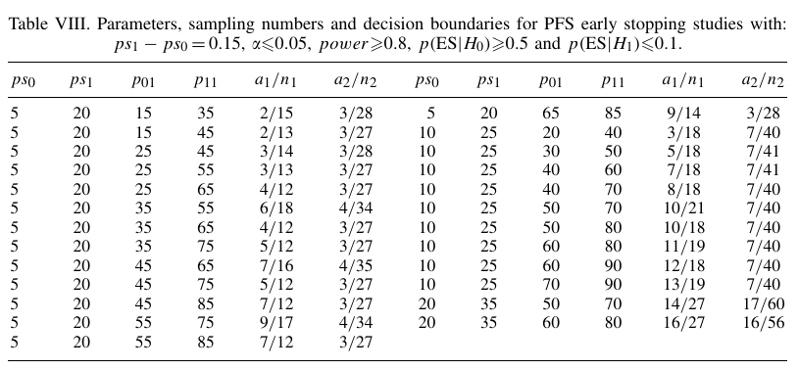
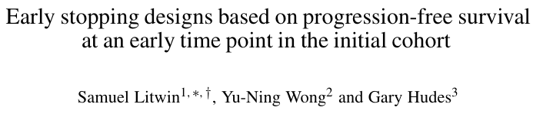
Litwin’s Design Example
Litwin’s Design Example Parameters

Slide 22
Part 4
Discussion and Conclusions

Slide 23
Discussion and Conclusions
Phase IIa Role
Response & Complexity
Adaptive & Bayesian Designs
Conclusion
Phase IIa has hugely important role of screening out ineffective treatments prior to costly Phase III trial
Faces multiple challenges - Delayed Response, Error Control, High Failure Rates, etc.
Adaptive & Bayesian designs can be used to combat issues
Multi-stage designs offer simple and powerful solution

Slide 24


Statsols.com/nquery-demo

Slide 25
Thank you
CONTACT US
info@statsols.com
MORE INFO
statsols.com

Slide 26
References
Simon, R. (1989). Optimal two-stage designs for phase II clinical trials. Controlled Clinical Trials, 10(1), 1–10.
Jung, S. H., Lee, T., Kim, K., & George, S. L. (2004). Admissible two-stage designs for phase II cancer clinical trials. Statistics in Medicine, 23(4), 561–569.
Bryant, J., & Day, R. (1995). Incorporating toxicity considerations into the design of two-stage phase II clinical trials. Biometrics, 51(4), 1372–1383.
Lin, Y., & Shih, W. J. (2004). Adaptive two-stage designs for single-arm phase IIA cancer clinical trials. Biometrics, 60(2), 482–490.
Sill, M. W., Rubinstein, L., Litwin, S., et al. (2012). A method for utilizing co-primary efficacy outcome measures to screen regimens for activity in two-stage phase II clinical trials. Clinical Trials, 9(4), 385–395.
Ensign, D. A., Gehan, E. A., Kamen, D. S., & Thall, P. F. (1994). An optimal three-stage design for phase II clinical trials. Statistics in Medicine, 13(17–18), 1727–1736.
Chen, T. T. (1997). Optimal three-stage designs for phase II cancer clinical trials. Statistics in Medicine, 16(23), 2701–2711.
Thézenas, S., Duffour, J., Culine, S., & Kramar, A. (2004). Five-year change in statistical designs of phase II trials published in leading cancer journals. European Journal of Cancer, 40(8), 1244–1249.
A'Hern, R. P. (2001). Sample size tables for exact single-stage phase II designs. Statistics in Medicine, 20(6), 859–866.
Ghosh, P., Liu, L., Senchaudhuri, P., Gao, P., & Mehta, C. (2017). Design and monitoring of multi-arm multi-stage clinical trials. Biometrics, 73(4), 1289–1299.
BIO, Biomedtracker, & Amplion. (2016). Clinical development success rates 2006–2015. https://www.bio.org

