Slide 2
Session 6
Bayesian Sample Size

Slide 3
Bayesian Sample Size Approaches
Bayesian Analysis continues to grow in popularity due to the ability to integrate prior knowledge and data into analyses
Sample Size for Bayesian Methods
Improving Sample Size Methods
Sample size for specific values of Bayesian parameters
e.g. Bayes Factors, Credible Intervals, Continual Reassessment Method (CRM)
Integrating Bayesian methods equals adding greater context for parameter uncertainty
e.g. Assurance, Predictive Power, Adaptive Designs

Slide 4
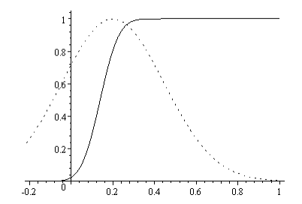
Quick Overview: Assurance for Clinical Trials
Assurance is the unconditional probability of significance given a prior
Focus on methods proposed by O’Hagan et al. (2005)
Assurance is the expectation of the power averaged over a prior distribution for the effect
Often framed as the “true probability of success” or “Bayesian Power” of a trial
Can be considered as a Bayesian analogue to comprehensive sensitivity analysis
Source: O’Hagan (2005)

Slide 5
Binary Assurance Example
“We determined that a sample size of 156 patients with a 1:1:1 randomization ratio would provide a power of more than 80% at a two-sided significance level of 0.05 (as calculated with the use of the chi-square test), assuming ACR 20 response rates of 50% in the brodalumab 280-mg group and 23% in the placebo group at week 12.”
Source: nejm.com
Parameter | Value
Significance Level (Two-Sided) | 0.05
Placebo ACR Rate | 0.23
Brodalumab 280mg ACR Rate | 0.5
n per Group | 52
Target Power (%) | 80%

Slide 6
Technical Issues With Assurance
How to decide on a prior for the assurance calculation?
Previous studies, educated guess, expert elicitation
Sheffield Elicitation Framework (SHELF) has industry interest
Able to use a non-normal prior?
Yes, but no analytical solution. Requires usage of simulation
More flexible methods added in nQuery in Spring 2018
Assurance for alternative data types or decision criteria?
Methods in literature for proportions and survival (see Spring 2018)
Assurance concept technically generalizable to any criteria

Slide 7
Recommendations For Assurance
Assurance instead of power to find the original sample size?
Would usually recommend “no” due to the nature of chosen effect size
If the effect size is the “expected” size it might make sense but are we interested in non-clinically relevant powers?
Does assurance measure for the question of interest or just the p-value?
Does Assurance replace sensitivity analysis completely?
Has many advantages but sensitivity analysis more “tactile”?
Assurance is vital contextual tool in the planning toolbox
Places uncertainty at the heart of the sample size determination process

Slide 8
Sample Size For Credible Intervals
Credible intervals are the most commonly used Bayesian method used for interval estimation
Focus here on methods of Adcock (1988) & Joseph and Bélisle (1997) for normal means
The method chosen depended both on the desired selection criterion and the estimation methodology
Selection Criteria
Average Coverage Criterion
Average Length Criterion
Worst Outcome Criterion
Testing Scenarios
Known Precision
Unknown Precision
Mixed Bayes/Frequentist

Slide 9
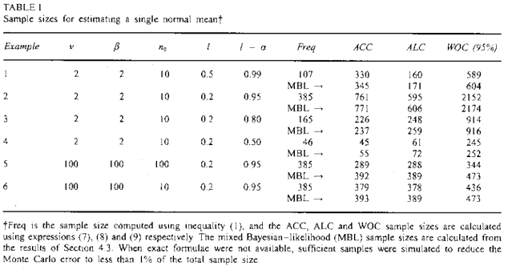
Credible Interval Example
“In practice, the prior information will be different in every problem, so it is impossible to provide exhaustive tables. Therefore, Table 1 presents a variety of examples that illustrate the relationships between the various criteria discussed for the case of estimating sample size requirements for a single normal mean. Example 1-3 … show that the Bayesian approach can provide larger sample sizes than the frequentist approach, even though prior information is incorporated ... The same examples also illustrate that sample size provided by the ALC tend to be smaller than that of the ACC when 1-α is near l and l is not near 0.”
Source: Wiley.com

Slide 10
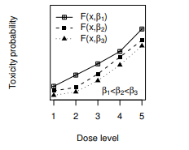
Continual Reassessment Method (CRM)
CRM is increasingly popular design for Phase I MTD trials
Provides better results for MTD over 3+3 design and allows potential efficacy assessment
Small N and minimal prior info requires simulations for planning
nQuery provides starting approximation for sample size from YK Cheung (2013)
Source: Y.K. Cheung (2011)

Slide 11
Continual Reassessment Example
“To provide a quick estimate of budget (that is, n) for a dose finding study of PTEN-long monotherapy in patients with pancreatic cancer, we calculated the required sample size … In the trial, the MTD was defined with target θ = 0.25. The starting dose of the trial would be determined based on a prior pharmacokinetic study, and would be the third dose level in a panel of K = 5 test doses. To obtain an average PCS of a* = 0.6 under R = 1.8, we obtained b* = 0.648 and ñ(b*) = 31.6. Thus, the sample size of the trial was set to be 32.”
Source: journals.sagepub.com
Parameter | Value
Probability of Success | 60%
Target Dose Toxicity Rate | 0.25
Number of Dose Levels | 9
Effect Size (Odds Ratio) | 0.66667

Slide 12
nQuery Plans for Bayesian Analysis
Continue to add more options for assurance
Custom priors, additional parametric priors, complex designs
Continue to add more options for credible intervals
Survival & regression endpoints, one sample binary, other priors
Add more options for continual reassessment sample size
Alternative variants, basic simulation capability, other models
Investigate other potential Bayesian methods/approaches
Predictive Power, Bayes Factors, Posterior Probability, cost methods
Feedback/Suggestions/Papers for methods very welcome

Slide 13
References
Bayesian Sample Size
O'Hagan, A., Stevens, J. W., & Campbell, M. J. (2005). Assurance in clinical trial design. Pharmaceutical Statistics, 4(3), 187-201.
Ren, S., & Oakley, J. E. (2014). Assurance calculations for planning clinical trials with time‐to‐event outcomes. Statistics in medicine, 33(1), 31-45.
Mease, P. J., et al (2014). Brodalumab, an anti-IL17RA monoclonal antibody, in psoriatic arthritis. New England Journal of Medicine, 370(24), 2295-2306.
Joseph, L., Du Berger, R., & Belisle, P. (1997). Bayesian and mixed Bayesian/likelihood criteria for sample size determination. Statistics in medicine, 16(7), 769-781.
Joseph, L., & Belisle, P. (1997). Bayesian sample size determination for normal means and differences between normal means. Journal of the Royal Statistical Society: Series D (The Statistician), 46(2), 209-226.
Kuen Cheung, Y. (2013). Sample size formulae for the Bayesian continual reassessment method. Clinical Trials, 10(6), 852-861.
Cheung, Y. K. (2011). Dose finding by the continual reassessment method. CRC Press.

