Slide 2
module 5
Group Sequential Designs

Slide 3
Group Sequential Designs
Group Sequential Trials (GST) facilitate interim analyses
Interim analyses are those which occur while a trial is on-going
In a GST, accrued data is analysed at pre-specified times
E.g. After half the subjects have been measured
At an interim analysis, can either stop for benefit or futility
If neither found, continue trial until end/next interim analysis
However, need to account for effect of multiple analyses
Do this by “spending” errors using error spending function

Slide 4
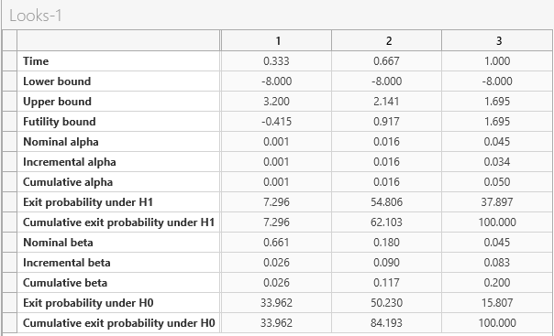
Why Use a Group Sequential Design?
Recruitment often sequential over long time period
Can follow study results as they come in instead of waiting
Stopping for Efficacy
Improved practice and to market sooner
Cut cost of expensive trial/study
Stopping for Futility
Prevents unnecessary risk exposure
Allows to quickly adjust or abandon trial

Slide 5
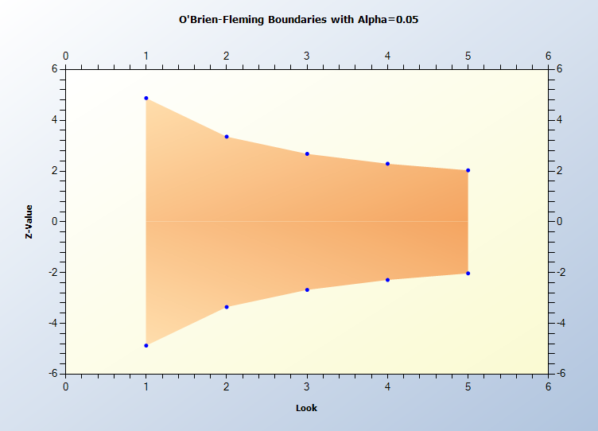
Error Spending (Lan & DeMets)
Two Criteria for early stopping
Efficacy (α-spending)
Futility (β-spending)
Multiple Error Spending Functions
O’Brien Fleming, Pocock etc.
Both α and β spending work similarly
Can be very liberal or conservative
At each interim analysis, spending a proportion of the total error
Makes analysis at endpoint more conservative
$$α\left(τ\right)=2\left(1−Φ\left(\frac{z_{α/2}}{τ}\right)\right)$$

Slide 6
Group Sequential Example
“A sample size of 242 subjects (121 per treatment group) provides at least 80% power to detect a relative difference of 53% between botulinum toxin A and standardized anticholinergic therapy, assuming a treatment difference of -0.80 and a common SD of 2.1 (effect size = 0.381), and a two-sided type I error rate of 5%. Sample size has been adjusted to allow for a 10% loss to follow-up over the 6-months of treatment as well as one interim analysis to stop early for benefit.”
Source: AG, Visco et al (2012)
Parameter | Value
Significance Level (2-sided) | 0.05
OnabotulinumtoxinA Mean | -2.3
Anticholinergic Mean | -1.5
Standard Deviation (Both) | 2.1
Power | 80%
# Interim Analyses | 1
α Spending Function | O’Brien-Fleming
Expected Dropout | 10%

Slide 7
nQuery Plans for Group Sequential
Improve methods and UX for current GSD tables
More flexibility in designs (e.g. skip looks) and spending functions
More options for boundary parameterisation in tables/plots
Add additional options for survival (accrual, piece-wise etc.)
Extend GSD methods to other design types and endpoints
One Sample, non-inferiority/equivalence, information-based
Addition of other types of adaptive trials and outputs
Sample Size Re-estimation, Conditional Power, Predictive Power
Feedback/Suggestions/Papers for methods very welcome

Slide 8
References
Group Sequential Designs
Demets, D. L., & Lan, K. K. (1994). Interim analysis: the alpha spending function approach. Statistics in medicine, 13(13‐14), 1341-1352.
Jennison, C., & Turnbull, B. W. (1999). Group sequential methods with applications to clinical trials. CRC Press.
Visco, A. G., et al (2012). Anticholinergic therapy vs. onabotulinumtoxina for urgency urinary incontinence. New England Journal of Medicine, 367(19), 1803-1813.

