Slide 2
Module I
Introducing Sample Size Determination & Pitfalls

Slide 3
Sample Size Determination (SSD) Review
SSD finds the appropriate sample size for your study
Common metrics are statistical power, interval width or cost
SSD seeks to balance ethical and practical issues
A standard design requirement for regulatory purposes
SSD is crucial to arrive at valid conclusions in a study
High incidence of non-replicable results, Type M/S errors
Yet many studies still have insufficient sample size
What solutions for innovative methods and uncertainty?

Slide 4
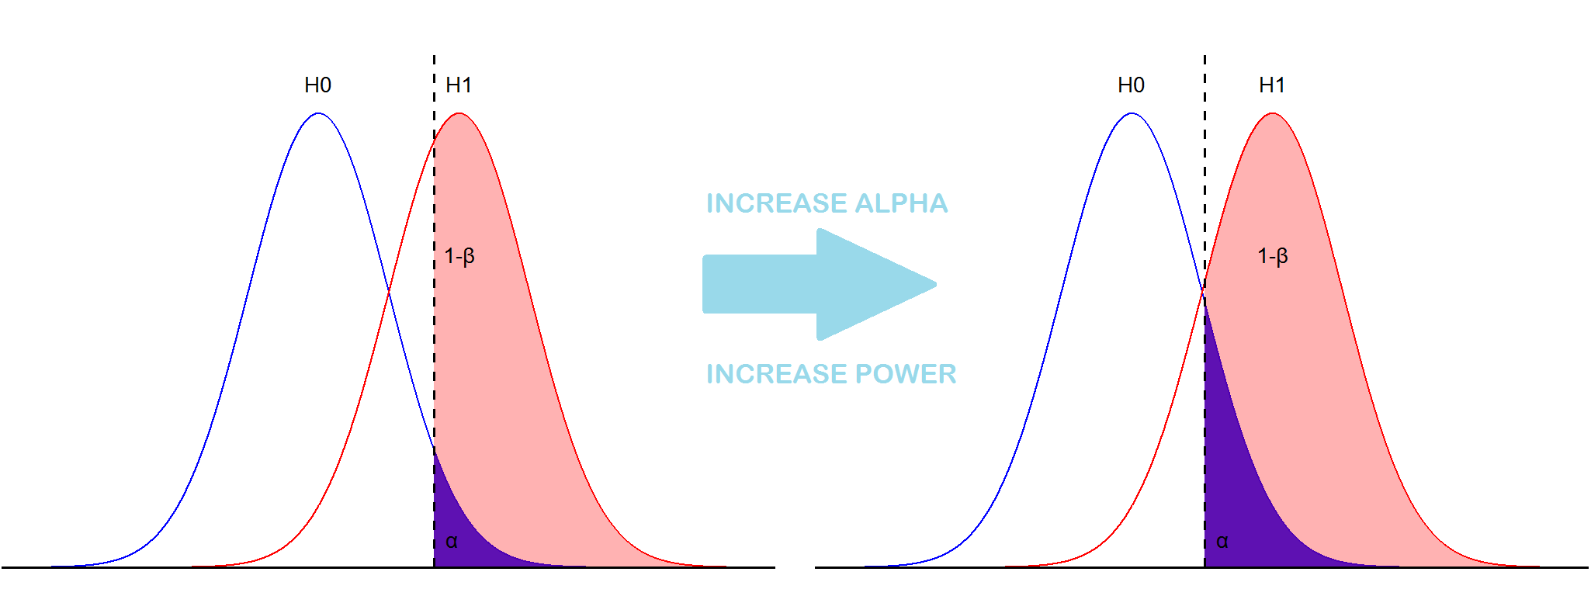
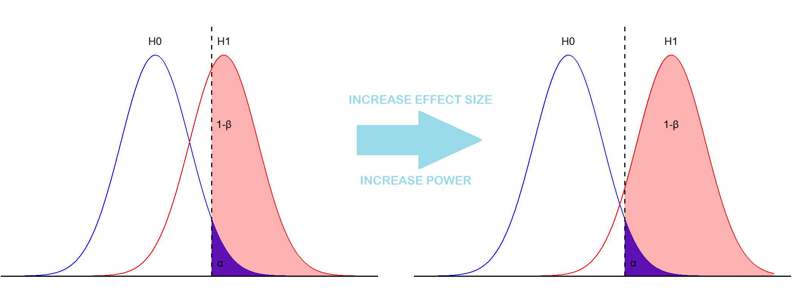
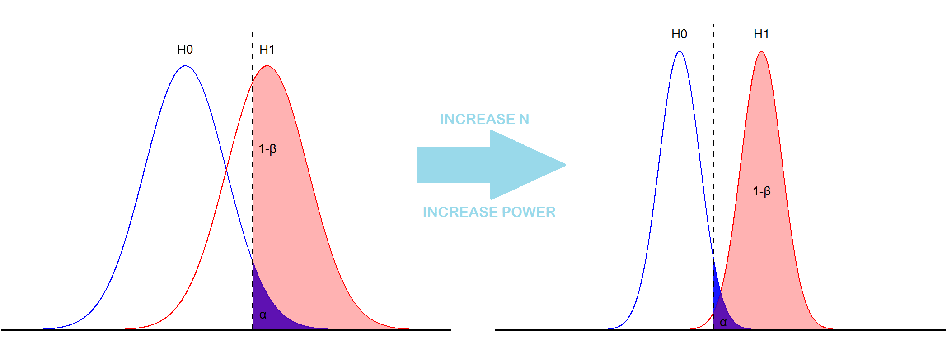
$$\begin{aligned}z=\frac{\left({\overline{x}}_{1}−{\overline{x}}_{2}\right)\sqrt{n}}{s\sqrt{2}}\#\left(1\right)\end{aligned}$$
$$\begin{aligned}δ=\frac{\left(μ_{1}−μ_{2}\right)}{σ}\#\left(2\right)\end{aligned}$$
$$\begin{aligned}Power=1−β=P\left(z>z_{1−α} | H_{1}\right)\#\left(3\right)\end{aligned}$$
$$\begin{aligned}=P\left(z − \frac{δ\sqrt{n}}{\sqrt{2}}>z_{1−α} − \frac{δ\sqrt{n}}{\sqrt{2}}|H_{1}\right)\#\left(4\right)\end{aligned}$$
$$\begin{aligned}\left(z − \frac{δ\sqrt{n}}{\sqrt{2}}\right) \sim N\left(0,1\right)\#\left(5\right)\end{aligned}$$
$$\begin{aligned}1−β=1− Φ\left(z_{1−α} − \frac{δ\sqrt{n}}{\sqrt{2}}\right)\#\left(6\right)\end{aligned}$$
$$\begin{aligned}z_{1−β}=\frac{δ\sqrt{n}}{\sqrt{2}}−z_{1−α}\#\left(7\right)\end{aligned}$$
$$\begin{aligned}n=\frac{2{\left(z_{1−β}+z_{1−α}\right)}^{2}}{δ^{2}}\#\left(8\right)\end{aligned}$$

Slide 5
5 Essential Steps for Sample Size
1 | Plan Study |  | Study question, primary outcome, statistical method
2 | Specify Parameters |  | Significance Level, Standard deviation, ICC, dispersion
3 | Choose Effect Size |  | Expected/targeted difference, ratio or other effect size
4 | Compute Sample Size |  | Sample Size for specified metric such as power
5 | Explore Uncertainty |  | Sensitivity Analysis, Assurance, Alternative Designs

Slide 6
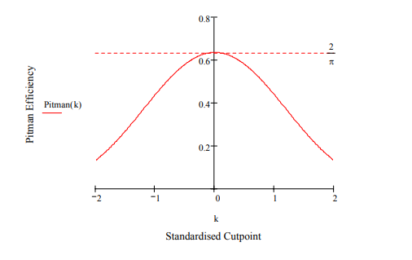
Overview & Pitfalls at Planning Stage
Fail to prepare, prepare to fail – Design, Design, Design!
SSD is one part of design process
Hypotheses, endpoints, methods
To start can rely on “standard” method
Consider choices effect on power
See “dichotomania”, different methods strengths/weaknesses
Power can also highlight poor choices!
Takeaway: Design first, N later
Source: S. Senn (2005)

Slide 7
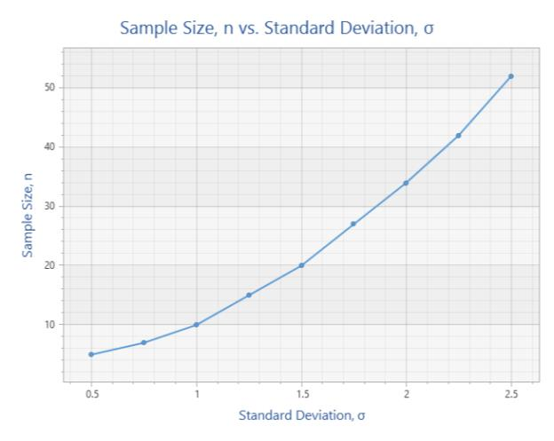
Overview & Pitfalls at Specify Stage
SSD occurs before trial so uncertainty is intrinsic challenge
Will specify multiple parameters
Some Fixed (α), some unknown (σ)
More Parameters, More Assumptions
Justify, if possible, your estimates
Pilot study, previous data, other studies, elicitation, guesswork etc.
Consistency = less problems
Takeaway: More evidence = better

Slide 8
Overview & Pitfalls with Effect Size
Differing opinions on meaning
Expected, clinical sig., standardised
“Minimum value worth detecting”
# of approaches to find value
Mix and match sources/methods
Approach and meaning linked
Do not reverse justify from N!
Also parameterisation options
Takeaway: Think about your ES and set appropriately
Source: S. Julious (2017)

Slide 9
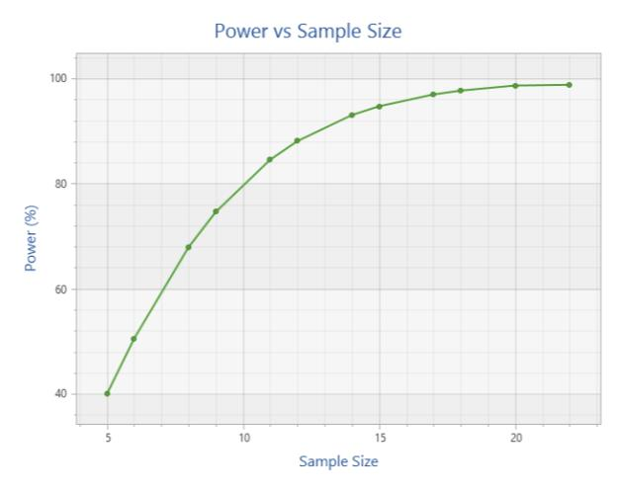
Overview & Pitfalls with Sample Size/Power
80/90% Power standard
90% gives “optimism” adjustment
90% = implicit 2-study adjustment
Some Sample size adjustments
Dropout, Unequal, CRT choices
Easier: N(D) = N/(1-P(Dropout))
Harder: Survival, Simulation, MNAR
For fixed sample size, more thought in planning needed
Takeaway: Be aware of biases and potential adjustments

Slide 10
Overview & Pitfalls at Exploration Stage
Biggest Pitfall: Not bothering
Should explore all assumptions
Design, ES, other values, N, power
Should do Sensitivity Analysis
What scenarios to test? (95% CI)
How confident in first N estimate?
Focus where uncertain/large effect
Other approaches can help
Plots, assurance, alternative methods
Takeaway: Vital for context when justifying your sample size
“The method by which the sample size is calculated should be given in the protocol, together with the estimates of any quantities used in the calculations (such as variances, mean values, response rates, event rates, difference to be detected)… It is important to investigate the sensitivity of the sample size estimate to a variety of deviations from these assumptions…”
-ICH E9: Statistical Principles for Clinical Trials

Slide 11
References
SSD Overview and Pitfalls
Senn, S. S. (2008). Statistical issues in drug development (2nd Edition), John Wiley & Sons.
Senn, S. J. (2005). Dichotomania: an obsessive compulsive disorder that is badly affecting the quality of analysis of pharmaceutical trials. Proceedings of the International Statistical Institute, 55th Session, Sydney.
Julious, S. A. (2009). Sample sizes for clinical trials. CRC Press.
ICH (1998), ICH E9: Statistical Principles for Clinical Trials

