Slide 2
Module 3
Survival Analysis (TTE) Sample Size

Slide 3
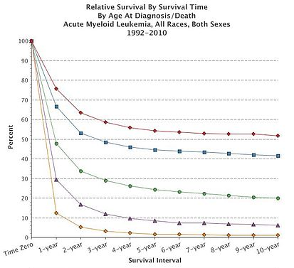
Sample Size for Survival Analysis
Survival Analysis is about the expected duration of time to an event
Methods like log-rank test & Cox Model
Power is related to the number of events NOT the sample size
Sample Size = Subjects to get no. of events
Flexibility expected in survival analysis methods and estimation
Sample Size methods need to follow suit but can make mistakes easier!
Source: SEER, NCI

Slide 4
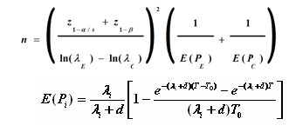
Evolution of Survival Sample Size Methods
General trend is away from simple approximations to more complex model
Initial methods based on normal approx. for exponential curves for log-rank test
Later methods derived to adjust for unequal follow-up and dropout
Complex methods using Markov models or simulation allow greater flexibility
Methods for other survival models (Cox, Gehan), trial designs (one sample, >2 samples) and adaptive methods (GSD, SSR)
Source: L.S. Freedman (1982)
Source: D Schoenfeld,1981
Source: J.M. Lachin & M.A Foulkes (1986)
Source: E Lakatos (1988)

Slide 5
Considerations in Survival Sample Size
What is the expected survival curve(s) in the group(s)?
Assume parametric approximation? Which test appropriate?
Effect of unequal follow-up due to accrual period?
What accrual pattern to assume? Set max follow-up same for all?
How to deal with expected dropouts or censoring?
Simple loss-to-followup or integrate dropout process into model?
Effect of subjects crossing over from one group to other?
Account for at planning stage? How will analysis handle it?

Slide 6
Survival Analysis Example
“Using an unstratified log-rank test at the one-sided 2.5% significance level, a total of 282 events would allow 92.6% power to demonstrate a 33% risk reduction (hazard ratio for RAD/placebo of about 0.67, as calculated from an anticipated 50% increase in median PFS, from 6 months in placebo arm to 9 months in the RAD001 arm). With a uniform accrual of approximately 23 patients per month over 74 weeks and a minimum follow up of 39 weeks, a total of 352 patients would be required to obtain 282 PFS events, assuming an exponential progression-free survival distribution with a median of 6 months in the Placebo arm and of 9 months in RAD001 arm. With an estimated 10% lost to follow up patients, a total sample size of 392 patients should be randomized.”
Source: nejm.org
Parameter | Value
Significance Level (One-Sided) | 0.025
Placebo Median Survival (months) | 6
Everolimus Median Survival (months) | 9
Hazard Ratio | 0.66667
Accrual Period (Weeks) | 74
Minimum Follow-Up (Weeks) | 39
Power (%) | 92.6

Slide 7
Summary of Survival Sample Size
Easy to make mistakes (nQuery will guide/help)
Same Time units, parameter conversion, equal follow-up
Lots of options and flexibility with survival SSD
But each additional option = an additional assumption
Can help to have approximation as starting point
Useful benchmark and can be tested using simulation
NB: Number of Events is the actual target for study
After # events reached can stop, N only for planning

Slide 8
nQuery Plans for Survival Analysis
More options for fixed term two sample designs
More simulation, tests & distributions; piece-wise models etc.
Methods for greater than two samples survival designs
Omnibus tests, multiplicity methods, conjunctive/disjunctive power
Adaptive designs for survival endpoints
Improved GSD, SSR (blinded and unblinded), conditional power
Bayesian approaches for survival endpoints
More assurance options, credible intervals, posterior prob. tests
Feedback/Suggestions/Papers for methods very welcome

Slide 9
References
Survival Sample Size
Freedman, L. S. (1982). Tables of the number of patients required in clinical trials using the logrank test. Statistics in medicine, 1(2), 121-129.
Schoenfeld, D. A. (1983). Sample-size formula for the proportional-hazards regression model. Biometrics, 499-503.
Lachin, J. M., & Foulkes, M. A. (1986). Evaluation of sample size and power for analyses of survival with allowance for nonuniform patient entry, losses to follow-up, noncompliance, and stratification. Biometrics, 507-519.
Lakatos, E. (1988). Sample sizes based on the log-rank statistic in complex clinical trials. Biometrics, 229-241.
Yao, J. C., et. al. (2011). Everolimus for advanced pancreatic neuroendocrine tumors. New England Journal of Medicine, 364(6), 514-523.

