Slide 2
module 4
Sample Size for Equivalence & Non-inferiority

Slide 3
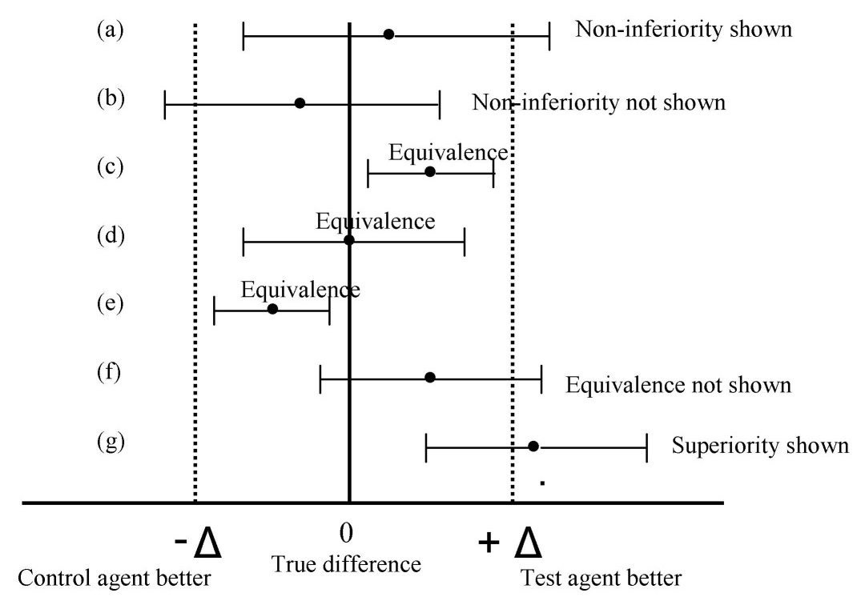
Equivalence/Non-Inferiority Background
This type of hypothesis very common in generics and medical devices.
Both trying to prove similarity to pre-existing treatment e.g. RLD
Non-inferiority = Test Not Inferior to Control
H0: True Diff < NIM, H1: True Diff > NIM
Equivalence = Test Equivalent to Control
Two One-sided Tests (Schuirmann)
H0: True Diff < LL or True Diff> UL
H1: LL < True Diff < UL
nQuery Advanced covers continuous, binary and survival endpoints
Parallel, Cross-over, paired, one sample designs
Source: C Pater (2004)

Slide 4
Non-Inferiority Example
“Calculation of the sample size was based on a margin of non-inferiority for in-segment late luminal loss of 0.16 mm. This value is equal to 35 percent of an assumed mean (±SD) late luminal loss of 0.46±0.45 mm in diabetic patients after the implantation of a sirolimus stent, as found in an analysis of a series of diabetic patients treated with sirolimus stents at participating centers in the 10 months that preceded the initiation of the study. Using a one-sided α level of 0.05, we estimated that 99 patients per group were needed to demonstrate noninferiority of the paclitaxel stent with a statistical power of 80 percent. Expecting that up to 20 percent of the patients would not return for follow-up coronary angiography, we included 250 patients in the study.”
Source: A. Dibra et. al. (2005)
Parameter | Value
Significance Level (1-sided) | 0.05
Expected Difference | 0
Non-Inferiority Margin | -0.16
Standard Deviation | 0.45
Power | 80%
Dropout Rate | 20%

Slide 5
nQuery Plans for Equivalence/Non-inferiority
Expand core options for common endpoints
Continuous: Complex cross-over, HVD methods, ABEL
Proportions: Likelihood tests, complete for all of one/two/paired
Survival: One-sample, more flexibility with null, unequal N
Investigating interactions with other areas of interest
Group Sequential Designs, Adaptive, Bayesian Methods
Work on related Superiority by Margin hypothesis methods
Feedback/Suggestions/Papers for methods very welcome

Slide 6
References
Session 4 (Non-inferiority/Equivalence)
Pater, C. (2004). Equivalence and noninferiority trials–are they viable alternatives for registration of new drugs?(III). Current controlled trials in cardiovascular medicine, 5(1), 8.
Senn, S. (2002). Cross-over trials in clinical research (2nd Edition). John Wiley & Sons.
Dibra, A., et al (2005). Paclitaxel-eluting or sirolimus-eluting stents to prevent restenosis in diabetic patients. New England Journal of Medicine, 353(7), 663-670.

