Slide 1
2020 Trends In Biostatistics
What you should know about study design
Demonstrated on
Notes:
www.Statsols.com/trial

Slide 2
Webinar Host
Head of Statistics
nQuery Lead Researcher
FDA Guest Speaker
Guest Lecturer
HOSTED BY: Ronan Fitzpatrick

Slide 3
AGENDA
Adaptive Designs in Confirmatory Trials
Using External Data in Study Planning
Innovative Designs in Early-stage Trials
Conclusions and Discussion
Notes:
Change bullet point

Slide 4
The complete trial design platform to make clinical trials faster, less costly and more successful
The solution for optimizing clinical trials

Slide 5
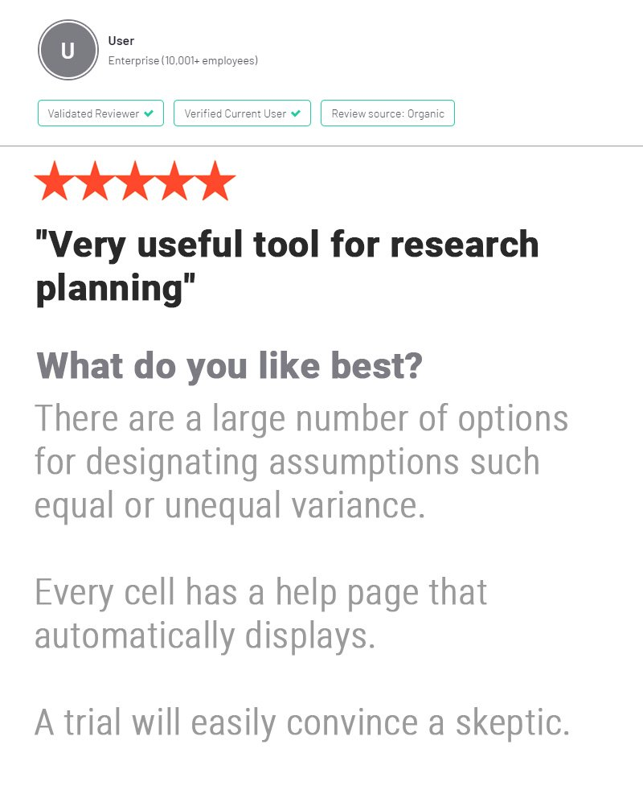
In 2019, 90% of organizations with clinical trials approved by the FDA used nQuery
Notes:
www.Statsols.com/trial

Slide 6
Adaptive designs in confirmatory trials
Part 1

Slide 7
Adaptive clinical trials have emerged a favored solution
Moving from fixed to flexible study designs
From regulators
and by industry
Notes:
https://www.fda.gov/downloads/Drugs/NewsEvents/UCM601630.pdf

Slide 8
Adaptive Trials Overview
Adaptive Trials are any trial where a change or decision is made to a trial while still on-going
Encompasses a wide variety of potential adaptions
Targets can be sample size, sub-groups, hypotheses, etc.
Adaptive trials seek to give control to trialist to improve trial based on all available information
Adaptive trials can thus decrease costs and lead to better and more efficient inferences

Slide 9
Adaptive Trials Designs
1 | Group Sequential Design | Stop trial for efficacy/futility
2 | Sample Size Re-estimation | Increase N adaptively
3 | Enrichment Designs | Increase subgroup N adaptively
4 | Selection Designs | Add/Remove Study Arms adaptively
5 | Allocation Designs | Allocate new patients adaptively
6 | Endpoint Designs | Amend statistical endpoint adaptively
7 | Multiple/Complex | 2+ of above/complex adaptions

Slide 10
Regulatory Background
First draft FDA CBER/CDER Guidance published in 2010
“Well-understood” and “Less well-understood” Designs
EMA published similar reflection paper (2007)
Interest in encouraging adaptive/innovative design
US: Innovative Cures Act, EU: Adaptive Pathways
Regulatory context becoming clear allowing more usage
New FDA Guidance published in late 2019
ICH E20 (Adaptive Design) EWG established (~3 years ETA)

Slide 11
2019 FDA Adaptive Guidance
“Adaptive designs have the potential to improve ...study power and reduce the sample size and total cost“ for investigational drugs, including "targeted medicines that are being put into development today”
New guidance published in Nov. 2019 (PDUFA VI requirement)
Far less categorical than 2010 draft
Emphasizes early collaboration with FDA
Focus on design issues and Type I error
e.g. pre-specification, blinding, simulation
In-depth on certain adaptive designs
SSR, enrichment, switching, multiple treats
Updated views on Bayesian and Complex
Moving from fixed to flexible study designs
Scott Gottlieb - Former FDA Commissioner
Notes:
https://www.fda.gov/downloads/Drugs/NewsEvents/UCM601630.pdf

Slide 12
Worked Example 1
Group Sequential Design for Survival
Parameter | Value
Significance Level (One-Sided) | 0.025
Placebo Median Survival (months) | 6
Everolimus Median Survival (months) | 9
Hazard Ratio | 0.66667
Accrual Period (Weeks) | 74
Minimum Follow-Up (Weeks) | 39
Power (%) | 92.6
Extend previous example to group sequential design with 2 interim analyses with O’Brien Fleming efficacy bound and non-binding Hwang-Shih-DeCani futility bound with gamma = -1.25
Parameter | Value
Number of Looks | 3
Efficacy Bound | O’Brien Fleming
Futility Bound | Non-Binding
Beta Spending Function | Hwang-Shih-DeCani
HSD Parameter | -1.25
Source: NEJM (2011)

Slide 13
Sample Size Re-estimation (SSR)
Will focus here on specific adaptive design of SSR
Adaptive Trial focused on higher sample size if needed
Obvious adaption target due to intrinsic SSD uncertainty
Could also adaptively lower N but not encouraged
Two Primary Types: 1) Unblinded SSR; 2) Blinded SSR
Differ on whether decision made on blinded data or not
Both target different aspects of initial SSD uncertainty

Slide 14
Unblinded SSR
SSR suggested when interim effect size is “promising” (Chen et al)
“Promising” user-defined but based on unblinded effect size
Extends GSD with 3rd option: continue, stop early, increase N
Power for optimistic effect but increase N for lower relevant effects
Updated FDA Guidance: Design which “can provide efficiency”
Common criteria proposed for unblinded SSR is conditional power (CP)
Probability of significance given interim data
2 methods here: Chen, DeMets & Lan; Cui, Hung & Wang
1st uses GSD statistics but only penultimate look & high CP
2nd uses weighted statistic but allowed at any look and CP

Slide 15
Worked Example 1 (cont.)
Sample Size Re-Estimation for Survival
Assume previous group sequential design with added SSR option
Assume interim HR= 0.8 (from 0.666) and inherit total E of 309 (interim E of 103 and 206) and final look alpha of 0.23 from GSD example.
What will required E for SSR for Chen-Demets-Lan/Cui-Hung-Wang assuming maximum events multiplier of 3?
Parameter | Value
Nominal Final Look Sig. Level | 0.0231
Initial HR | 0.667
Interim HR | 0.8
Initial Expected Events (E) | 309
Interim Events (2nd Look) | 206
Maximum Events (x3) | 927
Lower CP Bound (CDL/CHW) | Derived/40%
Upper CP Bound | 92.6%

Slide 16
Adaptive Survival Complications
Unknown follow-up means more interim planning uncertainty
Can be difficult to predict time when interim analysis will occur
Higher numbers likely in active cohort when interim analysis occurs
Adaptive designs for survival often come with new assumptions
Usually strong assumption of constant treatment effect for GSD and SSR
Two dimensions for increasing interim events: Sample Size & Time
N increase biases for early trends, time increase for later trends?
Freidlin and Korn (2017) show ability to pick “best” treatment period

Slide 17
Using external data
in study planning
Part 2

Slide 18
Real World Data/Evidence
Increasing interest in using real world evidence and data to improve process of regulatory approval
Wide number of potential areas of interest for RWD/RWE
Alternative uses, post-marketing approval, synthetic controls
FDA program active since 2016 (Innovative Cures Act) including program, workshops and guidance documents
2019 saw successes (e.g. Ibrance for men breast cancer) and these will accelerate interest in RWD/RWE

Slide 19
Success/Feasibility in SSD
Sample Size Determination typically assumes fixed values for unknown parameters e.g. variance, effect size
However, usually uncertainty around these estimates
Sensitivity analysis can help but often ad-hoc & post-hoc
Interest in methods for evaluating true “probability of success” rather than just if assumptions exactly correct
This can bridge gap between stakeholders in evaluating trial feasibility in light of this prior uncertainty

Slide 20
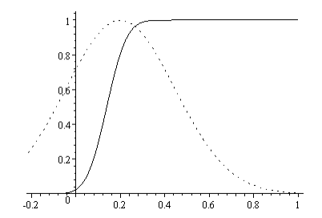
Assurance Overview
Assurance: Probability of sig. given prior for planning parameter
Focus on O’Hagan et al. (2005) d
Assurance is expectation of power averaged over prior distribution
Prior over ES and/or other parameters
“True prob. of success”/“Bayesian Power” d
Can be considered as a Bayesian analogue to comprehensive sensitivity analysis
Analogous approach for conditional power known as predictive power
Source: O’Hagan (2005)

Slide 21
Worked Example 2
Means Assurance Example
“We estimated that we would need to enrol 163 patients, given an expected mean (±SD) annual decline in the FVC of 9±16 percent of the predicted value and a dropout rate of 15 percent, to achieve a two-sided alpha level of 0.05 and a statistical power of 90 percent.”
Source: nejm.com
Parameter | Value
Significance Level (Two-Sided) | 0.05
Mean Difference (%) | -9
Standard Deviation (%) | 16
N per Group (post drop-out) | 0.85(163/2)= 68
Target Power | 90%

Slide 22
Innovative designs
in early-stage trials
Part 3

Slide 23
Early Stage Adaptive Design
Phase I: First human safety evaluation on healthy volunteers
Primary Objective: Safety Evaluation (e.g. MTD); efficacy optional
“Traditional” approaches based on rule-based designs e.g. 3+3
Phase II: Trial(s) for proof-of-concept and dose-finding
1st evaluation of efficacy in humans, high failure rate (~70-80%)
Phase IIa = Proof-of-Concept; Phase IIb = Dose-Finding
High Failure rate and uncertainty = adaptive design
Phase I: Adaptive designs update “best” dose e.g. CRM, Bayes Logistic
Phase IIa: Early futility stopping (Simon’s), IIb: Model selection (MCP-Mod)
Notes:
Difference between prediction intervals and tolerance intervals: A tolerance interval is constructed to contain at least a specified proportion on the population values with a specified level of confidence. A prediction interval will, with a specified degree of confidence, contain the value of a future observation of a random sample

Slide 24
MCP-Mod Introduction
MCP-Mod is method for Phase IIb dose-finding studies which combines process of multiple comparisons and modelling into single process
Multiple Comparisons Procedure (MCP)
Modelling (Mod)
Evaluate if dose-response signal exists using multiple comparisons methods. Establish as least one dose of potential interest
Traditional Methods: Bonferroni etc., Trend tests, William’s Test
Model the dose-response curve with parametric distribution. Find doses of interest for Phase III and efficacy estimates
Traditional Methods: Parametric models (linear, exp, beta etc.)

Slide 25
MCP-Mod Justification
MCP & modelling typically done separately/one done
MCP: Robust but restricted to selected doses since nominal
Mod: Flexible quantitative approach but reliant on model choice
MCP-Mod combines both into single method (Bretz et al)
Design: Select candidate models & get optimal tests/contrasts
MCP: Use contrasts to pick best model(s) w/ FWER control
Mod: Model using best model and find target dose(s) of interest
EMA CHMP (2014) & FDA (2016): “fit-for-purpose”
Increasingly popular in Phase II clinical trials

Slide 26
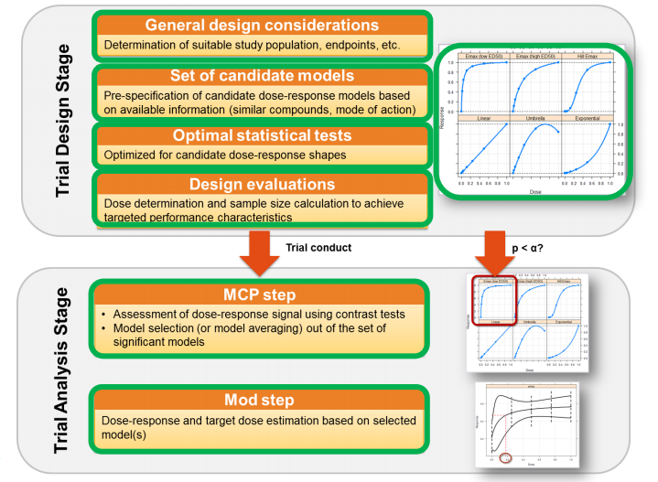
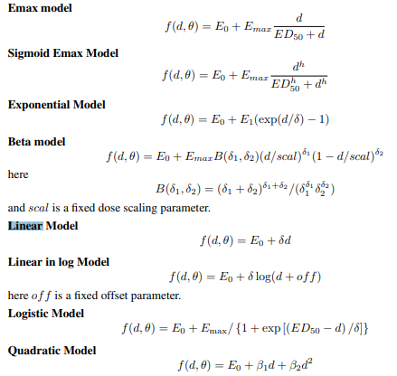
Source: DoseFinding (CRAN)
Source: Bretz et al (2005), Pinhiero et al. (2014)

Slide 27
Worked Example 3
MCP-Mod
Parameter | Value
Sig. Level (1-sided) | 0.05
Power | 80
Standard Deviation | 1
Placebo/Max Effect | 0/0.4
Doses (w/ Placebo) | 0,10,25,50,100,150
Models | Linear, Emax(25), Logistic(50, 10.88), Exp(85), Beta(0.33,2.31), Beta(1.39, 1.39) (scal=200)
“This example refers to a real Phase II design of a drug for the indication of generalized anxiety disorder (GAD). Five active doses are to be used in the study: 10, 25, 50, 100, and 150 mg, with an additional placebo arm (corresponding to a 0 mg dose.)…we will assume that δ0 = 0 and σ = 1, so that δmax = 0.4. … Emax it is assumed that ED50 = 25 … Logistic model parameters are ED50 = 50 and δ = 10.88111. We consider the determination of the sample size to achieve a power level of 0.8 … the unweighted mean is an appropriate choice … desired sample size is n = 62 patients per arm.”
Note: Exponential & Beta Model Parameters taken from Table 1
Source: Journal of Biopharmaceutical Statistics (2006)

Slide 28
MCP-Mod Notes
Flexible to # doses, # models, outcome (continuous, binary, TTE)
4-7 doses typical, 8 models in nQuery, control dose typically included
Multiple models may be considered at “Mod” stage
MCP selection exclusively related to contrast p-values by default
Method has been extended to other types of test
MCLRa, MCLRe: Likelihood ratio rather than MCP contrast test
MHMC: Hierarchial Sequential Test (selects and estimates model)
Notes:
Difference between prediction intervals and tolerance intervals: A tolerance interval is constructed to contain at least a specified proportion on the population values with a specified level of confidence. A prediction interval will, with a specified degree of confidence, contain the value of a future observation of a random sample

Slide 29
Discussion and Conclusions
Desire to improve trial efficiency/innovation at all stages
Coming from industry, legislation and patients
Adaptive trials could make Phase III trials more efficient
SSR is obvious starting point with well known methods
Real world data can be used to increase trial efficiency
Assurance for study planning, synthetic control arms, PMS
Early-stage adaptive design already prevalent and innovating
Design, planning & SSD for specific methods at II/I phase

Slide 30
Thank You
Questions?
info@statsols.com
Further information at Statsols.com

Slide 31
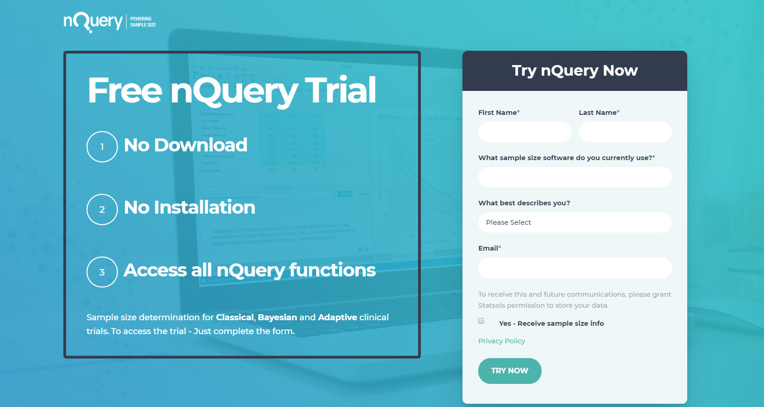
Statsols.com/trial

Slide 32
Trial solutions for all stages of clinical trial design
CRM
MCP-Mod
Simon’s Two Stage
1000+ Scenarios for Fixed Term, Adaptive & Bayesian Methods
Survival, Means, Proportions & Count endpoints
Sample Size Re-Estimation
Group Sequential Trials
Bayesian Assurance
Cross over & personalized medicine
EARLY PHASE
Animal Studies ANOVA / ANCOVA
PRE-CLINICAL / RESEARCH
CONFIRMATORY
Cohort Study
Case-control Study
POSTMARKETING

Slide 33
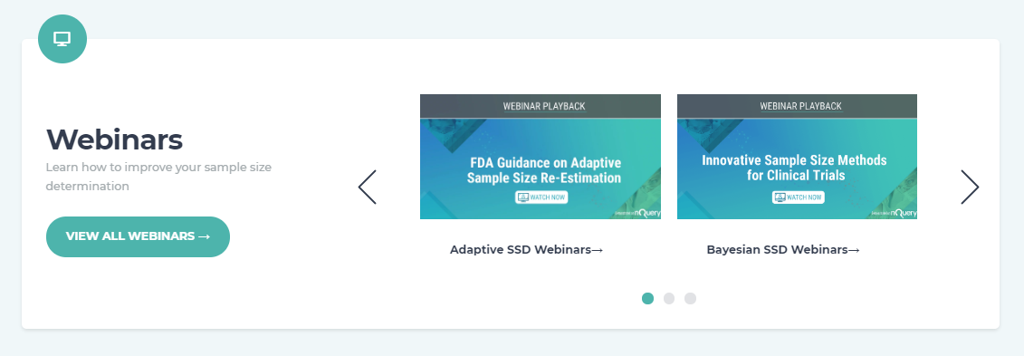
For video tutorials and worked examples
Statsols.com/start

Slide 34
References
Yao, J. C., et. al. (2011). Everolimus for advanced pancreatic neuroendocrine tumors. New England Journal of Medicine, 364(6), 514-523.
Jennison, C., & Turnbull, B. W. (1999). Group sequential methods with applications to clinical trials. CRC Press.
Friede, T., & Kieser, M. (2006). Sample size recalculation in internal pilot study designs: a review. Biometrical Journal: Journal of Mathematical Methods in Biosciences, 48(4), 537-555.
Chen, Y. J., DeMets, D. L., & Gordon Lan, K. K. (2004). Increasing the sample size when the unblinded interim result is promising. Statistics in medicine, 23(7), 1023-1038.
Cui, L., Hung, H. J., & Wang, S. J. (1999). Modification of sample size in group sequential clinical trials. Biometrics, 55(3), 853-857.
Mehta, C.R. and Pocock, S.J., 2011. Adaptive increase in sample size when interim results are promising: a practical guide with examples. Statistics in medicine, 30(28), pp.3267-3284.
Freidlin, B., & Korn, E. L. (2017). Sample size adjustment designs with time-to-event outcomes: a caution. Clinical Trials, 14(6), 597-604.

Slide 35
References
US Food and Drug Administration, 2019. Framework for FDA’s real-world evidence program.
US Food and Drug Administration, 2019. Submitting Documents Using Real-World Data and Real-World Evidence to FDA for Drugs and Biologics: Guidance for Industry: Draft Guidance. Rockville, MD: US Food and Drug Administration.
Wedam, S., Fashoyin-Aje, L., Bloomquist, E., Tang, S., Sridhara, R., Goldberg, K.B., Theoret, M.R., Amiri-Kordestani, L., Pazdur, R. and Beaver, J.A., 2019. FDA Approval Summary: Palbociclib for Male Patients with Metastatic Breast Cancer. Clinical Cancer Research, pp.clincanres-2580.
O'Hagan, A., Stevens, J. W., & Campbell, M. J. (2005). Assurance in clinical trial design. Pharmaceutical Statistics, 4(3), 187-201.
Oakley, J.E. and O’Hagan, A., 2010. SHELF: the Sheffield elicitation framework (version 2.0). Sheffield, UK: School of Mathematics and Statistics, University of Sheffield.
Ren, S., & Oakley, J. E. (2014). Assurance calculations for planning clinical trials with time‐to‐event outcomes. Statistics in medicine, 33(1), 31-45.
Tashkin, D. P., Elashoff, R., Clements, P. J., Goldin, J., Roth, M. D., Furst, D. E., ... & Seibold, J. R. (2006). Cyclophosphamide versus placebo in scleroderma lung disease. New England Journal of Medicine, 354(25), 2655-2666.

Slide 36
References
Ting, N; Chen, DG; Ho, S; Cappelleri, J; (2017). Phase II Clinical Development of New Drugs. Springer.
Fleming, T.R., 1982. One-sample multiple testing procedure for phase II clinical trials. Biometrics, pp.143-151.
Simon, R., 1989. Optimal two-stage designs for phase II clinical trials. Controlled clinical trials, 10(1), pp.1-10.
Topp, M.S., Kufer, P., Gökbuget, N., Goebeler, M., Klinger, M., Neumann, S., Horst, H.A., Raff, T., Viardot, A., Schmid, M. and Stelljes, M., 2011. Targeted therapy with the T-cell–engaging antibody blinatumomab of chemotherapy-refractory minimal residual disease in B-lineage acute lymphoblastic leukemia patients results in high response rate and prolonged leukemia-free survival. Journal of clinical oncology, 29(18), pp.2493-2498.
Bretz, F., Pinheiro, J.C. and Branson, M., 2005. Combining multiple comparisons and modeling techniques in dose‐response studies. Biometrics, 61(3), pp.738-748.
Pinheiro, J., Bornkamp, B. and Bretz, F., 2006. Design and analysis of dose-finding studies combining multiple comparisons and modeling procedures. Journal of biopharmaceutical statistics, 16(5), pp.639-656.

