Slide 1
2025 Trends in Clinical Trials
Improving Trial Coverage and Complex Trial Designs
January 2025

Slide 2
Ronan Fitzpatrick
Head of Statistics

Slide 3
Agenda
01
Adaptive Design
02
Bayesian Confirmatory Trials
03
Improving Trial Coverage
04
Conclusions & Discussion
Questions welcome throughout

Slide 4
Pre-clinical research
Animal studies
ANOVA / ANCOVA
Pilot Studies
Confirmatory
1000+ Scenarios for Fixed term, Adaptive & Bayesian Methods
Survival, Means, Proportions & Count endpoints
Group Sequential Trials
Bayesian:
Assurance
Credible Intervals
Posterior Error Approach
Sample Size Re-Estimation
Cross over & personalized medicine
MAMS
Prediction
Early Phase
CRM
MCP-Mod
Simon’s Two Stage
Flemings GST
The complete solution for optimizing your clinical trial designs
Post Marketing
Cohort Study
Case-control Study

Slide 5
nQuery Licensing nQuery operates on a tiered licensing model
BASE
PLUS
PRO
EXPERT
Sample size and power for fixed terms trials
100’s of designs,
endpoints and hypothesis types
Sample size for fully Bayesian (e.g. credible intervals)
+ Hybrid Bayes/Frequentist methods and designs (e.g. Assurance)
Sample size and power for early stage and confirmatory clinical trial
Adaptive Designs and tools for monitoring and adjustment in-trial
Additional tools for study design and monitoring
Incl milestone prediction for enrollment and (survival) event targets
Click Here to see our Package Comparison Tool

Slide 6
2025 Trends in Clinical Trial Overview
Clinical trials have become increasingly innovative in reaction to the challenges faced in bringing the right therapeutics to the right patients
Development costs also continue to rise meaning innovative solutions to reduce costs from drug discovery through clinical trial process
Dotmatics has variety of software for drug discovery – see AI-enabled discovery with Luma
Increasing pressure to find solutions to have clinical trials which reach out to and respond to needs of underrepresented and vulnerable populations
Regulatory environment much more open in last decade+ meaning clinical trial design innovations being developed & implemented at impressive rate
3 areas today: Adaptive Design, Bayesian Analysis & Clinical Trial Coverage

Slide 7
Adaptive Design
Part 1

Slide 8
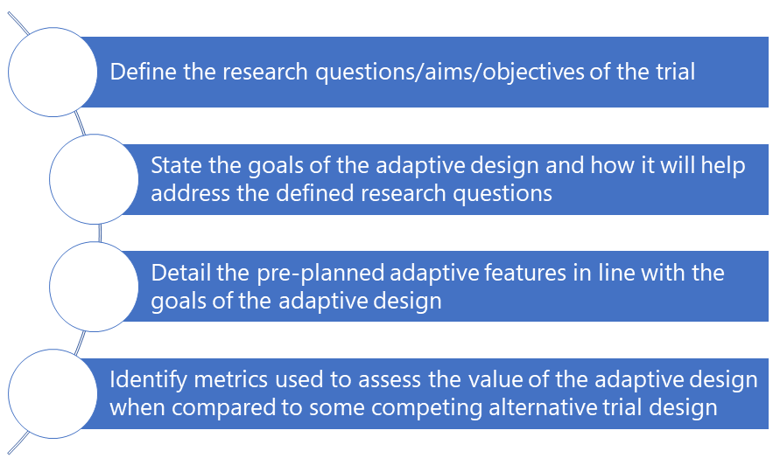
Adaptive Design (AD) Overview
Adaptive Design: Trial where a change or decision is made to a trial, while the trial is still on-going at interim analysis
Early Stopping, Sample Size Re-estimation, Adaptive Randomization (Response, Covariate, Enrichment)
Adaptive Design can lead to more effective & efficient trials
Careful planning (pre-specification, simulation) needed
Need to assess trade-offs, both statistical & logistical
Error Control, Cost, Integrity, Expected Benefit (↓ Sample Size)
Significant interest in applying to wider variety of domains
Growing interest in applying in publicly funded trials
Education resources and infrastructure improving quickly
PANDA, Ecraid, EU-Pearl, CONSORT ACE, trialdesign.org
Adaptive Design a key tool for designing clinical trials at all stages of the clinical trial process
Source: A Practical Adaptive &
Novel Designs and Analysis toolkit (PANDA)
https://panda.shef.ac.uk/

Slide 9
Trends in Adaptive Design
Phase I: Move towards designs for toxicity (MTD) & efficacy (OBD) – see FDA “Project Optimus”/“Optimizing the Dosage of Human Prescription Drugs and Biological Products for the Treatment of Oncologic Diseases” (Aug 24)
Phase II: Already common for interim futility analysis (e.g. Simon’s Design) but growing usage of Ib/II (Cohort Expansion), IIa/IIb (MCP-Mod) and II/III (MAMS Pick-the-Winner Dose-finding) seamless designs
Phase III (Confirmatory): Interim analysis very standard now; interest in integrating with more complex elements
Draft ICH E20 Draft on Adaptive Clinical Trials in Q1 2025 – Major Milestone for Adaptive Design Regulation
How aligned w/ current guidance e.g. FDA 2019 Guidance focus on pre-specification, simulation, trial integrity?
Are specific adaptive designs discussed (as in FDA Guidance) or more generalized set of recommendations?
Will there be more depth on intersection w/ other topics (Bayesian, Real-World Data) given recent advances?
“Advancing the Use of Complex Innovative Designs in Clinical Trials: From Pilot to Practice” workshop (March 2024)
Other: Significant continued interest in platform trials building on successes in oncology (Umbrella, Basket Master Protocol Trials) and Covid-19 therapeutics – seeing expansion to continue into non-oncology areas

Slide 10
Group Sequential Design Example
“A sample size of 242 subjects (121 per treatment group) provides at least 80% power to detect a relative difference of 53% between botulinum toxin A and standardized anticholinergic therapy, assuming a treatment difference of -0.80 and a common SD of 2.1 (effect size = 0.381), and a two-sided type I error rate of 5%. Sample size has been adjusted to allow for a 10% loss (ED: Equivalent to pre-dropout n = 109) to follow-up over the 6-months of treatment as well as one interim analysis to stop early for benefit.”
Parameter | Value
Significance Level (2-sided) | 0.05
OnabotulinumtoxinA Mean | -2.3
Anticholinergic Mean | -1.5
Standard Deviation (Both) | 2.1
Power | 80%
Sample Size (per arm) | 109
Analysis Timing | 0.5,1
Efficacy Boundary | O’Brien-Fleming

Slide 11
Bayesian Confirmatory Trials
Part 2

Slide 12
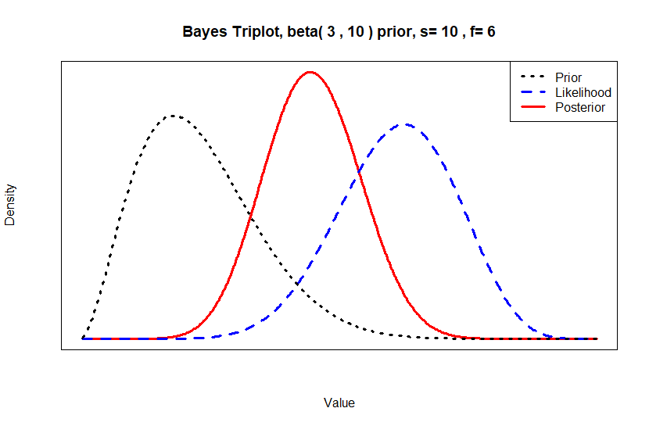
Bayesian Clinical Trials Overview
Bayesian analysis is statistical methodology where prior is updated by data for posterior distribution for test statistic
Prior + Likelihood = Posterior Distribution for θ
Why use? Flexibility, more intuitive, integrate priors
But does require specialized software + expertise
Bayesian Methods replacing obsolete 3+3 in Phase I trials
Both model & rule-based methods use Bayes
Even 3+3 “extensions” (i3+3) integrate Bayesian excessive toxicity assessment
Growing interest + usage of Bayesian methods in Phase II
Many Simon’s-like Designs (Thall & Simon, BOP2)
Bayesian models common for Basket & Umbrella trials
Useful for borrowing/seamless/monitoring aspects
But increasing interest in expanding usage in Phase III
Bayes’ Theorem
$$P\left(θ | D\right)=\frac{P(D|θ)×P(θ)}{P(D)}$$

Slide 13
Bayesian Confirmatory Trials
Bayesian Phase III trials still uncommon. Why? Unfamiliarity, little regulatory guidance, 0.025 Type I requirement
But notable recent uptick in application of Bayesian methods in Phase III - both fully Bayesian and hybrid
Covid-19 Vaccine (Bayesian Sequential Design), Lymphoma (External Control (ECA), Borrowing), Epilepsy (Borrowing, Sample Size), Pediatric MS (Extrapolation, Borrowing) & Psoriasis (Extrapolation, ECA)
Bayesian Methodology in Clinical Trials of Drugs and Biologics Draft FDA Guidance by end of 2025 (PDUFA VII)
Expect broad alignment w/ Adaptive Guidance principles e.g. pre-specification, early engagement, simulation
Don’t expect to be prescriptive on preferred methods/design choices (e.g. MAP vs Power prior, predictive vs posterior prob.). May provide overview of common use cases (borrowing, interim analysis – see CID case studies)
Will likely reference and “approve” of success of Bayesian methods in early-stage clinical trials esp. Phase I
Expect open approach in Phase III but with expectation of justifying value + 0.025 Type I error and statistical power still being key assessment criteria (Bayesian success criterion (set posterior prob?) specified or desired?)
Likely reference to strong value in certain areas such as rare diseases + pediatrics using borrowing & similar
Open view on Bayesian methods as complementary component: secondary endpoints, interim/AD choice criteria
Less likely but possible reference to decision-theoretic + P(Success) measures – more of a sponsor consideration?

Slide 14
Bayesian Probability of Success Example
“The outcome variable… is reduction in CRP after four weeks relative to baseline and the principal analysis will be a one-sided test of superiority at the 2.5% significance level. The (two) population variance… is assumed to be… equal to 0.0625… the test is required to have 80% power to detect a treatment effect of 0.2, leading to a proposed trial size of n1=n2=25 patients. ….For the calculation of assurance, we suppose that the elicitation of prior information… gives the mean of 0.2 and variance of 0.0625. If we assume a normal prior distribution, we can compute assurances with m=0.2, v=0.06… with n=25, we find assurance=0.595.”
Parameter | Value
Significance Level (1-Sided) | 0.025
Prior Mean Difference | 0.2
Prior Difference Variance | 0.06
Posterior Standard Deviation | √0.0625=0.25
Sample Size per Group | 25
Power | 80%
Assurance | 0.595 (59.5%)

Slide 15
Improving Trial Coverage
Part 3

Slide 16
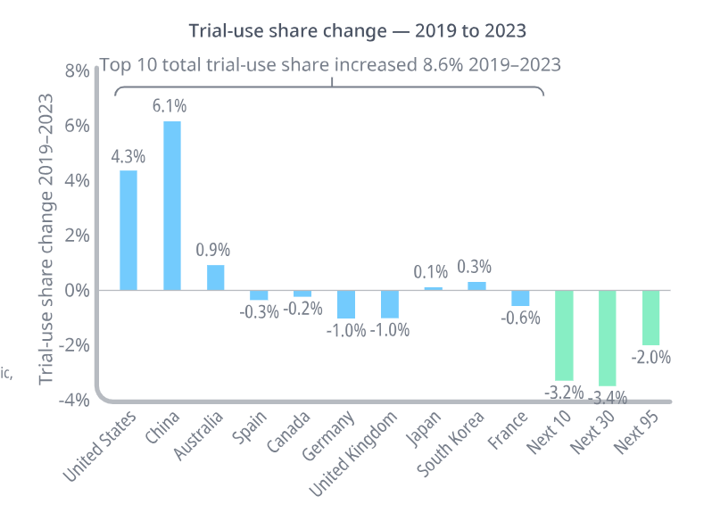
Improving Trial Coverage
Interest in development of treatments for difficult conditions + ensuring available to entire population who could benefit
Rare Diseases a focus for both regulators and sponsors
Approvals for pediatric population often not prioritized
Regulatory push to improve representativeness of trials
Hope to improve generalizability of trial conclusions
Create more buy-in from more skeptical populations
Multi-regional clinical trials (MRCT) now standard option for confirmatory trials especially for single-trial approvals
Regulatory background is now well established (ICH E17)
But regulators pushing back as nations lose trial share?
These trends have significant overlap which provides opportunity for synergy across these goals but also potential for conflict or contradictions
Source: Chen et al (2023)
Source: IQVIA (2024)

Slide 17
Trends in Improving Trial Coverage
Rare Disease/Pediatrics
Innovative Design: Interest in using innovative methods like adaptive design and Bayesian methods to maximize value of each patient and existing data – borrowing (RWD, historical data), external control arms, MAMS/RAR
Biomarker/Endpoint Development: Research to develop and evaluate biomarkers for rare diseases or for bridging to pediatric population – potential of decentralized tech (see below) but also focus on patient perspective
Trial Diversity
Improved Trial Integration: Decentralized trials, using remote diagnostics, could help make trials more accessible (mind the digital divide!) to more people alongside integrating trial conduct directly into route clinical care
Diversity Action Plans: Formal requirements for ensuring representative trials for ethnic and race factors with appropriate tracking plan
Multi-regional Clinical Trials (MRCT):
Minimum Regional Sample Size Requirements: ICH E17 provides broad principles for sample size but some regulators (Japan/PMDA) have own formal rules. See this spread to US/EU? Effect on developing regions?
AI/ML for Accrual Modelling: AI/ML tools helping to improve accrual success via prediction modelling based on prior trials – but could recommendations end up in conflict with other goals (diversity, regulator requirements)?

Slide 18
Regulatory Developments
Rare Diseases/Paediatrics
Improving Trial Diversity
Multi-regional Clinical Trials
FDA: “Rare Diseases: Considerations for the Development of Drugs and Biological Products” Final Guidance in December 2023
FDA: Rare Disease Innovation Hub announced Summer 2024 – meetings + feedback on-going
Accelerating Rare disease Cures (ARC) Program (2022)
Leader 3D Education
Rare Disease Endpoint Advancement Pilot (2022)
FDA updating guidance to reflect paediatric drug laws (PREA, BPCA)
See part 1/2 for Bayesian/Adaptive
FDA: “Conducting Clinical Trials With Decentralized Elements” Final Guidance in Sept 2024
FDA: “Integrating Randomized Controlled Trials for Drug and Biological Products Into Routine Clinical Practice” Draft Guidance in Sept 2024
FDA: “Diversity Action Plans to Improve Enrollment of Participants from Underrepresented Populations in Clinical Studies” Draft Guidance in June 2024
ICH E6 (Good Clinical Practice) + WHO “Guidance for best practices for clinical trials” updated
ICH: E17 “General Principles for Planning and Design of Multi-Regional Clinical Trials” in 2017
PMDA: “Basic principles on Global Clinical trials” in 2007 - included formal sample size rules
FDA “Considerations for Generating Clinical Evidence from Oncology Multiregional Clinical Development Programs” in Sept 24 – notes “decreasing proportion of U.S. participants”
AI/ML FDA Discussion paper in Nov 2023, Draft Guidance early 2025
EMA: “Accelerating Clinical Trials in EU” launched in 2022

Slide 19
Discussion and Conclusions
Clinical trial innovation continues at rapid pace in response to multiple challenges to conducting more efficient and comprehensive trials
Adaptive Design usage continues to grow at all stages of clinical trials with upcoming ICH E20 a major milestone for adaptive design adoption
Bayesian methods are common in early-stage trials but upcoming FDA Bayesian Guidance could be start of significant growth in Phase III usage
Initiatives to make trials more inclusive and flexible will help provide tools to better reach underserved populations and make trials more comprehensive

Slide 20
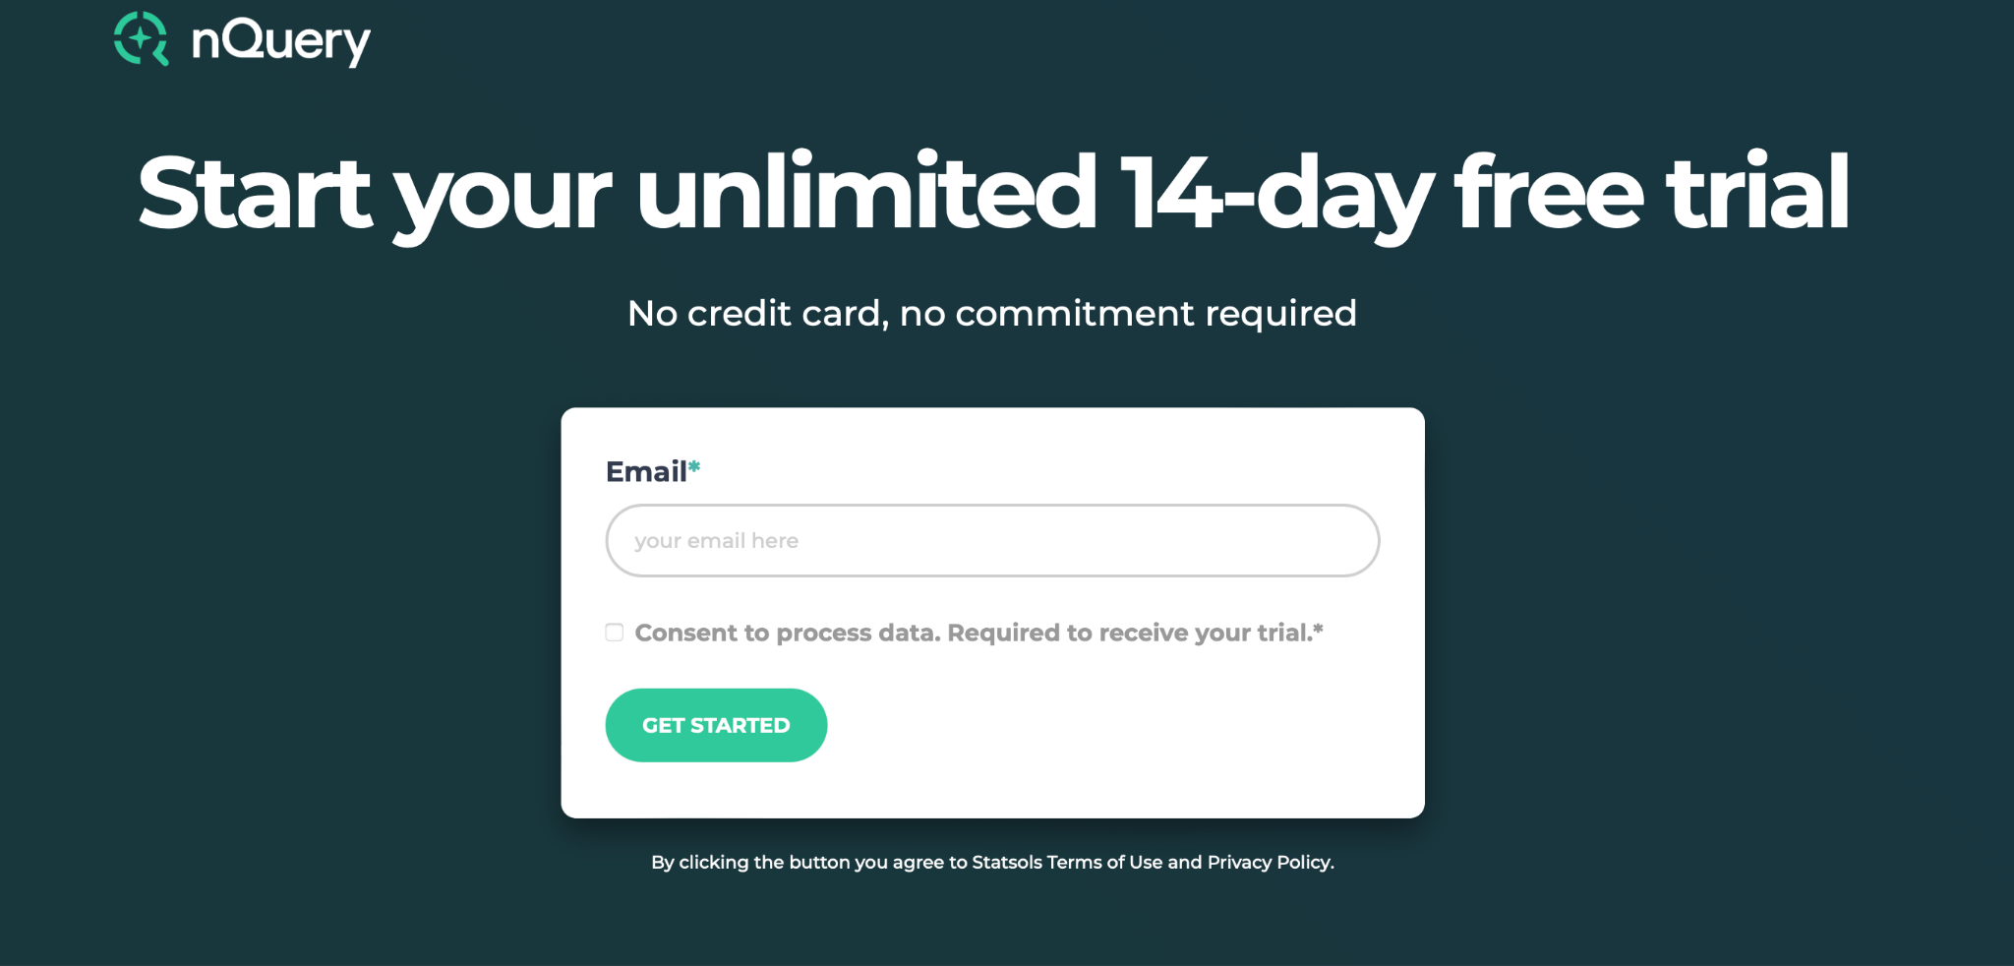
statsols.com/nquery-demo

Slide 21
Thank you
CONTACT US
info@statsols.com
MORE INFO
statsols.com

Slide 22
References (Introduction + Adaptive Design)
Dotmatics Website: https://www.dotmatics.com/
Dotmatics Luma: https://www.dotmatics.com/luma + Dotmatics
Dotmatics AI Driven Pharma R&D Whitepaper: https://www.dotmatics.com/whitepapers/ai-driven-pharma-r-and-d
U.S. Food and Drug Administration, Adaptive Designs for Clinical Trials of Drugs and Biologics, November 2019 Available from: https://www.fda.gov/media/78495/download
European Medicines Agency, Reflection Paper on Methodological Issues in Confirmatory Clinical Trials Planned with an Adaptive Design, October 2007 Available from: https://www.ema.europa.eu/en/documents/scientific-guideline/reflection-paper-methodological-issues-confirmatory-clinical-trials-planned-adaptive-design_en.pdf
European Patients’ Academy, New approaches to clinical trials: Adaptive designs, 2015, Available from: https://www.eupati.eu/clinical-development-and-trials/new-approaches-to-clinical-trials-adaptive-designs/
Bauer, P., Bretz, F., Dragalin, V., König, F. and Wassmer, G., 2016. Twenty‐five years of confirmatory adaptive designs: opportunities and pitfalls. Statistics in Medicine, 35(3), pp.325-347.
Jennison, C., & Turnbull, B. W. 1999. Group sequential methods with applications to clinical trials. CRC Press.
Wassmer, G. and Brannath, W., 2016. Group sequential and confirmatory adaptive designs in clinical trials. Springer.
A Practical Adaptive & Novel Designs and Analysis toolkit (PANDA), 2023, Available from: https://panda.shef.ac.uk/
EU-PEARL (EU-Patient Centric Clinical Trial Platforms), 2023. Available at: https://eu-pearl.eu/
Training modules on adaptive clinical trial designs: ERS-ECRAID initiative, 2024. Available at: https://ecraid.eu/projects/ecraid-base/ecraid-training-modules-adaptive-clinical-trial-designs
Dimairo, M., Pallmann, P., Wason, J., Todd, S., Jaki, T., Julious, S.A., Mander, A.P., Weir, C.J., Koenig, F., Walton, M.K. and Nicholl, J.P., 2020. The Adaptive designs CONSORT Extension (ACE) statement: a checklist with explanation and elaboration guideline for reporting randomised trials that use an adaptive design. bmj, 369.
MD Anderson Cancer Center, Integrated Platform for Designing Clinical Trials. Available from: https://trialdesign.org/
Bhatt, D.L. and Mehta, C., 2016. Adaptive designs for clinical trials. New England Journal of Medicine, 375(1), pp.65-74.

Slide 23
References (Adaptive Design)
U.S. Food and Drug Administration, Project Optimus. Available from: https://www.fda.gov/about-fda/oncology-center-excellence/project-optimus
U.S. Food and Drug Administration, Optimizing the Dosage of Human Prescription Drugs and Biological Products for the Treatment of Oncologic Diseases Guidance for Industry, August 2024. Available from: https://www.fda.gov/media/164555/download
U.S. Food and Drug Administration, Expansion Cohorts: Use in First-In-Human Clinical Trials to Expedite Development of Oncology Drugs and Biologics Guidance for Industry, March 2022. Available from: https://www.fda.gov/media/115172/download
Simon, R., 1989. Optimal two-stage designs for phase II clinical trials. Controlled Clinical Trials, 10(1), 1–10.
Bretz, F., Pinheiro, J. C., & Branson, M., 2005. Combining Multiple Comparisons and Modeling Techniques in Dose-Response Studies. Biometrics, 61(3), 738–748.
Thall, P.F., 2008. A review of phase 2–3 clinical trial designs. Lifetime data analysis, 14, pp.37-53.
Mehta, C.R. and Pocock, S.J., 2011. Adaptive increase in sample size when interim results are promising: a practical guide with examples. Statistics in medicine, 30(28), pp.3267-3284.
Friede, T., & Kieser, M. 2006. Sample size recalculation in internal pilot study designs: a review. Biometrical Journal: Journal of Mathematical Methods in Biosciences, 48(4), 537-555.
The International Council for Harmonisation of Technical Requirements for Pharmaceuticals for Human Use: E20: Adaptive Clinical Trials Concept Paper, November 2019. Available from: https://database.ich.org/sites/default/files/E20_FinalConceptPaper_2019_1107_0.pdf
The International Council for Harmonisation of Technical Requirements for Pharmaceuticals for Human Use: E20: Adaptive Clinical Trials Work Plan, August 2024. Available from: https://database.ich.org/sites/default/files/ICH_E20_EWG_WorkPlan_2024_0819.pdf
PSI Future Events (ICH E20 Event scheduled for Q2 2025): https://psiweb.org/events/future-events
FDA Complex Innovative Design Meeting Program Website: https://www.fda.gov/drugs/development-resources/complex-innovative-trial-design-meeting-program (Includes case study links)
U.S. Food and Drug Administration, Interacting with the FDA on Complex Innovative Trial Designs for Drugs and Biological Products (Final Guidance), December 2020. Available from: https://www.fda.gov/media/130897/download
U.S. Food and Drug Administration, Advancing the Use of Complex Innovative Designs in Clinical Trials: From Pilot to Practice, March 2024. Available from: https://www.fda.gov/news-events/advancing-use-complex-innovative-designs-clinical-trials-pilot-practice-03052024
.

Slide 24
References (Platform Trials + Bayesian Trials)
European Medicines Agency, Concept paper on platform trials, October 2022 Available from: https://www.ema.europa.eu/en/documents/scientific-guideline/concept-paper-platform-trials_en.pdf
U.S. Food and Drug Administration, Master Protocols: Efficient Clinical Trial Design Strategies To Expedite Development of Oncology Drugs and Biologics (Final Guidance), March 2022 Available from: https://www.fda.gov/media/120721/download
Berry S., 2020. Potential Statistical Issues Between Designers and Regulators in Confirmatory Basket, Umbrella, and Platform Trials, Clinical Pharmacology & Therapeutics, 108 (3), 444-446.
PROTAS Organization Website: https://protas.co.uk/
European Medicines Agency, Complex clinical trials – Questions and answers. May 2022. Available from: https://health.ec.europa.eu/system/files/2022-06/medicinal_qa_complex_clinical-trials_en.pdf
Clinical Trials Facilitation and Coordination Group, 2019. Recommendation Paper on the Initiation and Conduct of Complex Clinical Trials, Available at: https://www.hma.eu/fileadmin/dateien/Human_Medicines/01-About_HMA/Working_Groups/CTFG/2019_02_CTFG_Recommendation_paper_on_Complex_Clinical_Trials.pdf
Visco, A. G., et al (2012). Anticholinergic therapy vs. onabotulinumtoxina for urgency urinary incontinence. New England Journal of Medicine, 367(19), 1803-1813
Ionan, A.C., Clark, J., Travis, J., Amatya, A., Scott, J., Smith, J.P., Chattopadhyay, S., Salerno, M.J. and Rothmann, M., 2023. Bayesian methods in human drug and biological products development in CDER and CBER. Therapeutic Innovation & Regulatory Science, 57(3), pp.436-444.
McElreath, R., 2020. Statistical Rethinking: A Bayesian Course with Examples in R and STAN. New York: Chapman; Hall/CRC
Berry, D.A., 2006. Bayesian clinical trials. Nature reviews Drug discovery, 5(1), pp.27-36.
Berry, S.M., Carlin, B.P., Lee, J.J. and Muller, P., 2010. Bayesian adaptive methods for clinical trials. CRC press.
Lee, J.J. and Yin, G., 2021. Principles and reporting of Bayesian trials. Journal of Thoracic Oncology, 16(1), pp.30-36.
Muehlemann, N., Zhou, T., Mukherjee, R., Hossain, M.I., Roychoudhury, S. and Russek-Cohen, E., 2023. A tutorial on modern Bayesian methods in clinical trials. Therapeutic Innovation & Regulatory Science, 57(3), pp.402-416.
U.S. Food and Drug Administration, Guidance for the Use of Bayesian Statistics in Medical Device Clinical Trials, February 2010 Available from: https://www.fda.gov/media/71512/download

Slide 25
References (Early Stage Bayesian Trials)
Kurzrock, R., Lin, C.C., Wu, T.C., Hobbs, B.P., Pestana, R.C. and Hong, D.S., 2021. Moving beyond 3+ 3: the future of clinical trial design. American Society of Clinical Oncology Educational Book, 41, pp.e133-e144.
Zhou, H., Yuan, Y., & Nie, L., 2018. Accuracy, safety, and reliability of novel phase I trial designs. Clinical Cancer Research, 24(18), 4357-4364.
Liu, M., Wang, S.J. and Ji, Y., 2020. The i3+ 3 design for phase I clinical trials. Journal of biopharmaceutical statistics, 30(2), pp.294-304.
Lin, X. and Ji, Y., 2020. The Joint i3+ 3 (Ji3+ 3) design for phase I/II adoptive cell therapy clinical trials. Journal of Biopharmaceutical Statistics, 30(6), pp.993-1005.
Cheung, Y. K., 2011. Dose Finding by the continual reassessment method. CRC Press.
Yan, F., Mandrekar, S.J. and Yuan, Y., 2017. Keyboard: a novel Bayesian toxicity probability interval design for phase I clinical trials. Clinical Cancer Research, 23(15), pp.3994-4003.
Zhou, Y., Lin, R., Kuo, Y. W., Lee, J. J., & Yuan, Y., 2021. BOIN Suite: A Software Platform to Design and Implement Novel Early-Phase Clinical Trials. JCO Clinical Cancer Informatics, 5, 91-101.
Zhou, Y., Li, R., Yan, F., Lee, J.J. and Yuan, Y., 2021. A comparative study of Bayesian optimal interval (BOIN) design with interval 3+ 3 (i3+ 3) design for phase I oncology dose-finding trials. Statistics in biopharmaceutical research, 13(2), pp.147-155.
Yuan, Y., Lee, J.J. and Hilsenbeck, S.G., 2019. Model-assisted designs for early-phase clinical trials: simplicity meets superiority. JCO Precision Oncology, 3, pp.1-12.
Thall, P.F. and Simon, R., 1994. Practical Bayesian guidelines for phase IIB clinical trials. Biometrics, pp.337-349.
Zhou, H., Lee, J. and Yuan, Y., 2017. BOP2: Bayesian Optimal Design for Phase II Clinical Trials with Simple and Complex Endpoints. Statistics in Medicine, 36, 3302-3314.
Woodcock J., LaVange LM., 2017. Master Protocols to Study Multiple Therapies, Multiple Diseases, or Both, N Engl J Med, 377:62-70
Zhou, T. and Ji, Y., 2024. Bayesian Methods for Information Borrowing in Basket Trials: An Overview. Cancers, 16(2), p.251.
Ouma, L.O., Wason, J.M., Zheng, H., Wilson, N. and Grayling, M., 2022. Design and analysis of umbrella trials: Where do we stand?. Frontiers in Medicine, 9, p.1037439.
Freidlin, B. and Korn, E.L., 2013. Borrowing information across subgroups in phase II trials: is it useful?. Clinical Cancer Research, 19(6), pp.1326-1334.
Beall, J., Cassarly, C. and Martin, R., 2022. Interpreting a Bayesian phase II futility clinical trial. Trials, 23(1), p.953.

Slide 26
References (Confirmatory Bayesian Trials)
Ruberg, S.J., Harrell Jr, F.E., Gamalo-Siebers, M., LaVange, L., Jack Lee, J., Price, K. and Peck, C., 2019. Inference and decision making for 21st-century drug development and approval. The American Statistician, 73(sup1), pp.319-327.
Medical Outreach Subteam of the Drug Information Association Bayesian Scientific Working Group, Clark, J., Muhlemann, N., Natanegara, F., Hartley, A., Wenkert, D., Wang, F., Harrell, F.E. and Bray, R., 2022. Why are not there more Bayesian clinical trials? Perceived barriers and educational preferences among medical researchers involved in drug development. Therapeutic Innovation & Regulatory Science, pp.1-9.
Medical Outreach Team of the Drug Information Association Bayesian Scientific Working Group, Bray, R., Hartley, A., Wenkert, D., Muehlemann, N., Natanegara, F., Harrell Jr, F.E., Wang, F. and Clark, J., 2023. Why are there not more Bayesian clinical trials? Ability to interpret Bayesian and conventional statistics among medical researchers. Therapeutic Innovation & Regulatory Science, 57(3), pp.426-435.
Ruberg, S.J., Beckers, F., Hemmings, R., Honig, P., Irony, T., LaVange, L., Lieberman, G., Mayne, J. and Moscicki, R., 2023. Application of Bayesian approaches in drug development: starting a virtuous cycle. Nature Reviews Drug Discovery, 22(3), pp.235-250.
Lee, S.Y., 2024. Using Bayesian statistics in confirmatory clinical trials in the regulatory setting: a tutorial review. BMC Medical Research Methodology, 24(1), p.110.
Garczarek, U., Muehlemann, N., Richard, F., Yajnik, P. and Russek-Cohen, E., 2023. Bayesian strategies in rare diseases. Therapeutic Innovation & Regulatory Science, 57(3), pp.445-452.
Senn, S., 2022. The design and analysis of vaccine trials for COVID‐19 for the purpose of estimating efficacy. Pharmaceutical Statistics, 21(4), pp.790-807.
U.S. Food and Drug Administration, CID Case Study: External Control in Diffuse B-Cell Lymphoma, Available from: https://www.fda.gov/media/155405/download
U.S. Food and Drug Administration, CID Case Study: A Study in Pediatric Patients with Multiple Sclerosis, Available from: https://www.fda.gov/media/172313/download
U.S. Food and Drug Administration, CID Case Study: A Study in Patients with Epilepsy with Myoclonic-Atonic Seizures, Available from: https://www.fda.gov/media/172312/download
You, R., Weber, S., Bieth, B. and Vandemeulebroecke, M., 2022. Innovative pediatric development for secukinumab in psoriasis: faster patient access, reduction of patients on control. Clinical Pharmacology & Therapeutics, 111(3), pp.697-704.
U.S. Food and Drug Administration, PDUFA VII Commitment Letter, August 2021. Available from: https://www.fda.gov/media/151712/download
Zhou, T., & Ji, Y., 2023. On Bayesian Sequential Clinical Trial Designs. The New England Journal of Statistics in Data Science, 2(1), 136-151.

Slide 27
References (Extending Trial Coverage)
Chen, R., Liu, S., Han, J., Zhou, S., Liu, Y., Chen, X. and Zhang, S., 2023. Trends in rare disease drug development. Nature reviews. Drug Discovery.
U.S. Food and Drug Administration, Rare Diseases Innovation Hub, 2024. Available from: https://www.fda.gov/industry/medical-products-rare-diseases-and-conditions/fda-rare-disease-innovation-hub
U.S. Food and Drug Administration, Accelerating Rare disease Cures (ARC) Program, 2022. Available from: https://www.fda.gov/about-fda/center-drug-evaluation-and-research-cder/accelerating-rare-disease-cures-arc-program
U.S. Food and Drug Administration, Rare Disease Endpoint Advancement Pilot Program, 2022. Available from: https://www.fda.gov/drugs/development-resources/rare-disease-endpoint-advancement-pilot-program
U.S. Food and Drug Administration, Rare Diseases: Considerations for the Development of Drugs and Biological Products, December 2023. Available from: https://www.fda.gov/media/119757/download
Agency IQ, Seeking to accelerate pediatric drug development, FDA offers guidance on requirements of two pivotal laws, May 2023. Available from: https://www.agencyiq.com/blog/seeking-to-accelerate-pediatric-drug-development-fda-offers-guidance-on-requirements-of-two-pivotal-laws/
U.S. Food and Drug Administration, Emerging Technology Program, July 2023 Available from: https://www.fda.gov/about-fda/center-drug-evaluation-and-research-cder/emerging-technology-program
U.S. Food and Drug Administration, Conducting Clinical Trials With Decentralized Elements, September 2024. Available from: https://www.fda.gov/media/167696/download
U.S. Food and Drug Administration, Digital Health Technologies (DHTs) for Drug Development, May 2023. Available from: https://www.fda.gov/science-research/science-and-research-special-topics/digital-health-technologies-dhts-drug-development
U.S. Food and Drug Administration, Integrating Randomized Controlled Trials for Drug and Biological Products Into Routine Clinical Practice, September 2024. Available from: https://www.fda.gov/media/167696/download
European Commission, RECOMMENDATION PAPER ON DECENTRALISED ELEMENTS IN CLINICAL TRIALS, December 2022. Available from: https://health.ec.europa.eu/system/files/2023-03/mp_decentralised-elements_clinical-trials_rec_en.pdf
Rogers, A., De Paoli, G., Subbarayan, S., Copland, R., Harwood, K., Coyle, J., Mitchell, L., MacDonald, T.M., Mackenzie, I.S. and Trials@ Home Consortium, 2022. A systematic review of methods used to conduct decentralised clinical trials. British Journal of Clinical Pharmacology, 88(6), pp.2843-2862.

Slide 28
References (Extending Trial Coverage)
US Food and Drug Administration, Advancing Real-World Evidence Program, October 2022. Available from: https://www.fda.gov/drugs/development-resources/advancing-real-world-evidence-program
The International Council for Harmonisation of Technical Requirements for Pharmaceuticals for Human Use: GUIDELINE FOR GOOD CLINICAL PRACTICE E6(R3) Annex 2 (Draft Version), November 2024. Available from: https://database.ich.org/sites/default/files/ICH_E6%28R3%29_Annex%202_Step2_DraftGuideline_2024_1024_0.pdf
World Health Organization, Guidance for best practices for clinical trials, September 2024. Available from: https://www.who.int/publications/i/item/9789240097711
U.S. Food and Drug Administration, Diversity Action Plans to Improve Enrollment of Participants from Underrepresented Populations in Clinical Studies (Draft Guidance), June 2024. Available from: https://www.fda.gov/media/179593/download
The International Council for Harmonisation of Technical Requirements for Pharmaceuticals for Human Use, E17: GENERAL PRINCIPLES FOR PLANNING AND DESIGN OF MULTI-REGIONAL CLINICAL TRIALS, November 2017. Available from: https://database.ich.org/sites/default/files/E17EWG_Step4_2017_1116.pdf
Ministry of Health, Labour and Welfare, Basic principles on global clinical trials, 2007. Available from: https://www.pmda.go.jp/files/000153265.pdf
U.S. Food and Drug Administration, Considerations for Generating Clinical Evidence from Oncology Multiregional Clinical Development Programs, September 2024. Available from: https://www.fda.gov/media/181824/download
U.S. Food and Drug Administration, Artificial Intelligence and Machine Learning (AI/ML) for Drug Development, May 2023. Available from: https://www.fda.gov/science-research/science-and-research-special-topics/artificial-intelligence-and-machine-learning-aiml-drug-development
U.S. Food and Drug Administration, Using Artificial Intelligence and Machine Learning in the Development of Drug and Biological Products (Discussion Paper), May 2023. Available from: https://www.fda.gov/media/167973/download
European Medicines Agency, Reflection paper on the use of artificial intelligence in the lifecycle of medicines, July 2023. Available from: https://www.ema.europa.eu/en/documents/scientific-guideline/draft-reflection-paper-use-artificial-intelligence-ai-medicinal-product-lifecycle_en.pdf
U.S. Food and Drug Administration, CDER Guidance Agenda New & Revised Draft Guidance Documents (July 2024). Available from: https://www.fda.gov/media/134778/download
European Medicines Agency, Accelerating Clinical Trials in the EU (ACT EU), 2022. Available at: https://www.ema.europa.eu/en/documents/regulatory-procedural-guideline/accelerating-clinical-trials-eu-act-eu-delivering-eu-clinical-trials-transformation-initiative_en.pdf

