Slide 1

2026 Trends in Clinical Trials
Accelerating Clinical Trial Development
February 2026

Slide 2


Ronan Fitzpatrick
Head of Statistics

Slide 3
Agenda
01
New Era for Bayesian Trials
02
Go for Continuous Trials
03
Other Trends for 2026
04
Conclusions & Discussion
Questions welcome throughout

Slide 4


Pre-clinical research
Animal studies
ANOVA / ANCOVA
Pilot Studies
Confirmatory
1000+ Scenarios for Fixed term, Adaptive & Bayesian Methods
Survival, Means, Proportions & Count endpoints
Group Sequential Trials
Bayesian:
Assurance
Credible Intervals
Posterior Error Approach
Sample Size Re-Estimation
Cross over & personalized medicine
MAMS
Prediction
Early Phase
CRM
MCP-Mod
Simon’s Two Stage
Flemings GST
The complete solution for optimizing your clinical trial designs
Post Marketing
Cohort Study
Case-control Study

Slide 5
nQuery Licensing nQuery operates on a tiered licensing model
BASE
PLUS
PRO
EXPERT
Sample size and power for fixed terms trials
100’s of designs,
endpoints and hypothesis types
Sample size for fully Bayesian (e.g. credible intervals)
+ Hybrid Bayes/Frequentist methods and designs (e.g. Assurance)
Sample size and power for early stage and confirmatory clinical trial
Adaptive Designs and tools for monitoring and adjustment in-trial
Additional tools for study design and monitoring
Incl milestone prediction for enrollment and (survival) event targets
Click Here to see our Package Comparison Tool

Slide 6
2026 Trends in Clinical Trial Overview
Recent years have seen increasing pressure to innovate clinical trials processes in response to high costs, long timelines and global competition
Significant shift occurring at regulatory level to accommodate innovation, accelerating trend over last decade and in response to Covid-19 pandemic
See recent guidances on Adaptive Design (FDA (2019), ICH E20 (2025)), Master Protocols/Platform Trials (FDA (2023), EMA (2022)), RWE (FDA (2023))
Major recent focus is use of the “totality of evidence” to assist accelerating approvals and improve performance of clinical trials undertaken
Two major areas of innovation is the acceptance of Bayesian statistics in clinical trials and the greater demand for continuous trials
Also cover some other trends of interest at end including AI/ML and multi-regional trials

Slide 7
New Era for Bayesian Trials
Part 1

Slide 8
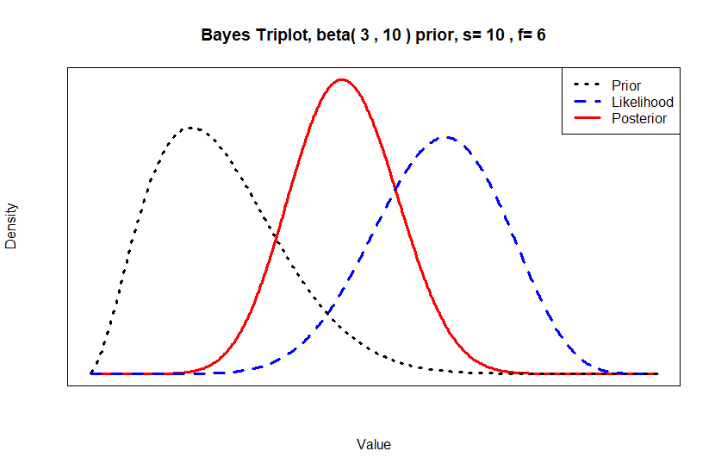
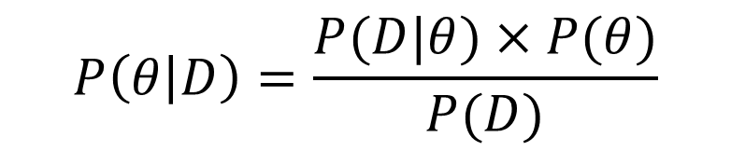
Bayesian Clinical Trials Overview
Bayesian analysis is statistical methodology where prior is updated by data for posterior distribution for test statistic
Prior + Likelihood = Posterior Distribution for θ
Bayesian already widely used in early stage clinical trials
Model (e.g. CRM)/rule-based (e.g. mTPI-2) designs replaced 3+3 dose-escalation and lead changes there
Bayesian grown quickly at Phase II for proof-of-concept (Thall & Simon, BOP2), dose-finding studies and master protocol designs (Basket, Umbrella)
Growth underpinned by additional flexibility in design and in integrating additional sources of evidence
Bayesian methods already used in Phase III but most implementations in case studies e.g. CID program
But this set to change with recent FDA Guidance
Bayes’ Theorem
$$P\left(θ | D\right)=\frac{P(D|θ)×P(θ)}{P(D)}$$

Slide 9
2026 FDA Bayesian Regulatory Guidance
Draft “Use of Bayesian Methodology in Clinical Trials of Drugs and Biologics Guidance for Industry” published January 2026
Outlines key concepts + real FDA examples: borrowing (from prior studies, across diseases/subtypes, between subgroups), external/NC controls, pediatric extrapolation, dose-finding
Bayesian success criterion (P(d > a) > c) described + that Type I error “may not be applicable or appropriate” (e.g. when borrowing)
Type I error calibration if adaptive design/noninformative priors
“a” from hypothesis, verify c = 2.5% under null (e.g. simulation)
Similar considerations for adaptive interim success criteria
Outlines direct Bayesian inference via posterior error (e.g. (P(d > a) > 0.98)) and decision-theoretic approaches (e.g. risk-benefit)
Defining + verifying operating characteristics gets own focus
Verify across range of plausible scenarios (e.g. param values)
Verify power, MSE, bias etc via simulation if Type I calibration
Bayesian have own criteria (e.g. Bayesian Power, P(Correct)) - must account for priors used: “analysis prior” & “design prior(s)”
"Bayesian methodologies help address two of the biggest problems of drug development: high costs and long timelines. Providing clarity around modern statistical methods will help sponsors bring more cures and meaningful treatments to patients faster and more affordably.”
Dr. Mark Makary
FDA Commissioner

Slide 10
2026 FDA Bayesian Regulatory Guidance
Longest section dedicated to prior distribution(s) – pre-specified + done in “systematic and transparent manner”
Non-informative prior used where “general uncertainty” and will tend to be quickly overwhelmed by trial data
Useful where minimal data available and for calibration (e.g. ESS) and sensitivity analysis vs informative prior
Must verify operating characteristics as can weight implausible values (esp. low N) or fail under transformation
Skeptical prior may be appropriate if self-similar treatments failed or Type I error calibration in adaptive designs
Informative Priors require justification for usage (e.g. rare disease), implementation etc for sponsor/FDA alignment
Notes: Account for “prior-data conflict” (e.g. sensitivity analysis), prior construction/usage “multi-disciplinary”
Start: Identify + review available evidence (trial data, PK/PD, RWD, expert opinion): should account for quality, reliability, relevance (recent similar RCT patient-level data ideal).
Next: Use (prespecified/documented) process to construct prior: Need methods + models that account for evidence strength/relevance - consider exchangeability, bias, functional dependence, discounting
Discounting: Static (invariant to data) vs dynamic (borrowing proportional to self-similarity of prior vs data)
“Goldilocks” problem: Overwhelm data if prior too strong, provides little inference/efficiency gain if prior too weak
Power (static and dynamic version), Mixture, Bayesian Hierarchical and elastic priors given as example methods
Last: Quantify effect of prior via appropriate metrics (e.g. prior mean, ESS) – post-hoc evaluate information borrowed, prior-data conflict etc – avoid Type I error as metric – sensitivity analysis over priors vital

Slide 11
2026 FDA Bayesian Regulatory Guidance
Estimand strategy required as usual – ideally if borrowing then alignment between prior data and study but if patient-level data available then could re-analyse using study strategy – may be difficult in practise
Software rely on variety of approximate sampling algorithms – FDA does not require specific software but must be reliable (ICH E9) & given practicalities of Bayesian analysis this needs accounting for esp for complex models
Documentation requirements outlined in detail for planning and reporting of Bayesian analyses
Feedback open on draft guidance until March 16th: Commentary has been highly positive w/ detailed guidance providing information needed to place Bayesian inference on equal footing to frequentist in clinical trials
Extensive engagement with Bayesian community evident from comprehensive nature of document
Some notes on terminology and ensuring phrasing fully open to extensions to additional domains
Expected to be overlap with current FDA priority initiatives (e.g. “Plausible Pathways”, “Continuous Trials”)
Impact of emergent standards from precedents – regulatory certainty vs other priorities
Strong desire to avoid any perception of being used to lower evidentiary standards for approvals
EMA Methodology WG concept paper on Bayesian analysis published in January 2026 - discusses “lack of clarity” and goes through long list of potential issues – aim for reflection paper to be finalized by 2028 (draft in 2027)
ICH Bayesian Guidance potential – separate guidance or as addendum to ICH E9?

Slide 12
Go for Continuous Trials
Part 2

Slide 13
Continuous Trials Overview
Recent shifts in global trial coverage (e.g. substantial growth in China) have led to desire to streamline clinical trial processes to stay competitive
FDA “Continuous Trials” concept proposed to supplant sequential Phase I-III process with larger, fluid trial(s) based on continuous (online) data sharing
Paired with other initiatives to decrease review timelines and reduce administrative burden
In practice, this push overlaps with multiple on-going initiatives (e.g. Project Optimus, CID) + recent regulatory guidances (e.g. adaptive design, DCT)
See also recent removal of “two trial” default rule for confirmatory Phase III trials
Seamless trial methodology has been evolving rapidly in recent years and this push for continuous trials may make these designs even more relevant
But where will reality fall between current initiatives and ambitious goals?

Slide 14
Sequential Clinical Trial Stage Overview
Approval Process
Pre-Clinical
Phase I
Phase II
Phase III
Phase IV
Lab Research in Cell Models, Animal Models etc.
Find candidate biologics, molecules and other therapeutics
First in-human trials
Select doses based on safety/toxicity (MTD)
May also seek optimal activity (OBD)
First target patient trials
Often split in two sub-phases.
Proof of concept for efficacy (IIa)
Find optimal dose(s) for Phase III (IIb)
Pivotal trial(s) for regulatory approval in patients from target population
Establish efficacy & safety in large randomized controlled trial
Post-Marketing Surveillance in real world patients post-approval
Focus on rare or long-term safety and efficacy profile

Slide 15
Seamless Trials (Current)
Approval Process
Pre-Clinical
Phase I/II
Phase II/III
Phase IV
Lab Research in Cell Models, Animal Models etc.
Find candidate biologics, molecules and other therapeutics
Safety + Dose-Finding
Dose-escalation study for safety (MTD) and for efficacy
Potential seamless design into efficacy comparison of candidate doses (e.g. cohort expansion)
Dose Selection + Confirmatory
Dose selection among randomized candidate doses
Seamless into confirmatory randomized comparison for approval
Possible to skip Phase II with Phase I/II dose-finding
Post-Marketing Surveillance in real world patients post-approval
Focus on rare or long-term safety and efficacy profile

Slide 16
Continuous Trials?
Approval Process
Pre-Clinical
Phase I/II/III
Phase IV
Lab Research in Cell Models, Animal Models etc.
Find candidate biologics, molecules and other therapeutics
Fully (Operational) Seamless Trial
Dose-escalation for safety and efficacy
Cohort expansion for randomized comparison of doses
Select candidate doses for further evaluation
Select best 1-2 doses for confirmatory evaluation
Continuous data sharing with regulator
Inferential seamless for stages with shared endpoint
Post-Marketing Surveillance in real world patients post-approval
Focus on rare or long-term safety and efficacy profile

Slide 17
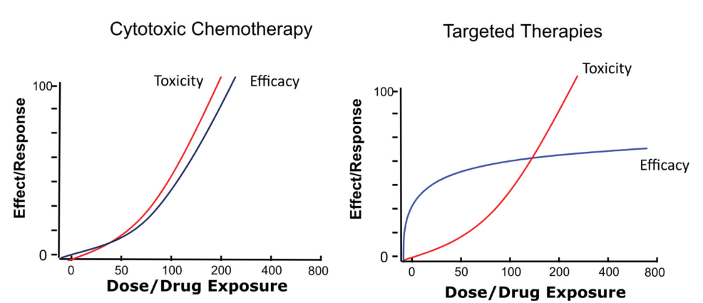
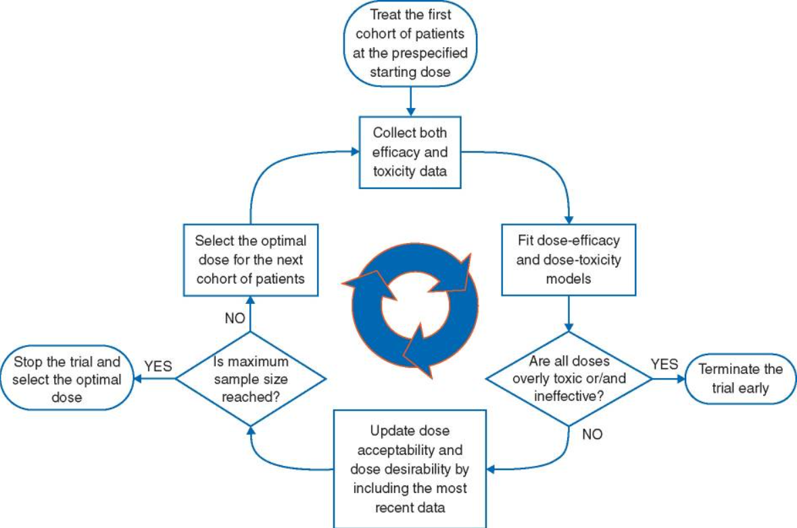
Seamless Phase I/II Trials
Seamless Phase I/II trials combine Phase I dose escalation with Phase II design aspects (proof-of-concept/dose-selection)
Dose-escalation focused on safety signal in FIH trials – traditionally targets maximum tolerated dose (MTD)
Cytotoxics expect monotonic safety + efficacy dose-response
Newer oncology treatments more complex dose-response profile - increases importance of earlier efficacy signal (OBD)
Seamless Phase I/IIa trial will simultaneously evaluate safety and efficacy to select doses to bring forward to future phases
Need dose-escalation model that can balance both e.g. EffTox
Expansion (cohort) can add patients to selected dose levels for further evaluation (efficacy, tumour-specific etc) if needed
See “Expansion Cohorts: Use in First-in-Human Clinical Trials to Expedite Development of Oncology Drugs and Biologics”
Recent guidance prefers randomized dose comparisons
Dose-Response Curves - Source: FDA
EffTox Design – Source: Yan et al (2017)

Slide 18
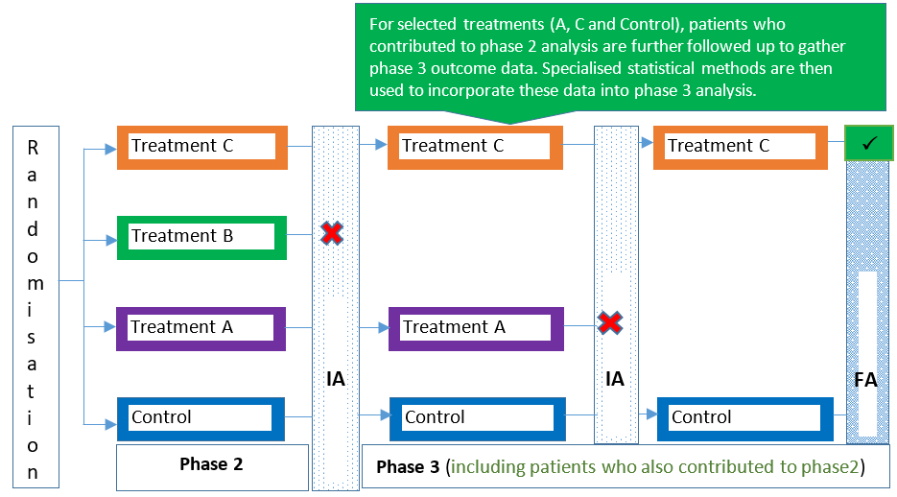
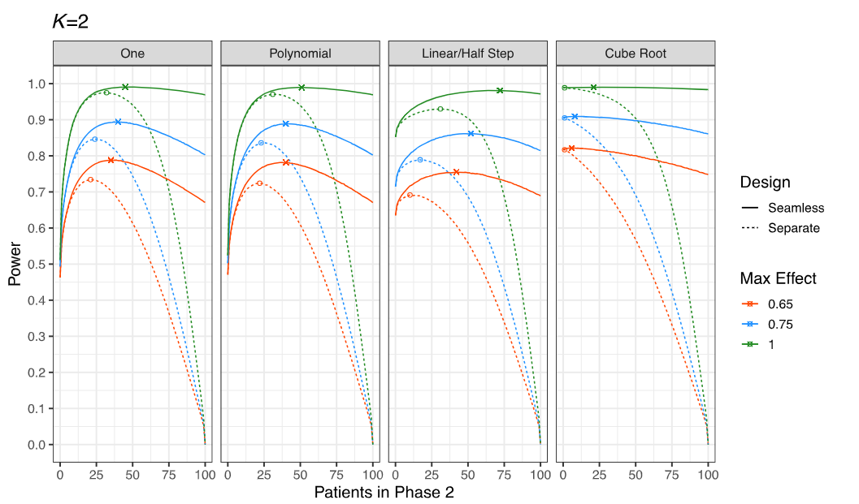
Seamless Phase II/III Trials
Seamless Phase II/III trials combine dose-finding (IIb) & select 1+ doses and seamlessly move subjects into Phase III trial
Dose-finding is selecting best dose(s) – pick-the-winner
Often include futility stop if all arms underperform
Data from control + successful dose moved into Phase III RCT
Should minimize delay operationally moving from Phase II to III and ideally lead to reduced sample size requirement
Greatest efficiency come from larger Phase II (30-50% N)
Requires statistical analysis to account for MAMS design
Combination tests, group sequential MAMS, Bayesian
Covered in Adaptive Design Guidances - see draft ICH E20
See Section 4.4: Treatment Selection for most salient aspects for Phase II/III design (RAR also relevant)

Slide 19
Challenges
Speed not always highest priority and comes with own set of risks
Safety considerations a major risk if move too fast in Phase I/II trials
Funding constraints may make seamless Phase II/III infeasible for many sponsors
Part of a regulatory “race to the bottom” or a “bonfire of excessive red tape”?
Vision of continuous data sharing will require significant technology investment and substantial evidence of faster timelines for sponsor buy-in
Must deliver on potential for faster + parallel assessments if have continuous data sharing
Requires greater ability to decentralize major aspects of trials in areas such as manufacturing and continuous monitoring
Interaction with other trends such as greater use of accelerated approvals
Can Phase IV make up for higher potential for ineffective treatments getting approval?

Slide 20
Other Trends for 2026
Part 3

Slide 21
Other 2026 Trends
Rare Disease/Pediatrics:
Developments: Accelerating Rare disease Cures (ARC) Program started in 2022 (incl. Leader 3D educational), Rare Disease final guidance published in late 2023, Rare Disease Innovation hub announced 2024, Plausible Mechanism Pathway guidance published in February 2026
Trends to Watch: Speed of adoption of plausible mechanism pathway, evolving precedents for trial requirements in rare disease, reaction of other regulatory agents to innovative approval pathways
AI/ML in Clinical Trials
Developments: EMA Reflection Paper on AI in Medicinal Product Lifecycle published in 2024, draft FDA Guidance published in early 2025 (following earlier concept papers), FDA qualified first AI drug development tool in late 2025 (liver biopsy tool for MASH evaluation), EMA/FDA AI “Guiding principles” published in early 2026
Trends to Watch: Final FDA Guidance, AI-driven rather than AI-assisted clinical design e.g. automated protocol changes, early signs of AI discovery success rate, continued evaluation as clinical trial design tool/assistant
Multi-regional Clinical Trials (MRCT):
Developments: PMDA guidance in 2007, ICH E17 published in 2017, FDA OCE 2024 Guidance notes “decreasing proportion of U.S. participants”, FDA ends “two trial” rule default (NEJM 2026)
Trends to Watch: Greater scrutiny of regional allocation in MRCT in US/EU including potential request for formal sample size calculation for allocation choice, final guidance from OCE on MRCT

Slide 22
Discussion and Conclusions
Demand for clinical trial innovation growing in response to need to reduce cost and timelines and greater global competition for trial location
FDA Draft Bayesian Guidance is milestone for Bayesian clinical trials which should accelerate utilization at every stage of clinical development
Continuous trials offer opportunity to consolidate clinical trial process and lead to faster decision making for patients and sponsors
Potential changes in areas such as AI/ML and rare diseases could help with wider objectives with greater scrutiny of regional allocation possible if global competition intensifies

Slide 23

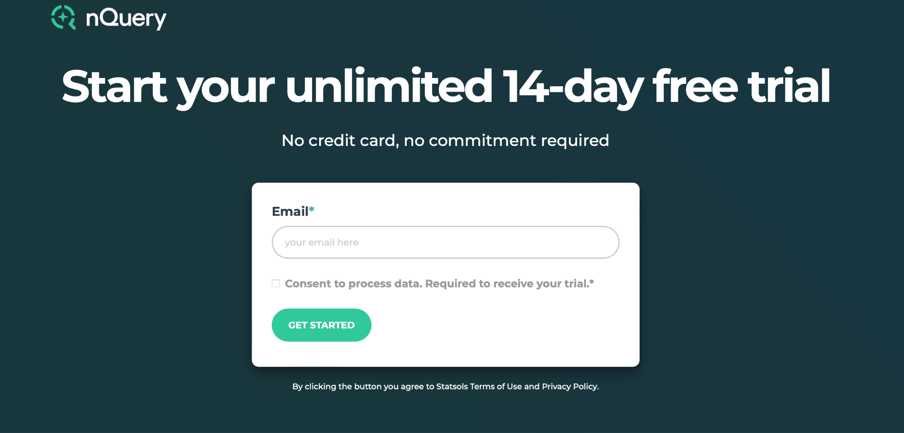
statsols.com/nquery-demo

Slide 24
Thank you
CONTACT US
info@statsols.com
MORE INFO
statsols.com

Slide 25
References
Introduction
The International Council for Harmonisation of Technical Requirements for Pharmaceuticals for Human Use (2025), E20: Adaptive Designs for Clinical Trials (Draft Version), Available from: https://database.ich.org/sites/default/files/ICH_E20EWG_Step3_DraftGuideline_2025_0625_0.docx
US Food and Drug Administration. (2019). Adaptive design clinical trials for drugs and biologics guidance for industry. Available from: https://www.fda.gov/media/78495/download
U.S. Food and Drug Administration, Master Protocols: Efficient Clinical Trial Design Strategies To Expedite Development of Oncology Drugs and Biologics (Final Guidance), March 2022 Available from: https://www.fda.gov/media/120721/download
European Medicines Agency, Concept paper on platform trials, October 2022 Available from: https://www.ema.europa.eu/en/documents/scientific-guideline/concept-paper-platform-trials_en.pdf
US Food and Drug Administration, Considerations for the Use of Real-World Data and Real-World Evidence To Support Regulatory Decision-Making for Drug and Biological Products (Final Guidance). August 2023 Available from: https://www.fda.gov/media/171667/download
US Food and Drug Administration, Submitting Documents Considerations for the Design and Conduct of Externally Controlled Trials for Drug and Biological Products (Final Guidance). February 2023 Available from: https://www.fda.gov/media/164960/download
Bayesian Analysis
Berry, D.A., 2006. Bayesian clinical trials. Nature reviews Drug discovery, 5(1), pp.27-36.
Lee, J.J. and Yin, G., 2021. Principles and reporting of Bayesian trials. Journal of Thoracic Oncology, 16(1), pp.30-36.
Lee, S.Y., 2024. Using Bayesian statistics in confirmatory clinical trials in the regulatory setting: a tutorial review. BMC Medical Research Methodology, 24(1), p.110.
Muehlemann, N., Zhou, T., Mukherjee, R., Hossain, M.I., Roychoudhury, S. and Russek-Cohen, E., 2023. A tutorial on modern Bayesian methods in clinical trials. Therapeutic Innovation & Regulatory Science, 57(3), pp.402-416.
Kurzrock, R., Lin, C.C., Wu, T.C., Hobbs, B.P., Pestana, R.C. and Hong, D.S., 2021. Moving beyond 3+ 3: the future of clinical trial design. American Society of Clinical Oncology Educational Book, 41, pp.e133-e144.
Thall, P.F. and Simon, R., 1994. Practical Bayesian guidelines for phase IIB clinical trials. Biometrics, pp.337-349.
Zhou, H., Lee, J. and Yuan, Y., 2017. BOP2: Bayesian Optimal Design for Phase II Clinical Trials with Simple and Complex Endpoints. Statistics in Medicine, 36, 3302-3314.

Slide 26
References
U.S. Food and Drug Administration, Master Protocols: Efficient Clinical Trial Design Strategies To Expedite Development of Oncology Drugs and Biologics (Final Guidance), March 2022 Available from: https://www.fda.gov/media/120721/download
Woodcock J., LaVange LM., 2017. Master Protocols to Study Multiple Therapies, Multiple Diseases, or Both, N Engl J Med, 377:62-70
Ouma, L.O., Wason, J.M., Zheng, H., Wilson, N. and Grayling, M., 2022. Design and analysis of umbrella trials: Where do we stand?. Frontiers in Medicine, 9, p.1037439.
Ruberg, S.J., Harrell Jr, F.E., Gamalo-Siebers, M., LaVange, L., Jack Lee, J., Price, K. and Peck, C., 2019. Inference and decision making for 21st-century drug development and approval. The American Statistician, 73(sup1), pp.319-327.
Ionan, A.C., Clark, J., Travis, J., Amatya, A., Scott, J., Smith, J.P., Chattopadhyay, S., Salerno, M.J. and Rothmann, M., 2023. Bayesian methods in human drug and biological products development in CDER and CBER. Therapeutic Innovation & Regulatory Science, 57(3), pp.436-444.
Medical Outreach Subteam of the Drug Information Association Bayesian Scientific Working Group, Clark, J., Muhlemann, N., Natanegara, F., Hartley, A., Wenkert, D., Wang, F., Harrell, F.E. and Bray, R., 2022. Why are not there more Bayesian clinical trials? Perceived barriers and educational preferences among medical researchers involved in drug development. Therapeutic Innovation & Regulatory Science, pp.1-9.
Medical Outreach Team of the Drug Information Association Bayesian Scientific Working Group, Bray, R., Hartley, A., Wenkert, D., Muehlemann, N., Natanegara, F., Harrell Jr, F.E., Wang, F. and Clark, J., 2023. Why are there not more Bayesian clinical trials? Ability to interpret Bayesian and conventional statistics among medical researchers. Therapeutic Innovation & Regulatory Science, 57(3), pp.426-435.
Ruberg, S.J., Beckers, F., Hemmings, R., Honig, P., Irony, T., LaVange, L., Lieberman, G., Mayne, J. and Moscicki, R., 2023. Application of Bayesian approaches in drug development: starting a virtuous cycle. Nature Reviews Drug Discovery, 22(3), pp.235-250.
U.S. Food and Drug Administration, Use of Bayesian Methodology in Clinical Trials of Drug and Biological Products (Draft Guidance), January 2026 Available from: https://www.fda.gov/media/190505/download
U.S. Food and Drug Administration, Guidance for the Use of Bayesian Statistics in Medical Device Clinical Trials, February 2010 Available from: https://www.fda.gov/media/71512/download
Viele, K., 2026. Guide to the Draft FDA Bayesian Guidance 2026. Berry Consultants. Available from: https://www.berryconsultants.com/resource/guide-to-the-draft-fda-bayesian-guidance-2026
Berry, SM. & Viele, K. (2026). 46: The FDA Bayesian Guidance, In the Interim Podcast. Available from: https://www.berryconsultants.com/resource/46-the-fda-bayesian-guidance

Slide 27
References
Doshi, P., 2026. FDA is now “open to bayesian statistics”: transformational change or new Pandora’s box?.
Ji, Y., 2026. Regulatory Expectations for Bayesian Methods in Drug and Biologic Clinical Trials: A Practical Perspective on FDA's 2026 Draft Guidance. arXiv preprint arXiv:2601.14701.
S, Jaeger., 2026. FDA’s Bayesian Guidance: Strategic Considerations for Sponsors. Cytel. Available from: https://cytel.com/perspectives/fdas-bayesian-guidance-strategic-considerations-for-sponsors/
European Medicines Agency, Concept Paper for the Development of a Reflection Paper on the use of Bayesian methods in clinical development, January 2026. Available from: https://www.ema.europa.eu/en/documents/scientific-guideline/concept-paper-development-reflection-paper-use-bayesian-methods-clinical-development_en.pdf
US Food and Drug Administration, Considerations for the Use of Real-World Data and Real-World Evidence To Support Regulatory Decision-Making for Drug and Biological Products (Final Guidance). August 2023 Available from: https://www.fda.gov/media/171667/download
US Food and Drug Administration, Submitting Documents Considerations for the Design and Conduct of Externally Controlled Trials for Drug and Biological Products (Final Guidance). February 2023 Available from: https://www.fda.gov/media/164960/download
FDA Complex Innovative Design Meeting Program Website: https://www.fda.gov/drugs/development-resources/complex-innovative-trial-design-meeting-program (Includes case study links)
U.S. Food and Drug Administration, Interacting with the FDA on Complex Innovative Trial Designs for Drugs and Biological Products (Final Guidance), December 2020. Available from: https://www.fda.gov/media/130897/download
Zhou, T. and Ji, Y., 2024. Bayesian Methods for Information Borrowing in Basket Trials: An Overview. Cancers, 16(2), p.251.
Freidlin, B. and Korn, E.L., 2013. Borrowing information across subgroups in phase II trials: is it useful?. Clinical Cancer Research, 19(6), pp.1326-1334.
Beall, J., Cassarly, C. and Martin, R., 2022. Interpreting a Bayesian phase II futility clinical trial. Trials, 23(1), p.953.
Berry, S.M., Carlin, B.P., Lee, J.J. and Muller, P., 2010. Bayesian adaptive methods for clinical trials. CRC press.
Zhou, T., & Ji, Y., 2023. On Bayesian Sequential Clinical Trial Designs. The New England Journal of Statistics in Data Science, 2(1), 136-151.
Berry, D.A., 2025. Adaptive bayesian clinical trials: the past, present, and future of clinical research. Journal of Clinical Medicine, 14(15), p.5267.
McElreath, R., 2020. Statistical Rethinking: A Bayesian Course with Examples in R and STAN. New York: Chapman; Hall/CRC

Slide 28
References
Continuous Trials
Tan, R., Hua, H., Zhou, S., Yang, Z., Yang, C., Huang, G., Zeng, J. and Zhao, J., 2025. Current landscape of innovative drug development and regulatory support in China. Signal Transduction and Targeted Therapy, 10(1), p.220.
Murphy, F., 2026. How China became the new world leader in clinical trials. bmj, 392.
Gaffney, A., 2025. What we know about Makary’s emerging proposal for ‘continuous trial’ reforms. Agency IQ. Available from: https://www.agencyiq.com/blog/what-we-know-about-makarys-emerging-proposal-for-continuous-trial-reforms/
The International Council for Harmonisation of Technical Requirements for Pharmaceuticals for Human Use (2025), E20: Adaptive Designs for Clinical Trials (Draft Version), Available from: https://database.ich.org/sites/default/files/ICH_E20EWG_Step3_DraftGuideline_2025_0625_0.docx
US Food and Drug Administration. (2019). Adaptive design clinical trials for drugs and biologics guidance for industry. Available from: https://www.fda.gov/media/78495/download
US Food and Drug Administration. (2023). Demonstrating Substantial Evidence of Effectiveness With One Adequate and Well-Controlled Clinical Investigation and Confirmatory Evidence (Draft Guidance). Available from: https://www.fda.gov/media/172166/download
Prasad, V. and Makary, M.A., 2026. One Pivotal Trial, the New Default Option for FDA Approval—Ending the Two-Trial Dogma. New England Journal of Medicine, 394(8), pp.815-817.
Viele, K.,(2026) The Rumored Shift to a One-Trial Standard for FDA Substantial Evidence. Berry Consultants Available from: https://www.berryconsultants.com/resource/the-rumored-shift-to-a-one-trial-standard-for-fda-substantial-evidence
Bui, N.Q. and Kummar, S., 2018. Evolution of early phase clinical trials in oncology. Journal of Molecular Medicine, 96(1), pp.31-38.
Yuan, Y., Nguyen, H.Q. and Thall, P.F., 2016. Bayesian designs for phase I-II clinical trials (pp. Chapman-and). New York:: Chapman & Hall/CRC.
Yan, F., Thall, P.F., Lu, K.H., Gilbert, M.R. and Yuan, Y., 2018. Phase I–II clinical trial design: a state-of-the-art paradigm for dose finding. Annals of Oncology, 29(3), pp.694-699.
Thall, P.F. and Cook, J., 2004. Dose-finding based on toxicity-efficacy trade-offs. Biometrics, 60(3), pp.684-693.
Thall, P.F., Herrick, R.C., Nguyen, H.Q., Venier, J.J. and Norris, J.C., 2014. Effective sample size for computing prior hyperparameters in Bayesian phase I–II dose-finding. Clinical Trials, 11(6), pp.657-666.
Jaki, T., Burdon, A., Chen, X., Mozgunov, P., Zheng, H. and Baird, R., 2023. Early phase clinical trials in oncology: Realising the potential of seamless designs. European Journal of Cancer, 189, p.112916.

Slide 29
References
U.S. Food and Drug Administration, Project Optimus. Available from: https://www.fda.gov/about-fda/oncology-center-excellence/project-optimus
US Food and Drug Administration. (2022). Expansion Cohorts: Use in First-in-Human Clinical Trials to Expedite Development of Oncology Drugs and Biologics. Available from: US Food and Drug Administration. (2023). https://www.fda.gov/media/115172/download
US Food and Drug Administration. (2024). Optimizing the Dosage of Human Prescription Drugs and Biological Products for the Treatment of Oncologic Diseases. Available from: https://www.fda.gov/media/164555/download
Tracey, A., 2022. FDA’s Brian Booth:“We need to reconsider our approach to dose selection”. The Cancer Letter, 48.
Herrero Colomina, J., Hu, X., Dinizulu, H., Yan, R., Poles, E., Dawson, R., Yap, C. and Carter, L., 2026. Expansion cohorts in phase 1 oncology trials: a systematic review of their design, implementation and outcomes: Clinical Studies. British Journal of Cancer, pp.1-7.
Oxnard, G., 2024. Introduction to Seamless Trial Design. FDA-AACR Optimizing Dosages for Oncology Drug Products Workshop. Available from: https://www.aacr.org/wp-content/uploads/2024/02/Session-3B-Slides.pdf
Burdon, A., Jaki, T., Chen, X., Mozgunov, P., Zheng, H. and Baird, R., 2024. Next generation clinical trials: Seamless designs and master protocols. arXiv preprint arXiv:2405.06353.
Thall, P.F., 2008. A review of phase 2–3 clinical trial designs. Lifetime data analysis, 14, pp.37-53.
Berry, L.R., Marion, J., Berry, S.M. and Viele, K., 2024. Optimal sample size division in two‐stage seamless designs. Pharmaceutical Statistics, 23(6), pp.854-863.
Jiang, L. and Yuan, Y., 2023. Seamless phase II/III design: a useful strategy to reduce the sample size for dose optimization. JNCI: Journal of the National Cancer Institute, 115(9), pp.1092-1098.
Broglio, K., Cooner, F., Wu, Y., Xiao, M., Xue, X.Q., Lowen, M., Ikhapoh, I. and He, P., 2024. A Systematic Review of Adaptive Seamless Clinical Trials for Late-Phase Oncology Development. Therapeutic Innovation & Regulatory Science, 58(5), pp.917-929.
Howard DR et al. 2018, Recommendations on multiple testing adjustment in multi-arm trials with a shared control group, Statistical Methods in Medical Research, Vol. 27(5), 1513–1530
Jaki, T., 2015. Multi-arm clinical trials with treatment selection: what can be gained and at what price?. Clinical Investigation, 5(4), pp.393-399.
Ghosh, P., Liu, L. and Mehta, C., 2020. Adaptive multiarm multistage clinical trials. Statistics in Medicine.
Parker, R., & Weir, C., 2020. Non-adjustment for multiple testing in multi-arm trials of distinct treatments: rationale and justification. Clinical Trials, 1740774520941419.

Slide 30
References
Friends of Cancer Research, 2025. Seamless Clinical Trial Designs in Rare Cancers: Leveraging Operational and Adaptive Strategies to Accelerate Drug Development (White Paper). Available from: https://friendsofcancerresearch.org/wp-content/uploads/Seamless-Clinical-Trial-Designs-in-Rare-Cancers-Leveraging-Operational-and-Adaptive-Strategies-toAccelerate-Drug-Development-1.pdf
MD Anderson Cancer Center, Integrated Platform for Designing Clinical Trials. Available from: https://trialdesign.org/
Alacrita Consulting, 2025. Enter the Dragon: How China's Reforms Are Influencing Drug Development Strategy. Available from: https://www.alacrita.com/blog/china-drug-approval-reforms-speed-regulatory-competition
U.S. Food and Drug Administration, Conducting Clinical Trials With Decentralized Elements, September 2024. Available from: https://www.fda.gov/media/167696/download
U.S. Food and Drug Administration, Digital Health Technologies (DHTs) for Drug Development, May 2023. Available from: https://www.fda.gov/science-research/science-and-research-special-topics/digital-health-technologies-dhts-drug-development
U.S. Food and Drug Administration, Integrating Randomized Controlled Trials for Drug and Biological Products Into Routine Clinical Practice, September 2024. Available from: https://www.fda.gov/media/167696/download
European Commission, RECOMMENDATION PAPER ON DECENTRALISED ELEMENTS IN CLINICAL TRIALS, December 2022. Available from: https://health.ec.europa.eu/system/files/2023-03/mp_decentralised-elements_clinical-trials_rec_en.pdf
Rogers, A., De Paoli, G., Subbarayan, S., Copland, R., Harwood, K., Coyle, J., Mitchell, L., MacDonald, T.M., Mackenzie, I.S. and Trials@ Home Consortium, 2022. A systematic review of methods used to conduct decentralised clinical trials. British Journal of Clinical Pharmacology, 88(6), pp.2843-2862.
US Food and Drug Administration. Accelerated Approval Program. Available from: https://www.fda.gov/drugs/nda-and-bla-approvals/accelerated-approval-program
European Medicines Agency, Accelerating Clinical Trials in the EU (ACT EU), 2022. Available at: https://www.ema.europa.eu/en/documents/regulatory-procedural-guideline/accelerating-clinical-trials-eu-act-eu-delivering-eu-clinical-trials-transformation-initiative_en.pdf
Rare Disease/Plausible Mechanism Pathway
Prasad, V. and Makary, M.A., 2025. FDA’s new plausible mechanism pathway. New England Journal of Medicine, 393(23), pp.2365-2367.
U.S. Food and Drug Administration, Considerations for the use of the Plausible Mechanism Framework to Develop Individualized Therapies that Target Specific Genetic Conditions with Known Biological Cause (Draft Guidance), February 2026. Available from: https://www.fda.gov/media/191247/download

Slide 31
References
Garczarek, U., Muehlemann, N., Richard, F., Yajnik, P. and Russek-Cohen, E., 2023. Bayesian strategies in rare diseases. Therapeutic Innovation & Regulatory Science, 57(3), pp.445-452.
Chen, R., Liu, S., Han, J., Zhou, S., Liu, Y., Chen, X. and Zhang, S., 2023. Trends in rare disease drug development. Nature reviews. Drug Discovery.
U.S. Food and Drug Administration, Rare Diseases Innovation Hub, 2024. Available from: https://www.fda.gov/industry/medical-products-rare-diseases-and-conditions/fda-rare-disease-innovation-hub
U.S. Food and Drug Administration, Accelerating Rare disease Cures (ARC) Program, 2022. Available from: https://www.fda.gov/about-fda/center-drug-evaluation-and-research-cder/accelerating-rare-disease-cures-arc-program
U.S. Food and Drug Administration, Rare Disease Endpoint Advancement Pilot Program, 2022. Available from: https://www.fda.gov/drugs/development-resources/rare-disease-endpoint-advancement-pilot-program
U.S. Food and Drug Administration, Rare Diseases: Considerations for the Development of Drugs and Biological Products, December 2023. Available from: https://www.fda.gov/media/119757/download
Agency IQ, Seeking to accelerate pediatric drug development, FDA offers guidance on requirements of two pivotal laws, May 2023. Available from:
https://www.agencyiq.com/blog/seeking-to-accelerate-pediatric-drug-development-fda-offers-guidance-on-requirements-of-two-pivotal-laws/
AI/ML
U.S. Food and Drug Administration & European Medicines Agency, Guiding Principles of Good AI Practice in Drug Development. February 2026. Available from: https://www.fda.gov/media/189581/download
U.S. Food and Drug Administration, Considerations for the Use of Artificial Intelligence To Support Regulatory Decision-Making for Drug and Biological Products (Draft Guidance), January 2025. Available from: https://www.fda.gov/media/184830/download
U.S. Food and Drug Administration, Artificial Intelligence and Machine Learning (AI/ML) for Drug Development, May 2023. Available from: https://www.fda.gov/science-research/science-and-research-special-topics/artificial-intelligence-and-machine-learning-aiml-drug-development
U.S. Food and Drug Administration, Artificial Intelligence and Machine Learning (AI/ML) for Drug Development, May 2023. Available from: https://www.fda.gov/science-research/science-and-research-special-topics/artificial-intelligence-and-machine-learning-aiml-drug-development
U.S. Food and Drug Administration, Using Artificial Intelligence and Machine Learning in the Development of Drug and Biological Products (Discussion Paper), May 2023. Available from: https://www.fda.gov/media/167973/download

Slide 32
References
European Medicines Agency, Reflection paper on the use of artificial intelligence in the lifecycle of medicines, July 2023. Available from: https://www.ema.europa.eu/en/documents/scientific-guideline/draft-reflection-paper-use-artificial-intelligence-ai-medicinal-product-lifecycle_en.pdf
U.S. Food and Drug Administration, FDA Qualifies First AI Drug Development Tool, Will Be Used in 'MASH' Clinical Trials. Available from: https://www.fda.gov/drugs/drug-safety-and-availability/fda-qualifies-first-ai-drug-development-tool-will-be-used-mash-clinical-trials
Dobler, D., Binder, H., Boulesteix, A.L., Igelmann, J.B., Köhler, D., Mansmann, U., Pauly, M., Scherag, A., Schmid, M., Al Tawil, A. and Weber, S., 2025. ChatGPT as a Tool for Biostatisticians: A Tutorial on Applications, Opportunities, and Limitations. Statistics in Medicine, 44(23-24), p.e70263.
Wang, Z., Theodorou, B., Fu, T., Xiao, C. and Sun, J., 2023. Pytrial: Machine learning software and benchmark for clinical trial applications. arXiv preprint arXiv:2306.04018.
Methnani, J., Latiri, I., Dergaa, I., Chamari, K. and Saad, H.B., 2023. ChatGPT for sample-size calculation in sports medicine and exercise sciences: A cautionary note. International Journal of Sports Physiology and Performance, 18(10), pp.1219-1223.
Dotmatics AI Driven Pharma R&D Whitepaper: https://www.dotmatics.com/whitepapers/ai-driven-pharma-r-and-d
Multi-Regional Clinical Trials (MRCT)
The International Council for Harmonisation of Technical Requirements for Pharmaceuticals for Human Use, E17: GENERAL PRINCIPLES FOR PLANNING AND DESIGN OF MULTI-REGIONAL CLINICAL TRIALS, November 2017. Available from: https://database.ich.org/sites/default/files/E17EWG_Step4_2017_1116.pdf
Ministry of Health, Labour and Welfare, Basic principles on global clinical trials, 2007. Available from: https://www.pmda.go.jp/files/000153265.pdf
U.S. Food and Drug Administration, Considerations for Generating Clinical Evidence from Oncology Multiregional Clinical Development Programs, September 2024. Available from: https://www.fda.gov/media/181824/download
Previous Webinars
Guide to Improving Sample Size Using Bayesian Thinking: https://www.statsols.com/guides/improving-sample-size-using-bayesian-thinking
Impact of ICH E20 on Adaptive Design in Clinical Trials? https://www.statsols.com/guides/impact-of-ich-e20-on-adaptive-design-in-clinical-trials
Designing MAMS Trials: https://www.statsols.com/guides/designing-mams-clinical-trials
Trial Design Issues for Phase II Trials https://www.statsols.com/guides/trial-design-issues-for-phase-ii-trials
Sample Size Allocation in Multi-Regional Clinical Trials https://www.statsols.com/guides/allocating-sample-sizes-for-multi-regional-clinical-trials
A Guide to Powering Phase IV Clinical Trials https://www.statsols.com/guides/powering-phase-iv-clinical-trials

Slide 33
Regulatory Developments
Rare Diseases/Paediatrics
Improving Trial Diversity
Multi-regional Clinical Trials
FDA: “Rare Diseases: Considerations for the Development of Drugs and Biological Products” Final Guidance in December 2023
FDA: Rare Disease Innovation Hub announced Summer 2024 – meetings + feedback on-going
Accelerating Rare disease Cures (ARC) Program (2022)
Leader 3D Education
Rare Disease Endpoint Advancement Pilot (2022)
FDA updating guidance to reflect paediatric drug laws (PREA, BPCA)
See part 1/2 for Bayesian/Adaptive
FDA: “Conducting Clinical Trials With Decentralized Elements” Final Guidance in Sept 2024
FDA: “Integrating Randomized Controlled Trials for Drug and Biological Products Into Routine Clinical Practice” Draft Guidance in Sept 2024
FDA: “Diversity Action Plans to Improve Enrollment of Participants from Underrepresented Populations in Clinical Studies” Draft Guidance in June 2024
ICH E6 (Good Clinical Practice) + WHO “Guidance for best practices for clinical trials” updated
ICH: E17 “General Principles for Planning and Design of Multi-Regional Clinical Trials” in 2017
PMDA: “Basic principles on Global Clinical trials” in 2007 - included formal sample size rules
FDA “Considerations for Generating Clinical Evidence from Oncology Multiregional Clinical Development Programs” in Sept 24 – notes “decreasing proportion of U.S. participants”
AI/ML FDA Discussion paper in Nov 2023, Draft Guidance early 2025
EMA: “Accelerating Clinical Trials in EU” launched in 2022

