Slide 1
A PRACTICAL GUIDE TO RANDOMIZATION IN CLINICAL TRIALS
Why it Matters, How it Affects Power and How to Generate a Randomization List
Notes:
www.Statsols.com/trial

Slide 2
Webinar
Host
Brian Ronayne
Research Statistician
nQuery

Slide 3
Agenda
Randomization in Clinical Trials
Common Randomization Strategies
Randomization Lists and Available Algorithms
Discussion and Conclusions
All example files will be available after the webinar

Slide 5
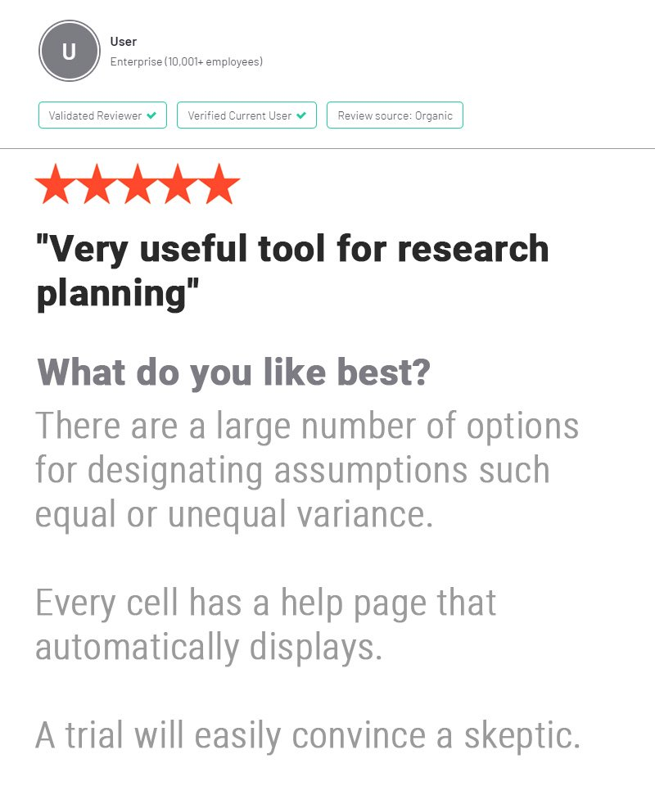
In 2021, 88% of organizations with clinical trials approved by the FDA used nQuery

Slide 6
Randomization in Clinical Trials
Part 1

Slide 7
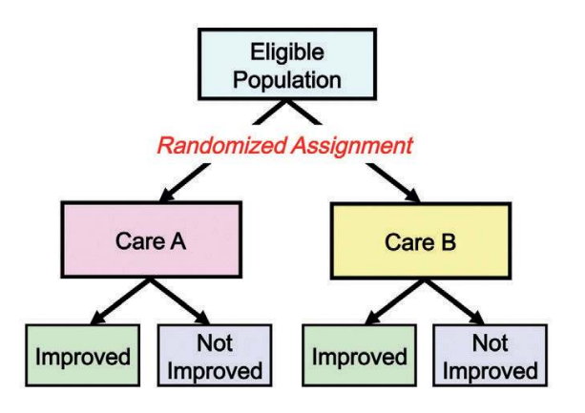
Randomization Introduction
Randomized controlled clinical trials (RCTs) represent gold standard for determining the efficacy and safety of a treatment
Patients must be assigned randomly to treatment groups in order to ensure an unbiased evaluation
Trials with inadequate randomization tend to overestimate treatment effects by up to 40% (Schul and Grimes, 2002)
Various types of trial designs which perform randomization at different levels
Simple, Cluster, Crossover, Cluster-Crossover etc
Source: Gordis (2013)

Slide 8
Reasons for Randomization
Provides a basis for standard methods of statistical analysis
Ensures that subjects in various groups do not differ in any systemic way
No “failed” randomization
Reduce bias
Potential for selection bias if treatment assignments are predictable
RCTs should be double masked to as much extent as possible
Additional benefit: Expected to balance covariates among treatment arms
High probability that treatment groups will be comparable with respect to balance of known and unknown covariates

Slide 9
Common Randomization Strategies
Part 2

Slide 10
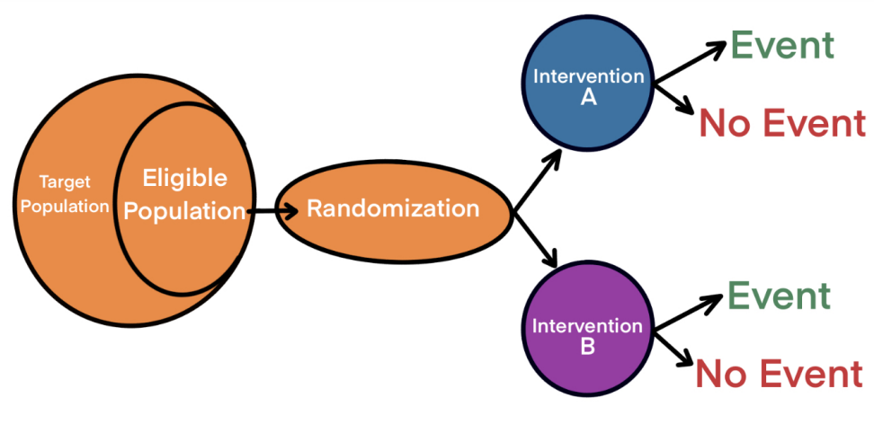
Parallel Randomized Controlled Trials
Study design and statistical methodology must be considered early when planning any clinical trial
Parallel design with individual randomization is the most common type of RCT
Individuals or subjects randomized to study arms and each arm receives a different treatment/intervention

Slide 11
Parallel RCT Advantages & Disadvantages
While parallel RCTS have many advantages, they also face some limitations that can be overcome with different trial designs.
Advantages
Disadvantages
Simplicity – Very common and well-established designs.
Versatile – Can be used for most disease types
Timelines – Different groups can be administered and evaluated simultaneously
Lower risk of contamination and bias
Lower power than other designs using same sample size (between-subject designs)
Recruitment can be difficult – similar parallel populations required
Short term effects can be missed
Should not normally use a placebo

Slide 12
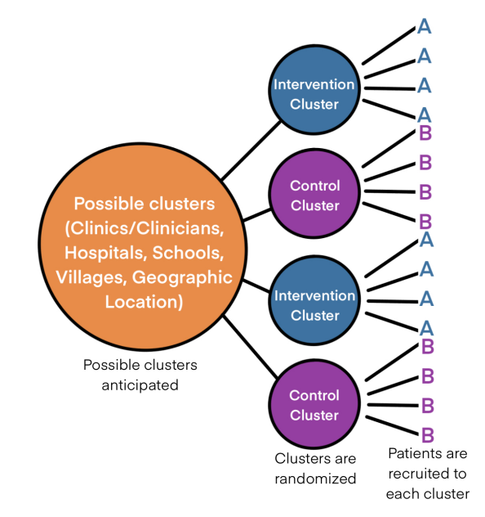
Cluster Randomized Trial (CRT) Overview
Involves randomizing clusters (e.g., school, hospital) rather than individuals
All subjects within cluster exposed to the same intervention/control condition
Expect that subjects within clusters will tend to be more self-similar due to variety of factors
May be due to influence on each other or other exogenous factors (e.g girls school vs. boys school)
Clustering will affect statistical analysis and subsequent power

Slide 13
Intracluster Correlation Coefficient (ICC)
The ICC is a measures the level of clustering on a scale of 0 (no clustering) to 1 (complete clustering).
Usually, ICC < 0.2. Typical values are between 0.01 and 0.05.
Previous similar trials or pilot studies are a good way of estimating the ICC.
ICC (Continuous RV)
ICC $=\frac{σ_{Between}^{2}}{σ_{Between}^{2}+σ_{Within}^{2}}$
Complete Clustering
1 1 1 1
1 1 1 1
0 0 0 0
No Clustering
1 0 1 1
1 0 1 1
1 0 1 1

Slide 14
CRT Advantages & Disadvantages
Advantages
Disadvantages
Can be only option when the intervention targets units
Good option when there is a high risk of contamination if the intervention would target individuals
Can simplify logistics of otherwise complicated trials
Reduces research infrastructure
Larger sample size compared to individual randomization equivalent
Higher risk of identification and recruitment bias
Concern about baseline imbalances. E.g., if age is prognostic factor and some clusters are older

Slide 15
Mixed-Effects (Hierarchical) Models
Extension of linear regression to include random effects
Fixed Effects: All variable values of interest exist
Random Effect: Variable values randomly drawn from possible values
Analyse one, two or three level designs with randomization occurring at different levels
Primary influence should follow level that treatment is randomized on
Useful for data with multiple levels of nesting
Accounts for correlation within clusters by estimating intra-cluster correlation for CRTs
General formula for Mixed-effects model
$$y_{ij}=c_{i0}+c_{1i}x_{ij}+…+c_{im}x_{ij}+e_{ij}$$
$$c_{ik}=β_{k}+n_{ik}$$
Fixed effect
Random effect

Slide 16
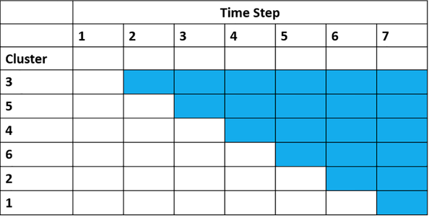
Other Possible Designs
Crossover Designs
Repeated measure design – each subject crosses over from one treatment to another at specified times.
Order of treatments is randomized, e.g., AB then BA
Cluster-Crossover Designs
Crossover designs where randomization happens at cluster level rather than subject. Clusters then cross over from one treatment to another
Stepped-Wedge Designs
RCT where subjects move from treatment to control over time in a randomized order.

Slide 17
Example | 2-Level Hierarchical Design
“A net difference (μ₁ – μ₂) of 1.1 kcal/kg/day is expected between intervention groups. We expect a standard deviation of σ = 3.67 kcal/kg/day. Here, we estimated the cluster sizes using an intracluster correlation (ρ) of 0.025.
How many churches are needed to achieve 80% power at a two-sided 5% significance level? When we recruit a fixed number of subjects (m = 20) from each participating church, the required number of churches for each intervention group is 13”.
Parameter | Value
Significance Level (2-sided) | 0.05
Mean Difference, δ = µ₁ - µ₂ | 1.1
Standard Deviation between Subjects | 3.670
Intracluster Correlation | 0.025
Group 1 Number of Clusters | 13
Group 2 Number of Clusters | 13
Cluster Ratio | 1
Subjects per Cluster | 20
Power | 80

Slide 18
Example | Cluster Randomized Trial
Parameter | Value
Significance Level (2-sided) | 0.05
Control Group Proportion | 0.35
Treatment Group Proportion | 0.5
ICC | 0.1
Average Sample Size Per Cluster | 120
Power | 82%
“Our sample size was calculated to detect a difference in the percentage of residents prescribed ≥800 IU/daily vitamin D at follow-up in the intervention versus control groups. We assumed an average of 120 residents per LTC home and that 30% of residents were prescribed ≥800 IU/daily vitamin D at baseline. We postulate a 20% increase in vitamin D prescribing in the intervention group and a 5% increase in the control group… Based on these assumptions, to detect a 15% difference in prescribing between the groups with an intracluster correlation of 0.10 (two-sided test with significance = 0.05), a sample size of 2,160 residents from 18 LTC homes in each of the intervention and control groups is required to achieve 82% power.”
Source: Kennedy et al. Implementation Science (2012)

Slide 19
Randomization Lists and Available Algorithms
Part 3

Slide 20
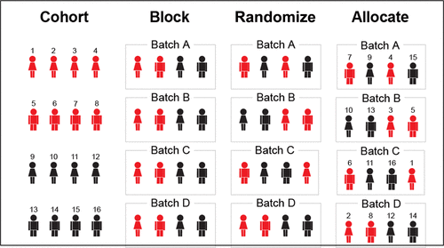
Block Randomization
Allows for many treatment groups and unequal allocation ratios
Involves assigning subjects in individually randomized blocks rather than one subject at a time
Maintains desired balance of assignments to different treatment groups both over time and at end
Source: B. Burger, M. Vaudel & H. Barsnes (2021)
User specifies block multiplier values which can be used to calculate block sizes
Example: Consider 3 treatment groups with equal allocation ratios. Subjects can be assigned in blocks of 3,6,9 etc, which will maintain balance
A variety of block sizes ensures low assignment predictability

Slide 21
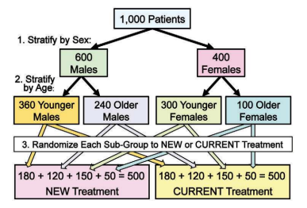
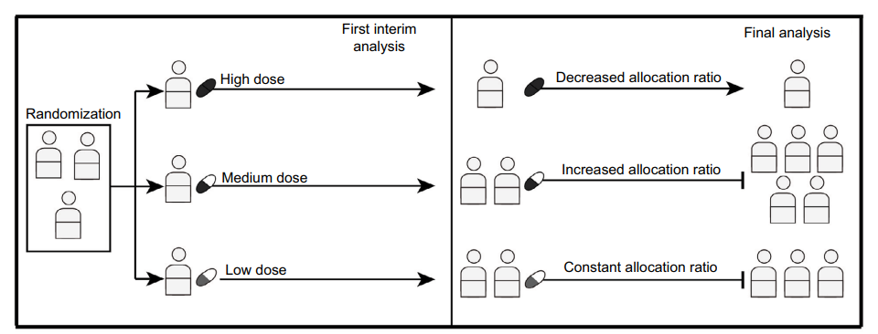
Other Randomization algorithms
Stratified Randomization
Researchers may have certain covariates (e.g. center, age) that they wish to balance between treatment groups
Subjects are split by covariate and separate randomization sequence implemented within each stratum
Improves power for small trials & facilitates subgroup and interim analysis
Other possible algorithms
Complete Randomization, Efron’s Biased Coin, Smith’s Randomization, Random Sorting
More appropriate for large trials
Adaptive Algorithms
Assignment probabilities are adjusted after each assignment to improve balance between treatments
E.g. Wei’s Urn algorithm
Source: Gordis (2013)
Source: Park, J.J. et al. (2014)

Slide 22
Example | Comparison of Balancing Properties
Randomize 500 subjects into 2 treatment groups with equal allocation ratios. Subjects will be drawn from the same center and will not be stratified on any covariates
In this example, we will examine generating randomization lists using various algorithms to compare balancing properties
Parameter | Value | Ratios
Target Sample Size | 500
Treatment Groups | 2 | 1:1
Centers | 1 (subjects drawn from same center) | 1
Stratification Factors | 0

Slide 23
Example | Block Randomization w/ Stratification
Randomize 192 subjects into 4 treatment groups with equal allocation ratios. Subjects are stratified on 3 centers, sex and smoking status (current, former, never), producing 18 strata in total
We will demonstrate how this can be generated using block randomization in nQuery
Parameter | Value | Ratios
Target Sample Size | 192
Treatment Groups | 4 | 1:1:1:1
Centers | 3 | 1:1:1
Stratification Factors | 2
Stratification Factor 1 (Sex) Levels | 2 | 1:1
Stratification Factor 2 (Smoking Status) Levels | 3 | 2:1:1

Slide 24
Discussion & Conclusions
Part 4

Slide 25
Discussion and Conclusions
Randomization is a critical feature of modern clinical trials
Provides basis for statistical analysis, reduces potential for bias
Different scenarios require randomization occurring at different levels
Choice of design, whether parallel, cluster, crossover, mixed-effects model etc., will all affect logistics and statistical analysis
Many possible algorithms exist for generating valid randomization lists
Block randomization most used as it preserves balance and conceals assignments well
Other algorithms such as complete randomization can also be used for designs with larger sample sizes.

Slide 26
Statsols.com/trial

Slide 27
Resources
Templates: www.statsols.com/templates
Webinars: www.statsols.com/webinars
Examples: www.statsols.com/examples

Slide 28
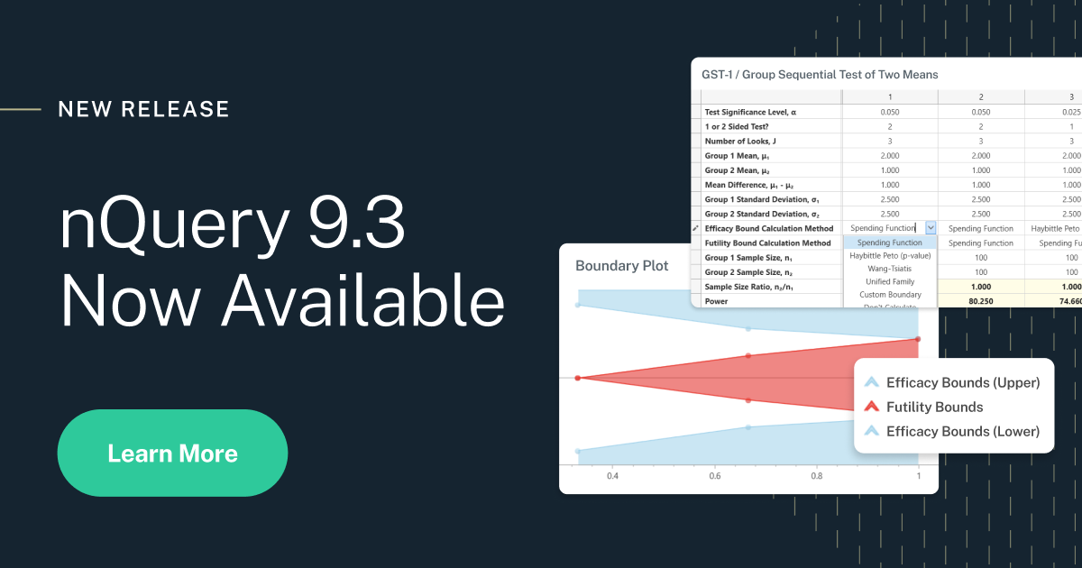
nQuery 9.3
25 new sample size tables
A major upgrade to group sequential design tables
Improvements to Randomization & Milestone Prediction tools.

Slide 29
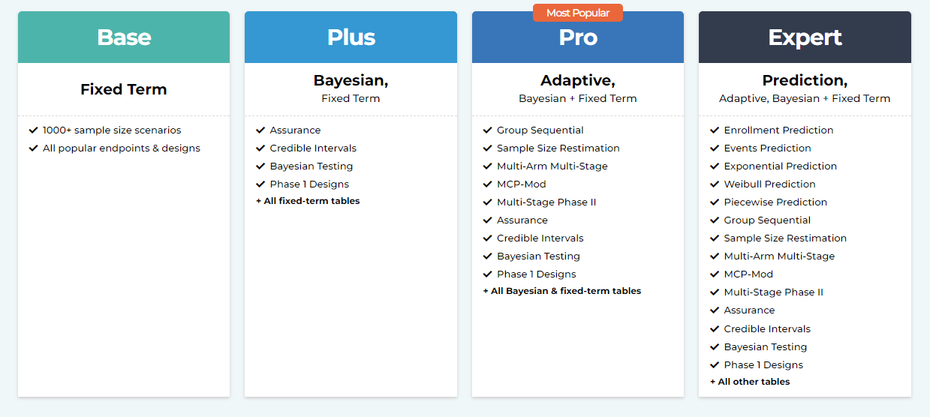
A plan for every organization

Slide 30
Thank You
Contact us:
info@statsols.com
More info:
Statsols.com

Slide 31
References (Randomization/Parallel Designs)
Rosenberger, W. F., & Lachin, J. M. (2015). Randomization in Clinical Trials: Theory and Practice (2nd ed.). Wiley.
Pocock, S. J. (1984). Clinical Trials: A Practical Approach. Wiley.
B. Burger, M. Vaudel, & H. Barsnes. (2021). Importance of Block Randomization When Designing Proteomics Experiments. Journal of Proteome Research, 20(1), 122-128.
Lachin, J. M., Matts, J. P., & Wei, L. (1988). Randomization in clinical trials: Conclusions and recommendations. Controlled Clinical Trials, 9(4), 365–374.
Efron, B. (1971). Forcing a sequential experiment to be balanced. Biometrika, 58(3), 403–417.
Senn, S. (2020, April 20). Randomisation is not about balance, nor about homogeneity but about randomness. Error Statistics Philosophy. https://errorstatistics.com/2020/04/20/s-senn-randomisation-is-not-about-balance-nor-about-homogeneity-but-about-randomness-guest-post/
Park, J. J., Thorlund, K., & Mills, E. J. (2018). Critical concepts in adaptive clinical trials. Clinical Epidemiology, Volume 10, 343–351. https://doi.org/10.2147/clep.s156708

Slide 32
References (Randomization)
de Diego-Otero, et Al. (2014). A combination of ascorbic acid and α-tocopherol to test the effectiveness and safety in the fragile X syndrome: study protocol for a phase II, randomized, placebo-controlled trial. Trials, 15(1). https://doi.org/10.1186/1745-6215-15-345
Kang, M., Ragan, B. G., & Park, J. H. (2008). Issues in Outcomes Research: An Overview of Randomization Techniques for Clinical Trials. Journal of Athletic Training, 43(2), 215–221. https://doi.org/10.4085/1062-6050-43.2.215
Suresh, K. (2011). An overview of randomization techniques: An unbiased assessment of outcome in clinical research. Journal of Human Reproductive Sciences, 4(1). https://doi.org/10.4103/0974-1208.82352
Gordis, L. (2013). Epidemiology (5th ed.). Saunders.
Frane, J. W. (1998). A Method of Biased Coin Randomization, Its Implementation, and Its Validation. Drug Information Journal, 32(2), 423–432. https://doi.org/10.1177/009286159803200213
Schulz, K. F., & Grimes, D. A. (2002). Allocation concealment in randomised trials: defending against deciphering. The Lancet, 359(9306), 614–618. https://doi.org/10.1016/s0140-6736(02)07750-4

Slide 33
References (Cluster Randomized Trials)
Kennedy, C.C., Ioannidis, G., Giangregorio, L.M. et al. An interdisciplinary knowledge translation intervention in long-term care: Study protocol for the vitamin D and osteoporosis study (ViDOS) pilot cluster randomized controlled trial. Implementation Sci 7, 48 (2012). https://doi.org/10.1186/1748-5908-7-48
Hemming K, Taljaard M, Weijer C, Forbes AB. Use of multiple period, cluster randomised, crossover trial designs for comparative effectiveness research. BMJ. 2020 Nov 4;371:m3800. doi: 10.1136/bmj.m3800. PMID: 33148538.
Hemming K, Haines TP, Chilton PJ, Girling AJ, Lilford RJ. The stepped wedge cluster randomised trial: rationale, design, analysis, and reporting. BMJ. 2015 Feb 6;350:h391. doi: 10.1136/bmj.h391. PMID: 25662947.
Kenyon, S., Dann, S., Hope, L. et al. Evaluation of a bespoke training to increase uptake by midwifery teams of NICE Guidance for membrane sweeping to reduce induction of labour: a stepped wedge cluster randomised design. Trials 18, 357 (2017). https://doi.org/10.1186/s13063-017-2106-1

Slide 34
References (Crossover Trials)
Chow, S.C, & Liu, J.P. (1992). Design and Analysis of Bioavailability and Bioequivalence Studies. Marcel Dekker.
Chen, K. W., Chow, S. C. & Li, G. (1997). A Note on Sample Size Determination for Bioequivalence Studies with Higher-order Crossover Designs. Journal of Pharmacokinetics and Biopharmaceutics, 25(6), 753-765.
Radicioni M, Castiglioni C, Giori A, Cupone I, Frangione V, Rovati S. (2017) Bioequivalence study of a new sildenafil 100 mg orodispersible film compared to the conventional film-coated 100 mg tablet administered to healthy male volunteers. Drug Des Devel Ther. 2017;11:1183-1192. Published 2017 Apr 11. doi:10.2147/DDDT.S124034
Corte-Real J, Guignard C, Gantenbein M, Weber B, Burgard K, Hoffmann L, Richling E, Bohn T. No influence of supplemental dietary calcium intake on the bioavailability of spinach carotenoids in humans. Br J Nutr. 2017 Jun;117(11):1560-1569. doi: 10.1017/S0007114517001532. Epub 2017 Jun 27. PMID: 28651681.

