Slide 2
Webinar Host
Head of Statistics
nQuery Lead Researcher
FDA Guest Speaker
Guest Lecturer
HOSTED BY: Ronan Fitzpatrick

Slide 3
Webinar Overview
Adaptive Design & Sample Size Re-estimation
Unblinded Sample Size Re-estimation Demo
Blinded Sample Size Re-estimation Demo
Discussion and Conclusions

Slide 4
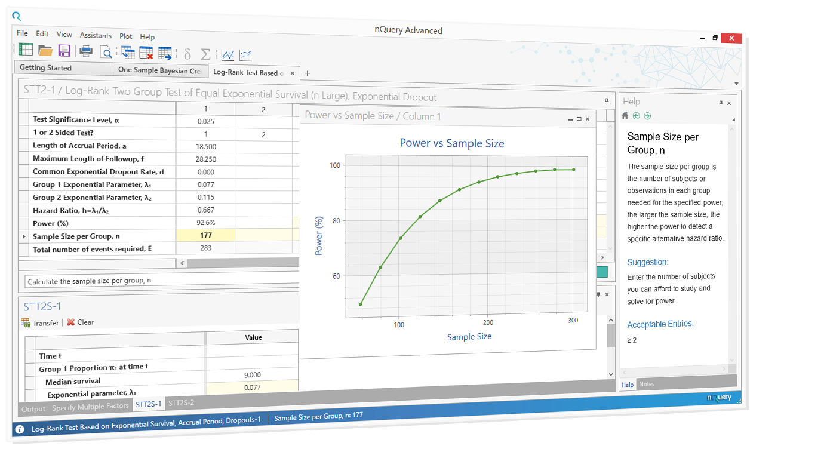
Worked Examples Overview
WORKED EXAMPLES
Two Means Group Sequential Trial
Unblinded SSR Example
Two Means Conditional Power
Two Means Blinded SSR
Unblinded Two Means SSR Example
Unblinded Two Props SSR Example
Unblinded incl. group sequential design & conditional power
Two Means Blinded SSR
Two Props Blinded SSR

Slide 5
Part 1
Adaptive Design & SSR

Slide 6
Adaptive Trials Overview
Adaptive Trials are any trial where a change or decision is made to a trial while still on-going
Encompasses a wide variety of potential adaptions
e.g. Early stopping, SSR, enrichment, seamless, dose-finding
Adaptive trials seek to give control to trialist to improve trial based on all available information
Adaptive trials can decrease costs & better inferences
Increasing interest but desire for more regulatory certainty
Notes:
Point 1:
http://rsos.royalsocietypublishing.org/content/1/3/140216 -> Screening problem analogy.
Type S Error = Sign Error i.e. sign of estimate is different than actual population value
Type M Error = Magnitude Error i.e. estimate is order of magnitude different than actual value
Point 2:
Know we have only 100 subjects available. Need to know what power will this give us, i.e. is there enough power to justify even doing the study.
Stage III clinical trials constitute 90% of trial costs, vital to reduce waste and ensure can fulfil goal.
Point 3:
Sample Size requirements described in ICH Efficacy Guidelines 9: STATISTICAL PRINCIPLES FOR CLINICAL TRIALS
See FDA/NIH draft protocol template here: http://osp.od.nih.gov/sites/default/files/Protocol_Template_05Feb2016_508.pdf (Section 10.5)
Nature Statistical Checklist: http://www.nature.com/nature/authors/gta/Statistical_checklist.doc
Point 4:
In Cohen’s (1962) seminal power analysis of the journal of Abnormal and Social Psychology he concluded that over half of the published studies were insufficiently powered to result in statistical significance for the main hypothesis. Many journals (e.g. Nature) now require that authors submit power estimates for their studies.
Power/Sample size one of areas highlighted when discussing “crisis of reproducibility” (Ioannidis). Relatively easy fix compared to finding p-hacking etc.

Slide 7
Adaptive Trials Evaluation
Opportunities
Earlier Decisions
Reduced Potential Cost
Higher Potential Success
Greater Generalizability
Stakeholder Buy-in
Risks
Complex/Different Stats
Logistical Costs and Issues
Bias/Unblinding (IDMC)
Type I Error Inflation
Potential Lower Efficiency

Slide 8
Sample Size Re-estimation (SSR)
Will focus here on specific adaptive design of SSR
Adaptive Trial focused on higher sample size if needed
Obvious adaption target due to intrinsic SSD uncertainty
Note that more suited to knowable/short follow-up
Could also adaptively lower N but not encouraged
Two Primary Types: 1) Unblinded SSR; 2) Blinded SSR
Differ on whether decision made on blinded data or not
Both target different aspects of initial SSD uncertainty
Notes:
Point 1:
http://rsos.royalsocietypublishing.org/content/1/3/140216 -> Screening problem analogy.
Type S Error = Sign Error i.e. sign of estimate is different than actual population value
Type M Error = Magnitude Error i.e. estimate is order of magnitude different than actual value
Point 2:
Know we have only 100 subjects available. Need to know what power will this give us, i.e. is there enough power to justify even doing the study.
Stage III clinical trials constitute 90% of trial costs, vital to reduce waste and ensure can fulfil goal.
Point 3:
Sample Size requirements described in ICH Efficacy Guidelines 9: STATISTICAL PRINCIPLES FOR CLINICAL TRIALS
See FDA/NIH draft protocol template here: http://osp.od.nih.gov/sites/default/files/Protocol_Template_05Feb2016_508.pdf (Section 10.5)
Nature Statistical Checklist: http://www.nature.com/nature/authors/gta/Statistical_checklist.doc
Point 4:
In Cohen’s (1962) seminal power analysis of the journal of Abnormal and Social Psychology he concluded that over half of the published studies were insufficiently powered to result in statistical significance for the main hypothesis. Many journals (e.g. Nature) now require that authors submit power estimates for their studies.
Power/Sample size one of areas highlighted when discussing “crisis of reproducibility” (Ioannidis). Relatively easy fix compared to finding p-hacking etc.

Slide 9
FDA CBER/CDER Adaptive Guidance (2018)
New draft guidance published in Oct 2018 (PDUFA VI requirement)
Comments up to Nov. 30th
Far less categorical than 2010 draft
Emphasizes early collaboration with FDA
Focus on design issues and Type I error
e.g. pre-specification, blinding, simulation
In-depth on certain adaptive designs
SSR, enrichment, switching, multiple treats
Also views on Bayesian and Complex
“Adaptive designs have the potential to improve ... study power and reduce the sample size and total cost" for investigational drugs, including "targeted medicines that are being put into development today” Scott Gottlieb (FDA Commissioner)
Notes:
Point 1:
http://rsos.royalsocietypublishing.org/content/1/3/140216 -> Screening problem analogy.
Type S Error = Sign Error i.e. sign of estimate is different than actual population value
Type M Error = Magnitude Error i.e. estimate is order of magnitude different than actual value
Point 2:
Know we have only 100 subjects available. Need to know what power will this give us, i.e. is there enough power to justify even doing the study.
Stage III clinical trials constitute 90% of trial costs, vital to reduce waste and ensure can fulfil goal.
Point 3:
Sample Size requirements described in ICH Efficacy Guidelines 9: STATISTICAL PRINCIPLES FOR CLINICAL TRIALS
See FDA/NIH draft protocol template here: http://osp.od.nih.gov/sites/default/files/Protocol_Template_05Feb2016_508.pdf (Section 10.5)
Nature Statistical Checklist: http://www.nature.com/nature/authors/gta/Statistical_checklist.doc
Point 4:
In Cohen’s (1962) seminal power analysis of the journal of Abnormal and Social Psychology he concluded that over half of the published studies were insufficiently powered to result in statistical significance for the main hypothesis. Many journals (e.g. Nature) now require that authors submit power estimates for their studies.
Power/Sample size one of areas highlighted when discussing “crisis of reproducibility” (Ioannidis). Relatively easy fix compared to finding p-hacking etc.

Slide 10
About nQuery
In 2017, 90% of organizations with clinical trials approved by the FDA used nQuery for sample size and power calculation

Slide 11
Part 2
Unblinded SSR

Slide 12
Unblinded Sample Size Re-estimation
SSR suggested when interim results “promising” (Chen et al)
“Promising” user-defined but based on unblinded effect size
Extends GSD with 3rd option: continue, stop early, increase N
Power for optimistic effect but increase N for lower relevant effects
Updated FDA Guidance: Design which “can provided efficiency”
Common criteria proposed for unblinded SSR is conditional power (CP)
Probability of significance given interim data (more detail on next slide)
2 methods here: Chen, DeMets & Lan; Cui, Hung & Wang
1st uses GSD statistics but only penultimate look & high CP
2nd uses weighted statistic but allowed at any look and CP
Notes:
Group sequential trials differ from the fixed period trials in that the data from the trial is analysed at one or more stages prior to the conclusion of the trial.
As a result the alpha value applied at each analysis or ‘look’ must be adjusted to preserve the overall Type 1 error.
So, in effect you are ‘spending’ some of your alpha at each ‘look’. The alpha values used at each look are calculated based upon the spending function chosen, the number of looks to be taken during the course of the trial as well as the overall Type 1 error rate.

Slide 13
Conditional Power (CP)
CP gives prob. of rejecting null given interim test statistic
Calculation still depends on what “true” difference set to
Often used as ad-hoc criteria for futility testing in GSD
More flexible than β-spending but less error guarantee
Focus here on CP as measure of “promising” results
“Promising” meaning less than target but close to target power
Note existence of related Bayesian Predictive Power
Essentially conditional power averaged over prior for effect
Notes:
Group sequential trials differ from the fixed period trials in that the data from the trial is analysed at one or more stages prior to the conclusion of the trial.
As a result the alpha value applied at each analysis or ‘look’ must be adjusted to preserve the overall Type 1 error.
So, in effect you are ‘spending’ some of your alpha at each ‘look’. The alpha values used at each look are calculated based upon the spending function chosen, the number of looks to be taken during the course of the trial as well as the overall Type 1 error rate.

Slide 14
Group Sequential Designs (GSD)
GSD allows early stopping @ interim analyses
Interim look = analysis done while trial on-going.
Analyses @ pre-specified times e.g. 50% subjects
2 Criteria for early stopping (otherwise continue)
Efficacy (α-spending)
Futility (β-spending)
Must account for effect of multiple analyses
Use Lan & DeMets “spending function” for errors
Spends set proportion of total error at each look
Multiple Error Spending Functions available
e.g. O’Brien Fleming (conservative), Pocock (liberal)
Both α and β spending work similarly
GSD Changes
Futility Only Designs
Additional Outputs
New Two Sample TTE
One Sample Mean GSD
One Sample Prop GSD
$$α\left(τ\right)=2\left(1−Φ\left(\frac{z_{α/2}}{τ}\right)\right)$$
Notes:
Group sequential trials differ from the fixed period trials in that the data from the trial is analysed at one or more stages prior to the conclusion of the trial.
As a result the alpha value applied at each analysis or ‘look’ must be adjusted to preserve the overall Type 1 error.
So, in effect you are ‘spending’ some of your alpha at each ‘look’. The alpha values used at each look are calculated based upon the spending function chosen, the number of looks to be taken during the course of the trial as well as the overall Type 1 error rate.

Slide 15
Means Group Sequential Example
Example 1
“A sample size of 242 subjects (121 per treatment group) provides at least 80% power to detect a relative difference of 53% between botulinum toxin A and standardized anticholinergic therapy, assuming a treatment difference of -0.80 and a common SD of 2.1 (effect size = 0.381), and a two-sided type I error rate of 5%. Sample size has been adjusted to allow for a 10% loss to follow-up over the 6-months of treatment as well as one interim analysis to stop early for benefit.”
Parameter | Value
Significance Level (2-sided) | 0.05
OnabotulinumtoxinA Mean | -2.3
Anticholinergic Mean | -1.5
Standard Deviation (Both) | 2.1
Power | 80%
# Interim Analyses | 1
α Spending Function | O’Brien-Fleming
Expected Dropout | 10%
Source: NEJM (2012)
Notes:
Actual mean values taken from elsewhere in paper.

Slide 16
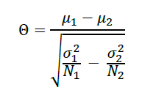
Unblinded Means SSR Example
Assume same design as GSD Example (Example 3) with HSD (γ=1.5) futility variant (n = 114)
Assume interim difference = 0.6 (from 0.8), interim common SD = 2.31 (from 2.1) and interim n of 57 per group with nominal alpha of 0.0245 for final look.
What will required N be for SSR for Chen-Demets-Lan, Cui-Hung-Wang assuming multiplier = 2?
Parameter | Value
Nominal Final Look Sig. Level | 0.0245
Interim Difference | -0.6
Interim SD (Both) | 2.31
Initial N per Group | 114
Interim N per Group | 57
Maximum N per group | 228
Lower CP Bound | Derived/40%
Upper CP Bound | 80%
Notes:
Actual mean values taken from elsewhere in paper.

Slide 17
Binomial GSD Example
Example 2
“The sample-size calculation was based on a two-sided alpha error of 0.05 and 80% power. On the basis of meta-analyses that estimated that mortality would be reduced from 12.7% to 4.7% with levosimendan use, we expected 10% mortality in the placebo group and 5% mortality in the levosimendan group. Accordingly, we calculated that a sample of 435 patients per group was needed … Interim analyses were planned after enrollments of 25% and 50% of the sample size.”
Parameter | Value
Significance Level (2-sided) | 0.05
Placebo Rate | 0.1
Levosimendan Rate | 0.05
Power | 80%
# Interim Analyses | 2 (25%, 50%)
α Spending Function | O’Brien-Fleming
Source: NEJM (2017)
Notes:
Actual mean values taken from elsewhere in paper.

Slide 18
Unblinded SSR Binomial Example
Assume same design as GSD.
Assume interim control proportion is 0.065 (increase of 0.015 over original design) with nominal (directional) alpha of 0.0245 for the final look.
What will required N be for SSR for Chen-Demets-Lan, Cui-Hung-Wang assuming N multiplier = 3? For CHW, what is effect of doing SSR at look 1 or 2?
Parameter | Value
Nominal Final Look Sig. Level | 0.0245
Interim Placebo Rate | 0.065
Interim Levosimendan Rate | 0.1
Initial N per Group | 434
Interim N per Group | 217/434
Maximum N per group | 1302
Lower CP Bound | Derived/30%
Upper CP Bound | 80%
Notes:
Actual mean values taken from elsewhere in paper.

Slide 19
Part 3
Blinded SSR

Slide 20
Blinded Sample Size Re-estimation
BSSR uses interim blinded nuisance parameter estimate
Use of blinded data reduces logistical/regulatory issues
A “well understood” & “attractive choice” for adaptive design
Multiple methods but focus on internal pilot approach
Update N based on parameter estimate from internal pilot
Use same methods as fixed term trial incl. pilot data
Small error inflation but negligible for most cases
Other methods control error but use p-value combination
Notes:
Point 1:
http://rsos.royalsocietypublishing.org/content/1/3/140216 -> Screening problem analogy.
Type S Error = Sign Error i.e. sign of estimate is different than actual population value
Type M Error = Magnitude Error i.e. estimate is order of magnitude different than actual value
Point 2:
Know we have only 100 subjects available. Need to know what power will this give us, i.e. is there enough power to justify even doing the study.
Stage III clinical trials constitute 90% of trial costs, vital to reduce waste and ensure can fulfil goal.
Point 3:
Sample Size requirements described in ICH Efficacy Guidelines 9: STATISTICAL PRINCIPLES FOR CLINICAL TRIALS
See FDA/NIH draft protocol template here: http://osp.od.nih.gov/sites/default/files/Protocol_Template_05Feb2016_508.pdf (Section 10.5)
Nature Statistical Checklist: http://www.nature.com/nature/authors/gta/Statistical_checklist.doc
Point 4:
In Cohen’s (1962) seminal power analysis of the journal of Abnormal and Social Psychology he concluded that over half of the published studies were insufficiently powered to result in statistical significance for the main hypothesis. Many journals (e.g. Nature) now require that authors submit power estimates for their studies.
Power/Sample size one of areas highlighted when discussing “crisis of reproducibility” (Ioannidis). Relatively easy fix compared to finding p-hacking etc.

Slide 21
Blinded SSR nQuery Summary (Winter 2018)
Blinded SSR Means
SSR Criteria: Variance
Three σ² Estimate Methods
Two Sample Inequality
Two Sample NI
Two Sample Equiv
Blinded SSR Props
SSR Criteria: Overall Success Rate
Assumes effect size true
Two Sample Inequality
Two Sample NI

Slide 22
Two Sample Mean Blinded SSR Example
Example 3
“We estimated that we would need to enrol 160 patients, given an expected mean (±SD) annual decline in the FVC of 9±16 percent of the predicted value and a dropout rate of 15 percent, to achieve a two-sided alpha level of 0.05 and a statistical power of 90 percent.”
Parameter | Value
Significance Level (2-Sided) | 0.05
Mean Difference (%) | -9
Standard Deviation (%) | 16
Dropout Rate | 15%
Target Power | 90%
Nuisance Parameter? | Standard Deviation
Source: NEJM (2006)

Slide 23
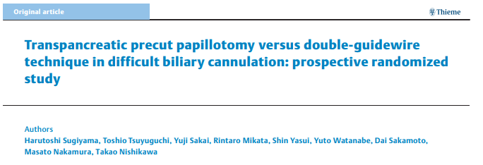
Two Sample Binomial BSSR Example
Example 4
“This number was based on results from a previous trial … where the success rate of biliary cannulation was 89.1 % for TPPP and 63.6 % for DGT [8]. The estimated probabilities of success were 60 % for the DGT group and 90 % for the TPPP group. Assuming a group difference of 30%, 32 patients per arm would provide a power of over 80%, enough to detect a difference between the DGT group and the TPPP group, using a two-sided chi-squared test at a 5 % level of significance.”
Parameter | Value
Significance Level (2-Sided) | 0.05
Control Rate | 0.6
Intervention Rate | 0.9
n per Group | 32
Target Power (%) | 80%
Nuisance Parameter | Overall Success Rate
Source: Endoscopy (2018)

Slide 24
Part 4
Sample Size Re-estimation

Slide 25
Discussion and Conclusions
Adaptive Trials expected to become more common
Regulatory & legislative environment increasingly positive
SSR continues to be a common form of adaptive trial
Blinded already widely accepted, unblinded growing
Unblinded SSR can “provide efficiency” over GSD
Plan up-front for expected effects but option to find lower ones
Blinded SSR is “attractive choice” for trial design
Deal with uncertainty in nuisance parameters with internal pilot
Notes:
Point 1:
http://rsos.royalsocietypublishing.org/content/1/3/140216 -> Screening problem analogy.
Type S Error = Sign Error i.e. sign of estimate is different than actual population value
Type M Error = Magnitude Error i.e. estimate is order of magnitude different than actual value
Point 2:
Know we have only 100 subjects available. Need to know what power will this give us, i.e. is there enough power to justify even doing the study.
Stage III clinical trials constitute 90% of trial costs, vital to reduce waste and ensure can fulfil goal.
Point 3:
Sample Size requirements described in ICH Efficacy Guidelines 9: STATISTICAL PRINCIPLES FOR CLINICAL TRIALS
See FDA/NIH draft protocol template here: http://osp.od.nih.gov/sites/default/files/Protocol_Template_05Feb2016_508.pdf (Section 10.5)
Nature Statistical Checklist: http://www.nature.com/nature/authors/gta/Statistical_checklist.doc
Point 4:
In Cohen’s (1962) seminal power analysis of the journal of Abnormal and Social Psychology he concluded that over half of the published studies were insufficiently powered to result in statistical significance for the main hypothesis. Many journals (e.g. Nature) now require that authors submit power estimates for their studies.
Power/Sample size one of areas highlighted when discussing “crisis of reproducibility” (Ioannidis). Relatively easy fix compared to finding p-hacking etc.

Slide 26
nQuery Winter 2018 Update
Winter 2018 release adds nQuery Adapt module, 32 new tables & undo/redo
Proportions + Crossover
Assurance
Conditional Power
GST + SSR
20
12
15
New Core Tables
nQuery Bayes Tables
nQuery Adapt Tables

Slide 27
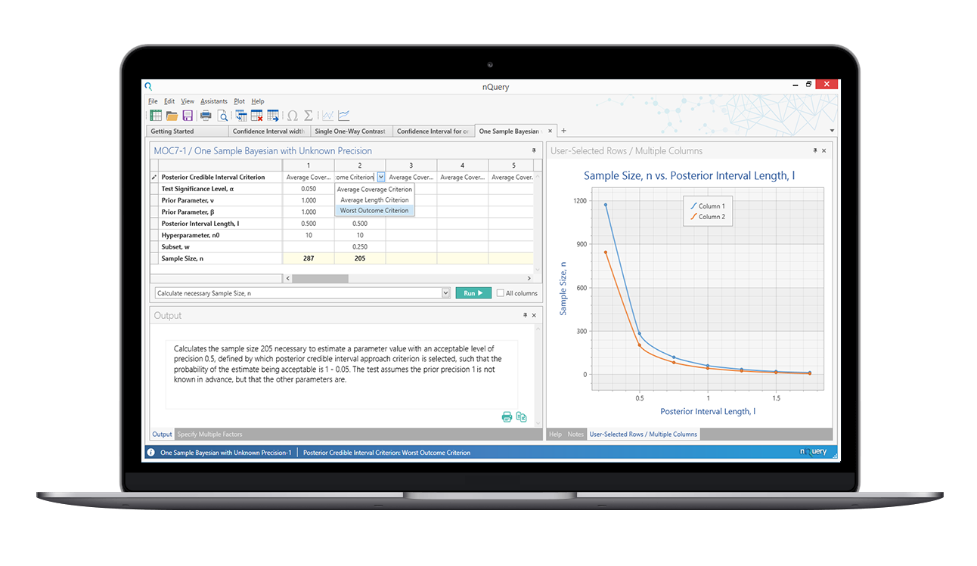
Q&A
Any Questions?
For further details, contact at:
info@statsols.com
Thanks for listening!

Slide 28
Resources
Summary of what’s new in nQuery’s Adaptive module: https://www.statsols.com/whats-new ______________________________________________________________
FDA Draft Guidance: https://www.fda.gov/downloads/drugs/guidances/ucm201790.pdf
Draft Comments/Submissions (30th November): https://www.federalregister.gov/documents/2018/10/01/2018-21314/adaptive-designs-for-clinical-trials-of-drugs-and-biologics-draft-guidance-for-industry-availability
Statsols Blog on FDA Guidance: https://blog.statsols.com/new-fda-guidance-on-adaptive-clinical-trial-design
More detail: See references and nQuery 8.3.0.0 Manual - Chapter 4

Slide 29
References
Jennison, C., & Turnbull, B. W. (1999). Group sequential methods with applications to clinical trials. CRC Press.
Chen, Y. J., DeMets, D. L., & Gordon Lan, K. K. (2004). Increasing the sample size when the unblinded interim result is promising. Statistics in medicine, 23(7), 1023-1038.
Cui, L., Hung, H. J., & Wang, S. J. (1999). Modification of sample size in group sequential clinical trials. Biometrics, 55(3), 853-857.
Mehta, C.R. and Pocock, S.J., 2011. Adaptive increase in sample size when interim results are promising: a practical guide with examples. Statistics in medicine, 30(28), pp.3267-3284.
Visco, A. G., et al (2012). Anticholinergic therapy vs. onabotulinumtoxina for urgency urinary incontinence. New England Journal of Medicine, 367(19), 1803-1813.
Landoni, G., Lomivorotov, V. V., Alvaro, G., Lobreglio, R., Pisano, A., Guarracino, F., ... & Bianchi, A. (2017). Levosimendan for hemodynamic support after cardiac surgery. New England Journal of Medicine, 376(21), 2021-2031.

Slide 30
References (cont.)
Friede, T., & Kieser, M. (2006). Sample size recalculation in internal pilot study designs: a review. Biometrical Journal: Journal of Mathematical Methods in Biosciences, 48(4), 537-555.
Friede, T., & Kieser, M. (2004). Sample size recalculation for binary data in internal pilot study designs. Pharmaceutical Statistics: The Journal of Applied Statistics in the Pharmaceutical Industry, 3(4), 269-279.
Wittes, J., & Brittain, E. (1990). The role of internal pilot studies in increasing the efficiency of clinical trials. Statistics in Medicine, 9(1‐2), 65-72.
Tashkin, D. P., Elashoff, R., Clements, P. J., Goldin, J., Roth, M. D., Furst, D. E., ... & Seibold, J. R. (2006). Cyclophosphamide versus placebo in scleroderma lung disease. New England Journal of Medicine, 354(25), 2655-2666.
Sugiyama, H., Tsuyuguchi, T., Sakai, Y., Mikata, R., Yasui, S., Watanabe, Y., ... & Nishikawa, T. (2018). Transpancreatic precut papillotomy versus double-guidewire technique in difficult biliary cannulation: prospective randomized study. Endoscopy, 50(1), 33-39.

