Slide 1
Alternatives to Power
Sample Size Determination using methods other than Power
November 2024

Slide 2
Brian Fox
Research Statistician

Slide 3
Agenda
01
SSD Power & Alternatives
02
Statistical Intervals
03
Bayesian Testing
04
Discussion and Conclusions
Questions welcome throughout

Slide 4
The complete solution for optimizing your clinical trial designs
Pre-clinical research
Animal studies
ANOVA / ANCOVA
Confirmatory
1000+ Scenarios for Fixed term, Adaptive & Bayesian Methods
Survival, Means, Proportions & Count endpoints
Group Sequential Trials
Bayesian:
Assurance
Credible Intervals
Posterior Error Approach
Sample Size Re-Estimation
Cross over & personalized medicine
MAMS
Prediction
Early Phase
CRM
MCP-Mod
Simon’s Two Stage
Flemings GST
Post Marketing
Cohort Study
Case-control Study

Slide 5
nQuery Licensing nQuery operates on a tiered licensing model
BASIC
PLUS
PRO
EXPERT
Sample size and power for fixed terms trials over 100’s of designs,
endpoints and hypothesis types.
Sample size for fully Bayesian (e.g. credible intervals)
+ Hybrid Bayes/Frequentist methods and designs (e.g. Assurance)
Sample size and power for range of early stage and confirmatory clinical trial
Adaptive Designs and tools for monitoring and adjustment in-trial
Additional tools for study design and monitoring.
Focus currently on milestone prediction for enrollment and (survival) event targets
Click Here to see our Package Comparison Tool

Slide 6
Part 1
SSD using Power & Alternatives

Slide 7
Introduction – Sample Size Determination
What is Sample Size Determination (SSD)?
SSD is the process of finding an appropriate sample size for a study.
We want to determine the minimum sample size that is expected to reach a desired value of a certain metric (e.g. power, interval width, cost).
Why is SSD important?
It is crucial that we arrive at valid conclusions and an appropriate sample size will reduce the chance of large errors.
The number of subjects enrolled in a trial raises both ethical and practical considerations.

Slide 8
Sample Size Determination using Power
Power is the most common metric for sample size determination.
It is defined as the probability of rejecting the null hypothesis when it is false. i.e. the probability of detecting a true effect of a specified size.
The calculated sample size will only achieve the target power if the assumed effect size and other assumptions are proven to be correct.
Deviations from these assumed values can lead to underpowered or overpowered studies.
Alternative methods may help alleviate this potential issue.

Slide 9
Alternatives to Power
Statistical Intervals – Sample Size may be calculated in order to ensure a certain criteria for a given interval width. For example to ensure a Confidence Level > 95%.
Common methods include Confidence Intervals, Prediction Intervals, Bayesian Credible Intervals, Mixed Bayesian Likelihood Intervals etc.
Hybrid Bayesian Methods – Bayesian methods can be integrated into existing sample size determination methods in order to provide greater context about parameter uncertainty.
MBL Intervals, Posterior Errors, Assurance, Predictive Power, Adaptive Designs.
Pure Bayesian Methods – Sample size can be calculated based on purely Bayesian parameters/metrics.
Bayes Factors, Credible Intervals, Continual Reassessment Method (CRM), Utility/Cost Function

Slide 10
Statistical Intervals
Part 2

Slide 11
Introduction to Statistical Intervals
Confidence Intervals
A range of values for a parameter of interest from a population which is expected to contain the true population value with a specified degree of confidence.
Credible Intervals
Interval containing a specified percentage of the posterior distribution. Can be considered the Bayesian analogue to confidence intervals.
95% Credible Interval | 95% Confidence Interval
Interval contains 95% of the posterior probability – i.e. there is a 95% chance that the true value is in the interval. Unknown parameter is a RV, bounds are fixed. | Under repeated sampling, 95% of confidence intervals constructed the same way will include the true value. Unknown parameter is fixed, bounds are RV’s.

Slide 12
Credible Interval Construction
Adcock (1988) and Joseph and Bélisle (1997) have developed methods to
construct credible intervals for normal means.
The method chosen depends on the selection criteria and the estimation
methodology.
Selection Criteria | Estimation Methodology
Average Coverage Criterion (ACC) | Known Precision
Average Length Criterion (ALC) | Unknown Precision
Worst Outcome Criterion (WOC) | Mixed Bayesian/Likelihood

Slide 13
Sample Size Determination using Intervals
Confidence Intervals
Sample Size is calculated in order to ensure that the confidence interval contains the population parameter, e.g. mean, with a specified degree of confidence.
Credible Intervals
Formula required depends on choice of selection criteria and estimation methodology. Require specification of the level of precision of the data, $λ=1/σ2.$
Known Precision (ACC, ALC, WOC)
Unknown Precision (ACC)
Joseph, L., & Belisle, P. (1997).

Slide 14
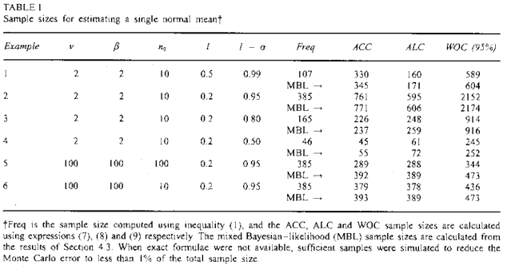
Credible Intervals | Example 1 & 2
“In practice, the prior information will be different in every problem, so it is impossible to provide exhaustive tables. Therefore, Table 1 presents a variety of examples that illustrate the relationships between the various criteria discussed for the case of estimating sample size requirements for a single normal mean. Example 1-3 … show that the Bayesian approach can provide larger sample sizes than the frequentist approach, even though prior information is incorporated ... The same examples also illustrate that sample size provided by the ALC tend to be smaller than that of the ACC when 1-α is near l and l is not near 0.”

Slide 15
Part 3
Bayesian Testing

Slide 16
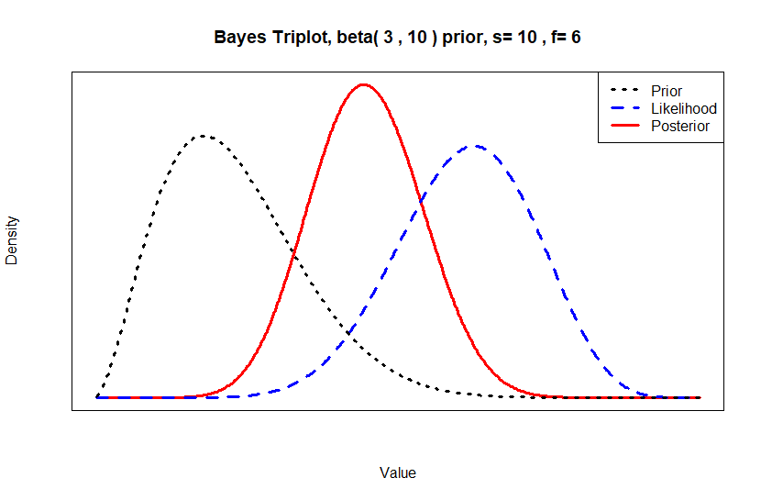
The Bayesian Paradigm
Bayesian Statistics combines existing knowledge, expert opinion and real-world data.
Parameters to be estimated are treated as random variables.
A posterior distribution is estimated from a prior distribution and observed data using Bayesian analysis.
The posterior is then used to make inferences.
Bayes’ Theorem
$$P\left(θ | D\right)=\frac{P(D|θ)×P(θ)}{P(D)}$$

Slide 17
Bayesian Sample Size Determination
How can we use Bayesian Statistics for SSD?
Pure Bayesian Sample Size Methods | Hybrid Bayesian Sample Size Methods
Calculates Sample Size based on specific values of Bayesian Parameters | Integrates Bayesian methods into existing sample size methods which adds greater context for parameter uncertainty
e.g. Bayes Factors, Credible Intervals, Continual Reassessment Method (CRM), Utility/Cost Function | e.g. MBL Intervals, Posterior Errors, Assurance, Predictive Power, Bayesian Adaptive Designs
How do we choose our prior?

Slide 18
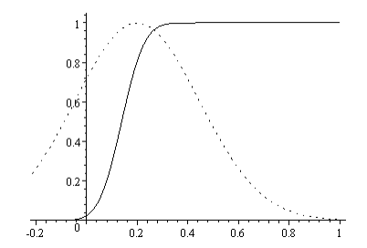
Bayesian Assurance
Assurance is the unconditional probability of trial success (significant result), given a prior for the effect size and/or nuisance parameters.
Calculated as the expectation of power, averaged over all plausible values for the effect size.
Framed as a closer representation of the “true probability of success” and can be considered as a Bayesian analogue to power.
Formalizes the sensitivity analysis and can be considered alongside power in a traditional frequentist framework.
Source: O’Hagan (2005)

Slide 19
Assurance Calculations
Let R be the event of rejecting a null hypothesis & 𝜽 be a vector of parameter values.
Power: 𝜋(𝜽)=𝑃(𝑅|𝜽)
Assurance: 𝐴=𝑃(𝑅)=𝐸(𝜋(𝜽))
Calculation Methods
Analytic
(Two Normal Means Inequality)
$$\overline{δ}\sim N\left(δ,τ^{2}\right); δ=μ_{2}−μ_{1}; τ^{2}=\frac{σ_{1}^{2}}{n_{1}}+\frac{σ_{2}^{2}}{n_{2}}$$
$Prior: δ\sim N\left(m,v\right)$
$$A=Φ\left(\frac{−τZ_{α/2}+m}{\sqrt{τ^{2}+v}}\right)$$
Numeric Integration
$$A=\int_{−∞}^{∞}{P\left(R|θ\right)P\left(θ\right)dθ}$$
Simulation
#sims=N; r=0
For (n in 1:N){
Sample $θ$ from prior
Sample required test statistic using models and $θ$
If outcome R has occurred, r++
}
$$A\text{≈}\frac{r}{N}$$

Slide 20
Posterior Error Approach
This approach developed by Lee & Zelen (2000) is a combination of the frequentist and Bayesian
frameworks.
Targets the Inverse-Conditional issue by using Bayesian posterior (Type I/II) error rates instead of
typical frequentist error rates.
These Bayesian posterior errors are based on the frequentist definition of success. (i.e. using the p-value)
It is assumed that a frequentist data analysis will follow.
The Bayesian framework can be seen as more intuitive and reflective of practical decision making. However, the regulators point of view may differ.
Conversion only requires statement of prior probability belief against H0.

Slide 21
Posterior Error Method | Example 3
“Assuming a mean (±SD) number of ventilator-free days of 12.7±10.6, we estimated that a sample of 524 patients would need to be enrolled in order for the study to have 80% power, at a two-tailed significance level of 0.05, to detect a mean between-group difference of 2.6 ventilator-free days. On the basis of data from the PAC-Man trial, we estimated that the study-withdrawal rate would be 3% and we therefore calculated that the study required a total of 540 patients.”
Parameter | Value
Significance Level (Two- Sided) | 0.05
Mean Difference | 2.6
Standard Deviation | 10.6
n per Group | 262
Target Power | 80%
Source: NEJM (2014)

Slide 22
Posterior Error Method | Example 3 Ctd.
Assume the Z-test example but we want a posterior Type I error of 0.05 (probability the null hypothesis is true given significance) and posterior Type II of 0.2 (probability the null hypothesis is false given non-significance).
What would be equivalent sample size and frequentist planning errors (α, 1-β) be assuming a range (0.25 - 0.75) of prior beliefs against the null hypothesis.
Parameter | Value
α* | 0.2
β* | 0.05
Mean Difference | 2.6
Standard Deviation | 10.6
N per Group | ?
Test Significance Level, α | ?
Power, 1-β | ?

Slide 23
Part 4
Discussion & Conclusion

Slide 24
Discussion and Conclusions
Power most common metric for SSD however has issues around parameter
Uncertainty and “success” criteria.
Deviations may result in under-powered or over-powered studies.
Statistical Intervals provide alternative method for SSD.
However may run into similar issues should assumptions fail.
Bayesian Methods can ameliorate & highlight issues .
MBL intervals use priors to fulfil Bayesian criteria & still ensure correct confidence interval.
Posterior error approach provides intuitive “success” criteria & prior success prob. Discussion.
Sensitivity Analysis may help alleviate Issues with Power.
Ad-hoc approach which may be at increased risk of Bias. Bayesian Assurance may provide
more formalized framework to deal with uncertainty.

Slide 25
Statsols.com/nquery-trial

Slide 26
Thank you
CONTACT US
info@statsols.com
MORE INFO
statsols.com

Slide 27
References
Chow, S.C., Shao, J., & Wang, H. (2008). Sample Size Calculations in Clinical Research (2nd ed.). Chapman & Hall
Joseph, L., & Belisle, P. (1997). Bayesian sample size determination for normal means and differences between normal means. Journal of the Royal
Statistical Society: Series D (The Statistician), 46(2), 209–226
Adcock, C. J. (1988). A Bayesian Approach to Calculating Sample Sizes. The Statistician, 37(4/5), 433–439
Hahn, G. J., & Meeker, W. Q. (1991). Statistical Intervals: A Guide for Practitioners (1st ed., section 4.4). Wiley-Interscience
Kass, R., & Raftery, A. (1995). Bayes Factors. Journal of the American Statistical Association, 90(430), 773-795
Weiss, R. (1997). Bayesian sample size calculations for hypothesis testing. Journal of the Royal Statistical Society: Series D (The Statistician), 46(2), 185–191
Dixon, W.J., & Massey, F.J. (1983). Introduction to Statistical Analysis (4th ed., pp. 80-85). McGraw-Hill
Lee, S. J., & Zelen, M. (2000). Clinical Trials and Sample Size Considerations: Another Perspective. Statistical Science, 15(2), 95–110
O'Hagan, A., Stevens, J. W., & Campbell, M. J. (2005). Assurance in clinical trial design. Pharmaceutical Statistics, 4(3), 187-201
Chen, DG., Chen, J.K. (2018). Statistical Power and Bayesian Assurance in Clinical Trial Design. In: Zhao, Y., Chen, DG. (eds) New Frontiers of Biostatistics and Bioinformatics. ICSA Book Series in Statistics. Springer, Cham
Dallow, N, Best, N, Montague, TH. Better decision making in drug development through adoption of formal prior elicitation. Pharmaceutical Statistics. 2018; 17: 301– 316
Oakley, J. E. and O'Hagan, A. SHELF: The Sheffield Elicitation Framework (version 2.0), School of Mathematics and Statistics, University of Sheffield, 2010
Rothman KJ, Greenland S. Planning Study Size Based on Precision Rather Than Power. Epidemiology. 2018 Sep;29(5):599-603

