Slide 1

Simulation for Survival Group Sequential Trials
August 2025

Slide 2


Brian Fox
Research Statistician

Slide 3
Agenda
1. Group Sequential Design
2. Survival Group Sequential Design
3. Survival Group Sequential Design Simulation
4. Discussion & Conclusion
Questions welcome throughout

Slide 4
nQuery: The complete solution
for optimizing your clinical trial designs
Early Phase
CRM
MCP-Mod
Simon’s Two Stage
Flemings GST
Confirmatory
1000+ Scenarios for Fixed term, Adaptive &
Bayesian Methods
Survival, Means, Proportions & Count endpoints
Group Sequential Trials + Simulation
Bayesian:
                Assurance
  Credible Intervals
  Posterior Error Approach
Sample Size Re-Estimation
Cross over & personalized medicine
MAMS
Prediction
Pre-clinical research
Animal studies
ANOVA / ANCOVA
Post Marketing
Cohort Study
Case-control Study

Slide 5
nQuery Licensing nQuery operates on a tiered licensing model
Base
Sample size and power for fixed terms trials over 100’s of designs,
endpoints and hypothesis types
Plus
Sample size for fully Bayesian (e.g. credible intervals)
+ hybrid Bayes/Frequentist methods and designs (e.g. Assurance)
Pro
Sample size and power for range of early stage and confirmatory clinical trial
Adaptive Designs and tools for monitoring and adjustment in-trial
Expert
Additional tools for study design and monitoring. Focus currently on milestone prediction for enrollment and (survival) event targets
Click Here to see our Package Comparison Tool

Slide 6
Group Sequential Design
Part 1

Slide 7
Group Sequential Design Introduction
Fully Sequential Vs Group Sequential
  Continuous Vs Cohorts of Subjects, i.e. ‘Groups’
Trial can stop early or adjustments made at each interim analysis
  Most common stopping criteria are for Efficacy and/or Futility
Allows multiple chances for a trial to “succeed”
  Naive analysis will inflate Type I error e.g. 5 looks: 0.05 -> 0.142 (Armitage)
Need to account for effect of multiple analyses
  Each analysis shares data – can use this to increase efficiency vs MCP
  Wide range of methods available

Slide 8
Types of Group Sequential Design
Error Spending | Spend alpha (efficacy) and/or beta (futility) errors across interim looks using “spending function” – highly flexible during design and analysis stage
Haybittle-Peto | Define (efficacy) boundaries in terms of unadjusted p-values – Haybittle-Peto method finds adjusted final p-value to retain Type I error
Wang-Tsiatis | 1 (efficacy only) or 2 (efficacy + futility – Pampallona-Tsiatis) Parameter Method – includes “optimal GSD” proposal to minimize average sample size
“Classic” Designs | O’Brien-Fleming & Pocock – fixed boundaries and less flexible during monitoring – not to be confused with O’Brien-Fleming & Pocock error spending functions
Unified Family | Unified 2-parameter method which includes Wang-Tsiatis and “Classic” designs as subsets – all three less flexible during monitoring than error spending
Whitehead | Extension of fully sequential SPRT to group sequential setting – sometimes referred to as “Triangular” or “Christmas Tree” designs
Others | Custom Futility (e.g. Conditional Power), Adaptive GSD (incl. SSR), MAMS GSD

Slide 9
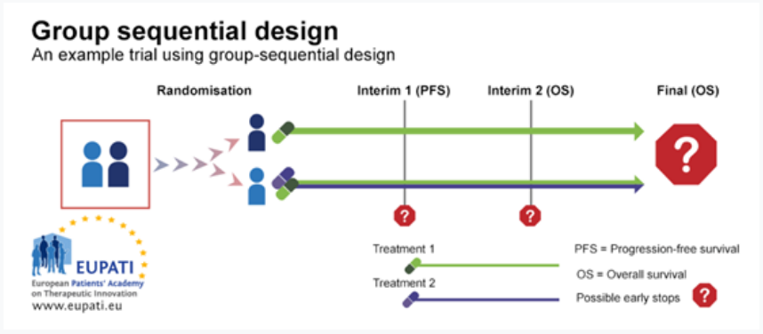
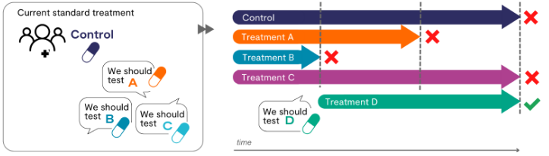
Complex Group Sequential Design
Survival Group Sequential Designs
  Patient follow-up – Until end or for fixed period?
  Non-proportional hazards?
  Dealing with Complex Accrual, Survival, Dropout
  Stratified analyses?
Adaptive Group Sequential Designs – Type I error Control?
  Treatment Arms – MAMS GSD/Drop the loser/Pick the winner
  Sample Size – BSSR/USSR
  Patient Subgroups
  Bayesian approach?
https://www.mrcctu.ucl.ac.uk/our-research/methodology/design/multi-arm-multi-stage-mams-platform-trials/

Slide 10
Part 2
Survival Group
Sequential Design

Slide 11


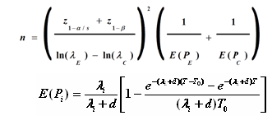






Power for Survival Analysis
Power for TTE related to several choices:
  Design (Parallel, One-Arm, Complex)
  Statistical Method (Log-Rank, Cox)
  Endpoint (Hazard Ratio, Survival Time)
  Survival Dist. (Exponential, Weibull)
Power is driven (primarily) by number of events (E) NOT sample size (N)
  Often calculate E separate from N
  Total Follow-up relevant for complex cases
Sample size determination interested in no. subjects to reach this events
  Often via flexible “meta-model” which includes accrual, dropout, crossover etc
D Schoenfeld (1981)
L.S. Freedman (1982)
J.M. Lachin & M.A Foulkes (1986)
E Lakatos (1988)
Y. Tang (2021/2022)

Slide 12
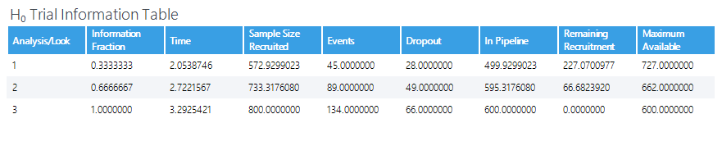
Survival GSD Complications
Unknown follow-up means more interim planning uncertainty
  Can be difficult to predict time when interim analysis will occur
  Higher numbers likely in active cohort when interim analysis occurs
  PFS or OS at each look
  Planning USSR? – Freidlin & Korn 2017
Survival GSDs often require additional assumptions
  Assume constant effect? NPH?
Interim Events dependant on two factors
  Increase sample size – Biases early trends
  Increase time – Biases later trends

Slide 13
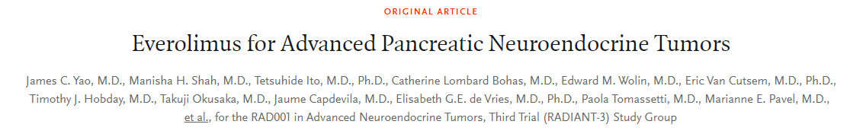
Survival GSD| Example 1
“Using an unstratified log-rank test at the one-sided 2.5% significance level, a total of 282 events would allow 92.6% power to demonstrate a 33% risk reduction (hazard ratio for RAD/placebo of about 0.67, as calculated from an anticipated 50% increase in median PFS, from 6 months in placebo arm to 9 months in the RAD001 arm).
With a uniform accrual of approximately 23 patients per month over 74 weeks and a minimum follow up of 39 weeks, a total of 352 patients would be required to obtain 282 PFS events, assuming an exponential progression-free survival distribution with a median of 6 months in the Placebo arm and of 9 months in RAD001 arm.
With an estimated 10% lost to follow up patients, a total sample size of 392 patients should be randomized.”
Parameter | Value
Significance Level (1-Sided) | 0.025
Placebo Median Survival (months) | 6
Everolimus Median Survival (months) | 9
Hazard Ratio | 0.66667
Accrual Period (Weeks) | 74
Minimum Follow-Up (Weeks) | 39
Power % (under constant HR) | 92.6

Slide 14
Survival GSD| Example 1 Continued
Assuming following Parameters
For GSD and Piecewise Survival
Parameter | Value
Looks | 4 (Equally Spaced)
Boundaries | Efficacy (LDM) & Futility (NB LDM)
Alpha Spending Function | O’Brien Fleming
Beta Spending Function | O’Brien Fleming
Survival Time Periods (Months) | 6, 18.5, 28.25
Placebo Exp. Hazard Rate | 0.077, 0.077,0.077
Placebo Dropout Rate | 0.03, 0,0
Everolimus Dropout Rate | 0, 0.03, 0.01
Parameter | Value
Significance Level (1-Sided) | 0.025
Placebo Median Survival (months) | 6
Everolimus Median Survival (months) | 9
Hazard Ratio | 0.66667
Accrual Period (Weeks) | 74
Minimum Follow-Up (Weeks) | 39
Power % (under constant HR) | 92.6

Slide 15
Survival Group Sequential
Design Simulation
Part 3

Slide 16
GSD Simulation Introduction
Uses simulated study data to predict group sequential design characteristics.
Very useful in understanding more complex GSDs
  Allows verification of original (closed form) design
    Verify Type I error (α), Type II error/Power (β/1-β), Expected Sample Size/Stopping Time
    Can be used directly in GS/boundary calculations
  Allows exploration of alternative design/study scenarios
    Can evaluate alternative hypotheses, e.g. treatment effect more/less than expected
    Changes to interim analyses/information fractions
Avoids some closed form analyses constraints and aids in communication to non-statisticians

Slide 17
GSD Simulation Regulatory Guidance
Regulatory guidance on simulation is widely positive
Simulation for Adaptive Designs of note in particular
ICH E20 - 5.2
“clearly define and focus on the key objectives the simulation study is designed to address”
“define and assess key operating characteristics that align with the questions the simulation study is designed to address”
“The scenarios included in the simulation study should cover the plausible range of assumptions to ensure a robust assessment of the performance of the proposed adaptive design”

Slide 18
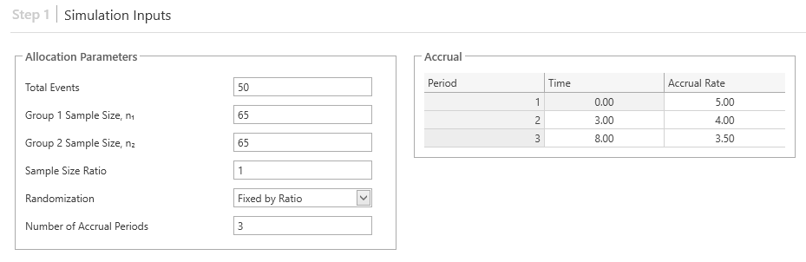
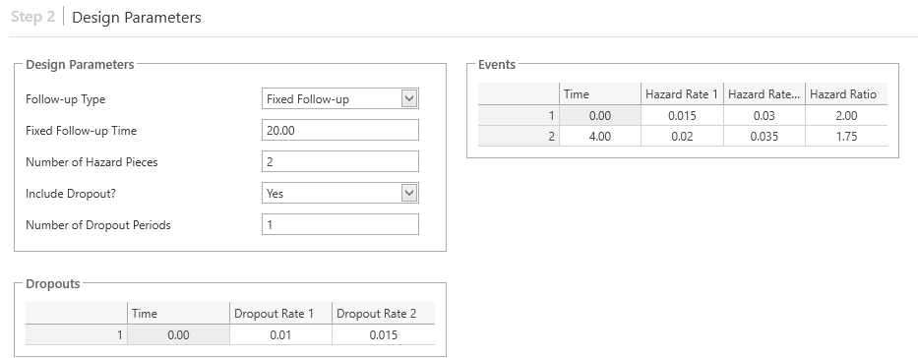
Survival GSD Simulation Considerations
Steps in designing Simulated Survival GST:
  Step 1 - Generating model assumptions
  Step 2 - Survival Design assumptions
  Step 3 - GSD assumptions
  Step 4 - Boundary/Information assumptions
  Step 5 – Simulation Control assumptions
Questions:
  How to justify population assumptions?
  How to avoid extrapolation issues?
  How to model survival/accrual process?

Slide 19
Survival GSD| Example 1 Continued
Assuming following Parameters
For GSD and Piecewise Survival
Parameter | Value
Looks | 4 (Equally Spaced)
Boundaries | Efficacy (LDM) & Futility (NB LDM)
Alpha Spending Function | Exponential (0.8)
Beta Spending Function | T-Distributed (0.5,0.2,5)
Survival Time Periods (Months) | 6, 18.5, 28.25
Placebo Exp. Hazard Rate | 0.077, 0.09,0.077
Placebo Dropout Rate | 0.1, 0,0
Everolimus Dropout Rate | 0, 0.05, 0.1
Parameter | Value
Significance Level (1-Sided) | 0.025
Placebo Median Survival (months) | 6
Everolimus Median Survival (months) | 9
Hazard Ratio | 0.66667
Accrual Period (Weeks) | 74
Minimum Follow-Up (Weeks) | 39
Power % (under constant HR) | 92.6

Slide 20
Part 4
Discussion &
Conclusions

Slide 21
Discussion and Conclusions
GSD allow interim analyses and facilitate interim decisions
Real life sequential studies can be complex
Survival sequential designs require additional considerations
Statistical and logistical considerations to be made
Difficult to predict interim timing
Endpoint for interim looks
Effect of varying HR, dropout, etc.
Simulation for Survival GSD very useful
Allows verification of operating characteristics
Allows exploration of alternative scenarios
Easy to understand & iterate
Regulatory guidance on Simulation for Survival GSD is positive

Slide 22

statsols.com/nquery-demo

Slide 23
Contact us: info@statsols.com
More info: www.statsols.com
Thank You.

Slide 24
References (Survival Analysis)
Cox, D.R. and Oakes, D., 1984. Analysis of survival data. CRC press.
Cox, D.R., 1972. Regression models and life‐tables. Journal of the Royal Statistical Society: Series B (Methodological), 34(2), 187-202.
Collett, D., 2015. Modelling survival data in medical research. CRC press.
Fleming, T.R. and Harrington, D.P., 2013. Counting processes and survival analysis. John Wiley & Sons.
Klein, J.P., Van Houwelingen, H.C., Ibrahim, J.G. and Scheike, T.H. eds., 2016. Handbook of survival analysis. CRC Press.
Andersen, P.K., Borgan, O., Gill, R.D. and Keiding, N., 2012. Statistical models based on counting processes. Springer Science & Business Media.
Lin, H. and Zelterman, D., 2002. Modeling survival data: extending the Cox model.
Klein, J.P. and Moeschberger, M.L., 2003. Survival analysis: techniques for censored and truncated data. New York: Springer.
Lemeshow, S., May, S. and Hosmer Jr, D.W., 2011. Applied survival analysis: regression modeling of time-to-event data. John Wiley & Sons.
Aalen, O., Borgan, O. and Gjessing, H., 2008. Survival and event history analysis: a process point of view. Springer Science & Business Media.
U.S. Food and Drug Administration, Clinical Trial Endpoints for the Approval of Cancer Drugs and Biologics. December 2018 Available from: http://www.fda.gov/downloads/Drugs/GuidanceComplianceRegulatoryInformation/Guidances/ucm071590.pdf

Slide 25
References (GSD)
Haybittle, J.L. (1971) Repeated assessment of results in clinical trials of cancer treatment. The British Journal of Radiology 44: 793-797.
Peto, R., M.C. Pike, P. Armitage, N.E. Breslow, D.R. Cox, S.V. Howard, N. Mantel, K. McPherson, J. Peto, and P.G. Smith. (1976). Design and analysis of randomized clinical trials requiring prolonged observation of each patient. I. Introduction and design. British Journal of Cancer 34 (6): 585–612.
O'Brien, P.C. & Fleming, T.R. (1979). A multiple testing procedure for clinical trials. Biometrics, 35, 549-556.
Pocock, S. J. (1977). Group sequential methods in the design and analysis of clinical trials. Biometrika, 64(2), 191–199.
Whitehead, J. & Stratton, I. (1983) Group Sequential clinical trials with triangular continuation regions. Biometrics, 39, 227-236.
Whitehead, J. (2001). “Use of the Triangular Test in Sequential Clinical Trials.” In Handbook of Statistics in Clinical Oncology, 211–228. New York: Marcel Dekker.
Lan, K. K. G., & DeMets, D. L. (1983). Discrete Sequential Boundaries for Clinical Trials. Biometrika, 70(3), 659–663.
Kim, K., and DeMets, D. L. (1987). “Design and Analysis of Group Sequential Tests Based on the Type I Error Spending Rate Function.” Biometrika 74:149–154.
Hwang IK, Shih WJ, and DeCani JS (1990). Group sequential designs using a family of type I error probability spending functions. Statistics in Medicine, 9, 1439-1445.
Lan, K. K. G., W. F. Rosenberger, and J. M. Lachin. (1993). Use of Spending Functions for Occasional or Continuous Monitoring of Data in Clinical Trials. Statistics in Medicine 12 (23):2219–31..
Demets, D. L., & Lan, K. G. (1994). Interim analysis: the alpha spending function approach. Statistics in medicine, 13(13‐14), 1341-1352.
Wang SK and Tsiatis AA (1987). Approximately optimal one-parameter boundaries for group sequential trials. Biometrics, 43, 193-99.
Pampallona S, Tsiatis AA and Kim K (2001). Interim monitoring of group sequential trials using spending functions for the type I and type II error probabilities. Drug Information Journal, 35, 1113-1121.
Emerson, S. S., and Fleming, T. R. (1989). “Symmetric Group Sequential Designs.” Biometrics 45:905–923.
Kittelson, J. M., and Emerson, S. S. (1999). “A Unifying Family of Group Sequential Test Designs.” Biometrics 55:874–882.

Slide 26
References (GSD & Simulation)
Jennison, C., & Turnbull, B. W. (1999). Group sequential methods with applications to clinical trials. CRC Press.
Gsponer T, Gerber F, Bornkamp B, Ohlssen D, Vandemeulebroecke M, Schmidli H (2014). A Practical Guide to Bayesian Group Sequential Designs. Pharmaceutical Statistics, 13(1) 71-80
Berry, S. M., Carlin, B. P., Lee, J. J., & Muller, P. (2010). Bayesian adaptive methods for clinical trials. CRC press.
ICH E20 Draft Guidance - https://www.ema.europa.eu/en/documents/scientific-guideline/ich-e20-guideline-adaptive-designs-clinical-trials-step-2b_en.pdf
Bauer, P., Bretz, F., Dragalin, V., König, F. and Wassmer, G., (2016). Twenty‐five years of confirmatory adaptive designs: opportunities and pitfalls. Statistics in Medicine, 35(3), pp.325-347.
Kelly, P. J., Roshini Sooriyarachchi, M., Stallard, N., & Todd, S. (2005). A practical comparison of group-sequential and adaptive designs. Journal of Biopharmaceutical Statistics, 15(4), 719-738.
Cui, L., Hung, H. J., & Wang, S. J. (1999). Modification of sample size in group sequential clinical trials. Biometrics, 55(3), 853-857.
Mehta, C. R., and Tsiatis, A. A. (2001). “Flexible Sample Size Considerations under Information Based Interim Monitoring.” Drug Information Journal 35:1095–1112.
Chen, Y. J., DeMets, D. L., & Gordon Lan, K. K. (2004). Increasing the sample size when the unblinded interim result is promising. Statistics in medicine, 23(7), 1023-1038.
Freidlin, B., & Korn, E. L. (2017). Sample size adjustment designs with time-to-event outcomes: a caution. Clinical Trials, 14(6), 597-604.
Muller, H-H. and Schafer, H. (2001). Adaptive group sequential designs for clinical trials: Combining the advantages of adaptive and of classical group sequential approaches. Biometrics, 57, 886-891.
Wassmer, G. (2006). Planning and analyzing adaptive group sequential survival trials. Biometrical Journal: Journal of Mathematical Methods in Biosciences, 48(4), 714-729.
Zelen, M. (1969). Play the winner rule and the controlled clinical trial. Journal of the American Statistical Association, 64(325), 131-146.
Ghosh, P., Liu, L. and Mehta, C., (2020). Adaptive multiarm multistage clinical trials. Statistics in Medicine

