Slide 1


Choosing the Right Sample Size
Rules for what will work for your study
Demonstrated on
Notes:
www.Statsols.com/trial

Slide 2


Webinar Host
Head of Statistics
nQuery Lead Researcher
FDA Guest Speaker
Guest Lecturer
HOSTED BY:
Ronan Fitzpatrick

Slide 3


AGENDA
  Options for Testing Proportions
  Flexibility in Survival Sample Size
  Non-Proportional Hazards in Survival
  Conclusions and Discussion
Notes:
Change bullet point

Slide 4



The solution for optimizing clinical trials
CRM
MCP-Mod
Simon’s Two Stage
Fleming’s GST
1000+ Scenarios for Fixed Term, Adaptive & Bayesian Methods
Survival, Means, Proportions &
Count endpoints
Sample Size Re-Estimation
Group Sequential Trials
Bayesian Assurance
Cross over & personalized medicine
EARLY PHASE
Animal Studies
ANOVA / ANCOVA
PRE-CLINICAL
/ RESEARCH
CONFIRMATORY
Cohort Study
Case-control Study
POST MARKETING

Slide 5
























In 2019, 90% of organizations with clinical trials approved by
the FDA used nQuery

Slide 6

5 Essential Steps for Sample Size
1 |  |  | Study question, primary outcome, statistical method
2 |  |  | Significance Level, Standard deviation, ICC, dispersion
3 |  |  | Expected/targeted difference, ratio or other effect size
4 |  |  | Sample Size for specified metric such as power
5 |  |  | Sensitivity Analysis, Assurance, Alternative Designs
Notes:
More detail available on our website via a whitepaper.
https://www.statsols.com/how-to-use-a-sample-size-calculator

Slide 7

Options for Testing Proportions
Part 1

Slide 8
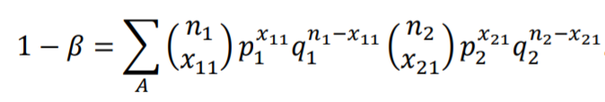
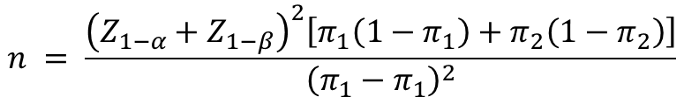
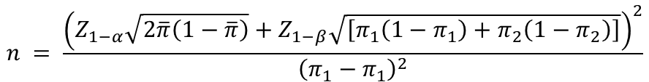
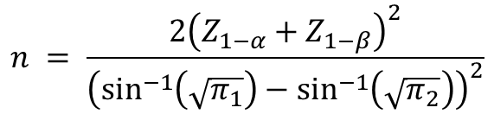
Sample Size for Proportions
Proportions (i.e. frequencies/categorical) one of the common endpoint in studies and trials
  Binary most common proportion “type”
Wide variety of different testing options available depending on specific study issues
  Different tests, parameterizations, adjustments, hypotheses
Sample size for proportions should follow the choices made for analysis
  Common approximations (z-test, arcsine) can be a useful starting point for sample size
  But methods tailored for specific methods available in software/libraries
$$n = \frac{{\left(Z_{1−α}+Z_{1−β}\right)}^{2}\left[π_{1}\left(1−π_{1}\right)+π_{2}\left(1−π_{2}\right)\right]}{{\left(π_{1}−π_{1}\right)}^{2}}$$
$$n = \frac{{\left(Z_{1−α}\sqrt{2\overline{π}\left(1−\overline{π}\right)}+Z_{1−β}\sqrt{\left[π_{1}\left(1−π_{1}\right)+π_{2}\left(1−π_{2}\right)\right]}\right)}^{2}}{{\left(π_{1}−π_{1}\right)}^{2}}$$
$$n = \frac{2{\left(Z_{1−α}+Z_{1−β}\right)}^{2}}{{\left(\sin^{−1}\left(\sqrt{π_{1}}\right)−\sin^{−1}\left(\sqrt{π_{2}}\right)\right)}^{2}}$$

Slide 9
Options for Proportions
What type of proportions data is being analyzed?
  1/2/>2 Groups, Stratified, Correlated/Paired, Stratified, Large Tables…
What type of hypothesis test is being proposed?
Inequality, Non-inferiority, equivalence, super superiority, interval
Which proportions test is most appropriate for data?
Chi-squared Tests, Exact Tests, Logistic Model, Likelihood Score Tests
Parameterizations, adjustments, approximations to use?
Difference/RR/OR, Continuity Correction, normal approximations

Slide 10
Two Proportions Tests
1 | Chi-Squared Tests | a.k.a. Z-test, CC, pooled/unpooled var.
2 | Exact Tests | Most Common: Fisher’s Test
3 | t-test | Replace values w/ 0/1 in usual t-test
4 | Conditional Mantel-Haenzel | Unstratified version of CMH test
5 | Likelihood Ratio Test | Subset of wider G-test for tables
6 | Wald Test | Common test from Logistic Regression
7 | Score Tests (NI/Equivalence) | Gart-Nam, Miettinen & Nurminen, F&M

Slide 11

Worked Example 1
“On the basis of published literature,11 we postulated that we would observe a clinically meaningful difference of 20 percentage points in the incidence of major complications between the open-procedure group (45%) and the hybrid-procedure group (25%). To show this between-group difference using a bilateral alpha type I error of 5%, at a power of 80% on the basis of the chi-square test, we calculated that the sample size for each group was 98. We anticipated losing a maximum of 4 patients to follow-up, and thus the estimated sample size for the trial was 200.”
Parameter | Value
Significance Level (Two-Sided) | 0.05
Control Complication Rate | 0.45
Hybrid Complication Rate | 0.25
n per Group | 98
Target Power (%) | 80%
Source: NEJM

Slide 12
Flexible Survival
Sample Size
Part 2

Slide 13
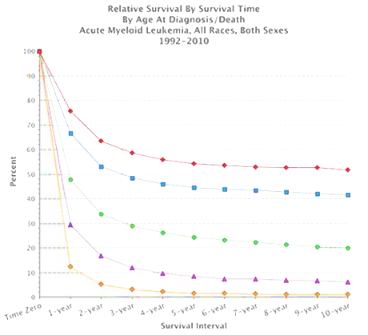
SSD for Survival Analysis
Survival analysis about the expected duration of time to event
  Methods like log-rank test & Cox Model
Power is related to the number of events NOT the sample size
  Sample Size = Subjects to get # of events
Flexibility expected in survival analysis methods and estimation
  Sample Size methods need to follow suit but can make mistakes more likely!
Source: SEER, NCI

Slide 14
Survival SSD Issues
What is the expected survival curve(s) in the group(s)?
  Assume parametric approximation? Which test appropriate?
Effect of unequal follow-up due to accrual period?
What accrual pattern to assume? Set max follow-up same for all?
How to deal with expected dropouts or censoring?
Simple loss to follow-up or integrate dropout process into model?
Effect of subjects crossing over from one group to other?
Account for at planning stage? How will analysis handle it?

Slide 15
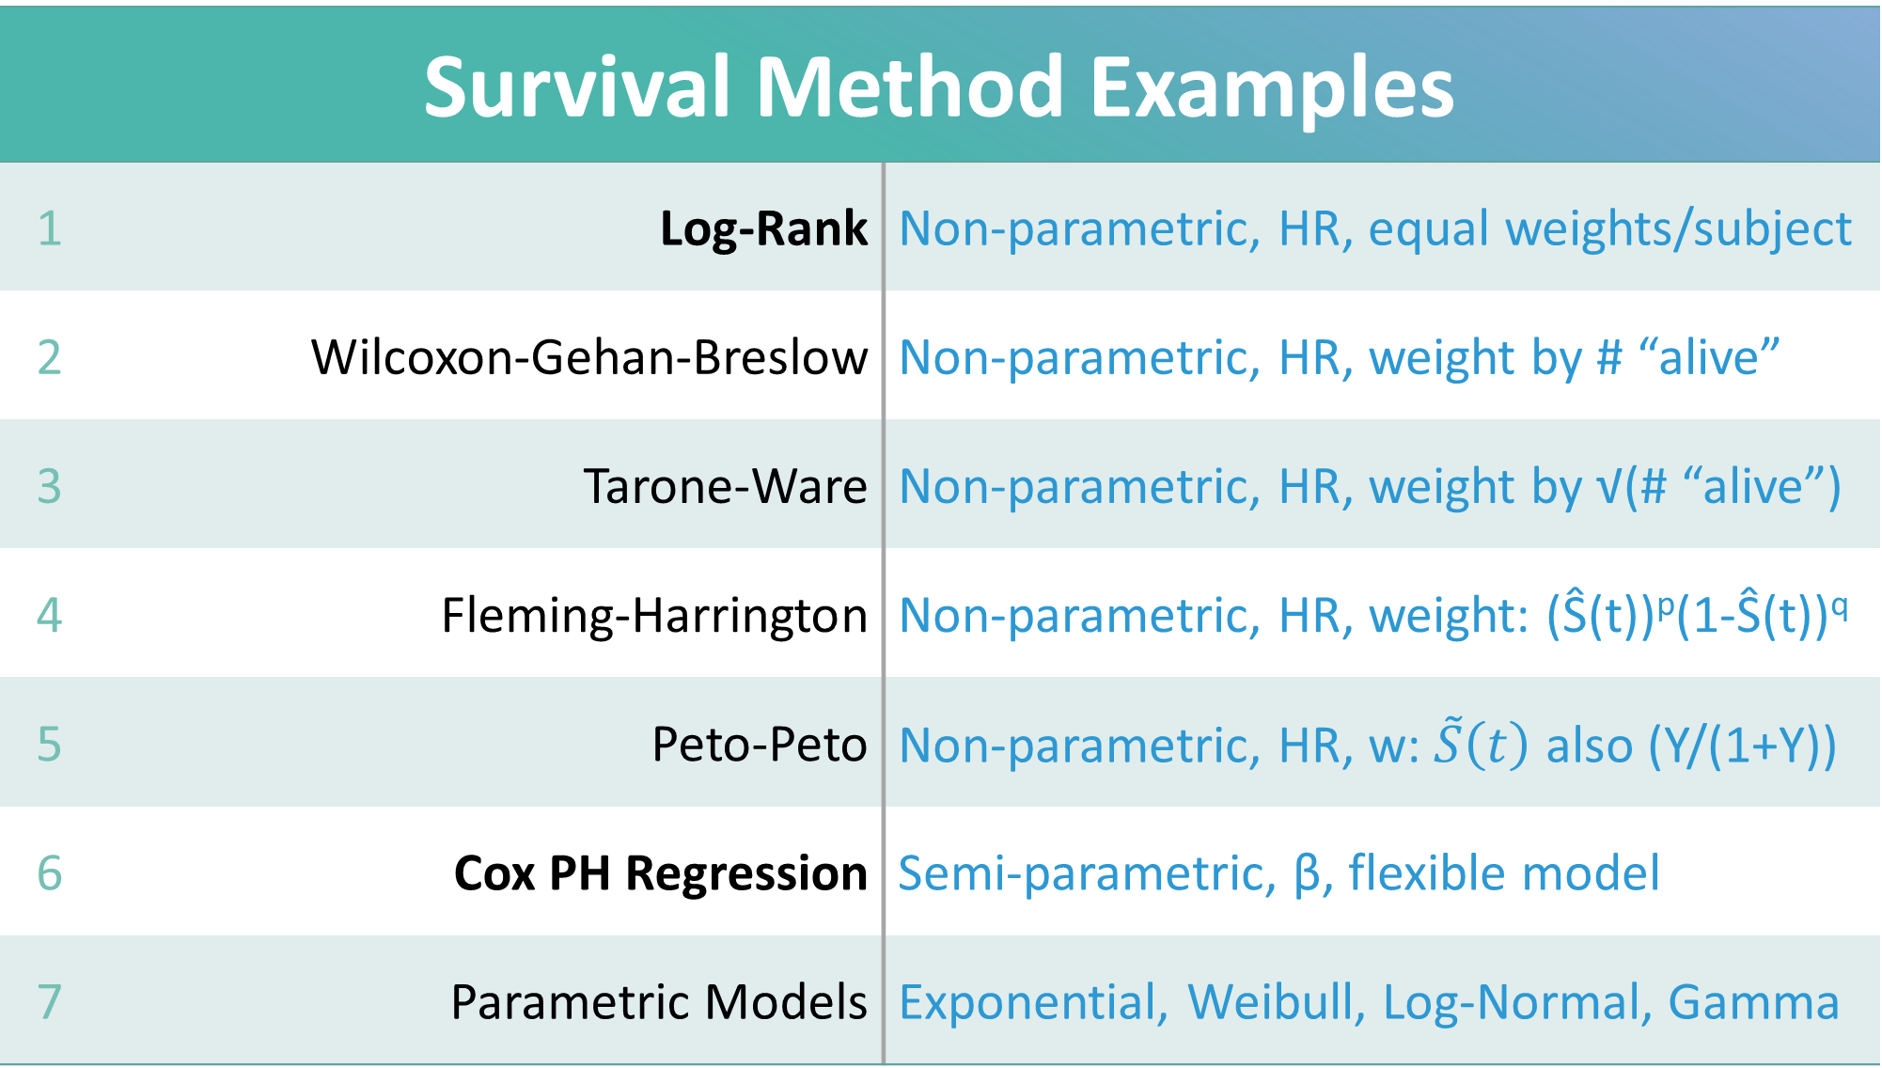
Survival Method Examples
1 | Log-Rank | Non-parametric, HR, equal weights/subject
2 | Wilcoxon-Gehan-Breslow | Non-parametric, HR, weight by # “alive”
3 | Tarone-Ware | Non-parametric, HR, weight by √(# “alive”)
4 | Fleming-Harrington | Non-parametric, HR, weight: (Ŝ(t))^{p}(1-Ŝ(t))^{q}
5 | Peto-Peto | Non-parametric, HR, w: $\tilde{S}\left(t\right)$ also (Y/(1+Y))
6 | Cox PH Regression | Semi-parametric, β, flexible model
7 | Parametric Models | Exponential, Weibull, Log-Normal, Gamma

Slide 16


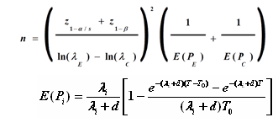


Evolution of Survival SSD
Move from simple approximations to more complex models
  Initial methods based on normal approx. for log-rank assuming exponential
  Later: Unequal follow-up and dropout
Complex methods (markov, simulation) allowed more flexibility
  Piece-wise curves, crossover etc.
SSD extensions for other survival models, trial designs & adaptive
  Cox, weighted, competing risks
  >2 Groups, 1 Group, CRT, CI, Adaptive
Source: L.S. Freedman (1982)
Source: D Schoenfeld (1981)
Source: J.M. Lachin & M.A Foulkes (1986)
Source: E Lakatos (1988)

Slide 17
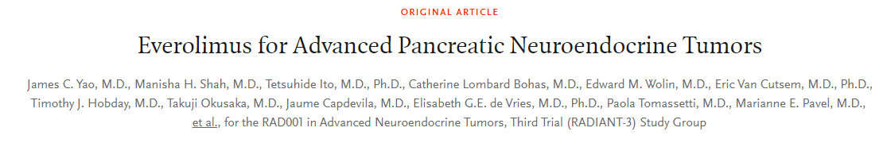
Worked Example 2
“Using an unstratified log-rank test at the one-sided 2.5% significance level, a total of 282 events would allow 92.6% power to demonstrate a 33% risk reduction (hazard ratio for RAD/placebo of about 0.67, as calculated from an anticipated 50% increase in median PFS, from 6 months in placebo arm to 9 months in the RAD001 arm).
With a uniform accrual of approximately 23 patients per month over 74 weeks and a minimum follow up of 39 weeks, a total of 352 patients would be required to obtain 282 PFS events, assuming an exponential progression-free survival distribution with a median of 6 months in the Placebo arm and of 9 months in RAD001 arm.
With an estimated 10% lost to follow up patients, a total sample size of 392 patients should be randomized.”
Parameter | Value
Significance Level (One-Sided) | 0.025
Placebo Median Survival (months) | 6
Everolimus Median Survival (months) | 9
Hazard Ratio | 0.66667
Accrual Period (Weeks) | 74
Minimum Follow-Up (Weeks) | 39
Power (%) | 92.6
“New” Delayed Duration (Months) | 6
Source: nejm.org
Source: NEJM (2011)

Slide 18
Non-Proportional Hazards Sample Size
Part 3

Slide 19
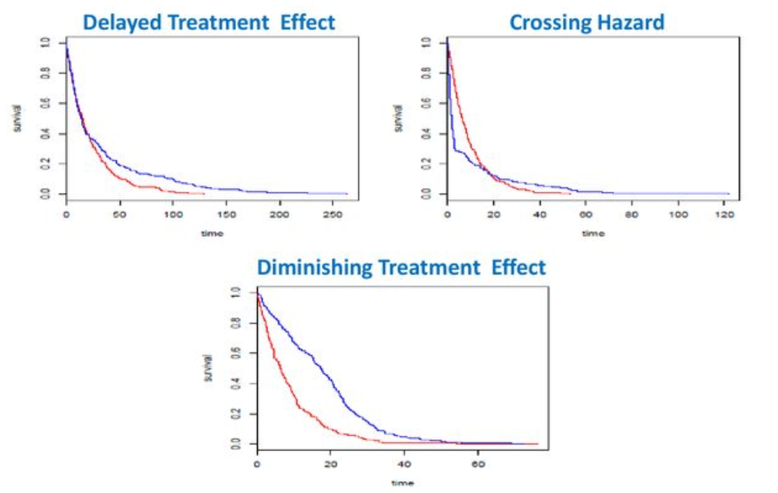
Non-proportional Hazards
Cox PH Model (& log-rank) rely on proportional hazards assumption
  Ignoring NPH may lead to wrong inference
Non-proportional hazards (NPH) occurs where non-constant effect size (HR)
  Increase/decrease over time, crossing, stratification, delayed effect, “responders”
  Very common issue in immunotherapies
Multiple methods proposed for analysing NPH data
  Models: Weighted Linear-Rank Test, Max-Combo, Piecewise Weighted Rank Test
  Model “Free”: Median Survival, RMST, KM
Source: Satrajit Roychoudhury

Slide 20
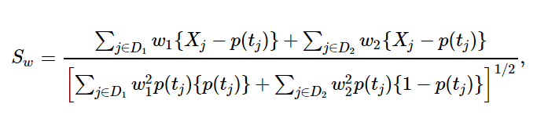
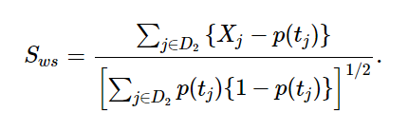
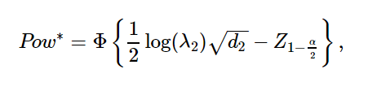
Piecewise Weighted Log-Rank Test
Piecewise Weighted Log-Rank Test proposed a model where NPH present
  Piecewise: Different HR per time period
  Weighted: Diff. weight per time period
Simple Delayed Effect Model: HR = 1 until time t, then constant HR onwards
  Weight = 0 before t, Weight = 1 post-t
  APPLE model as per Xu et al (2017)
Need strong assumption “delayed duration” (t) and baseline hazard
  Extension: Random time lag: APPLE+ method (Xu et al (2019))
Source: Xu et al (2017)

Slide 21
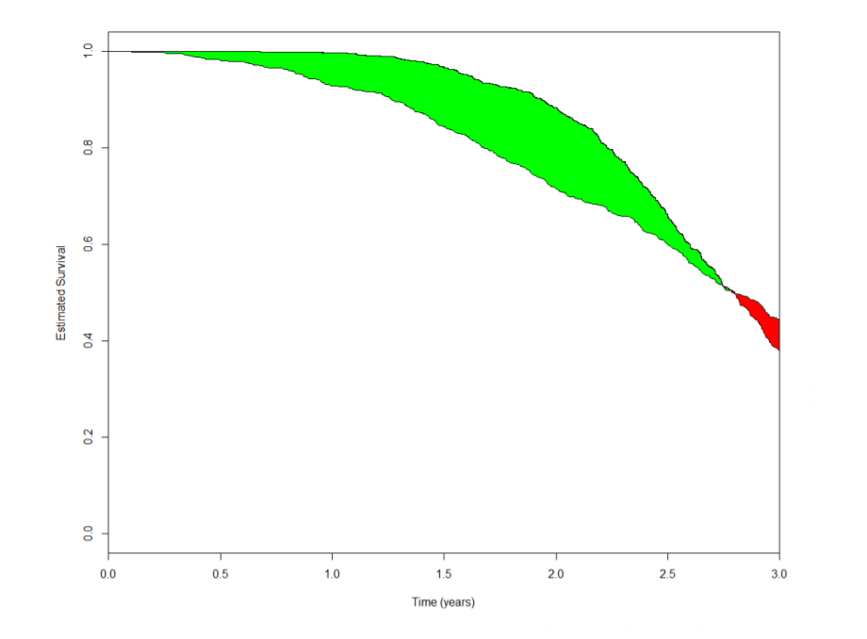
Restricted Mean Survival Time
RMST is the mean survival time under restricted time horizon, t*
  Equivalent to area under the K-M curve
  RMST diff = Area between K-M curve @ t*
RMST diff has two potential advantages
  Robust to non-proportional hazards
  Intuitive: Mean number of extra additional time units of survival up to t*
Sample size methods developing quickly with guidance on practical values
  Royston & Parmar (2013), Uno et. al. (2015), Eaton et. al. (2020)
Source: FDA/JSM (2017)

Slide 22
Worked Example 2 (cont.)
For weighted piecewise log-rank test, assume a study with expected results the same as the Everolimus study but assume no effect (HR=1) for first 6 months and after that desired hazard ratio (0.666…) occurs. Can then compare power for WPLRT vs log-rank.
For Restricted Mean Survival Time, assume Everolimus study with no “delay” with RMST assessed at 12 months.
Parameter | Value
Significance Level (One-Sided) | 0.025
Placebo Median Survival (months) | 6
Everolimus Median Survival (months) | 9
Hazard Ratio | 0.66667
Accrual Period (Weeks) | 74
Minimum Follow-Up (Weeks) | 39
Power (%) | 92.6
“New” Delayed Duration (Months) | 6
Source: nejm.org
Source: NEJM (2011)

Slide 23
Discussion and Conclusions
Sample Size problems will often have multiple options
  Rule of Thumb: Select method then select SSD method
Many tests and parameterizations available for proportions
  Select test based on study characteristics (small N, NI testing etc.)
Flexibility is important aspect of survival sample size
  But remember N is simply best estimate for “real” events target
Non-proportional hazards is area of growing interest
  Many methods being proposed (PWLRT, RMST etc.), SSD available

Slide 24
Thank You
Questions?
info@statsols.com
Further information at Statsols.com

Slide 25
Latest nQuery Release
The Spring 2021 (v8.7) release adds 28 new tables
to nQuery across multiple areas
Shedding Studies
GST + SSR
Phase II
Adaptive Designs
(Bryant & Day, Lin & Shih)
MAMS
Consensus Intervals, Bayes Factors
MCP-MOD
One, Paired, 2x2 X-over, 2 Proportions
NPH Survival Models
(RMST, APPLE+)

Slide 26

Statsols.com/trial

Slide 27




For video tutorials
and worked examples
Statsols.com/start

Slide 28
References (Proportions Options)
Fleiss, J.L., Levin, B. and Paik, M.C., 2013. Statistical methods for rates and proportions. John Wiley & Sons.
Lachin, J.M., 2009. Biostatistical methods: the assessment of relative risks. John Wiley & Sons.
Chow, S.C., Shao, J., Wang, H. and Lokhnygina, Y., 2017. Sample size calculations in clinical research. CRC press.
Machin, D., Campbell, M.J., Tan, S.B. and Tan, S.H., 2018. Sample sizes for clinical, laboratory and epidemiology studies. John Wiley & Sons.
Ryan, T.P., 2013. Sample size determination and power. John Wiley & Sons.
Cohen, J., 2013. Statistical power analysis for the behavioral sciences. Academic press.
D'agostino, R.B., Chase, W. and Belanger, A., 1988. The appropriateness of some common procedures for testing the equality of two independent binomial populations. The American Statistician, 42(3), pp.198-202.

Slide 29
References (Proportions Options)
Upton, G.J., 1982. A comparison of alternative tests for the 2 times 2 comparative trial. Journal of the Royal Statistical Society: Series A (General), 145(1), pp.86-105.
Miettinen, O. and Nurminen, M., 1985. Comparative analysis of two rates. Statistics in medicine, 4(2), pp.213-226.
Farrington, C.P. and Manning, G., 1990. Test statistics and sample size formulae for comparative binomial trials with null hypothesis of non‐zero risk difference or non‐unity relative risk. Statistics in medicine, 9(12), pp.1447-1454.
Gart, J.J. and Nam, J.M., 1990. Approximate interval estimation of the difference in binomial parameters: correction for skewness and extension to multiple tables. Biometrics, pp.637-643.
Mariette, C., Markar, S.R., Dabakuyo-Yonli, T.S., Meunier, B., Pezet, D., Collet, D., D’Journo, X.B., Brigand, C., Perniceni, T., Carrère, N. and Mabrut, J.Y., 2019. Hybrid minimally invasive esophagectomy for esophageal cancer. New England Journal of Medicine, 380(2), pp.152-162.

Slide 30
References (Flexible Survival)
Collett, D., 2015. Modelling survival data in medical research. CRC press.
Freedman, L. S. 1982. Tables of the number of patients required in clinical trials using the logrank test. Statistics in medicine, 1(2), 121-129.
Schoenfeld, D. A. 1983. Sample-size formula for the proportional-hazards regression model. Biometrics, 499-503.
Lachin, J. M., & Foulkes, M. A. 1986. Evaluation of sample size and power for analyses of survival with allowance for nonuniform patient entry, losses to follow-up, noncompliance, and stratification. Biometrics, 507-519.
Lakatos, E. 1988. Sample sizes based on the log-rank statistic in complex clinical trials. Biometrics, 229-241.
Yao, J. C., et. al. 2011. Everolimus for advanced pancreatic neuroendocrine tumors. New England Journal of Medicine, 364(6), 514-523.

Slide 31
References (NPH)
Yang, S and Prentice, R, 2010. Improved Logrank‐Type Tests for Survival Data Using Adaptive Weights, Biometrics 66: pp. 30‐38
Public Workshop: Oncology Clinical Trials in the Presence of Non‐Proportional Hazards, The Duke‐Margolis Center for Health Policy, Feb. 2018
Lin, R.S., Lin, J., Roychoudhury, S., Anderson, K.M., Hu, T., Huang, B., Leon, L.F., Liao, J.J., Liu, R., Luo, X. and Mukhopadhyay, P., 2020. Alternative Analysis Methods for Time to Event Endpoints Under Nonproportional Hazards: A Comparative Analysis. Statistics in Biopharmaceutical Research, 12(2), pp. 187-198.
Xu, Z., Zhen, B., Park, Y., & Zhu, B., 2017. Designing therapeutic cancer vaccine trials with delayed treatment effect, Statistics in medicine, 36(4), pp. 592-605
Xu, Z., Park, Y., Zhen, B. and Zhu, B., 2018. Designing cancer immunotherapy trials with random treatment time‐lag effect. Statistics in medicine, 37(30), pp. 4589-4609.
Xu, Z., Park, Y., Liu, K. and Zhu, B., 2020. Treating non-responders: pitfalls and implications for cancer immunotherapy trial design. Journal of hematology & oncology, 13(1), pp. 1-11.

Slide 32
References (NPH)
Kim, D.H., Uno, H. and Wei, L.J., 2017. Restricted mean survival time as a measure to interpret clinical trial results. JAMA cardiology, 2(11), pp.1179-1180.
Royston, P. and Parmar, M.K., 2013. Restricted mean survival time: an alternative to the hazard ratio for the design and analysis of randomized trials with a time-to-event outcome. BMC medical research methodology, 13(1), pp.1-15.
Uno, H., Claggett, B., Tian, L., Inoue, E., Gallo, P., Miyata, T., Schrag, D., Takeuchi, M., Uyama, Y., Zhao, L. and Skali, H., 2014. Moving beyond the hazard ratio in quantifying the between-group difference in survival analysis. Journal of clinical Oncology, 32(22), pp. 2380.
Uno, H., Wittes, J., Fu, H., Solomon, S., Claggett, B., Tian, L., Cai, T., Pfeffer, M., Evans, S. and Wei, L., 2015 Alternatives to Hazard Ratios for Comparing the Efficacy or Safety of Therapies in Noninferiority Studies, Annals of Internal Medicine, 163(2), p.127
Eaton, A., Therneau, T. and Le-Rademacher, J., 2020. Designing clinical trials with (restricted) mean survival time endpoint: Practical considerations. Clinical Trials, 17(3), pp.285-294.

Slide 33

The complete trial design platform to make clinical trials faster, less costly and more successful
The solution for optimizing clinical trials

