Slide 1
Crossover & Cluster Randomized Trials
Alternative Study Designs and Randomization Schemes
Demonstrated on
Notes:
www.Statsols.com/trial

Slide 2
Webinar host
Host
Paul Murphy
nQuery Research Statistician

Slide 3
AGENDA
1) Background
2) Crossover Trials
3) Cluster Randomized Trials
4) Discussion and Conclusions

Slide 4
The complete solution for optimizing your clinical trial designs
✓ CRM
✓ MCP-Mod
✓ Simon’s Two Stage
✓ Fleming’s GST
1000+ Scenarios for Fixed Term, Adaptive & Bayesian Methods
✓ Survival, Means, Proportions & Count endpoints
✓ Group Sequential Trials
✓ Bayesian: - Assurance
- Credible Intervals
- Posterior Error Approach
✓ Sample Size Re-Estimation
✓ Cross over & personalized medicine
✓ MAMS
✓ Prediction
EARLY PHASE
Animal Studies ANOVA / ANCOVA
PRE-CLINICAL RESEARCH
CONFIRMATORY
Cohort Study
Case-control Study
POST MARKETING

Slide 5
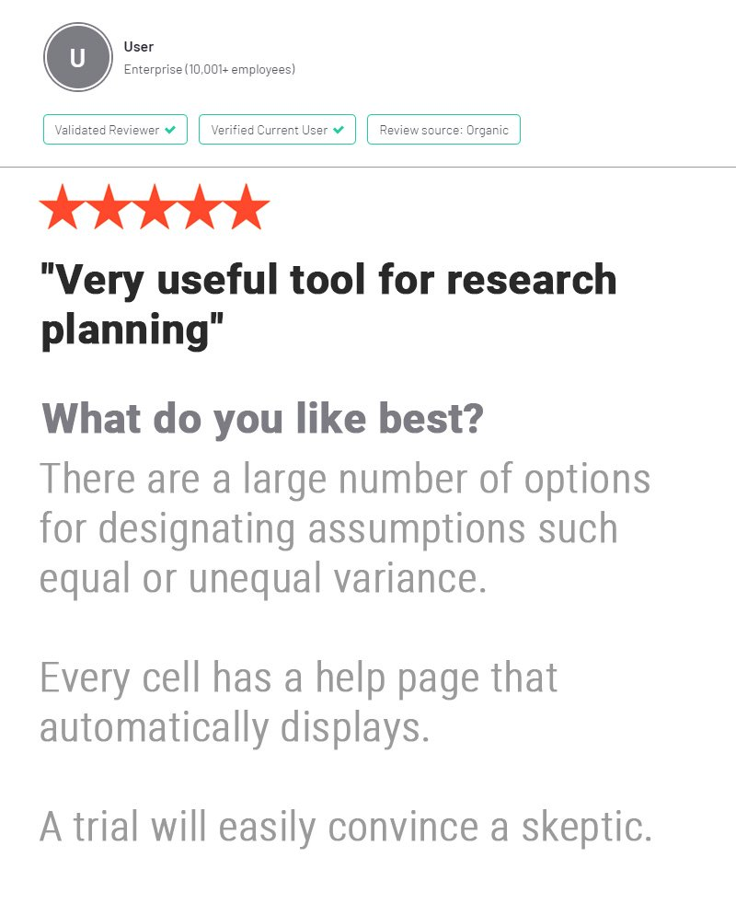
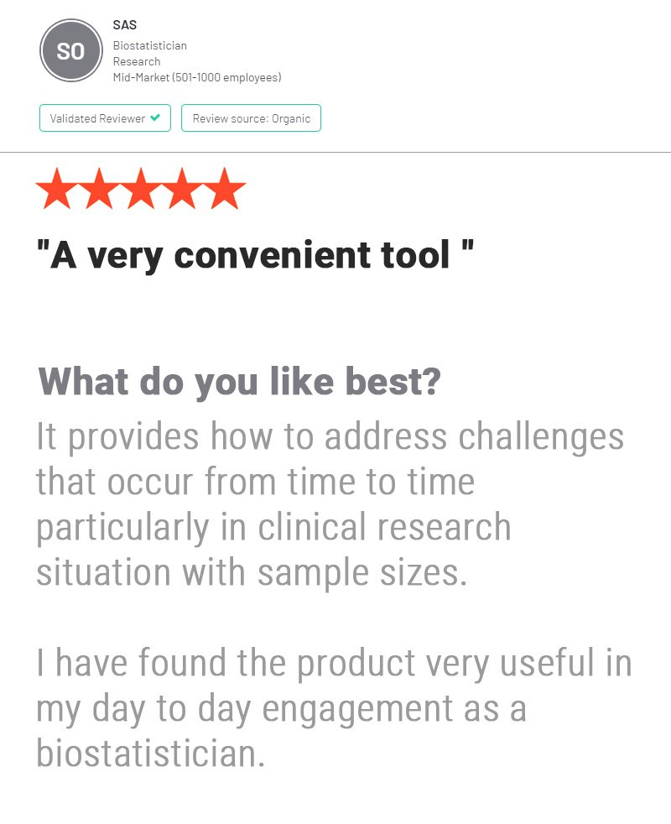
In 2020, 91% of organizations with clinical trials approved by the FDA used nQuery

Slide 6
Background
Part 1

Slide 7
Parallel Randomized Controlled Trials
Study design and statistical methodology must be considered early when planning any clinical trial.
Randomized controlled trials (RCTs) are often viewed as the gold standard for clinical trial design.
Parallel design with individual randomization is the most common type of RCT.
Individuals are randomized to study arms and each arm receives a different treatment/intervention.

Slide 8
Parallel RCT Advantages & Disadvantages
While parallel RCTs have many advantages, they also face some limitations that can be overcome with different trial designs.
Simplicity – Very common and well established designs.
Versatility – Can be used for most disease types.
Timeliness – Different groups can be administered and evaluated simultaneously.
Lower risk of bias and contamination
Lower power than other trial designs using the same sample size. (Between-subjects design)
Recruitment can be difficult – similar parallel populations required.
Short term effects can be missed.
Should not normally use a placebo
Advantages
Disadvantages

Slide 9
Crossover Trials
Part 2

Slide 10
Crossover Trial Design
Repeated measures design type.
Each subject receives more than one treatment.
Subjects “cross over” from one treatment to another at prespecified times during the course of the trial.
Each subject serves as their own control, helping to balance the covariates in the treatment and control arms
The order of the treatments is randomized.

Slide 11
2x2 Crossover Example
Treatment A
Washout
Period
Treatment B
Seq. 1
Enrolment
Randomization
Treatment B
Washout
Period
Treatment A
Seq. 2
Time Period 1
Time Period 2

Slide 12
Crossover Advantages & Disadvantages
Crossover designs offer many advantages over parallel designs. However, their use is not always appropriate.
Advantages
Reduces variation – treatments compared within subjects.hgjhjhjhjhjhjh
Each patient receives the new treatment.
Placebos can be used with less ethical concerns.
Decreased influence of confounding covariates.
Disadvantages
Only suitable for chronic, stable conditions. Treatment can’t have permanent effect.
Greater risk of bias & contamination.
Carryover effects may still be an issue even after a washout period.
Higher risk of dropout – longer follow-up time and more patient involvement.

Slide 13
Types of Crossover Trial
2x2 Crossover - AB vs BA
Williams Crossover Design – (2K x K for K odd, K x K for K even)
Compare K treatments
Constructed from Latin Squares.
e.g. 4x4 => ADBC vs BACD vs CBDA vs DCAB
Higher Order Crossover Designs
Balaam (4x2) – AA vs BB vs AB vs BA
Two Sequence Dual (2x3) – ABB vs BAA
Four Periods (2x4) – ABBA vs BAAB
Four Sequences & Periods (4x4) – AABB vs BBAA vs ABBA vs BAAB

Slide 14
2x2 Crossover Equivalence Example
Example 1
“The sample size for the study was determined with reference to the relevant, recent literature available on the pharmacokinetics of sildenafil, in particular the results of a study conducted after administration of two 25 mg capsules of Viagra film-coated tablets in a population of 12 male subjects. The highest coefficient of variance for the pharmacokinetic parameters Cmax and AUC was estimated to be 0.383 … Fixing the significance level α at 5% and the hypothesized test/reference mean ratio to 1, 50 subjects were considered sufficient to attain a power of 80% to correctly conclude the bioequivalence between the two formulations within the range 80.00%–125.00% for all parameters (Cmax and AUC).”
Parameter | Value
Significance Level | 0.05
Lower Equivalence Limit | 0.8
Upper Equivalence Limit | 1.25
Mean Ratio | 1
Coefficient of Variation | 0.383
Power (%) | 80
Source: Radicioni M et al (2016)

Slide 15
Williams Crossover Example
Example 2
“Area under the time – carotenoid concentration is assumed as main outcome for the sample size calculation. When there are … 3 treatments and a sample size of 4 in each of the 6 sequences, a 6x3 Williams Crossover inequality test of paired differences will have 96% power to detect a minimum difference of 4% of the area under time curve (AUC) (difference between 20% and 24% of AUC) or greater, assuming that the standard deviation of the paired differences is 4% at the 0.83% significance level. This leads to a total sample size of N=24 participants. In case of one drop-out per sequence (n=3 per sequence), the power will reduce to 83%, which will still provide sufficient statistical strength.”
Parameter | Value
Significance Level (Bonferroni-Adjusted) | 0.0083
Number of Treatments | 3
Min Expected Difference | 4
Standard Deviation of Differences | 4
Sample Size Per Sequence | 4
Source: Luxembourg Institute of Health (2019)

Slide 16
6x3 Williams Crossover Sequences
A
B
C
Seq. 1
B
C
A
Seq. 2
C
A
B
Seq. 3
C
B
A
Seq. 4
A
C
B
Seq. 5
B
A
C
Seq. 6

Slide 17
4x4 Williams Crossover Sequences
A
D
B
C
Seq. 1
B
A
C
D
Seq. 2
C
B
D
A
Seq. 3
D
C
A
B
Seq. 4

Slide 18
Cluster Randomized Trials
Part 3

Slide 19
Cluster Randomized Trial (CRT) Design
In a CRT, subjects are recruited in naturally forming groups called clusters. E.g. Clinics or hospital wards.
The clusters are then randomized to a treatment group (as opposed to the individuals).
Factors affecting power include the cluster size, the number of clusters and the intracluster correlation coefficient (ICC).

Slide 20
Intracluster Correlation Coefficient (ICC)
The ICC is a measures the level of clustering on a scale of 0 (no clustering) to 1 (complete clustering).
ICC (Continuous RV)
ICC $=\frac{σ_{Between}^{2}}{σ_{Between}^{2}+σ_{Within}^{2}}$
Complete Clustering
Usually ICC < 0.2. Typical values are between 0.01 and 0.05.
1 1 1 1
1 1 1 1
0 0 0 0
Previous similar trials or pilot studies are a good way of estimating the ICC.
No Clustering
1 0 1 1
1 0 1 1
1 0 1 1

Slide 21
CRT Advantages & Disadvantages
Larger Sample Size compared to individual randomization equivalent.
Higher risk of identification and recruitment bias.
Concern about baseline imbalances. e.g. if age is a prognostic factor and some clusters are older.
There are less units to randomize, increasing the odds of chance imbalances.
Advantages
Disadvantages
Can be the only option when the intervention targets units.
A good option when there is a high risk of contamination if the intervention would target individuals.
Simplifies the logistics of otherwise complicated trials.
Reduces research infrastructure

Slide 22
CRT Example
Example 3
“Our sample size was calculated to detect a difference in the percentage of residents prescribed ≥800 IU/daily vitamin D at follow-up in the intervention versus control groups. We assumed an average of 120 residents per LTC home and that 30% of residents were prescribed ≥800 IU/daily vitamin D at baseline. We postulate a 20% increase in vitamin D prescribing in the intervention group and a 5% increase in the control group… Based on these assumptions, to detect a 15% difference in prescribing between the groups with an intracluster correlation of 0.10 (two-sided test with significance = 0.05), a sample size of 2,160 residents from 18 LTC homes in each of the intervention and control groups is required to achieve 82% power.”
Parameter | Value
Significance Level (2-sided) | 0.05
Control Group Proportion | 0.35
Treatment Group Proportion | 0.5
ICC | 0.1
Average Sample Size Per Cluster | 120
Power | 82%
Source: Kennedy et al. Implementation Science (2012)

Slide 23
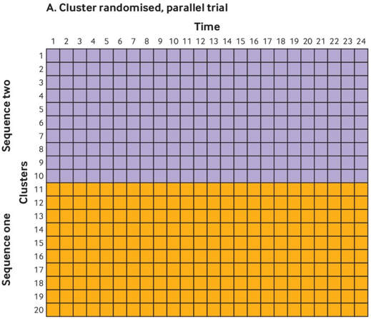
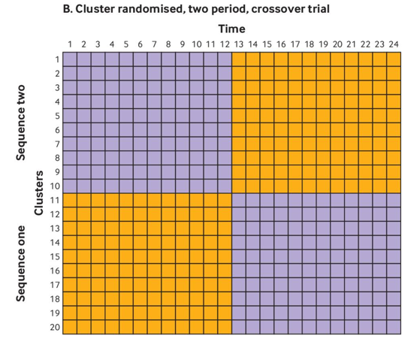
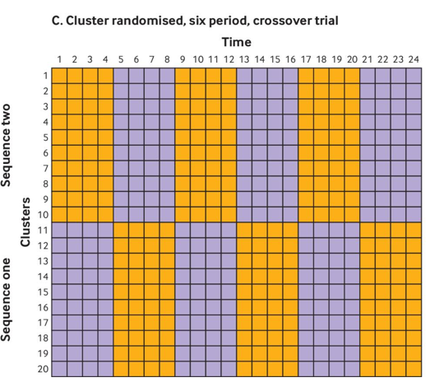
Cluster-Crossover Designs
Cluster randomization can be combined with the crossover design.
Increased randomization reduces the risk of chance imbalances.
Source: Hemming et. al (2020 ) Use of multiple period, cluster randomised, crossover trial designs for comparative effectiveness research.

Slide 24
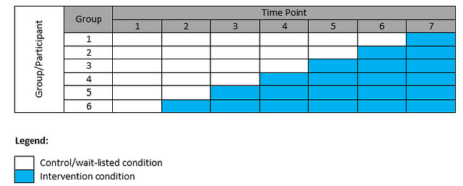
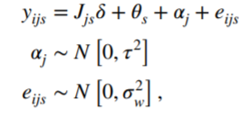
Stepped-Wedge Designs
RCT where subjects move from treatment to control over time in a randomized order.
1-way crossover, all control @ baseline
Useful for practical and statistical reasons, though some drawbacks
Uses: Treatment “scarcity”, patient recruitment, within-cluster analysis
Drawbacks: Allocation bias, expensive, complex analysis, treatment effect confounded with time effect.

Slide 25
Stepped-Wedge Example
Example 4
“We estimated that there would be approximately 12 births after 40 weeks gestation per week in each team. Birth data were collected for each team from 12 weeks prior to training until 12 weeks following training. Given this fixed sample size, we determined what difference in the primary outcome (proportion of women swept) would be detectable with 80% power. … We were guided by a review of estimates of ICCs which found that their values are typically in the range of 0.02–0.1. A small audit suggested … 32% of nulliparous women and 57% of multiparous women were currently being swept. … It was estimated that at 5% significance (two-tailed) and 80% power, for ICCs in the range of 0.02–0.1 and for baseline event rates of 20–60%, the study would have power to detect around a 10% absolute increase in proportion of women being swept. This was an increase felt to be clinically worthwhile.”
Parameter | Value
Significance Level (Two-Sided) | 0.05
Time Measurements (Weeks) | 12
Number of Clusters | 10
Measurements Per Cluster per Time | 12
ICC | 0.02 – 0.1
Baseline Proportion | 0.2-0.6
Power (%) | 80
Source: Trials (2017)

Slide 26
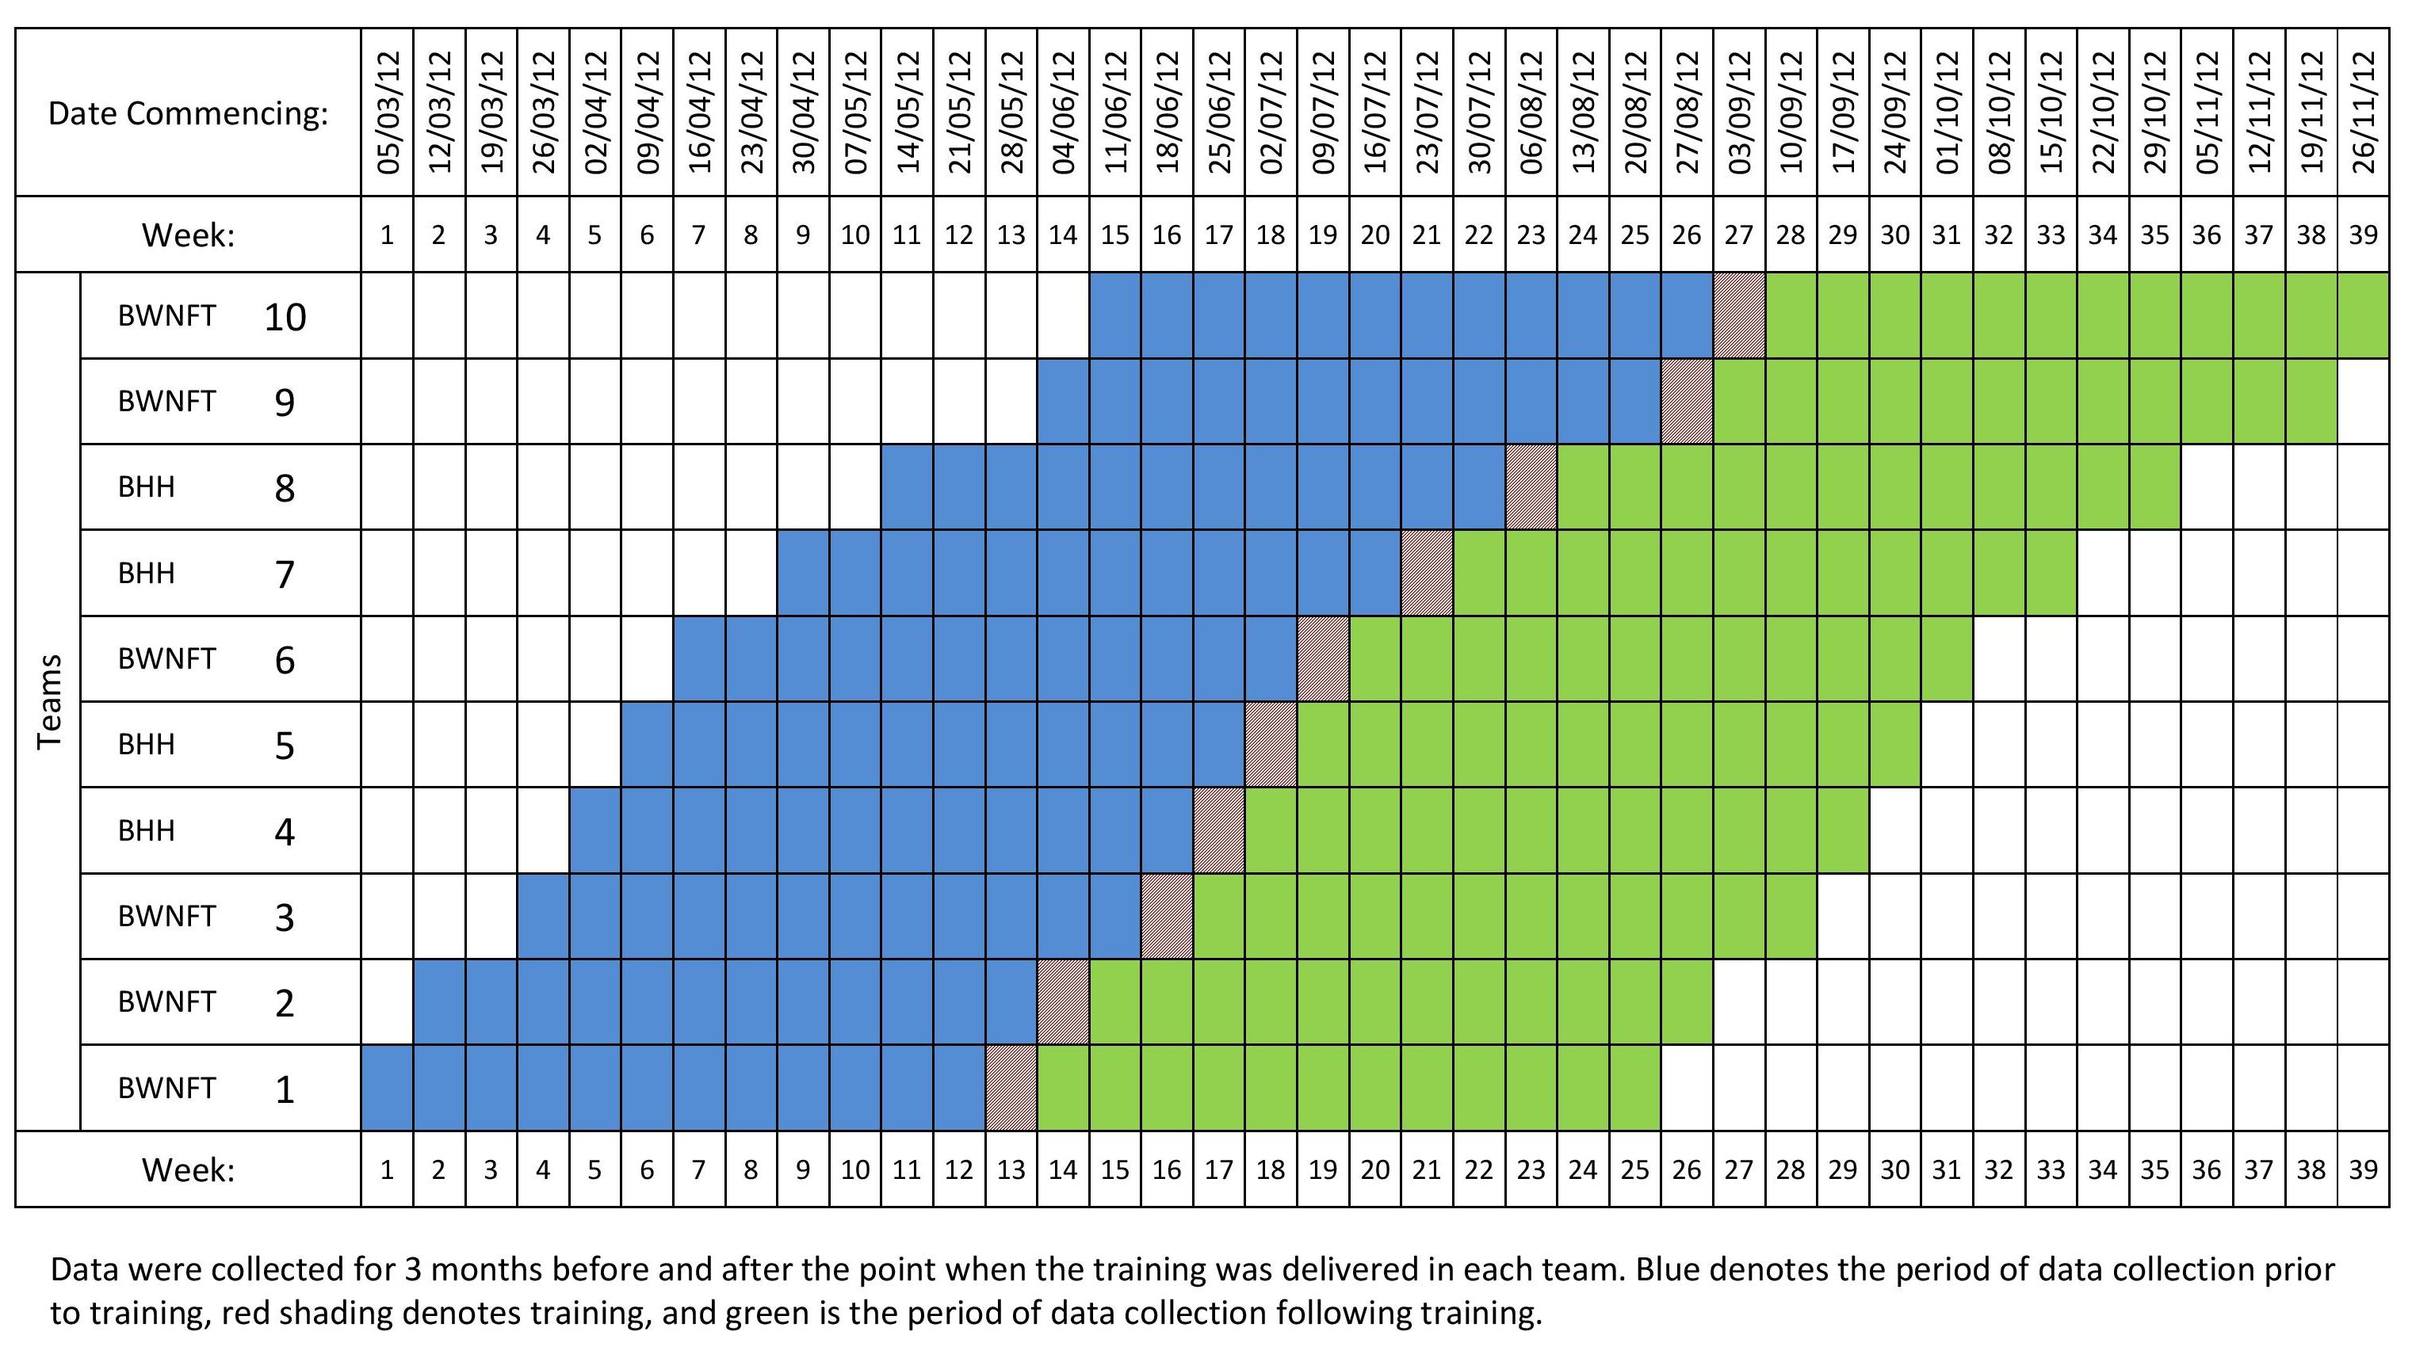

Slide 27
Discussion and Conclusions
Part 4

Slide 28
Discussion and Conclusions
Parallel designs with individual randomization are the most common type of RCT. However, sometimes other designs should be considered for reasons efficiency or logistics.
Crossover designs enable each subject to act as their own control and require smaller sample sizes than parallel designs.
Cluster randomized trials (CRTs) randomize groups instead of individuals and can help facilitate an otherwise unfeasible intervention rollout.
CRTs can also incorporate crossover characteristics, either in one way (Stepped-Wedge) or both directions (Cluster-Crossover).

Slide 29
Statsols.com/trial

Slide 30
Thank You
Questions?
info@statsols.com
Further information at Statsols.com

Slide 31
References (Crossover Trials)
Chow, S.C, & Liu, J.P. (1992). Design and Analysis of Bioavailability and Bioequivalence Studies. Marcel Dekker.
Chen, K. W., Chow, S. C. & Li, G. (1997). A Note on Sample Size Determination for Bioequivalence Studies with Higher-order Crossover Designs. Journal of Pharmacokinetics and Biopharmaceutics, 25(6), 753-765.
Radicioni M, Castiglioni C, Giori A, Cupone I, Frangione V, Rovati S. (2017) Bioequivalence study of a new sildenafil 100 mg orodispersible film compared to the conventional film-coated 100 mg tablet administered to healthy male volunteers. Drug Des Devel Ther. 2017;11:1183-1192. Published 2017 Apr 11. doi:10.2147/DDDT.S124034
Corte-Real J, Guignard C, Gantenbein M, Weber B, Burgard K, Hoffmann L, Richling E, Bohn T. No influence of supplemental dietary calcium intake on the bioavailability of spinach carotenoids in humans. Br J Nutr. 2017 Jun;117(11):1560-1569. doi: 10.1017/S0007114517001532. Epub 2017 Jun 27. PMID: 28651681.

Slide 32
References (Cluster Randomized Trials)
Kennedy, C.C., Ioannidis, G., Giangregorio, L.M. et al. An interdisciplinary knowledge translation intervention in long-term care: Study protocol for the vitamin D and osteoporosis study (ViDOS) pilot cluster randomized controlled trial. Implementation Sci 7, 48 (2012). https://doi.org/10.1186/1748-5908-7-48
Hemming K, Taljaard M, Weijer C, Forbes AB. Use of multiple period, cluster randomised, crossover trial designs for comparative effectiveness research. BMJ. 2020 Nov 4;371:m3800. doi: 10.1136/bmj.m3800. PMID: 33148538.
Hemming K, Haines TP, Chilton PJ, Girling AJ, Lilford RJ. The stepped wedge cluster randomised trial: rationale, design, analysis, and reporting. BMJ. 2015 Feb 6;350:h391. doi: 10.1136/bmj.h391. PMID: 25662947.
Kenyon, S., Dann, S., Hope, L. et al. Evaluation of a bespoke training to increase uptake by midwifery teams of NICE Guidance for membrane sweeping to reduce induction of labour: a stepped wedge cluster randomised design. Trials 18, 357 (2017). https://doi.org/10.1186/s13063-017-2106-1

