Slide 1

Design Considerations for Bioequivalence Studies
Cross-over Design Choices, Boundary Selection and Determining Sample Size
July 2025

Slide 2


Denis Desmond
Research Statistician

Slide 3
Agenda
01
Introduction to Bioequivalence
02
Overview of Crossover Designs
03
Crossover Trials in nQuery
04
Discussion & Conclusion
Questions welcome throughout

Slide 4

The complete solution for optimizing your clinical trial designs
Pre-clinical research
Animal studies
ANOVA / ANCOVA
Confirmatory
1000+ Scenarios for Fixed term, Adaptive & Bayesian Methods
Survival, Means, Proportions & Count endpoints
Group Sequential Trials
Bayesian:
                Assurance
  Credible Intervals
  Posterior Error Approach
Sample Size Re-Estimation
Cross over & personalized medicine
MAMS
Prediction
Early Phase
CRM
MCP-Mod
Simon’s Two Stage
Flemings GST
Post Marketing
Cohort Study
Case-control Study

Slide 5
nQuery Licensing nQuery operates on a tiered licensing model
BASE
PLUS
PRO
EXPERT
Sample size and power for fixed terms trials over 100’s of designs,
endpoints and hypothesis types.
Sample size for fully Bayesian (e.g. credible intervals)
+ Hybrid Bayes/Frequentist methods and designs (e.g. Assurance)
Sample size and power for range of early stage and confirmatory clinical trial
Adaptive Designs and tools for monitoring and adjustment in-trial
Additional tools for study design and monitoring.
Focus currently on milestone prediction for enrollment and (survival) event targets
Click Here to see our Package Comparison Tool

Slide 6
Introduction to Bioequivalence
Part 1

Slide 7
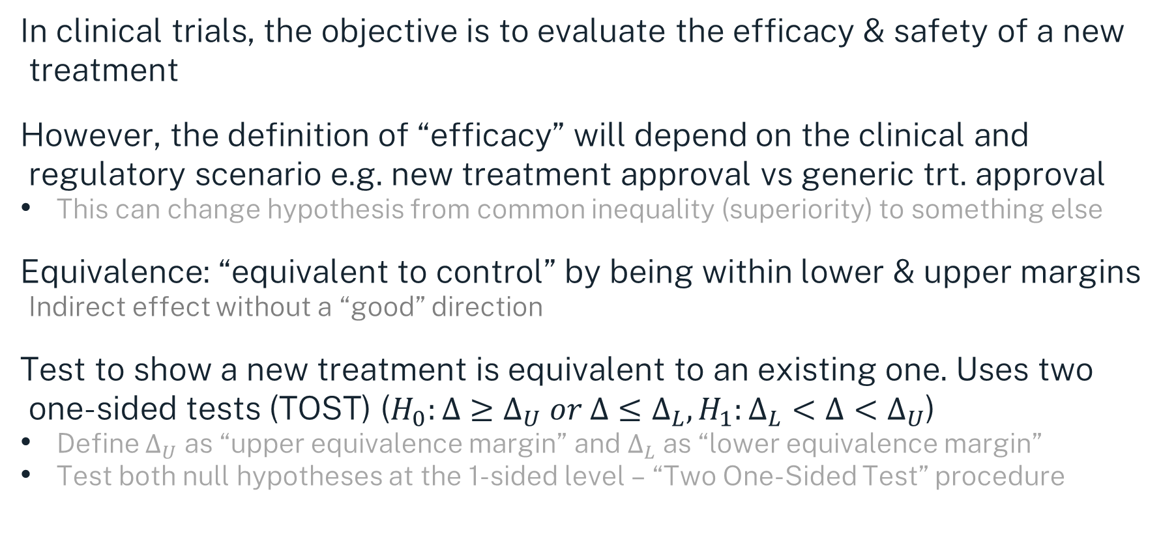
Introduction
In clinical trials, the objective is to evaluate the efficacy & safety of a new treatment
However, the definition of “efficacy” will depend on the clinical and regulatory scenario e.g. new treatment approval vs generic trt. approval
This can change hypothesis from common inequality (superiority) to something else
Equivalence: “equivalent to control” by being within lower & upper margins
Indirect effect without a “good” direction
Test to show a new treatment is equivalent to an existing one. Uses two one-sided tests (TOST) ($H_{0}:Δ≥Δ_{U} or Δ≤Δ_{L}, H_{1}:Δ_{L}<Δ<Δ_{U}$)
Define $Δ_{U}$ as “upper equivalence margin” and $Δ_{L}$ as “lower equivalence margin”
Test both null hypotheses at the 1-sided level – “Two One-Sided Test” procedure

Slide 8
Bioequivalence: Part One
Def^{n}: Two drug products containing the same drug(s) are considered bioequivalent (BE) if their relative bioavailability (BA) (rate and extent of drug absorption) after administration in the same molar dose lies within acceptable predefined limits. (ICH, 2024)
Two main uses of BE studies: (i) generic drug development (alternative to innovator drug), (ii) formulation changes (new formula of innovator drug)
Bioequivalence is a surrogate for safety & efficacy (therapeutic equivalence), and in most cases BE studies are carried out in healthy volunteers
Goal of a successful BE study is to reduce the time & cost of running a whole new clinical trial to make the drug more affordable for the patients

Slide 9
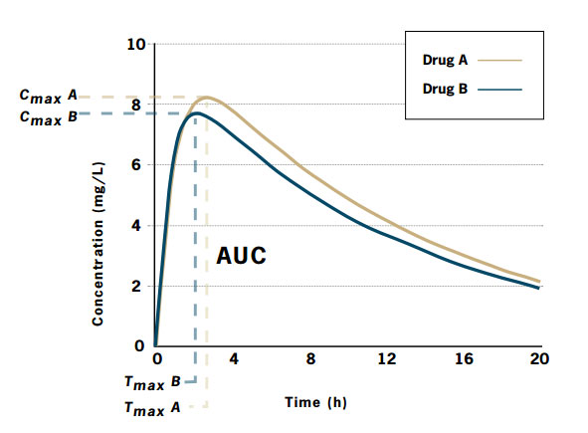
Bioequivalence : Part Two
There are a number of approaches for demonstrating BE: (i) pharmacokinetic (PK) measures, (ii) pharmacodynamic (PD) measures, (iii) comparative clinical trials, (iv) in vitro studies
PK measures: Area Under the Curve (AUC), maximum concentration (C_{max}), time at maximum concentration (T_{max})
There are also different criteria for assessing BE
In vivo {average (ABE), population (PBE), individual (IBE)}, in vitro
Margins for BE typically set by regulator, e.g. 0.8 - 1.25 for GMR. Otherwise, equivalence margins based on expertise or variance
Margin may need to be “scaled” upwards for highly variable drugs (HVD): CV > 30%
Conversely, margin may need to be “scaled” down for narrow therapeutic index drugs
Source: Best Practice Journal, 2007

Slide 10
Crossover Designs
Part 2

Slide 11
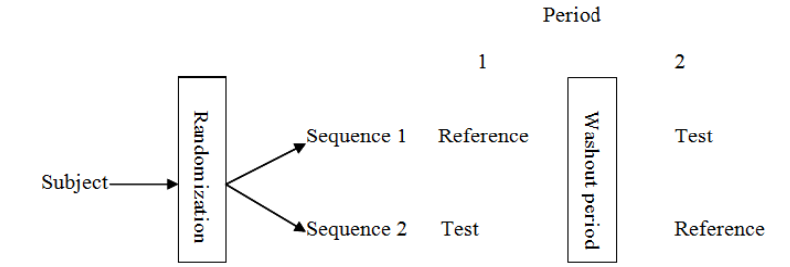
Introduction
A crossover trial is one in which subjects are given sequences of treatments with the object of studying differences between individual treatments (Senn)
Each subject serves as their own control, allowing within-subject comparisons
Most commonly used crossover design is the two sequence, two period (2x2)
Crossover designs often used for on-going or chronic conditions, as well as bioequivalence studies
Source: Fenta, 2014

Slide 12
Crossover Designs: Advantages & Disadvantages
Advantages
Disadvantages
Reduction in variation – treatment compared within subjects
Usually gain efficiency in sample size compared to similar parallel design
Each patient receives new treatment, less ethical concerns using placebos
Not suitable for instable conditions, or treatments with permanent effects
Carryover effects may still be a problem, even with a washout period
Higher risk of dropout (longer follow-up time, more patient involvement) which leads to additional complexity

Slide 13
Higher-Order Crossover Designs
Higher-order designs are those that have greater than two sequences or greater than two periods (or both). Notation: treatment x sequence x period
One aim of using higher-order designs is minimise the impact of carryover effects by obtaining an independent estimate for intra-subject variabilities
Also appropriate for assessing individual BE, fed vs. fasted, and testing HVD & NTID
Common higher-order designs for two treatments are 2x4x2 (Balaam’s design), 2x2x3 (dual balanced design), 2x2x4, 2x4x4
Latin Square designs are common design for >2 treatments, every treatment has the same frequency in each period (e.g. ABC | BCA | CAB)
Williams Squares are a subset of Latin Squares where each treatment follows every other treatment the same number of times (e.g. ABCD | BDAC | CADB | DCBA)

Slide 14
Crossover Trials in nQuery
Part 3

Slide 15
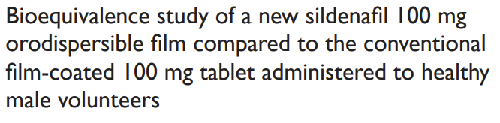
Bioequivalence Study | Example 1
“This bioequivalence study was a single-center, single-dose, randomized, open, two-way crossover study performed between the sildenafil 100 mg orodispersible film (IBSA, test) and the marketed Viagra 100 mg film-coated tablet (Pfizer, reference).
The highest coefficient of variance for the pharmacokinetic parameters Cmax and AUC was estimated to be 0.383… Fixing the significance level α at 5% and the hypothesized test/reference mean ratio to 1, 50 subjects were considered sufficient to attain a power of 80% to correctly conclude the bioequivalence between the two formulations within the range 80.00%–125.00% for all parameters (Cmax and AUC).”
Source: Radicioni, et al. (2017)
Parameter | Value
Significance Level | 0.05
Lower Equivalence Limit | 0.80
Upper Equivalence Limit | 1.25
Expected True Mean Ratio | 1
Coefficient of Variation | 0.383
Sample Size | 50
Power (%) | 80%

Slide 16
Bioequivalence Study | Example 2
Source: bebac.at
“We assume a CV of 0.25, a T/R-ratio of 0.95, and target a power of 0.80 in a 6-sequence 3-period Williams’ design.
As usual in BE, alpha = 0.05 is employed (we will assess the study by a 100(1−2α)=90%
confidence interval). The BE-limits are theta1 = 0.80 and theta2 = 1.25.”
Parameter | Value
Significance Level | 0.05
Lower Equivalence Limit | 0.80
Upper Equivalence Limit | 1.25
Expected True Mean Ratio | 0.95
Coefficient of Variation | 0.25
Sample Size | 30
Target power (%) | 80%

Slide 17
Bioequivalence Study | Example 3
Source: bebac.at
We assume a 2-sequence 4-period replicate design for the assessment of a NTID with a CV of 0.125, a T/R-ratio of 0.95, and target a power of 0.80.
As usual in BE, alpha = 0.05 is employed (we will assess the study by a 100(1−2α)=90%
confidence interval). The BE-limits are theta1 = 0.90 and theta2 = 1.1111.
Parameter | Value
Significance Level | 0.05
Lower Equivalence Limit | 0.90
Upper Equivalence Limit | 1.1111
Expected True Mean Ratio | 0.95
Coefficient of Variation | 0.125
Sample Size | 34
Target power (%) | 80%

Slide 18
Discussions
BE studies are those which aim to demonstrate equivalence with respect to bioavailability as a surrogate for therapeutic equivalence
BE studies are crucial in the fields of generic medicines and are most commonly carried out using a crossover design (often 2x2)
Crossover designs offer many benefits for BE studies, such as reduced variability & sample size efficiencies compared to similar parallel design
Higher-order crossover designs can be very useful if carry-over is a concern even with the included washout periods

Slide 19


Statsols.com/nquery-demo

Slide 20
Thank you
CONTACT US
info@statsols.com
MORE INFO
statsols.com

Slide 21
References (Bioequivalence)
Chow, S., & Liu, J. (2008). Design and Analysis of Bioavailability and Bioequivalence Studies, third edition. Chapman and Hall/CRC.
Hauschke, D., Steinijans, V., & Pigeot, I. (2007). Bioequivalence studies in drug development: Methods and Applications. Wiley.
Niazi, S. K. (2007). Handbook of Bioequivalence Testing. CRC Press.
Schütz, H. A short history of bioequivalence. https://bebac.at/articles/A-Short-History-of-Bioequivalence.phtml#Introduction
Schütz, H. Sample size estimation for equivalence studies in a replicate design. https://bebac.at/articles/Sample-Size-Estimation-for-Equivalence-Studies-in-a-Replicate-Design.phtml
Food and Drug Administration (FDA), Center for Drug Evaluation and Research (CDER) Bioequivalence Studies With Pharmacokinetic Endpoints for Drugs Submitted Under an ANDA Guidance for Industry. fda.gov. https://www.fda.gov/media/87219/download
Research, C. F. D. E. A. Helpful Webinars and Other Resources for Generic Drug Manufacturers. U.S. Food And Drug Administration. https://www.fda.gov/drugs/abbreviated-new-drug-application-anda/helpful-webinars-and-other-resources-generic-drug-manufacturers
European Medicines Agency, Guideline on the Investigation of Bioequivalence. https://www.ema.europa.eu/en/documents/scientific-guideline/guideline-investigation-bioequivalence-rev1_en.pdf
International Council for Harmonisation of Technical Requirements for Pharmaceuticals for Human Use, Bioequivalence for Immediate Release Solid Oral Dosage Forms M13A, https://database.ich.org/sites/default/files/ICH_M13A_Step4_Final_Guideline_2024_0723.pdf
Chow, S. (2014). Bioavailability and bioequivalence in drug development. Wiley Interdisciplinary Reviews Computational Statistics, 6(4), 304–312. https://doi.org/10.1002/wics.1310
Open Resources for Nursing (Open RN); Ernstmeyer K, Christman E, editors. Nursing Pharmacology [Internet]. 2nd edition. Eau Claire (WI): Chippewa Valley Technical College; 2023. Chapter 1 Pharmacokinetics & Pharmacodynamics. Available from: https://www.ncbi.nlm.nih.gov/books/NBK595006/
Saville, D. Bioequivalence - BPJ SE March 2007. https://bpac.org.nz/bpj/2007/march/bioequiv.aspx

Slide 22
References (Crossover Designs)
Chow, S., Shao, J., & Wang, H. (2007). Sample size calculations in clinical research. Chapman and Hall/CRC.
Senn, S. S. (1993). Cross-over trials in clinical research. Wiley.
Jones, B., & Kenward, M. G. (1989). Design and analysis of Cross-Over Trials. Chapman and Hall/CRC.
Schütz, H. Sample size estimation for equivalence studies in Higher-Order Crossover Designs. https://bebac.at/articles/Sample-Size-Estimation-for-Equivalence-Studies-in-Higher-Order-Crossover-Designs.phtml
Fenta, H. M. (2014). Determination of Sample Size for Two Stage Sequential Designs in Bioequivalence Studies under 2x2 Crossover Design. Science Journal of Clinical Medicine, 3(5), 82. https://doi.org/10.11648/j.sjcm.20140305.12
Radicioni, M., Castiglioni, C., Giori, A., Cupone, I., Frangione, V., & Rovati, S. (2017). Bioequivalence study of a new sildenafil 100 mg orodispersible film compared to the conventional film-coated 100 mg tablet administered to healthy male volunteers. Drug Design Development and Therapy, Volume11, 1183–1192. https://doi.org/10.2147/dddt.s124034
Comprehensive R Archive Network (CRAN). Power and Sample Size for (Bio)Equivalence Studies [R package PowerTOST version 1.5-6]. https://cran.r-project.org/package=PowerTOST
Owen, D. B. (1965). A special case of a bivariate Non-Central T-Distribution. Biometrika, 52(3/4), 437. https://doi.org/10.2307/2333696

