Slide 1

Design Considerations for Cluster Randomized Trials
Power and sample size for two-level, three-level and stepped-wedge designs

Slide 2


Ronan Fitzpatrick
Head of Statistics

Slide 3
Agenda
01
Cluster Randomization Overview
02
Types of Cluster Randomization
03
Powering Cluster Randomized Trials
04
Conclusions & Discussion
Questions welcome throughout

Slide 4


Pre-clinical research
Animal studies
ANOVA / ANCOVA
Pilot Studies
Confirmatory
1000+ Scenarios for Fixed term,
Adaptive & Bayesian Methods
Survival, Means, Proportions & Count endpoints
Group Sequential Trials
Bayesian:
                Assurance
  Credible Intervals
  Posterior Error Approach
Sample Size Re-Estimation
Cross over & personalized medicine
MAMS
Prediction
Early Phase
CRM
MCP-Mod
Simon’s Two Stage
Flemings GST
The complete solution
for optimizing your
clinical trial designs
Post Marketing
Cohort Study
Case-control Study

Slide 5
nQuery Licensing nQuery operates on a tiered licensing model
BASE
PLUS
PRO
EXPERT
Sample size and power for fixed terms trials
100’s of designs,
endpoints and hypothesis types
Sample size for fully Bayesian (e.g. credible intervals)
+ Hybrid Bayes/Frequentist methods and designs (e.g. Assurance)
Sample size and power for early stage and confirmatory clinical trial
Adaptive Designs and tools for monitoring and adjustment in-trial
Additional tools for study design and monitoring
Incl milestone prediction for enrollment and (survival) event targets
Click Here to see our Package Comparison Tool

Slide 6
Cluster Randomized
Trials Overview
Part 1

Slide 7
Trial Randomization Introduction
Randomization is vital in clinical trials to ensure causal inferential validity
Converts complexity into explainable error that is accounted for by the trial design
Most common randomization scheme in trials is individual randomization where each subject is randomly assigned to a given study group
Practically, assignment often done via block randomization rather than full randomization
Cluster Randomization is a common alternative where randomization is at the level of a cluster (e.g. hospital, school) rather than individual
Choice of randomization scheme will often follow from logistical or statistical concerns
This webinar will focus on what cluster randomization is, why it is used, different types of cluster randomization and the effect of cluster randomization on sample size determination and power calculations

Slide 8
Cluster Randomization Overview
Cluster Randomization is a common alternative where randomization is at the level of a cluster (e.g. hospital, school) rather than individual
e.g. every patient in a hospital is given the random treatment assigned to that hospital
Can reduce trial costs and logistical complexity (especially in larger trials), prevent treatment contamination and provide cluster-level inferences
Individual randomization may not be possible e.g. pragmatic trials, classroom interventions
But will require more complex inference (mixed model, GEE), provide lower power (within-cluster similarly) and open to bias (recruitment, imbalance)
Need appropriate design + strategy to maintain valid randomization (+ blinding if assumed)
Cluster Randomization can be applied to wide variety of trials with differing endpoints, trial designs and number of hierarchal structures
Wide variety of cluster randomization types for differing trial objectives and designs

Slide 9
Types of Cluster
Randomization
Part 2

Slide 10
Cluster Randomization Types
Parallel CRT | All subjects in each cluster are randomly assigned to given treatment group Commonly are two-arm trials but factorial randomization also possible May have to choose from multiple levels (e.g. hospital>ward>patient)
Matched Pair CRT | Match clusters into self-similar pairs and assign randomly within each pair If matching is strong (correlation > 0.3) then increases efficiency vs parallel or stratified cluster randomization – requires good prognostic covariates
Stepped-Wedge CRT | Complete SW = all clusters start on control then 1 cluster moves at each step cluster(s) until clusters in treatment group. Variants: batch, staircase, run-in Get within-cluster effects, allows staggered roll-out, everyone get treatment Higher model complexity (time-varying), increased time/cost/dropout risk
Cross-over CRT | Clusters receive different treatments over time in specified trt sequences Cluster is own control: more efficient as accounts for within-cluster variation Need to account for period effects, increases cost of cluster attrition and usually requires time for (and assumption of) of treatment “washout”

Slide 11
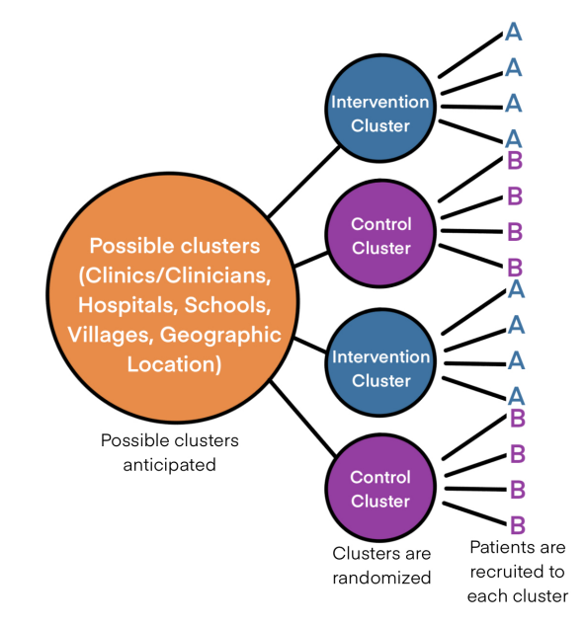
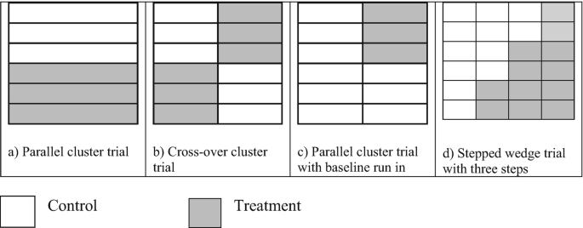
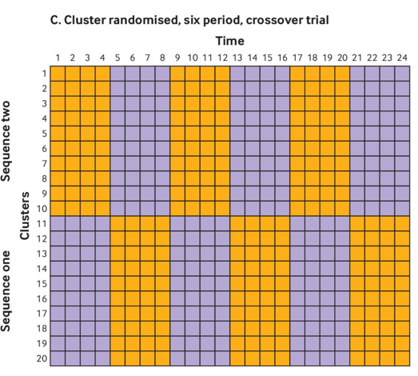
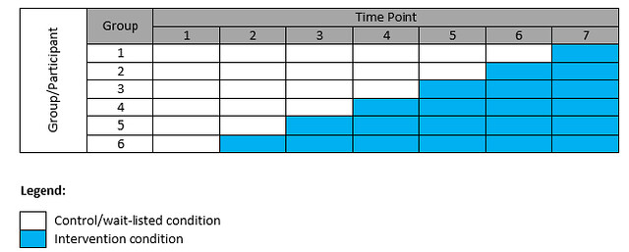

Slide 12
Choosing Cluster Randomization Approach
Cluster randomization approach should reflect the objective of trial, the endpoint’s characteristics and allowable design/model assumptions
Rule of thumb: Closest CRT to equivalent individually randomized design you would use
Parallel CRT is most common as often easiest in terms of logistics, modelling + assumptions - most analogous to randomized controlled trial
If strong covariates can either include in model or use matched pair/stratified CRT designs
Cross-over CRT adjusts for within-cluster effects which provides inferential value + efficiency/power benefits and patients access more/all treatments
Issues: Cross-sectional vs. cohort sampling? Suitable for irreversible/unstable/slow treatment effects? ↑ chance (↑ time on study) + cost (e.g. model issues) of cluster loss?
Stepped-Wedge similar pros/cons to cross-over CRT but better suited for irreversible effects and may have logistical and patient-centric advantages

Slide 13
Sample Size for Cluster
Randomized Trials
Part 3

Slide 14
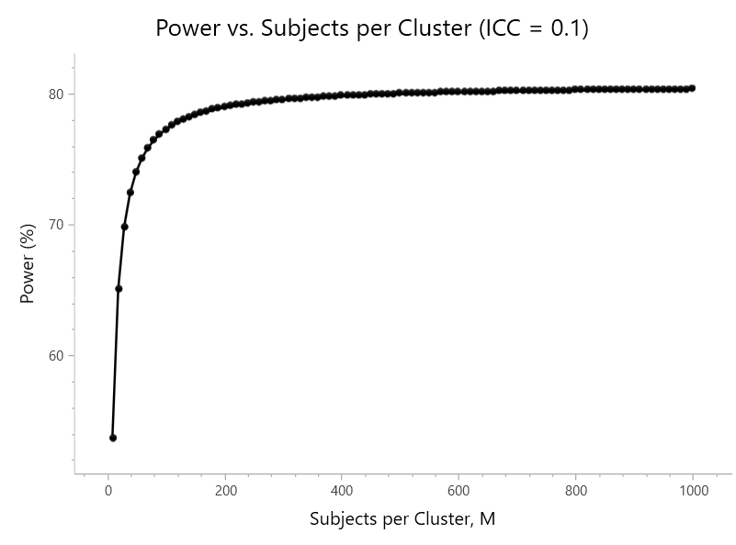


Sample Size for Cluster Randomized Trials
“Sample Size” for CRT more complex as consists of multiple sample size components for each cluster level
  Clusters (multiple levels?) vs number of subjects per cluster vs number of measurements per subject
Sample size calculation should ideally follow level of randomization rather than higher/lower levels
  Increasing the sample size of lower levels (e.g. sample size per cluster) can often not increase power!
  Sample Size calculations will require estimate of the within-cluster similarity to adjust for cluster randomized design
  Intracluster correlation (ICC) (“design effect”), coefficient of variation (CV) – CV also used for varying cluster size
  ↑ ICC = ↓ power (unless randomizing at a lower level)
  Complex CRT designs (e.g. stepped-wedge) will require additional design assumptions for sample size determination
  Cross-over pattern, # measurements, sampling method
2-Level CRT Sample Size
$$ICC=\frac{σ_{B}^{2}}{σ_{B}^{2}+σ_{W}^{2}}$$
$$DE=1+ICC(M+1)$$
$$N_{CRT}=DE{(N}_{Fixed})$$

Slide 15
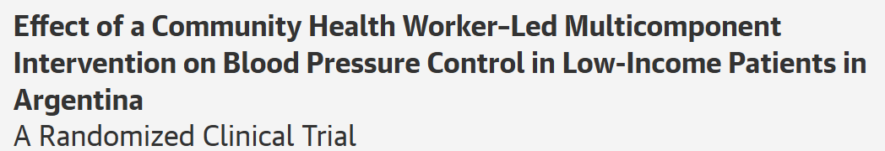
2-Level CRT Example 1
“The trial was designed to provide 80% statistical power to detect a 4.0-mm Hg or more reduction in systolic BP at a significance level of .05 using a 2-tailed test. Eighteen centers (9 in each group) with an average cluster size of 62 patients with hypertension … an intercluster correlation of 0.06, and a standard deviation of 10.0 mm Hg were assumed.”
Parameter | Value
Significance Level (2-sided) | 0.05
Mean Difference | 4
Standard Deviation | 10
ICC | 0.06
Sample Size Per Cluster | 62
Power | 80%
Clusters Per Group | 9

Slide 16
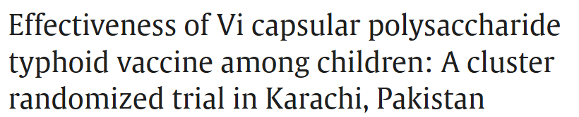
2-Level CRT Example 2
“A total of approximately 24,834 participants will be needed in order to have 80% power to detect a 60% vaccine protection at a 5% level of significance (two-tailed). This sample size calculation assumed a minimum cumulative typhoid incidence of 2.8 per 1,000 (during 2 years) and between cluster coefficient of variation (CV) of 0.5. … Cluster size will be 200-600 individuals (120 clusters).”
Parameter | Value
Significance Level | 0.05
Control Rate | 2.8/1000 = 0.0028
Vaccine Rate | 0.0028(1 - 0.6) =0.00112
CV | 0.5
Sample Size Per Cluster | 22834/120≈207
Clusters Per Group | 120/2 = 60
Power | 80%

Slide 17
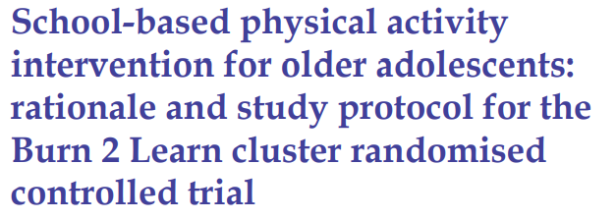
3-Level CRT Example
*Baseline Adjusted SD = sqrt(SD^2 (1 – r^2))
= sqrt(29^2 * (1 – 0.9^2)) = sqrt(159.79) =12.64
“Power calculations were based on the primary outcome of CRF, assessed using the Progressive Aerobic Cardiovascular Endurance Run (PACER) test. Baseline post-test correlation (r=0.90) and SD=29 values were obtained from our pilot trial, and conservative intraclass correlation coefficient values of 0.20 and 0.03 were used to account for clustering at the class and school levels, respectively. To detect a clinically meaningful baseline-adjusted between-group difference of 6 laps with 80% power at a 5% significance level will require 280 students per treatment group (ie, 2 classes of 14 students from each of 10 schools).”
Parameter | Value
Significance Level (2-sided) | 0.05
Mean Difference | 0.35
Standard Deviation (SD)* | 12.64*
ICC (Level 1, Level 2) | 0.2, 0.03
Sample Size (Level 1, 2, 3) | 280 (14, 2, 10)
Power | 80%

Slide 18

Matched-Pair CRT Example
“… with 12 practices each recruiting 20 patients, the study would have 80% power to detect a difference between the two arms of 20 percentage points (20% versus 40%) … with a between-cluster variance of 0.005. A difference of 20% was chosen as an estimate of clinically relevant change.”
Parameter | Value
Significance Level (2-sided) | 0.05
Control Group Proportion | 0.2
Treatment Group Proportion | 0.4
Between-Cluster Variance | 0.005
Number of Matched Pairs | 12/2=6
Subjects per Cluster | 20
Power | 80%

Slide 19
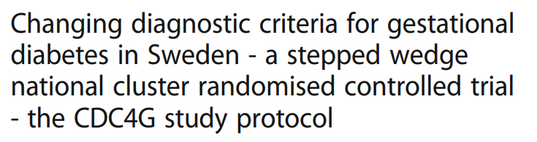
Stepped-Wedge CRT Example
“With 11 centres (clusters) participating and an intra cluster correlation (ICC) of 0.0026 a minimum sample size of 47,916 pregnant women … have 90% statistical power with a 5% significance level to detect an absolute reduction in LGA by 1.5% on a population level (from the existing 10 to 8.5%).”
Parameter | Value
Significance Level | 0.05
Control Proportion | 0.1
Treatment Proportion | 0.085
Variance Method | Null Variance
SW Design | Complete
Number of Clusters | 11
Power (%) | 90
Total Sample Size | 47916

Slide 20
Discussion and Conclusions
The choice of randomization scheme is a vital part of trial design with implications for the design, analysis and power of a trial
Cluster randomization, where randomize at level of cluster such as hospital, is commonly used for pragmatic reasons over individual randomization
Difference types of cluster randomization (parallel, matched, stepped-wedge, cross-over) can be used to increase trial efficiency and in response to practical challenges in randomization
Sample size determination for cluster randomized trials must account for cluster randomization type and within-cluster similarity (e.g. using ICC)

Slide 21
nQuery 9.5 Update (June 2025)
Base Tier (25 Tables)
Vaccines (8 Tables): Vaccine Efficacy (Rare Incidence, Composite Endpoint), Durability/Safety Cross-over Trial, Adverse Events (Self-Controlled Case Series)
Bioequivalence (8 Tables): Bioequivalence Cross-over Overhaul, Unequal N Equivalence/Non-inferiority, Multi-arm Equivalence (ANOVA-like)
Non-Parametric (3 Tables): Kruskal-Wallis (Continuous/Ordinal), Mann-Whitney U (Lehmann Method)
Mixed Models/Correlation (7 Tables): 2x2 Factorial Mixed Model
Pro + Plus Tier (2 Tables + Feature)
Group Sequential Design Simulation Tool for Operating Characteristics for Survival Endpoint
2-Stage Bioequivalence (Maurer)
Bayesian Bioequivalence (Bayes Factor)
UI: Select Table Overhaul

Slide 22


statsols.com/nquery-demo

Slide 23
Thank you
CONTACT US
info@statsols.com
MORE INFO
statsols.com

Slide 24
References
Randomization
Rosenberger, W. F., & Lachin, J. M., 2015. Randomization in Clinical Trials: Theory and Practice (2nd ed.). Wiley.
Lachin, J. M., Matts, J. P., & Wei, L., 1988. Randomization in clinical trials: Conclusions and recommendations. Controlled Clinical Trials, 9(4), 365–374.
Pocock, S. J., 1984. Clinical Trials: A Practical Approach. Wiley.
Kang, M., Ragan, B. G., & Park, J. H., 2008. Issues in Outcomes Research: An Overview of Randomization Techniques for Clinical Trials. Journal of Athletic Training, 43(2), 215–221.
Senn, S., 2013. Seven myths of randomisation in clinical trials. Statistics in medicine, 32(9), pp.1439-1450.
Dahly, D., 2020. Why We Randomize. Available from: https://www.youtube.com/watch?v=dSOjpxo1UX0
Dahly, D., 2020. Out of Balance, StatsEpi. Available from: https://statsepi.substack.com/p/out-of-balance
Cluster Randomization Overviews
Donner, A., & Klar, N., 2000. Design and Analysis of Cluster Randomization Trials in Health Research. Arnold Publishers.
Campbell, M.J., Walters, S.J., 2014. How to design, analyse and report cluster randomised trials in medicine and health related research. John Wiley & Sons.
Hayes, R.J. and Moulton, L.H., 2017. Cluster randomised trials. Chapman and Hall/CRC.
Eldridge, S. and Kerry, S., 2012. A practical guide to cluster randomised trials in health services research. John Wiley & Sons.
Jung, S.H., 2024. Cluster Randomization Trials: Statistical Design and Analysis. Chapman and Hall/CRC.
Murray, D.M., 1998. Design and analysis of group-randomized trials. Oxford University Press
Campbell, M.K., Piaggio, G., Elbourne, D.R. and Altman, D.G., 2012. Consort 2010 statement: extension to cluster randomised trials. Bmj, 345.
Campbell MJ, 2019. Cluster randomised trials. Med J Aust 210(4):154
Campbell, M.J., 2023. Cluster Randomized Trials and Stepped Wedge Trials. In Handbook of Epidemiology (pp. 1-38). New York, NY: Springer New York.
Hemming, K. and Taljaard, M., 2023. Key considerations for designing, conducting and analysing a cluster randomized trial. International journal of epidemiology, 52(5), pp.1648-1658.
Jaikumar, V., 2022. Cluster Randomized Trials: Concepts, Students 4 Best Evidence. Available from: https://s4be.cochrane.org/blog/2022/03/28/cluster-randomized-trials-concepts/

Slide 25
References
Issues in Cluster Randomized Designs
Donner, A. and Klar, N., 2004. Pitfalls of and controversies in cluster randomization trials. American journal of public health, 94(3), pp.416-422.
Campbell MJ , 2014. Challenges of cluster randomised trials. J Comp Effect Res 3(3):271–281
Edwards, S.J., Braunholtz, D.A., Lilford, R.J. and Stevens, A.J., 1999. Ethical issues in the design and conduct of cluster randomised controlled trials. Bmj, 318(7195), pp.1407-1409.
Taljaard, M., Weijer, C., Grimshaw, J.M. and Eccles, M.P., 2013. The Ottawa Statement on the ethical design and conduct of cluster randomised trials: precis for researchers and research ethics committees. Bmj, 346.
Arnup, S.J., Forbes, A.B., Kahan, B.C., Morgan, K.E. and McKenzie, J.E., 2016. Appropriate statistical methods were infrequently used in cluster-randomized crossover trials. Journal of clinical epidemiology, 74, pp.40-50.
Moerbeek M, 2006. Power and money in cluster randomized trials: when is it worth measuring a covariate? Stat Med 25:2607–2617
Kahan, B.C., Blette, B.S., Harhay, M.O., Halpern, S.D., Jairath, V., Copas, A. and Li, F., 2024. Demystifying estimands in cluster-randomised trials. Statistical methods in medical research, 33(7), pp.1211-1232.
Identification/Selection Bias in CRT
Puffer, S., Torgerson, D. and Watson, J., 2003. Evidence for risk of bias in cluster randomised trials: review of recent trials published in three general medical journals. Bmj, 327(7418), pp.785-789.
Hahn, S., Puffer, S., Torgerson, D.J. and Watson, J., 2005. Methodological bias in cluster randomised trials. BMC medical research methodology, 5(1), p.10.
Eldridge, S., Kerry, S. and Torgerson, D.J., 2009. Bias in identifying and recruiting participants in cluster randomised trials: what can be done?. Bmj, 339.
Eldridge, S., Campbell, M., Campbell, M., Dahota, A., Giraudeau, B., Higgins, J., Reeves, B. and Siegfried, N., 2016. Revised Cochrane risk of bias tool for randomized trials (RoB 2.0): additional considerations for cluster-randomized trials. Cochrane Methods Cochrane Database Syst Rev, 10(suppl 1).
Brierley, G., Brabyn, S., Torgerson, D. and Watson, J., 2012. Bias in recruitment to cluster randomized trials: a review of recent publications. Journal of evaluation in clinical practice, 18(4), pp.878-886.
Bolzern, J., Mnyama, N., Bosanquet, K. and Torgerson, D.J., 2018. A review of cluster randomized trials found statistical evidence of selection bias. Journal of clinical epidemiology, 99, pp.106-112.
Bobb, J.F., Qiu, H., Matthews, A.G., McCormack, J. and Bradley, K.A., 2020. Addressing identification bias in the design and analysis of cluster-randomized pragmatic trials: a case study. Trials, 21(1), p.289.
Li, F., Tian, Z., Bobb, J., Papadogeorgou, G. and Li, F., 2022. Clarifying selection bias in cluster randomized trials. Clinical Trials, 19(1), pp.33-41.

Slide 26
References
Pragmatic Trials
Zhang, S., Ahn, C. and Zhu, H., 2023. Design and analysis of pragmatic trials. Chapman and Hall/CRC.
Zwarenstein, M., 2008. Pragmatic Trials in Healthcare (Practihc) group. Improving the reporting of pragmatic trials: an extension of the CONSORT statement. Bmj, 11, p.3390.
Cook, A.J., Delong, E., Murray, D.M., Vollmer, W.M. and Heagerty, P.J., 2016. Statistical lessons learned for designing cluster randomized pragmatic clinical trials from the NIH Health Care Systems Collaboratory Biostatistics and Design Core. Clinical Trials, 13(5), pp.504-512.
Selecting Cluster Randomized Designs
Donner, A., & Klar, N., 1996. Statistical considerations in the design and analysis of community intervention trials. Journal of Clinical Epidemiology, 49(4), 435–439.
Hemming, K., Copas, A., Forbes, A. and Kasza, J., 2024. What type of cluster randomized trial for which setting?. Journal of epidemiology and population health, 72(1), p.202195.
Hemming, K., Eldridge, S., Forbes, G., Weijer, C. and Taljaard, M., 2017. How to design efficient cluster randomised trials. bmj, 358.
Watson, S.I., Girling, A. and Hemming, K., 2023. Optimal study designs for cluster randomised trials: An overview of methods and results. Statistical Methods in Medical Research, 32(11), pp.2135-2157.
Matched-Pair Design
Martin DC, Diehr P, Perrin EB, Koepsell TD, 1993. The effect of matching on the power of randomized community intervention studies. Stat Med 12:329–338
Klar N, Donner A., 1997. The merits of matching in community intervention trials. Stat Med 16:1753–1764
Donner, A., Taljaard, M. and Klar, N., 2007. The merits of breaking the matches: a cautionary tale. Statistics in medicine, 26(9), pp.2036-2051.
Imai, K., King, G. and Nall, C., 2009. The essential role of pair matching in cluster-randomized experiments, with application to the Mexican universal health insurance evaluation.
Rhodes, W., 2014. Pairwise cluster randomization: An exposition. Evaluation Review, 38(3), pp.217-250.
Chondros, P., Ukoumunne, O.C., Gunn, J.M. and Carlin, J.B., 2021. When should matching be used in the design of cluster randomized trials?. Statistics in Medicine, 40(26), pp.5765-5778.

Slide 27
References
Stepped Wedge Design
Hemming, K., Lilford, R., & Girling, A. J., 2014. Stepped-wedge cluster randomised controlled trials: a generic framework including parallel and multiple-level designs. Statistics in Medicine, 34(2), 181–196.
Hemming K, Haines TP, Chilton PJ, Girling AJ, Lilford RJ., 2015. The stepped wedge cluster randomised trial: rationale, design, analysis, and reporting. BMJ. 2015 Feb 6;350:h391.
Barker, D., McElduff, P., D’Este, C. and Campbell, M.J., 2016. Stepped wedge cluster randomised trials: a review of the statistical methodology used and available. BMC medical research methodology, 16(1), p.69.
Hussey, M. A., & Hughes, J. P., 2007. Design and analysis of stepped wedge cluster randomized trials. Contemporary Clinical Trials, 28(2), 182–191.
Copas AJ, Lewis JJ, Thompson JA et al., 2015. Designing a stepped wedge trial: three main designs, carry-over effects and randomisation approaches. Trials 16:352
Hughes, J.P., Granston, T.S. and Heagerty, P.J., 2015. Current issues in the design and analysis of stepped wedge trials. Contemporary clinical trials, 45, pp.55-60
Hemming, K., Taljaard, M., McKenzie, J.E., Hooper, R., Copas, A., Thompson, J.A., Dixon-Woods, M., Aldcroft, A., Doussau, A., Grayling, M. and Kristunas, C., 2018. Reporting of stepped wedge cluster randomised trials: extension of the CONSORT 2010 statement with explanation and elaboration. bmj, 363.
Campbell MJ, Hemming K, Taljaard M., 2019. The stepped wedge cluster randomised trial: what it is and when it should be used. Med J Aust 210(6):253–254
Hooper, R., 2020. Reasons for doing a stepped wedge trial. Stepped Wedgehog. Find at: https://steppedwedgehog.blog/three-kinds-of-stepped-wedge-trial/
Hooper, R., 2020. Three kinds of stepped wedge trial. Stepped Wedgehog. Find at: https://steppedwedgehog.blog/three-kinds-of-stepped-wedge-trial/
Hooper, R. and Eldridge, S.M., 2021. Cutting edge or blunt instrument: how to decide if a stepped wedge design is right for you. BMJ quality & safety, 30(3), pp.245-250.
Zhan, Z., van den Heuvel, E.R., Doornbos, P.M., Burger, H., Verberne, C.J., Wiggers, T. and de Bock, G.H., 2014. Strengths and weaknesses of a stepped wedge cluster randomized design: its application in a colorectal cancer follow-up study. Journal of clinical epidemiology, 67(4), pp.454-461.
Prost A, Binik A, Abubakar I et al., 2015. Logistic, ethical, and political dimensions of stepped wedge trials: critical review and case studies. Trials 16:351
Brown CA, Lilford RJ., 2006. The stepped wedge trial design: a systematic review. BMC Med Res Methodol 6:54

Slide 28
*Note many references from “Cluster Randomization” section earlier also cover sample size e.g. Donner & Klar, 2000
References
Cross-over Cluster Randomized Design
Hemming, K., Taljaard, M., Weijer, C. and Forbes, A.B., 2020. Use of multiple period, cluster randomised, crossover trial designs for comparative effectiveness research. bmj, 371.
McKenzie, J.E., Taljaard, M., Hemming, K., Arnup, S.J., Giraudeau, B., Eldridge, S., Hooper, R., Kahan, B.C., Li, T., Moher, D. and Turner, E.L., 2025. Reporting of cluster randomised crossover trials: extension of the CONSORT 2010 statement with explanation and elaboration. bmj, 388.
Arnup, S.J., McKenzie, J.E., Hemming, K., Pilcher, D. and Forbes, A.B., 2017. Understanding the cluster randomised crossover design: a graphical illustration of the components of variation and a sample size tutorial. Trials, 18(1), p.381.
Moerbeek, M., 2024. Optimal design of cluster randomized crossover trials with a continuous outcome: Optimal number of time periods and treatment switches under a fixed number of clusters or fixed budget. Behavior Research Methods, 56(8), pp.8820-8830.
Hemming, K., Taljaard, M., Weijer, C. and Forbes, A.B., 2020. Use of multiple period, cluster randomised, crossover trial designs for comparative effectiveness research. bmj, 371.
Hooper, R. and Bourke, L., 2015. Cluster randomised trials with repeated cross sections: alternatives to parallel group designs. bmj, 350.
Turner, R.M., White, I.R. and Croudace, T., 2007. Analysis of cluster randomized cross‐over trial data: a comparison of methods. Statistics in medicine, 26(2), pp.274-289.
Bellomo, R., Forbes, A., Akram, M., Bailey, M., Pilcher, D.V. and Cooper, D.J., 2013. Why we must cluster and cross over. Critical Care and Resuscitation, 15(3), pp.155-157.
Kasza, J., Hemming, K., Hooper, R., Matthews, J.N.S. and Forbes, A.B., 2019. Impact of non-uniform correlation structure on sample size and power in multiple-period cluster randomised trials. Statistical methods in medical research, 28(3), pp.703-716.
Sample Size for Cluster Randomized Trials*
Ahn, C., Heo, M., & Zhang, S., 2015. Sample Size Calculations for Clustered and Longitudinal Outcomes in Clinical Research. CRC Press.
C. Rutterford, A. Copas, S. Eldridge, Methods for sample size determination in cluster randomized trials. International Journal of Epidemiology, 44:1051–1067, 2015.
Donner A, Birkett N, Buck C (1981) Randomization by cluster: sample size requirements and analysis. Am J Epidemiol 114:906–914
Hayes, R.J. and Bennett, S., 1999. Simple sample size calculation for cluster-randomized trials. International journal of epidemiology, 28(2), pp.319-326.
van Breukelen, G.J. and Candel, M.J., 2012. Calculating sample sizes for cluster randomized trials: we can keep it simple and efficient!. Journal of clinical epidemiology, 65(11), pp.1212-1218.

Slide 29
References
ICC/CV for Sample Size
Campbell, M.K., Mollison, J. and Grimshaw, J.M., 2001. Cluster trials in implementation research: estimation of intracluster correlation coefficients and sample size. Statistics in medicine, 20(3), pp.391-399.
Vierron, E. and Giraudeau, B., 2009. Design effect in multicenter studies: gain or loss of power?. BMC medical research methodology, 9(1), p.39.
Kerry SM, Bland JM, 2001. Unequal cluster sizes for trials in English and Welsh general practice: implications for sample size calculations. Stat Med 20:377–390
Eldridge S, Kerry S, Ashby D,. 2006. Sample size for cluster randomized trials: effect of coefficient of variation of cluster size and analysis method. Int J Epidemiol 35:1292–1300
Korevaar, E., Kasza, J., Taljaard, M., Hemming, K., Haines, T., Turner, E.L., Thompson, J.A., Hughes, J.P. and Forbes, A.B., 2021. Intra-cluster correlations from the CLustered OUtcome Dataset bank to inform the design of longitudinal cluster trials. Clinical Trials, 18(5), pp.529-540.
Eldridge, S.M., Ukoumunne, O.C. and Carlin, J.B., 2009. The intra‐cluster correlation coefficient in cluster randomized trials: a review of definitions. International Statistical Review, 77(3), pp.378-394.
Sample Size for Complex CRT
Hooper R, Teerenstra S, de Hoop E et al,. 2016. Sample size calculation for stepped wedge and other longitudinal cluster randomised trials. Stat Med 35(26):4718–4728
Hemming K, Taljaard M., 2016. Sample size calculations for stepped wedge and cluster randomised trials: a unified approach. J Clin Epidemiol 69:137–146
Giraudeau, B., Ravaud, P. and Donner, A., 2008. Sample size calculation for cluster randomized cross‐over trials. Statistics in medicine, 27(27), pp.5578-5585.
Hemming K, Kasza J, Hooper R, Forbes A, Taljaard M., 2020. A tutorial on sample size calculation for multiple-period cluster randomized parallel, cross-over and stepped-wedge trials using the Shiny CRT calculator. Int J Epidemiol 49(3):979–995
Li, F., Forbes, A.B., Turner, E.L. and Preisser, J.S., 2019. Power and sample size requirements for GEE analyses of cluster randomized crossover trials. Statistics in Medicine, 38(4), pp.636-649.
Donner, A., 1992. Sample size requirements for stratified cluster randomization designs. Statistics in medicine, 11(6), pp.743-750.

Slide 30
References
Worked Examples
He, J., Irazola, V., Mills, K.T., Poggio, R., Beratarrechea, A., Dolan, J., Chen, C.S., Gibbons, L., Krousel-Wood, M., Bazzano, L.A. and Nejamis, A., 2017. Effect of a community health worker–led multicomponent intervention on blood pressure control in low-income patients in Argentina: a randomized clinical trial. Jama, 318(11), pp.1016-1025.
Khan, M.I., Soofi, S.B., Ochiai, R.L., Habib, M.A., Sahito, S.M., Nizami, S.Q., Acosta, C.J., Clemens, J.D., Bhutta, Z.A. and DOMI Typhoid Karachi Vi Effectiveness Study Group, 2012. Effectiveness of Vi capsular polysaccharide typhoid vaccine among children: a cluster randomized trial in Karachi, Pakistan. Vaccine, 30(36), pp.5389-5395.
Leahy, A.A., Eather, N., Smith, J.J., Hillman, C., Morgan, P.J., Nilsson, M., Lonsdale, C., Plotnikoff, R.C., Noetel, M., Holliday, E. and Shigeta, T.T., 2019. School-based physical activity intervention for older adolescents: rationale and study protocol for the Burn 2 Learn cluster randomised controlled trial. BMJ open, 9(5), p.e026029.
Moore, H., Greenwood, D., Gill, T., Waine, C., Soutter, J. and Adamson, A., 2003. A cluster randomised trial to evaluate a nutrition training programme. The British Journal of General Practice, 53(489), p.271.
Fadl, H., Saeedi, M., Montgomery, S., Magnuson, A., Schwarcz, E., Berntorp, K., Sengpiel, V., Storck-Lindholm, E., Strevens, H., Wikström, A.K. and Brismar-Wendel, S., 2019. Changing diagnostic criteria for gestational diabetes in Sweden-a stepped wedge national cluster randomised controlled trial-the CDC4G study protocol. BMC pregnancy and childbirth, 19(1), p.398.

