Slide 1
Design and Sample Size for Vaccine Trials
Case Study of Covid-19 Vaccine Trials
Demonstrated on
Notes:
www.Statsols.com/trial

Slide 2
Webinar Host
Head of Statistics
nQuery Lead Researcher
FDA Guest Speaker
Guest Lecturer
HOSTED BY: Ronan Fitzpatrick

Slide 3
AGENDA
1) Vaccine Trial Design
2) Covid-19 Trial Design
3) Worked Examples
4) Discussion & Conclusion

Slide 4
The complete trial design platform to make clinical trials faster, less costly and more successful
The solution for optimizing clinical trials

Slide 5
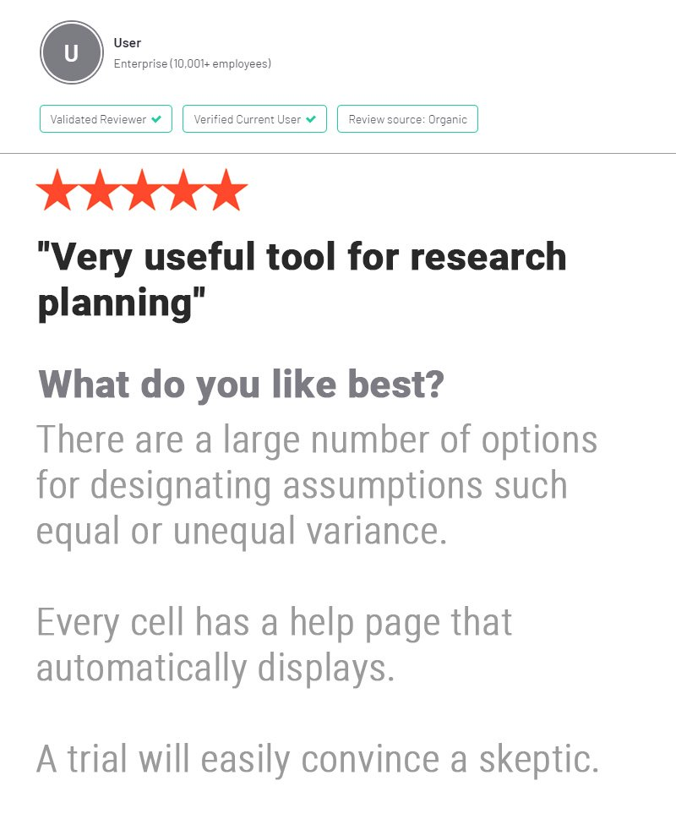
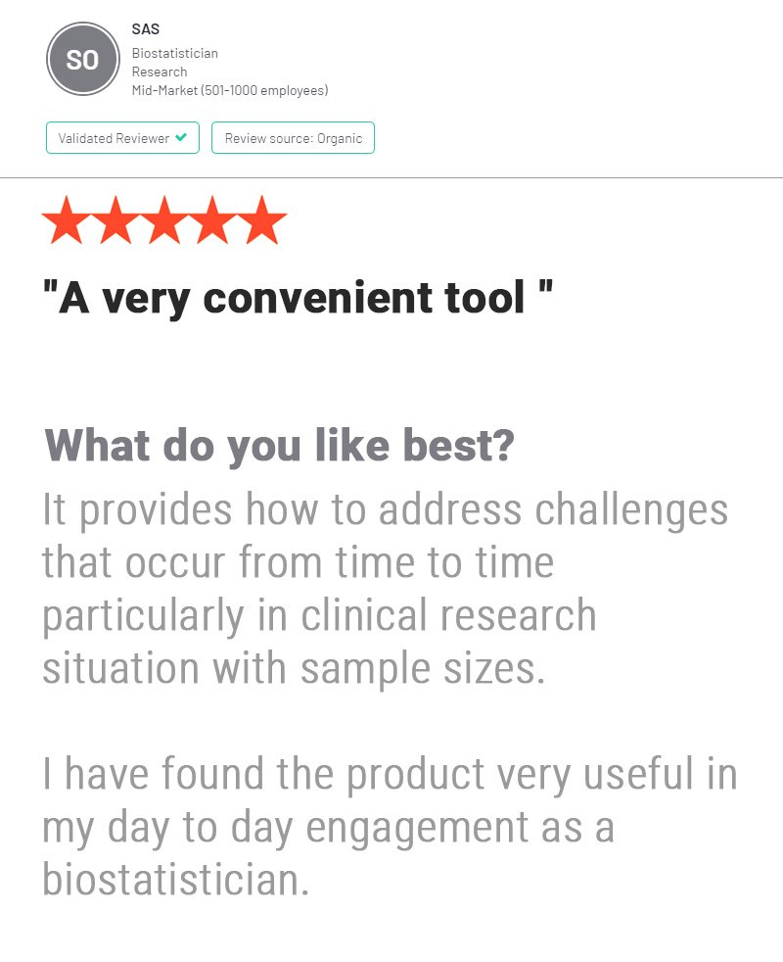
In 2020, 91% of organizations with clinical trials approved by the FDA used nQuery

Slide 6
Vaccine Trial Design
Part 1

Slide 7
Vaccine Trials
Development of vaccines is traditionally long and uniquely challenging
Focus today will be on challenges in Phase III confirmatory trials
Phase III vaccine trials will tend to be large even by Phase III standards
Reflects fact that many vaccinations will never be “activated”
This scale and other unique issues mean distinct approach/vocab
However, most can easily be mapped back & forth from other areas
Will focus on general vaccine trials and then extend to Covid-19 trials
C-19 has introduced a number of approaches rarer in vaccine trials

Slide 8
Vaccine Trial Design Issues
Vaccine Trials will tend to be “event” driven and thus very large
Can affect design (e.g. cluster randomization, cohort designs)
Vaccine trials place even higher standard on safety concerns
NB: Vaccines are given much wider population than therapeutics
Decisions required on choice of endpoint and statistical methods
Incidence vs. severity (composite?), proportion/count/TTE?
Length (5-10 years) & N (10000s) mean less focus on adaptive design
Accuracy (especially on safety endpoints) over speed in vaccines

Slide 9
Vaccine Methods/SSD Examples
1 | Confidence Interval for VE | O’Neill (1988) – Case-Control, Cohort
2 | One Proportions Tests | “Event-Driven”, Standard Tests
3 | Two Proportions Tests | VE = 1 – RR, Apply usual RR Tests/SSD
4 | Composite Models | Incidence + Severity, Callegaro (2020).
5 | Count (Poisson/NB) Models | “Standard” + “Rare Event” Approach
6 | Cox Regression | Common for NI/SM Hypotheses
7 | Cluster Randomized Designs | Counts/Props - Hayes & Bennett (1999)

Slide 10
Vaccine Trial EXAMPLE
“For the total effect among children, it was assumed that the laboratory confirmed influenza attack rate would be 5% per year (or 5 per 100 person/years) in the unvaccinated group, and we decided the minimum detectable effectiveness should be 50%. To assess total protection, 785 households are required per study group for 95% power. This was based on a conservative assumption of a coefficient of variation of 0.25 for the rates; with about 2 vaccine-eligible children per household”
Parameter | Value
Significance Level (2-sided) | 0.05
Control Incidence Rate | 0.05
Treatment Incidence Rate | 0.025 (VE = 50%)
Coefficient of Variation | 0.25
Sample Size per Cluster | 2
Power | 95%
Source: Vaccine (2012)

Slide 11
Covid-19 Vaccine Trials
Part 2

Slide 12
Covid-19 Vaccine Trials
Covid-19 Pandemic represented variety of unique challenges
Speed was priority, had knock-on effect on every design choice
Symptomatic disease is primary endpoint but other endpoints vital
FDA: H0: VE < 30% & VE Point Estimate > 50% (NB: R ≥ 2)
Interim analysis key aspect of trial design in all Covid-19 trials
Different approaches: Group sequential, SPRT, Bayesian Sequential
SSD event driven, “sample size” derived from ad-hoc rate calculation
Actual trajectory of pandemic led to unprecedented speed

Slide 13
Per-Trial Summary
 | AstraZeneca | Janssen (J&J) | Moderna | Pfizer
Sample Size (Trt:Control) | 30000 (2:1) | 60000 (1:1) | 30000 (1:1) | 44000 (1:1)
Max Events | 150 | 154 | 151 | 164
Statistical Method | Poisson Regression | Binomial (Event Split) | Cox PH Regression | Binomial (Event Split)
Target VE for 90% Power | 0.6 | 0.6 | 0.6 | 0.6
Interim Analysis Method (#) | Group Sequential | SPRT | Group Sequential | Bayesian Sequential
Interim Events (Alpha) | 75 (0.00155) | Weekly (after 20 events) | 53,106 (0.0002, 0.0073) | 32,62,92,120 (P(VE>30%) > 0.995)
Placebo Rate (6-month) | 0.8% | 0.8% | 0.75% | 0.65%
Seropositive @ Baseline | n/a | 10% | 15% | 20%

Slide 14
Worked
Examples
Part 3

Slide 15
Conversion Example
$$H_{0}:VE≤0.3 H_{1}:VE=0.6$$
$$π_{Placebo}=P\left(Sympomatic C−19 | Placebo\right); π_{Vaccine}=P\left(Sympomatic C−19 | Vaccine\right)$$
$$P_{H_{x}}\left(Vaccine Case|Case\right)=\frac{π_{Placebo}\left(1−VE\right)}{π_{Placebo}\left(1−VE\right)+π_{Placebo}}$$
Assume N = # Cases & V = # Vaccine Cases
$$V\sim Binomial\left(N,P_{H_{x}}\right); 1−β=P\left(V≥c | H_{1}\right)=0.9$$
$$P_{H_{0}}=\frac{0.08(1−0.3)}{0.08\left(1−0.3\right)+0.08}=0.4118;P_{H_{1}}=\frac{0.08(1−0.6)}{0.08\left(1−0.6\right)+0.08}=0.2857$$

Slide 16
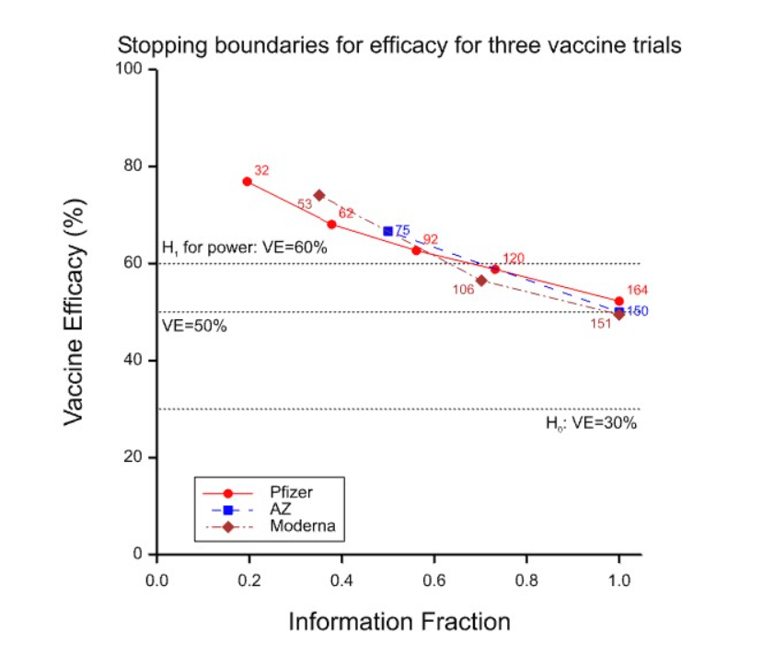

Slide 17
Discussion & Conclusion
Part 3

Slide 18
Discussion and Conclusions
Vaccine development is a complex and unique area
Wider target population affects size and concerns in trial design
Distinct set of parameterizations and models for vaccines
VE = 1 – RR/HR; count, proportions, survival all viable models
Covid-19 presented unique challenge and opportunity for trial design
Focus on speed in response to huge consequences of C-19 pandemic
Interim analysis was central aspect of design to respond to clinical need
Success of vaccines shown has led to current rapid vaccination programs

Slide 19
Statsols.com/trial

Slide 20
Thank You
Questions?
info@statsols.com
Further information at Statsols.com

Slide 21
References (Vaccine Trials)
Fleiss, J.L., Levin, B. and Paik, M.C., 2013. Statistical methods for rates and proportions. john wiley & sons.
Halloran, M.E., Longini, I.M., Struchiner, C.J. and Longini, I.M., 2010. Design and analysis of vaccine studies (Vol. 18). New York, NY: Springer.
Singh, K. and Mehta, S., 2016. The clinical development process for a novel preventive vaccine: An overview. Journal of postgraduate medicine, 62(1), p.4.
O’Neill, R.T., 1988. On sample sizes to estimate the protective efficacy of a vaccine. Statistics in Medicine, 7(12), pp.1279-1288.
Chan, I.S. and Bohidar, N.R., 1998. Exact power and sample size for vaccine efficacy studies. Communications in Statistics-Theory and Methods, 27(6), pp.1305-1322.
Gu, K., Ng, H.K.T., Tang, M.L. and Schucany, W.R., 2008. Testing the ratio of two poisson rates. Biometrical Journal: Journal of Mathematical Methods in Biosciences, 50(2), pp.283-298.
Schoenfeld, D.A., 1983. Sample-size formula for the proportional-hazards regression model. Biometrics, pp.499-503.
Callegaro, A., Curran, D. and Matthews, S., 2020. Burden‐of‐illness vaccine efficacy. Pharmaceutical statistics, 19(5), pp.636-645.
Chow, S.C., Shao, J., Wang, H. and Lokhnygina, Y., 2017. Sample size calculations in clinical research. CRC press.
Sullender, W., Fowler, K., Krishnan, A., Gupta, V., Moulton, L.H., Lafond, K., Widdowson, M.A., Lal, R.B. and Broor, S., 2012. Design and initiation of a study to assess the direct and indirect effects of influenza vaccine given to children in rural India. Vaccine, 30(35), pp.5235-5239.

Slide 22
References (Covid-19 Trials)
World Health Organization, 2020. Design of vaccine efficacy trials to be used during public health emergencies—points of considerations and key principles.
Haque, A. and Pant, A.B., 2020. Efforts at COVID-19 Vaccine Development: Challenges and Successes. Vaccines, 8(4), p.739.
Doshi, P., 2020. Covid-19 vaccine trial protocols released.
Polack, F.P., Thomas, S.J., Kitchin, N., Absalon, J., Gurtman, A., Lockhart, S., Perez, J.L., Pérez Marc, G., Moreira, E.D., Zerbini, C. and Bailey, R., 2020. Safety and efficacy of the BNT162b2 mRNA Covid-19 vaccine. New England Journal of Medicine, 383(27), pp.2603-2615.
Baden, L.R., El Sahly, H.M., Essink, B., Kotloff, K., Frey, S., Novak, R., Diemert, D., Spector, S.A., Rouphael, N., Creech, C.B. and McGettigan, J., 2021. Efficacy and safety of the mRNA-1273 SARS-CoV-2 vaccine. New England Journal of Medicine, 384(5), pp.403-416.
Voysey, M., Clemens, S.A.C., Madhi, S.A., Weckx, L.Y., Folegatti, P.M., Aley, P.K., Angus, B., Baillie, V.L., Barnabas, S.L., Bhorat, Q.E. and Bibi, S., 2021. Safety and efficacy of the ChAdOx1 nCoV-19 vaccine (AZD1222) against SARS-CoV-2: an interim analysis of four randomised controlled trials in Brazil, South Africa, and the UK. The Lancet, 397(10269), pp.99-111.
Sadoff, J., Le Gars, M., Shukarev, G., Heerwegh, D., Truyers, C., de Groot, A.M., Stoop, J., Tete, S., Van Damme, W., Leroux-Roels, I. and Berghmans, P.J., 2021. Interim Results of a Phase 1–2a Trial of Ad26. COV2. S Covid-19 Vaccine. New England Journal of Medicine.
Logunov, D.Y., Dolzhikova, I.V., Shcheblyakov, D.V., Tukhvatulin, A.I., Zubkova, O.V., Dzharullaeva, A.S., Kovyrshina, A.V., Lubenets, N.L., Grousova, D.M., Erokhova, A.S. and Botikov, A.G., 2021. Safety and efficacy of an rAd26 and rAd5 vector-based heterologous prime-boost COVID-19 vaccine: an interim analysis of a randomised controlled phase 3 trial in Russia. The Lancet, 397(10275), pp.671-681.

Slide 23
Resources (Covid-19 Trials)
PSI Vaccine SIG Webinar: Statistical Topics on COVID-19 vaccine and therapeutic clinical trials
Stephen Senn: Blogs and Web Papers
Berry Consultants Webinar on SARS-COV-2 Vaccine Trials
Pfizer Trial Protocol
AstraZeneca Protocol
Moderna Protocol
Janssen/J&J Protocol

