Slide 1
Designing MAMS Trials
Advantages, issues and sample size
Start Time 10am EDT / 3pm GMT
If your audio does not activate, click on screen
Demonstrated on

Slide 2
Webinar Host
Head of Statistics
nQuery Lead Researcher
FDA Guest Speaker
Guest Lecturer
HOSTED BY: Ronan Fitzpatrick

Slide 3
AGENDA
Introduction to MAMS
Common MAMS Designs
Designing MAMS – MAMS GSD
Conclusions and Discussion
Notes:
Change bullet point

Slide 4
The complete trial design platform to make clinical trials faster, less costly and more successful
The solution for optimizing clinical trials

Slide 5
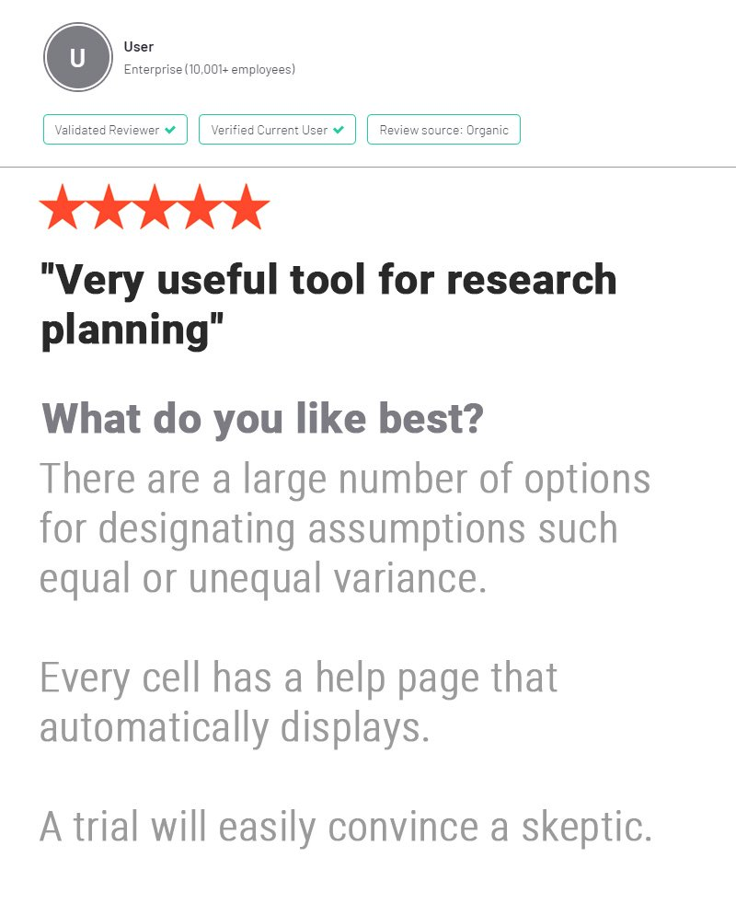
In 2019, 90% of organizations with clinical trials approved by the FDA used nQuery
Notes:
www.Statsols.com/trial

Slide 6
Introduction to MAMS
Part 1

Slide 7
MAMS Overview
Multi-arm Multi-stage designs compare multiple treatments (>2) with multiple stages (>1) for adaptions
Different choices available for adaptions at each stage
Drop arms/pick “winner(s)”, add arms, stop early, increase N
MAMS designs provide flexibility to assess wide range of treatments and mold trial towards desired end state
Increasing interest in MAMS designs to allow seamless designs & allow quicker evaluation of multiple treatments

Slide 8
MAMS Review
Advantages
Efficiency vs multiple trials
Seamless Trial Designs
Flexibility to add/drop trt.
Shared Control
More patients on trt. arms
Disadvantages
More Complex (Time Bias)
Logistical Issues
Uncertain Costs/Duration
Regulatory Approval
No Direct Trt. Comparisons

Slide 9
MAMS Methods Examples
1 | MAMS Group Sequential Design | Magirr et al. (2012), Gao et al (2014)
2 | Fixed K Drop the Loser Design | Wason et al. (2017)
3 | Optimal MAMS GSD | Wason and Jaki (2012)
4 | I-outcome/D-outcome MAMS | Royston et al. (2011)
5 | Add Arms Designs | Choodari-Oskooei et al (2020)
6 | (2 Stage) P-value Combination | Posch et al. (2005)
7 | Bayesian MAMS | Whitehead et al. (2015)

Slide 10
Common MAMS Designs
Part 2

Slide 11
Types of MAMS Design Trials
Platform Trial
Multiple therapies added/dropped for single disease over time
Umbrella Trial
Multiple targeted therapies for single disease (by gene/biomarker)
Basket Trial
Single targeted therapy for multiple diseases or disease subtypes
All typically use master protocol for clinical trial design & adaptive umbrella/basket can be seen as platform trials

Slide 12
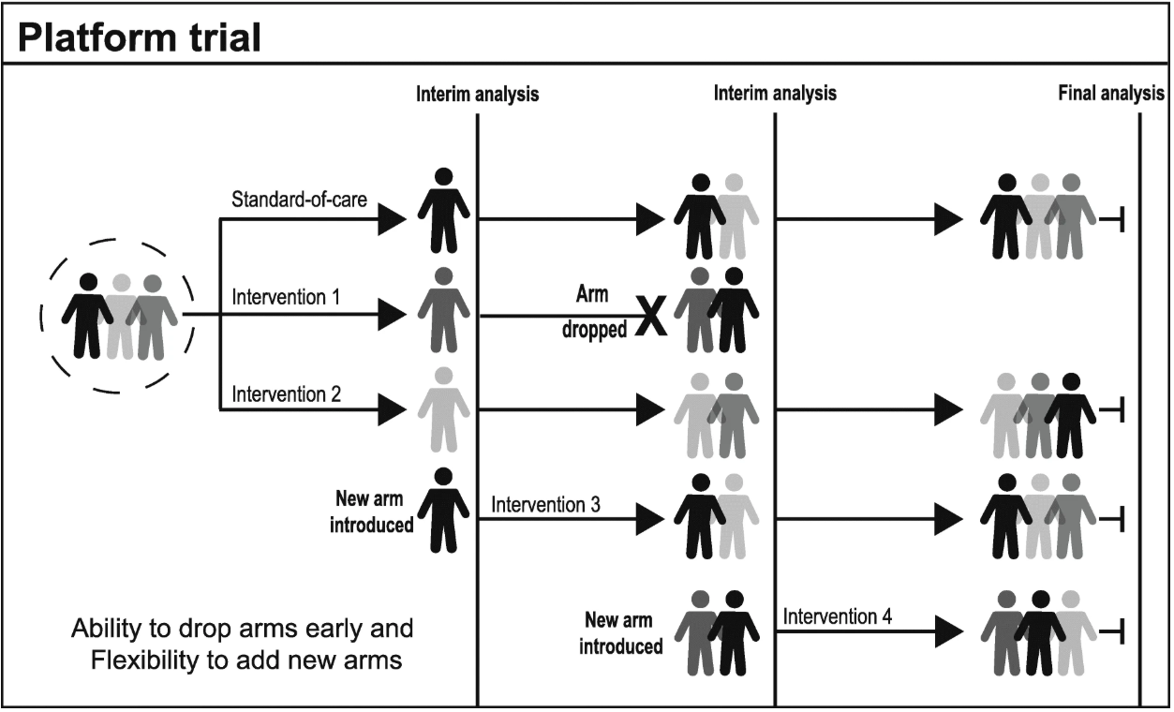
Platform Trial
Trial where multiple therapies evaluated and can add/drop arms
Can create “perpetual” master trial
Platform trial allows continuous evaluation of new possible treatments
Master protocol removes need to set up “new” trial for every possible treatment
Great interest due to increased flexibility & savings (shared control)
Examples include RECAP-CAP, STAMPEDE, I-SPY with latter 2 leading to seamless II/III
Source: Park, JJH et al. (2019)
Notes:
Phase II/III

Slide 13
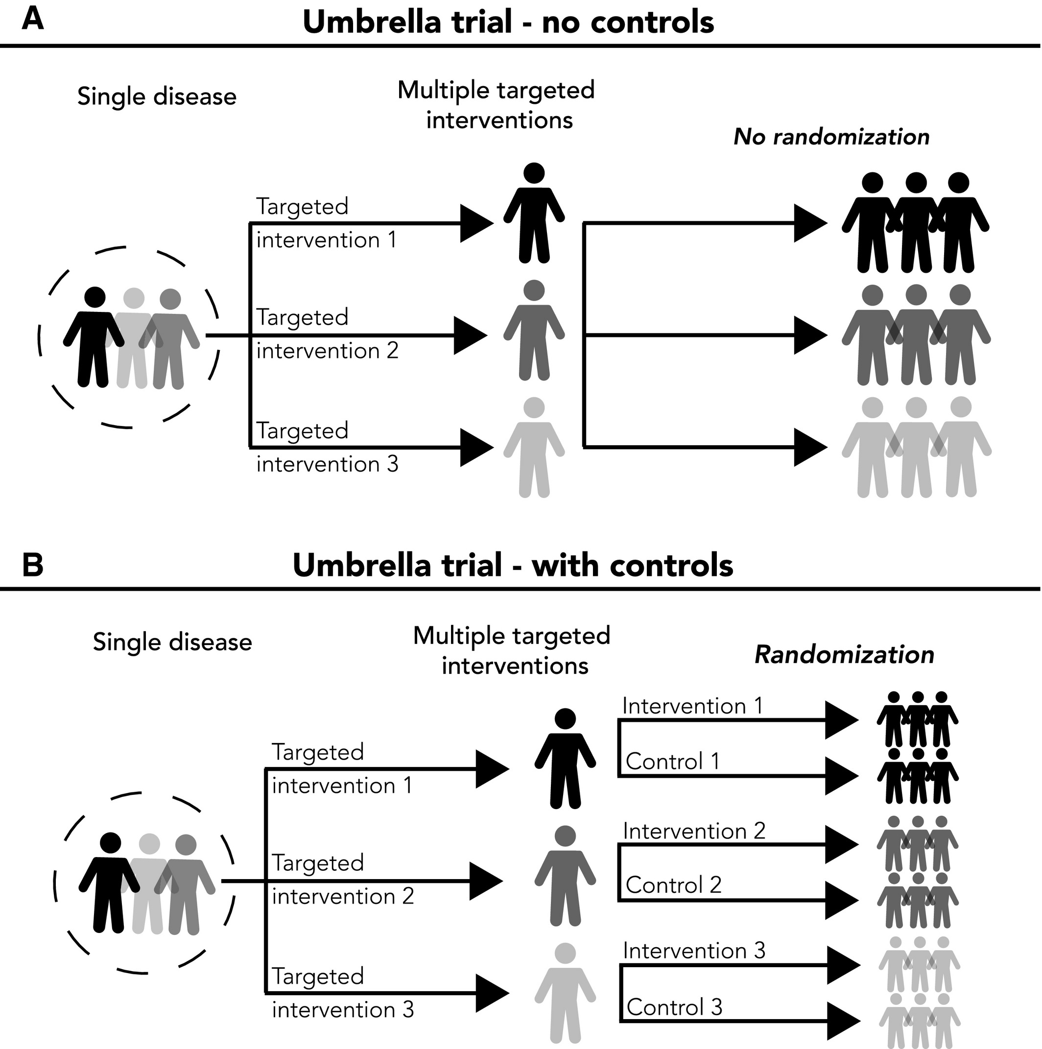
Umbrella Trial
Trial where multiple therapies evaluated for single disease type
Therapies usually targeted at specific subpopulation e.g. gene, biomarker
Different umbrella trial designs depending on disease & resources
Controls?, randomized?, patient in >1 pop.
High interest in oncology due to high degree of within-disease variation
Examples include Lung-MAP, FOCUS4 and plasmaMATCH
Source: Park, JJH et al. (2020)
Notes:
Phase II/III

Slide 14
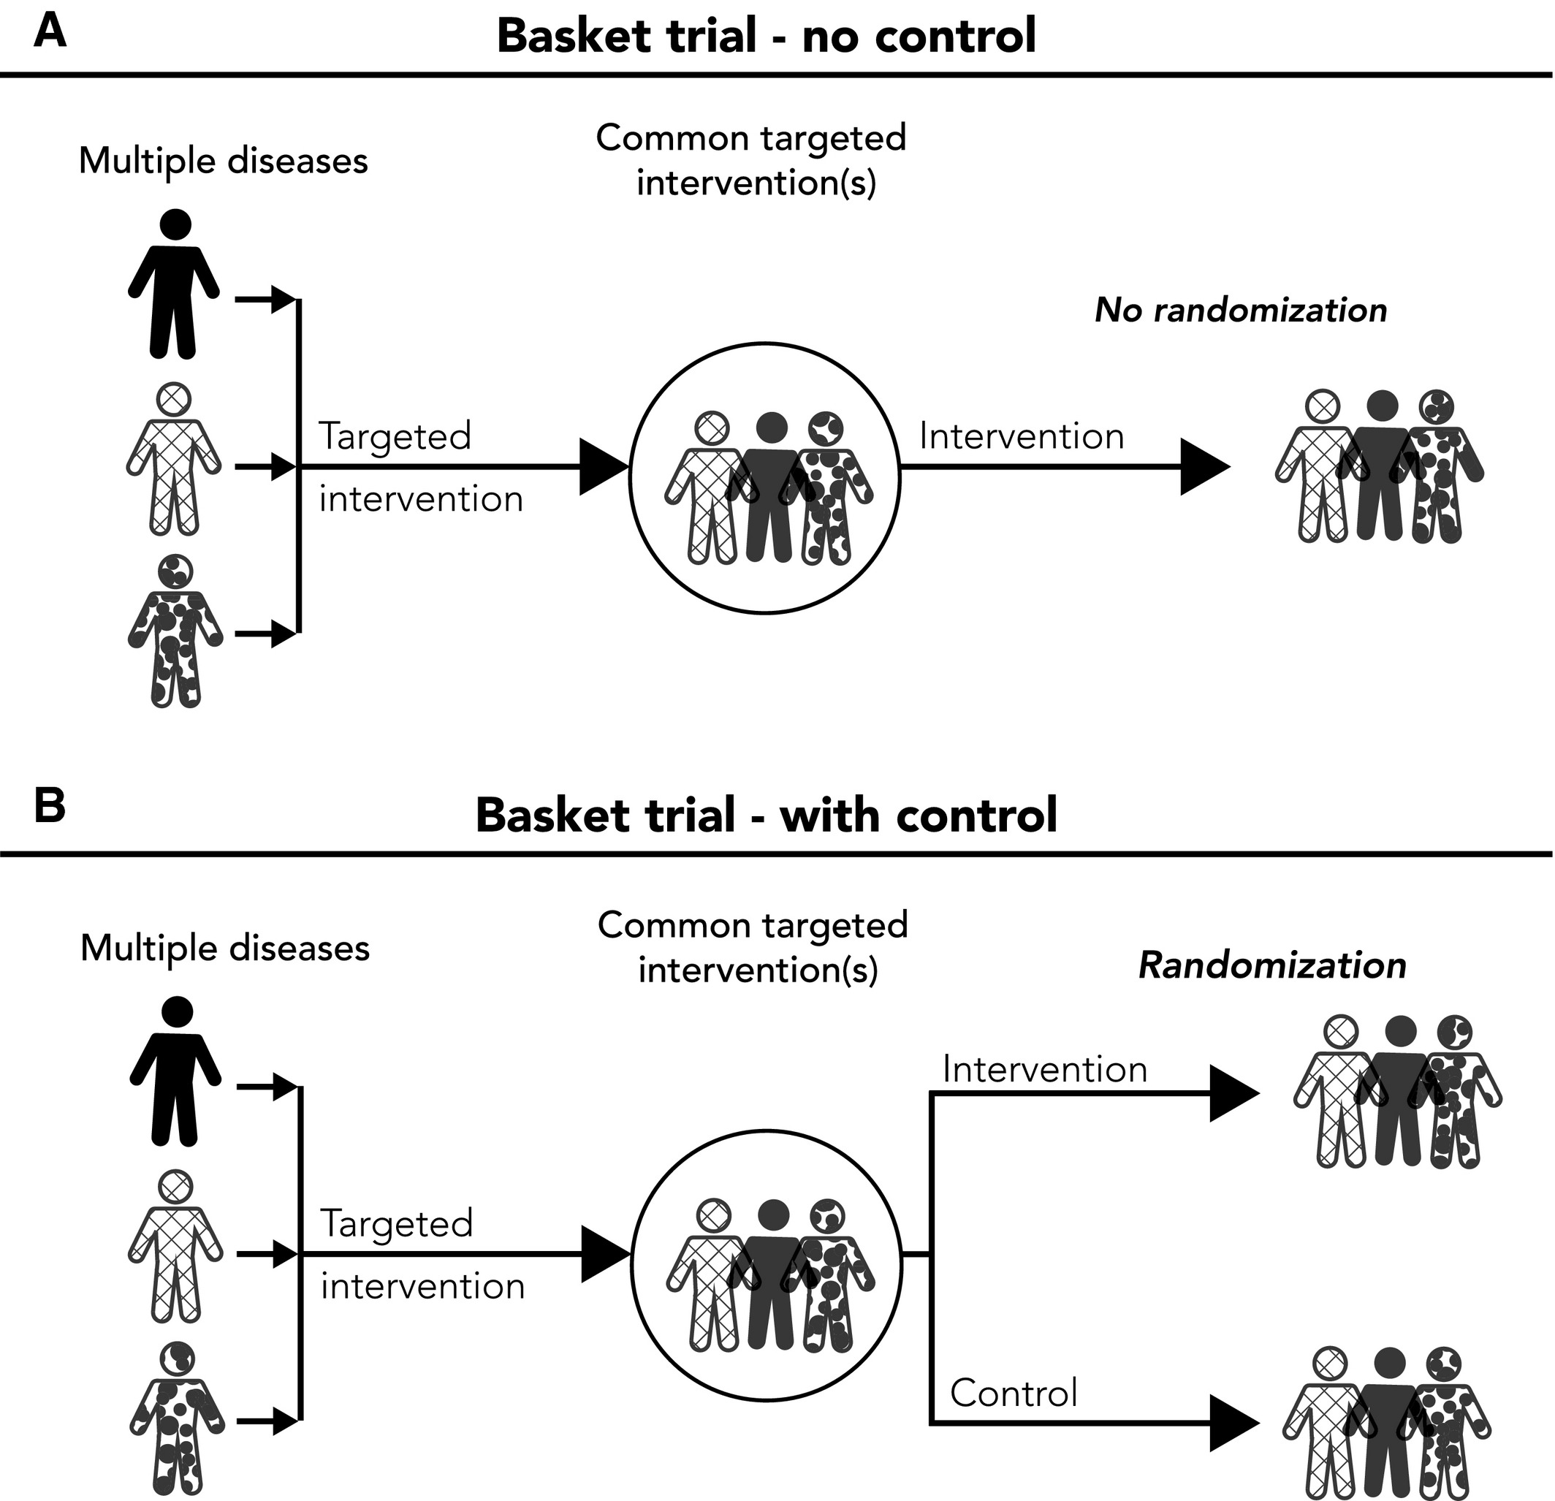
Basket Trial
Trial where single therapy evaluated for multiple diseases/subtypes
Therapy can evaluated for success in specific candidate populations
Want predictive risk factor to define “basket” of possible conditions
Common biomarker or gene pathway across cancer types and histology
Find “best” places for a treatment
E.g. NCI-Match, BRAF V600 Vemurafenib, Ado‐trastuzumab Emtasine HER2
Source: Park, JJH et al. (2020)
Notes:
Phase I/II

Slide 15
MAMS and Trial Design
MAMS terminology can refer to study design and/or statistical model(s) of interest
Most closely related to platform trial concept
But as previously, adaptive umbrella/basket ≈ platform trials
Focus today mostly on MAMS via statistical methods lens
Reflects design considerations of interest today e.g. power
But practical issues will have large effect on actual study

Slide 16
Designing MAMS
Part 3

Slide 17
MAMS Design Overview
Multi-arm multi-stage design combines usual design issues seen from multiplicity and adaptive design
Adaptive Design: Blinding, Pre-specification, efficiency, sim.
Multiplicity: FWER control, direct comparisons, choice limits
Disease and treatment characteristics effect model choice
Rare subtypes, common control possible, multiple diseases
Need statistical model that can accommodate choices
Add arms, drop arms, stop early, target # winners/losers?

Slide 18
MAMS Group Sequential Design
Can extend group sequential design to accommodate multiple arms by using Dunnett’s test to control FWER
Can use standard group sequential design approaches (error spending) if test for maximum effect size
Efficacy: max(ES) > efficacy bound (i.e. ≥1 trt. “succeeds”), Futility: max(ES) < futility bound (i.e. all arms “fail”)
However, can continue trial if desired but note requires common control group & not making direct comparisons

Slide 19
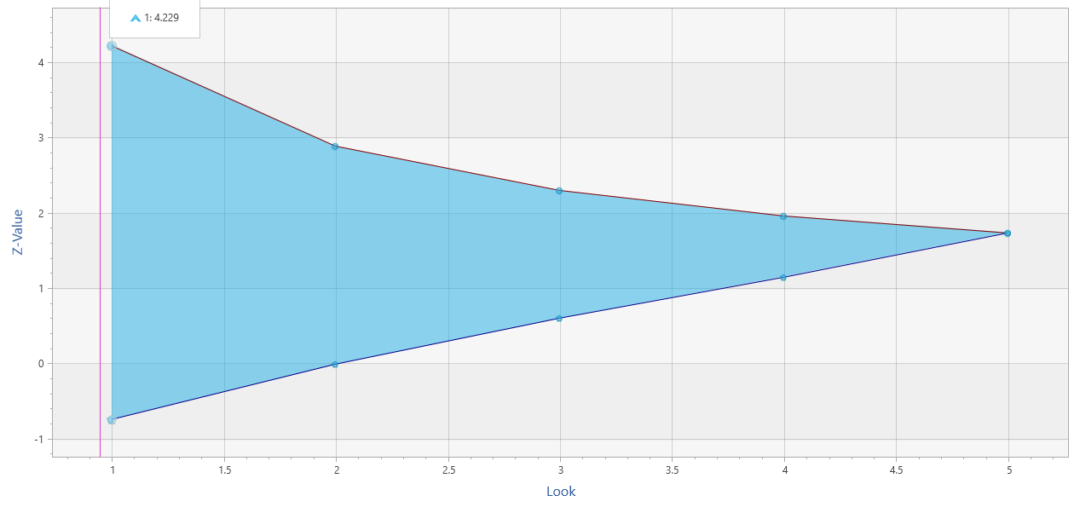
Group Sequential Design
2 early stopping criteria (work similar)
Efficacy (α-spending)
Futility (β-spending)
Use Lan & DeMets “spending function” to account for multiple analyses/chances
Spend proportion of total error at each look
More conservative N vs. fixed term analysis
Multiple SF available (incl. custom)
O’Brien-Fleming (conservative), Pocock (liberal)
Power Family, Hwang-Shih-DeCani (flexible)
Different heuristics for efficacy/futility
Conservative SF expected for efficacy
More flexibility for futility (less problematic)
$$α\left(τ\right)=2\left(1−Φ\left(\frac{z_{α/2}}{τ}\right)\right)$$
O’Brien-Fleming Spending Function
Notes:
Group sequential trials differ from the fixed period trials in that the data from the trial is analysed at one or more stages prior to the conclusion of the trial.
As a result the alpha value applied at each analysis or ‘look’ must be adjusted to preserve the overall Type 1 error.
So, in effect you are ‘spending’ some of your alpha at each ‘look’. The alpha values used at each look are calculated based upon the spending function chosen, the number of looks to be taken during the course of the trial as well as the overall Type 1 error rate.

Slide 20
Worked Example
Parameter | Value
Significance Level (1-Sided) | 0.025
Number of Arms (N Ratio) | 4 (1:1:1:1)
Number of Stages (incl. final) | 4
Minimum FEV1 Improvement | 0.14
Maximum FEV1 Improvement | 0.18
Common Standard Deviation | 0.5
Power | 90%
Spending Function (Efficacy) | O’Brien-Fleming
… (INHANCE) was a randomized clinical trial for the treatment of (COPD) in which four doses (75 mg, 150 mg, 300 mg, 500 mg) of inhaled indacaterol … were compared to placebo. The primary efficacy objective was to show the superiority of at least one dose over placebo at week 12 with respect to 24- hour post-dose (trough) forced expiratory volume in 1 second (FEV1). The improvement in FEV1 for indacaterol versus placebo, denoted by δ, was expected to be between 0.14 and 0.18 liters and the between-subject variability was assumed to be σ = 0.5. … we will use this setting to illustrate a MAMS design comprising three pair-wise comparisons (150 mg, 300 mg, 500 mg) to placebo over up to four equally spaced looks at the accumulating data. The design will utilize the Lan and DeMets (1983) error spending function to generate O’Brien-Fleming (1979) type boundaries … to generate early stopping efficacy boundaries.

Slide 21
MAMS GSD Considerations
Same logistical considerations e.g. overshoot and restrictions e.g. broken assumptions effect, as for GSD
Shared control group is key assumption & need appropriate size (√K, optimal) & definition
No direct comparison between treatments (and note power definition) so more a “filter” for effect sizes
Extension possible to more complex designs such as sample size re-estimation and ability to add arms

Slide 22
Discussion and Conclusions
Multi-arm Multi-stage designs are flexible design option
Useful for seamless designs, personalized medicine etc.
Several increasingly popular trial designs can use MAMS
Platform trials, umbrella trials, basket trials, adaptive versions
New stats methods being developed to accommodate
Common: p value-combination, MAMS GSD, Bayesian models
MAMS Group Sequential Design extends GSD for MAMS
Uses same framework and allows flexible dropping of arms

Slide 23
Thank You
Questions?
info@statsols.com
Further information at Statsols.com

Slide 24
Statsols.com/trial

Slide 25
For video tutorials and worked examples
Statsols.com/start

Slide 26
The solution for optimizing clinical trials
CRM
MCP-Mod
Simon’s Two Stage
1000+ Scenarios for Fixed Term, Adaptive & Bayesian Methods
Survival, Means, Proportions & Count endpoints
Sample Size Re-Estimation
Group Sequential Trials
Bayesian Assurance
Cross over & personalized medicine
EARLY PHASE
Animal Studies ANOVA / ANCOVA
PRE-CLINICAL / RESEARCH
CONFIRMATORY
Cohort Study
Case-control Study
POSTMARKETING

Slide 27
References
Millen, G.C. and Yap, C., 2019. Adaptive trial designs: what are multiarm, multistage trials?. Archives of Disease in Childhood-Education and Practice.
Jaki, T., 2015. Multi-arm clinical trials with treatment selection: what can be gained and at what price?. Clinical Investigation, 5(4), pp.393-399.
Ghosh, P., Liu, L. and Mehta, C., 2020. Adaptive multiarm multistage clinical trials. Statistics in Medicine.
European Patients’ Academy, New approaches to clinical trials: Adaptive designs, 2015, Available from: https://www.eupati.eu/clinical-development-and-trials/new-approaches-to-clinical-trials-adaptive-designs/
U.S. Food and Drug Administration, Master Protocols: Efficient Clinical Trial Design Strategies To Expedite Development of Oncology Drugs and Biologics (Draft Guidance), October 2018 Available from: https://www.fda.gov/media/120721/download
Friede, T. and Stallard, N., 2008. A comparison of methods for adaptive treatment selection. Biometrical Journal: Journal of Mathematical Methods in Biosciences, 50(5), pp.767-781.
Magirr D., Jaki T., Whitehead J., 2012, A generalized Dunnett test for multi-arm multi-stage clinical studies with treatment selection. Biometrika, 99(2), pp.494-501.

Slide 28
References
Magirr, D., Stallard, N. and Jaki, T., 2014. Flexible sequential designs for multi‐arm clinical trials. Statistics in Medicine, 33(19), pp.3269-3279.
Gao, P., Liu, L. and Mehta, C., 2014. Adaptive sequential testing for multiple comparisons. Journal of biopharmaceutical statistics, 24(5), pp.1035-1058.
Ghosh, P., Liu, L., Senchaudhuri, P., Gao, P. and Mehta, C., 2017. Design and monitoring of multi‐arm multi‐stage clinical trials. Biometrics, 73(4), pp.1289-1299.
Wason, J., Stallard, N., Bowden, J. and Jennison, C., 2017. A multi-stage drop-the-losers design for multi-arm clinical trials. Statistical methods in medical research, 26(1), pp.508-524.
Wason, J.M. and Jaki, T., 2012. Optimal design of multi‐arm multi‐stage trials. Statistics in medicine, 31(30), pp.4269-4279.
Royston, P., Barthel, F.M., Parmar, M.K., Choodari-Oskooei, B. and Isham, V., 2011. Designs for clinical trials with time-to-event outcomes based on stopping guidelines for lack of benefit. Trials, 12(1), p.81.
Royston, P., Parmar, M.K. and Qian, W., 2003. Novel designs for multi‐arm clinical trials with survival outcomes with an application in ovarian cancer. Statistics in medicine, 22(14), pp.2239-2256.

Slide 29
References
Choodari-Oskooei, B., Bratton D.J., Gannon M.R., Meade A.M., Sydes M.R., Parmar M., 2020. Adding new experimental arms to randomised clinical trials: Impact on error rates. Clinical Trials. OnlineFirst
Sydes, M.R., Parmar, M.K., Mason, M.D., Clarke, N.W., Amos, C., Anderson, J., de Bono, J., Dearnaley, D.P., Dwyer, J., Green, C. and Jovic, G., 2012. Flexible trial design in practice-stopping arms for lack-of-benefit and adding research arms mid-trial in STAMPEDE: a multi-arm multi-stage randomized controlled trial. Trials, 13(1), p.168.
Posch, M., Koenig, F., Branson, M., Brannath, W., Dunger‐Baldauf, C. and Bauer, P., 2005. Testing and estimation in flexible group sequential designs with adaptive treatment selection. Statistics in medicine, 24(24), pp.3697-3714.
Whitehead, J., Cleary, F. and Turner, A., 2015. Bayesian sample sizes for exploratory clinical trials comparing multiple experimental treatments with a control. Statistics in medicine, 34(12), pp.2048-2061.
Woodcock, J. and LaVange, L.M., 2017. Master protocols to study multiple therapies, multiple diseases, or both. New England Journal of Medicine, 377(1), pp.62-70.

Slide 30
References
Park, J.J., Siden, E., Zoratti, M.J., Dron, L., Harari, O., Singer, J., Lester, R.T., Thorlund, K. and Mills, E.J., 2019. Systematic review of basket trials, umbrella trials, and platform trials: a landscape analysis of master protocols. Trials, 20(1), pp.1-10.
Park, J.J., Hsu, G., Siden, E.G., Thorlund, K. and Mills, E.J., 2020. An overview of precision oncology basket and umbrella trials for clinicians. CA: A Cancer Journal for Clinicians, 70(2), pp.125-137.
Strzebonska, K. and Waligora, M., 2019. Umbrella and basket trials in oncology: ethical challenges. BMC medical ethics, 20(1), p.58.
Wason, J., Magirr, D., Law, M. and Jaki, T., 2016. Some recommendations for multi-arm multi-stage trials. Statistical methods in medical research, 25(2), pp.716-727.
Jennison, C., & Turnbull, B. W. (1999). Group sequential methods with applications to clinical trials. CRC Press.
Dunnett, C.W., 1955. A multiple comparison procedure for comparing several treatments with a control. Journal of the American Statistical Association, 50(272), pp.1096-1121.

