Slide 1
DESIGNING STUDIES with Recurrent Events
Model choices, pitfalls and group sequential design
Demonstrated on

Slide 2
Webinar Host
Head of Statistics
nQuery Lead Researcher
FDA Guest Speaker
Guest Lecturer
HOSTED BY: Ronan Fitzpatrick

Slide 3
AGENDA
Recurrent Event Data and Models Introduction
Sample Size for Recurrent Event Models
Group Sequential Design for Recurrent Events
Conclusions and Discussion

Slide 4
The complete trial design platform to make clinical trials faster, less costly and more successful
The solution for optimizing clinical trials

Slide 5
In 2019, 90% of organizations with clinical trials approved by the FDA used nQuery

Slide 6
Recurrent Event Data
Introduction
Part 1

Slide 7
Recurrent Events Overview
Recurrent event processes are endpoints where subject can have >1 informative event in time period
Common endpoint in clinical trials esp. chronic diseases
COPD/asthma exacerbations, MS relapses, migraines, seizures
Similar considerations and methods also relevant in case of count data e.g. imaging, epidemiology
Should use events/counts “as-is” for better estimation but historically often “simplified” to other endpoints

Slide 8
Recurrent Event Analysis Approaches
Event Rate Models: Estimate # of events per time unit
Parametric models for (constant over time) event rate ratio
e.g. Poisson (incl. quasi-P), negative binomial (both ZI, ZT)
Time-to-Events Models: Time(s) between/til next event
Semi-parametric models for hazard from each event
e.g. Andersen-Gill, Wei-Lin-Weissfeld, Prentice-Williams-Peterson
Mean Cumulative Event Function: E(Events) at time t
Non-parametric method for cumulative E’s e.g. Nelson-Aalen

Slide 9
Issues in Recurrent Event Analysis
What is the question/target of interest in study?
Use event rate, time between events, # of events?
Compare groups via rate ratio, # events, intensity/HR?
Interested in first K events, later events, more intense events?
What assumptions are reasonable for data?
Independent events, non-informative censoring,
Event process differs per subject, process changes over time
Some events more important, effect of terminal events

Slide 10
Count Model Examples
1 | Poisson Model | Event Rates, rate ratio, constant rate
2 | Negative Binomial | Event Rates, RR, event rate/subject
3 | Andersen-Gill | Time-to-Events, intensity/hazard of all E
4 | Wei-Lin-Weissfeld | Time-to-Events, time til 1st K events, HR
5 | Prentice-Williams-Peterson | Time-to-Events, gap between 1st K E’s, HR
6 | MCF | Non-parametric, # events at time t
7 | Approximate Models | Survival models (1st E), t-test, event “rates”

Slide 11
Sample Size for Recurrent Event Models
Part 2

Slide 12
Example Models for SSD
Poisson: Signorini (1991), Lehr (1992), Gu et .al. (2008)
Parametric model for rate ratio, assumes constant rate ratio
Rate constant over time, same rate per subject unless quasi-P
Negative Binomial: Zhu & Lakkis (2014), Tang (2015,18)
Parametric model for rate ratio, assumes constant rate ratio
Rate constant over T, Poisson rate/subject from gamma dist.
Andersen-Gill: Bernardo & Harrington (2001), Tang & Fitzpatrick (2019)
Semi-Parametric for intensity/hazard, assume constant RR here
Arbitrary rate over T (e.g. Weibull), need proportional hazards

Slide 13
Sample Size for Recurrent Events
SSD initially focussed on simple approx. assuming Poisson (e.g. √)
More work done for Poisson regression (& Quasi-Poisson
Recent work on Neg. Binomial and extend it & Poisson for unequal follow-up, dropout & NI/equiv SSD also derived for Andersen-Gill incl. flexible approach for design and hazard function assumptions
Source: R. Lehr (1992)
Source: D. Signorini (1991)
Source: H. Zhu & H. Lakkis (2014)
Source: Y. Tang (2015)
Source: Y. Tang & R. Fitzpatrick (2019)

Slide 14
Worked Example 1
Negative Binomial/ Recurrent Events Example
“On the basis of previous studies of ﬂuticasone propionate–salmeterol combinations we assumed a yearly exacerbation rate with vilanterol of 1·4 and a dispersion parameter of 0·7. Thus, we calculated that a sample size of 390 assessable patients per group in each study would provide each study with 90% power to detect a 25% reduction in exacerbations in the ﬂuticasone furoate and vilanterol groups versus the vilanterol only group at a two-sided 5% signiﬁcance level”
Parameter | Value
Significance Level (Two-Sided) | 0.05
Control Incidence Rate (per year) | 1.4
Rate Ratio | 0.75
Exposure Time (Years) | 1
Dispersion Parameter | 0.7
Power (%) | 90%
Source: Lancet Respiratory Medicine (2013)

Slide 15
Group Sequential Design for Recurrent Events
Part 3

Slide 16
Group Sequential Designs (GSD)
GSD allows interim analyses to stop early
Interim: look while trial is on-going
Looks occur at pre-specified times
E.g. After 50% subjects measured
Can stop for benefit and/or futility
Neither? Continue until end/next look
However, need to account for effect of multiple analyses
Do by “spending” error at each look
“Group sequential trials can provide ethical and efficiency advantages by reducing the expected sample size and calendar time of clinical trials and by accelerating the approval of effective new treatments.
For example, a group sequential design with a single interim analysis and can reduce the expected sample size of the trial by roughly 15 percent relative to a comparable non-adaptive trial.”

Slide 17
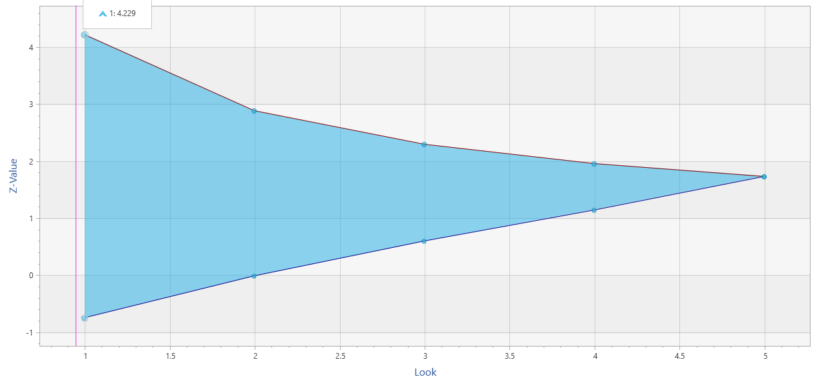
GSD Details
2 early stopping criteria (work similar)
Efficacy (α-spending)
Futility (β-spending)
Use “spending function” to account for multiple analyses/”chances”
Spend proportion of total error at each look
More conservative N vs. fixed term analysis
Multiple SF available (incl. custom)
O’Brien-Fleming (conservative), Pocock (liberal), Power, Hwang-Shih-DeCani (flexible)
Different heuristics for efficacy/futility
Conservative SF expected for efficacy
More flexibility for futility (less problematic)
$$α\left(τ\right)=2\left(1−Φ\left(\frac{z_{α/2}}{τ}\right)\right)$$
O’Brien-Fleming Spending Function

Slide 18
Recurrent Events GSD Issues
Appropriate MLE and test for GST
Normal approx. if t same per subject?
For NB, no closed form if t differs
How turn info. time into “real” time
Info. time related to follow-up times, n, rates and dispersion parameter
Equal t ~ Means, Unequal ~ TTE
Type I Error ↑ if low N/high κ
No Exact, some proposed altered stats
t-distribution GSD better for low N
Source: Mütze, T., Glimm, E., Schmidli, H., & Friede, T. (2019).

Slide 19
Worked Example 2
Group Sequential Design for Negative Binomial
Parameter | Value
Significance Level (Two-Sided) | 0.05
Control Incidence Rate (per year) | 1.4
Rate Ratio | 0.75
Exposure Time (Years) | 1
Dispersion Parameter | 0.7
Power (%) | 90%
Extend previous example to group sequential design with 2 interim analyses with O’Brien Fleming efficacy bound and non-binding Hwang-Shih-DeCani futility bound with gamma = -1.25
Parameter | Value
Number of Looks | 3
Efficacy Bound | O’Brien Fleming
Futility Bound | Non-Binding
Beta Spending Function | Hwang-Shih-DeCani
HSD Parameter | -1.25
Source: Lancet Respiratory Medicine (2013)

Slide 20
Discussion and Conclusions
Recurrent Events/Count data common in clinical trials
Move away from approximations to modelling process fully
Variety of models depending on scientific question
Parametric: event rate; Semi-parametric: t between/to events
SSD methods available for most common models
Negative Binomial, Poisson, Andersen-Gill; one less barrier
GSD methods available for recurrent events growing
Approx. work adequately for standard Phase III assumptions

Slide 21
Thank You
Questions?
info@statsols.com
Further information at Statsols.com

Slide 22
Statsols.com/trial

Slide 23
For video tutorials and worked examples
Statsols.com/start

Slide 24
The solution for optimizing clinical trials
CRM
MCP-Mod
Simon’s Two Stage
1000+ Scenarios for Fixed Term, Adaptive & Bayesian Methods
Survival, Means, Proportions & Count endpoints
Sample Size Re-Estimation
Group Sequential Trials
Bayesian Assurance
Cross over & personalized medicine
EARLY PHASE
Animal Studies ANOVA / ANCOVA
PRE-CLINICAL / RESEARCH
CONFIRMATORY
Cohort Study
Case-control Study
POSTMARKETING

Slide 25
References
Cameron, A. C., & Trivedi, P. K. (2013). Regression analysis of count data. Cambridge university press.
Cook, R. J., & Lawless, J. (2007). The statistical analysis of recurrent events. Springer Science & Business Media.
The Analysis of Recurrent Events: A Summary of Methodology; J Rogers, Oxford: https://www.psiweb.org/docs/default-source/resources/psi-subgroups/scientific/2016/time-to-event-and-recurrent-event-endpoints/jrogers.pdf?sfvrsn=a86d2db_2
Lehr, R. (1992). Sixteen S‐squared over D‐squared: A relation for crude sample size estimates. Statistics in medicine, 11(8), 1099-1102.
Signorini, D. F. (1991). Sample size for Poisson regression. Biometrika, 78(2), 446-450.
Gu, K., Ng, H. K. T., Tang, M. L., & Schucany, W. R. (2008). Testing the ratio of two poisson rates. Biometrical Journal, 50(2), 283-298.

Slide 26
References
Zhu, H. (2017). Sample size calculation for comparing two poisson or negative binomial rates in noninferiority or equivalence trials. Statistics in Biopharmaceutical Research, 9(1), 107-115.
Zhu, H., & Lakkis, H. (2015). Sample size calculation for comparing two negative binomial rates. Statistics in medicine, 33(3), 376-387.
Tang, Y. (2015). Sample size estimation for negative binomial regression comparing rates of recurrent events with unequal follow-up time. Journal of biopharmaceutical statistics, 25(5), 1100-1113.
Tang, Y. (2017). Sample size for comparing negative binomial rates in noninferiority and equivalence trials with unequal follow-up times. Journal of biopharmaceutical statistics, 1-17.
Tang, Y., & Fitzpatrick, R. (2019). Sample size calculation for the Andersen‐Gill model comparing rates of recurrent events. Statistics in Medicine, 38(24), 4819-4827.

Slide 27
References
Dransfield, M. T., et. al. (2013). Once-daily inhaled fluticasone furoate and vilanterol versus vilanterol only for prevention of exacerbations of COPD: two replicate double-blind, parallel-group, randomised controlled trials. The lancet Respiratory medicine, 1(3), 210-223.
Jennison, C., & Turnbull, B. W. (1999). Group sequential methods with applications to clinical trials. CRC Press.
Cook R. & Lawless J. (1996). Interim monitoring of longitudinal comparative studies with recurrent event responses. Biometrics 52: 1311–1323.
Mütze, T., Glimm, E., Schmidli, H., & Friede, T. (2019). Group sequential designs for negative binomial outcomes. Statistical methods in medical research, 28(8), 2326-2347.
Mutze, T., E. Glimm, H. Schmidli, and T. Friede. (2019). Group sequential designs with robust semiparametric recurrent event models. Statistical Methods in Medical Research

