Slide 1
Exploring Survival Analysis Designs for Clinical Trials
Identifying & Addressing Challenges With Survival Sample Size & Power
May 2024

Slide 2
Paul Murphy
Research Statistician

Slide 3
Agenda
1. Power for Survival Analysis 2. Survival Analysis Design Issues 3. Non-Proportional Hazards 4. Discussion and Conclusions
Questions welcome throughout
All example files will be available after the webinar

Slide 4
nQuery: The complete solution for optimizing your clinical trial designs
Early Phase
CRM
MCP-Mod
Simon’s Two Stage
Flemings GST
Confirmatory
1000+ Scenarios for Fixed term, Adaptive &
Bayesian Methods
Survival, Means, Proportions & Count endpoints
Group Sequential Trials
Bayesian:
Assurance
Credible Intervals
Posterior Error Approach
Sample Size Re-Estimation
Cross over & personalized medicine
MAMS
Prediction
Pre-clinical research
Animal studies
ANOVA / ANCOVA
Post Marketing
Cohort Study
Case-control Study

Slide 5
nQuery Licensing nQuery operates on a tiered licensing model
Base
Sample size and power for fixed terms trials over 100’s of designs, endpoints and hypothesis types
Plus
Sample size for fully Bayesian (e.g. credible intervals) + hybrid Bayes/Frequentist methods and designs (e.g. Assurance)
Pro
Sample size and power for range of early stage and confirmatory clinical trial Adaptive Designs and tools for monitoring and adjustment in-trial
Expert
Additional tools for study design and monitoring. Focus currently on milestone prediction for enrollment and (survival) event targets
Click Here to see our Package Comparison Tool

Slide 6
Power for Survival Analysis
Part 1

Slide 7
Survival Analysis Introduction
Survival Analysis (a.k.a time-to-event (TTE) analysis) is concerned with inferences regarding the expected length of time til an “event” of interest occurs
Events: Death (Overall Survival – OS – “Gold Standard”), Disease Progression (Progression Free Survival – PFS), Disease Occurrence/Recurrence, Symptom Expression
Survival analysis is one of the most widely used set of statistical tools in clinical trials
Survival analysis very common in clinical areas such as oncology and cardiology
Note earlier stage trials may often not use survival analysis and rely on “response rates” e.g. ORR
In this webinar, we look at survival analysis and focus in on the challenges in finding the power and sample size for a number of survival analysis procedures
Discuss available survival analysis tests, their power formulae and common input requirements
Worked examples for Log-Rank Tests, Linear-Rank (i.e. Weighted) Tests and MaxCombo Test

Slide 8
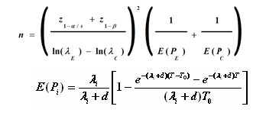
Power for Survival Analysis
Power for TTE related to several choices:
Design (Parallel, One-Arm, Complex)
Statistical Method (Log-Rank, Cox)
Endpoint (Hazard Ratio, Survival Time)
Survival Dist. (Exponential, Weibull)
Power is driven (primarily) by number of events (E) NOT sample size (N)
Often calculate E separate from N
Total Follow-up relevant for complex cases
Sample size determination interested in no. subjects to reach this events
Often via flexible “meta-model” which includes accrual, dropout, crossover etc
D Schoenfeld (1981)
L.S. Freedman (1982)
J.M. Lachin & M.A Foulkes (1986)
E Lakatos (1988)
Y. Tang (2021/2022)

Slide 9
Survival Analysis Design Issues
Part 2

Slide 10
Design Issues for Survival Analysis
Survival Distribution Issues
Expected (Parametric) Survival Distribution (e.g. Exponential)? Non-Proportional Hazards (e.g. Delayed Effect)? Time-Varying?
Study Design and Method Issues
Number of Groups Compared? Endpoint (e.g. OS and/or PFS)? Test Statistic (e.g. Hazard Ratio)? Statistical Test (e.g. Log-Rank)? Adaptive Design?
Recruitment Issues
Accrual Period Length? Accrual Pattern Expected (e.g. uniform)? Event-Driven vs Time-Driven Study Length? Censoring (e.g. Fixed Follow-up)?
Other Issues
Dropout (Simple vs. Dropout Distribution)? Drop-in/Non-Compliance? Cure Fraction? Competing Risks? Effect on Estimand Strategy?

Slide 11
Survival Analysis Power Inputs
Survival Distribution /Effect Size | Survival Distribution: Hazard Rate (Constant or Piecewise), Surviving Proportion Time, Median Survival, Distribution-Specific Parameters (e.g. Weibull Shape/Scale) Effect Size Choice + Estimate: Hazard Ratio, Relative Time, Survival Time Differences
Accrual/Follow-up | Follow-up/Study Length: Length of Subject Follow-up (Fixed Follow-up vs Event-Driven), Length of Study (Event-Driven vs Pre-Defined Time) -> Both feed into censoring strategy Accrual: Define via Accrual Period Length or Accrual Rate, Provide Accrual Process Pattern (Uniform/Constant Accrual, Parametric (e.g. truncated exponential), Piecewise)
Other Processes | Dropout: As % of Total N vs Modelling as Survival-like Hazard Rate/Pattern Group Cross-over: Non-compliance (trt -> Ctrl) & Drop-in (Ctrl -> Trt) rates Other Processes: Cure Event Rate/Pattern, Competing Risk Hazard Rate/Pattern

Slide 12
Survival Analysis | Example 1 ( Log-Rank)
“Using an unstratified log-rank test at the one-sided 2.5% significance level, a total of 282 events would allow 92.6% power to demonstrate a 33% risk reduction (hazard ratio for RAD/placebo of about 0.67, as calculated from an anticipated 50% increase in median PFS, from 6 months in placebo arm to 9 months in the RAD001 arm). With a uniform accrual of approximately 23 patients per month over 74 weeks and a minimum follow up of 39 weeks, a total of 352 patients would be required to obtain 282 PFS events, assuming an exponential progression-free survival distribution with a median of 6 months in the Placebo arm and of 9 months in RAD001 arm.
With an estimated 10% lost to follow up patients, a total sample size of 392 patients should be randomized.”
Parameter | Value
Significance Level (1-Sided) | 0.025
Placebo Median Survival (months) | 6
Everolimus Median Survival (months) | 9
Hazard Ratio | 0.66667
Accrual Period (Weeks) | 74
Minimum Follow-Up (Weeks) | 39
Power % (under constant HR) | 92.6

Slide 13
Non-Proportional Hazards
Part 3

Slide 14
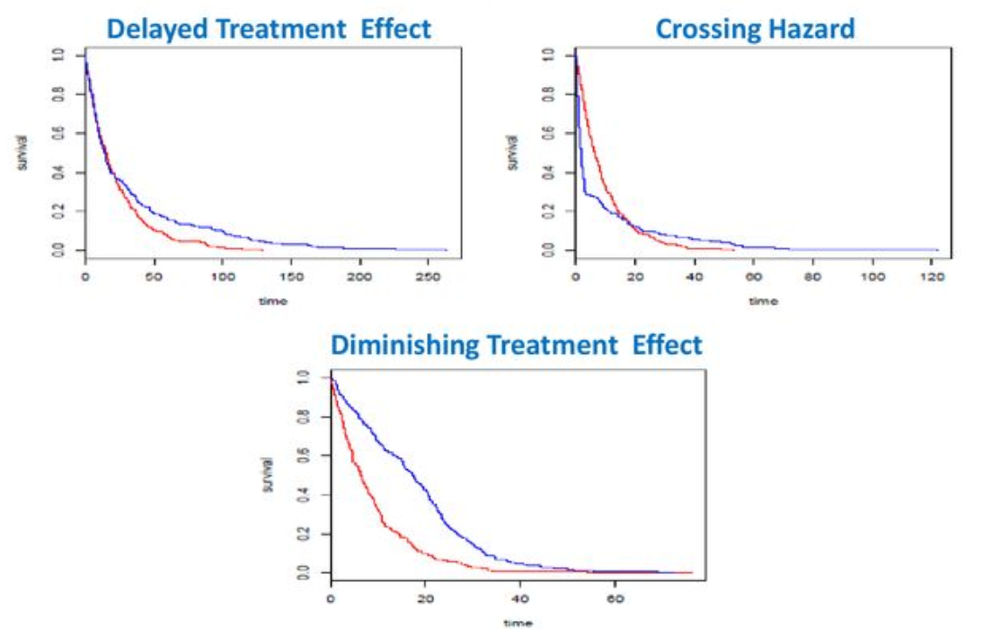
Non-Proportional Hazards ( NPH )
Common methods like Log-Rank/Cox Model assume “proportional hazards”
PH = Constant Hazard Ratio
Growing interest in “non-proportional hazards” scenarios like “delayed effects”
NPH = Hazard Ratio varies over time
Immunotherapies often have delayed effect
Significant interest in finding NPH-robust methods for clinical trials
On-going debate between various methods
Method ideally would be robust vs multiple survival pattern scenarios
Satrajit Roychoudhury (2018)

Slide 15
Non-Proportional Hazards Methods
Log-Rank | “Average Hazard Ratio” – same as from univariate Cox Regression model
Linear-Rank (Weighted) | Gehan-Breslow-Wilcoxon, Tarone-Ware, Farrington-Manning, Peto-Peto, Threshold Lag, Modestly Weighted Linear-Rank (MWLRT)
Piecewise Linear-Rank | Piecewise Parametric, Weighted Piecewise Model (e.g. APPLE), Change Point Models
Combination | Maximum Combination (MaxCombo) Test Procedure
Survival Time | Milestone Survival (KM), Restricted Mean Survival Time, Landmark Analysis
Relative Time | Ratio of Times to Reach Event Proportion, Accelerated Failure Time Models
Others | Responder-Based, Frailty Models, Renyi Models, Net Benefit (Buyse)

Slide 16
Maximum Combination (MaxCombo) Test
MaxCombo tests combination of multiple linear-rank tests simultaneously
MaxCombo controls Type I error while selecting “best” test from candidates
Typically, 2-4 candidate tests considered
Fleming-Harrington most common since flexible & includes Log-Rank + Peto-Peto
F-H (G) Tests | Proposal
G(0,1; 1,0) | Lee (2007)
G(0,0*; 0,1; 1,0) | Karrison (2016)
G(0,0; 0,1; 1,0; 1,1) | Lin et al (2020)
G(0,0; 0,0.5; 0.5,0; 0.5,0.5) | Roychoudhury et al (2021)
G(0,0; 0,0.5) | Mukhopadhyay et al (2022)
G(0,0; 0,0.5; 0.5,0) | Mukhopadhyay et al (2022)
*F-H(0,0) = Log-Rank Test

Slide 17
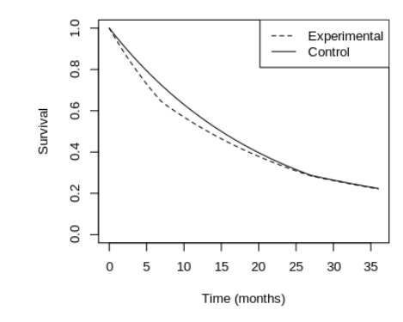
Maximum Combination Test Issues
Critics have focussed on Type I error control issues and estimand.
Statistical issues include significant results even if treatment always worse/equal or high “late efficacy” shown
Alternatives: Change F-M from 1->0.5 in MaxCombo; Modestly Weighted LR
Issues around interpretability of using the average hazard ratio as the estimand.
Suggestion – Use MaxCombo for the analysis but an alternative (RMST) for communicating results
Source: Magirr (2020)

Slide 18
Survival Analysis | Example 2 ( NPH )
Let us assume a study with expected results the same as the Everolimus study except assume no effect (i.e. a delayed effect) where HR = 1 for first 6 months and then the original desired hazard ratio (0.666…) occurs for the remainder of the study.
We will compare the results of the Log-Rank Test vs MaxCombo vs MaxCombo Test Choice (G(0,1)) vs 6-month Threshold Lag (APPLE)
Parameter | Value
Significance Level (1-Sided) | 0.025
Placebo Median Survival (months) | 6
Everolimus Median Survival (months) | 9
Hazard Ratio | 0.66667
Accrual Period (Weeks) | 74
Minimum Follow-Up (Weeks) | 39
Power % (under constant HR) | 92.6
“Artificial Delay” (Months) | 6

Slide 19
Discussion and Conclusions
Survival Analysis is one of the common statistical areas in clinical trials particularly in clinical areas such as oncology
Power analysis and sample size determination for survival involves finding the number of events required and sample size – the latter being more flexible
Trial considerations for power analysis include study design, statistical test, choice of endpoint and effect size, accrual and follow-up + dropout and cross-over
One recent area of interest has been methods for non-proportional hazards, such as the MaxCombo Test, with power methods becoming available in this area

Slide 20
Statsols.com/trial

Slide 21
Contact us: info@statsols.com More info: www.statsols.com
Thank You.

Slide 22
References (Survival Analysis)
Cox, D.R. and Oakes, D., 1984. Analysis of survival data. CRC press.
Cox, D.R., 1972. Regression models and life‐tables. Journal of the Royal Statistical Society: Series B (Methodological), 34(2), 187-202.
Collett, D., 2015. Modelling survival data in medical research. CRC press.
Fleming, T.R. and Harrington, D.P., 2013. Counting processes and survival analysis. John Wiley & Sons.
Klein, J.P., Van Houwelingen, H.C., Ibrahim, J.G. and Scheike, T.H. eds., 2016. Handbook of survival analysis. CRC Press.
Andersen, P.K., Borgan, O., Gill, R.D. and Keiding, N., 2012. Statistical models based on counting processes. Springer Science & Business Media.
Lin, H. and Zelterman, D., 2002. Modeling survival data: extending the Cox model.
Klein, J.P. and Moeschberger, M.L., 2003. Survival analysis: techniques for censored and truncated data. New York: Springer.
Lemeshow, S., May, S. and Hosmer Jr, D.W., 2011. Applied survival analysis: regression modeling of time-to-event data. John Wiley & Sons.
Aalen, O., Borgan, O. and Gjessing, H., 2008. Survival and event history analysis: a process point of view. Springer Science & Business Media.
U.S. Food and Drug Administration, Clinical Trial Endpoints for the Approval of Cancer Drugs and Biologics. December 2018 Available from: http://www.fda.gov/downloads/Drugs/GuidanceComplianceRegulatoryInformation/Guidances/ucm071590.pdf

Slide 23
References (Survival Power Analysis)
Kilickap, S., Demirci, U., Karadurmus, N., Dogan, M., Akinci, B. and Sendur, M.A.N., 2018. Endpoints in oncology clinical trials. J BUON, 23, 1-6.
Freedman, L. S. 1982. Tables of the number of patients required in clinical trials using the logrank test. Statistics in medicine, 1(2), 121-129.
Schoenfeld, D. A. 1983. Sample-size formula for the proportional-hazards regression model. Biometrics, 499-503.
Lachin, J. M., & Foulkes, M. A. 1986. Evaluation of sample size and power for analyses of survival with allowance for nonuniform patient entry, losses to follow-up, noncompliance, and stratification. Biometrics, 507-519.
Lakatos, E. 1988. Sample sizes based on the log-rank statistic in complex clinical trials. Biometrics, 229-241.
Lakatos, E., & Lan, K. K. G., 1992. A comparison of sample size methods for the logrank statistic. Statistics in Medicine, 11(2), 179–191.
Bariani, G.M., de Celis, F., Anezka, C.R., Precivale, M., Arai, R., Saad, E.D. and Riechelmann, R.P., 2015. Sample size calculation in oncology trials. American journal of clinical oncology, 38(6), 570-574.
Tang Y. 2021. A unified approach to power and sample size determination for log-rank tests under proportional and nonproportional hazards. Statistical Methods in Medical Research ,Vol. 30(5) 1211–1234.
Tang, Y., 2022. Complex survival trial design by the product integration method. Statistics in medicine, 41(4), 798-814.
Hsieh, F.Y. and Lavori, P.W., 2000. Sample-size calculations for the Cox proportional hazards regression model with nonbinary covariates. Controlled clinical trials, 21(6), 552-560.

Slide 24
References (Survival Power Analysis)
Wu, J. (2014). Sample size calculation for the one-sample log-rank test. Pharmaceutical Statistics, 14(1), 26–33.
Phadnis, M.A., 2019. Sample size calculation for small sample single-arm trials for time-to-event data: Logrank test with normal approximation or test statistic based on exact chi-square distribution?. Contemporary clinical trials communications, 15, p.100360.
Jung S. H. (2008). Sample size calculation for the weighted rank statistics with paired survival data. Statistics in medicine, 27(17), 3350–3365.
Lachin, J.M., 2013. Sample size and power for a logrank test and Cox proportional hazards model with multiple groups and strata, or a quantitative covariate with multiple strata. Statistics in medicine, 32(25), 4413-4425.
Litwin, S., Wong, Y.-N. and Hudes, G. 2007, Early stopping designs based on progression-free survival at an early time point in the initial cohort. Statistics in Medicine, Vol. 26(14) 4400-4415.
Liu, Y., & Lim, P. (2017). Sample size increase during a survival trial when interim results are promising. Communications in Statistics-Theory and Methods, 46(14), 6846-6863.
Freidlin, B., & Korn, E. L. (2017). Sample size adjustment designs with time-to-event outcomes: a caution. Clinical Trials, 14(6), 597-604.
Ren, S., & Oakley, J. E. (2014). Assurance calculations for planning clinical trials with time‐to‐event outcomes. Statistics in medicine, 33(1), 31-45.
Yao, J. C., et. al. 2011. Everolimus for advanced pancreatic neuroendocrine tumors. New England Journal of Medicine, 364(6), 514-523.

Slide 25
References (Non-Proportional Hazards)
Fine, G. D., 2007. Consequences of delayed treatment effects on analysis of time-to-event endpoints. Drug Information Journal, 41(4), 535-539.
Alexander, B.M., Schoenfeld, J.D. and Trippa, L., 2018. Hazards of hazard ratios-deviations from model assumptions in immunotherapy. The New England journal of medicine, 378(12), pp.1158-1159.
Public Workshop: Oncology Clinical Trials in the Presence of Non‐Proportional Hazards, The Duke‐Margolis Center for Health Policy, Feb. 2018. Available at: https://slideplayer.com/slide/14007912/
Royston, P. and B Parmar, M.K., 2020. A simulation study comparing the power of nine tests of the treatment effect in randomized controlled trials with a time-to-event outcome. Trials, 21(1), pp.1-17.
Logan, B.R., Klein, J.P. and Zhang, M.J., 2008. Comparing treatments in the presence of crossing survival curves: an application to bone marrow transplantation. Biometrics, 64(3), pp.733-740.
Fleming, T.R. and Harrington, D.P., 1981. A class of hypothesis tests for one and two sample censored survival data. Communications in Statistics-Theory and Methods, 10(8), pp.763-794.
Pepe, M.S. and Fleming, T.R., 1989. Weighted Kaplan-Meier statistics: a class of distance tests for censored survival data. Biometrics, pp.497-507.
Breslow, N. E., Edler, L., & Berger, J., 1984. A two-sample censored-data rank test for acceleration. Biometrics, 1049-1062
Lan, K.K.G. and Wittes, J., 1990. Linear rank tests for survival data: equivalence of two formulations. The American Statistician, 44(1), 23-26.
Yang, S and Prentice, R, 2010. Improved Logrank‐Type Tests for Survival Data Using Adaptive Weights, Biometrics 66: 30‐38

Slide 26
References (Non-Proportional Hazards)
Lee, S. H., 2007. On the versatility of the combination of the weighted log-rank statistics. Computational statistics & data analysis, 51(12), 6557-6564.
Hasegawa, T., 2014. Sample size determination for the weighted log-rank test with the Fleming–Harrington class of weights in cancer vaccine studies. Pharmaceutical Statistics, 13(2), 128–135.
Karrison, T., 2016. Versatile tests for comparing survival curves based on weighted log-rank statistics. Stata Journal, StataCorp LP, vol. 16(3), 678–690.
Lin, R.S., Lin, J., Roychoudhury, S., Anderson, K.M., Hu, T., Huang, B., Leon, L.F., Liao, J.J., Liu, R., Luo, X. and Mukhopadhyay, P., 2020. Alternative Analysis Methods for Time to Event Endpoints Under Nonproportional Hazards: A Comparative Analysis. Statistics in Biopharmaceutical Research, 12(2), 187-198.
Roychoudhury, S., Anderson, K.M., Ye, J. and Mukhopadhyay, P., 2021. Robust Design and Analysis of Clinical Trials With Nonproportional Hazards: A Straw Man Guidance From a Cross-Pharma Working Group. Statistics in Biopharmaceutical Research, 1-15.
Mukhopadhyay, P., Ye, J., Anderson, K.M., Roychoudhury, S., Rubin, E.H., Halabi, S. and Chappell, R.J., 2022. Log-rank test vs MaxCombo and difference in restricted mean survival time tests for comparing survival under nonproportional hazards in immuno-oncology trials: a systematic review and meta-analysis. JAMA oncology.
Freidlin, B. and Korn, E.L., 2019. Methods for accommodating nonproportional hazards in clinical trials: ready for the primary analysis?. Journal of Clinical Oncology, 37(35), 3455.
Bartlett, J.W., Morris, T.P., Stensrud, M.J., Daniel, R.M., Vansteelandt, S.K. and Burman, C.F., 2020. The hazards of period specific and weighted hazard ratios. Statistics in Biopharmaceutical Research, 12(4), p.518.

Slide 27
References (Non-Proportional Hazards)
Magirr, D. and Burman, C.F., 2019. Modestly weighted logrank tests. Statistics in medicine, 38(20), 3782-3790.
Magirr, D., 2021. Non‐proportional hazards in immuno‐oncology: Is an old perspective needed?. Pharmaceutical Statistics, 20(3), pp.512-527.
Magirr, D., & Burman, C. F., 2023. The MaxCombo Test Severely Violates the Type I Error Rate. JAMA oncology, 9(4), 571–572.
Mukhopadhyay, P., Roychoudhury, S. and Anderson, K.M., 2023. The MaxCombo Test Severely Violates the Type I Error Rate—Reply. JAMA oncology, 9(4), 572-572.
Royston, P. and Parmar, M.K., 2013. Restricted mean survival time: an alternative to the hazard ratio for the design and analysis of randomized trials with a time-to-event outcome. BMC medical research methodology, 13(1), 1-15.
Uno, H., Claggett, B., Tian, L., Inoue, E., Gallo, P., Miyata, T., Schrag, D., Takeuchi, M., Uyama, Y., Zhao, L. and Skali, H., 2014. Moving beyond the hazard ratio in quantifying the between-group difference in survival analysis. Journal of clinical Oncology, 32(22), 2380.
Uno, H., Wittes, J., Fu, H., Solomon, S., Claggett, B., Tian, L., Cai, T., Pfeffer, M., Evans, S. and Wei, L., 2015 Alternatives to Hazard Ratios for Comparing the Efficacy or Safety of Therapies in Noninferiority Studies, Annals of Internal Medicine, 163(2), p.127
Kim, D.H., Uno, H. and Wei, L.J., 2017. Restricted mean survival time as a measure to interpret clinical trial results. JAMA cardiology, 2(11), 1179-1180.
Uno, H. and Tian, L., 2020. Is the log-rank and hazard ratio test/estimation the best approach for primary analysis for all trials?. Journal of clinical oncology: official journal of the American Society of Clinical Oncology, 38(17), pp.2000-2001.

Slide 28
References (Non-Proportional Hazards)
Eaton, A., Therneau, T. and Le-Rademacher, J., 2020. Designing clinical trials with (restricted) mean survival time endpoint: Practical considerations. Clinical Trials, 17(3), 285-294.
Xu, Z., Zhen, B., Park, Y., & Zhu, B., 2017. Designing therapeutic cancer vaccine trials with delayed treatment effect, Statistics in medicine, 36(4), 592-605
Xu, Z., Park, Y., Zhen, B. and Zhu, B., 2018. Designing cancer immunotherapy trials with random treatment time‐lag effect. Statistics in medicine, 37(30), 4589-4609.
Xu, Z., Park, Y., Liu, K. and Zhu, B., 2020. Treating non-responders: pitfalls and implications for cancer immunotherapy trial design. Journal of hematology & oncology, 13(1), 1-11.
Phadnis, M. A., Mayo, M. S., 2021. Sample size calculation for two-arm trials with time-to-event endpoint for non-proportional hazards using the concept of Relative Time when inference is built on comparing Weibull distributions. Biometrical Journal, 63(7), 1406-1433
Anderson, K.M., 1991. A nonproportional hazards Weibull accelerated failure time regression model. Biometrics, 281-288.
Balan, T.A. and Putter, H., 2020. A tutorial on frailty models. Statistical Methods in Medical Research, 29(11), 3424-3454.
Chen, L.M., Ibrahim, J.G. and Chu, H., 2014. Sample size determination in shared frailty models for multivariate time-to-event data. Journal of biopharmaceutical statistics, 24(4), 908-923.
Rényi, A., 1953. On the theory of order statistics. Acta Math. Acad. Sci. Hung, 4(2), pp.48-89.
Buyse, M., 2010. Generalized pairwise comparisons of prioritized outcomes in the two‐sample problem. Statistics in medicine, 29(30), pp.3245-3257.

