Slide 1
Flexible Clinical Trial Design
Survival, Stepped-Wedge & MAMS Designs
Demonstrated on
Notes:
www.Statsols.com/trial

Slide 2
Webinar Host
Head of Statistics
nQuery Lead Researcher
FDA Guest Speaker
Guest Lecturer
HOSTED BY: Ronan Fitzpatrick

Slide 3
AGENDA
Sample Size for Flexible Survival Analysis
Power for Stepped-Wedge Designs
Designing MAMS Group Sequential Design
Conclusions and Discussion

Slide 4
The complete trial design platform to make clinical trials faster, less costly and more successful
The solution for optimizing clinical trials

Slide 5
In 2019, 90% of organizations with clinical trials approved by the FDA used nQuery

Slide 6
Flexible Survival Analysis
Part 1

Slide 7
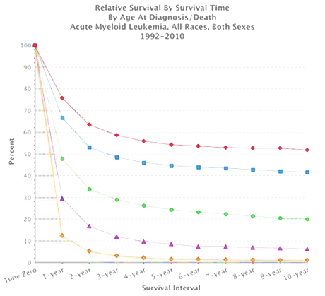
Sample Size for Survival Analysis
Survival Analysis is about the expected duration of time to an event
Methods like log-rank test & Cox Model
Power is related to the number of events NOT the sample size
Sample Size = Subjects to get # of events
Flexibility expected in survival analysis methods and estimation
Options will depend on model and endpoint and affect design choices
Source: SEER, NCI

Slide 8
Survival SSD Design Issues
What is the expected survival curve(s) in the group(s)?
Parametric approximation? Piece-wise curve? Proportional Hazards?
Effect of unequal follow-up due to accrual period?
What accrual pattern to assume? Maximum follow-up same for all?
How to deal with censoring, dropouts or other risks?
Right-censored? Want to model dropout and/or competing risks?
Effect of subjects crossing over or informative censoring?
Appropriate estimand for trial? Enough info to assume before study?

Slide 9
Worked Example 1
“Using an unstratified log-rank test at the one-sided 2.5% significance level, a total of 282 events would allow 92.6% power to demonstrate a 33% risk reduction (hazard ratio for RAD/placebo of about 0.67, as calculated from an anticipated 50% increase in median PFS, from 6 months in placebo arm to 9 months in the RAD001 arm). With a uniform accrual of approximately 23 patients per month over 74 weeks and a minimum follow up of 39 weeks, a total of 352 patients would be required to obtain 282 PFS events, assuming an exponential progression-free survival distribution with a median of 6 months in the Placebo arm and of 9 months in RAD001 arm.
With an estimated 10% lost to follow up patients, a total sample size of 392 patients should be randomized.”
Parameter | Value
Significance Level (One-Sided) | 0.025
Placebo Median Survival (months) | 6
Everolimus Median Survival (months) | 9
Hazard Ratio | 0.66667
Accrual Period (Weeks) | 74
Minimum Follow-Up (Weeks) | 39
Power (%) | 92.6
Source: nejm.org
Source: NEJM (2011)

Slide 10
Stepped-Wedge CRT
Part 2

Slide 11
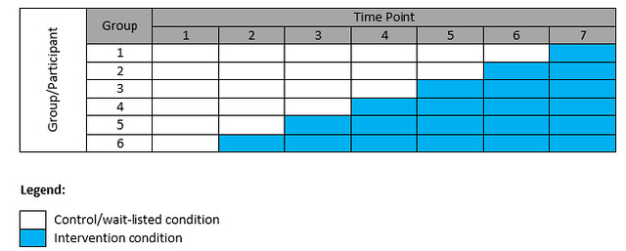
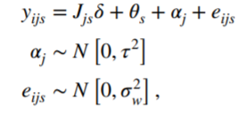
Stepped-Wedge Designs
RCT where subjects move from treatment to control over time
1-way crossover, all control @ baseline
Often used w/ cluster randomization
“Unit” becomes cluster not subject
Useful for practical and statistical reasons, though some drawbacks
Uses: Treatment “scarcity”, patient recruitment, within-cluster analysis
Drawbacks: Allocation bias, expensive, complex analysis

Slide 12
Stepped-Wedge Design Issues
Model must account for between-cluster & within-cluster variance, temporal effects and stepped-wedge structure
Different choices available for stepped-wedge design
Complete, incomplete, “missing” observations, partial effects
For cluster randomization, need to account for “self-similarity” within clusters using ICC, COV or similar
SSD well-developed for cross-sectional (new subjects per time) SW-CRT for common endpoints (mean, props, rates)

Slide 13
Worked Example 2
“We estimated that there would be approximately 12 births after 40 weeks gestation per week in each team. Birth data were collected for each team from 12 weeks prior to training until 12 weeks following training. Given this fixed sample size, we determined what difference in the primary outcome (proportion of women swept) would be detectable with 80% power. … We were guided by a review of estimates of ICCs which found that their values are typically in the range of 0.02–0.1. A small audit suggested … 32% of nulliparous women and 57% of multiparous women were currently being swept. … It was estimated that at 5% significance (two-tailed) and 80% power, for ICCs in the range of 0.02–0.1 and for baseline event rates of 20–60%, the study would have power to detect around a 10% absolute increase in proportion of women being swept. This was an increase felt to be clinically worthwhile.”
Parameter | Value
Significance Level (Two-Sided) | 0.05
Time Measurements (Weeks) | 12
Number of Clusters | 10
Measurements Per Cluster per Time | 12
ICC | 0.02 – 0.1
Baseline Proportion | 0.2-0.6
Power (%) | 80
Source: nejm.org
Source: Trials (2017)

Slide 14
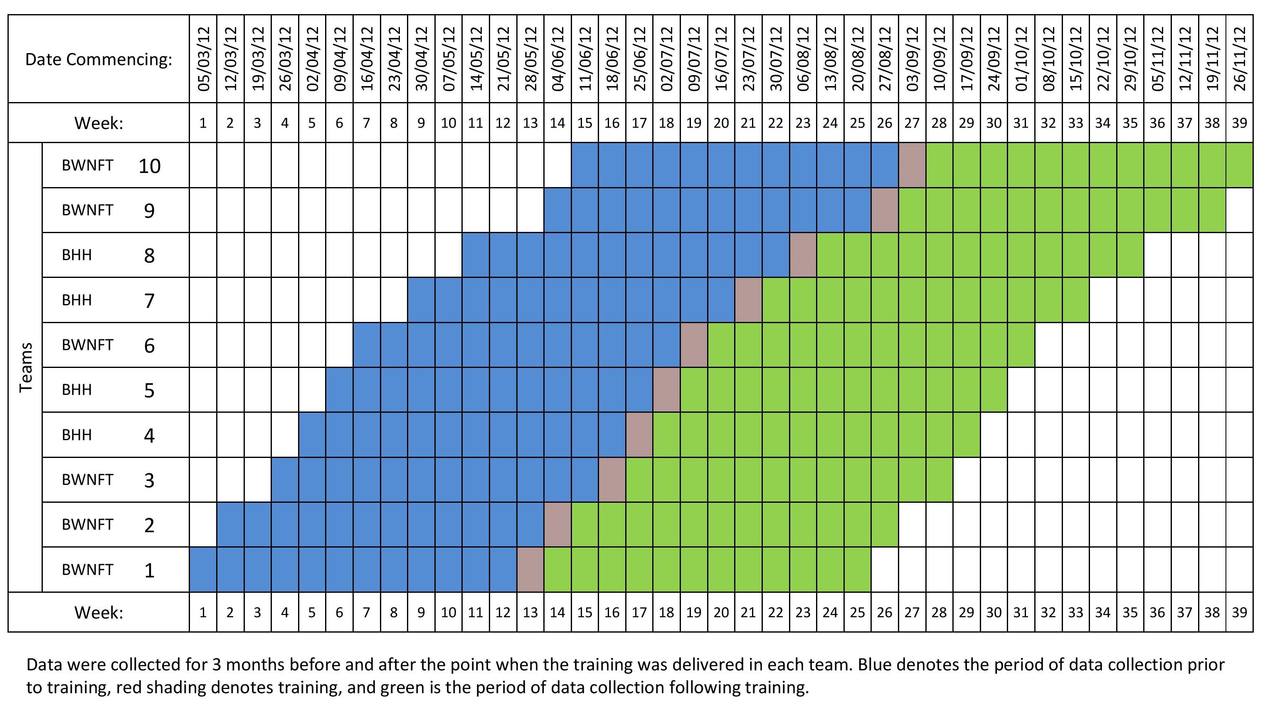

Slide 15
Designing MAMS GSD
Part 3

Slide 16
MAMS Overview
Multi-arm Multi-stage designs compare multiple treatments (>2) with multiple stages (>1) for adaptions
Different choices available for adaptions at each stage
Drop arms/pick “winner(s)”, add arms, stop early, increase N
MAMS designs provide flexibility to assess wide range of treatments and mold trial towards desired end state
Increasing interest in MAMS designs to allow seamless designs & allow quicker evaluation of multiple treatments

Slide 17
MAMS Review
Advantages
Efficiency vs multiple trials
Seamless Trial Designs
Flexibility to add/drop trt.
Shared Control
More patients on trt. arms
Disadvantages
More Complex (Time Bias)
Logistical Issues
Uncertain Costs/Duration
Regulatory Approval
No Direct Trt. Comparisons

Slide 18
MAMS Methods Examples
1 | MAMS Group Sequential Design | Magirr et al. (2012), Gao et al (2014)
2 | Fixed K Drop the Loser Design | Wason et al. (2017)
3 | Optimal MAMS GSD | Wason and Jaki (2012)
4 | I-outcome/D-outcome MAMS | Royston et al. (2011)
5 | Add Arms Designs | Choodari-Oskooei et al (2020)
6 | (2 Stage) P-value Combination | Posch et al. (2005)
7 | Bayesian MAMS | Whitehead et al. (2015)

Slide 19
MAMS Design Overview
Multi-arm multi-stage design combines usual design issues seen from multiplicity and adaptive design
Adaptive Design: Blinding, Pre-specification, efficiency, sim.
Multiplicity: FWER control, direct comparisons, choice limits
Disease and treatment characteristics effect model choice
Rare subtypes, common control possible, multiple diseases
Need statistical model that can accommodate choices
Add arms, drop arms, stop early, target # winners/losers?

Slide 20
Types of MAMS Design Trials
Platform Trial
Multiple therapies added/dropped for single disease over time
Umbrella Trial
Multiple targeted therapies for single disease (by gene/biomarker)
Basket Trial
Single targeted therapy for multiple diseases or disease subtypes
All typically use master protocol for clinical trial design & adaptive umbrella/basket can be seen as platform trials

Slide 21
MAMS Group Sequential Design
Can extend group sequential design to accommodate multiple arms by using Dunnett’s test to control FWER
Can use standard group sequential design approaches (error spending) if test for maximum effect size
Efficacy: max(ES) > efficacy bound (i.e. ≥1 trt. “succeeds”), Futility: max(ES) < futility bound (i.e. all arms “fail”)
However, can continue trial if desired but note requires common control group & not making direct comparisons

Slide 22
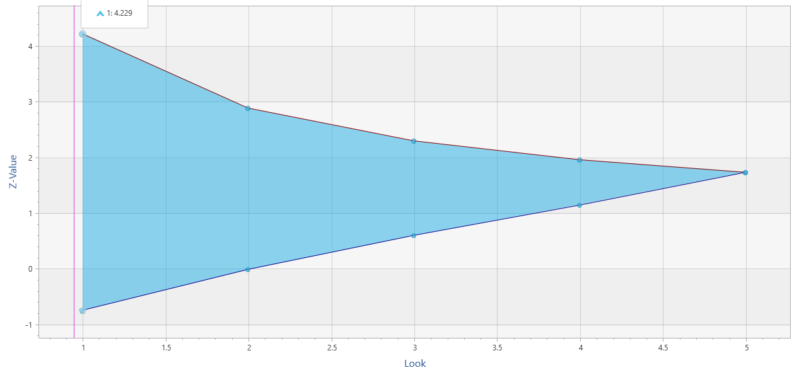
Group Sequential Design
2 early stopping criteria (work similar)
Efficacy (α-spending)
Futility (β-spending)
Use Lan & DeMets “spending function” to account for multiple analyses/chances
Spend proportion of total error at each look
More conservative N vs. fixed term analysis
Multiple SF available (incl. custom)
O’Brien-Fleming (conservative), Pocock (liberal)
Power Family, Hwang-Shih-DeCani (flexible)
Different heuristics for efficacy/futility
Conservative SF expected for efficacy
More flexibility for futility (less problematic)
$$α\left(τ\right)=2\left(1−Φ\left(\frac{z_{α/2}}{τ}\right)\right)$$
O’Brien-Fleming Spending Function
Notes:
Group sequential trials differ from the fixed period trials in that the data from the trial is analysed at one or more stages prior to the conclusion of the trial.
As a result the alpha value applied at each analysis or ‘look’ must be adjusted to preserve the overall Type 1 error.
So, in effect you are ‘spending’ some of your alpha at each ‘look’. The alpha values used at each look are calculated based upon the spending function chosen, the number of looks to be taken during the course of the trial as well as the overall Type 1 error rate.

Slide 23
Worked Example 3
Parameter | Value
Significance Level (1-Sided) | 0.025
Number of Arms (N Ratio) | 4 (1:1:1:1)
Number of Stages (incl. final) | 2-4
FEV Means (0 = Control) | 0,0.14,0.16,0.18
Common Standard Deviation | 0.5
Power | 90%
Spending Function (Efficacy) | O’Brien-Fleming
SF (Non-binding - Futility) | O’Brien-Fleming
… (INHANCE) was a randomized clinical trial for the treatment of (COPD) in which four doses (75 mg, 150 mg, 300 mg, 500 mg) of inhaled indacaterol … were compared to placebo. The primary efficacy objective was to show the superiority of at least one dose over placebo at week 12 with respect to 24- hour post-dose (trough) forced expiratory volume in 1 second (FEV1). The improvement in FEV1 for indacaterol versus placebo, denoted by δ, was expected to be between 0.14 and 0.18 liters and the between-subject variability was assumed to be σ = 0.5. … we will use this setting to illustrate a MAMS design comprising three pair-wise comparisons (150 mg, 300 mg, 500 mg) to placebo over up to four equally spaced looks at the accumulating data. The design will utilize the Lan and DeMets (1983) error spending function to generate O’Brien-Fleming (1979) type boundaries … to generate early stopping efficacy boundaries.

Slide 24
MAMS GSD Considerations
Same logistical considerations e.g. overshoot and restrictions e.g. broken assumptions effect, as for GSD
Shared control group is key assumption & need appropriate size (√K, optimal) & definition
No direct comparison between treatments (and note power definition) so more a “filter” for effect sizes
Extension possible to more complex designs such as sample size re-estimation and ability to add arms

Slide 25
Discussion and Conclusions
Flexibility of increasing interest in trial design and SSD
Better accommodate complexities in clinical and RW trials
Survival analysis design methods built for flexibility
E.g. Interest in non-proportional hazards in immunotherapy
Stepped-Wedge Designs accommodate real world issues
Flexibility for constraints of field trials in real-world situations
MAMS Group Sequential Design extends GSD for MAMS
Can flexibly dropping of arms while still using GSD framework

Slide 26
Thank You
Questions?
info@statsols.com
Further information at Statsols.com

Slide 27
Statsols.com/trial

Slide 28
For video tutorials and worked examples
Statsols.com/start

Slide 29
The solution for optimizing clinical trials
CRM
MCP-Mod
Simon’s Two Stage
1000+ Scenarios for Fixed Term, Adaptive & Bayesian Methods
Survival, Means, Proportions & Count endpoints
Sample Size Re-Estimation
Group Sequential Trials
Bayesian Assurance
Cross over & personalized medicine
EARLY PHASE
Animal Studies ANOVA / ANCOVA
PRE-CLINICAL / RESEARCH
CONFIRMATORY
Cohort Study
Case-control Study
POSTMARKETING

Slide 30
References (Survival)
Klein, J.P. and Moeschberger, M.L., 2006. Survival analysis: techniques for censored and truncated data. Springer Science & Business Media.
Hosmer, D.W., Lemeshow, S., & May, S., Applied Survival Analysis: Regression Modeling of Time‐to‐Event Data, Second Edition. Wiley
Collett, D., 2015. Modelling survival data in medical research. CRC press.
Cox, D.R., 1972. Regression models and life‐tables. Journal of the Royal Statistical Society: Series B (Methodological), 34(2), pp.187-202.
Bariani, G.M., de Celis, F., Anezka, C.R., Precivale, M., Arai, R., Saad, E.D. and Riechelmann, R.P., 2015. Sample size calculation in oncology trials. American journal of clinical oncology, 38(6), pp.570-574.
Freedman, L. S., 1982. Tables of the number of patients required in clinical trials using the logrank test. Statistics in medicine, 1(2), 121-129.
·Kim, K. and Tsiatis, A.A., 1990. Study duration for clinical trials with survival response and early stopping rule, Biometrics, pp. 81-92

Slide 31
References (Survival)
Schoenfeld, D. A., 1983. Sample-size formula for the proportional-hazards regression model. Biometrics, 499-503.
Lachin, J. M., & Foulkes, M. A., 1986. Evaluation of sample size and power for analyses of survival with allowance for nonuniform patient entry, losses to follow-up, noncompliance, and stratification. Biometrics, 507-519.
Lakatos, E., 1988. Sample sizes based on the log-rank statistic in complex clinical trials. Biometrics, 229-241.
Hsieh, F.Y. and Lavori, P.W., 2000. Sample-size calculations for the Cox proportional hazards regression model with nonbinary covariates. Controlled clinical trials, 21(6), pp.552-560.
Xu, Z., Zhen, B., Park, Y., & Zhu, B. (2017), Designing therapeutic cancer vaccine trials with delayed treatment effect, Statistics in medicine, 36(4), pp. 592-605
Yao, J. C., et. al. (2011). Everolimus for advanced pancreatic neuroendocrine tumors. New England Journal of Medicine, 364(6), 514-523.

Slide 32
References (Stepped-Wedge)
Brown, C.A. and Lilford, R.J., 2006. The stepped wedge trial design: a systematic review. BMC medical research methodology, 6(1), p.54.
Hemming, K., Haines, T.P., Chilton, P.J., Girling, A.J. and Lilford, R.J., 2015. The stepped wedge cluster randomised trial: rationale, design, analysis, and reporting. Bmj, 350, p.h391.
Hemming, K., Lilford, R., & Girling A.J., 2015 Stepped-wedge cluster randomised controlled trials: a generic framework including parallel and multiple-level designs, Statistics in Medicine, 34, pp. 181-196
Hemming, K., & Girling A., 2014. A menu-driven facility for power and detectable-difference calculations in stepped-wedge cluster-randomized trials, The Stata Journal, 14, pp. 363-380
Hussey, M.A., & Hughes, J.P., 2007. Design and analysis of stepped wedge cluster randomized trials, Contemporary Clinical Trials, 28, pp. 182-191
Kenyon, S., Dann, S., Hope, L., Clarke, P., Hogan, A., Jenkinson, D. and Hemming, K., 2017. Evaluation of a bespoke training to increase uptake by midwifery teams of NICE Guidance for membrane sweeping to reduce induction of labour: a stepped wedge cluster randomised design. Trials, 18(1), p.357.

Slide 33
References (MAMS)
Millen, G.C. and Yap, C., 2019. Adaptive trial designs: what are multiarm, multistage trials?. Archives of Disease in Childhood-Education and Practice.
Jaki, T., 2015. Multi-arm clinical trials with treatment selection: what can be gained and at what price?. Clinical Investigation, 5(4), pp.393-399.
Ghosh, P., Liu, L. and Mehta, C., 2020. Adaptive multiarm multistage clinical trials. Statistics in Medicine.
European Patients’ Academy, New approaches to clinical trials: Adaptive designs, 2015, Available from: https://www.eupati.eu/clinical-development-and-trials/new-approaches-to-clinical-trials-adaptive-designs/
U.S. Food and Drug Administration, Master Protocols: Efficient Clinical Trial Design Strategies To Expedite Development of Oncology Drugs and Biologics (Draft Guidance), October 2018 Available from: https://www.fda.gov/media/120721/download
Friede, T. and Stallard, N., 2008. A comparison of methods for adaptive treatment selection. Biometrical Journal: Journal of Mathematical Methods in Biosciences, 50(5), pp.767-781.
Magirr D., Jaki T., Whitehead J., 2012, A generalized Dunnett test for multi-arm multi-stage clinical studies with treatment selection. Biometrika, 99(2), pp.494-501.

Slide 34
References (MAMS)
Magirr, D., Stallard, N. and Jaki, T., 2014. Flexible sequential designs for multi‐arm clinical trials. Statistics in Medicine, 33(19), pp.3269-3279.
Gao, P., Liu, L. and Mehta, C., 2014. Adaptive sequential testing for multiple comparisons. Journal of biopharmaceutical statistics, 24(5), pp.1035-1058.
Ghosh, P., Liu, L., Senchaudhuri, P., Gao, P. and Mehta, C., 2017. Design and monitoring of multi‐arm multi‐stage clinical trials. Biometrics, 73(4), pp.1289-1299.
Wason, J., Stallard, N., Bowden, J. and Jennison, C., 2017. A multi-stage drop-the-losers design for multi-arm clinical trials. Statistical methods in medical research, 26(1), pp.508-524.
Wason, J.M. and Jaki, T., 2012. Optimal design of multi‐arm multi‐stage trials. Statistics in medicine, 31(30), pp.4269-4279.
Royston, P., Barthel, F.M., Parmar, M.K., Choodari-Oskooei, B. and Isham, V., 2011. Designs for clinical trials with time-to-event outcomes based on stopping guidelines for lack of benefit. Trials, 12(1), p.81.
Royston, P., Parmar, M.K. and Qian, W., 2003. Novel designs for multi‐arm clinical trials with survival outcomes with an application in ovarian cancer. Statistics in medicine, 22(14), pp.2239-2256.

Slide 35
References (MAMS)
Choodari-Oskooei, B., Bratton D.J., Gannon M.R., Meade A.M., Sydes M.R., Parmar M., 2020. Adding new experimental arms to randomised clinical trials: Impact on error rates. Clinical Trials. OnlineFirst
Sydes, M.R., Parmar, M.K., Mason, M.D., Clarke, N.W., Amos, C., Anderson, J., de Bono, J., Dearnaley, D.P., Dwyer, J., Green, C. and Jovic, G., 2012. Flexible trial design in practice-stopping arms for lack-of-benefit and adding research arms mid-trial in STAMPEDE: a multi-arm multi-stage randomized controlled trial. Trials, 13(1), p.168.
Posch, M., Koenig, F., Branson, M., Brannath, W., Dunger‐Baldauf, C. and Bauer, P., 2005. Testing and estimation in flexible group sequential designs with adaptive treatment selection. Statistics in medicine, 24(24), pp.3697-3714.
Whitehead, J., Cleary, F. and Turner, A., 2015. Bayesian sample sizes for exploratory clinical trials comparing multiple experimental treatments with a control. Statistics in medicine, 34(12), pp.2048-2061.
Woodcock, J. and LaVange, L.M., 2017. Master protocols to study multiple therapies, multiple diseases, or both. New England Journal of Medicine, 377(1), pp.62-70.

Slide 36
References (MAMS)
Park, J.J., Siden, E., Zoratti, M.J., Dron, L., Harari, O., Singer, J., Lester, R.T., Thorlund, K. and Mills, E.J., 2019. Systematic review of basket trials, umbrella trials, and platform trials: a landscape analysis of master protocols. Trials, 20(1), pp.1-10.
Park, J.J., Hsu, G., Siden, E.G., Thorlund, K. and Mills, E.J., 2020. An overview of precision oncology basket and umbrella trials for clinicians. CA: A Cancer Journal for Clinicians, 70(2), pp.125-137.
Strzebonska, K. and Waligora, M., 2019. Umbrella and basket trials in oncology: ethical challenges. BMC medical ethics, 20(1), p.58.
Wason, J., Magirr, D., Law, M. and Jaki, T., 2016. Some recommendations for multi-arm multi-stage trials. Statistical methods in medical research, 25(2), pp.716-727.
Jennison, C., & Turnbull, B. W. (1999). Group sequential methods with applications to clinical trials. CRC Press.
Dunnett, C.W., 1955. A multiple comparison procedure for comparing several treatments with a control. Journal of the American Statistical Association, 50(272), pp.1096-1121.

