Slide 1
Improving Sample Size using Bayesian Thinking
Hybrid Bayesian / Frequentist Methods for Sample Size Determination
Demonstrated on
Notes:
www.Statsols.com/trial

Slide 2
Webinar Host
Host
Paul Murphy
nQuery Research Statistician

Slide 3
AGENDA
1) Bayesian Sample Size Determination
2) Bayesian Assurance
3) Mixed Bayesian/Frequentist Intervals
4) Discussion and Conclusions

Slide 4
The complete solution for optimizing your clinical trial designs
✓ CRM
✓ MCP-Mod
✓ Simon’s Two Stage
✓ Fleming’s GST
1000+ Scenarios for Fixed Term, Adaptive & Bayesian Methods
✓ Survival, Means, Proportions & Count endpoints
✓ Group Sequential Trials
✓ Bayesian: - Assurance
- Credible Intervals
- Posterior Error Approach
✓ Sample Size Re-Estimation
✓ Cross over & personalized medicine
✓ MAMS
✓ Prediction
EARLY PHASE
Animal Studies ANOVA / ANCOVA
PRE-CLINICAL RESEARCH
CONFIRMATORY
Cohort Study
Case-control Study
POST MARKETING

Slide 5
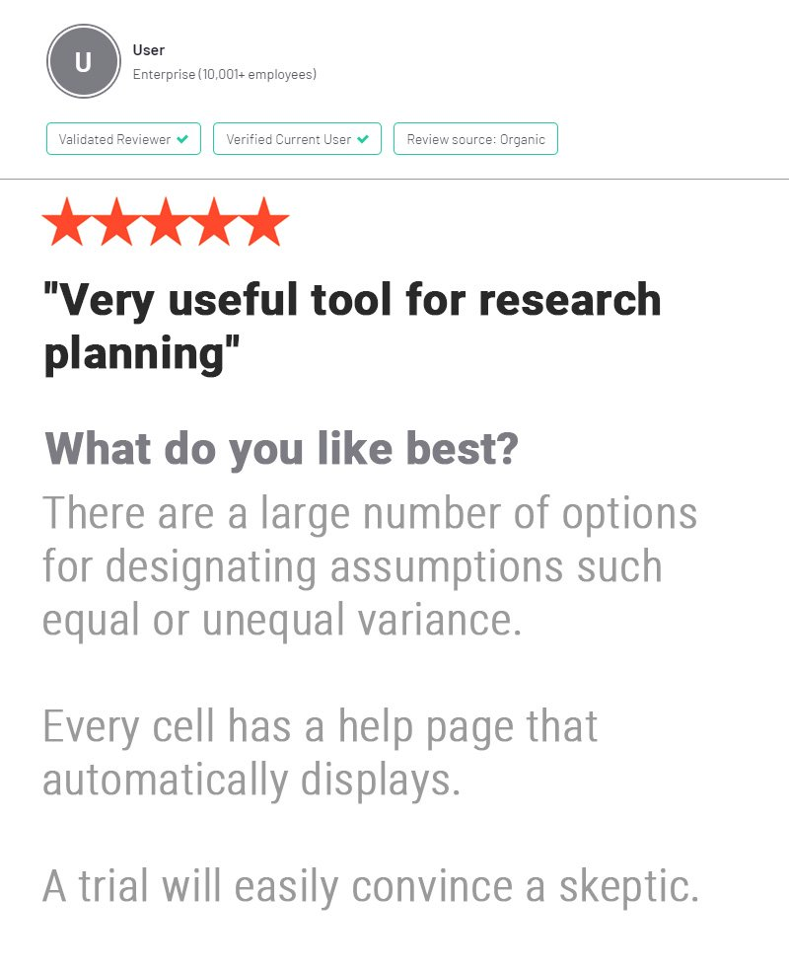
In 2021, 88% of organizations with clinical trials approved by the FDA used nQuery

Slide 6
Bayesian Sample Size Determination
Part 1

Slide 7
Sample Size Determination
What is Sample Size Determination (SSD)?
SSD is the process of finding an appropriate sample size for a study.
We want to determine the minimum sample size that is expected to reach a desired value of a certain metric (e.g. power, interval width, cost).
Why is SSD important?
It is crucial that we arrive at valid conclusions and an appropriate sample size will reduce the chance of large errors.
The number of subjects enrolled in a trial raises both ethical and practical considerations.

Slide 8
Statistical Power
Power is the most common metric for sample size determination.
It is defined as the probability of rejecting the null hypothesis when it is false. i.e. the probability of detecting a true effect of a specified size.
The calculated sample size will only achieve the target power if the assumed effect size and other assumptions are proven to be correct.
Deviations from these assumed values can lead to underpowered or overpowered studies.
A sensitivity analysis or Bayesian approaches can help us investigate this potential issue.

Slide 9
Sensitivity Analysis
A sensitivity analysis for power involves varying the values of assumed parameters (e.g. effect size, variance) and observing how they effect the power.
Provides an overview of the impact of varying the effect size or analysis parameters.
However, this is an ad-hoc approach that sometimes only involves testing a small number of scenarios.
As there are no formal rules for choosing these scenarios, this can lead to poor quality analysis which is at an increased risk of bias.
Bayesian assurance provides a formalized framework to deal with parameter uncertainty.

Slide 10
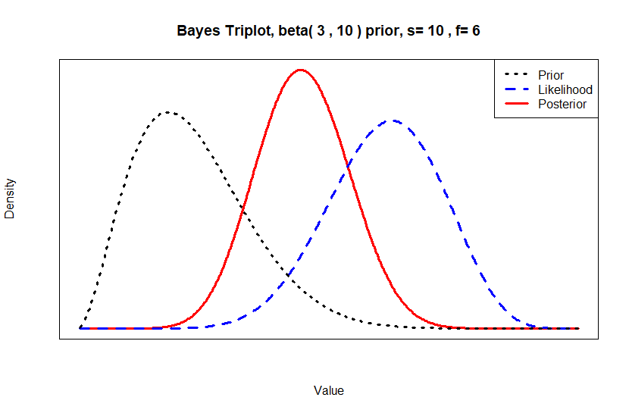
The Bayesian Paradigm
Bayesian Statistics combines existing knowledge, expert opinion and real-world data.
Parameters to be estimated are treated as random variables.
A posterior distribution is estimated from a prior distribution and observed data using Bayesian analysis.
The posterior is then used to make inferences.
Bayes’ Theorem
$$P\left(θ | D\right)=\frac{P(D|θ)×P(θ)}{P(D)}$$

Slide 11
Bayesian Sample Size Approaches
How can we use Bayesian Statistics for SSD?
Sample Size for Bayesian Methods
Improving Sample Size Methods
Sample size for specific values of Bayesian parameters.
Integrating Bayesian methods equals adding greater context for parameter uncertainty.
e.g. Bayes Factors, Credible Intervals, Continual Reassessment Method (CRM), Utility/Cost Function
e.g. MBL Intervals, Posterior Errors, Assurance, Predictive Power, Adaptive Designs
How do we choose our prior?

Slide 12
SHELF Elicitation Protocol
Sheffield Elicitation Framework developed by Profs O’Hagan & Oakley, University of Sheffield.
Provides templates, guides and software to formalize the elicitation procedure.
Led by a facilitator who guides the group of experts and delivers the end probability distribution.
Initial judgments are elicited from each expert individually.
This is followed by a group discussion with the goal of reaching a consensus judgement.

Slide 13
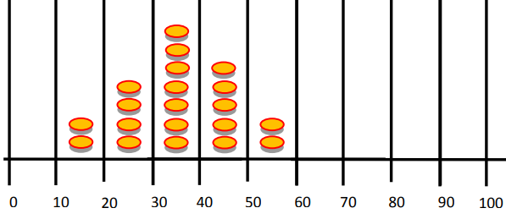
SHELF Methods
Tertile/Quartile Method [Individual or Group]
Expert gives median value and then quartiles or tertiles.
Roulette Method [Individual Only]
Counters represent equal probability and expert distributes counters across values on a grid
Probability Method [Group Only]
Facilitator selects values $x_{1},x_{2},x_{0}$ and expert assigns probabilities.
Facilitator expects $x_{1}$ to be relatively low, $x_{2}$ to be relatively high and $x_{0}$ to be intermediate.
Probability Method
M
L
$$T_{1}$$
$$T_{2}$$
U
$P\left(X<x_{1}\right)$
$P(X>x_{2})$
$P(X<x_{0})$

Slide 14
Bayesian Assurance
Part 2

Slide 15
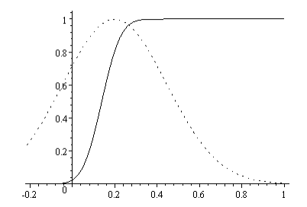
Bayesian Assurance
Assurance is the unconditional probability of trial success (significant result), given a prior for the effect size and/or nuisance parameters.
Calculated as the expectation of power, averaged over all plausible values for the effect size.
Framed as a closer representation of the “true probability of success” and can be considered as a Bayesian analogue to power
Formalizes the sensitivity analysis and can be considered alongside power in a traditional frequentist framework.
Source: O’Hagan (2005)

Slide 16
Assurance Calculations
Let R be the event of rejecting a null hypothesis & $θ$ be a vector of parameter values.
Power: $π\left(θ\right)=P(R|θ)$
Assurance: $A=P\left(R\right)=E(π(θ))$
Calculation Methods
Analytic
(Two Normal Means Inequality)
$$\overline{δ}\sim N\left(δ,τ^{2}\right); δ=μ_{2}−μ_{1}; τ^{2}=\frac{σ_{1}^{2}}{n_{1}}+\frac{σ_{2}^{2}}{n_{2}}$$
$Prior: δ\sim N\left(m,v\right)$
$$A=Φ\left(\frac{−τZ_{α/2}+m}{\sqrt{τ^{2}+v}}\right)$$
Numeric Integration
$$A=\int_{−∞}^{∞}{P\left(R|θ\right)P\left(θ\right)dθ}$$
Simulation
#sims=N; r=0
For (n in 1:N){
Sample $θ$ from prior
Sample required test statistic using models and $θ$
If outcome R has occurred, r++
}
$$A\text{≈}\frac{r}{N}$$

Slide 17
Assurance Example – Normal Means
Example 1
“The outcome variable… is reduction in CRP after four weeks relative to baseline and the principal analysis will be a one-sided test of superiority at the 2.5% significance level. The (two) population variance… is assumed to be… equal to 0.0625… the test is required to have 80% power to detect a treatment effect of 0.2, leading to a proposed trial size of n1=n2=25 patients. ….For the calculation of assurance, we suppose that the elicitation of prior information… gives the mean of 0.2 and variance of 0.0625. If we assume a normal prior distribution, we can compute assurances with m=0.2, v=0.06… with n=25, we find assurance=0.595.”
Parameter | Value
Significance Level (One-Sided) | 0.025
Prior Mean Difference | 0.2
Prior Difference Variance | 0.06
Posterior Standard Deviation | √0.0625=0.25
Sample Size per Group | 25
Source: Wiley.com

Slide 18
Assurance Example - Two Proportions
Example 2
“We planned to enrol 2500 heifers (1250 each of Pestigard®- and placebo-treated heifers). Statistical power calculations indicated that the trial would have had power of 0.72, 0.73 and 0.91 for detecting a significant difference at the 0.05 level (two-sided) in proportions of heifers that were pregnant by 6 weeks between Pestigard® and placebo treated heifers, if the proportions in the placebo-treated heifers were 40%, 60% and 80%, respectively, and if Pestigard® treatment increases these proportions by 0.05 (i.e. 5 percentage points).”
Parameter | Value
Significance Level (2-Sided) | 0.05
Control Proportion | 0.8
Treatment Proportion | 0.85
Treatment Proportion Prior | Beta(56.67, 10)
Sample Size Per Group | 1250
Power | 91%
Source: New England Journal of Medicine (2013)

Slide 19
Mixed Bayesian/Frequentist Intervals
Part 3

Slide 20
Credible Intervals
Credible Intervals are the most commonly used Bayesian method for interval estimation.
Can be considered the Bayesian analogue to confidence intervals.
95% Credible Interval
95% Confidence Interval
Interval contains 95% of the posterior probability – i.e. there is a 95% chance that the true value is in the interval.
Unknown parameter is a RV, bounds are fixed.
Under repeated sampling, 95% of confidence intervals constructed the same way will include the true value.
Unknown parameter is fixed, bounds are RV’s.

Slide 21
Credible Interval Construction
Adcock (1988) and Joseph and Bélisle (1997) have developed methods to construct credible intervals for normal means.
The method chosen depends on the selection criteria and the estimation methodology.
Selection Criteria
Average Coverage Criterion
Average Length Criterion
Worst Outcome Criterion
Estimation Methodology
Known Precision
Unknown Precision
Mixed Bayesian/Likelihood.

Slide 22
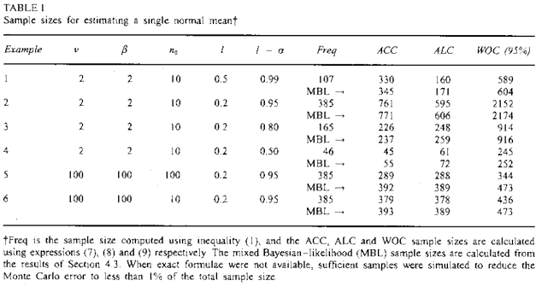
MBL Interval Example
Example 3
“In practice, the prior information will be different in every problem, so it is impossible to provide exhaustive tables. Therefore, Table 1 presents a variety of examples that illustrate the relationships between the various criteria discussed for the case of estimating sample size requirements for a single normal mean. Example 1-3 … show that the Bayesian approach can provide larger sample sizes than the frequentist approach, even though prior information is incorporated ... The same examples also illustrate that sample size provided by the ALC tend to be smaller than that of the ACC when 1-α is near l and l is not near 0.”
Source: Wiley.com

Slide 23
Consensus-Based Criteria
The choice of prior density to use in Bayesian analysis can be problematic and controversial.
Would like to consider a range of prior densities.
Joseph and Bélisle (2019) developed methods to account for variability in prior opinions.
What sample size is required to induce posterior agreement to a prespecified degree?
Want to limit the max distance between the HPD limits from different posterior densities.
Selection Criteria
Average Coverage Criterion
Modified Worst Outcome Criterion
Worst Outcome Criterion
Design Priors
Linear Combination
Clinical Prior
Both Analysis Priors

Slide 24
Consensus-Based Criteria Example
Example 4
“We define posterior agreement to be that the maximum difference between the upper and lower 95% posterior HPD intervals from the two researchers should be not larger than 0.005… Assume analysis priors for the first and second researchers of beta(116.064, 12.045) and beta(194.0375, 47.79375), respectively. We next assume a design prior that covers the full range of the researchers prior beliefs... Which implies a beta(36.596, 5.6483) design density… A sample size of n = 3, 979 is required to ensure a maximum distance between upper and lower HPD limits from the two researchers posterior densities of 0.005 on average over all data sets. A very similar sample size of 4047 is required to attain the same posterior agreement over half of all data sets, whereas the size increases to 5423 to cover 90% of all data sets… To cover 100% of all data sets, one requires a much larger sample size of 16 386”
Parameter | Value
Coverage Probability | 0.95
Max. Accepted Difference | 0.005
Prior 1 Beta Parameters | (116.064,12.045)
Prior 2 Beta Parameters | (194.038,47.794)
Clinical Prior Beta Parameters | (36.596,5.6483)
MODWOC Proportions | 0.5, 0.9
Source: Statistics in Medicine (2019)

Slide 25
Discussion & Conclusion
Part 3

Slide 26
Discussion and Conclusions
Power and confidence intervals are common frequentist metrics for sample size determination.
Assurance and Mixed Bayesian/Likelihood intervals use Bayesian principles to enhance a frequentist trial.
Bayesian methods allow the trialist to formally incorporate prior knowledge into the design and utilise metrics with more intuitive interpretations
The difficulty associated with choosing a prior can be aided by formalized elicitation and consensus based intervals

Slide 27
Statsols.com/trial

Slide 28
Thank You
Questions?
info@statsols.com
Further information at Statsols.com

Slide 29
References
Dallow, N, Best, N, Montague, TH. Better decision making in drug development through adoption of formal prior elicitation. Pharmaceutical Statistics. 2018; 17: 301– 316. https://doi.org/10.1002/pst.1854
Oakley, J. E. and O'Hagan, A. SHELF: The Sheffield Elicitation Framework (version 2.0), School of Mathematics and Statistics, University of Sheffield, 2010 http://tonyohagan.co.uk/shelf.
Sabin T, Matcham J, Bray S, Copas A, Parmar MK. A Quantitative Process for Enhancing End of Phase 2 Decisions. Stat Biopharm Res. 2014 Jan;6(1):67-77. doi: 10.1080/19466315.2013.852617. Epub 2014 Feb 1. PMID: 24683441; PMCID: PMC3967501.
O'Hagan, A., Stevens, J. W., & Campbell, M. J. (2005). Assurance in clinical trial design. Pharmaceutical Statistics, 4(3), 187-201.
Chen, DG., Chen, J.K. (2018). Statistical Power and Bayesian Assurance in Clinical Trial Design. In: Zhao, Y., Chen, DG. (eds) New Frontiers of Biostatistics and Bioinformatics. ICSA Book Series in Statistics. Springer, Cham. https://doi.org/10.1007/978-3-319-99389-8_9

Slide 30
References
Morton, J., Phillips, N., Taylor, L. and McGowan, M. (2013), Bovine viral diarrhoea virus in beef heifers in commercial herds in Australia: mob-level seroprevalences and incidences of seroconversion, and vaccine efficacy. Aust Vet J, 91:517-524. https://doi.org/10.1111/avj.12129
Adcock, C. J. (1988). A Bayesian approach to calculating sample sizes. The statistician, 433-439
Joseph, L., Du Berger, R., & Belisle, P. (1997). Bayesian and mixed Bayesian/likelihood criteria for sample size determination. Statistics in medicine, 16(7), 769-781.
Joseph, L., & Belisle, P. (1997). Bayesian sample size determination for normal means and differences between normal means. Journal of the Royal Statistical Society: Series D (The Statistician), 46(2), 209-226.
Joseph, L., & Bélisle, P. (2019). Bayesian consensus‐based sample size criteria for binomial proportions. Statistics in Medicine, 38(23), 1-8.

