Slide 1
Introducing nQUERY PREDICT
A New Tool for Clinical Trial Milestone Predictions
Demonstrated on
Notes:
www.Statsols.com/trial

Slide 2
Webinar Host
Head of Statistics
nQuery Lead Researcher
FDA Guest Speaker
Guest Lecturer
HOSTED BY: Ronan Fitzpatrick

Slide 3
AGENDA
Clinical Trial Milestone Prediction
nQuery Predict Overview
Worked Example
Conclusions and Discussion
Notes:
Change bullet point

Slide 4
The complete solution for optimizing your clinical trial designs
✓ CRM
✓ MCP-Mod
✓ Simon’s Two Stage
✓ Fleming’s GST
1000+ Scenarios for Fixed Term, Adaptive & Bayesian Methods
✓ Survival, Means, Proportions & Count endpoints
✓ Group Sequential Trials
✓ Bayesian: - Assurance
- Credible Intervals
- Posterior Error Approach
✓ Sample Size Re-Estimation
✓ Cross over & personalized medicine
✓ MAMS
EARLY PHASE
Animal Studies ANOVA / ANCOVA
PRE-CLINICAL RESEARCH
CONFIRMATORY
Cohort Study
Case-control Study
POST MARKETING

Slide 5
In 2020, 91% of organizations with clinical trials approved by the FDA used nQuery

Slide 6
Clinical Trial
Milestone Prediction
Part 1

Slide 7
Trial Design and Key Milestones
Clinical trial design typically focusses initially on aspects such as operational, statistical and sample size considerations
Adaptive Design consideration, statistical modelling choices, power calculations
Most trials will have key milestones that need to be achieved before key decisions can be made such as interim analyses or ending the study
Examples: Sample Size/Enrollment Target, Events Target for Survival Trials
~80% of trials delayed, ~85% do not reach recruitment goal
Increasing interest in using real trial data to evaluate if trial are “on schedule” and what changes may be needed if not
High potential for using statistical approaches for this purposes (sims, ML etc)

Slide 8
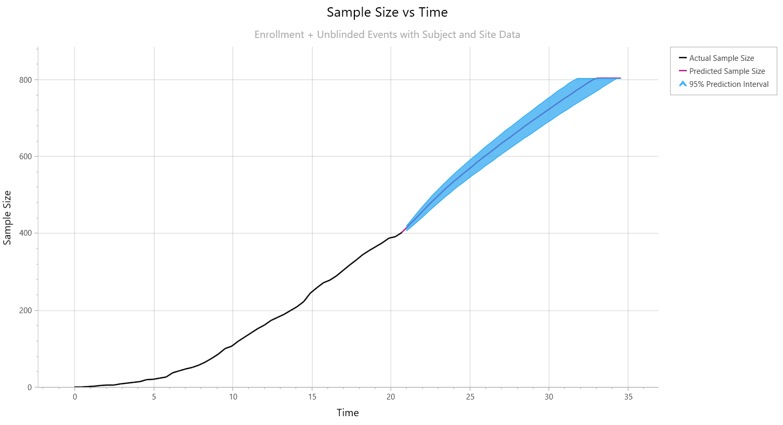
Enrollment Prediction
Enrollment Prediction focussed on recruitment (sample size) milestones
Key milestone for majority of clinical trials
Multiple levels and approaches to look at enrollment prediction
Level: Global, Regional, Site-level
Approaches: Equation, Statistical Model, Simulation, Bayesian
Can use prediction for key trial decisions
e.g. add or drop sites due to performance

Slide 9
Enrollment Prediction Method Examples
1 | Parametric Model | e.g. Fit Linear, Polynomial, Poisson
2 | Parametric Piecewise Modelling | e.g. Piecewise Poisson
3 | Global Simulation | e.g. exponential inter-arrival times
4 | Explicit Per-Site Simulation | e.g. fixed rate per site
5 | Per-Site Simulation via Model | e.g. Poisson-Gamma Bayesian
6 | Machine Learning | Based on current and/or simulations
7 | Others | Regional Effects, Optimization, Cost

Slide 10
Survival Event Predictions
Survival (Time-to-Event) analysis focussed on inference about time to event using methods such as Cox Regression
Common Endpoints: Overall Survival, Progression-Free Survival
Key milestones (interim analysis, study end) in survival analysis usually related to achieving a target number of events (e.g. cancer progress)
Deviations from pre-trial analysis (e.g. SSD) common and of high concern
Event milestone prediction requires modelling the survival process but likely also the accrual (i.e. enrollment) process & competing processes
Competing Processes: Dropout, censoring, cure process, competing risks

Slide 11
Event Prediction Method Examples
1 | Parametric Modelling | e.g. Exponential, Weibull, Log-Normal
2 | Parametric Piecewise Modelling | e.g. Markov process (Lakatos)
3 | Simulation using Survival Model | e.g. Exponential, Piecewise Exp., Weibull
4 | Model Selection Algorithm | Select Models and/or Changepoints
5 | Machine Learning Algorithm | Trained on Current &/or Simulations
6 | Non-Proportional Hazards | Cure Rate Model, “Responder”-based
7 | Other Considerations | External Data (Bayesian), Blinded EM

Slide 12
nQuery Predict
Overview
Part 2

Slide 13
nQuery Predict Overview
nQuery Predict is new tool in nQuery that will focus on clinical trial milestone prediction with a guided user-friendly interface
Initial focus is on enrollment and event prediction via simulations
Provide flexible options depending on information available and useful visualizations and reports to summarize simulation results
Provides different options depending on access and granularity of data
Provides useful complement to existing sample size determination tools in nQuery, especially for Phase III adaptive designs
For example, interim analyses in context of group sequential design

Slide 14
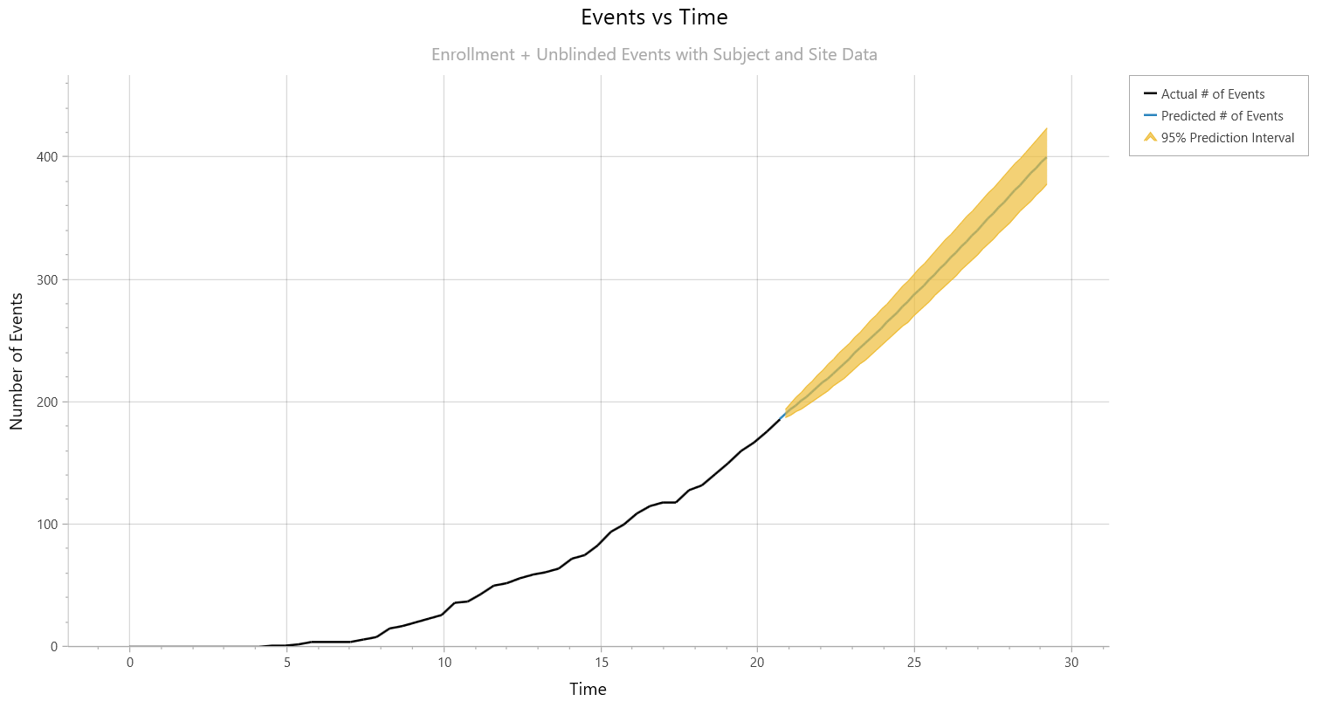
nQuery Predict Features
Two approaches: interim data and summary data
Interim Data: Real Clinical Trial Data – Arrival Times, Events Times, Current Status etc.
Summary Data: Basic summary data (pre or during trial) – Sample Size, # Events, Time etc.
Targets: Enrollment and Event Milestones
Poisson process for enrollment
Blinded or Unblinded Event Process
Exponential, Piecewise Exponential, Weibull
Detailed Reports for Simulation Results
Plots for Enrollment, Events, Dropout Trends
Summary Report for Inputs & Results
Optional Access to per-simulation results

Slide 15
nQuery Predict (1.0) | Interim Data | Summary Data
Subject Level Modelling (Enrollment) | ✓ | ✓
Subject Level Modelling (Survival) | ✓ | ✓
Site Level Modelling (Enrollment) | ✓ | X
Unblinded (Comparative) Survival Model | ✓ | ✓
Blinded (Non-Comparative) Survival Model | ✓ | ✓
Survival Model with Enrollment Ongoing | ✓ | ✓
Survival Model with Enrollment Complete | ✓ | ✓
Poisson Enrollment Model | ✓ | ✓
Exponential Survival Model | ✓ | ✓
Piecewise Exponential Survival Model | ✓ | X
Weibull Survival Model | ✓ | X
Exponential Dropout Model | ✓ | ✓
Piecewise Exponential Dropout Model | ✓ | X
Weibull Dropout Model | X | X
Fixed Followup | ✓ | X
Pre-Trial Prediction | X | ✓

Slide 16
Worked
Example
Part 3

Slide 17
Trial Summary
Interim analysis conducted at 50% of total required events (187/374). Enrollment is 87% complete (402/460) with 118 out of 127 sites opened. In this example, will explore the following scenarios:
Subject vs Site-Level Enrollment
Unblinded vs Blinded Survival Model
Different Survival Models
Parameter | Value
Current Calendar Time | 24.92
Current Sample Size | 402
Current Events | 187
Current Dropouts | 3
Target Sample Size | 460
Target Events | 374
Sites Open | 118

Slide 18
Discussion and Conclusions
Delays very common in clinical trials due to missed milestones
Need methods to help deal with enrollment and/or survival uncertainty
nQuery Predict is new tool for clinical trial milestone prediction
Enrollment & event prediction using simulation based on interim data
Prediction models for variety of different levels of data available
Summary Data (Pre/During Trial), Interim Data (Subject, Site-level)
Methods available for Enrollment & Event Milestone Predictions
Enrollment: Poisson (Subject or Site Level); Event: Exponential, Piecewise, Weibull, Fixed Followup, Dropout Processes

Slide 19
Thank You
Free Trial |Questions
info@statsols.com
Further information at Statsols.com

Slide 20
References (Background)
Lamberti, MJ. State of Clinical Trials Industry. Thomson Centerwatch.
Clinical Trials Arena. 2012. “Clinical trial delays: America’s patient recruitment dilemma” https://www.clinicaltrialsarena.com/analysis/featureclinical-trial-patient-recruitment
McDonald, A.M., Knight, R.C., Campbell, M.K., Entwistle, V.A., Grant, A.M., Cook, J.A., Elbourne, D.R., Francis, D., Garcia, J., Roberts, I. and Snowdon, C., 2006. What influences recruitment to randomised controlled trials? A review of trials funded by two UK funding agencies. Trials, 7(1), pp.1-8.
Bower, P., Brueton, V., Gamble, C., Treweek, S., Smith, C.T., Young, B. and Williamson, P., 2014. Interventions to improve recruitment and retention in clinical trials: a survey and workshop to assess current practice and future priorities. Trials, 15(1), pp.1-9.
Cognizant. 2015. “Patient Recruitment Forecast in Clinical Trials.” https://www.cognizant.com/whitepapers/patients-recruitment-forecast-in-clinical-trials-codex1382.pdf
Gkioni, E., Rius, R., Dodd, S. and Gamble, C., 2019. A systematic review describes models for recruitment prediction at the design stage of a clinical trial. Journal of clinical epidemiology, 115, pp.141-149.
Kearney, A., Harman, N. L., Rosala-Hallas, A., Beecher, C., Blazeby, J. M., Bower, P., … Gamble, C. (2018). Development of an online resource for recruitment research in clinical trials to organise and map current literature. Clinical Trials, 15(6), 533–542. https://doi.org/10.1177/1740774518796156

Slide 21
References (Enrollment)
Lee, Y.J., 1983. Interim recruitment goals in clinical trials. Journal of Chronic Diseases, 36(5), pp.379-389.
Comfort, S., 2013. Improving clinical trial enrollment forecasts using SORM. Applied Clinical Trials, 22(5), p.32.
Carter, R.E., Sonne, S.C. and Brady, K.T., 2005. Practical considerations for estimating clinical trial accrual periods: application to a multi-center effectiveness study. BMC medical research methodology, 5(1), pp.1-5.
Carter, R.E., 2004. Application of stochastic processes to participant recruitment in clinical trials. Controlled clinical trials, 25(5), pp.429-436.
Senn, S., 1998. Some controversies in planning and analysing multi‐centre trials. Statistics in medicine, 17(15‐16), pp.1753-1765.
Anisimov, V.V. and Fedorov, V.V., 2007. Modelling, prediction and adaptive adjustment of recruitment in multicentre trials. Statistics in medicine, 26(27), pp.4958-4975.
Anisimov, V., 2009, August. Predictive modelling of recruitment and drug supply in multicenter clinical trials. In Proc. of joint statistical meeting (pp. 1248-1259).

Slide 22
References (Enrollment)
Anisimov, V.V., 2011. Statistical modeling of clinical trials (recruitment and randomization). Communications in Statistics-Theory and Methods, 40(19-20), pp.3684-3699.
Bakhshi, A., Senn, S. and Phillips, A., 2013. Some issues in predicting patient recruitment in multi‐centre clinical trials. Statistics in medicine, 32(30), pp.5458-5468.
Jiang, Y., Guarino, P., Ma, S., Simon, S., Mayo, M.S., Raghavan, R. and Gajewski, B.J., 2016. Bayesian accrual prediction for interim review of clinical studies: open source R package and smartphone application. Trials, 17(1), pp.1-8.
Gajewski, B.J., Simon, S.D. and Carlson, S.E., 2008. Predicting accrual in clinical trials with Bayesian posterior predictive distributions. Statistics in medicine, 27(13), pp.2328-2340.
Abbas, I., Rovira, J. and Casanovas, J., 2007. Clinical trial optimization: Monte Carlo simulation Markov model for planning clinical trials recruitment. Contemporary clinical trials, 28(3), pp.220-231.
Moussa, M.A.A., 1984. Planning a clinical trial with allowance for cost and patient recruitment rate. Computer programs in biomedicine, 18(3), pp.173-179.

Slide 23
References (Events)
Lakatos, E., 1988. Sample sizes based on the log-rank statistic in complex clinical trials. Biometrics, pp.229-241.
Fang, L. and Su, Z., 2011. A hybrid approach to predicting events in clinical trials with time-to-event outcomes. Contemporary clinical trials, 32(5), pp.755-759.
Rufibach, K. (2016). Event projection: quantify uncertainty and manage expectations of broader teams. 2016. http://bbs.ceb-institute.org/wp-content/uploads/2016/06/Kaspar-event_tracking.pdf.
Walke, R., 2010. Example for a Piecewise Constant Hazard Data Simulation in R. Max Planck Institute for Demographic Research.
Goodman, M.S., Li, Y. and Tiwari, R.C., 2011. Detecting multiple change points in piecewise constant hazard functions. Journal of applied statistics, 38(11), pp.2523-2532.
Guyot, P., Ades, A.E., Beasley, M., Lueza, B., Pignon, J.P. and Welton, N.J., 2017. Extrapolation of survival curves from cancer trials using external information. Medical Decision Making, 37(4), pp.353-366.
Royston, P., 2012. Tools to simulate realistic censored survival-time distributions. The Stata Journal, 12(4), pp.639-654.
Crowther, M.J. and Lambert, P.C., 2012. Simulating complex survival data. The Stata Journal, 12(4), pp.674-687.

