Slide 1
Optimizing Oncology Trial Design
FAQs & Common Issues
Demonstrated on
Notes:
www.Statsols.com/trial

Slide 2
Webinar Host
Head of Statistics
nQuery Lead Researcher
FDA Guest Speaker
Guest Lecturer
HOSTED BY: Ronan Fitzpatrick

Slide 3
AGENDA
Method Choice
Design Issues
Special Topics
Conclusions and Discussion
Notes:
Change bullet point

Slide 4
The complete trial design platform to make clinical trials faster, less costly and more successful
The solution for optimizing clinical trials

Slide 5
In 2019, 90% of organizations with clinical trials approved by the FDA used nQuery
Notes:
www.Statsols.com/trial

Slide 6
Method
Choice
Part 1

Slide 7
Common Questions on Methods
Which endpoint(s) should I use for an oncology clinical trial?
Which model(s) are best for analysing oncology time-to-event data?
How to deal with covariates, stratification and censoring issues?
What is appropriate sample size for my oncology clinical trial?

Slide 8
Oncology Endpoints Overview
Oncology clinical trials primarily interested in survival analysis, typically for time-to-event endpoint
Different choices for appropriate endpoint for trial
Overall survival, progression free survival, overall response etc.
Important considerations are cancer type, stage, purpose of treatment, and expected duration of survival
Endpoint & model should reflect assumptions regarding disease, trend and study constraints (e.g. # subjects)

Slide 9
Survival Method Examples
1 | Log-Rank | Non-parametric, HR, equal weights/subject
2 | Wilcoxon-Gehan-Breslow | Non-parametric, HR, weight by # “alive”
3 | Tarone-Ware | Non-parametric, HR, weight by √(# “alive”)
4 | Fleming-Harrington | Non-parametric, HR, weight: (Ŝ(t))^{p}(1-Ŝ(t))^{q}
5 | Peto-Peto | Non-parametric, HR, w: $\tilde{S}\left(t\right)$ also (Y/(1+Y))
6 | Cox PH Regression | Semi-parametric, β, flexible model
7 | Parametric Models | Exponential, Weibull, Log-Normal, Gamma

Slide 10
Covariates and Stratification
To adjust for covariates, Cox PH regression model provides flexible approach to modelling outcome
Covariate modelling works similar to other equivalent regression models
Log-Rank test extensible to stratified case assuming constant HR across strata
Cox PH regression can also model stratification by assuming different hazard fn. (not coefficient) per model

Slide 11
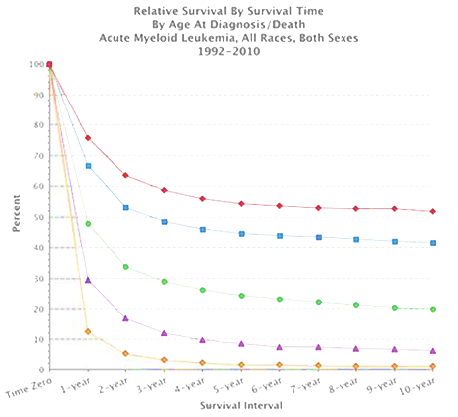
Sample Size for Survival Analysis
Survival Analysis is about the expected duration of time to an event
Methods like log-rank test & Cox Model
Power is related to the number of events NOT the sample size
Sample Size = Subjects to get # of events
Flexibility expected in survival analysis methods and estimation
Options will depend on model and endpoint and affect design choices
Source: SEER, NCI

Slide 12
Worked Example 1
“Using an unstratified log-rank test at the one-sided 2.5% significance level, a total of 282 events would allow 92.6% power to demonstrate a 33% risk reduction (hazard ratio for RAD/placebo of about 0.67, as calculated from an anticipated 50% increase in median PFS, from 6 months in placebo arm to 9 months in the RAD001 arm).”
Parameter | Value
Significance Level (One-Sided) | 0.025
Hazard Ratio | 0.66667
Power (%) | 92.6
Source: nejm.org
Source: NEJM (2011)

Slide 13
Design
Issues
Part 2

Slide 14
Survival SSD Design Issues
What is the expected survival curve(s) in the group(s)?
Assume parametric approximation? Piece-wise curve?
Effect of unequal follow-up due to accrual period?
What accrual pattern to assume? Maximum follow-up same for all?
How to deal with censoring, dropouts or other risks?
Right-censored? Want to model dropout and/or competing risks?
Effect of subjects crossing over from one group to other?
Appropriate estimand for trial? Enough info to assume before study?

Slide 15
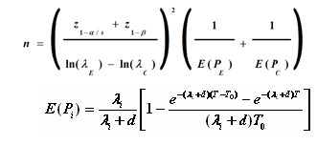
Evolution of Survival SSD
Move from simple approximations to more complex models
Initial methods based on normal approx. for log-rank assuming exponential
Later approximations adjust for unequal follow-up and dropout
Complex methods (markov, simulation) allowed more flexibility
Piece-wise curves, crossover etc.
SSD extensions for other survival models, trial designs & adaptive
Cox, weighted, competing risks
>2 Groups, 1 Group, CRT, CI
Adaptive Design: GSD, SSR etc.
Source: L.S. Freedman (1982)
Source: D Schoenfeld (1981)
Source: J.M. Lachin & M.A Foulkes (1986)
Source: E Lakatos (1988)

Slide 16
Worked Example 2
“Using an unstratified log-rank test at the one-sided 2.5% significance level, a total of 282 events would allow 92.6% power to demonstrate a 33% risk reduction (hazard ratio for RAD/placebo of about 0.67, as calculated from an anticipated 50% increase in median PFS, from 6 months in placebo arm to 9 months in the RAD001 arm). With a uniform accrual of approximately 23 patients per month over 74 weeks and a minimum follow up of 39 weeks, a total of 352 patients would be required to obtain 282 PFS events, assuming an exponential progression-free survival distribution with a median of 6 months in the Placebo arm and of 9 months in RAD001 arm.
With an estimated 10% lost to follow up patients, a total sample size of 392 patients should be randomized.”
Parameter | Value
Significance Level (One-Sided) | 0.025
Placebo Median Survival (months) | 6
Everolimus Median Survival (months) | 9
Hazard Ratio | 0.66667
Accrual Period (Weeks) | 74
Minimum Follow-Up (Weeks) | 39
Power (%) | 92.6
Source: nejm.org
Source: NEJM (2011)

Slide 17
Special Topics
Part 3

Slide 18
Adaptive Design Review
Advantages
Earlier Decisions
Reduced Potential Cost
Higher Potential Success
Greater Control
Better Seamless Designs
Disadvantages
More Complex
Logistical Issues
Modified Test Statistics
Greater Expertise
Regulatory Approval

Slide 19
Survival SSR Complications
Unknown follow-up = more interim planning uncertainty
Can be difficult to predict time when interim analysis will occur
Higher # likely in active cohort when interim analysis occurs
Survival adaptive design may need new assumptions
e.g. assumption of constant treatment effect for GSD and SSR
Two ways for increasing interim events: Sample Size, Time
Increase N: biased for early trends; Time: later trends bias?
Freidlin & Korn (2017) talk about optimizing for “best” result

Slide 20
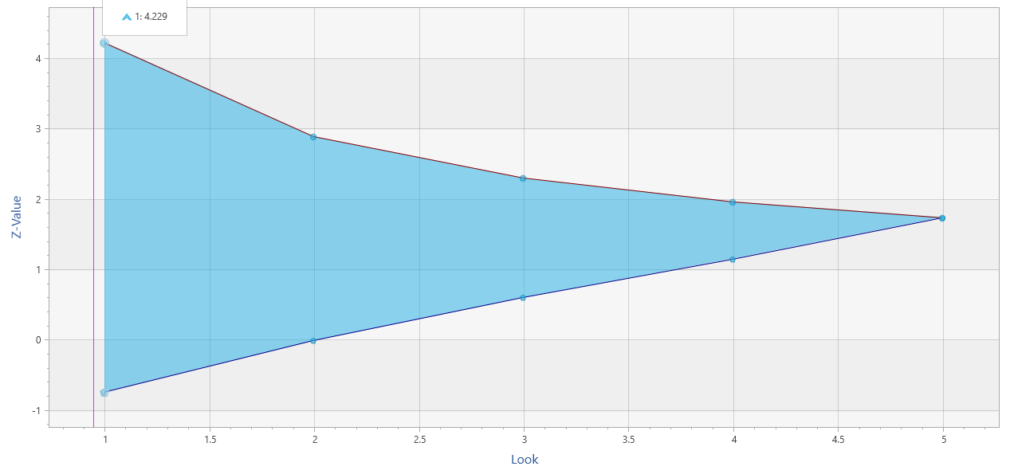
Group Sequential Design
2 early stopping criteria (work similar)
Efficacy (α-spending)
Futility (β-spending)
Use Lan & DeMets “spending function” to account for multiple analyses/chances
Spend proportion of total error at each look
More conservative N vs. fixed term analysis
Multiple SF available (incl. custom)
O’Brien-Fleming (conservative), Pocock (liberal)
Power Family, Hwang-Shih-DeCani (flexible)
Different heuristics for efficacy/futility
Conservative SF expected for efficacy
More flexibility for futility (less problematic)
$$α\left(τ\right)=2\left(1−Φ\left(\frac{z_{α/2}}{τ}\right)\right)$$
O’Brien-Fleming Spending Function
Notes:
Group sequential trials differ from the fixed period trials in that the data from the trial is analysed at one or more stages prior to the conclusion of the trial.
As a result the alpha value applied at each analysis or ‘look’ must be adjusted to preserve the overall Type 1 error.
So, in effect you are ‘spending’ some of your alpha at each ‘look’. The alpha values used at each look are calculated based upon the spending function chosen, the number of looks to be taken during the course of the trial as well as the overall Type 1 error rate.

Slide 21
Unblinded SSR
SSR suggested when interim effect size is “promising” (Chen et al)
“Promising” user-defined but based on unblinded effect size
Extends GSD with 3rd option: continue, stop early, increase N
Power for optimistic effect but increase N for lower relevant effects
Updated FDA Guidance: Design which “can provide efficiency”
Common criteria proposed for unblinded SSR is conditional power (CP)
Probability of significance given interim data
2 methods here: Chen, DeMets & Lan; Cui, Hung & Wang
1st uses GSD statistics but only penultimate look & high CP
2nd uses weighted statistic but allowed at any look and CP

Slide 22
Worked Example 3
Parameter | Value
Significance Level (One-Sided) | 0.025
Placebo Median Survival (months) | 6
Everolimus Median Survival (months) | 9
Hazard Ratio | 0.66667
Accrual Period (Weeks) | 74
Minimum Follow-Up (Weeks) | 39
Power (%) | 92.6
Extend previous example to group sequential design with 2 interim analyses with O’Brien Fleming efficacy bound and non-binding Hwang-Shih-DeCani futility bound with gamma = -2
Parameter | Value
Number of Looks | 3
Efficacy Bound | O’Brien Fleming
Futility Bound | Non-Binding
Beta Spending Function | Hwang-Shih-DeCani
HSD Parameter | -2
Source: NEJM (2011)

Slide 23
Worked Example 3
Assume previous group sequential design with added SSR option
Assume interim HR= 0.8 (from 0.666) and inherit total E of 303 (interim E of 101 and 202) and final look alpha of 0.23 from GSD.
What will required E for SSR for Chen-Demets-Lan/Cui-Hung-Wang assuming maximum events multiplier of 3?
Parameter | Value
Nominal Final Look Sig. Level | 0.0231
Initial HR | 0.667
Interim HR | 0.8
Initial Expected Events (E) | 303
Interim Events (2nd Look) | 202
Maximum Events | 909
Lower CP Bound (CDL/CHW) | Derived/40%
Upper CP Bound | 92.6%

Slide 24
Other Topics
SSD for log-rank/Cox extensible to deal with one sample or >2 sample cases, as well as other adaptive designs
Other models of interest: cure models, frailty models, delayed effect (immunotherapy), joint OS/PFS GSD
Confidence Interval SSD possible for special cases
Log(HR) if assume normal, one group w/ Type II censoring
Bayesian methods should be possible, nQuery already provides assurance for survival case

Slide 25
Discussion and Conclusions
Oncology clinical trials primarily use survival models
Choice of endpoint important and based on real world issues
Variety of models available for survival/TTE data
Most common: Log-rank and Cox PH Regression model
SSD methods available for these common models
Can also integrate many design issues (accrual, dropout etc.)
Methods for adaptive design advancing quickly
Also more options for ≠2 groups, frailty models, CI, Bayesian…

Slide 26
Thank You
Questions?
info@statsols.com
Further information at Statsols.com

Slide 27
Statsols.com/trial

Slide 28
For video tutorials and worked examples
Statsols.com/start

Slide 29
The solution for optimizing clinical trials
CRM
MCP-Mod
Simon’s Two Stage
1000+ Scenarios for Fixed Term, Adaptive & Bayesian Methods
Survival, Means, Proportions & Count endpoints
Sample Size Re-Estimation
Group Sequential Trials
Bayesian Assurance
Cross over & personalized medicine
EARLY PHASE
Animal Studies ANOVA / ANCOVA
PRE-CLINICAL / RESEARCH
CONFIRMATORY
Cohort Study
Case-control Study
POSTMARKETING

Slide 30
References
Kilickap, S., Demirci, U., Karadurmus, N., Dogan, M., Akinci, B. and Sendur, M.A.N., 2018. Endpoints in oncology clinical trials. J BUON, 23, pp.1-6.
U.S. Food and Drug Administration, Clinical Trial Endpoints for the Approval of Cancer Drugs and Biologics. December 2018 Available from: http://www.fda.gov/downloads/Drugs/GuidanceComplianceRegulatoryInformation/Guidances/ ucm071590.pdf
Klein, J.P. and Moeschberger, M.L., 2006. Survival analysis: techniques for censored and truncated data. Springer Science & Business Media.
Hosmer, D.W., Lemeshow, S., & May, S., Applied Survival Analysis: Regression Modeling of Time‐to‐Event Data, Second Edition. Wiley
Collett, D., 2015. Modelling survival data in medical research. CRC press.
Cox, D.R., 1972. Regression models and life‐tables. Journal of the Royal Statistical Society: Series B (Methodological), 34(2), pp.187-202.
Bariani, G.M., de Celis, F., Anezka, C.R., Precivale, M., Arai, R., Saad, E.D. and Riechelmann, R.P., 2015. Sample size calculation in oncology trials. American journal of clinical oncology, 38(6), pp.570-574.

Slide 31
References
Freedman, L. S. (1982). Tables of the number of patients required in clinical trials using the logrank test. Statistics in medicine, 1(2), 121-129.
Schoenfeld, D. A. (1983). Sample-size formula for the proportional-hazards regression model. Biometrics, 499-503.
Lachin, J. M., & Foulkes, M. A. (1986). Evaluation of sample size and power for analyses of survival with allowance for nonuniform patient entry, losses to follow-up, noncompliance, and stratification. Biometrics, 507-519.
Lakatos, E. (1988). Sample sizes based on the log-rank statistic in complex clinical trials. Biometrics, 229-241.
Hsieh, F.Y. and Lavori, P.W., 2000. Sample-size calculations for the Cox proportional hazards regression model with nonbinary covariates. Controlled clinical trials, 21(6), pp.552-560.
Yao, J. C., et. al. (2011). Everolimus for advanced pancreatic neuroendocrine tumors. New England Journal of Medicine, 364(6), 514-523.
US Food and Drug Administration. (2019) Adaptive design clinical trials for drugs and biologics (Guidance). Retrieved from https://www.fda.gov/media/78495/download

Slide 32
References
Jennison, C., & Turnbull, B. W. (1999). Group sequential methods with applications to clinical trials. CRC Press.
Chen, Y. J., DeMets, D. L., & Gordon Lan, K. K. (2004). Increasing the sample size when the unblinded interim result is promising. Statistics in medicine, 23(7), 1023-1038.
Cui, L., Hung, H. J., & Wang, S. J. (1999). Modification of sample size in group sequential clinical trials. Biometrics, 55(3), 853-857.
Mehta, C.R. and Pocock, S.J., (2011). Adaptive increase in sample size when interim results are promising: a practical guide with examples. Statistics in medicine, 30(28), 3267-3284.
Chen, Y. J., Li, C., & Lan, K. G. (2015). Sample size adjustment based on promising interim results and its application in confirmatory clinical trials. Clinical Trials, 12(6), 584-595
Liu, Y., & Lim, P. (2017). Sample size increase during a survival trial when interim results are promising. Communications in Statistics-Theory and Methods, 46(14), 6846-6863.
Freidlin, B., & Korn, E. L. (2017). Sample size adjustment designs with time-to-event outcomes: a caution. Clinical Trials, 14(6), 597-604.

Slide 33
References
Phadnis, M.A., 2019. Sample size calculation for small sample single-arm trials for time-to-event data: Logrank test with normal approximation or test statistic based on exact chi-square distribution?. Contemporary clinical trials communications, 15, p.100360.
Lachin, J.M., 2013. Sample size and power for a logrank test and Cox proportional hazards model with multiple groups and strata, or a quantitative covariate with multiple strata. Statistics in medicine, 32(25), pp.4413-4425.
Ren, S., & Oakley, J. E. (2014). Assurance calculations for planning clinical trials with time‐to‐event outcomes. Statistics in medicine, 33(1), 31-45.
Xu, Z., Zhen, B., Park, Y. and Zhu, B., 2017. Designing therapeutic cancer vaccine trials with delayed treatment effect. Statistics in medicine, 36(4), pp.592-605.
Chen, L.M., Ibrahim, J.G. and Chu, H., 2014. Sample size determination in shared frailty models for multivariate time-to-event data. Journal of biopharmaceutical statistics, 24(4), pp.908-923.
Sozu, T., Sugimoto, T., Hamasaki, T. and Evans, S.R., 2015. Sample size determination in clinical trials with multiple endpoints. New York: Springer.

