Slide 1
Overcoming challenges for survival Trials
Non-Proportional Hazards & Stratified Survival
Analysis Case Studies
Demonstrated on

Slide 2
Webinar Host
Host
Brian Fox
nQuery Research Statistician

Slide 3
AGENDA
Challenges in Survival Analysis
Non-Proportional Hazards and Solutions
Stratified effects in Survival Analysis
Conclusions and Discussion

Slide 4
The complete solution for optimizing your clinical trial designs
✓ CRM
✓ MCP-Mod
✓ Simon’s Two Stage
✓ Fleming’s GST
1000+ Scenarios for Fixed Term, Adaptive & Bayesian Methods
✓ Survival, Means, Proportions & Count endpoints
✓ Group Sequential Trials
✓ Bayesian: - Assurance
- Credible Intervals
- Posterior Error Approach
✓ Sample Size Re-Estimation
✓ Cross over & personalized medicine
✓ MAMS
EARLY PHASE
Animal Studies ANOVA / ANCOVA
PRE-CLINICAL RESEARCH
CONFIRMATORY
Cohort Study
Case-control Study
POST MARKETING

Slide 5
In 2020, 91% of organizations with clinical trials approved by the FDA used nQuery

Slide 6
Challenges in Survival Analysis
Part 1

Slide 7
Challenges in Survival Trials
Survival trials are among the most common
Common in areas of oncology, cardiology, etc.
Survival/time-to-event modelling is one of most complex
Issues caused by NPH, varying accrual patterns, Stratification, etc.
New methods needed to deal with complex survival trends
Combination Tests, Restricted Mean Survival Time, etc.

Slide 8
Survival Analysis Considerations
What is the expected survival curve(s) in the group(s)?
Assume parametric approximation? Which test appropriate?
How to handle complex survival curves?
Non-Prop. Hazards (Delayed effect), Stratified effect, etc.
How to deal with expected dropouts or censoring?
Simple loss to follow-up or integrate dropout process into model?
Effect of unequal follow-up due to accrual period?
What accrual pattern to assume? Set max follow-up same for all?

Slide 9
Non-Proportional Hazards & Solutions
Part 2

Slide 10
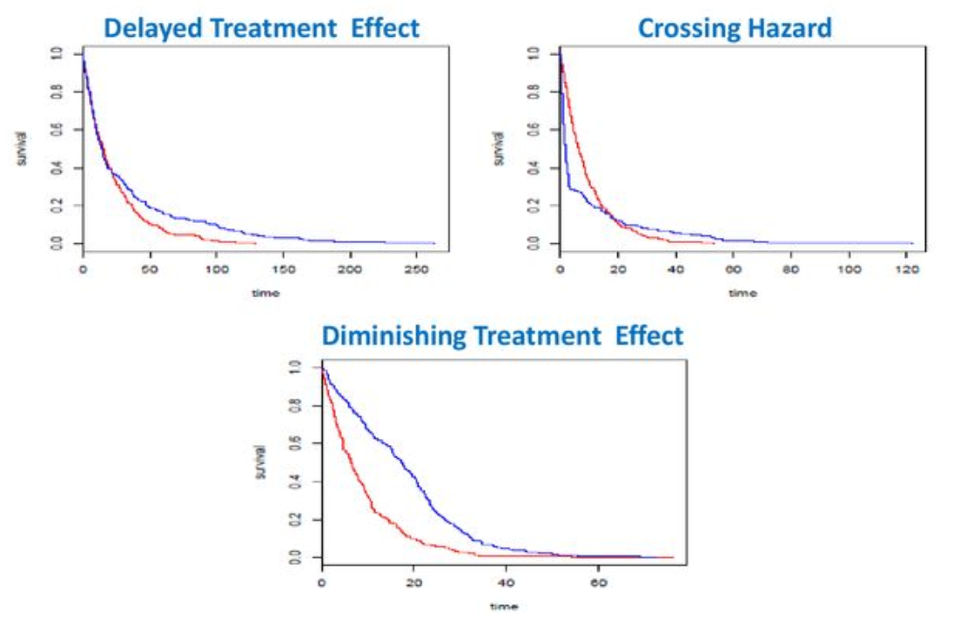
Non-Proportional Hazards
Cox PH Model (& log-rank) rely on proportional hazards assumption
Ignoring NPH can lead to wrong inference
Non-proportional hazards (NPH) equivalent to non-constant hazard ratio
E.g. Increase/decrease over time, crossing
Causes? Time with effect size interaction, Responders vs Non-Responders, frailty
Very common issue in immunotherapies
Multiple methods proposed for NPH
No consensus on “best” approach
Source: Satrajit Roychoudhury

Slide 11
NPH Survival Model Examples
1 | Log-Rank Test/Cox Model | Average Hazard Ratio
2 | Weighted Tests (Log-Rank, K-M) | e.g. Gehan, Tarone-Ware, F-H, Peto-Peto
3 | Piecewise Models | e.g. Delayed Effect Weighted Log-Rank
4 | Combination Tests | e.g. Maximum Combination (MaxCombo)
5 | Restricted Mean Survival Time | RMST Difference at time t*
6 | Relative Time | Ratio of time to achieve Event %
7 | Others | Responder-based, Frailty, Renyi tests

Slide 12
Weighted Piecewise Log-Rank Test
Piecewise Weighted Log-Rank Test proposed a model where NPH present
Piecewise: Different HR per time period
Weighted: Diff. weight per time period
Simple Delayed Effect Model: HR = 1 until time t, then constant HR onwards
Weight = 0 before t, Weight = 1 post-t
APPLE model as per Xu et al (2017)
Need strong assumption “delayed duration” (t) and baseline hazard
Extension: Random time lag: APPLE+ method (Xu et al (2019))
Source: Xu et al (2017)

Slide 13
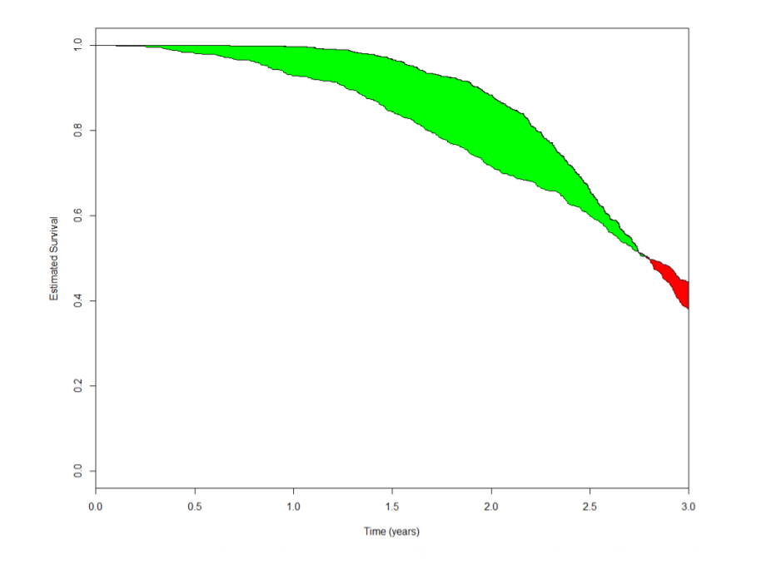
Restricted Mean Survival Time Difference
RMST is the mean survival time under restricted time horizon, t*
Equivalent to area under the K-M curve
RMST diff = Area between K-M curves @ t*
RMST difference has two advantages
Robust to non-proportional hazards
Intuitive: Mean number of extra additional time units of survival up to t*
Sample size methods developing quickly with guidance on practical values
Royston & Parmar (2013), Uno et. al. (2015), Eaton et. al. (2020), Tang (unpublished, ETA: 2021)
Source: FDA/JSM (2017)

Slide 14
Maximum Combination Test
NPH very common issue & often incorrectly ignored
Hinders the use of Log-rank & Cos PH models
Many different types of NPH exist
Solutions made simpler if type of NPH known, often not the case
Combination Tests provide robust methods in these cases
Maximum Combination Test Common Solution
Provides flexible framework to detect NPH patterns
Controls type I error

Slide 15
Maximum Combination Test Example
Worked Example 1
Assume uniform accrual.
Assume 3 equal time periods, 0-3, 3-6, 6-9 (months)
Assume no effect (HR=1) for first 3 months, then a HR of 0.75 and 0.6 for second and third time periods respectively
Assume no subjects in the trial at beginning of accrual period
Parameter | Value
Significance Level (One-Sided) | 0.025
Placebo Exponential Hazard Rate | 0.077
Treatment Exponential Hazard Rate | 0.103, 0.126
Hazard Ratio | 0.75,0.6
Accrual Period (Months) | 6
Maximum Follow-Up (Months) | 9
Initial Accrual Proportion | 0
Power (%) | 80
Number of Tests | 4
Number of Periods | 3
Source: nejm.org

Slide 16
Stratified effects in Survival Analysis
Part 3

Slide 17
Challenges in Survival Trials
Varying effects for different cohorts
E.g. Age, Gender, Responder Vs Non-Responder.
One common solution is Stratification
Common Methods include Stratified Log Rank Test, Cox PH Regression with covariates, etc.
For Complex cases, need to account for interaction effects
Common Methods include 1xk Factorial Interaction Test (Peterson & George, 1993)

Slide 18
Stratification Worked Example
Worked Example 1 (cont.)
Parameter | Value
Significance Level (One-Sided) | 0.05
Number of Strata | 2
Treatment Hazard Rate | 0.14, 0.21
Control Hazard Rate | 0.21, 0.33
Proportion in Stratum 1 | 0.25
Accrual Period (Weeks) | 3
Maximum Follow-Up (Years) | 5
Power (%) | 90
Sample Size | 431
“Uniform entry is assumed…
Consider the case of two prognostic strata, such ad early- versus late-stage disease, with stratum-specific hazards and relative strata sizes K_{a} = 0.25 and K_{b} = 0.75. We assume that the control group hazard in the early-stage stratum is less than in the late stage stratum (λ_{ca} = 0.21 and λ_{cb} = 0.33). However we again desire a 1/3 reduction in the hazard for the experimental group…”
Source: nejm.org
Lachin & Foulkes (1986)

Slide 19
Conclusions and Discussion
Part 4

Slide 20
Discussion and Conclusions
Complex Challenges Exist for Modern Survival trials
Delayed effects in Immunotherapies, Crossing Effects, Diminishing Effects, etc.
NPH is a commonly encountered issue and many solutions exist
Max Combo provides robust solution to detect various NHP patterns
Cohort Specific Effects also common
Consider Stratified Models or Flexible Cox Regression alternatives

Slide 21
nQuery 9.1 | Update now Statsols.com/whats-new
New Module
Upgrade
8
Trial Milestone Prediction
To GST functionality
New Survival Tables
Including: Enrolment Prediction
Event Prediction
Access and conduct GST calculations easier than before
Including: Maximum Combination Test Log-Rank test with Stratification
5
3
1
New Proportions Tables
Base Prediction Models
New Bayesian Table
Including: 3 non-inferiority tests (Difference, Ratio, Odds Ratio)
Continuous Endpoints Survival Endpoints Binary Endpoints
Consensus Based Sample Size for One Mean

Slide 22
Statsols.com/trial

Slide 23
Thank You
Questions?
info@statsols.com
Further information at Statsols.com

Slide 24
References (Non-Proportional Hazards)
Yang, S and Prentice, R, 2010. Improved Logrank‐Type Tests for Survival Data Using Adaptive Weights, Biometrics 66: pp. 30‐38
Public Workshop: Oncology Clinical Trials in the Presence of Non‐Proportional Hazards, The Duke‐Margolis Center for Health Policy, Feb. 2018
Lin, R.S., Lin, J., Roychoudhury, S., Anderson, K.M., Hu, T., Huang, B., Leon, L.F., Liao, J.J., Liu, R., Luo, X. and Mukhopadhyay, P., 2020. Alternative Analysis Methods for Time to Event Endpoints Under Nonproportional Hazards: A Comparative Analysis. Statistics in Biopharmaceutical Research, 12(2), pp. 187-198.
Anderson, K.M., 1991. A nonproportional hazards Weibull accelerated failure time regression model. Biometrics, pp.281-288.
Xu, Z., Zhen, B., Park, Y., & Zhu, B., 2017. Designing therapeutic cancer vaccine trials with delayed treatment effect, Statistics in medicine, 36(4), pp. 592-605

Slide 25
References (Non-Proportional Hazards)
Xu, Z., Park, Y., Zhen, B. and Zhu, B., 2018. Designing cancer immunotherapy trials with random treatment time‐lag effect. Statistics in medicine, 37(30), pp. 4589-4609.
Xu, Z., Park, Y., Liu, K. and Zhu, B., 2020. Treating non-responders: pitfalls and implications for cancer immunotherapy trial design. Journal of hematology & oncology, 13(1), pp. 1-11.
Kim, D.H., Uno, H. and Wei, L.J., 2017. Restricted mean survival time as a measure to interpret clinical trial results. JAMA cardiology, 2(11), pp.1179-1180.
Royston, P. and Parmar, M.K., 2013. Restricted mean survival time: an alternative to the hazard ratio for the design and analysis of randomized trials with a time-to-event outcome. BMC medical research methodology, 13(1), pp.1-15.
Uno, H., Claggett, B., Tian, L., Inoue, E., Gallo, P., Miyata, T., Schrag, D., Takeuchi, M., Uyama, Y., Zhao, L. and Skali, H., 2014. Moving beyond the hazard ratio in quantifying the between-group difference in survival analysis. Journal of clinical Oncology, 32(22), pp. 2380.

Slide 26
References (Non-Proportional Hazards)
Uno, H., Wittes, J., Fu, H., Solomon, S., Claggett, B., Tian, L., Cai, T., Pfeffer, M., Evans, S. and Wei, L., 2015 Alternatives to Hazard Ratios for Comparing the Efficacy or Safety of Therapies in Noninferiority Studies, Annals of Internal Medicine, 163(2), p.127
Eaton, A., Therneau, T. and Le-Rademacher, J., 2020. Designing clinical trials with (restricted) mean survival time endpoint: Practical considerations. Clinical Trials, 17(3), pp.285-294.
Tang, Y., 2021. A unified approach to power and sample size determination for log-rank tests under proportional and nonproportional hazards. Statistical Methods in Medical Research, 30(5), pp.1211-1234.
Tang, Y., 2021. Complex survival trial design by the product integration method. (Unpublished – Available on Request)
Balan, T.A. and Putter, H., 2020. A tutorial on frailty models. Statistical Methods in Medical Research, 29(11), pp.3424-3454.

Slide 27
References (Survival Adaptive Design)
Jennison, C., & Turnbull, B. W. (1999). Group sequential methods with applications to clinical trials. CRC Press.
Friede, T., & Kieser, M. (2006). Sample size recalculation in internal pilot study designs: a review. Biometrical Journal: Journal of Mathematical Methods in Biosciences, 48(4), 537-555.
US Food and Drug Administration. (2018) Adaptive design clinical trials for drugs and biologics (Draft guidance). Retrieved from https://www.fda.gov/media/78495/download
Chen, Y. J., DeMets, D. L., & Gordon Lan, K. K. (2004). Increasing the sample size when the unblinded interim result is promising. Statistics in medicine, 23(7), 1023-1038.
Cui, L., Hung, H. J., & Wang, S. J. (1999). Modification of sample size in group sequential clinical trials. Biometrics, 55(3), 853-857.
Mehta, C.R. and Pocock, S.J., (2011). Adaptive increase in sample size when interim results are promising: a practical guide with examples. Statistics in medicine, 30(28), 3267-3284.

Slide 28
References (Stratification)
Collett, D., 2015. Modelling survival data in medical research. CRC press.
Freedman, L. S. 1982. Tables of the number of patients required in clinical trials using the logrank test. Statistics in medicine, 1(2), 121-129.
Schoenfeld, D. A. 1983. Sample-size formula for the proportional-hazards regression model. Biometrics, 499-503.
Lachin, J. M., & Foulkes, M. A. 1986. Evaluation of sample size and power for analyses of survival with allowance for nonuniform patient entry, losses to follow-up, noncompliance, and stratification. Biometrics, 507-519.
Lakatos, E. 1988. Sample sizes based on the log-rank statistic in complex clinical trials. Biometrics, 229-241.
Yao, J. C., et. al. 2011. Everolimus for advanced pancreatic neuroendocrine tumors. New England Journal of Medicine, 364(6), 514-523.

