Slide 1
Phase II Oncology Trial Designs
Unique Issues & Adaptive Solutions
Demonstrated on
Notes:
www.Statsols.com/trial

Slide 2
Webinar Host
Host
Brian Fox
nQuery Research Statistician

Slide 3
AGENDA
1) Phase II Oncology Trial Designs Introduction
2) Phase II Oncology Trial Design Examples
Simons Design
Bryant & Day Design
Lin & Shih's Design
MAMS Group Sequential Design
3) Discussion & Conclusion

Slide 4
The complete trial design platform to make clinical trials faster, less costly and more successful
The solution for optimizing clinical trials

Slide 5
In 2020, 91% of organizations with clinical trials approved by the FDA used nQuery

Slide 6
Phase II Oncology Trial Designs Introduction
Part 1

Slide 7
Clinical Trials Phases
3 pre-approval clinical trial phases: I, II (IIa/IIb), III
Phase IV: Post-approval evaluation
Phase I: First-in-human in trial (10-50 subjects)
Evaluate safety in healthy volunteers (find MTD)
Phase II: Proof-of-concept & Dose-Finding (50-1000)
Often split POC & DF into two distinct phases of IIa and IIb
Phase III: Confirmatory trial (300-5000 subjects)
Prove efficacy and safety of treatment for regulatory approval

Slide 8
Phase IIa & IIb
Phase IIa: Proof-of-Concept Trial
Find proof of positive response for proposed treatment to recommend for further clinical trial evaluation Example Methods: One sample, Fleming’s GST, Simon’s Design
Phase IIb: Dose-Finding
Find dose-response curve to see dose-response relationship, evaluate if strong enough response & if so select Phase III doses Examples Methods: Contrast tests, Cochran-Armitage, MCP-Mod, Multi-arm Multi-Stage designs

Slide 9
Phase II Oncology Trials Overview
More likely to be single arm, open label and non-randomized than trials in other areas
Usually uses binary endpoint – e.g. proportion of patients progression-free at a specific time point
Often data from Phase II trial alone results in approval of drug/treatment – 17% between 1998 and 2008
Interim analysis commonly used for ethical reasons – Simon’s design most frequently used (Thezenas et al, 2004)

Slide 10
Phase II Oncology Trial Issues
Safety Considerations
Ethical and Safety issues often more prevalent
Recruitment Obstacles
< 5% of adult Oncology patients enroll in trials
High failure rates in comparison with other areas - Bio (2016)
5.1% success rate of new therapies (n=3163)
24.6% progression rate from Phase II to Phase III
Time constraints
Fastest approval of all areas studied - Bio (2016)
Places additional pressure on optimized study design

Slide 11
Phase II Oncology Trial Design Examples
Part 2

Slide 12
Simon’s Design
Simon’s Design is 2-stage design with early futility stopping
Tests null “poor” response vs alternative “good” response
2 Common Criteria for Design
Optimal: Minimise expected N (ESS)
Minimax: Minimise maximum N
Analysis & SSD based on exact binomial results for “response”
Get # responses for test failure/success
Recruit n1
<r1 responses
Recruit n2
Start Stage I
End Stage I
Start Stage II
End Stage II
<r responses
>r responses
Do not recommend
Recommend
>r1 responses
Stop Early (Futility)
Decision

Slide 13
Simon’s Design Example
“The first stage will enroll 15 patients. If there are 8 or fewer responses … not worthy of further study … stop the trial. … 9 or more responses, … accrual continues for a total of 43 patients. … 26 or fewer responses … no further investigation … 27 or more responses … further investigation … “Expected" sample size of the trial is 23.5 … “
“ Upon reviewing response data for the first 8 patients, … no responses thus far. As per the two-stage optimal Simon's design … The study was stopped due to lack of improved efficacy compared to historical controls.”
Parameter | Value
Test Significance Level (α) | 0.05
Design Criterion | Optimal
“Poor” Response (π₁) | 0.5
“Good” Response (π₁) | 0.7
Power | 80
Clinicaltrials.gov: Journal of Clinical Oncology (2011)
Identifier: NCT00786682

Slide 14
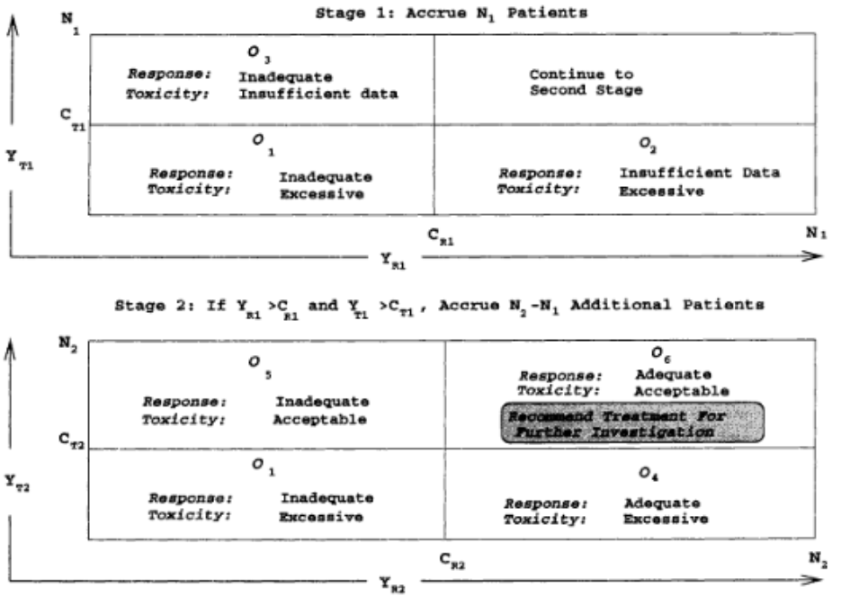
Bryant & Day Design
Similar in structure to Simon’s Design is 2-stage design
Evaluates both Clinical Response and Toxicity
Tackles uncertainty in level of toxicity assumed
2 Common Criteria for Design
Optimal: Minimise expected N (ESS) Minimax: Minimise maximum N
Source: J. Bryant, R. Day, (1995), 'Incorporating Toxicity Considerations Into the Design of Two-Stage Phase II Clinical Trails', Biometrics; 51: 1372 - 1383.

Slide 15
Bryant & Day Example
Bryant & Day Example Parameters
Simon’s Design Example Parameters
Parameter | Value
Response Significance Level (α_{R}) | 0.05
Toxicity Significance Level (α_{T}) | 0.1
Design Criterion | Optimum
Unacceptable Response (π_{R0}) | 0.5
Acceptable Response (π_{R1}) | 0.7
Unacceptable Non-Toxicity (π_{T0}) | 0.8
Acceptable Non-Toxicity (π_{T1}) | 0.95
Power | 80
Parameter | Value
Test Significance Level (α) | 0.05
Design Criterion | Optimum
“Poor” Response (π₁) | 0.5
“Good” Response (π₁) | 0.7
Power | 80
Clinicaltrials.gov: Journal of Clinical Oncology (2011)
Identifier: NCT00786682

Slide 16
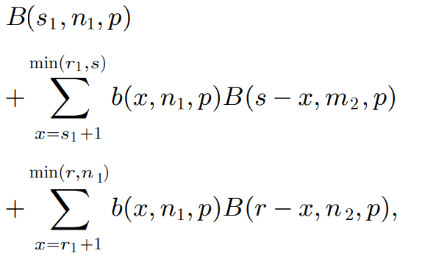
Lin & Shih’s Design
Adaptive 2-stage design which allows choice between “Optimistic” and “Sceptical” response estimates
Tackles uncertainty in estimate used for the alternative – Common issue in Phase IIa Oncology trials
Study is powered under Optimistic or Sceptical choices based on interim result
4 different Optimality Criteria

Slide 17
Lin & Shih’s Design Example
Lin & Shih’s Example Parameters
Simon’s Design Example Parameters
Parameter | Value
Test Significance Level (α) | 0.05
Design Criterion | Type I
Maximum Ineffective Prop. (π₀) | 0.5
Case 1 Min. Efficacy Prop. (π₁) | 0.7
Case 2 Min. Efficacy Prop. (π₂) | 0.8
Case 1 Type II Error (β₁) | 0.2
Case 1 Type II Error (β₁) | 0.2
Power | 80
Parameter | Value
Test Significance Level (α) | 0.05
Design Criterion | Optimum
“Poor” Response (π₁) | 0.5
“Good” Response (π₁) | 0.7
Power | 80
Clinicaltrials.gov: Journal of Clinical Oncology (2011)
Identifier: NCT00786682

Slide 18
MAMS Group Sequential Design
Multi-arm Multi-stage designs compare multiple treatments (>2) with multiple stages (>1) for adaptions
Different choices available for adaptions at each stage
Drop arms/pick “winner(s)”, add arms, stop early, increase N
Efficacy: max(ES) > efficacy bound (i.e. ≥1 trt. “succeeds”), Futility: max(ES) < futility bound (i.e. all arms “fail”)
However, can continue trial if desired but note requires common control group & not making direct comparisons

Slide 19
MAMS GSD Example
MAMS GSD Example Parameters
Simon’s Design Example Parameters
Parameter | Value
Significance Level | 0.05
Number of Arms (N Ratio) | 3 (1:1:1)
Number of Stages (incl. final) | 2-4
Proportions (0.5 = Control) | 0.5,0.65,0.7
Power | 80%
Spending Function (Efficacy) | O’Brien-Fleming
SF (Non-binding - Futility) | O’Brien-Fleming
Parameter | Value
Test Significance Level (α) | 0.05
Design Criterion | Optimum
“Poor” Response (π₁) | 0.5
“Good” Response (π₁) | 0.7
Power | 80
Clinicaltrials.gov: Journal of Clinical Oncology (2011)
Identifier: NCT00786682

Slide 20
Discussion & Conclusion
Part 3

Slide 21
Discussion & Conclusion
Phase II Oncology trials face many unique challenges
Safety Considerations
Recruitment Obstacles
High failure rates
High failure rates indicate need for improved design choice
Expansions upon Simon’s design offer multiple advantages
Bryant and Day offers ability to assess toxicity
Lin & Shih designs tackles uncertainty in assumed response
MAMS GSD design provides flexible application of adaptive methods

Slide 22
Statsols.com/trial

Slide 23
Thank You
Questions?
info@statsols.com
Further information at Statsols.com

Slide 24
References
Thezenas S, Duffour J, Culine S, Kramar A. Five-year change in statistical designs of Phase II trials published in leading cancer journals. Eur. J. Cancer 40(8), 1244–1249 (2004).
R. Simon, (1989), 'Optimal Two-Stage Designs for Phase II Clinical Trials', Controlled Clinical Trials; 10: 1 - 10.
J. Bryant, R. Day, (1995), 'Incorporating Toxicity Considerations Into the Design of Two-Stage Phase II Clinical Trails', Biometrics; 51: 1372 - 1383.
Y. Lin, W. Shih (2004), Adaptive Two-Stage Designs for Single-Arm Phase IIA Cancer Clinical Trials, Biometrics, 60, pp. 482-490.
R. P. A'Hern (2001), Sample Size tables for exact single-stage phase II designs, Statistics in Medicine, 20, pp. 859-866.
P. Ghosh, L. Liu, P. Senchaudhuri, P. Gao, C. Mehta, (2017), Design and Monitoring of Multi-Arm Multi-Stage Clinical Trials, Biometrics 73: 1289-1299.
“Clinical Development Success Rates 2006-2015”, Bio, Biomedtracker, Amplion, 2016. (Link: https://www.bio.org/sites/default/files/legacy/bioorg/docs/Clinical%20Development%20Success%20Rates%202006-2015%20-%20BIO,%20Biomedtracker,%20Amplion%202016.pdf)

