Slide 1
Power for Complex Hypotheses
Sample Size for Non-Inferiority, Superiority by a Margin and Equivalence Testing
October 2024

Slide 2
Denis Desmond
Research Statistician

Slide 3
Agenda
01
Introduction to Complex Hypotheses
02
Non-inferiority/Superiority by a Margin Testing
03
Equivalence Testing
04
Discussion and Conclusions
Questions welcome throughout

Slide 4
The complete solution for optimizing your clinical trial designs
Pre-clinical research
Animal studies
ANOVA / ANCOVA
Confirmatory
1000+ Scenarios for Fixed term, Adaptive & Bayesian Methods
Survival, Means, Proportions & Count endpoints
Group Sequential Trials
Bayesian:
Assurance
Credible Intervals
Posterior Error Approach
Sample Size Re-Estimation
Cross over & personalized medicine
MAMS
Prediction
Early Phase
CRM
MCP-Mod
Simon’s Two Stage
Flemings GST
Post Marketing
Cohort Study
Case-control Study

Slide 5
nQuery Licensing nQuery operates on a tiered licensing model
BASIC
PLUS
PRO
EXPERT
Sample size and power for fixed terms trials over 100’s of designs,
endpoints and hypothesis types.
Sample size for fully Bayesian (e.g. credible intervals)
+ Hybrid Bayes/Frequentist methods and designs (e.g. Assurance)
Sample size and power for range of early stage and confirmatory clinical trial
Adaptive Designs and tools for monitoring and adjustment in-trial
Additional tools for study design and monitoring.
Focus currently on milestone prediction for enrollment and (survival) event targets
Click Here to see our Package Comparison Tool

Slide 6
Part 1
Introduction to Complex Hypotheses

Slide 7
Introduction

Slide 8
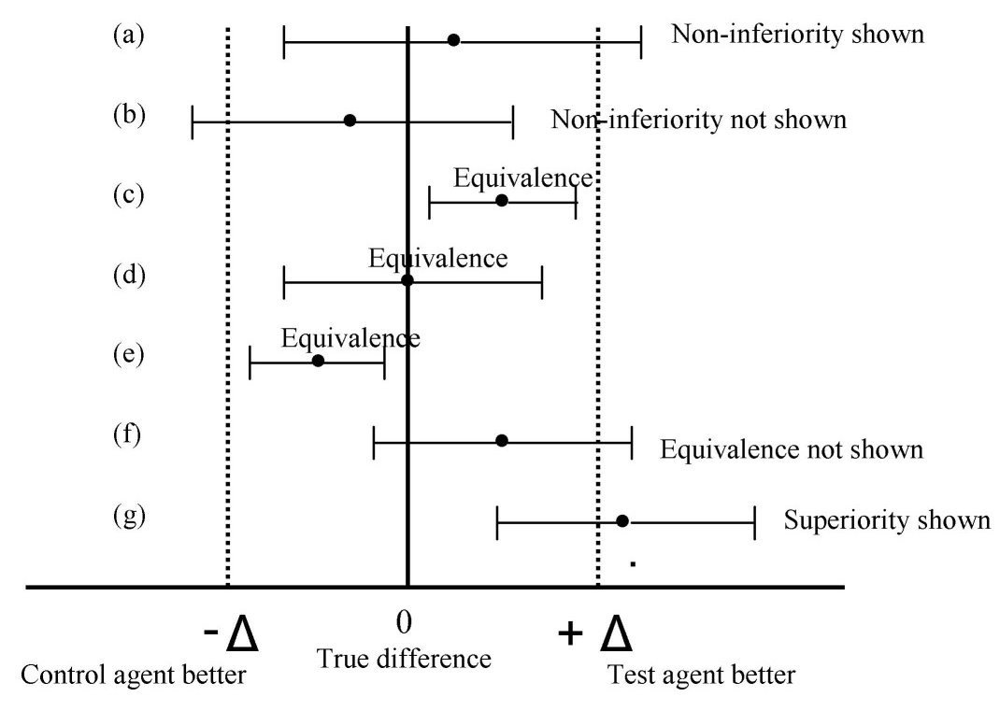
Overview of Complex Hypotheses
Non-inferiority (NI): “non-inferior to control” by a specified margin Direct effect with a “good” direction
Equivalence: “equivalent to control” by being within lower + upper margins Indirect effect without a “good” direction
Non-inferiority/Equivalence both test if new treatment is similar to existing one
Superiority by a margin: “superior to control” by a specified margin
Effectively the inverse of NI testing
Source: C Pater (2004)

Slide 9
Non-inferiority & Superiority by a margin testing
Part 2

Slide 10
Non-Inferiority Testing

Slide 11
Superiority by a Margin Testing

Slide 12
Sample Size Determination for NI and SM
Endpoint | Common Tests | Sample Size Methods | Example Formula
Means | t-test, Z-test, Mann-Whitney U | Schuirmann (1987), Phillips (1990)
Proportions | Likelihood ratio tests (e.g. Farrington-Manning), Chi-squared test, Exact tests | Miettinen & Nurminen (1985), Farrington & Manning (1990), Gart & Nam (1990)
Survival/ Time-to-Event | Log-rank test, Cox regression, Linear Rank tests (e.g. Fleming-Harrington), MaxCombo, RMST | Schoenfeld(1983), Chow (2008), Tang (2021)
Counts/ Incidence Rates | Poisson/Quasi-Poisson, Negative Binomial, Andersen-Gill | Zhu (2017), Tang (2017), Tang and Fitzpatrick (2019)

Slide 13
Non-Inferiority Means | Example 1
“Calculation of the sample size was based on a margin of non-inferiority for in-segment late luminal loss of 0.16 mm. This value is equal to 35 percent of an assumed mean (±SD) late luminal loss of 0.46±0.45 mm in diabetic patients after the implantation of a sirolimus stent, as found in an analysis of a series of diabetic patients treated with sirolimus stents at participating centers in the 10 months that preceded the initiation of the study. Using a one-sided α level of 0.05, we estimated that 99 patients per group were needed to demonstrate noninferiority of the paclitaxel stent with a statistical power of 80 percent.”
Parameter | Value
Significance Level (1-sided) | 0.05
Expected Difference | 0
Non-Inferiority Margin | -0.16
Standard Deviation | 0.45
Power | 80%
Sample Size per Group | 99

Slide 14
Non-Inferiority Proportions | Example 2
“The trial was powered to detect noninferiority of ketamine to ECT. With a noninferiority margin of −10 percentage points (i.e., the percentage of patients with a response to ketamine would be no more than 10 percentage points less than the percentage with a response to ECT), we calculated that a total of 346 participants would provide the trial with 80% power to detect the noninferiority of ketamine according to the Farrington–Manning score statistic (one-sided alpha of 0.025), assuming that 50% of the patients would have a response to ECT and that the actual between-group difference in response would be 5 percentage points.”
Parameter | Value
Significance Level (1-sided) | 0.025
Non-Inferiority Margin | 0.10
Expected Difference | 0.05
Standard Proportion | 0.5
Method | Farrington-Manning
Power | 80%
Sample Size | 346

Slide 15
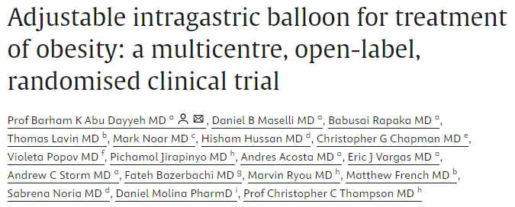
Superiority by a Margin Means | Example 3
“The true population mean TBL in the control group is assumed to be 3‧3% based on previous trials of other non-adjustable IGBs. The standard deviation of TBL is assumed to be approximately 6‧6%, based on prior data. With these two assumptions, and a true population mean TBL in the aIGB group of 10‧34%, a total sample size of 240 subjects randomized 2:1 (160 in the aIGB group and 80 in the control group) would provide 80% power to demonstrate super-superiority of 4‧5% TBL over the control at a one-sided significance of 2‧5%.”
Parameter | Value
Significance Level (1-sided) | 0.025
Non-Inferiority Margin | 0.045
Expected Difference | 0.0704 (0.1034-0.033)
Common Standard Deviation | 0.066
Sample Size | 240
Power | 80%

Slide 16
Part 3
Equivalence testing

Slide 17
Equivalence Testing

Slide 18
Sample Size Determination for Equivalence
Endpoint | Common Tests | Sample Size Methods | Example Formula
Means | t-test, Z-test, Mann-Whitney U | Schuirmann (1987)
Proportions | Likelihood ratio tests (e.g. Farrington-Manning), Chi-squared test, Exact tests | Miettinen & Nurminen (1985), Farrington & Manning (1990), Gart & Nam (1990), Chow et al (2018)
Survival/ Time-to-Event | Log-rank test, Cox regression, Linear Rank tests (e.g. Fleming-Harrington), MaxCombo, RMST | Schoenfeld (1983), Chow et al (2008), Tang (2021)
Counts/ Incidence Rates | Poisson/Quasi-Poisson, Negative Binomial, Andersen-Gill | Zhu (2017), Tang (2017), Tang and Fitzpatrick (2019)

Slide 19
Equivalence Means | Example 4
“Assuming that the mean difference in the log uNTx/uCr value at Week 13 from baseline between MW032 and the innovator drug is 0, the significance level α = 0.05, and the power is 80%, according to the pivotal study of the innovator drug in China, the difference in change of log uNTx/uCr at Week 13 from baseline between Denosumab and Zoledronic Acid and its 95% confidence interval are -0.316 (-0.444, -0.188), taking half of the upper limit of the 50% confidence interval [-0.36, -0.27] as the equivalence margin, i.e., the equivalence margin is 0.135 and the common standard deviation is 0.58. The ratio of patients in the two groups is 1:1, so a total of 634 patients (317 patients in each group) should be enrolled in the two groups.”
Parameter | Value
Significance Level (2-sided) | 0.05
Equivalence Margin (Lower, Upper) | -0.135, 0.135
Expected Mean Difference | 0
Common Standard Deviation | 0.58
Power | 80%
Sample Size per Group | 317

Slide 20
Discussion and Conclusions
Complex hypotheses are of interest if we want to test if a treatment is non-inferior to, superior by a margin to, or equivalent to an existing treatment
Distinction between ‘clinical’ and ‘statistical’ superiority based on value of margin, δ
Non-inferiority testing direct effect, equivalence often testing indirect effect
NI & SM very similar statistically, but differ in terms of clinical objectives
Margin selection a crucial element of study design, often based on expertise
Can include factors other than M1, e.g. safety profile, secondary endpoints, regulator advice
Sample size determination for various endpoints for each hypothesis type
Similar calculations to inequality testing in the case of normal, more complex otherwise

Slide 21
Statsols.com/nquery-demo

Slide 22
Thank you
CONTACT US
info@statsols.com
MORE INFO
statsols.com

Slide 23
References
Food and Drug Administration Non-inferiority clinical trials to establish effectiveness. Guidance for industry. November 2016. https://www.fda.gov/downloads/Drugs/Guidances/UCM202140.pdf
European Medicines Agency GUIDELINE ON THE CHOICE OF THE NON-INFERIORITY MARGIN. January 2006. https://www.ema.europa.eu/en/documents/scientific-guideline/guideline-choice-non-inferiority-margin_en.pdf
International Conference on Harmonisation; choice of control group and related issues in clinical trials; availability. Notice. (2001). PubMed, 66(93), 24390–24391. https://pubmed.ncbi.nlm.nih.gov/12356096
Chow, S., Shao, J., & Wang, H. (2007). Sample size calculations in clinical research. Chapman and Hall/CRC.
Chow, S., Shao, J., (2006). On Non-Inferiority Margin and Statistical Tests in Active Control Trial. Statistics in Medicine, 25, pp. 1101–1113.
Senn, S. (2002). Cross-over trials in clinical research (2nd Edition). John Wiley & Sons.
Farrington, C. P., & Manning, G. (1990). Test statistics and sample size formulae for comparative binomial trials with null hypothesis of non-zero risk difference or non-unity relative risk. Statistics in Medicine, 9(12), 1447–1454.
Miettinen, O., & Nurminen, M. (1985). Comparative analysis of two rates. Statistics in Medicine, 4(2), 213–226.
Gart, J. J., & Nam, J. M. (1990). Approximate Interval Estimation of the Difference in Binomial Parameters: Correction for Skewness and Extension to Multiple Tables. Biometrics, 46(3), 637.
Dixon, W.J., & Massey, F.J. (1983). Introduction to Statistical Analysis (4th ed., pp. 123-126). McGraw-Hill.
O'Brien, R. G., & Muller, K. E. (1993). Unified power analysis for t-tests through multivariate hypotheses. In L. K. Edwards (Ed.), Statistics: Textbooks and monographs, Vol. 137. Applied analysis of variance in behavioral science (pp. 297–344). Marcel Dekker.

Slide 24
References
Schuirmann, D. J. (1987). A comparison of the Two One-Sided Tests Procedure and the Power Approach for assessing the equivalence of average bioavailability. Journal of Pharmacokinetics and Biopharmaceutics, 15(6) , 657–680. https://doi.org/10.1007/bf01068419
Phillips, K. F. (1990). Power of the two one-sided tests procedure in bioequivalence. Journal of Pharmacokinetics and Biopharmaceutics, 18(2) , 137–144. https://doi.org/10.1007/bf01063556
Owen, D. B. (1965). A Special Case of a Bivariate Non-Central t-Distribution. Biometrika, 52(3/4), 437-446. https://doi.org/10.2307/2333696
Fleming, T.R., 2008. Current Issues in Non-inferiority Trials. Statistics in Medicine, 27, pp. 317-332.
Chaplin, S. (2017). Biosimilars in the EU: a new guide for health professionals. Prescriber, 28(10), 27–31. https://doi.org/10.1002/psb.1617
Dibra, A., et al (2005). Paclitaxel-eluting or sirolimus-eluting stents to prevent restenosis in diabetic patients. New England Journal of Medicine, 353(7), 663-670.
Anand, A., Mathew, S. J., Sanacora, G., Murrough, J. W., Goes, F. S., Altinay, M., Aloysi, A. S., Asghar-Ali, A. A., Barnett, B. S., Chang, L. C., Collins, K. A., Costi, S., Iqbal, S., Jha, M. K., Krishnan, K., Malone, D. A., Nikayin, S., Nissen, S. E., Ostroff, R. B., . . . Hu, B. (2023). Ketamine versus ECT for Nonpsychotic Treatment-Resistant Major Depression. New England Journal of Medicine, 388(25), 2315–2325. https://doi.org/10.1056/nejmoa2302399
Dayyeh, B. K. A., Maselli, D. B., Rapaka, B., Lavin, T., Noar, M., Hussan, H., Chapman, C. G., Popov, V., Jirapinyo, P., Acosta, A., Vargas, E. J., Storm, A. C., Bazerbachi, F., Ryou, M., French, M., Noria, S., Molina, D., & Thompson, C. C. (2021). Adjustable intragastric balloon for treatment of obesity: a multicentre, open-label, randomised clinical trial. The Lancet, 398(10315), 1965–1973. https://doi.org/10.1016/s0140-6736(21)02394-1
Zhang, S., Yin, Y., Xiong, H., Wang, J., Liu, H., Lu, J., Zhang, Q., Zhang, L., Zhong, J., Nie, J., Lei, K., Wang, H., Yang, S., Yao, H., Wu, H., Yu, D., Ji, X., Zhang, H., Wu, F., . . . Jiang, Z. (2024). Efficacy, safety, and population pharmacokinetics of MW032 compared with denosumab for Solid Tumor–Related bone metastases. JAMA Oncology. https://doi.org/10.1001/jamaoncol.2023.6520

