Slide 1


Practical Guide to Sequential Design
Primer on Sequential Design Methods
and Design Choices
Notes:
www.Statsols.com/trial

Slide 2





Webinar
Host
Ronan Fitzpatrick
Lead Statistician
nQuery

Slide 3
Agenda
Sequential Design Overview
Issues in Sequential Design
Group Sequential Design
Discussion and Conclusions
All example files will be available after the webinar

Slide 4
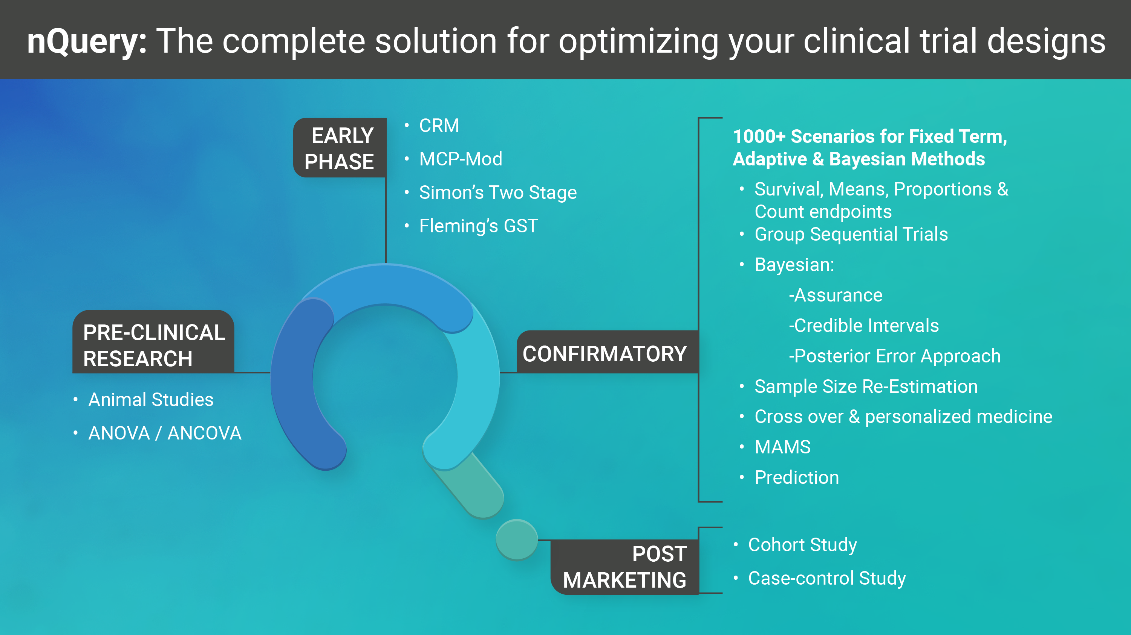

Slide 5


















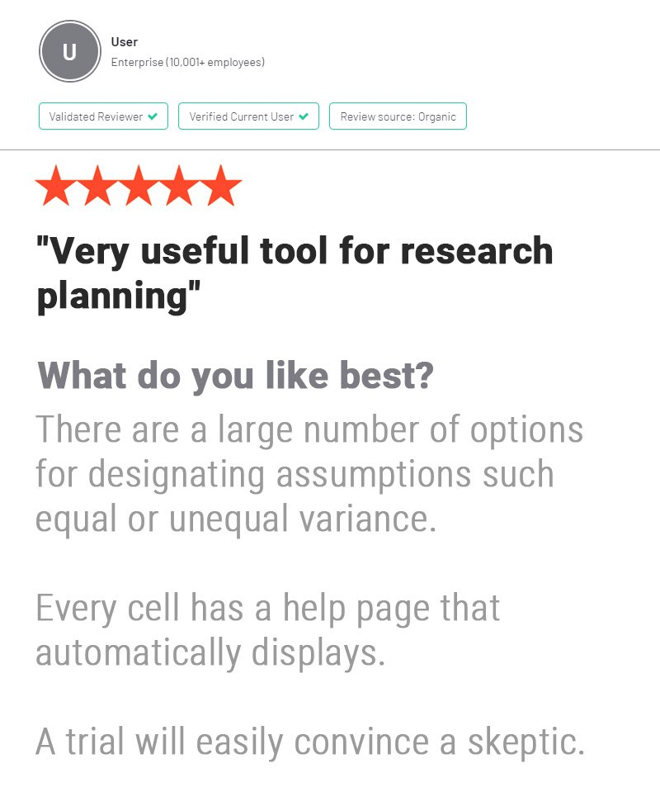




In 2021, 88% of organizations with clinical trials
approved by the FDA used nQuery

Slide 6
Sequential Design Overview
Part 1

Slide 7
Sequential Design Introduction
Sequential Designs are a type of adaptive designs which allow for a trial to stop early if there is sufficient evidence for or against a treatment being effective
  In Favour of Treatment: “Stopping for Efficacy”, Against Treatment: “Stopping for Futility”
By allowing early stopping, significant gains can be made for patients and sponsors
  Earlier access to successful treatments and less resources wasted on failing treatments
  Does introduce additional logistical and statistical burdens to deal with various forms of bias
In this webinar, we provide a practical introduction to sequential design focussing on the different types of sequential design and the practical considerations that occur
  Special focus on group sequential designs – most common sequential design in Phase III clinical trials
  Worked example for Two Means Groups Sequential Design using Error Spending approach

Slide 8
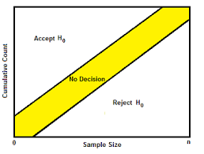
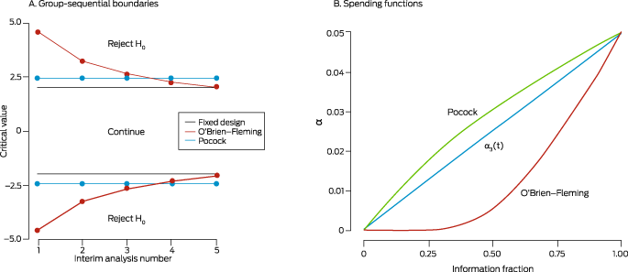
Sequential Design Adjustment
Sequential Design implies multiple chances for a trial to “succeed”
  Naïve analysis will inflate Type I error e.g. 5 looks: 0.05 -> 0.142 (Armitage)
Sequential Designs must adjust for this!
  Multiple Comparisons type problem
  But each analysis shares data – can use this to increase efficiency vs MCP
  NB: Also account for operational bias and other outcomes (e.g. safety)
Two Primary Types of Sequential Design: Fully Sequential & Group Sequential

Slide 9
Types of Sequential Design
Fully Sequential | Data Analysis continuously conducted after each subject’s results become available Pros: Quick results, minimize expected sample size, easy communication Cons: Estimate Reliability/Validity, Logistics, Treatment Lags, higher and/or open study length and maximum sample size Methods: Sequential Probability Ratio Test (SPRT, tSPRT, MaxSPRT, mSPRT), Bayesian
Group Sequential | Data Analysis conducted after a pre-defined cohorts of subjects becomes available Pros: Estimate validity, simpler planning/pre-spec, lower logistical burden, flexibility Cons: Slower Results, more rigid interim timing, lower reduction in expected sample size Examples: Error Spending, Haybittle-Peto, Wang-Tsiatis, Whitehead Triangular

Slide 10
Issues in Sequential Design
Part 2

Slide 11
Issues for Sequential Design
Design and Endpoint Choice
Type of trial (e.g. number of arms)? Effect of trial endpoint (e.g. special considerations for survival and counts)? Multiple efficacy endpoints (Co-primary? Interim:Final -> PFS:OS?)
Choice of Sequential Design
Fully Sequential vs. Group Sequential Design? Which statistical method/adjustment method to use to control Type I error? Need flexibility during analysis stage?
Interim Analysis Timing
How many interim analyses to conduct (trade-off vs maximum N)? When should interim analyses occur (validity concerns)? Base on fixed period or reaching sample size/events?
Efficacy and Futility Boundary Choice
Conservative (common for efficacy – regulator risk) or liberal (common for futility –sponsor risk) boundaries - Spending Function/Parameter Choice? Non-binding Futility? Skip looks?

Slide 12
Issues for Sequential Design
Sample Size and Power
What will be maximum sample size? What will be expected sample size under null and alternative (+ other?) hypotheses? Comparison to equivalent designs e.g. fixed term?
Interim Analyses
Who will conduct interim analyses (e.g. IDMC)? How will decision to stop early/continue/adjust be made? How to retain blinding at interim analyses?
Protocol Deviations and Analysis Lags
How to adjust if interim analysis differs from design? Adjust if contradict boundaries (e.g. continue trial despite crossing?) Use randomized subjects at interim or if trial stops early?
Safety (AE) Endpoints
Are efficacy analysis plans consistent with regulatory requirements on adverse events? How will analysis be conducted if trial adjusted or stopped early under safety concerns?

Slide 13
Covid-19 Vaccine Trials Comparison
 | AstraZeneca | Janssen (J&J) | Moderna | Pfizer
Target VE for 90% Power | 0.6 | 0.6 | 0.6 | 0.6
Sample Size (Trt:Ctrl) | 30000 (2:1) | 60000 (1:1) | 30000 (1:1) | 44000 (1:1)
Max Events | 150 | 154 | 151 | 164
Statistical Model | Poisson | Binomial/Events | Cox PH | Binomial/Events
Sequential Method | Group Sequential | Constrained tSPRT | Group Sequential | Bayesian Group Sequential
Interim Success Criterion | α < 0.00155 | SPRT Boundary | α < 0.0002, 0.0073 | P(VE>30%) > 0.995)
Interim Events Schedule | 75 (0.00155) | Weekly (after 20 events) | 53,106 | 32,62,92,120
Placebo Rate (6-month) | 0.8% | 0.8% | 0.75% | 0.65%
Seropositive @ Baseline | n/a | 10% | 15% | 20%

Slide 14
Group Sequential Design
Part 3

Slide 15
Group Sequential Design (GSD)
Group Sequential Design: Sequential analysis after cohort of subjects analysed
  Modern proposals made in 70’s – widespread adoption in last 30 years
Trial can stop early for either efficacy and/or futility at each interim analysis
  Interim analysis timing and boundaries should be pre-specified in protocol
Wide range of methods available for GSD
  Lan-DeMets “error spending approach” most common
  Wang-Tsiatis & Haybittle-Peto also popular
Method | Key Papers
SPRT | Wald (1947), Armitage (1954)
Haybittle-Peto | Haybittle (1971), Peto (1976)
Pocock Test | Pocock (1977)
O’Brien-Fleming Test | O’Brien & Fleming (1979)
Whitehead Designs | Whitehead & Stratton (1983), Whitehead (1997, 2001)
Error Spending Functions | Lan and DeMets (1983), Kim and DeMets (1987), Hwang, Shih and DeCani (1990)
Wang-Tsiatis | Wang and Tsiatis (1987), Pampallona and Tsiatis (1994)
Unified Family | Kittelson and Emerson (1999)

Slide 16
Types of Group Sequential Design
Error Spending | Spend alpha (efficacy) and/or beta (futility) errors across interim looks using “spending function” – highly flexible during design and analysis stage
Haybittle-Peto | Define (efficacy) boundaries in terms of unadjusted p-values – Haybittle-Peto method finds adjusted final p-value to retain Type I error
Wang-Tsiatis | 1 (efficacy only) or 2 (efficacy + futility – Pampallona-Tsiatis) Parameter Method – includes “optimal GSD” proposal to minimize average sample size
“Classic” Designs | O’Brien-Fleming & Pocock – fixed boundaries and less flexible during monitoring – not to be confused with O’Brien-Fleming & Pocock error spending functions
Unified Family | Unified 2-parameter method which includes Wang-Tsiatis and “Classic” designs as subsets – all three less flexible during monitoring than error spending
Whitehead | Extension of full sequential SPRT to group sequential setting – sometimes referred to as “Triangular” or “Christmas Tree” designs
Others | Custom Futility (e.g. Conditional Power), Adaptive GSD (incl. SSR), Bayesian GSD

Slide 17
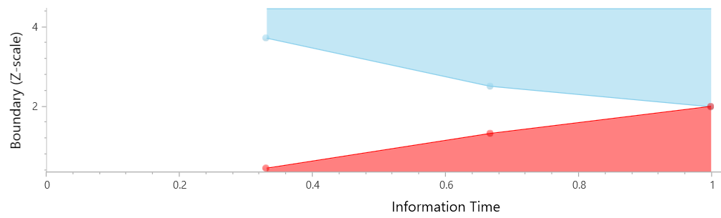
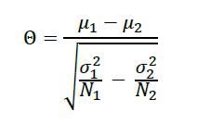
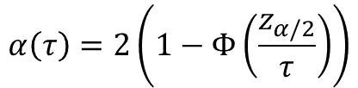

Lan-DeMets “Error Spending”
Use Lan & DeMets “spending function” to account for multiple analyses
  Spend proportion of total error at each look
Can stop early for success and/or failure
  Efficacy = α-spending
  Futility = β-spending
Multiple spending functions proposed:
  O’Brien-Fleming, Pocock, Power Family, Hwang-Shih-DeCani, Distributions, Custom
Easy to adjust errors during analysis stage
  Interim timing differs from plan, add looks
  Should still minimize divergence in trials
$$α\left(τ\right)=2\left(1−Φ\left(\frac{z_{α/2}}{τ}\right)\right)$$
O’Brien-Fleming Spending Function
$θ=F\left(K,α,β,Z_{i}\right) IF= {\left(\frac{θ}{z_{1−α}+z_{β}}\right)}^{2} θ$ = $δ\sqrt{I_{max}}$
Drift Parameter
Drift Parameter for Two Means

Slide 18
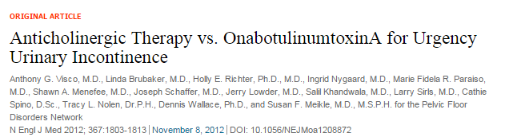
Group Sequential| Example 1 (Two Means)
“A sample size of 242 subjects (121 per treatment group) provides at least 80% power to detect a relative difference of 53% between botulinum toxin A and standardized anticholinergic therapy, assuming a treatment difference of -0.80 and a common SD of 2.1 (effect size = 0.381), and a two-sided type I error rate of 5%. Sample size has been adjusted to allow for a 10% loss (ED: Equivalent to pre-dropout n = 109) to follow-up over the 6-months of treatment as well as one interim analysis to stop early for benefit.”
Parameter | Value
Significance Level (2-Sided) | 0.05
OnabotulinumtoxinA Mean | -2.3
Anticholinergic Mean | -1.5
Standard Deviation (Both) | 2.1
Power | 80%
Sample Size (pre-dropout) | ~109
Analysis Timing | 0.5, 1
Efficacy Boundary | O’Brien-Fleming

Slide 19
Discussion and Conclusions
Sequential analysis allows a trial to stop early in the presence of strong evidence for (efficacy) or against (futility) a treatment while the trial is on-going
Sequential analysis offers significant potential advantages to patients and sponsors but requires careful consideration of the choice of design and method
In clinical trials, consideration is needed of issues such as timing, boundary choice and construction method, and strategies for real-world interim analysis stage issues
Group sequential design, especially Lan-DeMets error spending, is widely used, understood and trusted approach to sequential analysis in clinical trials

Slide 20
Resources
Templates: www.statsols.com/templates
Webinars: www.statsols.com/webinars
Examples: www.statsols.com/examples

Slide 21

Statsols.com/trial

Slide 22
Thank You
Contact us:
info@statsols.com
More info:
Statsols.com

Slide 23
References (Sequential Methods)
Ghosh, B. K., & Sen, P. K. (1991). Handbook of sequential analysis. CRC Press.
Whitehead, J. (1997). The Design and Analysis of Sequential Clinical Trials. Rev. 2nd ed. Chichester, UK: John Wiley & Sons.
Jennison, C., & Turnbull, B. W. (1999). Group sequential methods with applications to clinical trials. CRC Press.
Proschan, M. A., Lan, K. G., & Wittes, J. T. (2006). Statistical monitoring of clinical trials: a unified approach. Springer Science & Business Media.
DeMets, D. L., Furberg, C. D., and Friedman, L. M. (2006). Data Monitoring in Clinical Trials. New York: Springer.
Wassmer, G., & Brannath, W. (2016). Group sequential and confirmatory adaptive designs in clinical trials. Cham: Springer International Publishing.
Rosenberger, W.F., (2020). Sequential design and analysis in the randomized clinical trial: A historical perspective. Sequential Analysis, 39(3), pp.295-306.
Wald, A. (1945) Sequential Tests of Statistical Hypotheses. The Annals of Mathematical Statistics 16: 117-186.
Wald, A. (1947) Sequential Analysis, New York: Wiley.
Rushton, S. (1950). On a Sequential t-Test. Biometrika 37 (3-4):326–33.
Bross, I. (1952). Sequential Medical Plans. Biometrics 8 (3):188–205.
Anscombe, F. (1953). Sequential Estimation. Journal of the Royal Statistical Society: Series B (Methodological) 15 (1):1–29
Armitage, P. (1954) Sequential Analysis in Therapeutic Trials. Quarterly Journal of Medicine 23: 255–74.
Armitage, P. (1957) Restricted Sequential Procedures. Biometrika 44: 9-26
Armitage, P. (1958). Numerical studies in the sequential estimation of a binomial parameter. Biometrika, 45(1/2), 1-15.
Anderson, T. W. (1960). A modification of the sequential probability ratio test to reduce the sample size. The Annals of Mathematical Statistics, 165-197.
Tantaratana, S., & Thomas, J. B. (1977). Truncated sequential probability ratio test. Information Sciences, 13(3), 283-300.
Kulldorff, Martin; Davis, Robert L.; Kolczak, Margarette; Lewis, Edwin; Lieu, Tracy; Platt, Richard (2011). A Maximized Sequential Probability Ratio Test for Drug and Vaccine Safety Surveillance. Sequential Analysis. 30: 58–78

Slide 24
References (Sequential Methods/Issues)
Psioda, M. A. (2020) Bayesian Sequential Monitoring of Clinical Trials Using SAS®. SAS Global Forum 2020
Armitage, P., McPherson, C. K., and Rowe, B. C. (1969). “Repeated Significance Test on Accumulating Data.” Journal of the Royal Statistical Society, Series A 132:235–244.
Elfring, G.L. & Scuhltz, J.R. (1973) Ground Sequential designs for clinical trials. Biometrics, 29, 471-477.
Sébille, V., & Bellissant, E. (2003). Sequential methods and group sequential designs for comparative clinical trials. Fundamental & clinical pharmacology, 17(5), 505-516.
Silva, I. R., & Kulldorff, M. (2015). Continuous versus group sequential analysis for post‐market drug and vaccine safety surveillance. Biometrics, 71(3), 851-858.
Stefan, A. M., Schönbrodt, F. D., Evans, N. J., & Wagenmakers, E. J. (2022). Efficiency in sequential testing: Comparing the sequential probability ratio test and the sequential Bayes factor test. Behavior Research Methods, 54(6), 3100-3117.
Georgi Georgiev, G. (2022), Fully Sequential vs Group Sequential Tests, Analytics Toolkit. Available at: https://blog.analytics-toolkit.com/2022/fully-sequential-vs-group-sequential-tests/
Albers, C. (2019). The problem with unadjusted multiple and sequential statistical testing. Nature Communications, 10(1), 1921.
Senn, S. (2021). Statistical Issues in Drug Development, 3rd Edition. New York: John Wiley & Sons.
University of Sheffield (2023), PANDA: A Practical Adaptive & Novel Designs and Analysis toolkit. Available at: https://panda.shef.ac.uk/
Pocock, S. J., and White, I. (1999). Trials Stopped Early: Too Good to Be True? Lancet 353:943–944.
U.S. Food and Drug Administration (FDA) Guidance for Clinical Trial Sponsors – Establishment and Operation of Clinical Trial Data Monitoring Committees. 1 March 2006. https://www.fda.gov/media/75398/download
O’Neill, R. T. (1994). Interim Analysis: A Regulatory Perspective on Data Monitoring and Interim Analysis. In Statistics in the Pharmaceutical Industry, edited by C. R. Buncher and J.-Y. Tsay, 285–290. New York: Marcel Dekker.
Lan, K. K. G., Lachin, J. M., and Bautista, O. (2003). Over-ruling a Group Sequential Boundary: A Stopping Rule versus a Guideline. Statistics in Medicine 22:3347–3355.
Tharmanathan, P., Calvert, M., Hampton, J., & Freemantle, N. (2008). The use of interim data and Data Monitoring Committee recommendations in randomized controlled trial reports: frequency, implications and potential sources of bias. BMC medical research methodology, 8, 1-8.
Fleming, T. R., Ellenberg, S. S., & DeMets, D. L. (2018). Data monitoring committees: current issues. Clinical Trials, 15(4), 321-328.

Slide 25
References (Covid-19 Vaccine Trials)
Senn, S. (2022). The design and analysis of vaccine trials for COVID‐19 for the purpose of estimating efficacy. Pharmaceutical Statistics, 21(4), 790-807.
Stephen Senn: Blogs and Web Papers on Covid-19
Mütze, T., & Friede, T. (2020). Data monitoring committees for clinical trials evaluating treatments of COVID-19. Contemporary Clinical Trials, 98, 106154.
Patterson, S., Fu, B., Meng, Y., Bailleux, F., & Chen, J. (2022). Statistical observations on vaccine clinical development for pandemic diseases. Statistics in Biopharmaceutical Research, 14(1), 28-32.
Dragalin, V., & Fedorov, V. (2006). Multistage designs for vaccine safety studies. Journal of Biopharmaceutical Statistics, 16(4), 539-553.
Thomas SJ, Moreira ED Jr, Kitchin N, et al., (2021). Safety and efficacy of the BNT162b2 mRNA Covid‐19 vaccine through 6 months. N Engl J Med., 385:1761‐1773.
Falsey AR, Sobieszczyk ME, Hirsch I, et al., (2021). Phase 3 safety and efficacy of AZD1222 (ChAdOx1 nCoV‐19) Covid‐19 vaccine. N Engl J Med., 385:2548‐2360.
Voysey, M., Clemens, S.A.C., Madhi, S.A., Weckx, L.Y., Folegatti, P.M., Aley, P.K., Angus, B., Baillie, V.L., Barnabas, S.L., Bhorat, Q.E. and Bibi, S., (2021). Safety and efficacy of the ChAdOx1 nCoV-19 vaccine (AZD1222) against SARS-CoV-2: an interim analysis of four randomised controlled trials in Brazil, South Africa, and the UK. The Lancet, 397(10269), pp.99-111.
Baden LR, El Sahly HM, Essink B, et al., (2021). Efficacy and safety of the mRNA‐1273 SARS‐CoV‐2 vaccine. N Engl J Med., 384(5):403‐416.
Heath PT, Galiza EP, Baxter DN, et al., (2021). Safety and efficacy of NVX‐CoV2373 Covid‐19 vaccine. N Engl J Med., 385(13):1172‐1183.
Sadoff J, Gray G, Vandebosch A, et al., (2021). Safety and efficacy of single‐dose Ad26.COV2.S vaccine against Covid‐19. N Engl J Med., 384(23):2187‐2201
Pfizer Covid-19 Vaccine Trial Protocol
AstraZeneca Covid-19 Vaccine Protocol
Moderna Covid-19 Vaccine Protocol
Janssen/J&J Covid-19 Vaccine Protocol
Novavax Covid-19 Vaccine Protocol
External Webinars: PSI Vaccine SIG Webinar: Statistical Topics on COVID-19 vaccine, Berry Consultants Webinar: SARS-COV-2 Vaccine Trials

Slide 26
References (Group Sequential Methods)
Haybittle, J.L. (1971) Repeated assessment of results in clinical trials of cancer treatment. The British Journal of Radiology 44: 793-797.
Peto, R., M.C. Pike, P. Armitage, N.E. Breslow, D.R. Cox, S.V. Howard, N. Mantel, K. McPherson, J. Peto, and P.G. Smith. (1976). Design and analysis of randomized clinical trials requiring prolonged observation of each patient. I. Introduction and design. British Journal of Cancer 34 (6): 585–612.
O'Brien, P.C. & Fleming, T.R. (1979). A multiple testing procedure for clinical trials. Biometrics, 35, 549-556.
Pocock, S. J. (1977). Group sequential methods in the design and analysis of clinical trials. Biometrika, 64(2), 191–199.
Whitehead, J. & Stratton, I. (1983) Group Sequential clinical trials with triangular continuation regions. Biometrics, 39, 227-236.
Whitehead, J. (2001). “Use of the Triangular Test in Sequential Clinical Trials.” In Handbook of Statistics in Clinical Oncology, 211–228. New York: Marcel Dekker.
Lan, K. K. G., & DeMets, D. L. (1983). Discrete Sequential Boundaries for Clinical Trials. Biometrika, 70(3), 659–663.
Kim, K., and DeMets, D. L. (1987). “Design and Analysis of Group Sequential Tests Based on the Type I Error Spending Rate Function.” Biometrika 74:149–154.
Hwang IK, Shih WJ, and DeCani JS (1990). Group sequential designs using a family of type I error probability spending functions. Statistics in Medicine, 9, 1439-1445.
Lan, K. K. G., W. F. Rosenberger, and J. M. Lachin. (1993). Use of Spending Functions for Occasional or Continuous Monitoring of Data in Clinical Trials. Statistics in Medicine 12 (23):2219–31.
Lan K. K. G. and Zucker D. (1993). Sequential monitoring of clinical trials: the role of information and Brownian motion. Stats. in Med., 12, 753-65.
Demets, D. L., & Lan, K. G. (1994). Interim analysis: the alpha spending function approach. Statistics in medicine, 13(13‐14), 1341-1352.
Wang SK and Tsiatis AA (1987). Approximately optimal one-parameter boundaries for group sequential trials. Biometrics, 43, 193-99.
Pampallona S, Tsiatis AA and Kim K (2001). Interim monitoring of group sequential trials using spending functions for the type I and type II error probabilities. Drug Information Journal, 35, 1113-1121.
Emerson, S. S., and Fleming, T. R. (1989). “Symmetric Group Sequential Designs.” Biometrics 45:905–923.
Kittelson, J. M., and Emerson, S. S. (1999). “A Unifying Family of Group Sequential Test Designs.” Biometrics 55:874–882.

Slide 27
References (Group Sequential Methods)
Rudser, K. D., and Emerson, S. S. (2007). “Implementing Type I and Type II Error Spending for Two-Sided Group Sequential Designs.” Contemporary Clinical Trials 29:351–358.
Kittelson, J. M., Sharples, K., & Emerson, S. S. (2005). Group sequential clinical trials for longitudinal data with analyses using summary statistics. Statistics in Medicine, 24(16), 2457-2475.
Jennison, C., and B. W. Turnbull. (1984). Repeated Confidence Intervals for Group Sequential Clinical Trials. Controlled Clinical Trials 5 (1):33–45.
Jennison, C., and B. W. Turnbull. (1985). Repeated Confidence Intervals for the Median Survival Time. Biometrika 72 (3):619–25.
Jennison, C., and B. W. Turnbull. (1989). Interim Analyses: The Repeated Confidence Interval Approach. Journal of Royal Statistical Society: Series B (Methodological) 51 (3):305–61. with discussion).
Jennison, C., and B. W. Turnbull. (1990). Statistical Approaches to Interim Monitoring of Medical Trials: A Review and Commentary. Statistical Science 5 (3):299–317.
Reboussin D.M., DeMets D.L., Kim K., and Lan K.K.G. (2002). Programs for computing group sequential boundaries using the Lan-DeMets method. SDAC, Dept.of Biostat. And Med.Informatics, University of Wisconsin Medical School.
Kim K and Tsiatis AA (1990). Study duration for clinical trials with survival response and early stopping rule. Biometrics, 46, 81-92.
Gsponer T, Gerber F, Bornkamp B, Ohlssen D, Vandemeulebroecke M, Schmidli H (2014). A Practical Guide to Bayesian Group Sequential Designs. Pharmaceutical Statistics, 13(1) 71-80
Berry, S. M., Carlin, B. P., Lee, J. J., & Muller, P. (2010). Bayesian adaptive methods for clinical trials. CRC press.
Baum, C.W. & Veeravalli, V.V. (1994) A sequential procedure for multihypothesis testing. IEEE Trans. Inform Theory, 40, 1994-2007.
Ye, Y., Li, A., Liu, L., & Yao, B. (2013). A group sequential Holm procedure with multiple primary endpoints. Statistics in Medicine, 32(7), 1112-1124.
Lakens, D., Pahlke, F., & Wassmer, G. (2021). Group sequential designs: A tutorial.
Lakens, D. (2014). Performing high-powered studies efficiently with sequential analyses. European Journal of Social Psychology, 44(7), 701–710.
Visco, A. G., et al (2012). Anticholinergic therapy vs. onabotulinumtoxina for urgency urinary incontinence. New England Journal of Medicine, 367(19), 1803-1813.

Slide 28
References (Adaptive Designs)
US Food and Drug Administration. (2019). Adaptive design clinical trials for drugs and biologics guidance for industry. 2019.
ICH E20 Concept Paper - https://database.ich.org/sites/default/files/E20_FinalConceptPaper_2019_1107_0.pdf
Bauer, P., Bretz, F., Dragalin, V., König, F. and Wassmer, G., (2016). Twenty‐five years of confirmatory adaptive designs: opportunities and pitfalls. Statistics in Medicine, 35(3), pp.325-347.
Kelly, P. J., Roshini Sooriyarachchi, M., Stallard, N., & Todd, S. (2005). A practical comparison of group-sequential and adaptive designs. Journal of Biopharmaceutical Statistics, 15(4), 719-738.
Cui, L., Hung, H. J., & Wang, S. J. (1999). Modification of sample size in group sequential clinical trials. Biometrics, 55(3), 853-857.
Mehta, C. R., and Tsiatis, A. A. (2001). “Flexible Sample Size Considerations under Information Based Interim Monitoring.” Drug Information Journal 35:1095–1112.
Chen, Y. J., DeMets, D. L., & Gordon Lan, K. K. (2004). Increasing the sample size when the unblinded interim result is promising. Statistics in medicine, 23(7), 1023-1038.
Mehta, C.R. and Pocock, S.J., (2011). Adaptive increase in sample size when interim results are promising: a practical guide with examples. Statistics in medicine, 30(28), pp.3267-3284.
Freidlin, B., & Korn, E. L. (2017). Sample size adjustment designs with time-to-event outcomes: a caution. Clinical Trials, 14(6), 597-604.
Muller, H-H. and Schafer, H. (2001). Adaptive group sequential designs for clinical trials: Combining the advantages of adaptive and of classical group sequential approaches. Biometrics, 57, 886-891.
Wassmer, G. (2006). Planning and analyzing adaptive group sequential survival trials. Biometrical Journal: Journal of Mathematical Methods in Biosciences, 48(4), 714-729.
Zelen, M. (1969). Play the winner rule and the controlled clinical trial. Journal of the American Statistical Association, 64(325), 131-146.
Magirr D., Jaki T., Whitehead J., (2012), A generalized Dunnett test for multi-arm multi-stage clinical studies with treatment selection. Biometrika, 99(2), pp.494-501.
Ghosh, P., Liu, L., Senchaudhuri, P., Gao, P. and Mehta, C., (2017). Design and monitoring of multi‐arm multi‐stage clinical trials. Biometrics, 73(4), pp.1289-1299.
Ghosh, P., Liu, L. and Mehta, C., (2020). Adaptive multiarm multistage clinical trials. Statistics in Medicine
Friede, T., Kieser, M. (2006): Sample size recalculation in internal pilot study designs: a review. Biometrical Journal 48, 537-555.

