Slide 1
Projecting How Long Your Trial Will Take
A Practical Guide to Milestone Prediction
Notes:
www.Statsols.com/trial

Slide 2
Webinar
Host
Paul Murphy
Research Statistician
nQuery

Slide 3
Agenda
Background – Clinical Trial Milestones
Enrollment & Event Milestone Predictions
Worked Example
Discussion and Conclusions
All example files will be available after the webinar

Slide 5
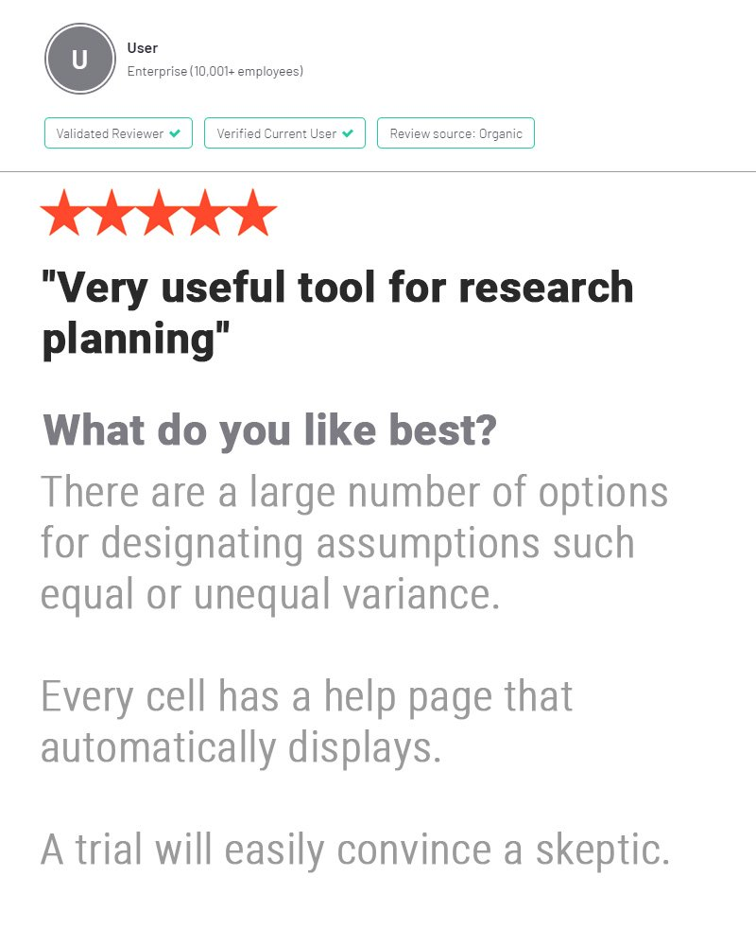
In 2021, 88% of organizations with clinical trials approved by the FDA used nQuery

Slide 6
Background – Clinical Trial Milestones
Part 1

Slide 7
Clinical Trial Milestones
Sample Size Determination usually focuses on calculating the required number of subjects to achieve a statistical “success” criterion (power)
Note SSD is itself downstream of other major study design decisions
Milestone Prediction focuses on how long it is expected for a study to reach milestone target (e.g. enrollment) for study end/interim analysis
Prediction is focussed on pragmatic issues of time and prob. of reaching goals
Whether before a trial or while it is on-going, milestone prediction can let trialists know if “on schedule” and what change(s) needed if not
Common Issue: ~80% of trials delayed, ~85% do not reach recruitment goal

Slide 8
Considerations for Milestone Predictions
What are our primary and secondary milestones?
E.g. Study end time, interim analyses timings, safety analysis, specific sponsor requests
What information is available and who will do the prediction?
E.g. Summary data only, subject-level data, site-level data, blinded or unblinded. Prediction by trialist or external?
How often should predictions be done? How much change to make?
Predict only at planned interim analyses, or continuously as data comes in?

Slide 9
Enrollment & Event Milestone Predictions
Part 2

Slide 10
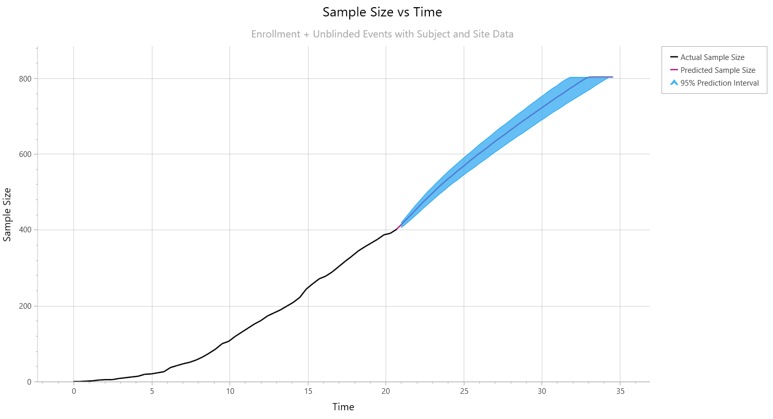
Enrollment Prediction
Enrolment Prediction focussed on recruitment milestones
Relevant for all trial endpoints
Multiple levels and approaches to look at enrolment prediction
nQuery Models: Poisson, Piecewise Poisson
Model Level: Global, Regional/Site-level
Can use prediction for decisions
e.g. add or drop sites via performance

Slide 11
Enrollment Prediction Method Examples
Parametric Model | e.g. Fit Linear, Polynomial, Poisson
Parametric Piecewise Modelling | e.g. Piecewise Poisson
Global Simulation | e.g. Exponential inter-arrival times
Explicit Per-Site Simulation | e.g. Fixed rate per site
Per-Site Simulation via Model | e.g. Poisson-Gamma Bayesian
Machine Learning | Based on current and/or simulations
Others | Regional Effects, Optimization, Cost

Slide 12
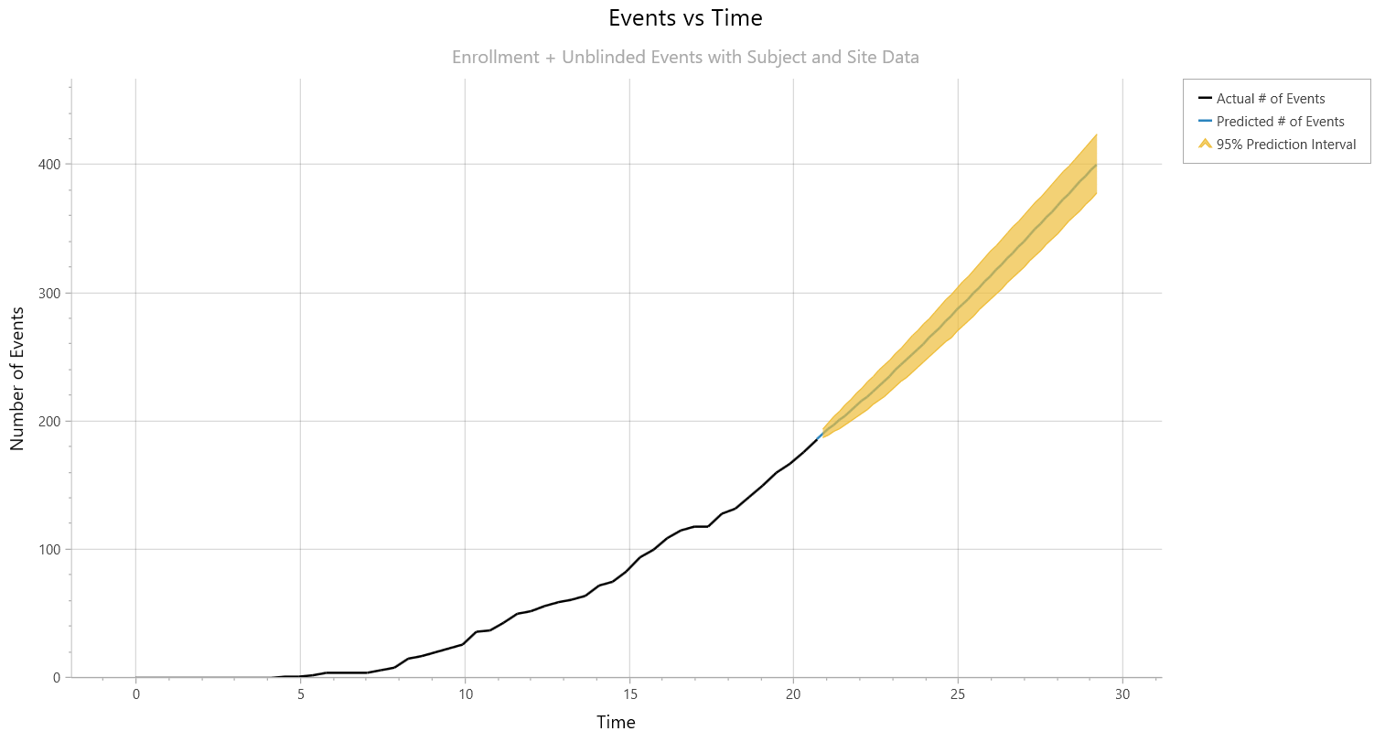
Events Prediction
Events Prediction focussed on event milestones (e.g. death)
Relevant for survival (TTE) endpoint
Variety of possible survival models
nQuery Models: Exponential, Piecewise Exponential, Survival
Can also model other considerations:
Enrollment as before if on-going at time of prediction
Other processes: Dropout (same models as event process)

Slide 13
Event Prediction Method Examples
Parametric Modelling | e.g. Exponential, Weibull, Log-Normal
Parametric Piecewise Modelling | e.g. Markov process (Lakatos)
Simulation using Survival Model | e.g. Exponential, Piecewise Exp., Weibull
Model Selection Algorithm | Select Models and/or Changepoints
Machine Learning Algorithm | Trained on Current &/or Simulations
Non-Proportional Hazards | Cure Rate Model, “Responder”-based
Other Considerations | External Data (Bayesian), Blinded EM

Slide 14
Worked Example
Part 3

Slide 15
Interim Milestone Prediction Example
Interim analysis conducted at 50% of total required events (187/374). Enrolment is 87% complete (402/460) with 118 out of 127 sites opened.
In this example, will explore the following scenarios:
Global vs Site-Level Enrolment
Unblinded vs Blinded Survival Model
Different Survival Models
Parameter | Value
Current Calendar Time | 24.9
Current Sample Size | 402
Current Events | 187
Current Dropouts | 3
Target Sample Size | 460
Target Events | 374
Sites Open | 118

Slide 16
Discussion & Conclusions
Part 4

Slide 17
Discussion & Conclusions
Delays in clinical trials due to recruitment are very common
Prediction of key milestones before and during trials valuable
Number of considerations involved when selecting prediction model
Target? Type of model? Information available? When to predict?
Enrolment prediction focussed on recruitment process
Predict only at planned interim analyses, or continuously as data comes in?
In survival trials, milestones are based on fixed number of events
Need to model survival processes with enrolment, dropouts etc.

Slide 18
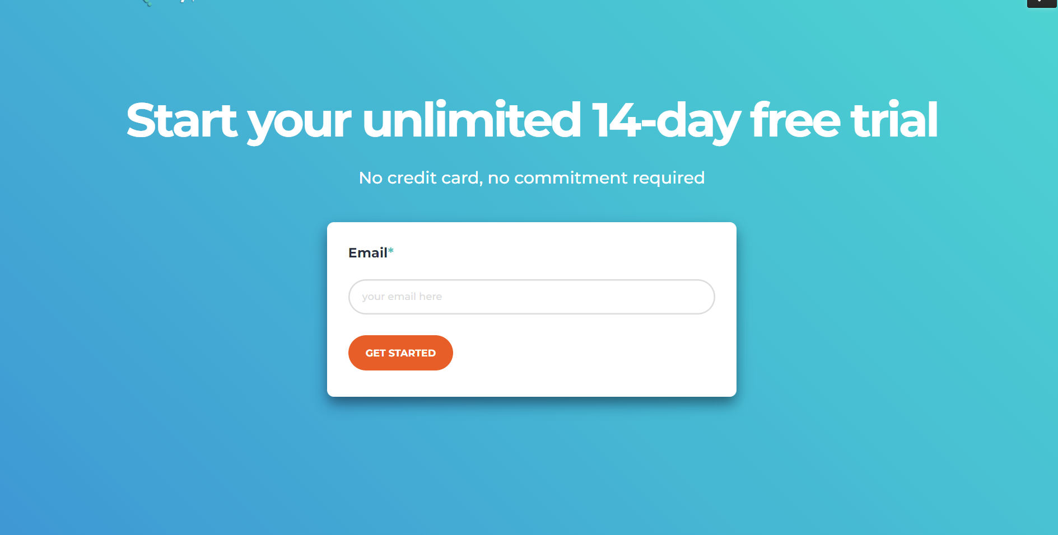
Statsols.com/trial

Slide 19
Thank You
Contact us:
info@statsols.com
More info:
Statsols.com

Slide 20
References (Background)
Lamberti, MJ. State of Clinical Trials Industry. Thomson Centerwatch.
Clinical Trials Arena. 2012. “Clinical trial delays: America’s patient recruitment dilemma” https://www.clinicaltrialsarena.com/analysis/featureclinical-trial-patient-recruitment
McDonald, A.M., Knight, R.C., Campbell, M.K., Entwistle, V.A., Grant, A.M., Cook, J.A., Elbourne, D.R., Francis, D., Garcia, J., Roberts, I. and Snowdon, C., 2006. What influences recruitment to randomised controlled trials? A review of trials funded by two UK funding agencies. Trials, 7(1), pp.1-8.
Bower, P., Brueton, V., Gamble, C., Treweek, S., Smith, C.T., Young, B. and Williamson, P., 2014. Interventions to improve recruitment and retention in clinical trials: a survey and workshop to assess current practice and future priorities. Trials, 15(1), pp.1-9.
Cognizant. 2015. “Patient Recruitment Forecast in Clinical Trials.” https://www.cognizant.com/whitepapers/patients-recruitment-forecast-in-clinical-trials-codex1382.pdf
Gkioni, E., Rius, R., Dodd, S. and Gamble, C., 2019. A systematic review describes models for recruitment prediction at the design stage of a clinical trial. Journal of clinical epidemiology, 115, pp.141-149.
Kearney, A., Harman, N. L., Rosala-Hallas, A., Beecher, C., Blazeby, J. M., Bower, P., … Gamble, C. (2018). Development of an online resource for recruitment research in clinical trials to organise and map current literature. Clinical Trials, 15(6), 533–542. https://doi.org/10.1177/1740774518796156

Slide 21
References (Enrolment)
Lee, Y.J., 1983. Interim recruitment goals in clinical trials. Journal of Chronic Diseases, 36(5), pp.379-389.
Comfort, S., 2013. Improving clinical trial enrollment forecasts using SORM. Applied Clinical Trials, 22(5), p.32.
Carter, R.E., Sonne, S.C. and Brady, K.T., 2005. Practical considerations for estimating clinical trial accrual periods: application to a multi-center effectiveness study. BMC medical research methodology, 5(1), pp.1-5.
Carter, R.E., 2004. Application of stochastic processes to participant recruitment in clinical trials. Controlled clinical trials, 25(5), pp.429-436.
Senn, S., 1998. Some controversies in planning and analysing multi‐centre trials. Statistics in medicine, 17(15‐16), pp.1753-1765.
Anisimov, V.V. and Fedorov, V.V., 2007. Modelling, prediction and adaptive adjustment of recruitment in multicentre trials. Statistics in medicine, 26(27), pp.4958-4975.
Anisimov, V., 2009, August. Predictive modelling of recruitment and drug supply in multicenter clinical trials. In Proc. of joint statistical meeting (pp. 1248-1259).

Slide 22
References (Enrolment)
Anisimov, V.V., 2011. Statistical modeling of clinical trials (recruitment and randomization). Communications in Statistics-Theory and Methods, 40(19-20), pp.3684-3699.
Bakhshi, A., Senn, S. and Phillips, A., 2013. Some issues in predicting patient recruitment in multi‐centre clinical trials. Statistics in medicine, 32(30), pp.5458-5468.
Jiang, Y., Guarino, P., Ma, S., Simon, S., Mayo, M.S., Raghavan, R. and Gajewski, B.J., 2016. Bayesian accrual prediction for interim review of clinical studies: open source R package and smartphone application. Trials, 17(1), pp.1-8.
Gajewski, B.J., Simon, S.D. and Carlson, S.E., 2008. Predicting accrual in clinical trials with Bayesian posterior predictive distributions. Statistics in medicine, 27(13), pp.2328-2340.
Abbas, I., Rovira, J. and Casanovas, J., 2007. Clinical trial optimization: Monte Carlo simulation Markov model for planning clinical trials recruitment. Contemporary clinical trials, 28(3), pp.220-231.
Moussa, M.A.A., 1984. Planning a clinical trial with allowance for cost and patient recruitment rate. Computer programs in biomedicine, 18(3), pp.173-179.

Slide 23
References (Events)
Lakatos, E., 1988. Sample sizes based on the log-rank statistic in complex clinical trials. Biometrics, pp.229-241.
Fang, L. and Su, Z., 2011. A hybrid approach to predicting events in clinical trials with time-to-event outcomes. Contemporary clinical trials, 32(5), pp.755-759.
Rufibach, K. (2016). Event projection: quantify uncertainty and manage expectations of broader teams. 2016. http://bbs.ceb-institute.org/wp-content/uploads/2016/06/Kaspar-event_tracking.pdf.
Walke, R., 2010. Example for a Piecewise Constant Hazard Data Simulation in R. Max Planck Institute for Demographic Research.
Goodman, M.S., Li, Y. and Tiwari, R.C., 2011. Detecting multiple change points in piecewise constant hazard functions. Journal of applied statistics, 38(11), pp.2523-2532.
Guyot, P., Ades, A.E., Beasley, M., Lueza, B., Pignon, J.P. and Welton, N.J., 2017. Extrapolation of survival curves from cancer trials using external information. Medical Decision Making, 37(4), pp.353-366.
Royston, P., 2012. Tools to simulate realistic censored survival-time distributions. The Stata Journal, 12(4), pp.639-654.
Crowther, M.J. and Lambert, P.C., 2012. Simulating complex survival data. The Stata Journal, 12(4), pp.674-687.

