Slide 1

Sample Size Allocation for Multi-Regional Clinical Trials
Selecting Appropriate Regional Proportions
November 2025

Slide 2


Denis Desmond
Research Statistician

Slide 3
Agenda
01
Overview of MRCTs
02
MRCT Design Considerations
03
Sample Size Determination
04
Discussion and Conclusions
Questions welcome throughout

Slide 4


Pre-clinical research
Animal studies
ANOVA / ANCOVA
Pilot Studies
Confirmatory
1000+ Scenarios for Fixed term, Adaptive & Bayesian Methods
Survival, Means, Proportions & Count endpoints
Group Sequential Trials
Bayesian:
Assurance
Credible Intervals
Posterior Error Approach
Sample Size Re-Estimation
Cross over & personalized medicine
MAMS
Prediction
Early Phase
CRM
MCP-Mod
Simon’s Two Stage
Flemings GST
The complete solution for optimizing your clinical trial designs
Post Marketing
Cohort Study
Case-control Study

Slide 5
nQuery Licensing nQuery operates on a tiered licensing model
BASE
PLUS
PRO
EXPERT
Sample size and power for fixed terms trials
100’s of designs,
endpoints and hypothesis types
Sample size for fully Bayesian (e.g. credible intervals)
+ Hybrid Bayes/Frequentist methods and designs (e.g. Assurance)
Sample size and power for early stage and confirmatory clinical trial
Adaptive Designs and tools for monitoring and adjustment in-trial
Additional tools for study design and monitoring
Incl milestone prediction for enrollment and (survival) event targets
Click Here to see our Package Comparison Tool

Slide 6
Overview of Multi-Regional Clinical Trials
Part 1

Slide 7
Introduction
A multi-regional clinical trial (MRCT) is one which is conducted in more than one region under a single trial protocol (Source: ICH E17, 2017)
Traditionally drug products are developed in conjunction with a single regulator to receive approval for use in that region, e.g. USA & FDA
Then a bridging study may have been required if the sponsor wished to make the product available in subsequent markets, e.g. EU, Japan Done to address any potential differences in genetics, culture, medical practices, etc.
Recently there has been a trend to move towards MRCT due to the globalization of drug development, and the efficiencies they can offer

Slide 8
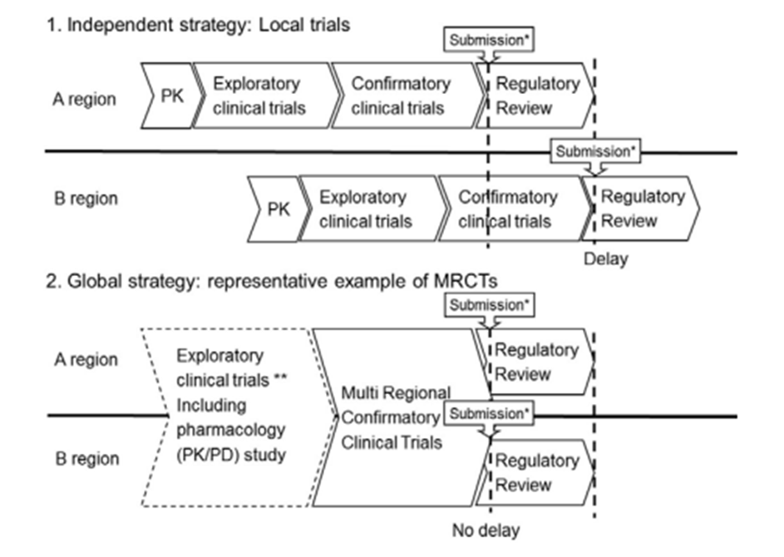
Overview of MRCTs
MRCTs avoid the duplication of studies, and can be a more efficient use of time and resources It is possible for MRCTs to be the singular pivotal trial for a regulatory submission
There is also the patient benefit as MRCTs can reduce time-lag before drug is available in other regions
MRCTs are of greater interest to more regulators now as pharmaceutical industry becomes more global
Source: ICH E17 (2017)

Slide 9
Multi-Regional Clinical Trials Design Considerations
Part 2

Slide 10
Regulatory Context
ICH E5 issued in 1998 was first major guidance on the acceptability of foreign clinical data – focused on scenarios that needed bridging studies Split ethnic factors into two groups: intrinsic (genetic, etc.) & extrinsic (cultural, etc.)
Japanese Pharmaceutical and Medical Devices Agency (PMDA) were key proponents of global clinical trials and the inclusion of Japanese patients During E5 Working Group Q&A they suggested simultaneous global drug development
In response, MHLW issued it’s 2007 guidance outlining basic principles for MRCTs inc. two criteria for determining Japanese representation This was done to specifically counteract the drug-lag faced by Japanese patients
ICH E17 issued in 2017 focuses more on overall framework for conducting MRCTs with the goal of simultaneous approval from multiple agencies

Slide 11
Design Considerations for MRCTs
Clinical | Diverse medical practices; regional differences in hospitalization/home-care; intrinsic/extrinsic population differences; ethical considerations; disease def.
Statistical | Heterogeneity of subjects; regional effects; type-I error control; pre-defined regions for the purposes of analysis; consistency across regions; overall effect
Regulatory | Early communication with regulators; satisfy local laws and requirements, e.g. prior provision of PK data; guidelines for termination of enrolment
Operational | Appropriate number of trial sites; standardized training/equipment; impacts on recruitment, e.g. disease prevalence; common trial protocol; supply chains
Commercial | Is the product of value compared to the current standard of care; would the intention be to expand product to other markets if developed in traditional way

Slide 12
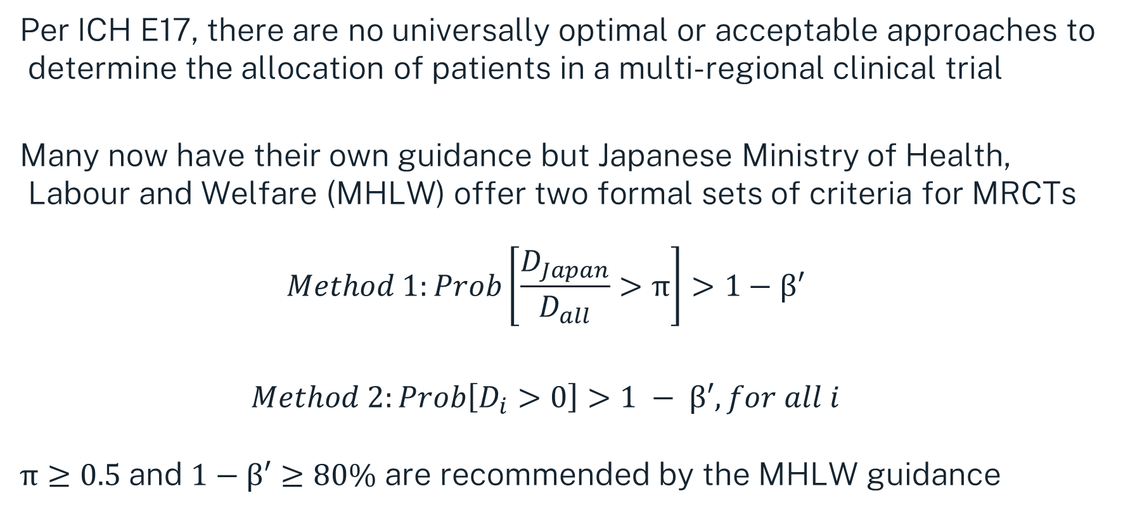
Allocation Criteria for MRCTs
Per ICH E17, there are no universally optimal or acceptable approaches to determine the allocation of patients in a multi-regional clinical trial
Many now have their own guidance but Japanese Ministry of Health, Labour and Welfare (MHLW) offer two formal sets of criteria for MRCTs
$$Method 1:Prob\left[\frac{D_{Japan}}{D_{all}}>π\right]>1−β′$$
$$Method 2:Prob\left[D_{i}>0\right]>1 − β′, for all i$$
$π≥0.5$and $1−β′≥80\%$ are recommended by the MHLW guidance

Slide 13
Part 3
Sample Size Determination

Slide 14
Example One - Bridging Studies
Suppose a clinical trial was conducted in Region A to establish the safety and efficacy as a new drug. In this trial the mean difference between test and placebo was 2, the common coefficient of variation was 0.4 and 1000 subjects were required to achieve the target power of 80%. Now suppose the sponsor is required carry out a bridging study in Region B, then a sample size of 160 is required in the new region to achieve 80% power, given equivalence limits of [-0.2, 0.2]. (Source: Table 1)
Parameter | Value
Significance Level | 0.05
Equivalence Limits [Lower, Upper] | [-0.2, 0.2]
Original Study Mean Difference | 2
Original Study Sample Size | 1000
Common CV | 0.4
Power (%) | 80
Bridging Study Sample Size | 160

Slide 15
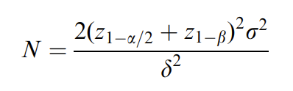
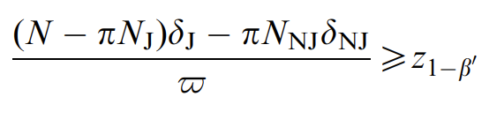




Sample Size Based on PMDA Methods
$$Method 1:Pr\left[{D_{Japan}}/{D_{all}}>π\right]>1 − β′$$
$$Method 2:Prob\left[D_{i}>0\right]>1 − β′, for all i$$
$$\sqrt{\frac{N}{2}}\frac{Δ}{σ}=z_{1−α/2}+z_{1−β}$$
$$P=\prod_{j=1}^{s}{Φ\left[\sqrt{p_{j}}\left(z_{1−α/2}+z_{1−β}\right)\right]}$$
Source: Quan et al. (2009)
Source: Kawai et al. (2008)

Slide 16
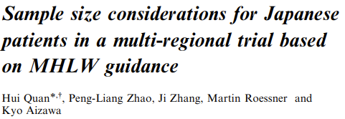
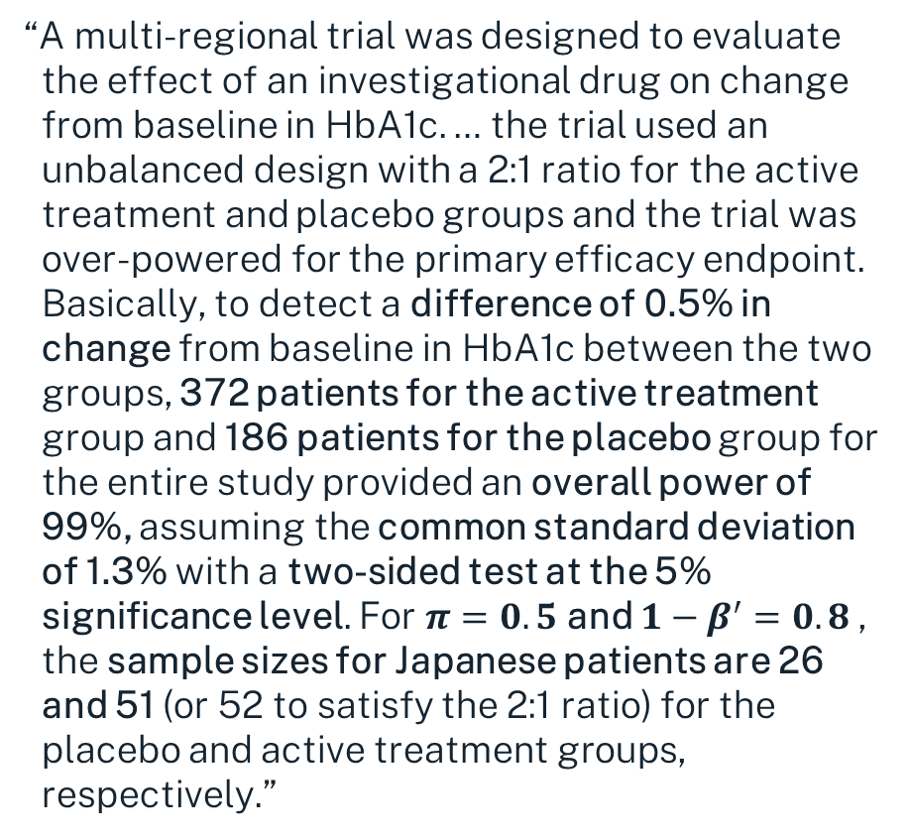
Example Two – PMDA Method One
“A multi-regional trial was designed to evaluate the effect of an investigational drug on change from baseline in HbA1c. … the trial used an unbalanced design with a 2:1 ratio for the active treatment and placebo groups and the trial was over-powered for the primary efficacy endpoint. Basically, to detect a difference of 0.5% in change from baseline in HbA1c between the two groups, 372 patients for the active treatment group and 186 patients for the placebo group for the entire study provided an overall power of 99%, assuming the common standard deviation of 1.3% with a two-sided test at the 5% significance level. For $π=0.5$ and $1−β^{′}=0.8$, the sample sizes for Japanese patients are 26 and 51 (or 52 to satisfy the 2:1 ratio) for the placebo and active treatment groups, respectively.”
Parameter | Value
Significance Level | 0.05
Overall Effect Size | 0.5
Regional Effect Size Ratio | 1
Common Standard Deviation | 1.3
Testing Threshold | 0.5
Power (%) | 99%
Consistency (%) | 80%
Bridging Study Sample Size | 78 [52, 26]

Slide 17
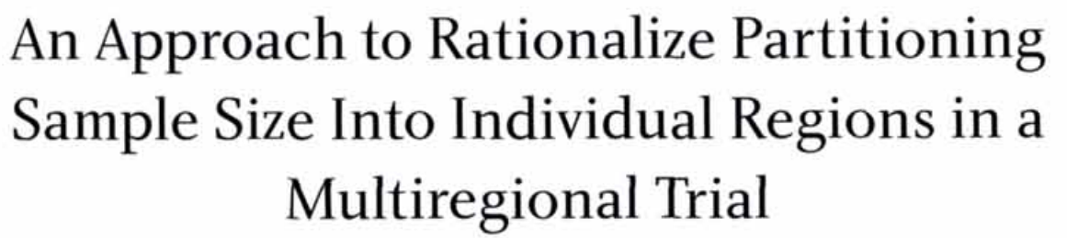
Example Three – PMDA Method Two
Consider a trial conducted in three regions with sample size splits of 25%, 25%, and 50%. The overall sample size for this trial will be 1006 in order to achieve a target power of 80%, and consistency of 80% given an overall effect size of 0.125, a common standard deviation of 1, and a two-sided test significance level of 0.05. (Source: Table 1)
Source: Kawai et al. (2008)
Parameter | Value
Significance Level | 0.05
Regional Proportions | (0.25, 0.25, 0.5)
Overall Effect Size | 0.125
Common Standard Deviation | 1
Power (%) | 80%
Consistency (%) | 80%
Overall Sample Size | 1006

Slide 18
Other Methods for Sample Size Allocation
Proportional Allocation | Allocation based on the sizes of the regions, and the prevalence of disease
Equal Allocation | Equal allocation of subjects across all regions
Preservation of Effect | Allocation to region(s) based on preservation of proportion of treatment effect
Local Significance | Allocate sufficient subjects to demonstrate significant results in each region
Fixed Minimum Number | Allocate a fixed minimum number of subjects to each region
Non-exhaustive list from ICH E17, innovation and further development is still encouraged

Slide 19
Discussion and Conclusions
Important to consider intrinsic & extrinsic differences in populations (e.g. genetics, culture) when looking to offer new drugs in other markets
Traditionally drugs are developed for one market, then a bridging study would be conducted if required by regulators to expand into new market
Recent trends have seen multi-regional clinical trials become increasingly more common as the drug development industry becomes more global
There is no universally accepted or optimal way to allocate the subjects in MRCTs, depends on factors like disease prevalence and local regulation

Slide 20


statsols.com/nquery-demo

Slide 21
Thank you
CONTACT US
info@statsols.com
MORE INFO
statsols.com

Slide 22
References
The International Council for Harmonisation of Technical Requirements for Pharmaceuticals for Human Use (1998), Ethnic Factors In The Acceptability Of Foreign Clinical Data E5(R1), Available from: https://database.ich.org/sites/default/files/E5_R1__Guideline.pdf
The International Council for Harmonisation of Technical Requirements for Pharmaceuticals for Human Use (2006), E5 Implementation Working Group Questions & Answers (R1), Available from: https://database.ich.org/sites/default/files/E5_Q%26As__R1_Q%26As.pdf
Basic Principles on Global Clinical Trials. (2007). PMDA. https://www.pmda.go.jp/files/000153265.pdf
The International Council for Harmonisation of Technical Requirements for Pharmaceuticals for Human Use (2017), General Principles for Planning and Design of Multi-regional Clinical Trials E17, Available from: https://database.ich.org/sites/default/files/E17EWG_Step4_2017_1116.pdf
US Food and Drug Administration. (2024). Considerations for Generating Clinical Evidence from Oncology Multiregional Clinical Development Programs (Draft Version). Available from: https://www.fda.gov/regulatory-information/search-fda-guidance-documents/considerations-generating-clinical-evidence-oncology-multiregional-clinical-development-programs
The International Council for Harmonisation of Technical Requirements for Pharmaceuticals for Human Use (1998), Statistical Principles For Clinical Trials E9, Available from: https://database.ich.org/sites/default/files/E9_Guideline.pdf
Liu, J., Chow, S., & Hsiao, C. (2012). Design and analysis of bridging studies. CRC Press.
Li, G., Binkowitz, B., Wang, W., Quan, H., & Chen, J. (2021). Simultaneous global new drug development: Multi-Regional Clinical Trials after ICH E17. CRC Press.
Asano, K., Aoi, Y., Kamada, S., Uyama, Y., & Tohkin, M. (2020). Points to Consider for Implementation of the ICH E17 Guideline: Learning from Past Multiregional Clinical Trials in Japan. Clinical Pharmacology & Therapeutics, 109(6), 1555–1563. https://doi.org/10.1002/cpt.2121
Zhang, M., Onakpoya, I., & Rupalla, K. (2022). International oncology drug approvals for multiregional or single-country clinical trials: A systematic review. Frontiers in Medicine, 9, 1084980. https://doi.org/10.3389/fmed.2022.1084980

Slide 23
References
Li L, Barnes M, Aldinger C, Bierer B. (2015) Global Clinical trials: ethics, harmonization and commitments to transparency. Harvard Public Health Review. Spring; 6. https://doi.org/10.54111/0001/f2
Long, M., Wu, H., Liu, X., Li, P., Lin, R., Zhao, Z., Kou, X., Zhu, C., Ji, C., Zhang, W., Zhang, K., Yu, B., Wang, Y., Zhang, H., Jia, F., & Hou, Y. (2025). Basic Considerations for the consistency Evaluation based on ICH E17 Guideline. Therapeutic Innovation & Regulatory Science, 59(2), 328–336. https://doi.org/10.1007/s43441-024-00737-z
Sohn, M., Song, Y., Jeon, A. Y., Oh, J. M., & Kim, I. (2019). Perspectives on adopting the guideline for multi-regional clinical trials in Korea: a multi-stakeholder survey. Korean Journal of Clinical Pharmacy, 29(4), 267–277. https://doi.org/10.24304/kjcp.2019.29.4.267
Liu, J., Hsueh, H., & Chen, J. J. (2002). Sample size requirements for evaluation of bridging evidence. Biometrical Journal, 44(8), 969–981. https://doi.org/10.1002/bimj.200290008
Chow, S., Shao, J., & Hu, O. Y. (2002). Assessing sensitivity and similarity in bridging studies. Journal of Biopharmaceutical Statistics, 12(3), 385–400. https://doi.org/10.1081/bip-120014567
Quan, H., Zhao, P., Zhang, J., Roessner, M., & Aizawa, K. (2009). Sample size considerations for Japanese patients in a multi‐regional trial based on MHLW guidance. Pharmaceutical Statistics, 9(2), 100–112. https://doi.org/10.1002/pst.380
Ikeda, K., & Bretz, F. (2010). Sample size and proportion of Japanese patients in multi‐regional trials. Pharmaceutical Statistics, 9(3), 207–216. https://doi.org/10.1002/pst.455
Kawai, N., Chuang-Stein, C., Komiyama, O., & Li, Y. (2008). An Approach to Rationalize Partitioning Sample Size into Individual Regions in a Multiregional Trial. Drug Information Journal, 42(2), 139–147. https://doi.org/10.1177/009286150804200206
Uesaka, H. (2009). Sample size allocation to regions in a multiregional trial. Journal of Biopharmaceutical Statistics, 19(4), 580–594. https://doi.org/10.1080/10543400902963185

