Slide 1
Sample Size and Power for Non-Parametric Analysis
April 2024

Slide 2
Denis Desmond
Research Statistician

Slide 3
Agenda
1. Parametric Assumptions 2. Non-Parametric Methods 3. Sample Size for Non-Parametric Tests 4. Discussion and Conclusions
Questions welcome throughout

Slide 4
nQuery: The complete solution for optimizing your clinical trial designs
Early Phase
CRM
MCP-Mod
Simon’s Two Stage
Flemings GST
Confirmatory
1000+ Scenarios for Fixed term, Adaptive &
Bayesian Methods
Survival, Means, Proportions & Count endpoints
Group Sequential Trials
Bayesian:
Assurance
Credible Intervals
Posterior Error Approach
Sample Size Re-Estimation
Cross over & personalized medicine
MAMS
Prediction
Pre-clinical research
Animal studies
ANOVA / ANCOVA
Post Marketing
Cohort Study
Case-control Study

Slide 5
nQuery Licensing nQuery operates on a tiered licensing model
Base
Sample size and power for fixed terms trials over 100’s of designs, endpoints and hypothesis types
Plus
Sample size for fully Bayesian (e.g. credible intervals) + hybrid Bayes/Frequentist methods and designs (e.g. Assurance)
Pro
Sample size and power for range of early stage and confirmatory clinical trial Adaptive Designs and tools for monitoring and adjustment in-trial
Expert
Additional tools for study design and monitoring. Focus currently on milestone prediction for enrollment and (survival) event targets
Click Here to see our Package Comparison Tool

Slide 6
Parametric Assumptions
Part 1

Slide 7
Introduction to Parametric Assumptions
Statistical methods have assumptions for their interpretation to be statistically valid
Many common statistical methods make assumptions about the distribution (+ form) of the underlying data – these are often referred to as “parametric assumptions” Common example is normal distribution assumption for t-test and ANOVA-type methods
Alternatively, can think of model defined using a (finite) set of distributional parameters
However, a lot of real clinical data does not map onto these parametric assumptions Complex distributional data (e.g. extreme outliers), ordinal or interval type data
Note parametric tests often hold up well even in presence of distributional divergence
Flexible statistical methods can be useful tools for handling these trial scenarios

Slide 8
Parametric vs Semi-Parametric vs Non-Parametric
Parametric | Methods which make distributional assumptions about data generating process – model data via (finite) set of distributional parameters Examples: t-tests/Z-tests, ANOVA (and similar), Linear Regression, Generalized Linear Models (e.g. Logistic regression, Poisson Regression)
Semi-Parametric | Methods with parametric & non-parametric components – often parametric linear/additive component of interest with underlying distribution undefined Examples: Cox Regression Model for time-to-event data, Proportional Odds Model for ordinal data
Non- Parametric | Methods which make no (or minimal) distributional assumptions about data generating process – no distribution related model parameters Examples: Wilcoxon-Mann-Whitney U-test, Wilcoxon Signed-Rank test, Kruskal-Wallis, Quantile regression

Slide 9
Non-Parametric Methods
Part 2

Slide 10
Introduction to Non-Parametric Methods
Non-parametric methods make no/minimal distributional assumptions about data Fewer assumptions can come at cost of interpretability and lower statistical power
Non-parametric often equivalent to subset of semi-parametric – log-rank subset of Cox regression, Wilcoxon tests subset of proportional odds model (see Harrell)
These methods are highly useful for dealing with complex continuous data (e.g. extreme outliers, infinite variance) or ordered data (ordinal, interval)
Non-parametric methods often more associated with testing rather than estimation
But non-parametric regression models growing in popularity e.g. quantile regression
Will focus here on non-parametric rank tests & their associated sample size/power

Slide 11
Rank Tests Overview
Rank tests are a common type of non-parametric test used for complex continuous data (e.g. outliers), ordinal data (ordered categories) and interval (scale) data
Rank tests are interested in hypothesis tests based on the relative ranks of outcomes for each subject (i.e. not the direct underlying value) across groups
Hypotheses framed around P(X>Y) type statistics – exact definition often complex
Rank tests often conflated with test of medians but only valid under location shift assumption
Can map many rank tests onto equivalent parametric tests e.g. W-M-W U-test = t-test
Rank tests will tend to struggle with estimation (e.g. confidence intervals) and data dependency (e.g. covariates) - consider semi-parametric here
For example, proportional odds model is good candidate for ordinal/interval type data

Slide 12
Types of Non-Parametric Tests
Parametric Test | Non-Parametric Equivalent
One-Sample/Paired t-test | Wilcoxon Signed Rank Test
Two-Sample t-test | (Wilcoxon-)Mann-Whitney U-test
ANOVA | Kruskal-Wallis (One-way), Friedman (Repeated Measures)
Pearson Correlation | Spearman Correlation
Other Non-Parametric Methods | Median tests, Sign test, Log-Rank test, Cohen’s Kappa, Kendall’s Tau-B, Non-parametric regression (e.g. quantile regression)

Slide 13
Part 3
Sample Size for Non-Parametric Tests

Slide 14
Sample Size for Non-Parametric Tests
Different approaches required for complex continuous and ordinal power analysis
Even when using same power formula, practical input requirements will be different
For continuous data, will usually need to specify a data distribution regardless
Most common power methods assume location shift hypothesis (i.e. same distribution)
For ordinal data, specify the proportion of subjects in each rank across each group
Power Methods for Continuous | Asymptotic Relative Efficiency (A.R.E.), Calculation of Moment(s), Direct Input of Moments (e.g. p1 = P[X>Y]), Exemplary Dataset Approach, Simulation-based power
Power Methods for Ordinal | Calculation of Moment(s) (e.g. Kolassa or O’Brien & Castelloe for Mann-Whitney U-test), Exemplary Dataset Approach, Simulation-based power

Slide 15
Two-Sample Continuous Case | Example 1
“The study sample was set … 70 per group were fully assessable. This number was estimated by assuming that all patients would achieve ulcer healing by the end of week 24±1, and that mean (SD) time to healing would be 84 (42) days in the placebo group and 63 (42) days in the mesoglycan group. The specified significance level was 0.05 (two-tailed) and statistical power was 0.80.”
Parameter | Value
Significance Level (2-sided) | 0.05
Mean (Placebo/Treatment) | 84 / 63 days
Common Standard Deviation | 42 days
Sample Size per group | 70
Target Power | 80%

Slide 16
One-Sample Continuous Case | Example 2
“For the power calculation, we used Shieh’s method. For a power of 0.8 with alpha = 0.05, based on previous studies, and assuming a median-difference-to-standard-deviation ratio of 0.8 in motor function tests, the required sample size was calculated as between 11 (Laplace distribution) and 14 (uniform distribution). The final sample in our study comprised 15 patients ”
Parameter | Value
Significance Level (1-sided) | 0.05
Distributions Used | Laplace, Uniform
Effect Size | 0.8
Sample Size (Laplace/Uniform) | 11/14
Power | 80%

Slide 17
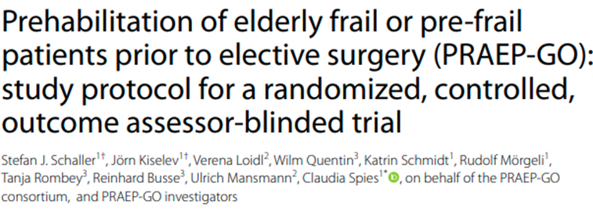
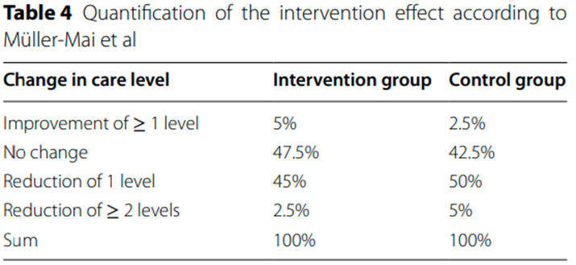
Two-Sample Ordinal Case | Example 3
“Formally, the probability of changes in the level of care is an ordered categorical outcome, so the sample size was calculated according to Kolassa … . Based on this calculation, a sample size of 470 patients in each group will have 80% power to detect the expected quantified effects shown in Table 4, using a Wilcoxon-Mann-Whitney rank sum test with a 0.05 two-sided level.”
Parameter | Value
Significance Level (2-sided) | 0.05
Number of Categories | 4
Control Changes | {2.5%, 42.5%, 50%, 5%}
Treatment Changes | {5%, 47.5%, 45%, 2.5%}
Sample Size per group | 470
Power | 80%

Slide 18
Discussion and Conclusions
Many common statistical methods require making assumptions about the underlying data generating process i.e. parametric assumptions
However, when these assumptions are not met (extreme outliers, ordinal data) then more flexible semi- or non-parametric methods may be appropriate
Non-parametric methods make no assumptions about the underlying distribution with rank tests being a common approach for testing in presence of complex data
Power and sample size methods for non-parametric tests are available but typically require either specifying the distribution or an ordinal data frequency pattern

Slide 19
Statsols.com/trial

Slide 20
Thank You
Contact us:
info@statsols.com
More info:
Statsols.com

Slide 21
References
Noether, G. E. (1987). Sample Size Determination for Some Common Nonparametric Tests. Journal of the American Statistical Association, 82(398), 645–647.
Shieh, G., Jan, S. L., & Randles, R. H. (2007). Power and sample size determinations for the Wilcoxon signed-rank test. Journal of Statistical Computation and Simulation, 77(8), 717–724.
Wang, H., Chen, B., & Chow, S. C. (2003). Sample Size Determination Based on Rank Tests in Clinical Trials. Journal of Biopharmaceutical Statistics, 13(4), 735–751.
Kolassa, J. E. (1995). A comparison of size and power calculations for the Wilcoxon statistic for ordered categorical data. Statistics in Medicine, 14(14), 1577–1581.
Whitehead, J. (1993). Sample size calculations for ordered categorical data. Statistics in Medicine, 12(24), 2257–2271.
Dixon, W.J., & Massey, F.J. (1983). Introduction to Statistical Analysis (4th ed.). McGraw-Hill.
O'Brien, R. G., & Muller, K. E. (1993). Unified power analysis for t-tests through multivariate hypotheses. In L. K. Edwards (Ed.),
Statistics: Textbooks and monographs, Vol. 137. Applied analysis of variance in behavioral science (pp. 297–344). Marcel Dekker.
Divine, G., Kapke, A., Havstad, S., & Joseph, C. L. (2009). Exemplary data set sample size calculation for Wilcoxon–Mann–Whitney tests. Statistics in Medicine (Print), 29(1), 108–115.

Slide 22
References
Tang, Y. (2011). Size and power estimation for the Wilcoxon–Mann–Whitney test for ordered categorical data. Statistics in Medicine, 30(29), 3461–3470.
Arosio, E., Ferrari, G., Santoro, L., Gianese, F., & Coccheri, S. (2001). A placebo-controlled, double-blind study of mesoglycan in the treatment of chronic venous ulcers. European Journal of Vascular and Endovascular Surgery, 22(4), 365–372.
Segal, I., Khamis, S., Sagie, L., Genizi, J., Azriel, D., Katzenelenbogen, S., & Fattal‐Valevski, A. (2023). Functional Benefit and Orthotic Effect of Dorsiflexion-FES in Children with Hemiplegic Cerebral Palsy. Children (Basel), 10(3), 531.
Schaller, S., Kiselev, J., Loidl, V., Quentin, W., Schmidt, K., Mörgeli, R., Rombey, T., Busse, R., Mansmann, U., Spies, C., Spies, C., Marschall, U., Eckardt-Felmberg, R., Landgraf, I., Schwantes, U., Busse, R., & Mansmann, U. (2022). Prehabilitation of elderly frail or pre-frail patients prior to elective surgery (PRAEP-GO): study protocol for a randomized, controlled, outcome assessor-blinded trial. Trials, 23(1).
Harrell, F. E., Jr. (n.d.). Biostatistics for Biomedical research. https://hbiostat.org/bbr/
Harrell, F. Statistical thinking - What does a statistical method assume? https://www.fharrell.com/post/assume/
Conroy, R. (2012). What Hypotheses do “Nonparametric” Two-Group Tests Actually Test? The Stata Journal, 12(2), 182-192

