Slide 1
Sample Size for Frequentist & Bayesian Statistical Intervals
Design Considerations for Confidence, Prediction, Tolerance & Credible Intervals
February 2024

Slide 2
Paul Murphy
Research Statistician

Slide 3
Agenda
01
Statistical Intervals Overview
02
Sample Size for Confidence Intervals
03
Sample Size for Prediction & Tolerance Intervals
04
Sample Size for Credible Intervals
Questions welcome throughout

Slide 4
Pre-clinical research
Animal studies
ANOVA / ANCOVA
Pilot Studies
Confirmatory
1000+ Scenarios for Fixed term, Adaptive & Bayesian Methods
Survival, Means, Proportions & Count endpoints
Group Sequential Trials
Bayesian:
Assurance
Credible Intervals
Posterior Error Approach
Sample Size Re-Estimation
Cross over & personalized medicine
MAMS
Prediction
Early Phase
CRM
MCP-Mod
Simon’s Two Stage
Flemings GST
The complete solution for optimizing your clinical trial designs
Post Marketing
Cohort Study
Case-control Study

Slide 5
nQuery Licensing nQuery operates on a tiered licensing model
BASE
PLUS
PRO
EXPERT
Sample size and power for fixed terms trials over 100’s of designs,
endpoints and hypothesis types.
Sample size for fully Bayesian (e.g. credible intervals)
+ Hybrid Bayes/Frequentist methods and designs (e.g. Assurance)
Sample size and power for range of early stage and confirmatory clinical trial
Adaptive Designs and tools for monitoring and adjustment in-trial
Additional tools for study design and monitoring.
Focus currently on milestone prediction for enrollment and (survival) event targets
Click Here to see our Package Comparison Tool

Slide 6
Statistical Intervals Overview
Part 1

Slide 7
Statistical Intervals Introduction
Statistical intervals quantify the degree of uncertainty (via interval precision/width) in parameter estimates of interest
Emphasize the “quality” of estimate rather than point value
Most statistical intervals will become more precise as the sample size increases (e.g. lower standard error)
Therefore, natural to determine sample size for given precision
Most common intervals are frequentist intervals based on percentage of intervals containing X under repeated sampling
Will cover Bayesian perspective later in webinar

Slide 8
Types of Statistical Intervals
Confidence Intervals | Percentage of Intervals of contain parameter under repeated sampling
Prediction Intervals | Percentage of Intervals of contain “future” sample/parameter under repeated (future) sampling
Tolerance Intervals | Percentage of Intervals of contain given proportion of sample under repeated sampling
Credible Intervals | Given interval contains true parameter with given probability

Slide 9
Considerations for Interval Choice
What is the desired target of the interval of interest?
Parameter of interest (location, spread etc.), future observation(s)?
How is the statistical interval defined regarding “confidence”?
Therefore, natural to determine sample size for given precision
What is the nature of underlying population and sampling procedure?
Will cover Bayesian perspective later in webinar
How to calculate the statistical interval from the given data?
Parametric model? Distribution-free (tolerance)? Bootstrapping?

Slide 10
Sample Size for Confidence Intervals
Part 2

Slide 11
Confidence Intervals (CIs)
Confidence intervals are constructed so that a percentage of intervals will include the parameter of interest under repeated sampling.
Emphasize the “quality” of estimate rather than point value Confidence (e.g. 95%) is the % of intervals that will include the parameter.
The most common statistical interval used in practice in areas from clinical trials, survey design and field studies.
Commonly given alongside the statistical testing procedure.
Confidence intervals (and sample size) are available for vast majority of endpoints and models of clinical interest.
Means, proportions, survival, parallel, crossover, hierarchical etc.

Slide 12
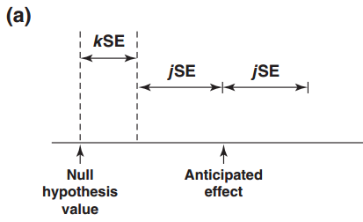
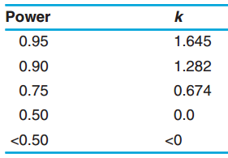
Sample Size for Confidence Intervals
Most common SSD methods for confidence intervals based on parametric assumptions
Normal approximations common for sample size
However, exact methods available for common cases
Most SSD calculations target “average” precision (length/width) of interval
Can show via rearrangement of common CI formulae
Related to common concepts such standard error
However, can show interval will often be lower than target width (Kupper & Hafner - 1989)
Can ensure interval less than target width using coverage probability/P(width) input
Concept of interval limit as random variable, similar idea can show relationship to power
$$\overline{π} ∓ z_{α}\left(\frac{σ}{\sqrt{n}}\right)\overset{⇒}{.}n= {\left(\frac{z_{α}σ}{ω}\right)}^{2}$$
Source: IARC, WHO

Slide 13
Example 1. Two Means CI
“It was estimated that 10 subjects per treatment group would provide a 95% confidence interval half-width of 1.5 mg/kg per min for the difference in glucose disposal rates between treatment groups (assuming a standard deviation of 1.7 mg/kg per min)”
Parameter | Value
Confidence Level (Two-Sided) | 0.95
Standard Deviation (σ) | 1.7
C.I. Half-Width | 1.5
Sample Size Per Group | 10
Source: Diabetic Medicine, Wiley, 2004

Slide 14
Example 2. One Proportion CI
“Initial enrolment was planned for 48 patients, with 24 EGFR(+) and 24 EGFR(−) cases. With a total sample size of 24 patients, the 95% confidence interval for the response rate would have a half width no greater than ±20%. The actual half width was dependent on observed response rate.”
Parameter | Value
Confidence Level (Two-Sided) | 0.95
Standard Proportion (π) | 0.5
Average CI Half-Width | 0.2
Sample Size Per Group | 24
Source: Annals of Oncology, Medscape, 2012

Slide 15
Prediction and Tolerance Intervals
Part 3

Slide 16
Prediction & Tolerance Intervals
Confidence intervals is the most common frequentist interval but other intervals exist under the repeated sampling framework
Confidence intervals are often used when they’re not the most appropriate interval
Prediction Intervals (PIs) give an interval for future observations or parameter values sampled from the same population
Most commonly cited is the prediction interval for one future value.
Tolerance intervals (TIs) give an interval that contains a specified proportion of the sample under repeated sampling
Equivalent to confidence intervals for specified percentiles.

Slide 17
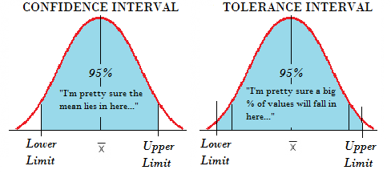
Sample Size for Prediction/Tolerance Intervals
Prediction interval sample size determination available for one normal mean case
PI for future mean, standard deviation, k observations
Prediction interval sample size based on interval width relative to “limiting interval”
Limiting Interval: Interval when sample size at infinity
Note “sample size” (n) is original sample not future sample (size = k), effectively known parameter case
Tolerance interval SSD for one normal, gamma or exponential sample
Based on proportion covered (P) with exceedance adjustment (margin + probability of exceedance)
Note non-parametric approach exists (not yet in nQuery)
Limiting Intervals for Future Mean, k observations and standard deviation

Slide 18
Example 3. Prediction Interval
“Approximately 50% of the population was to be male and 50% female to allow for analyses within each gender. A sample size of 120 subjects was thus planned, which was estimated to yield a 95% prediction interval with a width approximately 1.2% larger than that of the smallest achievable prediction interval, whilst analyses of each gender (60 in each group) would yield a 95% prediction interval with a width approximately 5.2% larger than that of the smallest achievable ”
Parameter | Value
Confidence Level (Two-Sided) | 0.95
Relative Width | 1.012/1.025
Future Sample Size (k) | 1
Sample Size | 120/60

Slide 19
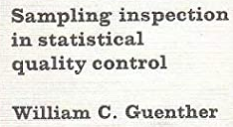
Example 4. Tolerance Interval
One Exponential Example:
P = 0.9, 1 – α = 0.95, P + δ = 0.95, and α’ = 0.05.
Gives sample size of 22
Source: Guenther, W.C. (1977). Sampling Inspection in Statistical Quality Control. Charles Griffin and Company Limited. P181.
Parameter | Value
Confidence Level (One-Sided) | 0.95
Proportion Covered (P) | 0.9
Exceedance Margin (δ) | 0.05
Exceedance Probability | 0.05
Sample Size | 22

Slide 20
Credible Intervals
Part 4

Slide 21
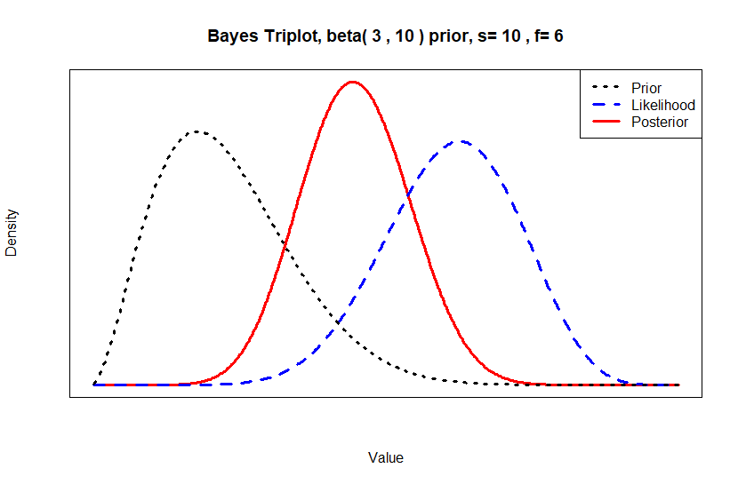
Bayesian Statistics Overview
Bayesian Statistics combines existing knowledge, expert opinion and real-world data.
Parameters to be estimated are treated as random variables.
A posterior distribution is estimated from a prior distribution and observed data using Bayesian analysis.
The posterior is then used to make inferences.
Bayes’ Theorem
$$P\left(θ | D\right)=\frac{P(D|θ)×P(θ)}{P(D)}$$

Slide 22
Credible Intervals
Credible Intervals are the most commonly used Bayesian method for interval estimation.
Can be considered to be the Bayesian analogue to confidence intervals.
95% Credible Interval | 95% Confidence Interval
Interval contains 95% of the posterior probability – i.e. there is a 95% chance that the true value is in the interval. Unknown parameter is a RV, bounds are fixed. | Under repeated sampling, 95% of confidence intervals constructed the same way will include the true value. Unknown parameter is fixed, bounds are RV’s.

Slide 23
Credible Interval Construction
Adcock (1988) and Joseph and Belisle (1997) have developed methods to construct credible intervals for normal means
The method chosen depends on the selection criteria and the estimation methodology.
Selection Criteria | Estimation Methodology
Average Coverage Criterion (ACC) | Known Precision
Average Length Criterion (ALC) | Unknown Precision
Worst Outcome Criterion (WOC) | Mixed Bayesian/Likelihood

Slide 24
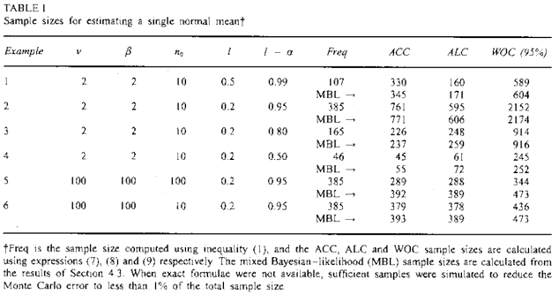
Example 5. Credible & MBL Interval
“In practice, the prior information will be different in every problem, so it is impossible to provide exhaustive tables. Therefore, Table 1 presents a variety of examples that illustrate the relationships between the various criteria discussed for the case of estimating sample size requirements for a single normal mean. Example 1-3 … show that the Bayesian approach can provide larger sample sizes than the frequentist approach, even though prior information is incorporated ... The same examples also illustrate that sample size provided by the ALC tend to be smaller than that of the ACC when 1-α is near l and l is not near 0.”

Slide 25
Discussion and Conclusions
Statistical Intervals give insight into uncertainty in estimates
· Sample Size focused on target interval precision (i.e. length/width)
Confidence Intervals are most common & available type
· Sample size well development for most areas, note coverage issue
Other frequentist intervals are prediction & tolerance intervals
· Sample size methods available but more "abstract" versus CI SSD.
Credible intervals give alternative interval-specific insight
· Sample size has wide range of options and approaches

Slide 26
statsols.com/nquery-demo

Slide 27
Thank you
CONTACT US
info@statsols.com
MORE INFO
statsols.com

Slide 28
References (Statistical Intervals)
Meeker, W.Q., Hahn, G.J. and Escobar, L.A., 2017. Statistical intervals: a guide for practitioners and researchers (Vol. 541). John Wiley & Sons.
Zar, J. H. (1999). Biostatistical analysis. Pearson Education India.
Craggs, C. (1989). Statistics in Research: Basic Concepts and Techniques for Research Workers.
Moore, D. S., & McCabe, G. P. (1989). Introduction to the Practice of Statistics. WH Freeman/Times Books/Henry Holt & Co.
Fleiss, J. L., Levin, B., & Paik, M. C. (2013). Statistical methods for rates and proportions. John wiley & sons.
Severini, T. A. (1991). On the relationship between Bayesian and non‐Bayesian interval estimates. Journal of the Royal Statistical Society: Series B (Methodological), 53(3), 611-618.
Neyman, J. (1937). Outline of a theory of statistical estimation based on the classical theory of probability. Philosophical Transactions of the Royal Society of London. Series A, Mathematical and Physical Sciences, 236(767), 333-380.

Slide 29
References (Statistical Intervals)
Paoli, B., Haggard, L., & Shah, G. (2002). Confidence intervals in public health. Office of Public Health Assessment, Utah Department of Health, 8.
Morey, R. D., Hoekstra, R., Rouder, J. N., Lee, M. D., & Wagenmakers, E. J. (2016). The fallacy of placing confidence in confidence intervals. Psychonomic bulletin & review, 23(1), 103-123.
Robinson, G. K. (1975). Some counterexamples to the theory of confidence intervals. Biometrika, 62(1), 155-160.
Mayo, D. G. (1981). In defense of the Neyman-Pearson theory of confidence intervals. Philosophy of Science, 48(2), 269-280.

Slide 30
References (Confidence Intervals)
Julious, S.A., (2009). Sample sizes for clinical trials. Chapman and Hall/CRC.
Chow, S.C., Shao, J., & Wang, H. (2008). Sample Size Calculations in Clinical Research (2nd ed.). Chapman & Hall.
Mathews, P. (2010). Sample size calculations: Practical methods for engineers and scientists. Mathews Malnar and Bailey.
Rothman, K.J. and Greenland, S., (2018). Planning study size based on precision rather than power. Epidemiology, 29(5), pp.599-603.
Kelley, K., Maxwell, S.E. and Rausch, J.R., 2003. Obtaining power or obtaining precision: Delineating methods of sample-size planning. Evaluation & the health professions, 26(3), pp.258-287.
Dos Santos Silva, I. (1999), Cancer Epidemiology: Principles and Methods, IARC.
Clayton, D., & Hills, M. (2013), Statistical Models in Epidemiology, OUP Oxford, 206-208.

Slide 31
References (Confidence Intervals)
W. Wang (2010), On Construction of the Smallest One-sided Confidence Interval for the Difference of Two Proportions. The Annals of Statistics, 38(2)1227–1243.
Kupper, L. L., & Hafner, K. B. (1989). How appropriate are popular sample size formulas?. The American Statistician, 43(2), 101-105.
Beal, S. L. (1989). Sample size determination for confidence intervals on the population mean and on the difference between two population means. Biometrics, 969-977.
Liu, X. S. (2009). Sample size and the width of the confidence interval for mean difference. British Journal of Mathematical and Statistical Psychology, 62(2), 201-215.
Bennett, S. M. A., et al. (2004), Rosiglitazone Improves Insulin Sensitivity, Glucose Tolerance and Ambulatory Blood Pressure in Subjects with Impaired Glucose Tolerance, Diabetic Medicine, 21(5) 415-422.
Pipas, J. M., et al. (2012), Neoadjuvant Cetuximab, Twice-weekly Gemcitabine, and Intensity-modulated Radiotherapy (IMRT) in Patients with Pancreatic Adenocarcinoma, Annals of Oncology, 23(11) 2820-2827.

Slide 32
References (Prediction & Tolerance Intervals)
Lawless, J. F., & Fredette, M. (2005). Frequentist prediction intervals and predictive distributions. Biometrika, 92(3), 529-542.
Gkisser, S. (2017). Predictive inference: an introduction. Chapman and Hall/CRC.
Meeker, W. Q., & Hahn, G. J. (1982). Sample sizes for prediction intervals. Journal of Quality Technology, 14(4), 201-206.
Meeker, W. Q., Hahn, G. J., & Escobar, L.A. (2017). Sample Size Requirements for Prediction Intervals. In Statistical Intervals.
Wolthers, O. D., Lomax, M., & Schmedes, A. V. (2021). Paediatric reference range for overnight urinary cortisol corrected for creatinine. Clinical Chemistry and Laboratory Medicine (CCLM), 59(9), 1563-1568.
Krishnamoorthy, K., & Mathew, T. (2009). Statistical tolerance regions: theory, applications, and computation. John Wiley & Sons.
Howe, W. G. (1969). Two-sided tolerance limits for normal populations—some improvements. Journal of the American Statistical Association, 64(326), 610-620.

Slide 33
References (Prediction & Tolerance Intervals)
Guenther, W. C. (1972). Tolerance intervals for univariate distributions. Naval Research Logistics Quarterly, 19(2), 309-333.
Guenther, W. C. (1977). Sampling Inspection in statistical quality control (No. 04; TS156. 4, G8.).
Odeh, R. E., Chou, Y. M., & Owen, D. B. (1989). Sample-size determination for two-sided β-expectation tolerance intervals for a normal distribution. Technometrics, 31(4), 461-468.
Young, D. S., Gordon, C. M., Zhu, S., & Olin, B. D. (2016). Sample size determination strategies for normal tolerance intervals using historical data. Quality Engineering, 28(3), 337-351.

Slide 34
References (Credible Intervals)
Jaynes, E. T., & Kempthorne, O. (1976). Confidence intervals vs Bayesian intervals. In Foundations of probability theory, statistical inference, and statistical theories of science (pp. 175-257). Springer, Dordrecht.
Jeffreys, H. (1961), Theory of Probability (3rd. ed,), Oxford, U.K.: Oxford University Press.
Adcock, C.J., (1988). A Bayesian approach to calculating sample sizes. Journal of the Royal Statistical Society: Series D (The Statistician), 37(4-5), pp.433-439.
Joseph, L., & Belisle, P. (1997). Bayesian sample size determination for normal means and differences between normal means. Journal of the Royal Statistical Society: Series D (The Statistician), 46(2), 209-226.
Joseph, L., Wolfson, D. B., & Berger, R. D. (1995). Sample Size Calculations for Binomial Proportions via Highest Posterior Density Intervals. The Statistician, 44(2), 143–154
Joseph, L., M’Lan, C. E., & Wolfson, D. B. (2008). Bayesian sample size determination for binomial proportions. Bayesian Analysis, 3(2), 269–296.

Slide 35
References (Credible Intervals)
Joseph, L., Du Berger, R., & Belisle, P. (1997). Bayesian and mixed Bayesian/likelihood criteria for sample size determination. Statistics in medicine, 16(7), 769-781.
Joseph, L., & Bélisle, P. (2019). Bayesian consensus‐based sample size criteria for binomial proportions. Statistics in Medicine, 38(23), 1-8.

