Slide 1
Sample Sizes for Vaccine Trials
Trial Designs for Assessing Vaccine Efficacy, Safety & Durability

Slide 2
Calvin O’Brien
Research Statistician

Slide 3
Agenda
01
Vaccine Trial Designs
02
Assessing Vaccine Efficacy
03
Vaccine Safety - Self Controlled Case Studies
04
Vaccine Durability - Deferred Vaccine Designs
Questions welcome throughout

Slide 4
The complete solution for optimizing your clinical trial designs
Pre-clinical research
Animal studies
ANOVA / ANCOVA
Confirmatory
1000+ Scenarios for Fixed term, Adaptive & Bayesian Methods
Survival, Means, Proportions & Count endpoints
Group Sequential Trials
Bayesian:
Assurance
Credible Intervals
Posterior Error Approach
Sample Size Re-Estimation
Cross over & personalized medicine
MAMS
Prediction
Early Phase
CRM
MCP-Mod
Simon’s Two Stage
Flemings GST
Post Marketing
Cohort Study
Case-control Study

Slide 5
nQuery Licensing nQuery operates on a tiered licensing model
BASIC
PLUS
PRO
EXPERT
Sample size and power for fixed terms trials over 100’s of designs,
endpoints and hypothesis types.
Sample size for fully Bayesian (e.g. credible intervals)
+ Hybrid Bayes/Frequentist methods and designs (e.g. Assurance)
Sample size and power for range of early stage and confirmatory clinical trial
Adaptive Designs and tools for monitoring and adjustment in-trial
Additional tools for study design and monitoring.
Focus currently on milestone prediction for enrollment and (survival) event targets
Click Here to see our Package Comparison Tool

Slide 6
Vaccine Trial Design
Part 1

Slide 7
Vaccine Trial Designs
Development of vaccines is traditionally long and uniquely challenging, due to the size of trials and emphasis on safety
Rare diseases means low number of cases / adverse events
Phase III vaccine trials will tend to be large even by Phase III standards
Reflects fact that many vaccinations will never be “activated”
Safety assessed at all stages of the trial process
Phase III primary safety endpoints, Post market surveillance on safety
Uniquely prevalent issues has led to distinct methods/terminology for vaccine trials
Most can be mapped onto methods from other areas

Slide 8
Vaccine Trial Challenges
Vaccine Trials will tend to be “event” driven and thus very large
Can affect design (e.g. cluster randomization, cohort designs)
Vaccine trials place even higher standard on safety concerns
NB: Vaccines are given much wider population than therapeutics
Decisions required on choice of endpoint and statistical methods
Incidence vs. severity (composite?), proportion/count/TTE?
Length (5-10 years) & N (10000s) mean less focus on adaptive design
Accuracy (especially on safety endpoints) over speed in vaccines

Slide 9
Assessing Vaccine Efficacy
Part 2

Slide 10
Vaccine Efficacy
Vaccine Efficacy is equal to 1 - Risk Ratio (RR = ARV/ARU)
-∞ < VE ≤ 1; higher score means stronger protection
Multiple tests available depending on assumptions around cases
Counts, Proportions, Time to Event
VE typically primary endpoint of clinical trials along with safety endpoints
Cases could be defined using symptom expression rather than disease incidence

Slide 11
Vaccine Methods/SSD Examples
Confidence Interval for VE | O’Neill (1988) – Case-Control, Cohort
One Proportions Tests | “Event-Driven”, Standard Tests
Two Proportions Tests | VE = 1 – RR, Apply usual RR Tests/SSD
Composite Models | Incidence + Severity, Callegaro (2020)
Count (Poisson/NB) Models | “Standard” + “Rare Event” Approach
Cox Regression | Common for NI/SM Hypotheses
Cluster Randomized Designs | Counts/Props - Hayes & Bennett (1999)

Slide 12
Worked Example 1 - Covid 19 Trials
 | AstraZeneca | Janssen (J&J) | Moderna | Pfizer
Sample Size (Trt:Control) | 30000 (2:1) | 60000 (1:1) | 30000 (1:1) | 44000 (1:1)
Max Events | 150 | 154 | 151 | 164
Statistical Method | Poisson Regression | Binomial (Event Split) | Cox PH Regression | Binomial (Event Split)
Target VE for 90% Power | 0.6 | 0.6 | 0.6 | 0.6
Interim Analysis Method (#) | Group Sequential | SPRT | Group Sequential | Bayesian Sequential
Interim Events (Alpha) | 75 (0.00155) | Weekly (after 20 events) | 53,106 (0.0002, 0.0073) | 32,62,92,120 (P(VE>30%) > 0.995)
Placebo Rate (6-month) | 0.8% | 0.8% | 0.75% | 0.65%
Seropositive @ Baseline | n/a | 10% | 15% | 20%

Slide 13
Conversion Example
Assume N = # Cases & V = # Vaccine Cases

Slide 14
Vaccine Safety - Self Controlled Case Studies
Part 3

Slide 15
Vaccine Safety
Safety often surrounding incidence of adverse events after vaccination
Primary safety endpoints monitoring (severe) adverse events
Post-market surveillance systems capture rare adverse events (<1/10,000)
Phase 4 studies and dedicated vaccine safety networks continue monitoring after widespread implementation
Self-controlled studies are often utilised to monitor for uptick in relative adverse events, such as self-controlled case series studies.

Slide 16
Self-Controlled Case Series
SCCS is a modified cohort method for estimating the relative incidence (RI) of specified adverse events in a defined period after a transient exposure.
SCCS permits valid inference about the relative incidence of events in risk periods relative to the control period, using only data on cases.
Methods based on sampling distribution of relative incidence, log of relative incidence, binomial proportion or signed root likelihood ratio.
Age effects can be considered with signed root likelihood ratio.
Without Age Effect:
With Age Effect:

Slide 17
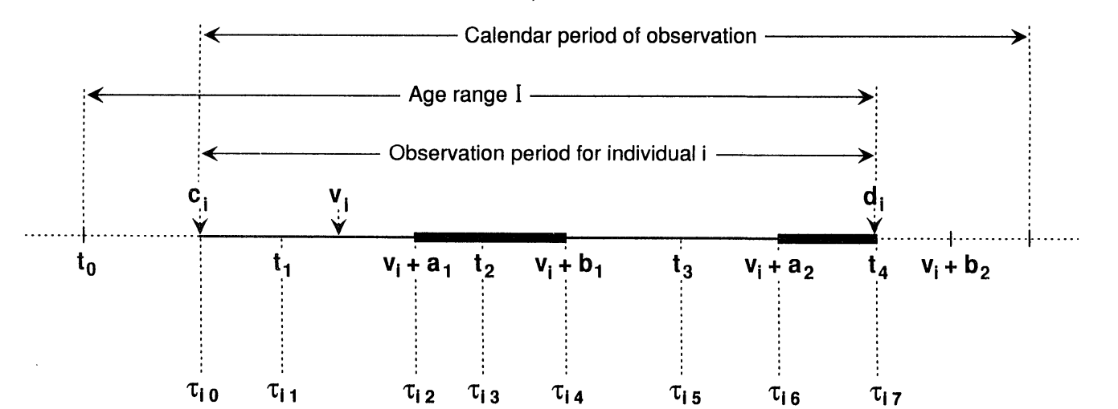

Slide 18
Worked Example 2 - SCCS
“Miller et al. [13] studied the association between measles, mumps, rubella (MMR) vaccine
and idiopathic thrombocytopenic purpura (ITP) (abnormal bleeding into the skin due to low
blood platelet count) in children aged 12–23 months during the period from October 1991 to September 1994 within 42 days of receiving the vaccine.”
“The observation period includes the ages 366–730
days, which we subdivide into J = 4 periods of lengths e1 = e2 = e3 = 91 days, and e4 = 92 days. We take the proportions vaccinated in each of these age intervals to be p1 = 0.6, p2 = 0.2, p3 = 0.05, p4 = 0.05. We take the age effects to be e1 = 1, e2 = 0.6, e3 = e4 = 0.4. The risk period is e∗ = 42 days. We set ⍴ = 3, z⍺ = 1.96 and zꞵ = 0.8416 for 80 per cent power to detect a relative incidence of 3 at the 5 per cent significance level.”
Parameter | Overall
Number of Periods | 4
Observation Periods | 91, 91, 91, 92 days
Risk Period | 42 days
P(Exposure) | 0.6, 0.2, 0.05, 0.05
Age Effects | 1, 0.6, 0.4, 0.4
Relative Incidence | 3
Alpha (2-sided) | 0.05
Power | 80%

Slide 19
Vaccine Durability - Deferred Vaccine Designs
Part 4

Slide 20
Vaccine Durability Trials
Ethical considerations: offer vaccine to placebo group once efficacy established
Crossover design: all participants receive vaccine; still allows efficacy and durability analysis
Maintains blinding during initial phase to preserve unbiased comparison
Less precise estimates vs. standard design
Unreliable estimates disrupt later periods, strong as “weakest link”
Enables subgroup harm/safety analysis
Supports evaluation of differential vaccine efficacy across demographic and clinical subgroups
Notes:
Influenza vaccine wanes within months Covid vaccine test for waning efficacy

Slide 21
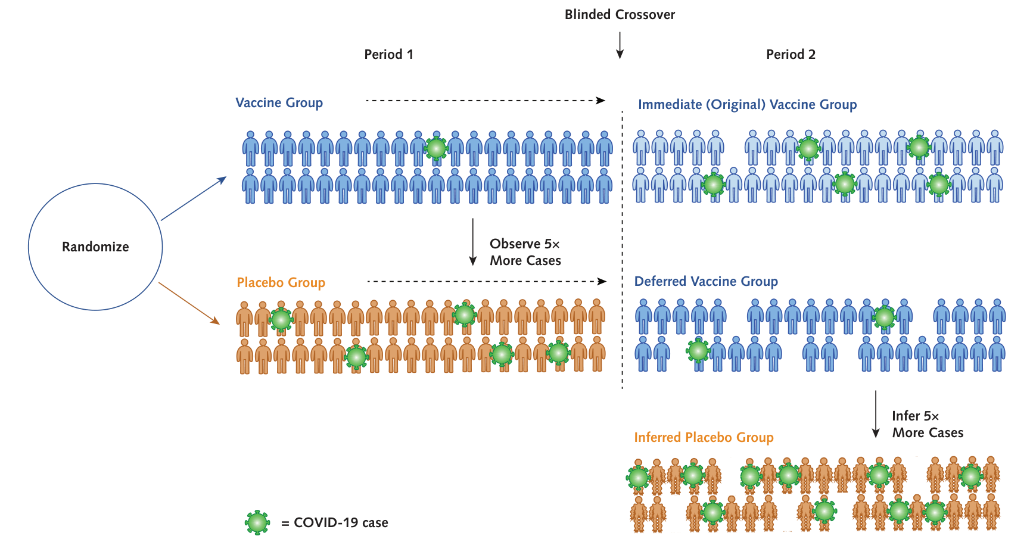

Slide 22
Worked Example 3 - Durability & Harm
“The first four rows show scenarios with high efficacy where durability is of interest. The second four rows correspond to a subgroup where late harm is of concern. VE2 is the vaccine efficacy in period 2. Powers of 0.025 are type I error rates, and a sample size ratio of 2.0 indicates the deferred vaccination design requires twice the number of study participants as a standard design to achieve the same statistical performance.”
Parameter | Overall | Subgroup
Confidence Level (One-Sided) | 0.975 | 0.975
VE Period 1/2 | 90%/75% | 50%/-100%
Placebo Cases Period 1/2 | 200/200 | 25/12

Slide 23
Discussion and Conclusions
Vaccine development is a complex and unique area.
Wider target population affects size and concerns in trial design.
Multiple approaches depending on parameterizations/models.
VE = 1 – RR/HR; count, proportions, survival all viable models
SCCS monitors adverse events relating to vaccination.
Can determine changes in relative incidence with age effects
Deferred vaccine trials allow testing for durability ethically.
Crossover design allows all patients to be vaccinated

Slide 24
statsols.com/nquery-demo

Slide 25
Thank you
CONTACT US
info@statsols.com
MORE INFO
statsols.com

Slide 26
References (Introduction)
Fleiss, J.L., Levin, B. and Paik, M.C., 2013. Statistical methods for rates and proportions. John Wiley & Sons.
Halloran, M.E., Longini, I.M., Struchiner, C.J. and Longini, I.M., 2010. Design and analysis of vaccine studies (Vol. 18). New York, NY: Springer.
Singh, K. and Mehta, S., 2016. The clinical development process for a novel preventive vaccine: An overview. Journal of postgraduate medicine, 62(1), p.4.
O’Neill, R.T., 1988. On sample sizes to estimate the protective efficacy of a vaccine. Statistics in Medicine, 7(12), pp.1279-1288.
Chan, I.S. and Bohidar, N.R., 1998. Exact power and sample size for vaccine efficacy studies. Communications in Statistics-Theory and Methods, 27(6), pp.1305-1322.
Gu, K., Ng, H.K.T., Tang, M.L. and Schucany, W.R., 2008. Testing the ratio of two poisson rates. Biometrical Journal: Journal of Mathematical Methods in Biosciences, 50(2), pp.283-298.
Schoenfeld, D.A., 1983. Sample-size formula for the proportional-hazards regression model. Biometrics, pp.499-503.
Callegaro, A., Curran, D. and Matthews, S., 2020. Burden‐of‐illness vaccine efficacy. Pharmaceutical statistics, 19(5), pp.636-645.
Chow, S.C., Shao, J., Wang, H. and Lokhnygina, Y., 2017. Sample size calculations in clinical research. CRC press.

Slide 27
References (Vaccine Efficacy)
Polack, F.P., Thomas, S.J., Kitchin, N., Absalon, J., Gurtman, A., Lockhart, S., Perez, J.L., Pérez Marc, G., Moreira, E.D., Zerbini, C. and Bailey, R., 2020. Safety and efficacy of the BNT162b2 mRNA Covid-19 vaccine. New England Journal of Medicine, 383(27), pp.2603-2615.
Baden, L.R., El Sahly, H.M., Essink, B., Kotloff, K., Frey, S., Novak, R., Diemert, D., Spector, S.A., Rouphael, N., Creech, C.B. and McGettigan, J., 2021. Efficacy and safety of the mRNA-1273 SARS-CoV-2 vaccine. New England Journal of Medicine, 384(5), pp.403-416.
Voysey, M., Clemens, S.A.C., Madhi, S.A., Weckx, L.Y., Folegatti, P.M., Aley, P.K., Angus, B., Baillie, V.L., Barnabas, S.L., Bhorat, Q.E. and Bibi, S., 2021. Safety and efficacy of the ChAdOx1 nCoV-19 vaccine (AZD1222) against SARS-CoV-2: an interim analysis of four randomised controlled trials in Brazil, South Africa, and the UK. The Lancet, 397(10269), pp.99-111.
Sadoff, J., Le Gars, M., Shukarev, G., Heerwegh, D., Truyers, C., de Groot, A.M., Stoop, J., Tete, S., Van Damme, W., Leroux-Roels, I. and Berghmans, P.J., 2021. Interim Results of a Phase 1–2a Trial of Ad26. COV2. S Covid-19 Vaccine. New England Journal of Medicine.
Logunov, D.Y., Dolzhikova, I.V., Shcheblyakov, D.V., Tukhvatulin, A.I., Zubkova, O.V., Dzharullaeva, A.S., Kovyrshina, A.V., Lubenets, N.L., Grousova, D.M., Erokhova, A.S. and Botikov, A.G., 2021. Safety and efficacy of an rAd26 and rAd5 vector-based heterologous prime-boost COVID-19 vaccine: an interim analysis of a randomised controlled phase 3 trial in Russia. The Lancet, 397(10275), pp.671-681.

Slide 28
References (Vaccine Safety)
Petersen, I., Douglas, I. and Whitaker, H., 2016. Self controlled case series methods: an alternative to standard epidemiological study designs. BMJ, 354. Musonda, P., Paddy Farrington, C. and Whitaker, H.J., 2006. Sample sizes for self‐controlled case series studies. Statistics in Medicine, 25(15), pp.2618-2631.
Farrington CP. 1995. Relative incidence estimation from case series for vaccine safety evaluation. Biometrics 51:228-235. page 228. Dodd, C., Andrews, N., Petousis-Harris, H., Sturkenboom, M., Omer, S.B. and Black, S., 2021. Methodological frontiers in vaccine safety: qualifying available evidence for rare events, use of distributed data networks to monitor vaccine safety issues, and monitoring the safety of pregnancy interventions. BMJ global health, 6(Suppl 2), p.e003540.
Knipe, D.M., Levy, O., Fitzgerald, K.A. and Mühlberger, E., 2020. Ensuring vaccine safety. Science, 370(6522), pp.1274-1275.
Matz, K.M., Marzi, A. and Feldmann, H., 2019. Ebola vaccine trials: progress in vaccine safety and immunogenicity. Expert review of vaccines, 18(12), pp.1229-1242.
Pormohammad, A., Zarei, M., Ghorbani, S., Mohammadi, M., Razizadeh, M.H., Turner, D.L. and Turner, R.J., 2021. Efficacy and safety of COVID-19 vaccines: a systematic review and meta-analysis of randomized clinical trials. Vaccines, 9(5), p.467.

Slide 29
References (Vaccine Durability)
Choe, P.G., Kang, C.K., Suh, H.J., Jung, J., Song, K.H., Bang, J.H., Kim, E.S., Kim, H.B., Park, S.W., Kim, N.J. and Park, W.B., 2021. Waning antibody responses in asymptomatic and symptomatic SARS-CoV-2 infection. Emerging infectious diseases, 27(1), p.327.
Nason, M. and Follmann, D., 2010. Design and analysis of crossover trials for absorbing binary endpoints. Biometrics, 66(3), pp.958-965.
Makubate, B. and Senn, S., 2010. Planning and analysis of cross‐over trials in infertility. Statistics in medicine, 29(30), pp.3203-3210.
Follmann, D., 2006. Augmented designs to assess immune response in vaccine trials. Biometrics, 62(4), pp.1161-1169.
Palin, A.C., Alter, G., Crotty, S., Ellebedy, A.H., Lane, M.C., Lee, F.E.H., Locci, M., Malaspina, A., Mallia, C., McElrath, M.J. and Pulendran, B., 2022. The persistence of memory: defining, engineering, and measuring vaccine durability. Nature immunology, 23(12), pp.1665-1668. Fintzi, J. and Follmann, D., 2021. Assessing vaccine durability in randomized trials following placebo crossover. Statistics in Medicine, 40(27), pp.5983-6007.
Follmann, D., Fintzi, J., Fay, M.P., Janes, H.E., Baden, L.R., El Sahly, H.M., Fleming, T.R., Mehrotra, D.V., Carpp, L.N., Juraska, M. and Benkeser, D., 2021. A deferred-vaccination design to assess durability of COVID-19 vaccine effect after the placebo group is vaccinated. Annals of internal medicine, 174(8), pp.1118-1125.

Slide 30
References (Vaccine Durability)
Lin, D.Y., Zeng, D. and Gilbert, P.B., 2021. Evaluating the long-term efficacy of coronavirus disease 2019 (COVID-19) vaccines. Clinical Infectious Diseases, 73(10), pp.1927-1939.
Lipsitch, M., 2019. Challenges of vaccine effectiveness and waning studies. Clinical Infectious Diseases, 68(10), pp.1631-1633.

