Slide 1
Sample Size for Categorical Data
Binary, Ordinal and
Contingency Table Data
Notes:
www.Statsols.com/trial

Slide 2
Webinar
Host
Ronan Fitzpatrick
Lead Statistician
nQuery

Slide 3
Agenda
Categorical Data Overview
Binary Data Methods & Sample Size
Ordinal Data Methods & Sample Size
Contingency Table Methods & Sample Size
All example files will be available after the webinar

Slide 5
In 2021, 88% of organizations with clinical trials approved by the FDA used nQuery

Slide 6
Categorical Data Overview
Part 1

Slide 7
Categorical Data Introduction
Categorical data is data in which values fall into a (limited) set of categories
Response/No Response, Objective Response Rate, Pain Scale, Diet Type
Categorical (esp. binary) data very common in clinical trials and research
Occurs often and has “intuitive” interpretation (though not analysis?)
Don’t overuse – Dichotomania, ignoring time-to-event or repeated events
In this webinar, we look at three types of categorical data and the methods for analysis and sample size most appropriate for each
Data Types: Binary Data, Ordinal (Ordered) Data, Contingency Table Data

Slide 8
Categorical Data Types & Methods
Binary | Data with Two Distinct Categories (e.g. Yes/No, Alive/Dead) Chi-Squared Test, Exact Tests, Logistic Regression, McNemar
Nominal/ Multinomial/Polytomous | Data with >2 Independent Categories a.k.a. multinomial, polytomous Multinomial Regression, Chi-Squared/Exact Tests, Goodness-of-Fit
Ordinal /Ordered | Data with >2 Ordered Categories (e.g. Ranking 1 – 5 Likert Scale) Proportional Odds Model, Non-Parametric Tests (Wilcoxon) tests
“Derivative” Measures | Domain specific categorical data e.g. diagnostics (sensitivity/specificity), agreement measures (Kappa)

Slide 9
Binary Data
Part 2

Slide 10
Binary Data Overview
Binary data is data where endpoint falls into two distinct categories
Examples: Response/No response, Alive/Dead, Cured/Not Cured, Yes/No
Special case of categorical data (e.g. 2x2 contingency table) with specific considerations such as effect size parameterization (PD vs RR vs OR)
Wide variety of designs and statistical methods available for binary data
But should avoid “artificially” creating binary data due to “ease” of analysis
Advanced methods often available such as adaptive designs (group sequential) or domain specific methods (e.g. Phase II – Simon’s Design)

Slide 11
Binary Data Designs/Methods
Two Groups | Chi-squared, Exact, Likelihood Ratio, t-test, Wald test, Mantel-Haenszel (stratified)
One Group | Exact Test, Chi-Squared, Rare Events (P(E>1)), Wald Test, Reliability Tests
Correlated (Paired) | McNemar Test, Matched Case-Control, Hybrid, Conditional LR, Cross-over
>2 Groups | Logistic Trend, Chi-Squared (Independence, Goodness-of-fit, ANOVA-like)
Non-inf. & Equivalence | Likelihood Score (M&N, G&N, F&M), Chi-squared, CI-based (e.g. Wilson CI)
Regression | Logistic Regression, Probit Regression, Log-Linear Regression, LDA
Intervals | Wald/Chi-squared (Normal), Exact (e.g. Clopper-Pearson), Score (e.g. Wilson)

Slide 12
Binary Data Sample Size
Sample Size Determination should ideally follow trialist/statistician trial pre-trial choices
Design: Parallel, Paired, Adaptive, Crossover etc.
Effect Size: Difference, Ratio, Odds Ratio, VE
Test/Model: Exact Test, Logistic Regression
Two main approaches to power calculations:
Binomial Enumeration: Enumerate power over all “success” outcomes by their probability
Normal Approximation: Formulae based on binary approximation to normal distribution
Binomial Enumeration is “exact” approach so considered preferable though will be slower for higher sample sizes
Fleiss (1980) Approximation for Parallel Design
$$1−β=\sum_{H_{1}: z_{t}>z_{α}}{\left(\begin{matrix}n_{1} \\ x_{1}\end{matrix}\right)π_{1}\left(1−π_{1}\right)\left(\begin{matrix}n_{2} \\ x_{2}\end{matrix}\right)π_{2}\left(1−π_{2}\right)}$$
Binomial Enumeration for Parallel Design
Recruit n₁
<r₁ responses
Recruit n₂
Start Phase I
End Phase I
Start Phase II
End Phase II
<r responses
>r responses
Do not recommend
Recommend
>r₁ responses
Stop Early (Futility)
Decision
Simon’s Design

Slide 13
Binary Data Example
“Assuming that there would be a 35% incidence of tuberculosis-associated IRIS in the placebo group (approximating the 33% incidence in the early ART group in the Cambodian Early versus Late Introduction of Antiretrovirals [CAMELIA] trial15) and 50% fewer cases in the prednisone group than in the placebo group, we calculated that 110 patients would need to be enrolled in each group to provide 80% power to test for the difference between the groups in the incidence of tuberculosis-associated IRIS, at a two-sided significance level of 5%. Assuming a 10% loss to follow-up, we planned to enroll a total of 240 patients. … The primary hypothesis will be tested comparing the proportion of patients with paradoxical IRIS among treatment groups using Fisher's exact test”
Parameter | Value
Significance Level (2-sided) | 0.05
Placebo Proportion | 0.35 (35%/100)
Treatment Proportion | 0.175 (0.35 * 0.5)
Power (%) | 80%
Statistical Test | Fisher’s Exact Test
Sample Size (per Group) | 110

Slide 14
Ordinal Data
Part 3

Slide 15
Ordinal Data Overview
Ordinal data is data where (>2) categories can be ordered in a hierarchy
Common when evaluating qualitative or “subjective” endpoints (e.g. pain)
Examples: Numeric Pain Rating, Gross Motor Function Classification System
Ordinal nature of data often ignored in favor of treating as categorical data (making binary) or as continuous/interval data (numeric distance)
Methods available to test and estimate for this type of data directly based on characteristics of ordinal data
Two Common Approaches: Ordinal Regression, Non-Parametric Tests

Slide 16
Methods for Ordinal Data
Ordinal Regression (e.g. Proportional Odds Model, Generalized Ordinal Regression)
Models the odds ratio between adjacent ordinal categories – proportional odds assumes same odds ratio between all categories, generalized allows these to differ
OR (similar to logistic) Model is flexible model for testing & estimation of independent variable including w/ covariates – proportional odds model considered most interpretable
Sample size usually based on Whitehead (1993) approximate formulae or extensions
Non-Parametric Tests (e.g. Mann-Whitney U, Brunner-Munzel, Signed Rank, Kruskal-Wallis)
“Distribution-free” Hypothesis tests comparing ranks associated with outcomes in groups
“Test to Design” approach (similar to t-test, ANOVA) regarding P(X<Y) hypothesis, some debate in literature regarding appropriateness/interpretability of effect size
NB: Mann-Whitney U/Kruskal-Wallis ≈ Special cases of Proportional Odds Model (Harrell)
Numerous sample size papers (e.g. Kolassa (1995), Tang (2011)) – typically require probability of falling in given category in each ordered group

Slide 17
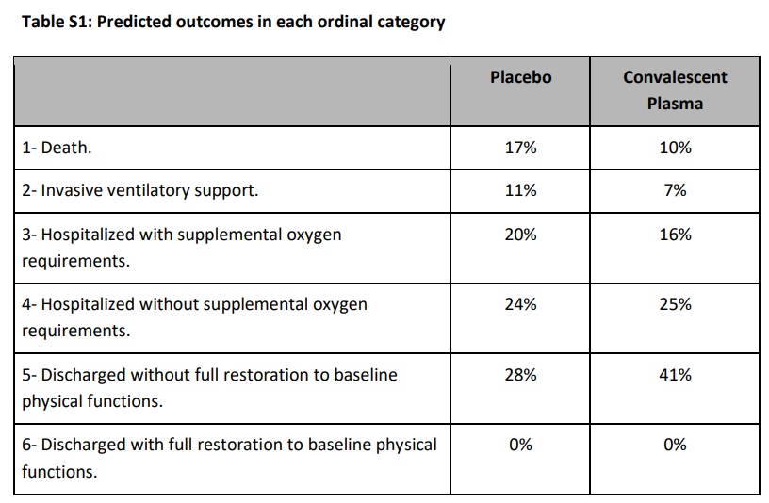
Ordinal Data Example
“The trial was designed to enroll 333 patients (222 in the plasma group and 111 in the placebo group). We calculated that this sample size would provide 80% power to detect a proportional odds ratio of 1.8 for plasma as compared with placebo on the clinical ordinal scale at the 0.05 (two-sided) level of significance. More details are provided in Table S1”
Parameter | Value
Significance Level (2-sided) | 0.05
Odds Ratio | 1.8
Placebo Proportions | 0.17, 0.11, 0.20, 0.24, 0.28, 0
Sample Size (Placebo:Trt) | 111:222
Calculated Power (%) | 80%

Slide 18
Contingency Tables
Part 4

Slide 19
Contingency Tables Overview
Contingency table are tables used to compare the proportion (or frequency) of outcomes that occur across one or more nominal variables
Two-way contingency tables are the most common for hypothesis testing
e.g. 2x2 two-way table equivalent to parallel design binary data analysis
Can be used to summarize ordinal data but should not use same tests
Flexible method to understand the relationship between nominal variables
Commonly used in epidemiology, surveys, engineering, lab science, business
In clinical trials, usually supplemental analysis outside 2x2/binary exception

Slide 20
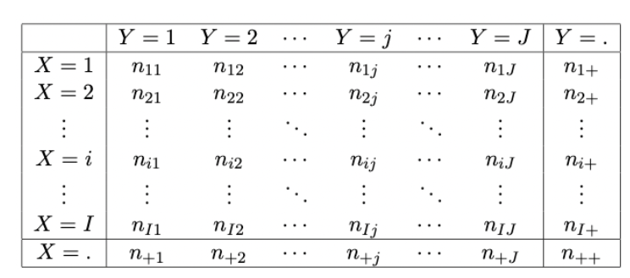
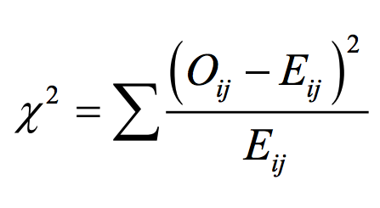
Methods & Sample Size for Contingency Tables
Two main hypotheses for contingency tables
Goodness-of-Fit: Custom Cell Probabilities
Independence: Cross-tab Cell Probabilities = Product of Margin Probabilities
Multiple tests/models available for analysis
Chi-squared, Exact tests – similar to binary
Multinomial Regression – flexible approach
For sample size, usually need to specify the test and the dimensions of contingency table
Power for chi-squared possible based on standardized effect size
Can calculate effect size based on completed contingency table under H1

Slide 21
Contingency Table Example
The following is a table from a paper comparing two antibiotic regimes to placebo for preventing AOM in infants:
What sample size would have been required (if assume equal sample size per group) assuming same AOM rates in each group via following hypothesis:
H0: π(Amox.) = π(Sulf.) = π(Placebo)
Parameter | Value
Significance Level | 0.05
Number of Groups | 3
Number of Categories | 2
Power | 80/90%

Slide 22
Discussion and Conclusions
Categorical data is one of the most common endpoints in clinical trials with a variety of types and appropriate methods of interest
Binary data is the most encountered categorical data type with methods & sample size/power available for many different goals, designs & hypothesis types
Ordinal is commonly encountered in clinical trials with specific methods such as the proportional odds model recommended over simplified approaches
Contingency tables are a useful way to quickly evaluate the relationship between multiple categorical variables including via goodness-of-fit/independence tests

Slide 23
Statsols.com/trial

Slide 24
Thank You
Contact us:
info@statsols.com
More info:
Statsols.com

Slide 25
References (Categorical + General Sample Size)
Fleiss, J.L., Levin, B. and Paik, M.C., 2013. Statistical methods for rates and proportions. John Wiley & sons.
Agresti, A., 2012. Categorical data analysis. John Wiley & Sons.
Antony, G.M. and Raghavendra, D., 2011. Categorical Data Analysis. Applied Clinical Trials, 20(5).
Lachin, John M. 2000. Biostatistical Methods. John Wiley & Sons.
Bevans, R. Types of Variables in Research and Statistics. Available at: https://www.scribbr.com/methodology/types-of-variables/
Friendly, M., 2000, April. Visualizing categorical data: Data, stories, and pictures. In Proceedings of the Twenty-Fifth Annual SAS Users Group International Conference.
Senn, S., 2005. Dichotomania: an obsessive compulsive disorder that is badly affecting the quality of analysis of pharmaceutical trials. Proceedings of the International Statistical Institute, 55th Session, Sydney.
van Smeden, M., 2022. A very short list of common pitfalls in research design, data analysis, and reporting. PRiMER, 6.
Altman, D.G. and Bland, J.M., 1994. Diagnostic tests. 1: Sensitivity and specificity. BMJ: British Medical Journal, 308(6943), p.1552.
Sim, J. and Wright, C.C., 2005. The kappa statistic in reliability studies: use, interpretation, and sample size requirements. Physical therapy, 85(3), pp.257-268.
Chow, S.C., Shao, J., Wang, H. & Lokhnygina, Y. 2018. Sample Size Calculations in Clinical Research (3rd ed.). Taylor & Francis/CRC.
Chow, S.C. and Liu, J.P., 2008. Design and analysis of clinical trials: concepts and methodologies (Vol. 507). John Wiley & Sons.
Machin, D., Campbell, M.J., Tan, S.B. and Tan, S.H., 2018. Sample sizes for clinical, laboratory and epidemiology studies. John Wiley & Sons.
Julious, S.A., 2009. Sample sizes for clinical trials. Chapman and Hall/CRC.

Slide 26
References (Binary Data)
Bland, J.M. and Altman, D.G., 2000. The odds ratio. Bmj, 320(7247), p.1468.
Holmberg, M.J. and Andersen, L.W., 2020. Estimating risk ratios and risk differences: alternatives to odds ratios. Jama, 324(11), pp.1098-1099.
Upton, G.J., 1982. A comparison of alternative tests for the 2 times 2 comparative trial. Journal of the Royal Statistical Society: Series A (General), 145(1), pp.86-105.
D’Agostino, R. B., Chase, W., & Belanger, A. 1988. The Appropriateness of Some Common Procedures for Testing the Equality of Two Independent Binomial Populations. The American Statistician, 42(3), 198.
Fleiss, J.L., Tytun, A. and Ury, H.K., 1980. A simple approximation for calculating sample sizes for comparing independent proportions. Biometrics, pp.343-346.
Dupont, W.D., 1988. Power calculations for matched case-control studies. Biometrics, pp.1157-1168.
Farrington, C. P., & Manning, G. 1990. Test statistics and sample size formulae for comparative binomial trials with null hypothesis of non-zero risk difference or non-unity relative risk. Statistics in Medicine, 9(12), 1447–1454.
Hsieh, F., Bloch, D. and Larsen, M. 1998. A simple method of sample size calculation for linear and logistic regression. Statistics in Medicine, 17(14), 1623-1634.
Demidenko, E., 2008. Sample size and optimal design for logistic regression with binary interaction. Statistics in medicine, 27(1), pp.36-46.
Agresti, A. and Coull, B.A., 1998. Approximate is better than “exact” for interval estimation of binomial proportions. The American Statistician, 52(2), pp.119-126.
Meintjes, G., Stek, C., Blumenthal, L., Thienemann, F., Schutz, C., Buyze, J., Ravinetto, R., van Loen, H., Nair, A., Jackson, A. and Colebunders, R., 2018. Prednisone for the prevention of paradoxical tuberculosis-associated IRIS. New England Journal of Medicine, 379(20), pp.1915-1925.

Slide 27
References (Ordinal Data)
McCullagh, P., 1980. Regression models for ordinal data. Journal of the Royal Statistical Society: Series B (Methodological), 42(2), pp.109-127.
Agresti, A., 2010. Analysis of ordinal categorical data (Vol. 656). John Wiley & Sons.
Scott, S.C., Goldberg, M.S. and Mayo, N.E., 1997. Statistical assessment of ordinal outcomes in comparative studies. Journal of clinical epidemiology, 50(1), pp.45-55.
Harrell, Jr, F.E. and Harrell, F.E., 2015. Ordinal logistic regression. Regression modeling strategies: with applications to linear models, logistic and ordinal regression, and survival analysis, pp.311-325.
Hilton, J.F., 1996. The appropriateness of the Wilcoxon test in ordinal data. Statistics in medicine, 15(6), pp.631-645.
Harrell, F., 2022. Equivalence of Wilcoxon Statistic and Proportional Odds Model.
Karch, J.D., 2021. Psychologists should use Brunner-Munzel’s instead of Mann-Whitney’s U test as the default nonparametric procedure. Advances in Methods and Practices in Psychological Science, 4(2), p.2515245921999602.
Whitehead, J., 1993, Sample Size Calculations for Ordered Categorical Data, Statistics in Medicine, 12, 2257-2271.
Kolassa, J.E., 1995. A comparison of size and power calculations for the Wilcoxon statistic for ordered categorical data. Statistics in Medicine, 14(14), pp.1577-1581.
Tang, Y., 2011. Size and power estimation for the Wilcoxon–Mann–Whitney test for ordered categorical data. Statistics in Medicine, 30(29), pp.3461-3470.
Simonovich, V.A., Burgos Pratx, L.D., Scibona, P., Beruto, M.V., Vallone, M.G., Vázquez, C., Savoy, N., Giunta, D.H., Pérez, L.G., Sánchez, M.D.L. and Gamarnik, A.V., 2021. A randomized trial of convalescent plasma in Covid-19 severe pneumonia. New England Journal of Medicine, 384(7), pp.619-629.

Slide 28
References (Contingency Tables)
Everitt, B.S., 1992. The analysis of contingency tables. CRC Press.
Fagerland, M.W., Lydersen, S. and Laake, P., 2017. Statistical analysis of contingency tables. Chapman and Hall/CRC.
Kateri, M., 2014. Contingency table analysis. Methods and Implementation Using R.
Cochran, W.G., 1952. The χ2 test of goodness of fit. The Annals of mathematical statistics, pp.315-345.
Verbeek, A. and Kroonenberg, P.M., 1985. A survey of algorithms for exact distributions of test statistics in r × c contingency tables with fixed margins. Computational Statistics & Data Analysis, 3, pp.159-185.
Agresti, A., 1992. A survey of exact inference for contingency tables. Statistical science, 7(1), pp.131-153.
Mehta, C.R. and Patel, N.R., 1983. A network algorithm for performing Fisher's exact test in r× c contingency tables. Journal of the American Statistical Association, 78(382), pp.427-434.
Menard, S., 2002. Applied logistic regression analysis (No. 106). Sage.
Engel, J., 1988. Polytomous logistic regression. Statistica Neerlandica, 42(4), pp.233-252.
Cohen, J. (2013). Statistical power analysis for the behavioral sciences. Routledge.
Cramér, H., 1999. Mathematical methods of statistics (Vol. 26). Princeton university press.
Lachin, J.M., 1977. Sample size determinations for rxc comparative trials. Biometrics, pp.315-324.
Teele, D.W., Klein, J.O., Word, B.M., Rosner, B.A., Starobin, S., Earle Jr, R., Ertel, C.S., Fisch, G., Michaels, R., Heppen, R. and Strause, N.P., 2000. Antimicrobial prophylaxis for infants at risk for recurrent acute otitis media. Vaccine, 19, pp.S140-S143.

