Slide 1
Sample Size for Measures of Association
Correlation, Agreement, and Diagnostic Measures

Slide 2
Webinar
Host
Denis Desmond
Research Statistician
nQuery

Slide 3
Agenda
Correlation Methods and Sample Size
Agreement Methods and Sample Size
Diagnostic Testing Methods and Sample Size
Discussion and Conclusions
All example files will be available after the webinar

Slide 5
In 2021, 88% of organizations with clinical trials approved by the FDA used nQuery

Slide 6
Correlation Methods and Sample Size
Part 1

Slide 7
Correlation — Overview
Correlation coefficients are a type of statistical measure which evaluates the strength of relationship between two variables (e.g. age, income, blood pressure)
Many different correlation coefficients have been proposed for different scenarios Pearson’s r, Spearman’s correlation coefficient, Kendall’s Tau-b, tetrachoric correlation, etc.
Correlation measures are often useful when assessing relationships being evaluated using models such as linear regression (e.g. r x r = R² (% Variance Explained))
But the choice of correlation coefficient should reflect the type of the variables being measured (continuous, ordinal, binary) & their expected relationship (linear, non-linear)

Slide 8
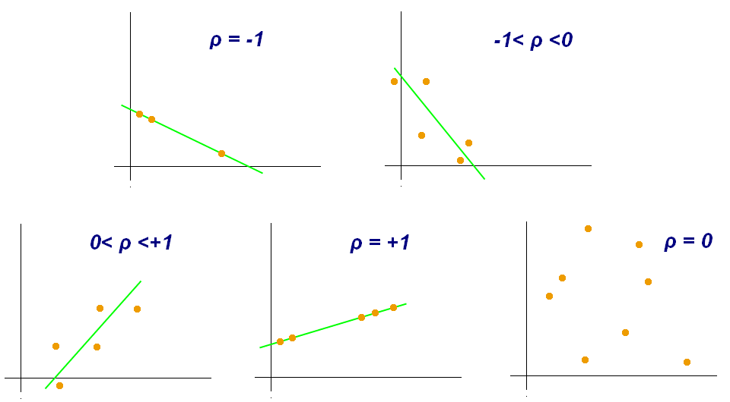
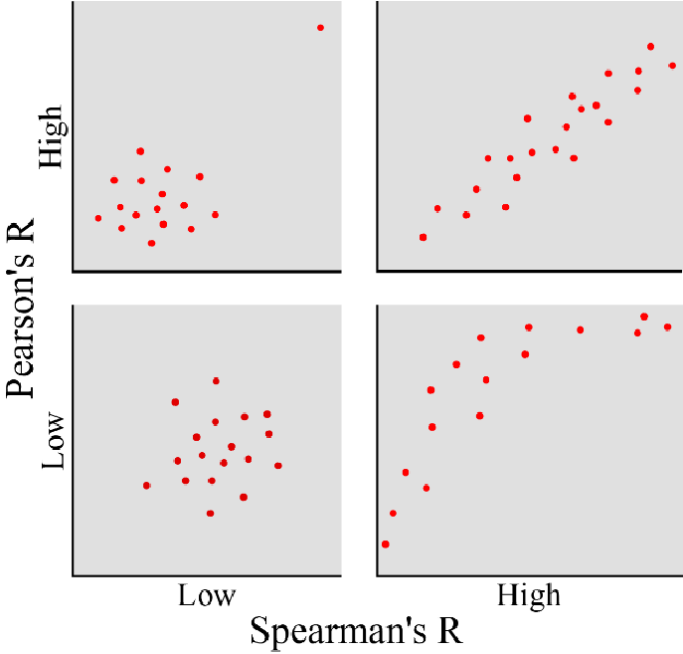
Types of Correlation Coefficient
Pearson | Linear Relationship between two continuous variables
Spearman | Relationship between ranks of two variables
Kendall tau-B | Relationship between ranks of two variables
Polychoric | Relationship between ranks of two ordinal variables
Goodman & Kruskal γ | Relationship between ranks of two ordinal variables
Point Biserial | Relationship between a dichotomous variable and continuous variable

Slide 9
Spearman’s Correlation — Sample Size
Spearman’s Correlation is a rank correlation coefficient
Data ordered from lowest to highest w/ ranking used rather than raw data
Other rank correlations examples: Kendall’s tau-B, tetrachoric correlation.
As a non-parametric measure, unlike Pearson’s $r$, it doesn’t require linear relationship or normality assumptions
Sample size methods used are an extension of the traditional Pearson methods.
Sample Size Formula
$$n=b+ c^{2}{\left[\frac{z_{α/2}+z_{1−φ}}{z\left(ρ_{1}\right)−z\left(ρ_{0}\right)}\right]}^{2}$$
$$b=3$$
$$c=\left\{\begin{aligned}1+\left({{\hat{ρ}}_{s}^{2}}/2\right) if \left|{\hat{ρ}}_{s}\right|<0.95 \\ 1.06 otherwise\end{aligned}\right.$$

Slide 10
Spearman’s Correlation | Example
“The sample size for the test-retest analyses was also calculated, based on the minimum number of participants required to detect a Spearman's correlation of 0.5, with 80% power, and a significance level = 0.05. A sample size of 30 was deemed necessary for the test-retest analyses.”
Parameter | Value
Significance Level (2-sided) | 0.05
Null Hypothesis Correlation | 0
Alternative Hypothesis Correlation | 0.5
Sample Size | 30
Power | 80%

Slide 11
Agreement Methods and Sample Size
Part 2

Slide 12
Agreement Methods — Overview
Agreement refers to the consistency/reliability between two (or more) sets of measurements for the same target outcomes e.g. image analyzed by two radiologists, patient’s body temperature taken via different methods
Many methods available to test the degree of agreement between measurements e.g. Kappa (Cohen’s, Intraclass), Cronbach’s Alpha, Bland-Altman, Lin’s Concordance, ICC etc.
The level of agreement observed will often be directly tested against the agreement that would be expected by “chance” alone
Agreement provides context-useful information for comparing reliability of measurements versus methods for contingency tables (e.g. Chi-Squared) or correlation

Slide 13
Cohen’s Kappa — Overview
Common coefficient of agreement for nominal scales in areas such as psychology
The “classic” case started out as a method for assessing two raters and $k$ categories.
Weighted kappa is a variation that is suitable for ordinal data and Fleiss’ kappa is an extension for more than two raters.
However, neither of these overcome the third limitation which is a lack of “directionality”.
Cohen’s Kappa (1960)
$$κ=\frac{p_{o}−p_{e}}{1 −p_{e}}$$
$$p_{o}=\sum_{i=1}^{k}{p_{ii}}$$
$$p_{e}=\sum_{i=1}^{k}{p_{i∙}p_{∙i}}$$

Slide 14
Cohen’s Kappa | Example
“In a test for agreement between two assessments using the Kappa statistics, a sample of 45 subjects was identifying as achieving 90.4% power (at significance level of 0.05) to detect a true Kappa value of 0.7 in a test of H₀: Kappa = 0.30 vs. H₁: Kappa $≠$ 0.30. Sample size analyses were conducted considering 3-level categorical variables with frequencies equal to 16% (disabled), 59% (pre-frail and frail), and 25% (robust) as described in literature for the French population”
Parameter | Value
Significance Level (2-sided) | 0.05
Number of Categories | 3
Null Agreement | 0.3
Alternative Agreement | 0.7
Sample Size | 45
Power | 90.4%
Marginal Probabilities | 0.16, 0.59, 0.25

Slide 15
Diagnostic Testing Methods and Sample Size
Part 3

Slide 16
Diagnostic Testing Methods — Overview
Diagnostic tests are used to identify whether or not an individual is likely to have a condition of interest e.g. disease vs no disease
Increasingly important area across a wide range of domains including medical diagnostics, screening programs, industrial applications and data mining classification
In a medical setting, it is common for a gold-standard method for identifying a given condition to have drawbacks so alternative testing methods are needed e.g. Ultrasound elastography instead of a liver biopsy, cancer screening programs prior to biopsy
Diagnostic testing is vital to ensure that proposed screening or testing procedures have the appropriate accuracy, usually compared to gold standard, for clinical use

Slide 17
Confusion Matrix
Most definitions of “accuracy” depend on a “cut-off” when someone moves to being more likely to have the disease
e.g. Cut-off value between 0-1 for logistic regression probabilities
Reliance on a cut-off makes these measures vulnerable, especially for class imbalanced conditions (e.g. rare disease)
“Good” accuracy if set all subjects = “no disease” for rare condition
ROC curves are a robust method which can evaluate accuracy across the range of all possible cut-off thresholds
 | Predicted
Actual | Total Sample = P + N | Positive (PP) | Negative (PN)
 | Positive (P) | True Positive (TP) | False Negative (FN)
 | Negative (N) | False Positive (FP) | True Negative (TN)
Sensitivity (TPR) | $$TPR= \frac{TP}{P}= \frac{TP}{TP+FN}$$
Specificity (TNR) | $$TNR= \frac{TN}{N}= \frac{TN}{TN+FP}$$
Precision (PPV) | $$PPV= \frac{TP}{TP+FP}$$

Slide 18
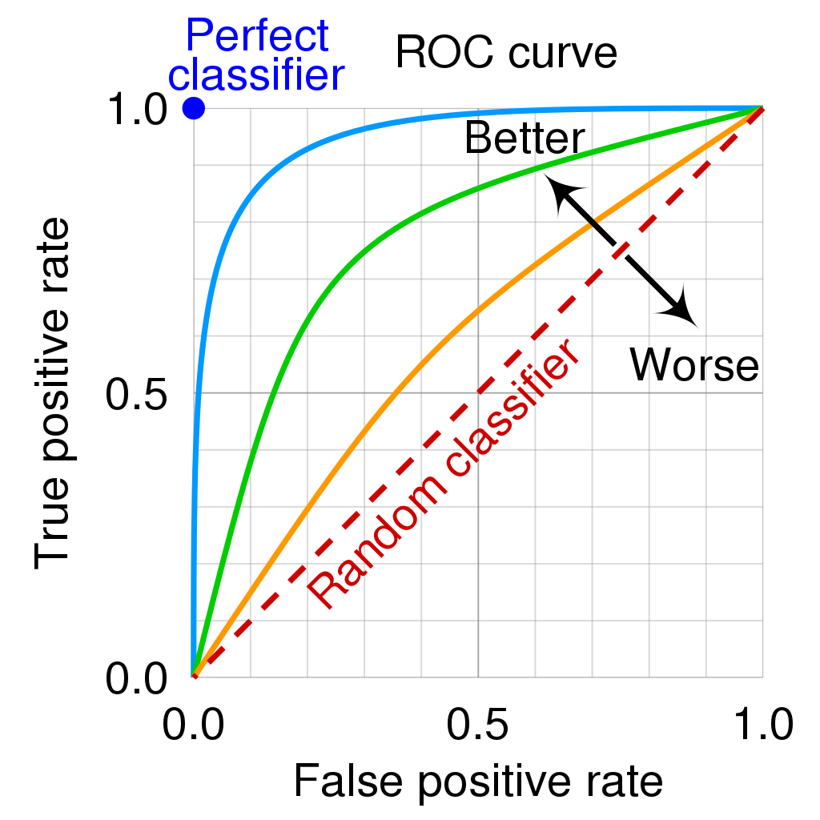
Receiver Operating Characteristic (ROC) Curve
The Receiver Operating Characteristic (ROC) curve is commonly used approach to assess a diagnostic test.
ROC curve plots the sensitivity (TPR) vs. the false positive rate across the entire range of cut-off values.
ROC curves can be either non-parametric or parametric.
The Area Under the Curve (AUC) can be used as a robust measure of the “accuracy” of the test
AUC equivalent to probability of assigning a random “positive subject” higher than a random “negative subject”
Partial AUC (pAUC) can be used to compare the performance of two tests in specific regions of the false positive rate
https://en.wikipedia.org/wiki/Receiver_operating_characteristic

Slide 19
One Sample ROC Curve | Example
“The required sample size for a prospective ROC study of a single diagnostic test allowing a type I error of 0.05 and a power of 0.80, with the more conservative AUC₁ of 0.80, AUC₀ of 0.70, and the allocation ratio of 4 (prevalence of common psychiatric disorders is estimated to be 20% in the primary care population, thus the prevalence of non-diseased is estimated at 80%) was 370 subjects (74 clinically confirmed cases and 296 clinically confirmed non-cases).”
Parameter | Value
Significance Level (2-sided) | 0.05
Data Type | Discrete
Null Hypothesis AUC | 0.7
Alternative Hypothesis AUC | 0.8
Standard Deviation Ratio | 1
Positive Group Sample Size | 74
Negative Group Sample Size | 296
Power | 80%

Slide 20
Discussion and Conclusions
Part 4

Slide 21
Discussion and Conclusions
It is important to pick the correct measure of association for the type of analysis and type of data that is of interest in a particular study
Correlation coefficients can be used to describe the relationship between two variables as is commonly seen in the context of regression modelling
Measures like Cohen’s kappa allow for the assessment of reliability for two (or more) raters which can be compared to the level of agreement expected by chance
ROC analysis evaluates the accuracy of diagnostic tests to a gold-standard over all possible cut-offs for a positive result for probability or score measurements

Slide 22
Statsols.com/trial

Slide 23
Thank You
Contact us:
info@statsols.com
More info:
Statsols.com

Slide 24
References [Correlation]
May, J., & Looney, S. W. (2020). Sample Size Charts for Spearman and Kendall Coefficients. Journal of Biometrics & Biostatistics
Bhandari, P. (2022). Correlation Coefficient | Types, Formulas & Examples. Scribbr. https://www.scribbr.com/statistics/correlation-coefficient/
Schober, P., Boer, C., & Schwarte, L. A. (2018). Correlation Coefficients. Anesthesia & Analgesia, 126(5), 1763–1768
Carter, S. J., Ng, R., El-Den, S., & Schneider, C. E. (2021). A patient-reported experience measure for community pharmacy including development of a short-form: The perceived service quality scale. Research in Social & Administrative Pharmacy, 18(8), 3369–3378
Ekström, J. (2009). A generalized definition of the polychoric correlation coefficient. Department of Statistics, UCLA

Slide 25
References [Agreement]
Cohen, J. (1960). A Coefficient of Agreement for Nominal Scales. Educational and Psychological Measurement, 20(1), 37–46
Flack, V. F., Afifi, A. A., Lachenbruch, P. A., & Schouten, H. C. (1988). Sample size determinations for the two rater kappa statistic. Psychometrika, 53(3), 321–325
Fleiss, J. L., Cohen, J., & Everitt, B. S. (1969). Large sample standard errors of kappa and weighted kappa. Psychological Bulletin, 72(5), 323–327
Bloch, D., & Kraemer, H. C. (1989). 2 x 2 Kappa Coefficients: Measures of Agreement or Association. Biometrics, 45(1), 269
Fleiss, J. L., Levin, B., & Paik, M. C. (2003). Statistical Methods for Rates and Proportions. Wiley Series in Probability and Statistics
Cronbach, L. J. (1951). Coefficient alpha and the internal structure of tests. Psychometrika, 16(3), 297–334
Landis, J. R., & Koch, G. G. (1977). The Measurement of Observer Agreement for Categorical Data. Biometrics, 33(1), 159
Ranganathan, P., Pramesh, C., & Aggarwal, R. (2017). Common pitfalls in statistical analysis: Measures of agreement. Perspectives in Clinical Research, 8(4), 187
Cesari, M., Demougeot, L., Boccalon, H., Guyonnet, S., Van Kan, G. A., Vellas, B., & Andrieu, S. (2014). A Self-Reported Screening Tool for Detecting Community-Dwelling Older Persons with Frailty Syndrome in the Absence of Mobility Disability: The FiND Questionnaire. PLOS ONE, 9(7), e101745
McHugh, M. L. (2012). Interrater reliability: the kappa statistic. Biochemia Medica, 276–282

Slide 26
References [Diagnostic Testing]
Hanley, J. A., & McNeil, B. J. (1982). The meaning and use of the area under a receiver operating characteristic (ROC) curve. Radiology, 143(1), 29–36
Hanley, J. A., & McNeil, B. J. (1983). A method of comparing the areas under receiver operating characteristic curves derived from the same cases. Radiology, 148(3), 839–843
Obuchowski, N. A., & McClish, D. K. (1997). Sample Size Determination For Diagnostic Accuracy Studies Involving Binormal Roc Curve Indices. Statistics in Medicine, 16(13), 1529–1542
Anjara, S., Bonetto, C., Van Bortel, T., & Brayne, C. (2020). Using the GHQ-12 to screen for mental health problems among primary care patients: psychometrics and practical considerations. International Journal of Mental Health Systems, 14(1)
Ranganathan, P. (2022). An Introduction to Statistics: Diagnostic Tests. Indian Journal of Critical Care Medicine, 25(S3), S283–S284
Nahm, F. S. (2022). Receiver operating characteristic curve: overview and practical use for clinicians. Korean Journal of Anesthesiology, 75(1), 25–36
Streiner, D. L., & Cairney, J. (2007). What’s under the ROC? An Introduction to Receiver Operating Characteristics Curves. The Canadian Journal of Psychiatry, 52(2), 121–128
Zou, K. H., O’Malley, A. J., & Mauri, L. (2007). Receiver-Operating Characteristic Analysis for Evaluating Diagnostic Tests and Predictive Models. Circulation, 115(5), 654–657
Perkins, N. J., & Schisterman, E. F. (2006). The Inconsistency of “Optimal” Cutpoints Obtained using Two Criteria based on the Receiver Operating Characteristic Curve. American Journal of Epidemiology, 163(7), 670–675

