Slide 1
Sample SIZe for Non-INFERIORITY Studies
Design and Endpoint Considerations
Demonstrated on
Notes:
www.Statsols.com/trial

Slide 2
Webinar Host
Head of Statistics
nQuery Lead Researcher
FDA Guest Speaker
Guest Lecturer
HOSTED BY: Ronan Fitzpatrick

Slide 3
AGENDA
Introduction to Non-inferiority Testing
Design Considerations for Non-inferiority Studies
Non-inferiority for Trial Endpoints
Sample Size for Non-inferiority Designs
Notes:
Change bullet point

Slide 4
The complete solution for optimizing your clinical trial designs
✓ CRM
✓ MCP-Mod
✓ Simon’s Two Stage
✓ Fleming’s GST
1000+ Scenarios for Fixed Term, Adaptive & Bayesian Methods
✓ Survival, Means, Proportions & Count endpoints
✓ Group Sequential Trials
✓ Bayesian: - Assurance
- Credible Intervals
- Posterior Error Approach
✓ Sample Size Re-Estimation
✓ Cross over & personalized medicine
✓ MAMS
✓ Prediction
EARLY PHASE
Animal Studies ANOVA / ANCOVA
PRE-CLINICAL RESEARCH
CONFIRMATORY
Cohort Study
Case-control Study
POST MARKETING

Slide 5
In 2021, 88% of organizations with clinical trials approved by the FDA used nQuery

Slide 6
Introduction to
Non-inferiority
Part 1

Slide 7
Non-inferiority Background
Non-inferiority studies find evidence that new therapy is “no worse” than current method by a specified amount
Hypothesis: Treatment not inferior to standard by specified non-inferiority margin (H₀: Δ₀≤Δ, H1: Δ₀>Δ, Δ₀ = NI margin/effect size)
Note NI “testing” often framed in terms of confidence intervals being “above” non-inferiority margin
NB: 1-sided test at X% alpha = (1-2X)% 2-sided confidence interval (e.g. 5% Alpha level = 90% 2-sided Interval)
Very common endpoint for trials evaluating medical devices, generic medicines, surgeries and vaccines
NI may be applicable if new treatment is safer, cheaper, less invasive or multiple “versions” useful (e.g. antibiotics)

Slide 8
Non-inferiority Considerations
Select non-inferiority margin based on expertise & data
FDA: Fixed fraction (M2) of active control effect (M1)
NI margin can take into account other considerations than just standard treatment’s effect size (M1)
Safety, secondary endpoints, value (e.g. easier administration)
Conservative pre-specified NI margin encouraged by FDA
Two-arm (new vs standard) trial assumption: Standard’s effect size same as from its approval (assay sensitivity)
Need to replicate standard’s approval trial conditions closely
More evidence/data or three arm design for regulatory approval

Slide 9
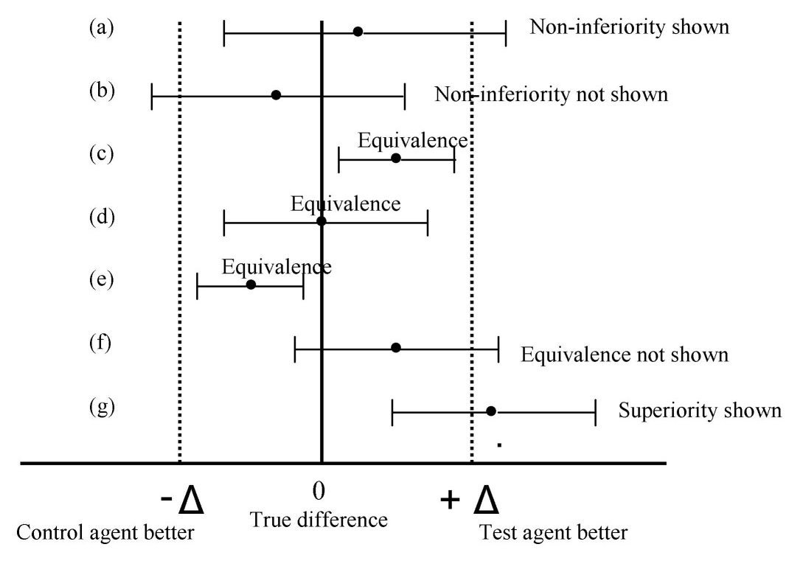
Non-inferiority & Similar Hypotheses
Non-inferiority and equivalence both test if new treatment similar to standard
Non-inferiority: Not Inferior to Control
Direct effect measure w/ “good” direction
Equivalence: Equivalent to Control
Indirect effect measure w/o “good” direction
Superiority by a Margin: Better than control by specified amount
Effectively inverse of NI testing
Not to be confused with traditional inequality/superiority hypothesis
Source: C Pater (2004)
Notes:
Not mentioned is superiority by a margin tests which are inverse of NI where CI would need to be above +Δ in graph above.

Slide 10
Design Considerations
For Non-inferiority
Part 2

Slide 11
Common Non-inferiority Designs
Parallel: Randomized Controlled Trial w/ NI testing for Treatment vs Standard
Well understood flexible approach, common in Phase III NI trials
Crossover: Treatment & Standard for all subjects in one of available sequences
Efficient and controls for between-subject error, common for generics
(For details on parallel and crossover design, see February 2022 webinar “Crossover & Cluster Randomized Trials” at www.statsols.com/webinars)
Three Arm (Gold Standard): Treatment, Standard and Placebo parallel arms
Same use case as parallel but includes placebo to address assay sensitivity
Other: One-arm trials, paired trials, >2 arm trials, cluster randomized trials

Slide 12
Three-Armed Trials Overview
Have Experimental (E), Reference (R) & Placebo (P) groups
Direct evaluation of assay sensitivity (“gold standard”)
Concurrent placebo only allowable if it is ethical to do so
Need to test H₁(a): E/R > P and then H₁(b) E > NIM
Conjunctive hypothesis, powering for both joint hypotheses
Can simplify to a “ratio of differences” test: (E-P)/(R-P) > θ
Framework of Wald-type test for “retention of effect”
Can use same approach for means, props, survival, rates
Can also find optimal allocation for given alternative

Slide 13
Non-inferiority for
Trial Endpoints
Part 3

Slide 14
Non-inferiority for Endpoints
Continuous normal (Z-test, t-test, ANOVA etc) equivalent to shifted 1-sided inequality/superiority testing
Non-normal endpoints more complicated under NI testing
Complications: Variance-Location dependence under hypotheses, different effect size parameterizations, wider variety of tests
Compare approaches for specific scenarios for best performance
However, most commonly used NI methods for non-normal endpoints extend common tests for inequality/superiority
Chi-squared for proportion, Log-rank for survival, Poisson for count

Slide 15
Non-inferiority Tests for Endpoints
1 | Normal Continuous | t-test, Z-test, ANOVA/ANCOVA constrasts
2 | Binomial (Difference, Risk Ratio, Odds Ratio) | Chi-Squared, Likelihood Score Test (Farrington-Manning, Gart-Nam, Miettinen and Nurminen), Exact, t-test, Newcombe-Wilson Score Confidence Interval
3 | Survival/Time-to-Event | Log-Rank Test, Cox Regression, MaxCombo, Linear-Rank Tests (e.g. Fleming-Harrington), Restricted Mean Survival Time
4 | Count/Incidence Rates | Poisson, Negative Binomial, Andersen-Gill
5 | Other Endpoints and Design Issues | Non-parametric (Wilcoxon), Correlation, Agreement, Hierarchical, Sequential, Adaptive

Slide 16
Sample Size For
Non-inferiority Testing
Part 4

Slide 17
Sample Size for NI testing
For normal endpoint, can use shifted 1-sided inequality SSD
Non-inferiority methods primarily assist in clarifying user inputs
For non-normal endpoints, SSD should ideally follow from derivation based on choice of design and method for used
Choices: Design, Test, Variance Definition, Effect Parameterization
Approximation for desired test or commonly used design/method (e.g. log-rank for two-arm survival) may be adequate
For non-inferiority sample size, must provide explicit null (i.e. NI margin) & alternative (expected/true) hypothesis values
Most other parameters should be similar as for inequality case

Slide 18
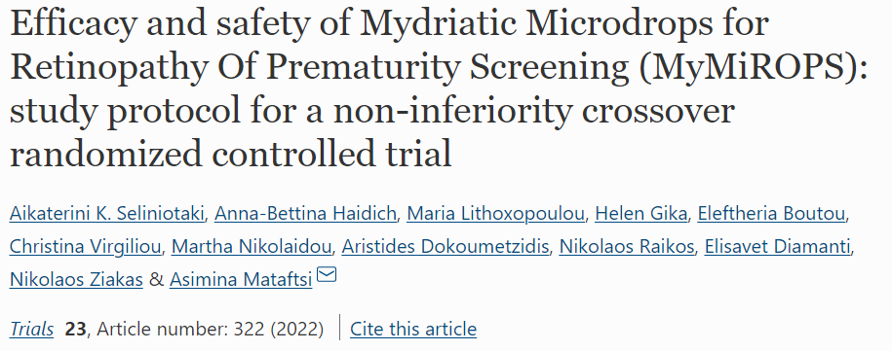
Sample Size Examples for Normal Endpoint
Parallel Design – Normal Endpoint
Crossover Design – Normal Endpoint
Three-Arm Design – Normal Endpoint
Parameter | Value
Significance Level | 0.05
Expected Difference | 0
Non-Inferiority Margin | -0.16
Standard Deviation | 0.45
Power | 80%
Sample Size (per group) | 99
Parameter | Value
Significance Level | 0.025
Expected Difference | -0.1
Non-Inferiority Margin | 0.04
Within-Subject SD/MSE | 0.55
Power | 90%
Sample Size (per sequence) | 37
Parameter | Value
Sig. Level | 0.025
Treatment Mean | 1.56
Reference Mean | 1.56
Placebo Mean | 0
NI Ratio Margin | 0.5
Common St. Dev. | 2.5
Power | 80%
Allocation (E:R:P) | 0.38:0.38:0.24
Sample Size | 350 (133:133:84)
Source: NEJM (2005)
Source: Trials (2022)
Source: JBMR (2012)

Slide 19
Binomial Proportion Parallel Example
“For early clinical response, assuming a rate of response of 82% in both treatment groups, a noninferiority margin of 10%, 90% power, and a one-sided alpha level of 0.025 and using the method of Farrington and Manning, we calculated that 632 patients were required.
Under the assumption of an 85% rate of clinical response in both treatment groups, a noninferiority margin of 10%, a one-sided alpha level of 0.0125, and 632 patients, there was 89% power to show noninferiority for investigator-assessed clinical response at the post-treatment evaluation in the modified intention-to-treat population.”
Parameter | Value
Significance Level | 0.025/0.0125
Non-inferiority Difference Margin | 0.1
True Difference | 0
Standard Proportion | 0.82
Method | Farrington-Manning
Power | 90%/85%
Sample Size | 632
Source: NEJM (2019)

Slide 20
Survival Parallel Arm Example
“On the basis of data from the CONKO-001 trial, we assumed that the 3-year survival rate of the gemcitabine group would be 36%.
We expected that the hazard ratio (HR) for mortality of S-1 compared with gemcitabine would be 0·87. We calculated that 240 events were needed to have 80% power to reject the null hypothesis of an increased risk of death with S-1 (non-inferiority margin 1·25), using a one-sided type I error at 2·5%.
We calculated that the total sample size needed to be 360 eligible patients, with an enrolment period of 3 years, and the initially planned final analysis 2 years after the last patient was enrolled.”
Parameter | Value
Significance Level | 0.025
Non-inferiority Hazard Ratio | 1.25
True Hazard Ratio | 0.87
Survival Proportion (3 year) | 0.36
Accrual Period | 3 years
Study Length | 5 years
Power | 80%
Sample Size/Events | 360/240
Source: The Lancet (2016)

Slide 21
Count Parallel Arm Example
Assuming a rate of 7.56 days within 24 months in both groups, a dispersion parameter of 0.44, and a significance level of 2.5%, a Negative Binomial regression analysis would detect a significant difference of the quotient of the rates compared to a non-inferiority limit of 0.8 with an 80% power, if 181 participants were treated in both arms.
Parameter | Value
Significance Level | 0.025
Non-inferiority Risk Ratio | 0.8
True Risk Ratio | 1
Dispersion | 0.44
Power | 80%
Sample Size (per group) | 181
Source: Trials (2021)

Slide 22
Discussion and Conclusions
Non-inferiority: Show a treatment “no worse” than standard
“No worse” defined via NI margin relative to control effect (M2)
Parallel, crossover & three-arm designs common for NI testing
Each useful, three-arm “gold standard” to deal w/ assay sensitivity
NI similar to inequality for normal data, complicated elsewhere
For non-normal need to choose test, parameterization, variance etc
Sample size should follow design/method choices used in trial
Approximations for common methods can be used sometimes

Slide 23
Thank You
Questions?
info@statsols.com
Further information at Statsols.com

Slide 24
Statsols.com/trial

Slide 25
References (Non-inferiority)
Food and Drug Administration Non-inferiority clinical trials to establish effectiveness. Guidance for industry. November 2016. https://www.fda.gov/downloads/Drugs/Guidances/UCM202140.pdf
European Medicines Agency GUIDELINE ON THE CHOICE OF THE NON-INFERIORITY MARGIN. January 2006. https://www.ema.europa.eu/en/documents/scientific-guideline/guideline-choice-non-inferiority-margin_en.pdf
Senn, S.S., 2021. Statistical issues in drug development (3rd Edition). John Wiley & Sons.
Ng, T.H., 2014. Noninferiority testing in clinical trials: issues and challenges. Taylor & Francis
Schumi, J. and Wittes, J.T., 2011. Through the looking glass: understanding non-inferiority. Trials, 12(1), pp.1-12.
Blackwelder, W.C., 2002. Showing a Treatment Is Good Because It Is Not Bad: When Does ‘Noninferiority’ Imply Effectiveness?. Control Clinical Trials, 23, pp. 52–54.
Chow, S.C., Shao, J., 2006. On Non-Inferiority Margin and Statistical Tests in Active Control Trial.” Statistics in Medicine, 25, pp. 1101–1113.
Fleming, T.R., 2008. Current Issues in Non-inferiority Trials. Statistics in Medicine, 27, pp. 317-332.
Althunian, T.A., de Boer, A., Groenwold, R.H. and Klungel, O.H., 2017. Defining the noninferiority margin and analysing noninferiority: an overview. British journal of clinical pharmacology, 83(8), pp.1636-1642
Pater, C. 2004. Equivalence and noninferiority trials–are they viable alternatives for registration of new drugs?(III). Current controlled trials in cardiovascular medicine, 5(1), 8.

Slide 26
References (Non-inferiority/Designs)
Walker, E. and Nowacki, A.S., 2011. Understanding equivalence and noninferiority testing. Journal of general internal medicine, 26(2), pp.192-196.
Chow, S.C, & Liu, J.P. 1992. Design and Analysis of Bioavailability and Bioequivalence Studies. Marcel Dekker.
Wellek, S., 2002. Testing statistical hypotheses of equivalence. Chapman and Hall/CRC.
Food and Drug Administration (2018). The Drug Development Process. Find at: https://www.fda.gov/patients/learn-about-drug-and-device-approvals/drug-development-process
Meinert, C.L., 2012. Clinical Trials: design, conduct and analysis (Vol. 39). OUP USA.
Moher, D., Hopewell, S., Schulz, K.F., Montori, V., Gøtzsche, P.C., Devereaux, P.J., Elbourne, D., Egger, M. and Altman, D.G., 2012. CONSORT 2010 explanation and elaboration: updated guidelines for reporting parallel group randomised trials. International journal of surgery, 10(1), pp.28-55.
Senn, S. 2002. Cross-over trials in clinical research (2nd Edition). John Wiley & Sons.
I. Pigeot, J. Schäfer, J. Röhmel, D. Hauschke., 2003. Assessing non-inferiority of a new treatment in a three-arm clinical trial including a placebo. Statistics in Medicine, 22, pp. 883-899.
M. Hasler, R. Vonk, L.A. Hothorn., 2008. Assessing non-inferiority of a new treatment in a three-arm trial in the presence of heteroscedasticity. Statistics in Medicine, 27, pp. 490-503.

Slide 27
References (Designs/Endpoints/Sample Size)
M. Mielke, A. Munk, and A. Schacht., 2008. The assessment of non‐inferiority in a gold standard design with censored, exponentially distributed endpoints. Statistics in Medicine, 27, pp. 5093-5110.
M. Mielke and A. Munk., 2009. The assessment and planning of non-inferiority trials for retention of effect hypotheses-towards a general approach. arXiv:0912.4169
T. Mütze, F. Konietschke, A. Munk, T. Friede., 2017, A studentized permutation test for three-arm trials in the `gold standard’ design. Statistics in Medicine, 36, pp. 883-898.
Mielke, M., 2010. Maximum Likelihood Theory for Retention of Effect Non-Inferiority Trials (Doctoral dissertation, Niedersächsische Staats-und Universitätsbibliothek Göttingen).
T. Mütze, A. Munk, T. Friede., 2016. Design and analysis of three‐arm trials with negative binomially distributed endpoints. Statistics in Medicine, 35, pp. 505-521.
Julious, S.A., (2009). Sample sizes for clinical trials. Chapman and Hall/CRC.
Chow, S.C., Shao, J., & Wang, H. (2008). Sample Size Calculations in Clinical Research (2nd ed.). Chapman & Hall.
Mathews, P. (2010). Sample size calculations: Practical methods for engineers and scientists. Mathews Malnar and Bailey.
Farrington, C. P., & Manning, G. (1990). Test statistics and sample size formulae for comparative binomial trials with null hypothesis of non-zero risk difference or non-unity relative risk. Statistics in Medicine, 9(12), 1447–1454.

Slide 28
References (Endpoints/Sample Size)
Newcombe, R.G. (1988). Interval estimation for the difference between independent proportions: comparison of eleven methods. Statistics in Medicine 17, 873-890.
Rothmann, M., Li, N., Chen, G., Chi, G. Y. H., Temple, R., & Tsou, H.-H. (2002). Design and analysis of non-inferiority mortality trials in oncology. Statistics in Medicine, 22(2), 239–264. https://doi.org/10.1002/sim.1400
Jung, S.H., Kang, S.J., McCall, L.M. and Blumenstein, B., 2005. Sample size computation for two-sample noninferiority log-rank test. Journal of Biopharmaceutical Statistics, 15(6), pp.969-979.
Tang Y. 2021. A unified approach to power and sample size determination for log-rank tests under proportional and nonproportional hazards.
·Uno, H., Wittes, J., Fu, H., Solomon, S. D., Claggett, B., Tian, L., Cai, T., Pfeffer, M. A., Evans, S. R., & Wei, L. J. 2015. Alternatives to Hazard Ratios for Comparing the Efficacy or Safety of Therapies in Noninferiority Studies. Annals of Internal Medicine, 163(2), 127.
Zhu, H. 2017. Sample Size Calculation for Comparing Two Poisson or Negative Binomial Rates in Noninferiority or Equivalence Trials. Statistics in Biopharmaceutical Research, 9(1), 107–115.
Tang, Y. 2017. Sample size for comparing negative binomial rates in noninferiority and equivalence trials with unequal follow-up times. Journal of Biopharmaceutical Statistics, 28(3), 475–491.
Tang, Y., & Fitzpatrick, R. 2019. Sample size calculation for the Andersen‐Gill model comparing rates of recurrent events. Statistics in Medicine, 38(24), 1–9.
·

Slide 29
References (Examples)
Dibra, A., et al 2005. Paclitaxel-eluting or sirolimus-eluting stents to prevent restenosis in diabetic patients. New England Journal of Medicine, 353(7), 663-670.
Seliniotaki, A.K., Haidich, A.B., Lithoxopoulou, M., Gika, H., Boutou, E., Virgiliou, C., Nikolaidou, M., Dokoumetzidis, A., Raikos, N., Diamanti, E. and Ziakas, N., 2022. Efficacy and safety of Mydriatic Microdrops for Retinopathy Of Prematurity Screening (MyMiROPS): study protocol for a non-inferiority crossover randomized controlled trial. Trials, 23(1), pp.1-10.
Binkley, N., Bolognese, M., Sidorowicz‐Bialynicka, A., Vally, T., Trout, R., Miller, C., Buben, C.E., Gilligan, J.P., Krause, D.S. and Oral Calcitonin in Postmenopausal Osteoporosis (ORACAL) Investigators, 2012. A phase 3 trial of the efficacy and safety of oral recombinant calcitonin: the Oral Calcitonin in Postmenopausal Osteoporosis (ORACAL) trial. Journal of bone and mineral research, 27(8), pp.1821-1829.
O’Riordan, W., Green, S., Overcash, J.S., Puljiz, I., Metallidis, S., Gardovskis, J., Garrity-Ryan, L., Das, A.F., Tzanis, E., Eckburg, P.B. and Manley, A., 2019. Omadacycline for acute bacterial skin and skin-structure infections. New England Journal of Medicine, 380(6), pp.528-538.
Uesaka, K., Boku, N., Fukutomi, A., Okamura, Y., Konishi, M., Matsumoto, I., Kaneoka, Y., Shimizu, Y., Nakamori, S., Sakamoto, H. and Morinaga, S., 2016. Adjuvant chemotherapy of S-1 versus gemcitabine for resected pancreatic cancer: a phase 3, open-label, randomised, non-inferiority trial (JASPAC 01). The Lancet, 388(10041), pp.248-257.
Guntinas-Lichius, O., Geißler, K., Asendorf, T., Tostmann, R. and Löhler, J., 2021. Tonsillectomy versus tonsillotomy for recurrent acute tonsillitis in children and adults (TOTO): study protocol for a randomized non-inferiority trial. Trials, 22(1), pp.1-12.

