Slide 1
(Statistical) Power from First Principles
Approximate, Exact & Simulation Approaches

Slide 2
Ronan Fitzpatrick
Head of Statistics

Slide 3
Agenda
01
Statistical Power Overview
02
Power in Clinical Trial Planning
03
Approaches to Calculate Power
04
Conclusions & Discussion
Questions welcome throughout

Slide 4
Pre-clinical research
Animal studies
ANOVA / ANCOVA
Pilot Studies
Confirmatory
1000+ Scenarios for Fixed term, Adaptive & Bayesian Methods
Survival, Means, Proportions & Count endpoints
Group Sequential Trials
Bayesian:
Assurance
Credible Intervals
Posterior Error Approach
Sample Size Re-Estimation
Cross over & personalized medicine
MAMS
Prediction
Early Phase
CRM
MCP-Mod
Simon’s Two Stage
Flemings GST
The complete solution for optimizing your clinical trial designs
Post Marketing
Cohort Study
Case-control Study

Slide 5
nQuery Licensing nQuery operates on a tiered licensing model
BASE
PLUS
PRO
EXPERT
Sample size and power for fixed terms trials
100’s of designs,
endpoints and hypothesis types
Sample size for fully Bayesian (e.g. credible intervals)
+ Hybrid Bayes/Frequentist methods and designs (e.g. Assurance)
Sample size and power for early stage and confirmatory clinical trial
Adaptive Designs and tools for monitoring and adjustment in-trial
Additional tools for study design and monitoring
Incl milestone prediction for enrollment and (survival) event targets
Click Here to see our Package Comparison Tool

Slide 6
Statistical Power Overview
Part 1

Slide 7
Statistical Power
Statistical power is probability of finding for “success” given a specified statistical procedure under a given (potentially hypothetical) outcome
Success: Statistical procedure provides output(s) congruent with finding in favour of the conclusion of interest e.g. low p-value ≈ new therapeutic is effective in clinical trial
Most often associated with hypothesis testing but in principle can extend to any design + method where pre-define a “success” criterion for trial
Other “Power” Examples: P(Bayes Factor > Critical BF), P(Interval Width > Specified Width)
Power is a vital concept in clinical trials especially for trial planning, comparing methods/designs and finding the appropriate sample size
In this webinar will focus on what statistical power is, how it relates to hypothesis testing , how it used for sample size planning and summarize the approaches for calculating power

Slide 8
Hypothesis Testing
(Null) Hypothesis (Significance) Testing (NHST) is the most common approach for testing in research + clinical trials
NHST is “compromise” that emerged from Fisher hypothesis testing & Neyman-Pearson hypothesis testing
Primary focus in NHST is in rejecting the Null Hypothesis
Most common test hypothesis is superiority/inequality
Other: Non-inferiority, Supersuperiority, Equivalence
Probability of rejecting the null hypothesis (H₀) when H₀ is true* is known as the Type I (α) error (“false positive”)
*and all other procedure assumptions are also be true!
Reject H₀ (“Success”) by testing if p-value (α “estimate”) less than test significance level (α “decision boundary”)
Statistical analysis based on hypothesis testing only requires definition of desired Type I error under null
But what about alternative hypothesis (H₁) errors?
Two Sample Z-test Hypothesis Tests
Superiority
$H_{0}:μ_{1}−μ_{2}≤0$ $H_{1}:μ_{1}−μ_{2}>0$
$$\begin{aligned}Z=\frac{\left({\overline{x}}_{1}−{\overline{x}}_{2}\right)}{\sqrt{\frac{s^{2}}{n}+\frac{s^{2}}{n}}} ,\begin{aligned} Z|H_{0}\sim N(0,1)\#\end{aligned} \\ \#\end{aligned}$$
$$Z_{1−α}= φ\left(1−α\right)$$
$e.g. α=0.025⇒Z_{1−α}≈1.96$
Reject Null if $Z>Z_{1−α}⇒\begin{aligned}α=P\left(Z>Z_{1−α} | H_{0}\right)\#\end{aligned}$
Non-inferiority/Supersuperiority
$H_{0}:μ_{1}−μ_{2}≤∆_{0}$ $H_{1}:μ_{1}−μ_{2}>∆_{0}$
Equivalence
$$H_{0}:μ_{1}−μ_{2}≤∆_{L} | μ_{1}−μ_{2}≥∆_{U}$$
$H_{1}:∆_{L}<μ_{1}−μ_{2}<∆_{U}$

Slide 9
Power in Hypothesis Testing
Prob. of not rejecting null hypothesis (H₀) when alternative hypothesis (H₁) is true is Type II (β) error (“false positive”)
Fail to Reject H₀ (“Failure”) by comparing p-value vs test significance level i.e. p-value > test significance level
Power is the probability of rejecting the null hypothesis when the alternative is true i.e. 1 – β (“true positive”)
Reject H₀ (“Success”) as per α scenario (p-value < test significance level) but this is now desired outcome
Type II error/Power requires a specific alternative hypothesis
May be based on expected or clinically relevant outcome
But only the null hypothesis is needed to run a statistical analysis based on hypothesis test: What does H₁ add?
Theoretical framework for selecting tests (UMP)
Practically, method to evaluate chance of trial “succeeding” given a scenario of interest
$$\begin{aligned}Z=\frac{\left({\overline{x}}_{1}−{\overline{x}}_{2}\right)}{\sqrt{\frac{s^{2}}{n}+\frac{s^{2}}{n}}}=\frac{\left({\overline{x}}_{1}−{\overline{x}}_{2}\right) }{s}\sqrt{\frac{n}{2}}\#\end{aligned}$$
$$\begin{aligned}δ_{1}=\frac{\left(μ_{1}−μ_{2}\right)}{σ}\#\end{aligned}$$
$$\begin{aligned}Power=1−β=P\left(Z>Z_{1−α} | H_{1}:δ=δ_{1}\right)\#\end{aligned}$$
$$\begin{aligned}=P\left(Z − \frac{δ\sqrt{n}}{\sqrt{2}} > Z_{1−α} − \frac{δ\sqrt{n}}{\sqrt{2}}|H_{1}\right)\#\end{aligned}$$
$$\begin{aligned}\left(Z − \frac{δ\sqrt{n}}{\sqrt{2}}\right) \sim N\left(0,1\right)\#\end{aligned}$$
$$\begin{aligned}1−β=1− Φ\left(Z_{1−α} − \frac{δ\sqrt{n}}{\sqrt{2}}\right)\#\end{aligned}$$
$$\begin{aligned}Z_{1−β}=\frac{δ\sqrt{n}}{\sqrt{2}}−Z_{1−α}\#\end{aligned}$$
$\begin{aligned}n=\frac{2{\left(Z_{1−β}+Z_{1−α}\right)}^{2}}{δ^{2}}=\#\end{aligned}$ $\frac{2{\left(Z_{1−β}+Z_{1−α}\right)σ}^{2}}{{\left(μ_{1}−μ_{2}\right)}^{2}}$

Slide 10
Power in Clinical Trial Planning
Part 2

Slide 11
Power for Planning
Power is a useful a priori metric to evaluate the chance of success of a trial
Post-hoc power is not useful! Usually misunderstood and is a simple function of p-value
Can be used to evaluate between the various choices/scenarios of note
Choosing statistical method or hypothesis, evaluating effect of different design parameters, feasibility based on expected/clinically relevant outcomes
But most common use of power is to find the appropriate sample size of the trial since sample size is often the “free” variable in a power calculation
Fixed Variables: Study Design, Statistical Method, Hypothesis Test, Significant Level
Esimated Variables: Effect Size (e.g. difference), Nuisance Parameters (e.g. Variance)
Increasing sample size will increase the power as it provides a less variable estimate of the estimator of interest - see how lowers Z-test standard error
In practice, keep increasing sample size until the desired power (e.g. 80%/90%) reached

Slide 12
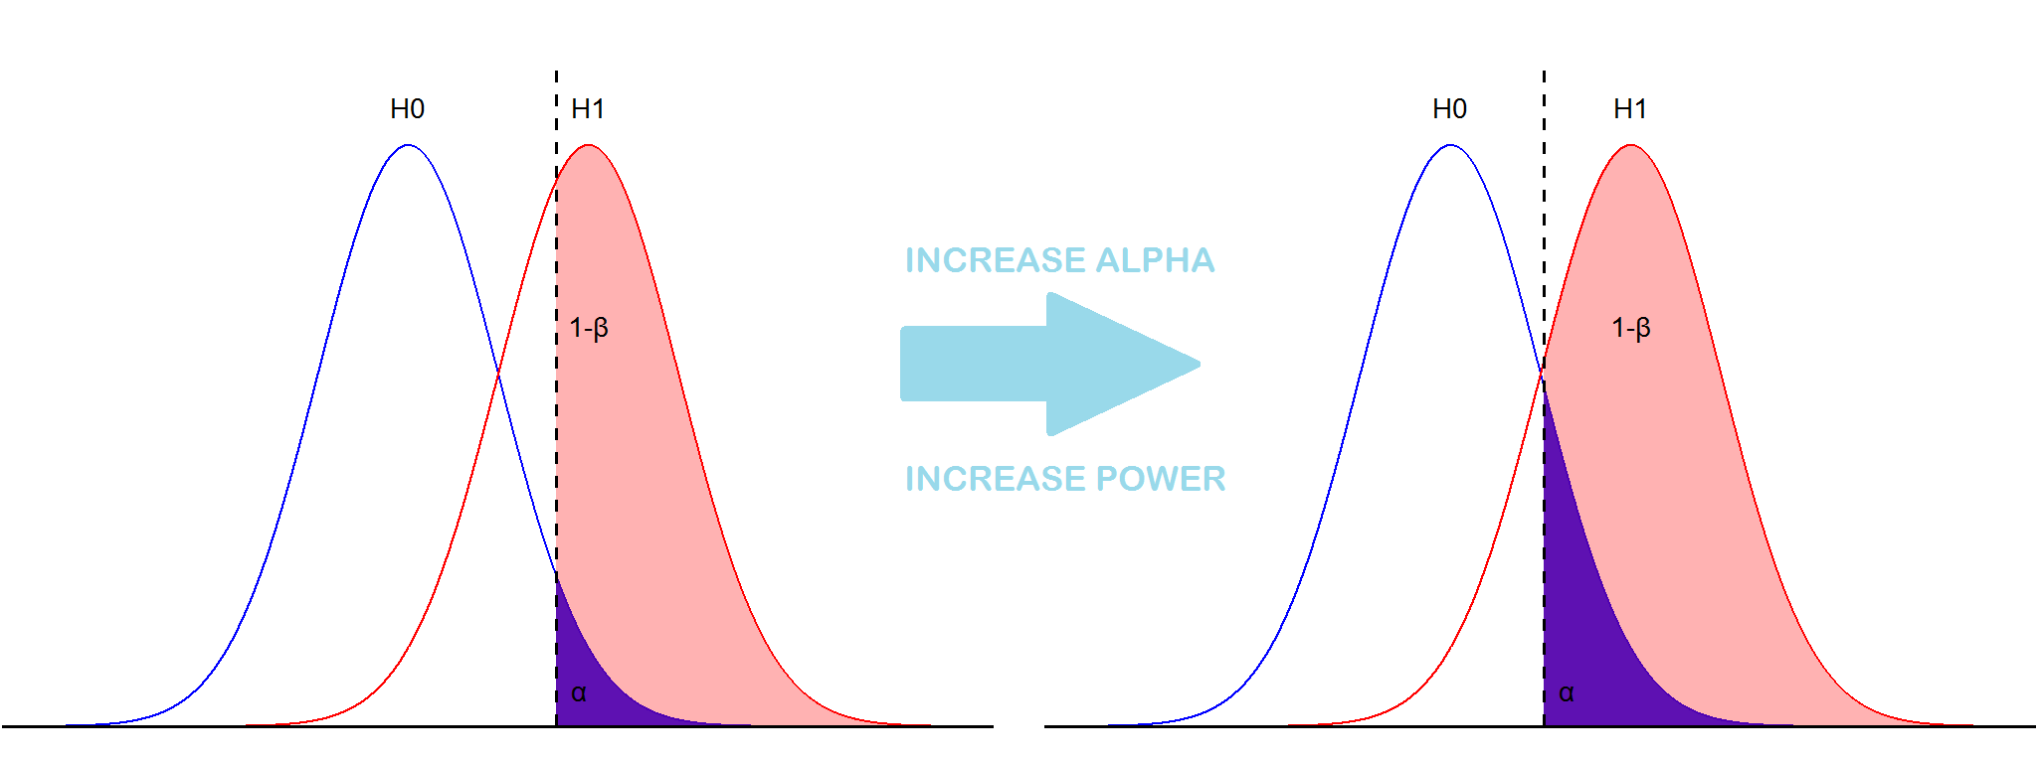
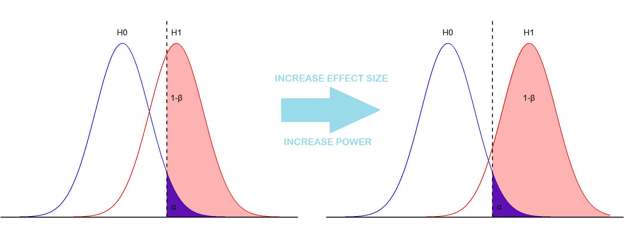
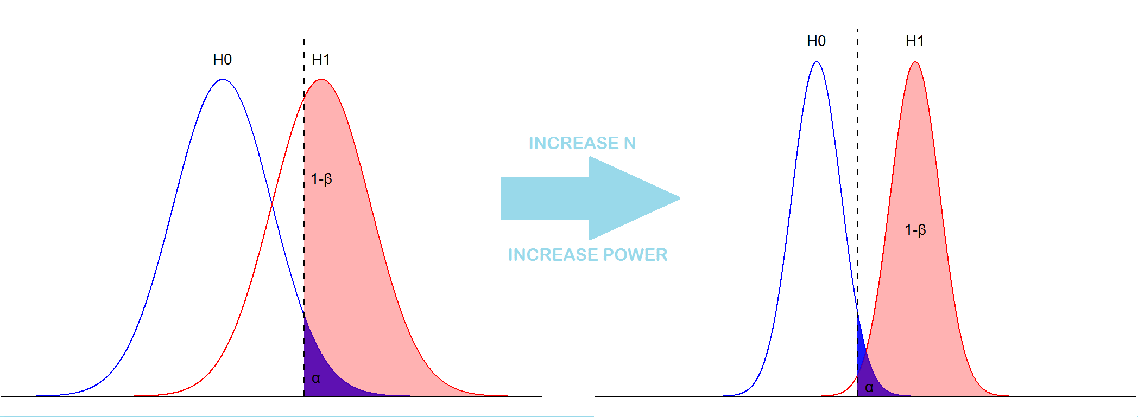

Slide 13
Other Strategies to Increase Power
Avoid Simplifying Data
Problem: Researchers often “simplify” data but this “throws away” data & increases sample size requirements - see “dichotomania” (Senn (2005)) for continuous outcome (e.g. responder analysis)
Solutions: Analyze data “as-is” unless have a very strong justification - can use sample size determination to demonstrate real cost of “simplicity” e.g. dichotomizing “best case” can easily increase sample size by >50%
Using Additional Data
Problem: Researchers will often not use or mis-use additional information such as covariates or real-world data which could be used to increase statistical power
Solutions: Use sensitivity analysis to show value of model choice (e.g. ANOVA vs ANCOVA), consider methods which integrate real world data sources (e.g. Bayesian borrowing)
Improved Study Designs
Problem: Researchers will often avoid using some study designs despite this increasing the overall sample size requirements
Solutions: Group sequential designs offer obvious benefit for parallel trials (Jennison: 3 Looks = ~30% less expected N despite only 5% max N increase), other adaptive designs allow dynamic assessment of multiple arms (e.g. platform trials), paired/cross-over designs have higher efficiency if appropriate, factorial designs may be better suited for multiple hypotheses

Slide 14
Calculating Power
Part 3

Slide 15
Calculating Power
Given value of calculating power there is large number of books, papers, software etc for calculating power across variety of designs, models & tests
Widely used books/primers provided in references section. www.statsols.com for nQuery!
These approaches for calculating power can be broken down into three primary categories: approximate, exact and simulation-based
Common for there to be multiple examples of power calculations within and across each of these approaches for any given design/statistical scenario
Choosing “best” approach for your trial is a function of available resources + expertise e.g. more complex approach often means more assumed inputs
Common to start with simpler method as sanity check and then use more complex approaches to investigate design decisions or more complex scenarios

Slide 16
Approximate Power
Approximate Power calculates the power function using approximate methods and formula – often re-arranged for “n”
Most common approx. is formulae using normal approximation
Examples across binary, survival, count, ordinal + more
Two primary aspects: calculate variance (under null + alternative) & scale (e.g. diff, ratio) + link (e.g. log, sqrt)
Usually lower computational requirements than exact/sim.
Lesser consideration with modern computing & software
Oft require less user inputs but beware hidden assumptions
Need to benchmark accuracy of power approximation vs exact and/or simulation-based approaches
Paper describing method will often include benchmarks for common scenarios – more care if atypical inputs used
$$1−β=Φ\left(\frac{\left(∆\right)\sqrt{n}−Z_{1−α}\sqrt{V_{0}}}{\sqrt{V_{1}}}\right)$$
$$n={\left(\frac{Z_{1−α}\sqrt{V_{0}}+Z_{1−β}\sqrt{V_{1}}}{link(∆)}\right)}^{2}$$
Two Sample t-test
Log-Rank Test (Schoenfeld)
$$n=\frac{{\left(Z_{1−α}+Z_{1−β}\right)}^{2}σ^{2}}{{\left(μ_{1}−μ_{2}\right)}^{2}}$$
$$E=\frac{4{\left(Z_{1−α}+Z_{1−β}\right)}^{2}}{{\left(\ln{HR}\right)}^{2}}$$
Two Sample Chi-Squared Test (Fleiss)
$$n={\left(\frac{Z_{1−α}\sqrt{2\overline{π}\left(1−\overline{π}\right)}+Z_{1−β}\sqrt{π_{1}\left(1−π_{1}\right)+π_{2}\left(1−π_{2}\right)}}{π_{1}−π_{2}}\right)}^{2}$$
Two Poisson (Lehr)
$$n=\frac{4}{{\left(\sqrt{λ_{1}}−\sqrt{λ_{2}}\right)}^{2}}$$

Slide 17
Exact Power
Exact power calculates the power function exactly for given statistical analysis and distributional assumptions
Don’t confuse with exact tests – can have approximate power for exact tests or exact power for approximate tests
Derivations available for most scenarios but often complex
Need to derive parameter (e.g. variance) under alternative
Trade-offs in areas such as performance, legibility, tradition means approx. often used even if exact method available
Often computationally expensive if used for discrete data (proportions, counts) where must enumerate all scenarios
Will rise rapidly as higher sample size + number of arms
Exact power calculations still limited to underlying distributional (and other) assumptions was derived under
May prefer simulation if want to evaluate robustness under other scenarios
Two Sample t-test
$$1−β=1 −T\left(t_{1−α},df,NCP\right)$$
$$df=2n−2$$
$$NCP=\begin{aligned}\frac{\left(μ_{1}−μ_{2}\right)\sqrt{n}}{σ}\#\end{aligned}$$
Two Sample Proportions
Compute test statistic/p-value for desired test for # successes ranging from 0 to n₁ in group 1 and 0 to n₂ in group 2 for all combinations
Create rejection set (A) of all significant combinations by comparing vs critical threshold
Sum product of group 1 and group 2 binomial density over all combinations in rejection set given assumed group 1 and group 2 proportions
$$1−β=\sum_{A}{B(x_{1},n_{1},π_{1})B(x_{2},n_{2,},π_{2})}$$
$$B\left(x,n,π\right)=\left(\begin{matrix}x \\ n\end{matrix}\right)π^{x}{\left(1−π\right)}^{n−x}$$

Slide 18
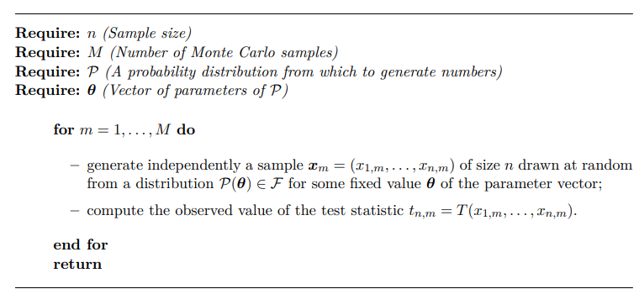
Simulated Power
Simulation calculates power by simulating data under a specified alternative and counting number of successful sims
Flexible tool for assessing wide variety of design scenarios
Handles complex scenarios and extensions very well
Standard method for complex designs (adaptive/Bayesian)
Requires additional computation (less problematic today) and more full specification of the alternative hypothesis of interest
Often much wider range of user inputs than for standard power formula – simplicity vs flexibility
Often useful to compare by replicating common power formula (approximate or exact) as “sanity check”
Provides insight into hidden assumptions and jumping off point for more involved exploration
Two Sample t-test Simulation
Compute n₁ variates from group 1 and n₂ variates from group 2 under specified distributions under the alternative e.g. $N\left(μ_{1},σ^{2}\right),N(μ_{2},σ^{2})$
Calculate t-statistic/p-value based on simulated data
Compare vs critical t-statistic/test significance level - if significant add to success counter set
Repeat 1 to 3 for specified number of simulations
Calculate power as number of successes divided by number of simulations

Slide 19
Discussion and Conclusions
Statistical power is the probability of finding for success given a specified alternative hypothesis scenario
Power is a useful tool for study planning for comparing different design choices and finding the appropriate sample size for your study
The three primary types of power calculation are approximate formulae, exact calculations and simulation-based power
Each approach has its own strengths and weaknesses with approximate formulae often useful for quick starting calculations while simulation allows exploration of more complex scenarios and designs

Slide 20
statsols.com/nquery-demo

Slide 21
Thank you
CONTACT US
info@statsols.com
MORE INFO
statsols.com

Slide 22
References (Power Overview)
Previous Webinars
Everything to Know About Sample Size Determination | A Step-by-Step Guide including Common Pitfalls: https://www.statsols.com/articles/everything-to-know-about-sample-size-determination
Choosing the Effect Size for Sample Size Calculations | Understanding MCID, Sensitivity Analysis and Assurance: https://www.statsols.com/guides/choosing-the-effect-size-for-sample-size-calculations
Power for Complex Hypotheses | Sample Size for Non-inferiority, Superiority by a Margin and Equivalence Testing: https://www.statsols.com/guides/power-for-complex-hypotheses
Power for Sample Size Overviews
Julious, S. A. 2023. Sample sizes for clinical trials (2nd Edition). CRC Press.
Chow, S.C., Shao, J., Wang, H. and Lokhnygina, Y., 2017. Sample size calculations in clinical research. Chapman and Hall/CRC.
Machin, D., Campbell, M.J., Tan, S.B. and Tan, S.H., 2018. Sample sizes for clinical, laboratory and epidemiology studies. John Wiley & Sons.
Ryan, T.P., 2013. Sample size determination and power. John Wiley & Sons.
Desu, M.M., 2012. Sample size methodology. Elsevier.
Aberson, C.L., 2019. Applied power analysis for the behavioral sciences. Routledge.
Zar, JH., 2010, Biostatistical Analysis (5th Edition), Prentice Hall.
Cohen, J., 2013. Statistical power analysis for the behavioral sciences. Academic Press.
Cohen, J. 1992. A power primer. Psychological Bulletin, 112, 155-159.
Lakens, D., 2022. Sample size justification. Collabra: Psychology, 8(1), p.33267.
Trial Design Overviews
Senn, S.S., 2021. Statistical issues in drug development (3rd Edition). John Wiley & Sons.
Meinert, C.L., 2012. Clinical Trials: design, conduct and analysis (Vol. 39). OUP USA.
Friedman, L.M., Furberg, C.D., DeMets, D.L., Reboussin, D.M. and Granger, C.B., 2015. Fundamentals of clinical trials. Springer.
International Council for Harmonisation of Technical Requirements for Pharmaceuticals for Human Use (ICH), STATISTICAL PRINCIPLES FOR CLINICAL TRIALS E9. Find at: https://database.ich.org/sites/default/files/E9_Guideline.pdf
Senn, S.S., 2002. Cross-over trials in clinical research. John Wiley & Sons.

Slide 23
References (Hypothesis Testing)
Hypothesis Testing Perspectives
Lehmann, E.L., 2011. Fisher, Neyman, and the creation of classical statistics. Springer Science & Business Media.
Lehmann, E.L. and Romano, J.P., 1986. Testing statistical hypotheses (Vol. 3). New York: springer.
Lehmann, E.L., 1993. The Fisher, Neyman-Pearson theories of testing hypotheses: one theory or two?. Journal of the American statistical Association, 88(424), pp.1242-1249.
Perezgonzalez, J.D., 2015. Fisher, Neyman-Pearson or NHST? A tutorial for teaching data testing. Frontiers in psychology, 6, p.223.
Nuzzo, R., 2014. Scientific method: statistical errors. Nature, 506(7487).
Fisher, R.A. and Yates, F., 1990. Statistical methods, experimental design, and scientific inference: a re-issue of statistical methods for research workers, the design of experiments and statistical methods and scientific inference. Oxford University Press.
Wald, A., 1942. Chapter ii: The Neyman-Pearson theory of testing a statistical hypothesis. In On the Principles of Statistical Inference (Vol. 1, pp. 10-21). University of Notre Dame.
Wasserstein, R.L. and Lazar, N.A., 2016. The ASA statement on p-values: context, process, and purpose. The American Statistician, 70(2), pp.129-133.
Lakens, D., 2021. The practical alternative to the p value is the correctly used p value. Perspectives on psychological science, 16(3), pp.639-648.
Greenland, S., 2019. Valid p-values behave exactly as they should: Some misleading criticisms of p-values and their resolution with s-values. The American Statistician, 73(sup1), pp.106-114.
Mayo, D.G., 2018. Statistical inference as severe testing: How to get beyond the statistics wars. Cambridge University Press.
Alternative Perspectives on Power/Sample Size
Gelman, A. and Carlin, J., 2014. Beyond power calculations: Assessing type S (sign) and type M (magnitude) errors. Perspectives on Psychological Science, 9(6), pp.641-651.
Vasishth, S., Mertzen, D., Jäger, L.A. and Gelman, A., 2018. The statistical significance filter leads to overoptimistic expectations of replicability. Journal of Memory and Language, 103, pp.151-175.
Schulz, K.F. and Grimes, D.A., 2005. Sample size calculations in randomised trials: mandatory and mystical. The Lancet, 365(9467), pp.1348-1353.
Kunzmann, K., Grayling, M.J., Lee, K.M., Robertson, D.S., Rufibach, K. and Wason, J.M., 2021. A review of Bayesian perspectives on sample size derivation for confirmatory trials. The American Statistician, 75(4), pp.424-432.
Lindley, D.V., 1997. The choice of sample size. Journal of the Royal Statistical Society: Series D (The Statistician), 46(2), pp.129-138.

Slide 24
References (Power Resources/Issues)
Shiny Apps for Power
Understanding Statistical Power and Significance Testing: https://rpsychologist.com/d3/nhst/
Distribution of Cohen's d, p-values, and power curves for an independent two-tailed t-test: https://shiny.ieis.tue.nl/d_p_power/
PowerSimulate: https://shiny.jdl-svr.lat/PowerSimulate/
Arnholt, A.T., 2019. Using a Shiny app to teach the concept of power. Teaching Statistics, 41(3), pp.79-84.
Post-Hoc Power
Hoenig, J.M. and Heisey, D.M., 2001. The abuse of power: the pervasive fallacy of power calculations for data analysis. The American Statistician, 55(1), pp.19-24.
Althouse, A.D., 2021. Post hoc power: not empowering, just misleading. Journal of Surgical Research, 259, pp.A3-A6.
Heinsberg, L.W. and Weeks, D.E., 2022. Post hoc power is not informative. Genetic epidemiology, 46(7), pp.390-394.
Gelman, A., 2019. Don’t calculate post-hoc power using observed estimate of effect size. Annals of surgery, 269(1), pp.e9-e10.
Onwuegbuzie, A.J. and Leech, N.L., 2004. Post hoc power: A concept whose time has come. Understanding statistics, 3(4), pp.201-230.
Lenth, R.V., 2007. Post hoc power: tables and commentary. Iowa City: Department of Statistics and Actuarial Science, University of Iowa, pp.1-13.
Prevalence of Underpowered Research
Cohen, J., 1962. The statistical power of abnormal-social psychological research: A review. The Journal of Abnormal and Social Psychology, 65, 145
BuPon, K. S., Ioannidis, J. P. A., Mokrysz, C., Nosek, B. A., Flint, J., Robinson, E. S. J, Munafo, M. R. 2011. Power failure: Why small sample size undermines the reliability of neuroscience. Nature Reviews Neuroscience, 14, 365 - 376.
Sedlmeier, P., & Gigerenzer, G., 1989. Do studies of statistical power have an effect on the power of studies? Psychological Bulletin, 105(2), 309–316.
Vankov, I., Bowers, J., & Munafò, M. R., 2014. On the persistence of low power in psychological science. The Quarterly Journal of Experimental Psychology, 67(5), 1037–1040.
Szucs, D., & Ioannidis, J. P. A., 2017. Empirical assessment of published effect sizes and power in the recent cognitive neuroscience and psychology literature. PLOS Biology, 15(3), e2000797.
Dumas-Mallet, E., Button, K. S., Boraud, T., Gonon, F., & Munafò, M. R., 2017. Low statistical power in biomedical science: a review of three human research domains. Royal Society Open Science, 4(2), 160254–11.
Charles, P., Giraudeau, B., Dechartres, A., Baron, G., & Ravaud, P., 2009. Reporting of sample size calculation in randomised controlled trials: review. BMJ, 338, b1732.

Slide 25
References (Improving Power)
Strategies to Improve Power
Senn, S. 2005. Dichotomania: an obsessive compulsive disorder that is badly affecting the quality of analysis of pharmaceutical trials. Proceedings of the International Statistical Institute, 55th Session, Sydney.
Wason, J., McMenamin, M. and Dodd, S., 2020. Analysis of responder-based endpoints: improving power through utilising continuous components. Trials, 21, pp.1-6.
Senn, S. 2006. Change from baseline and analysis of covariance revisited. Statistics in medicine, 25(24), 4334-4344.
Van Breukelen, G. J., 2006. ANCOVA versus change from baseline had more power in randomized studies and more bias in nonrandomized studies. Journal of clinical epidemiology, 59(9), 920-925.
Food and Drug Administration (FDA), 2023. Adjusting for Covariates in Randomized Clinical Trials for Drugs and Biological Products Guidance for Industry. Download at: https://www.fda.gov/media/148910/download
Food and Drug Administration (FDA), 2019. Adaptive Designs for Clinical Trials of Drugs and Biologics Guidance for Industry. Download at: https://www.fda.gov/media/78495/download
A Practical Adaptive & Novel Designs and Analysis toolkit (PANDA). Find at: https://panda.shef.ac.uk/
Jennison, C., & Turnbull, B. W. (1999). Group sequential methods with applications to clinical trials. CRC Press.
Wassmer, G., & Brannath, W. (2016). Group sequential and confirmatory adaptive designs in clinical trials. Cham: Springer International Publishing.
Bauer, P., Bretz, F., Dragalin, V., König, F. and Wassmer, G., 2016. Twenty‐five years of confirmatory adaptive designs: opportunities and pitfalls. Statistics in Medicine, 35(3), pp.325-347.
Pallmann, P., Bedding, A.W., Choodari-Oskooei, B., Dimairo, M., Flight, L., Hampson, L.V., Holmes, J., Mander, A.P., Odondi, L.O., Sydes, M.R. and Villar, S.S., 2018. Adaptive designs in clinical trials: why use them, and how to run and report them. BMC medicine, 16(1), pp.1-15.
The Adaptive Platform Trials Coalition, 2019. Adaptive platform trials: definition, design, conduct and reporting considerations. Nature Reviews Drug Discovery 18(10): 797-807.
Park, J.J., Siden, E., Zoratti, M.J., Dron, L., Harari, O., Singer, J., Lester, R.T., Thorlund, K. and Mills, E.J., 2019. Systematic review of basket trials, umbrella trials, and platform trials: a landscape analysis of master protocols. Trials, 20, pp.1-10.
Kahan, B.C., Juszczak, E., Beller, E., Birchenall, M., Chan, A.W., Hall, S., Little, P., Fletcher, J., Golub, R.M., Goulao, B. and Hopewell, S., 2025. Guidance for protocol content and reporting of factorial randomised trials: explanation and elaboration of the CONSORT 2010 and SPIRIT 2013 extensions. bmj, 388.

Slide 26
References (Approximate Power)
Approximate Power – Categorical Examples
Fleiss, J.L., Levin, B. and Paik, M.C., 2013. Statistical methods for rates and proportions. John Wiley & sons.
Agresti, A., 2012. Categorical data analysis. John Wiley & Sons.
Lachin, John M. 2000. Biostatistical Methods. John Wiley & Sons.
Whitehead, J. 1993. Sample size calculations for ordered categorical data. Statistics in Medicine, 12(24), 2257–2271.
Kolassa, J. E. 1995. A comparison of size and power calculations for the wilcoxon statistic for ordered categorical data. Statistics in Medicine, 14(14), 1577–1581.
Approximate Power – Survival Examples
Freedman, L. S. 1982. Tables of the number of patients required in clinical trials using the logrank test. Statistics in medicine, 1(2), 121-129.
Schoenfeld, D. A. 1983. Sample-size formula for the proportional-hazards regression model. Biometrics, 499-503.
Lachin, J. M., & Foulkes, M. A. 1986. Evaluation of sample size and power for analyses of survival with allowance for nonuniform patient entry, losses to follow-up, noncompliance, and stratification. Biometrics, 507-519.
Lakatos, E. 1988. Sample sizes based on the log-rank statistic in complex clinical trials. Biometrics, 229-241.
Hsieh, F.Y. and Lavori, P.W., 2000. Sample-size calculations for the Cox proportional hazards regression model with nonbinary covariates. Controlled clinical trials, 21(6), 552-560.
Approximate Power – Counts Examples
Lehr, R.,1 992. Sixteen S‐squared over D‐squared: A relation for crude sample size estimates. Statistics in medicine, 11(8), 1099-1102.
Gu, K., Ng, H. K. T., Tang, M. L., & Schucany, W. R., 2008. Testing the ratio of two poisson rates. Biometrical Journal, 50(2), 283-298.
Zhu, H., & Lakkis, H., 2014. Sample size calculation for comparing two negative binomial rates. Statistics in medicine, 33(3), 376-387.
Tang, Y., 2015. Sample size estimation for negative binomial regression comparing rates of recurrent events with unequal follow-up time. Journal of biopharmaceutical statistics, 25(5), 1100-1113.
Tang, Y. and Fitzpatrick, R., 2019. Sample size calculation for the Andersen‐Gill model comparing rates of recurrent events. Statistics in Medicine, 38(24), pp.4819-4827.
Shieh, G., 2001. Sample size calculations for logistic and Poisson regression models. Biometrika, 88(4), pp.1193-1199.
Approximate Power – Other
Cundill, B. and Alexander, N.D., 2015. Sample size calculations for skewed distributions. BMC medical research methodology, 15, pp.1-9.

Slide 27
References (Exact Power)
Exact Power – Categorical Examples
Berger, R., 1994. Power comparison of exact unconditional tests for comparing two binomial proportions. Institute of Statistics Mimeo Series, (2266), pp.1-19.
Blackwelder, W.C., 1993. Sample size and power for prospective analysis of relative risk. Statistics in medicine, 12(7), pp.691-698.
Chan, I.S., 2002. Power and sample size determination for noninferiority trials using an exact method. Journal of Biopharmaceutical Statistics, 12(4), pp.457-469.
Suissa, S. and Shuster, J.J., 1991. The 2 x 2 matched-pairs trial: exact unconditional design and analysis. Biometrics, pp.361-372.
Mehta, C.R. and Hilton, J.F., 1993. Exact power of conditional and unconditional tests: going beyond the 2× 2 contingency table. The American Statistician, 47(2), pp.91-98.
Mehta, C.R., Patel, N.R. and Senchaudhuri, P., 1998. Exact power and sample-size computations for the Cochran-Armitage trend test. Biometrics, pp.1615-1621.
Mehta, C.R., 1990. StatXact: A statistical package for exact nonparametric inference. Journal of classification.
Chernick, M.R. and Liu, C.Y., 2002. The saw-toothed behavior of power versus sample size and software solutions: single binomial proportion using exact methods. The American Statistician, 56(2), pp.149-155.
Exact Power – Survival Examples
Phadnis, M.A., 2019. Sample size calculation for small sample single-arm trials for time-to-event data: Logrank test with normal approximation or test statistic based on exact chi-square distribution?. Contemporary Clinical Trials Communications, 15, p.100360.
Exact Power – Counts Examples
Guenther, W.C., 1977. Sampling Inspection in statistical quality control. Macmillan.
Chan, I.S. and Bohidar, N.R., 1998. Exact power and sample size for vaccine efficacy studies. Communications in Statistics-Theory and Methods, 27(6), pp.1305-1322.
Menon, S., Massaro, J., Lewis, J., Pencina, M., Wang, Y.C. and Lavin, P., 2011. Sample size calculation for Poisson endpoint using the exact distribution of difference between two Poisson random variables. Statistics in Biopharmaceutical Research, 3(3), pp.497-504.
Exact Power – Other
Shieh, G., 2016. Exact power and sample size calculations for the two one-sided tests of equivalence. PloS one, 11(9), p.e0162093.
Gatsonis, C. and Sampson, A.R., 1989. Multiple correlation: exact power and sample size calculations. Psychological bulletin, 106(3), p.516.

Slide 28
References (Simulation Power)
Overviews
Arnold, B.F., Hogan, D.R., Colford, J.M. and Hubbard, A.E., 2011. Simulation methods to estimate design power: an overview for applied research. BMC medical research methodology, 11, pp.1-10.
Kimko, H.C. and Duffull, S.B., 2002. Simulation for designing clinical trials. Marcel Dekker Incorporated.
Landau, S. and Stahl, D., 2013. Sample size and power calculations for medical studies by simulation when closed form expressions are not available. Statistical methods in medical research, 22(3), pp.324-345.
Eng, J., 2004. Sample size estimation: a glimpse beyond simple formulas. Radiology, 230(3), pp.606-612.
Meyer, K.M., Mooij, W.M., Vos, M., Hol, W.G. and van der Putten, W.H., 2009. The power of simulating experiments. Ecological Modelling, 220(19), pp.2594-2597.
Feiveson, A.H., 2002. Power by simulation. The Stata Journal, 2(2), pp.107-124.
Hooper, R., 2013. Versatile sample-size calculation using simulation. The Stata Journal, 13(1), pp.21-38.
McConnell, B. and Vera-Hernández, M., 2015. Going beyond simple sample size calculations: a practitioner's guide.
Huang, C., Li, P. and Martin, C.R., 2022. Simplification or simulation: Power calculation in clinical trials. Contemporary clinical trials, 113, p.106663.
Wilson, D.T., Hooper, R., Brown, J., Farrin, A.J. and Walwyn, R.E., 2021. Efficient and flexible simulation-based sample size determination for clinical trials with multiple design parameters. Statistical methods in medical research, 30(3), pp.799-815.
Specific Scenario (Mixed Models)
Arend, M.G. and Schäfer, T., 2019. Statistical power in two-level models: A tutorial based on Monte Carlo simulation. Psychological methods, 24(1), p.1.
Green, P. and MacLeod, C.J., 2016. SIMR: An R package for power analysis of generalized linear mixed models by simulation. Methods in Ecology and Evolution, 7(4), pp.493-498.
Complex Designs Examples (Bayesian/Adaptive)
Müller, P., Berry, D.A., Grieve, A.P., Smith, M. and Krams, M., 2007. Simulation-based sequential Bayesian design. Journal of statistical planning and inference, 137(10), pp.3140-3150
Krotka, P., Hees, K., Jacko, P., Magirr, D., Posch, M. and Roig, M.B., 2023. NCC: An R-package for analysis and simulation of platform trials with non-concurrent controls. SoftwareX, 23, p.101437.

