Slide 1
Trial Design Issues for Phase II Trials
Guide to Two-Stage IIa Designs and IIa/IIb using MCP-Mod
Notes:
www.Statsols.com/trial

Slide 2
Webinar
Host
Denis Desmond
Research Statistician
nQuery

Slide 3
Agenda
Phase II Designs
Phase IIa
Phase IIa/IIb with MCP-Mod
Discussion and Conclusions
All example files will be available after the webinar

Slide 5
In 2021, 88% of organizations with clinical trials approved by the FDA used nQuery

Slide 6
Clinical Trial Overview
Clinical Trials Process
Establish safety, toxicity and tolerability profile (MTD) of candidate therapeutic
Phase II
First target patient trials
Phase IV
Phase III
Pre-Clinical
Find candidate biologics, molecules and other therapies
Pivotal trial(s) for regulatory approval in patients from target population
Focus on rare or long-term safety effects of treatment
Phase I
First in-human trials
Research, cell models, animal models
Real world patients post-approval i.e., post-marketing surveillance
Often split in two: proof of concept for efficacy (IIa) & find optimal dose(s) for Phase III (IIb)
Establish efficacy & safety in randomized controlled trial

Slide 7
Phase II Trials
Part 1

Slide 8
Phase II Trials
The first stage (usually) testing efficacy of a candidate therapeutic in the target population
Phase II is usually split into two separate phases: Phase IIa & Phase IIb
Phase IIa is the proof-of-concept phase and Phase IIb is the dose-finding phase
Phase II is the clinical trial stage with the highest failure rate Failure rate at this stage is between 50-80%

Slide 9
Phase II Trial Issues
We want trial designs that allow for quick rejection of unsuccessful candidates
Large uncertainty about dose selection at this stage, costs associated with incorrect selections
Use of surrogate endpoints, instead of ‘gold standard’ endpoints to facilitate faster decisions, e.g., Progression Free Survival (PFS) or Overall Response Rate (ORR) as surrogates for Overall Survival
Large investment costs, particularly when Phase II success doesn’t translate into Phase III

Slide 10
Phase IIa Designs
Part 2

Slide 11
Phase IIa Trial Design
Phase IIa: Proof-of-concept trial testing if there is sufficient evidence of positive effect
Often test using surrogate endpoint, e.g., Overall Response Rate (ORR), Progression Free Survival (PFS), systolic & diastolic blood pressure
Phase IIa has a very high failure rate so need to reject poor candidates quickly
Approximately 70% of drugs fail after phase II
Main reason is these therapeutics have (likely) never been tested for efficacy in humans up to now, but can also be due to previously unknown side-effects, insufficient efficacy, etc.
Thus two-stage one-arm trials common
Stage One: Futility assessment
Stage Two: Recommendation decision
Maximum Futile Proportion, Minimum Efficacy Proportion

Slide 12
Phase IIa Methods Examples
1 | One-Stage Design | A’hern’s Design – Exact Test, Chi-Squared Test
2 | Two-Stage (Efficacy Only) | Simon, Fleming, Gehan, Lin & Shih, Litwin (PFS)
3 | Two-Stage (Efficacy & Safety) | Bryant & Day, Thall and Cheng
4 | Three-Stage Designs | Extension of Two-Stage methods (rare)
5 | Bayesian Methods | Bayesian Two-Stage/Sequential/Adaptive
6 | Contrast Tests | Dose-response Model, MCP-Mod approach
7 | Others | Seamless II/III (Pick Winner), RCT (Phase 3-like)

Slide 13
Simon’s Two-Stage Design
Simon’s Design is a two-stage design with early futility stopping Very popular trial design in practice
Tests null ‘poor’ response vs. alternative ‘good’ response Two common criteria for the design:
(i) Optimum: minimize the expected N (ESS), or (ii) Minimax: minimize the maximum N
Analysis & sample size determination based on exact binomial results for “response” Get number of responses for test failure/success
Start Stage I
Recruit n₁
End Stage I
≤r₁ responses
>r₁ responses
Start Stage II
Stop Early (Futility)
Recruit n₂
End Stage II
>r responses
≤r responses
Decision
Recommend
Do not recommend

Slide 14
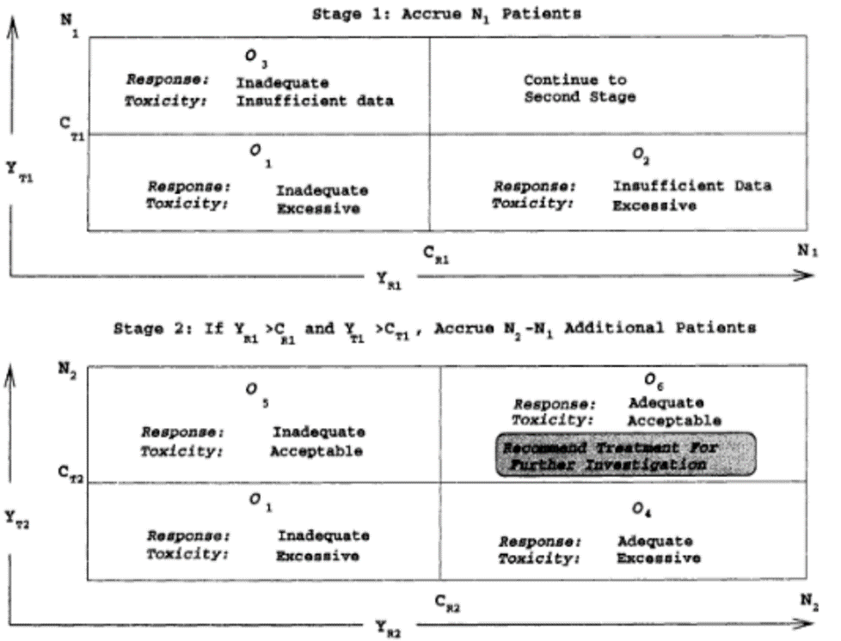
Bryant & Day’s Design
Similar in structure to Simon’s Design
Extends the method to evaluate both efficacy & toxicity Drug toxicity is any adverse reaction caused by the candidate therapeutic
Tackles uncertainty in level of toxicity assumed Only limited Phase I toxicity data available
Again, two common design criteria (i) Optimum: minimize the expected N (ESS), or (ii) Minimax: minimize the maximum N
Source: J. Bryant, R. Day, (1995)

Slide 15
Simon’s Design | Example 1
“For each cohort, the null hypothesis that the true response rate was 5% was tested against a one-sided alternative using a Simon ‘minimax’ study design at a type I error rate of 5%. For each cohort, 13 patients were accrued in the first stage. If there were no responses in the cohort, the study would be stopped for that cohort. If at least one response was observed, 14 additional patients would be accrued to that cohort, for a total of 27 patients. The null hypothesis would be rejected for that cohort if four or more responses were observed. Under an alternative hypothesis that the true response rate was 20%, this design provided 80% power to reject the null hypothesis.”
Parameter | Value
Test Significance Level (one-sided) | 0.05
Design Criterion | Minimax
‘Poor’ Response (π₀) | 0.05
‘Good’ Response (π₁) | 0.20
Power | 80%
Sample Size (Stage I/Final) | 13/27

Slide 16
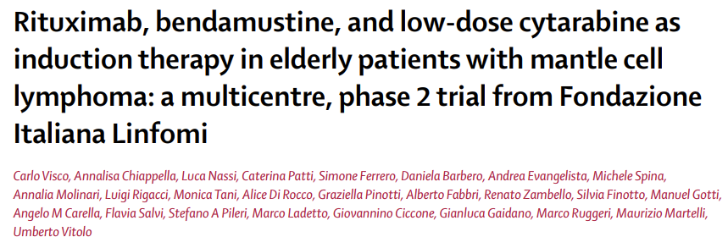
Bryant & Day’s Design | Example 2
“We set the upper bounds on the probabilities of erroneously recommending the treatment at 0·05 both when complete response was inadequate and when toxicity was unacceptable. The upper bound on the probability of failing to recommend the treatment when it was acceptable with respect to both response and toxicity was 0·2 (80% power). We fixed the probability of unacceptable complete response at 0·40 and the probability of acceptable complete response at 0·60. In an analogous manner, the cutoffs for toxicity probabilities were 0·40 (unacceptable) and 0·20 (acceptable). According to these parameters, 19 patients were required for the first stage and 57 patients for the second stage.”
Parameter | Value
Response Significance Level (α_{R}) | 0.05
Toxicity Significance Level (α_{T}) | 0.05
Design Criterion | Optimum
Unacceptable Response (π_{R0}) | 0.4
Acceptable Response (π_{R1}) | 0.6
Unacceptable Non-Toxicity (π_{T0}) | 0.6
Acceptable Non-Toxicity (π_{T1}) | 0.8
Power | 80%
Sample Size (Stage I/Final) | 19/57

Slide 17
Phase IIa/IIb Designs
Part 3

Slide 18
Phase IIb Trial Design & Methods
Phase IIb: Trial to estimate dose-response curve to allow Phase III dose selection
Phase III: 1 or 2 dose levels selected
Large number of candidate dose-response models possible
Monotonic: ↑ dose = ↑ response
Non-monotonic: complex model
Select via expertise and/or tests
Multiple Comparisons Procedure - Modelling (MCP-Mod) combines contrast PoC test w/ model selection & estimation

Slide 19
Phase IIb Dose-Response Models
1 | Linear Models | Linear on Dose or Log(Dose)
2 | Emax Models | Emax(ED50), Sigmoid Emax(ED50, h), Bayesian Hierarchical Emax
3 | Logistic Model | Logistic(ED50, δ)
4 | Exponential Model | Exponential(δ)
5 | Beta Models | Beta(a, b, Scale) – non-monotonic
6 | Quadratic Model | Quadratic(δ) – non-monotonic
7 | MCP-Mod | Model Selection Procedure

Slide 20
MCP-Mod – Introduction
Multiple ComParisons (MCP)
Modelling (Mod)
Evaluate if dose-response signal exists using multiple comparisons methods. Establish at least one dose of potential interest.
Traditional Methods: Bonferroni, etc., trend tests, William’s test
Model the dose-response curve with parametric distribution. Find doses of interest for Phase III and efficacy estimates.
Traditional Methods: Parametric models (linear, exponential, beta, etc.)

Slide 21
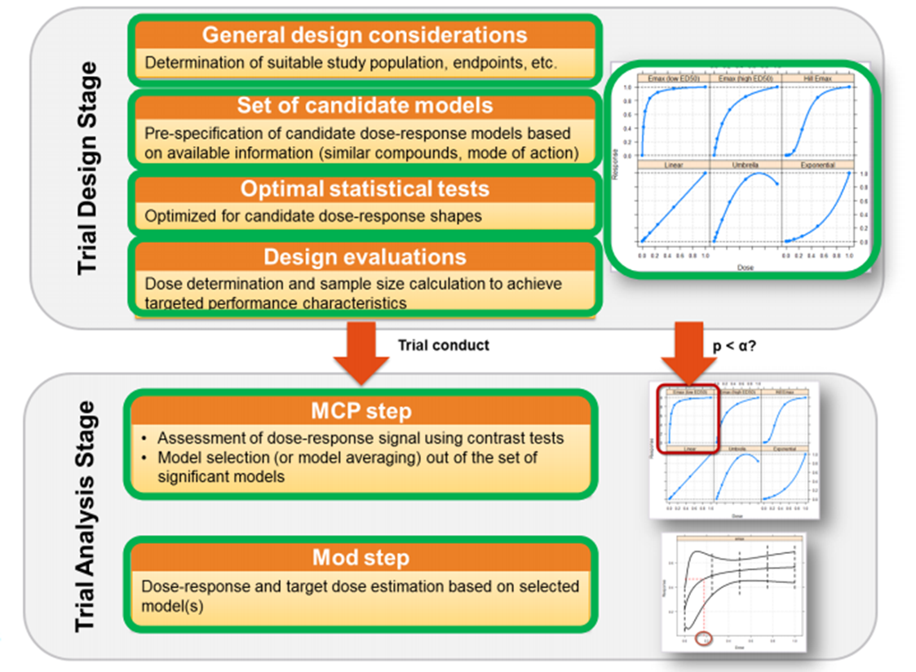
MCP-Mod Justification
MCP & modelling typically done separately
MCP: Robust but restricted to selected doses as nominal variable
Mod: Flexible quantitative approach but reliant on the model choice
MCP-Mod combines both into one method (Bretz et al.)
Design Stage: Select candidate models & generate optimal tests
MCP Stage: Select best model(s) w/ appropriate contrasts but control FWER
Mod Stage: Model using best model and find the target dose(s) of interest
Source: Bretz, et al. (2005), Pinhiero et al. (2014)

Slide 22
MCP-Mod | Example 3
“This example refers to a real Phase II design of a drug for the indication of generalized anxiety disorder (GAD). Five active doses are to be used in the study: 10, 25, 50, 100, and 150 mg, with an additional placebo arm (corresponding to a 0 mg dose.) … we will assume that δ₀ = 0 and σ = 1, so that δ_{max} = 0.4. … E_{max} it is assumed that ED₅₀ = 25 … Logistic model parameters are ED₅₀ = 50 and δ = 10.88111. We consider the determination of the sample size to achieve a power level of 0.8 … the unweighted mean is an appropriate choice … desired sample size is n = 62 patients per arm.”
Parameter | Value
Sig. Level (1-sided) | 0.05
Standard Deviation | 1
Placebo/Max Effect | 0/0.4
Doses (inc. placebo) | 0, 10, 25, 50, 100, 150mg
Models | Linear, Emax (25), Logistic (50, 10.88111), Exp (85), Beta (0.33, 2.31), Beta (1.39, 1.39) (scale = 200)
Power | 80%
Sample Size | 62 per arm (N = 372)

Slide 23
Discussion and Conclusions
Phase II trials are often the first phase to test efficacy, & and often split into IIa/IIb
Good design required due to high failure rates, and uncertainty in dose selection
Phase IIa is proof-of-concept phase, multi-stage designs help reject a larger number of poor candidate therapeutics quickly
Phase IIb is the dose-finding stage, innovative methods like MCP-Mod can help select the best model, and improve efficiency by merging Phase IIa & IIb

Slide 24
Statsols.com/trial

Slide 25
Thank You
Contact us:
info@statsols.com
More info:
Statsols.com

Slide 26
References
Simon, R. (1989). Optimal two-stage designs for phase II clinical trials. Controlled Clinical Trials, 10(1), 1–10
A’Hern, R. P. (2001). Sample size tables for exact single-stage phase II designs. Statistics in Medicine, 20(6), 859–866
Fleming, T. R. (1982). One-Sample Multiple Testing Procedure for Phase II Clinical Trials. Biometrics, 38(1), 143–151
Bryant, J., & Day, R. (1995). Incorporating Toxicity Considerations Into the Design of Two-Stage Phase II Clinical Trials. Biometrics, 51(4), 1372–1383
Tung, N., et al., (2020). TBCRC 048: Phase II study of Olaparib for metastatic breast cancer and mutations in homologous Recombination-Related Genes. Journal of Clinical Oncology, 38(36), 4274–4282
Visco, C., et al., (2017). Rituximab, bendamustine, and low-dose cytarabine as induction therapy in elderly patients with mantle cell lymphoma: a multicentre, phase 2 trial from Fondazione Italiana Linfomi. The Lancet Haematology, 4(1), e15–e23.

Slide 27
References
Gajewski, B. J., Meinzer, C., Berry, S. M., Rockswold, G. L., Barsan, W. G., Korley, F. K., & Martin, R. (2019). Bayesian hierarchical EMAX model for dose‐response in early phase efficacy clinical trials. Statistics in Medicine, 38(17), 3123–3138
Office of the Commissioner. (2023, October 2). Project Optimus. U.S. Food And Drug Administration. https://www.fda.gov/about-fda/oncology-center-excellence/project-optimus
Research, C. F. D. E. A. (2022, February 28). Table of surrogate endpoints that were the basis of drug approval or licensure. U.S. Food And Drug Administration. https://www.fda.gov/drugs/development-resources/table-surrogate-endpoints-were-basis-drug-approval-or-licensure
Van Norman, G. A. (2019). Phase II trials in drug development and adaptive trial design. JACC: Basic to Translational Science, 4(3), 428–437. https://doi.org/10.1016/j.jacbts.2019.02.005
Biotechnology Innovation Organization (BIO), Biomedtracker, & Amplion. (2016). Clinical Development Success Rates 2006-2015. https://www.bio.org/sites/default/files/legacy/bioorg/docs/Clinical%20Development%20Success%20Rates%202006-2015%20-%20BIO,%20Biomedtracker,%20Amplion%202016.pdf

Slide 28
References
U.S. Department of Health and Human Services Food and Drug Administration Center for Biologics Evaluation and Research. (2007). Guidance for Industry: Toxicity Grading Scale for Healthy Adult and Adolescent Volunteers Enrolled in Preventive Vaccine Clinical Trials. FDA. https://www.fda.gov/media/73679/download
Fleming, T. R., & Powers, J. H. (2012). Biomarkers and surrogate endpoints in clinical trials. Statistics in Medicine, 31(25), 2973–2984
Pinheiro, J., Bornkamp, B., & Bretz, F. (2006). Design and Analysis of Dose-Finding Studies Combining Multiple Comparisons and Modeling Procedures. Journal of Biopharmaceutical Statistics, 16(5), 639–656
A. Genz., & F. Bretz. (2002). Methods for the computation of multivariate t-probabilities. Journal of Computational Graphical Stat, 11, 950–971
Ruberg, S. J. (1995). Dose response studies I. some design considerations. Journal of Biopharmaceutical Statistics, 5(1), 1–14
Bretz, F., Pinheiro, J. C., & Branson, M. (2005). Combining Multiple Comparisons and Modeling Techniques in Dose-Response Studies. Biometrics, 61(3), 738–748

