Slide 1
Alternatives to the p-value & power: Effect on Sample Size Determination

Slide 2
Head of Statistics
nQuery Lead Researcher
FDA Guest Speaker
Guest Lecturer
HOSTED BY: Ronan Fitzpatrick

Slide 3
Demo Overview
Power, p-values & SSD Alternatives
Sample Size for Frequentist Intervals
Bayesian Sample Size
Discussion & Conclusions

Slide 4
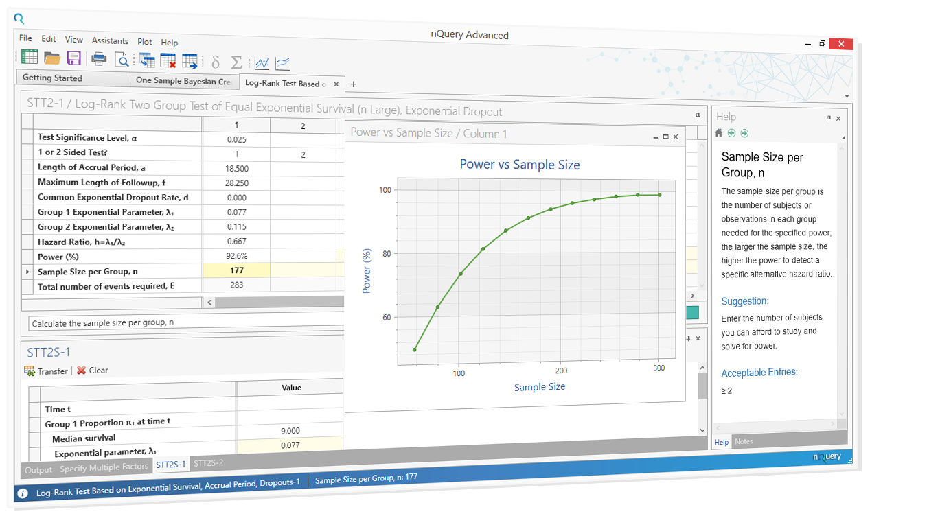
Worked Examples Overview
WORKED EXAMPLES
Confidence Interval for Two Means
Tolerance Interval for One Mean
Prediction Interval for One Subject
Credible Interval for One Mean
Posterior Error for Two Sample Z-test

Slide 5
About nQuery
In 2018, 91% of organizations with clinical trials approved by the FDA used nQuery for sample size and power calculation

Slide 6
Part 1
Introduction to Bayesian SSD

Slide 7
Sample Size Determination (SSD)
SSD finds the appropriate sample size for your study
SSD seeks to balance ethical and practical study design issues
Valid conclusions, cost constraints, regulatory requirements
Most common criteria for SSD is statistical power
Power: prob. study will detect a true effect of a specified size
Common definition is tied to usage of hypothesis tests/p-values
But NHST/p-values under significant scrutiny in literature
What alternatives exist for study design and sample size?
Notes:
Point 1:
http://rsos.royalsocietypublishing.org/content/1/3/140216 -> Screening problem analogy.
Type S Error = Sign Error i.e. sign of estimate is different than actual population value
Type M Error = Magnitude Error i.e. estimate is order of magnitude different than actual value
Point 2:
Know we have only 100 subjects available. Need to know what power will this give us, i.e. is there enough power to justify even doing the study.
Stage III clinical trials constitute 90% of trial costs, vital to reduce waste and ensure can fulfil goal.
Point 3:
Sample Size requirements described in ICH Efficacy Guidelines 9: STATISTICAL PRINCIPLES FOR CLINICAL TRIALS
See FDA/NIH draft protocol template here: http://osp.od.nih.gov/sites/default/files/Protocol_Template_05Feb2016_508.pdf (Section 10.5)
Nature Statistical Checklist: http://www.nature.com/nature/authors/gta/Statistical_checklist.doc
Point 4:
In Cohen’s (1962) seminal power analysis of the journal of Abnormal and Social Psychology he concluded that over half of the published studies were insufficiently powered to result in statistical significance for the main hypothesis. Many journals (e.g. Nature) now require that authors submit power estimates for their studies.
Power/Sample size one of areas highlighted when discussing “crisis of reproducibility” (Ioannidis). Relatively easy fix compared to finding p-hacking etc.

Slide 8
Controversy over NHST/p-values
Longstanding criticisms common for NHST & p-values
Misinterpretation, abuse, p & N, ignore ES, priors, inverse cond.
However, still most widely used statistical framework in practise
ASA statement (2017) brought debate back to fore
Emphasis on precise definition, good design and weaknesses
Supplementary Material outlines range of views on topic
Renewed calls to abandon completely recently (Nature (2019))
Big open question over what should replace them?
Notes:
Point 1:
http://rsos.royalsocietypublishing.org/content/1/3/140216 -> Screening problem analogy.
Type S Error = Sign Error i.e. sign of estimate is different than actual population value
Type M Error = Magnitude Error i.e. estimate is order of magnitude different than actual value
Point 2:
Know we have only 100 subjects available. Need to know what power will this give us, i.e. is there enough power to justify even doing the study.
Stage III clinical trials constitute 90% of trial costs, vital to reduce waste and ensure can fulfil goal.
Point 3:
Sample Size requirements described in ICH Efficacy Guidelines 9: STATISTICAL PRINCIPLES FOR CLINICAL TRIALS
See FDA/NIH draft protocol template here: http://osp.od.nih.gov/sites/default/files/Protocol_Template_05Feb2016_508.pdf (Section 10.5)
Nature Statistical Checklist: http://www.nature.com/nature/authors/gta/Statistical_checklist.doc
Point 4:
In Cohen’s (1962) seminal power analysis of the journal of Abnormal and Social Psychology he concluded that over half of the published studies were insufficiently powered to result in statistical significance for the main hypothesis. Many journals (e.g. Nature) now require that authors submit power estimates for their studies.
Power/Sample size one of areas highlighted when discussing “crisis of reproducibility” (Ioannidis). Relatively easy fix compared to finding p-hacking etc.

Slide 9
Alternatives to Power in SSD
#1 Precision Sample Size (Rothman (2018), Kelley (2003))
SSD based on desired precision of estimate with focus on width of statistical intervals, whether frequentist or Bayesian
Examples: Confidence Interval, Credible Interval, Tolerance Interval
#2 Other test “Success” criteria (Adcock (1988), Lindley (1997))
SSD based on criterion other than power/p-value (e.g. Bayesian criteria) or based on fulfilling >1 simultaneous success criteria including power
Examples: FDR, Bayesian criteria (BFs, Posterior Error), decision-theoretic, LR

Slide 10
Part 2
SSD for Frequentist Intervals

Slide 11
Interval Estimation Background
Want interval for “probable” range for unknown parameter
Frequentist intervals use “probability” under repeated sampling
Interval emphasizes estimate value & it’s uncertainty
Encourages debate around clinical relevance & estimate variation
SSD target is desired width (precision) of the interval
Emphasize “quality” of estimate rather than point estimate value
Specific effect size expected either not needed or de-emphasized

Slide 12
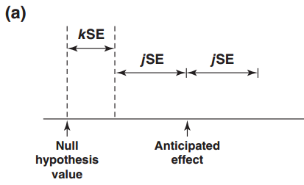
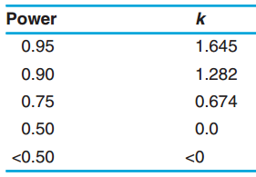
Confidence Interval (CI) Sample Size
$$n= {\left(\frac{z_{α}σ}{HalfWidth}\right)}^{2}$$
CI is most widely used stat. interval
P(incl. value under repeated sampling)
SSD targets desired interval width
Closely tied to expected SE of estimate
N gives correct width on “average”
Can coverage correct probability of excess length
Power & CI sample size are related
Test of lower limit vs null hypothesis
Source: IARC (1999)
Notes:
Point 1:
http://rsos.royalsocietypublishing.org/content/1/3/140216 -> Screening problem analogy.
Type S Error = Sign Error i.e. sign of estimate is different than actual population value
Type M Error = Magnitude Error i.e. estimate is order of magnitude different than actual value
Point 2:
Know we have only 100 subjects available. Need to know what power will this give us, i.e. is there enough power to justify even doing the study.
Stage III clinical trials constitute 90% of trial costs, vital to reduce waste and ensure can fulfil goal.
Point 3:
Sample Size requirements described in ICH Efficacy Guidelines 9: STATISTICAL PRINCIPLES FOR CLINICAL TRIALS
See FDA/NIH draft protocol template here: http://osp.od.nih.gov/sites/default/files/Protocol_Template_05Feb2016_508.pdf (Section 10.5)
Nature Statistical Checklist: http://www.nature.com/nature/authors/gta/Statistical_checklist.doc
Point 4:
In Cohen’s (1962) seminal power analysis of the journal of Abnormal and Social Psychology he concluded that over half of the published studies were insufficiently powered to result in statistical significance for the main hypothesis. Many journals (e.g. Nature) now require that authors submit power estimates for their studies.
Power/Sample size one of areas highlighted when discussing “crisis of reproducibility” (Ioannidis). Relatively easy fix compared to finding p-hacking etc.

Slide 13
Example 1
“It was estimated that 10 subjects per treatment group would provide a 95% confidence interval half-width of 1.5 mg/kg per min for the difference in glucose disposal rates between treatment groups (assuming a standard deviation of 1.7 mg/kg per min)”
Parameter | Value
Confidence Level (1-α) | 0.95
1 or 2-Sided? | 2
Standard Deviation (σ) | 1.7
C.I. Half-Width | 1.5
Source: Diabetic Medicine, Wiley, 2004

Slide 14
Example 2
“Initial enrollment was planned for 48 patients, with 24 EGFR(+) and 24 EGFR(−) cases. With a total sample size of 24 patients, the 95% confidence interval for the response rate would have a half width no greater than ±20%. The actual half width was dependent on observed response rate.”
Parameter | Value
Confidence Level (1-α) | 0.95
1 or 2-Sided? | 2
Standard Proportion (π) | 0.5
C.I. Half-Width | 0.2
Sample Size | 24
Source: Annals of Oncology, Medscape, 2012

Slide 15
Other Frequentist Intervals
Other intervals target things beside a parameter value
Prediction Intervals – Interval to contain a future sample subject/parameter with a given probability
Classic case is interval for a single future observation
SSD focus on relative width to limiting interval (expected or corrected)
Tolerance Intervals – Interval to contain a given proportion of the sampled population with a given probability
Emphasises “population” coverage and error rate for interval
SSD focus on calculation of tolerance factor for given distribution
Notes:
Difference between prediction intervals and tolerance intervals: A tolerance interval is constructed to contain at least a specified proportion on the population values with a specified level of confidence. A prediction interval will, with a specified degree of confidence, contain the value of a future observation of a random sample

Slide 16
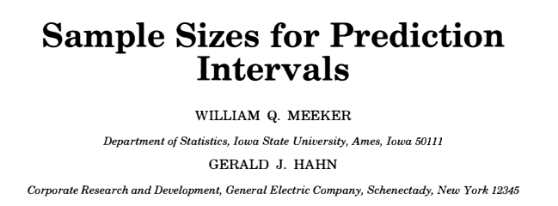
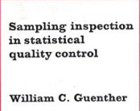
Example 3
Tolerance Interval Exponential | Value
Confidence Level (Lower) | 0.95
Proportion Covered | 0.9
Exceedance Margin | 0.05
Exceedance Probability | 0.05
Sample Size | 22
Prediction Interval Single Observation | Value
Confidence Level (Two-Sided) | 0.95
Relative Width | 1.177
Future Observation(s) | 1
Sample Size | 10

Slide 17
Part 3
Bayesian Sample Size

Slide 18
Bayesian Sample Size Approaches
Bayesian Analysis continues to grow in popularity due to the ability to integrate prior knowledge and its intuitive interpretation
Sample Size for Bayesian Methods
Improving Sample Size Methods
Sample size for specific values of Bayesian parameters
e.g. Bayes Factors, Credible Intervals, Continual Reassessment Method (CRM), Utility functions
Integrating Bayesian methods to adding greater context for parameter uncertainty
e.g. Assurance, MBL Intervals, posterior errors, adaptive design

Slide 19
Sample Size For Credible Intervals
Credible intervals are the most commonly used Bayesian method used for interval estimation
Focus here on methods of Adcock (1988) & Joseph and Bélisle (1997) for normal means
The method chosen depended both on the desired selection criterion and the estimation methodology
Selection Criteria
Average Coverage Criterion
Average Length Criterion
Worst Outcome Criterion
Testing Scenarios
Known Precision
Unknown Precision
Mixed Bayes/Frequentist

Slide 20
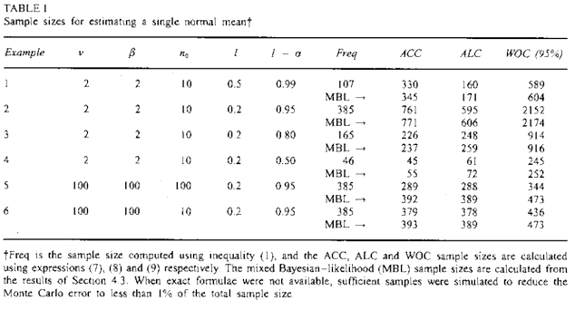
Example 4
“In practice, the prior information will be different in every problem, so it is impossible to provide exhaustive tables. Therefore, Table 1 presents a variety of examples that illustrate the relationships between the various criteria discussed for the case of estimating sample size requirements for a single normal mean. Example 1-3 … show that the Bayesian approach can provide larger sample sizes than the frequentist approach, even though prior information is incorporated ... The same examples also illustrate that sample size provided by the ALC tend to be smaller than that of the ACC when 1-α is near l and l is not near 0.”
Source: Wiley.com

Slide 21
Mixed Bayesian/Likelihood (MBL) Intervals
Methods initially focused on credible intervals but confidence intervals continue to be prevalent
Joseph and Belisle extend framework to find N which fulfils Bayesian and frequentist criteria
Same criteria available from credible intervals but assume inference from confidence interval
“The posterior is
where f(x|θ) is the likelihood of the data x. If f(θ) is a uniform densit then this is the normalized likelihood. One can either let f (θ) represent the true prior information in both the posterior predictive distribution and posterior, that is, a fully Bayesian (FB) approach, or let f (θ) be the true prior information in the posterior predictive distribution but substitute a uniform density for f(θ) in the posterior, which we call the mixed Bayesian/likelihood (MBL) approach.”
-Joseph and Bélisle (1997)

Slide 22
Posterior Error Approach
Posterior Error method tries to deal with issue of prior uncertainty and the inverse-conditional problem
Lee & Zelen derive Bayesian Type I/II errors for posterior chance of H₀/H₁ being true given frequentist “success” (i.e. significance)
Conversion only requires statement of prior probability belief against H₀
Argue this better reflects practical decision-making though note difference between requirement of clinician vs. regulator
Method can be applied to any point null hypothesis and nQuery has Posterior Error Assistant and showcase tables for means case
Notes:
The posterior error approach was developed by Lee and Zelen in 2000. They used general Bayesian sample size determination to come up with a simple yet general alternative to the traditional frequentist type 1 an type 2 error rates which are commonly known as alpha and beta. The main difference between these error rates and those used in the approach recommended by Lee and Zelen is that the Frequentist error rates are conditional on the true state of the hypotheses whereas the Posterior Error rates are conditional on the outcome of the trial. Lee and Zelen argue that the consequences of false negative and positive decisions after the clinical trial has been completed, i.e. type 1 and type 2 errors, are conditional on the outcome of the clinical trial. Hence the false positive and negative error rates should also be conditional on the trial outcome.
One of the main benefits of the approach which Lee and Zelen come up with is that it’s useable in the traditional frequentist manner. This is because the Posterior Error Rates are comparable to the frequentist error rates through a simple application of Bayes theorem with the additional specification of the prior probability of rejecting the null hypothesis.

Slide 23
Example 5
“Assuming a mean (±SD) number of ventilator-free days of 12.7±10.6, we estimated that a sample of 524 patients would need to be enrolled in order for the study to have 80% power, at a two-tailed significance level of 0.05, to detect a mean between-group difference of 2.6 ventilator-free days. On the basis of data from the PAC-Man trial, we estimated that the study-withdrawal rate would be 3% and we therefore calculated that the study required a total of 540 patients.”
Parameter | Value
Significance Level (Two- Sided) | 0.05
Mean Difference | 2.6
Standard Deviation | 10.6
n per Group | 262
Target Power | 80%
Source: NEJM (2014)

Slide 24
(cont.)
Example 5
“Assume the Z-test example but we want a posterior Type I error of 0.05 (probability the null hypothesis is true given significance) and posterior Type II of 0.2 (probability the null hypothesis is false given non-significance). What would be equivalent sample size and frequentist planning errors (α, 1-β) be assuming a range (0.25 - 0.75) of prior beliefs against the null hypothesis”
Parameter | Value
α* | 0.2
β* | 0.05
Mean Difference | 2.6
Standard Deviation | 10.6
N per Group | ?
Test Significance Level, α | ?
Power, 1-β | ?

Slide 25
Part 4
Discussion and Conclusions

Slide 26
Discussion and Conclusions
Sample Size determination vital for study design
Power is most common criteria but tied to NHST/p-values
SSD methods would be desirable for alternatives
Frequentist intervals (confidence, tolerance, prediction) emphasize effect size & variance with SSD targeting latter
Credible intervals have same advantages but have a more “intuitive” interpretation than confidence interval
Posterior error approaches provide new “success” criteria and encourages thought about prior success prob.
Notes:
Point 1:
http://rsos.royalsocietypublishing.org/content/1/3/140216 -> Screening problem analogy.
Type S Error = Sign Error i.e. sign of estimate is different than actual population value
Type M Error = Magnitude Error i.e. estimate is order of magnitude different than actual value
Point 2:
Know we have only 100 subjects available. Need to know what power will this give us, i.e. is there enough power to justify even doing the study.
Stage III clinical trials constitute 90% of trial costs, vital to reduce waste and ensure can fulfil goal.
Point 3:
Sample Size requirements described in ICH Efficacy Guidelines 9: STATISTICAL PRINCIPLES FOR CLINICAL TRIALS
See FDA/NIH draft protocol template here: http://osp.od.nih.gov/sites/default/files/Protocol_Template_05Feb2016_508.pdf (Section 10.5)
Nature Statistical Checklist: http://www.nature.com/nature/authors/gta/Statistical_checklist.doc
Point 4:
In Cohen’s (1962) seminal power analysis of the journal of Abnormal and Social Psychology he concluded that over half of the published studies were insufficiently powered to result in statistical significance for the main hypothesis. Many journals (e.g. Nature) now require that authors submit power estimates for their studies.
Power/Sample size one of areas highlighted when discussing “crisis of reproducibility” (Ioannidis). Relatively easy fix compared to finding p-hacking etc.

Slide 27
nQuery Summer 2019 Update
Adds new tables across nQuery to help you with any trial design – Classical, Bayesian & Adaptive
www.statsols.com/whats-new
29
5
7
New Classical Design Tables
New Bayesian Design Tables
New Adaptive Design Tables
Hierarchical Modelling
Interval Estimation
Assurance
Posterior Error
Blinded SSR
Unblinded Survival SSR
Conditional Power

Slide 28
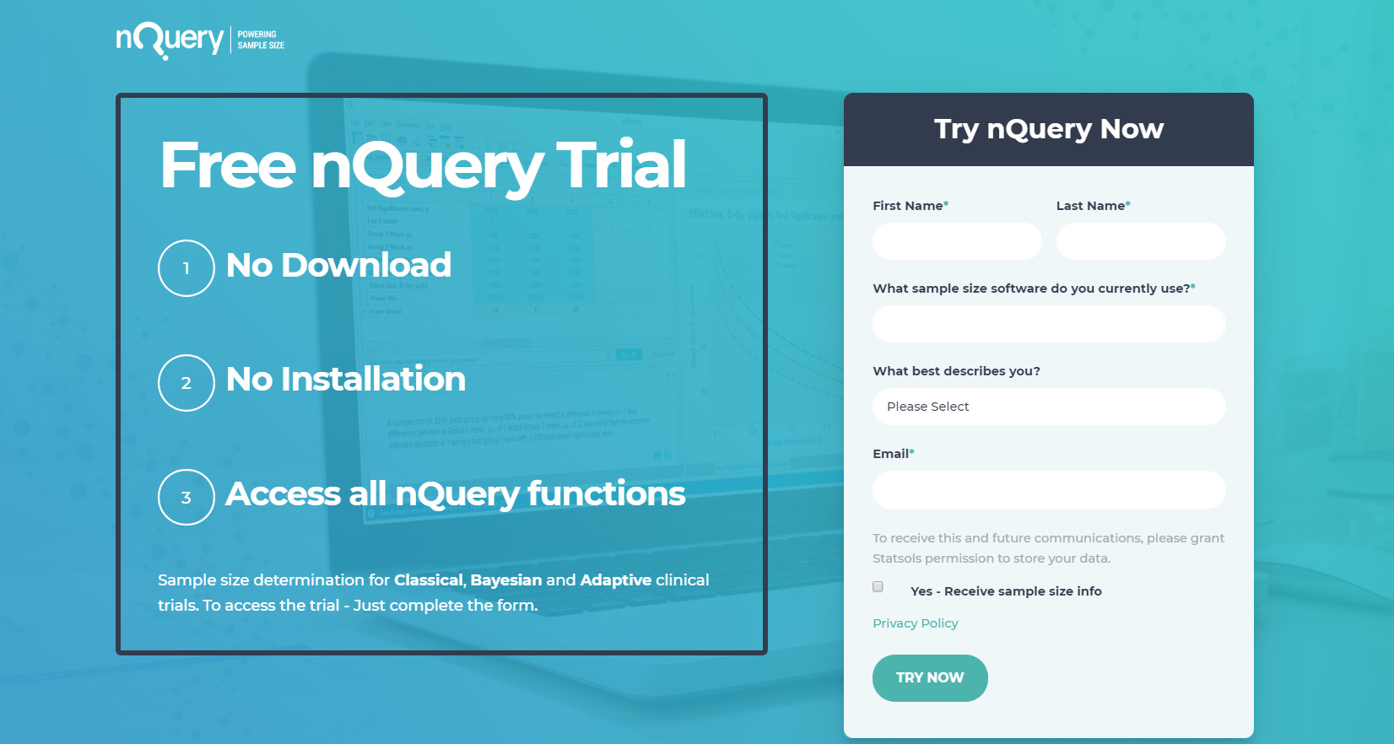
Statsols.com/trial

Slide 29
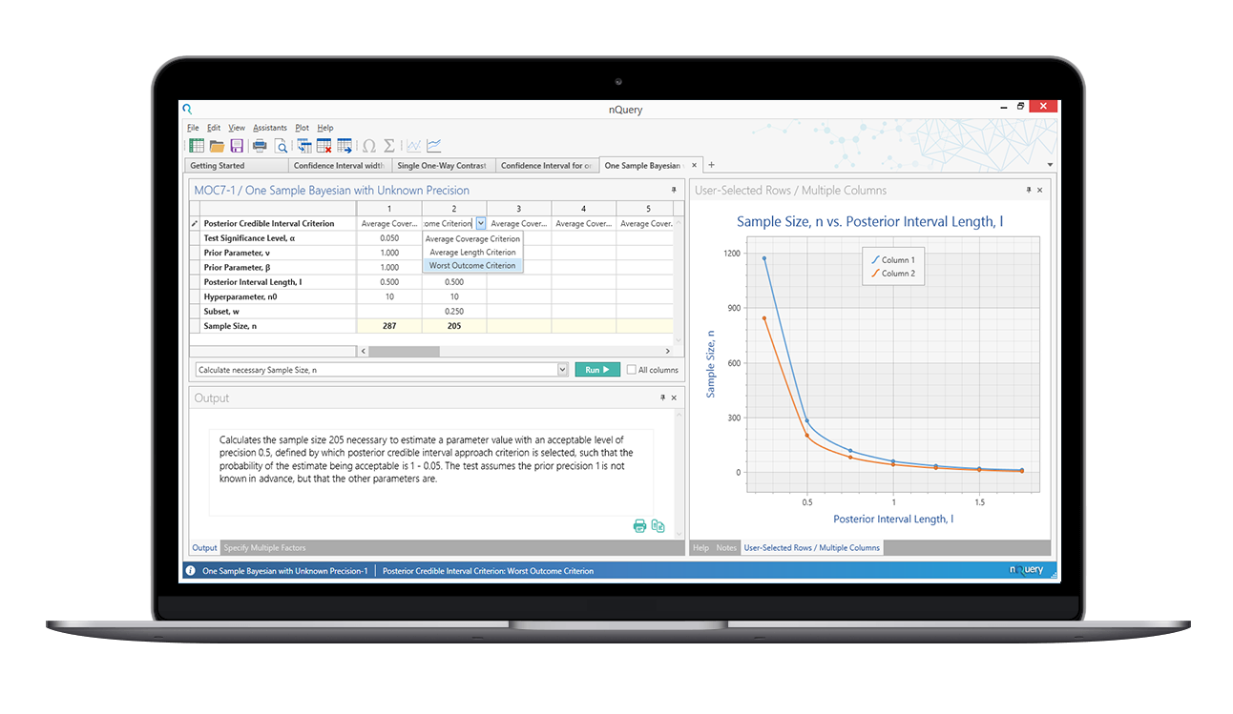
Q&A
Any Questions?
For further details, contact at:
info@statsols.com
Thanks for listening!

Slide 30
References
Julious, S.A., (2009). Sample sizes for clinical trials. Chapman and Hall/CRC.
Wasserstein, R.L. and Lazar, N.A., (2016). The ASA’s statement on p-values: context, process, and purpose. The American Statistician, 70(2), pp.129-133.
Amrhein, V., Greenland, S. and McShane, B., (2019). Retire statistical significance. NATURE, 567.
McShane, B.B., Gal, D., Gelman, A., Robert, C. and Tackett, J.L., (2019). Abandon statistical significance. The American Statistician, 73(sup1), pp.235-245.
Rothman, K.J. and Greenland, S., (2018). Planning study size based on precision rather than power. Epidemiology, 29(5), pp.599-603.
Kelley, K., Maxwell, S.E. and Rausch, J.R., 2003. Obtaining power or obtaining precision: Delineating methods of sample-size planning. Evaluation & the health professions, 26(3), pp.258-287.

Slide 31
References
Adcock, C.J., (1988). A Bayesian approach to calculating sample sizes. Journal of the Royal Statistical Society: Series D (The Statistician), 37(4-5), pp.433-439.
Lindley, D.V., (1997). The choice of sample size. Journal of the Royal Statistical Society: Series D (The Statistician), 46(2), pp.129-138.
dos Santos Silva, I., (1999). Cancer epidemiology: principles and methods. IARC. pp. 333-353
Bennett, S. M. A., et al. (2004), Rosiglitazone Improves Insulin Sensitivity, Glucose Tolerance and Ambulatory Blood Pressure in Subjects with Impaired Glucose Tolerance, Diabetic Medicine, 21(5) pp. 415-422.
Pipas, J. M., et al. (2012), Neoadjuvant Cetuximab, Twice-weekly Gemcitabine, and Intensity-modulated Radiotherapy (IMRT) in Patients with Pancreatic Adenocarcinoma, Annals of Oncology, 23(11) pp. 2820-2827.
Guenther, W. C. (1977). Sampling Inspection in statistical quality control (No. 04; TS156. 4, G8.).

Slide 32
References
Meeker, W. Q., & Hahn, G. J. (1982). Sample sizes for prediction intervals. Journal of Quality Technology, 14(4), 201-206.
Joseph, L., Du Berger, R., & Belisle, P. (1997). Bayesian and mixed Bayesian/likelihood criteria for sample size determination. Statistics in medicine, 16(7), 769-781.
Joseph, L., & Belisle, P. (1997). Bayesian sample size determination for normal means and differences between normal means. Journal of the Royal Statistical Society: Series D (The Statistician), 46(2), 209-226.
Lee, S. J., & Zelen, M. (2000). Clinical trials and sample size considerations: another perspective. Statistical science, 15(2), 95-110.
McAuley, D. F., Laffey, J. G., O'Kane, C. M., Perkins, G. D., Mullan, B., Trinder, T. J., ... & McNally, C. (2014). Simvastatin in the acute respiratory distress syndrome. New England Journal of Medicine, 371(18), 1695-1703.

